Slide 1

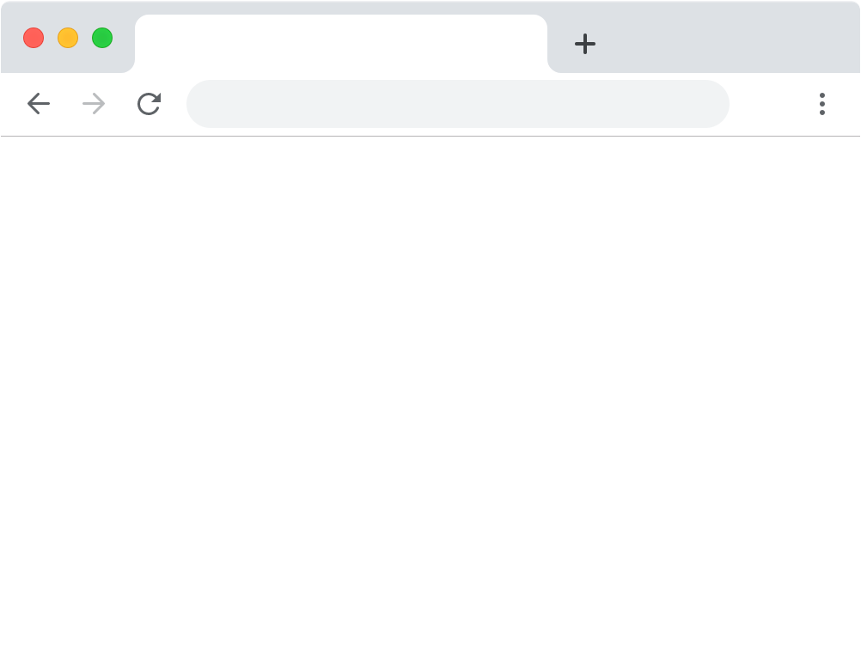
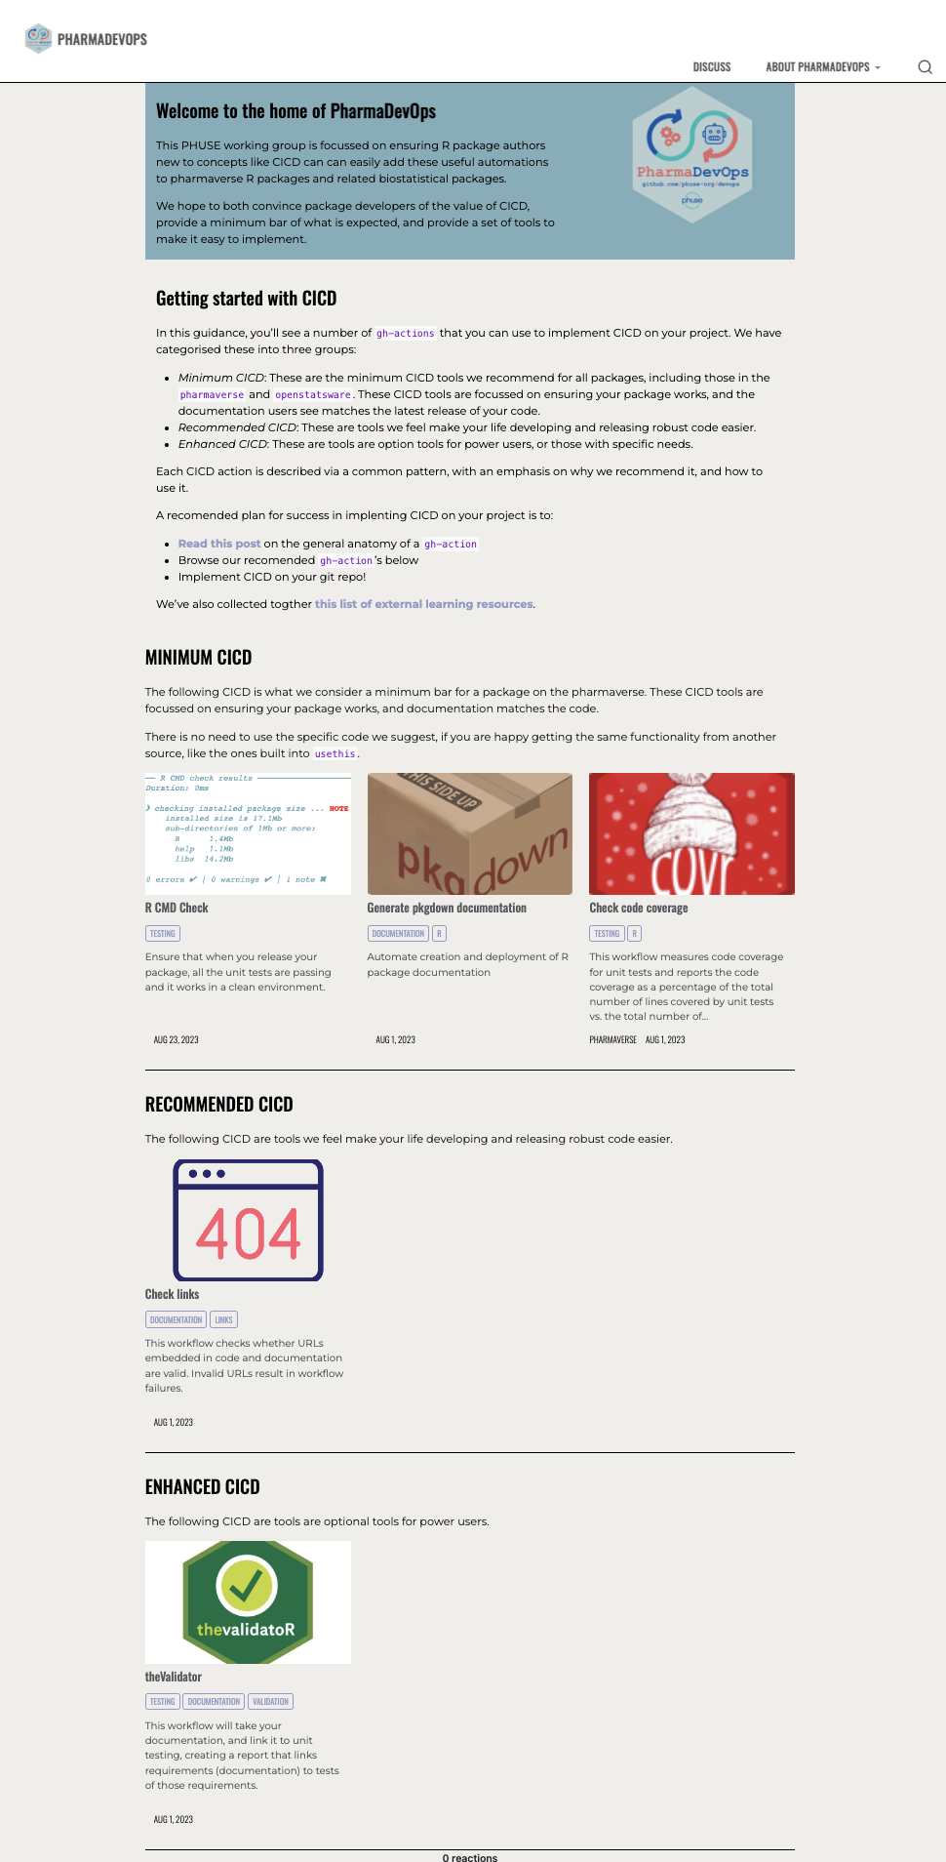

PP03: Bringing devops to the pharmaverse
the PHUSE PharmaDevOps working group
Working group members (alphabetical): Ben Straub, Dinakar Kulkarni, James Black
Purpose
To help R package authors implement continuous integration/continuous delivery (CI/CD) for pharma-related packages.
Our deliverable
A website (phuse-org.github.io/devops), that helps to orientate you on why CI/CD is important, and the different types of CI/CD we expect to see on pharmaverse packages.
Why CI/CD?
CI/CD (Continuous Integration/Continuous Delivery) allows teams to automate testing, integration, and deployment processes, leading to faster, more reliable software releases with fewer manual errors and reduced risk.
Our website helps to summarise key CI/CD that can help generate more robust code and documentation, stratified into 3 tiers based on how important these tools are to your R package.
We include examples of these CI/CD tools in existing pharmaverse packages, as well as copy and paste code for how you can add them to your package.
CI/CD Tiers
Minimum: Run package checks before updating the main branch, generate documentation to ensure code stays in sync with your pkgdown website and automate code coverage checks.
Recommended: Automatically check any and all links in your documentation, to ensure broken links are identified quickly.
Enhanced: Generate a PDF that that links documented functionality (roxygen) to unit tests (testthat) of that functionality.
https://phuse-org.github.io/devops/
Check
out the
site!
Contact details listed online

