Slide 1
Yushan – Home of Stories
A Webnovel Reading Platform with Gamification
Module: Architecting Scalable Systems – Practice Project

Slide 2
Context & Business Problem
The rise of online storytelling platforms (like Amazon, Webnovel, RakutenViki & Wattpad) shows strong demand for interactive and engaging reading experiences.
Problem: Most platforms lack reward-based engagement and bidirectional interaction between readers and authors.
Our Goal: Build a unified platform where users can read, write, and be rewarded - blending literary creativity with gamified engagement.

Slide 3
Platform Thinking Aspects
Built as a multi-service architecture supporting different personas: Readers, Authors, and Admins.
Designed to be extensible: future addition of AI-assisted writing tools, subscription systems, or virtual events.
Encourages a creator ecosystem where users can both consume and create content.
Supports gamified ranking and rewards for continued participation.

Slide 4
Scope of Yushan Platform
User Goals:
Secure registration, login, and role-based access control.
Manage personal library and profile.
Author Goals:
Create and manage novels, chapters, and metadata.
Track novel analytics and engagement.
Reader Goals:
Discover, read, comment, and review novels.
Earn EXP, Yuan (virtual currency), and badges through activity.

Slide 5
Overview Q&A
Questions on the project overview before we move on?
Yushan Platform Webapp:
https://maugus0.github.io/yushan-platform-frontend/
Yushan Platform Admin Dashboard:
https://maugus0.github.io/yushan-platform-admin/admin/login

Slide 6
Current Project Status
System Architecture:
Transitioned from a monolithic Spring Boot application to a fully microservices-based architecture.
Implemented five core services:
  User Service: Identity & Access Management
  Content Service: Novel & Chapter Management
  Engagement Service: Comments, Reviews, Votes
  Gamification Service: EXP, Yuan, Achievements
  Analytics Service: Rankings, Reports, History

Slide 7
Infrastructure & DevOps:
CI/CD Pipelines for both Frontend and Backend (automated build, test, deploy).
Eureka Service Discovery, API Gateway, and Spring Cloud Config Server for centralized management.
Prometheus & Kibana integrated for monitoring and centralized logging.
Circuit Breakers added per service for fault tolerance.
Kafka (asynchronous messaging), Redis (caching), and PostgreSQL (data persistence).

Slide 8
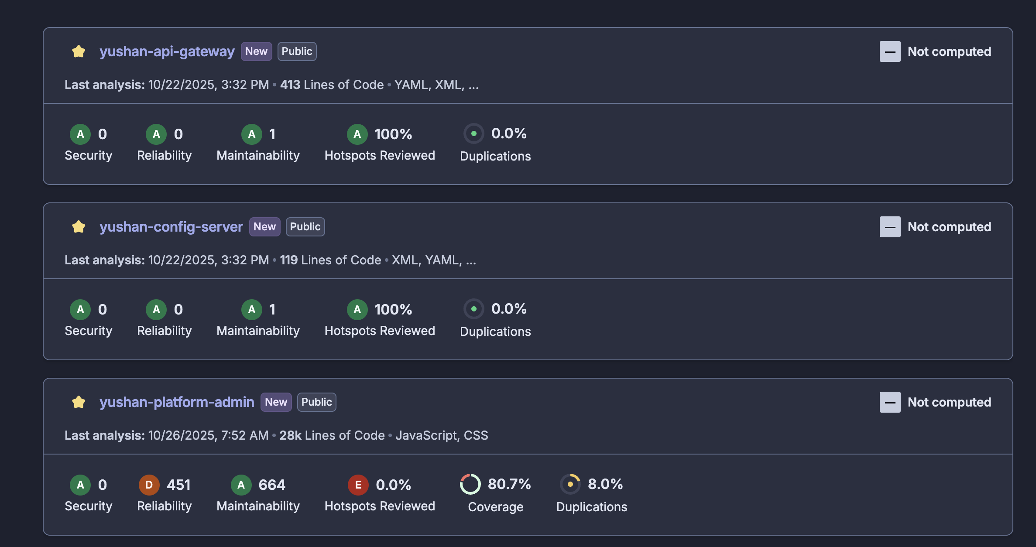
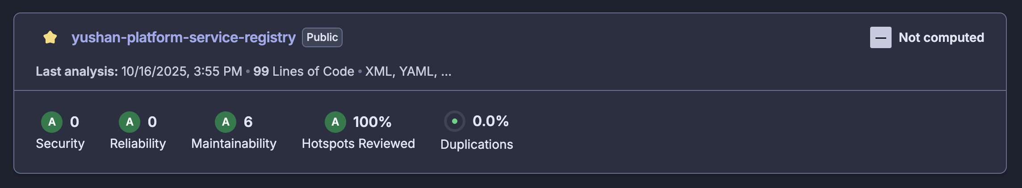
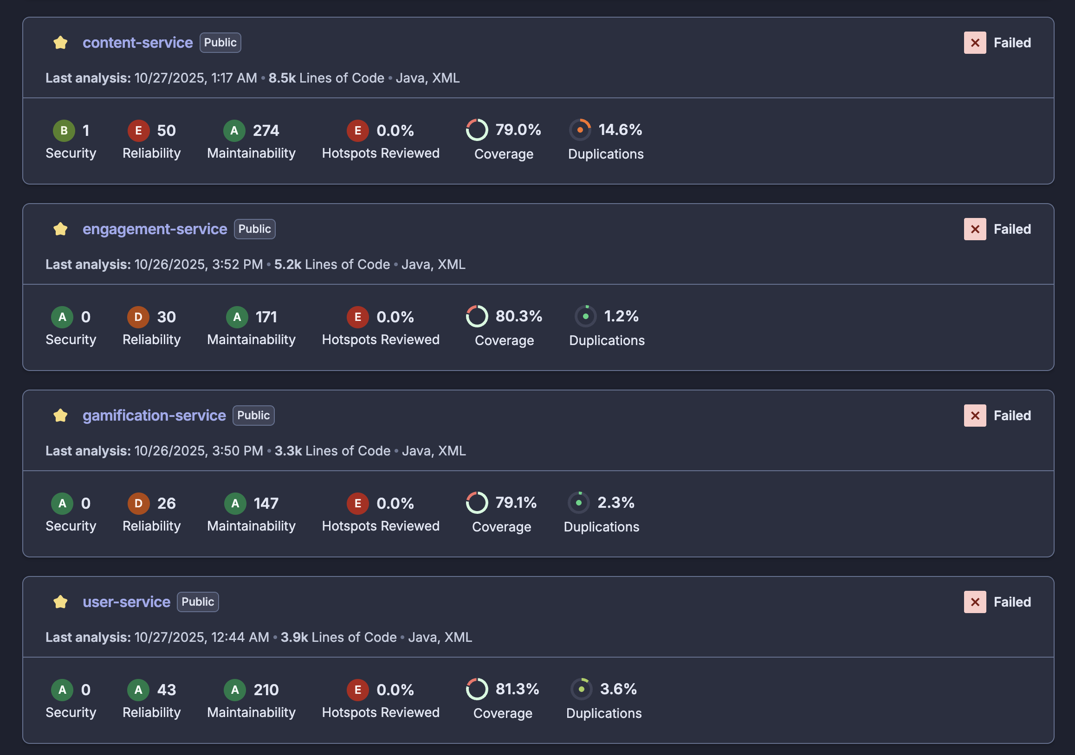
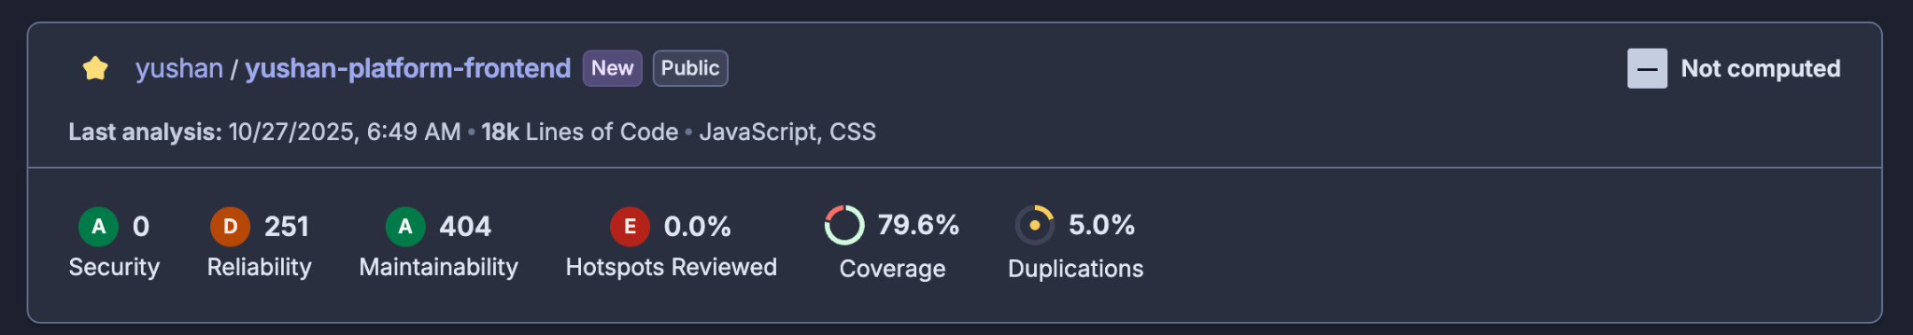
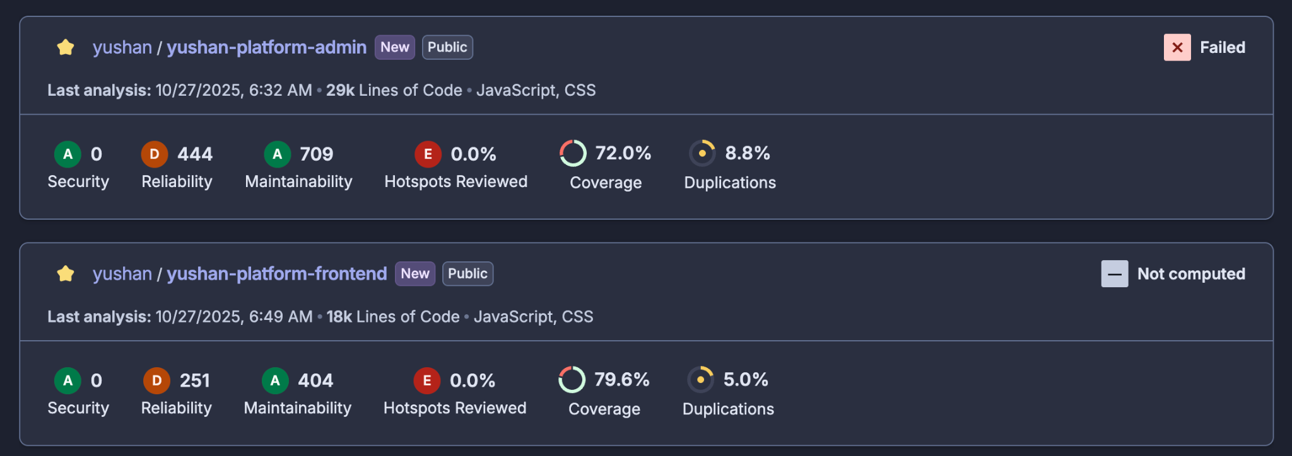
SonarQube analysis

Slide 9
Quality & Frontend:
Yushan Platform Frontend: Reader & Writer portal
Yushan Admin Portal: Administrative controls and analytics view
Maintained >80% automated test coverage across all microservices and frontends.
Current Status:
All core services functional and integrated.
CI/CD and observability stack operational.
Preparing for production-grade scaling and performance tuning.

Slide 10
Milestones & Team Effort @1
Ahan Jaiswal
Developed Yushan Platform Frontend and built the complete Yushan Admin Panel Frontend
Created the Analytics Service from scratch
Acted as Product Owner, overseeing feature roadmap and prioritization
Set up and managed the Jira board, conducted Scrum ceremonies, and ensured smooth QA processes
Implemented and maintained the CI/CD Pipeline and Infrastructure Deployment
Nguyen Phu Truong
Designed and implemented Engagement, Content, and Gamification Services
Conducted complete QA for Engagement and Content microservices
Designed, implemented, and managed the CI/CD pipelines, overseeing infrastructure configuration and end-to-end deployments across all microservices on DigitalOcean
Architected and implemented the Centralized Logging and Metrics & Monitoring System
Maintained daily JIRA board and attended Scrum ceremonies

Slide 11
Milestones & Team Effort @2
Yang Shuang
Took ownership of the Yushan Platform frontend development, driving integration with microservice backend APIs
Design and writing unit and integration tests for the frontend development, assisted in writing unit and integration tests for the Admin Panel
Maintained daily JIRA board and attended Scrum ceremonies and designed & moderated the core features
Supported backend development in the Gamification Service
Zhang Yan
Designed and implemented the User Service and part of Gamification Service
Performed complete QA and testing for User Service and Gamification Service
Maintained daily JIRA board and attended Scrum ceremonies and designed & moderated the core features
Designed & created Database
Zhu Yuhui
Took ownership of the Yushan Platform frontend development, driving integration with microservice backend APIs
Supported backend development for the Engagement Service
Design and writing unit and integration tests for the frontend development
Maintained daily JIRA board and attended Scrum ceremonies designed & moderated the core features

Slide 12
Q&A
Any questions before we move to the system design and demo?
Eureka – http://167.172.72.189:8761/
Swaggers:
http://167.71.216.54:8081/swagger-ui/index.html#/
http://157.245.153.167:8082/swagger-ui/index.html
http://139.59.243.188:8083/swagger-ui/index.html#/
http://167.172.65.76:8084/swagger-ui/index.html#/
http://139.59.243.188:8085/swagger-ui/index.html

Slide 13
Logical Architecture & Design

Slide 14
System Architecture Overview
CLIENT LAYER
Web Page
API GATEWAY LAYER
Spring Cloud Gateway (Port 8080)
• Handle CORS
INFRASTRUCTURE SERVICES LAYER
Eureka Server
(Port 8761)
• Registration
• Discovery
Config Server
(Port 8888)
• Config Mgmt
• Environment
Kafka
(Port 9092)
• Event Bus

Slide 15
System Architecture Overview
BUSINESS SERVICES LAYER
User Service
(Port 8081)
• Auth
• Users Profile
• Users Library
Content Service
(Port 8082)
• Novel
• Chapter
• Category
• Search
Analytics Service
(Port 8083)
• Ranking
• Analytic (Admin)
• History
Engagement Service
(Port 8084)
• Comment
• Review
• Vote
• Report
Gamification Service
(Port 8085)
• EXP, Level
• Yuan
• Achievement
DATA STORAGE LAYER
PostgreSQL per service
• Primary Database
Redis per service
• Cache
• Sessions
Elasticsearch
(Port 9200)
• Search
• Analysis
Kafka Topics
• Events

Slide 16
System Architecture Overview
OBSERVABILITY LAYER
Prometheus
(Port 9090)
• Metrics
• Alerting
Grafana
(Port 3000)
• Dashboards
• Charts
Elasticsearch
(Logs)
• Log Storage
• Indexing
Kibana
(Port 5601)
• Log View
• Discovery

Slide 17
Domain Driven Design: Bounded Contexts
User Context
Aggregate Root: User
Value Objects: Email, Username, PasswordHash
Services: AuthService, ProfileService, LibraryService
Repository: UserRepository, LibrarayRepository
Domain Events:
UserRegistered
UserLoggedIn
ProfileUpdated
AddToLibrary
Anti-Corruption Layer:
Feign clients isolate external service dependencies
Content Context
Aggregate Root: Novel, Chapter, Category
Value Objects: Genre, Tag, Synopsis
Services: NovelService, ChapterService, CategoryService, SearchService
Repository: NovelRepository, ChapterRepository, CategoryRepository
Domain Events:
NovelPublished
ChapterCreated
ContentModerated
Specialized Storage:
PostgreSQL for transactional data
Elasticsearch for search optimization

Slide 18
Domain Driven Design: Bounded Contexts
Engagement Context
Aggregate Root: Comment, Review, Vote, Report
Value Objects: Rating, Sentiment
Services: CommentService, ReviewService, VoteService, ReportService
Repository: CommentRepository, ReviewRepository, VoteRepository, ReportRepository
Domain Events:
CommentPosted
ReviewCreated
Voted
ReportCreated
Gamification Context
Aggregate Root: EXP+Level, Achievement, Yuan
Value Objects: Badge, Quest, Reward
Services: LevelService, AchievementService
Repository: EXPRepository, AchievementRepository, YuanRepository
Domain Events:
YuanAdded
AchievementUnlocked
LevelUped

Slide 19
Domain Driven Design: Bounded Contexts
Analytics Context
Aggregate Root: History, Ranking, Admin
Value Objects: Aggregation, Trend
Services: AnalyticsService, RankingService, HistoryService
Repository: HistoryRepository
Domain Events:
DataAnalysis
RankingUpdated
HistoryCreated

Slide 20
Domain Driven Design: Context Mapping
Published Language: Kafka events provide a shared communication protocol
Conformist: Analytics service conforms to events published by other services
Customer/Provider: Engagement service is a customer of Content service
Anti-Corruption Layer: Each service maintains its own view of data from other services

Slide 21
Producer-Consumer Interactions - ASYNC
Producer | Kafka Topic | Consumer
User Service When register When log in | user-events | Gamification service Reward
Engagement Service When user comment | comment-events | Gamification service Reward
Engagement Service When user review | review-events | Gamification service Reward
Engagement Service When user vote | vote-events | Gamification service Reward
Every Service When use trigger APIs | active | User Service Update last active

Slide 22
Producer-Consumer Interactions - SYNC
Producer | Consumer
User Service GET /api/v1/users/{userId} POST /api/v1/users/batch/get | Engagement Service Analytics Service
Content Service GET /api/v1/novels/{novelId} POST /api/v1/novels/batch/get GET /api/v1/chapters/{chapterId} POST /api/v1/chapters/batch/get | User service Engagement Service Analytics Service
Content Service GET /api/v1/novels/{novelId}/vote-count POST /api/v1/novels/{novelId}/vote PUT /api/v1/novels/{novelId}/rating GET /api/v1/chapters/novel/{novelId} | Engagement Service
Gamification Service GET /api/v1/gamification/votes/check | Engagement service
Gamification Service GET /api/v1/gamification/rank | Analytics Service

Slide 23
Yushan Platform - Physical Architecture & Design
—— Decisions, Deployment, Persistence, User flow
Notes:
In this part me and yang will walk through the Yushan platform’s physical architecture design.

Slide 24
Key Architectural Decisions
Microservices
  domain-split services — user, content, engagement, gamification, analytics
Dockerized Java backends (Spring Boot)
  container deployment units
Infrastructure on DigitalOcean, provisioned with Terraform
Centralized runtime
  Config Server & Eureka (service discovery)
Single API Gateway as public entry
  https://yushan.duckdns.org/api/v1
DB-per-service using PostgreSQL; async events for decoupling; Redis for realtime counters
CI/CD:
  https://github.com/maugus0/yushan-platform-frontend/actions
Notes:
First, for the architectural decisions part
We run our system as domain‑split microservices. This lets each service scale on its own.
And then, all backends are Dockerized Spring Boot apps. Containers give us consistent environments and faster, safer deployments.
Infrastructure is provisioned on DigitalOcean with Terraform. That makes our infra easy to review.
Also, we use a centralized runtime: a Config Server for configuration and Eureka for service registration and discovery. This avoids hard‑coded addresses and reduces configuration errors.
A single API Gateway is the public entry point.
Each service owns its PostgreSQL database. We use sync and async events to decouple services and Redis for fast counters and caching. This combination gives us strong transactions, scalable background processing, and low‑latency reads.
Finally, we use CI/CD for repeatable builds and safer releases.
These decisions together keep the platform reliable, scalable, and easier to operate.

Slide 25
Physical Architecture
Public layer:
  Frontend CDN (GitHub Pages) → API Gateway (yushan.duckdns.org)
Control plane:
  Infra droplet(s) — Nginx, API Gateway, Config Server, Eureka (Terraform-provisioned)
Services:
  content / user / engagement / gamification / analytics
  per-service containers on DO Droplets
Middleware:
  Postgres instances (DB-per-service)
  Redis
  Kafka
  Spaces (object storage)
  Elasticsearch cluster
Notes:
Then we move to our physical architecture, we’ll show our architecture diagram later, I just overview now
Our frontend is hosted on GitHub Pages to serve static assets fast and keep costs low.
Also, our all API calls go through a single API Gateway, which handles authentication and routing so the backend can stay private.
And then, core services and control components run on DigitalOcean. This makes the infrastructure repeatable and easy to change.
Each service runs as its own container on droplets, which simplifies deployments and isolates errors.
The middleware layer uses Postgres for durable data, Redis for hot data and one time data, Kafka for reliable event streams, Elasticsearch for search, and Spaces for large files.

Slide 26
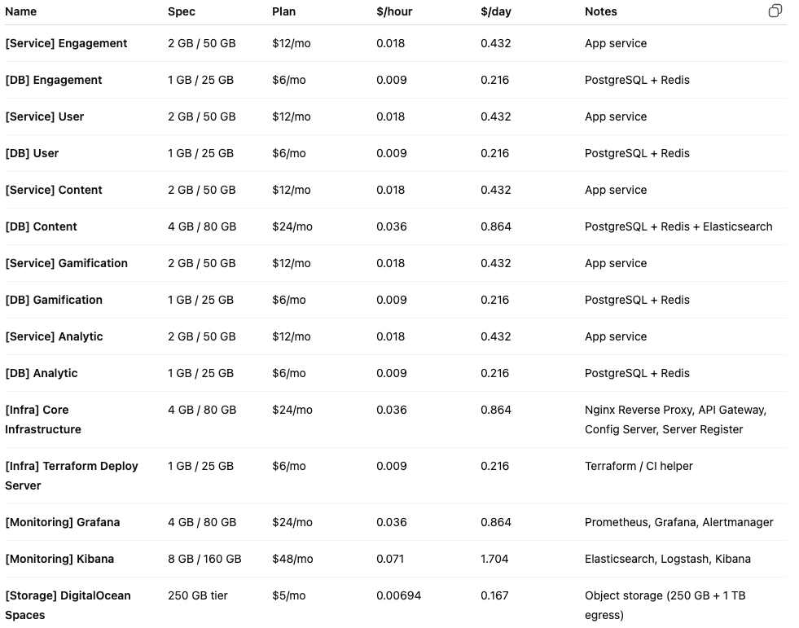

Notes:
This table shows the DigitalOcean cost breakdown. We use small droplets and Spaces to keep costs low.

Slide 27
Persistence Design
Data Type | Primary Storage | Notes
Users & Auth | Postgres (user-db) | Strong consistency; hashed passwords; Flyway migrations
Content metadata & index | Postgres (content-db) | Metadata and chapter index
Chapter body & media | DigitalOcean Spaces (object storage) | Large text/images; DB stores keys or presigned URLs
Full-text search | Elasticsearch | Search index maintained by content-service
Ranking & OTP | Redis (in-memory) | Get aggregates from Postgres periodically & get one time verification code
Event stream | Kafka (topics: events) | Decouples engagement / analytics / gamification
Notes:
Next, for the persistence design
User accounts and authentication need strong consistency and safe storage, so we keep them in a transactional database with hashed passwords and migrations.
Content metadata and indexes stay in the relational store so we can run joins and fast lookups.
Large chapter bodies and images are stored in object storage. That keeps the database small.
And then, Full‑text search runs in Elasticsearch so text queries are fast.
Rankings and one‑time tokens live in Redis for very low‑latency reads and writes.
Finally, Kafka holds our event stream so services are decoupled and events can be replayed for some services.
Together, this mix gives us durability, speed, and the ability to scale each concern independently.

Slide 28
Resilience & Ops checklist
Health checks: Dockerfiles probe /actuator/health
Events:
  implement retries & dead-letter queues
  use idempotency keys for reward/tx writes
DNS/TLS: ensure yushan.duckdns.org resolves to gateway & automated cert renewal
Monitoring: setup Prometheus scrape & Grafana dashboards for SLA alerts
Alerting: Automated alerts for critical issues
Notes:
Well, we use health checks so the platform can detect and restart unhealthy instances quickly.
For events, we add retries and dead‑letter queues so messages are not lost
And, we keep DNS and TLS automated so the public API stays reachable and certificates renew without manual work.
For visibility, we show metrics in Grafana dashboards so we can track service health and performance.
Finally, we enable automated alerts for critical issues so engineers can respond fast and reduce downtime.
These steps make the system more reliable and easier to operate.

Slide 29
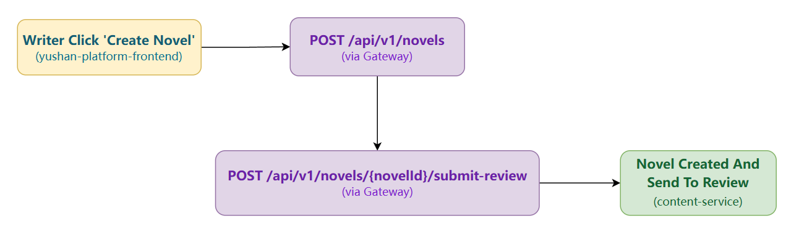
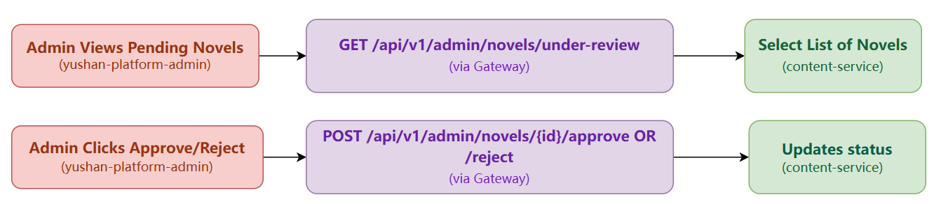
Detailed Design: Writer create a novel and admin review
Notes:
change
2min(All content of Detailed Design: Author Publishes New Chapter)
Okay, here are the English speaker notes corresponding to the 3-slide PPT plan for the "Detailed Design: Author Publishes New Chapter" use case.
Speaker Notes for Slide 1: Use Case: Author Publishes Chapter (1/3)
(Start Timer)
"Alright, for the final section, let's walk through a representative user case: 'Author Publishes a New Chapter,' to see how our system design works end-to-end.
(Point to Diagram/Slide Content)
The process begins when the author finishes writing and hits 'publish' in our React frontend. The frontend then sends a POST request containing the chapter data and the user's JWT authentication token to the /api/v1/chapters endpoint.
This request first hits our API Gateway. The gateway acts as the front door; it matches the path /api/v1/chapters, looks up a healthy instance of the Content Service using Eureka, and forwards the request to that instance.
Once the request reaches the Content Service, security checks kick in. It first validates the JWT token using the shared secret to confirm the user's identity. Then, Spring Security checks if the authenticated user has the necessary permissions – basically, confirming they are indeed the author of this novel."

Slide 30
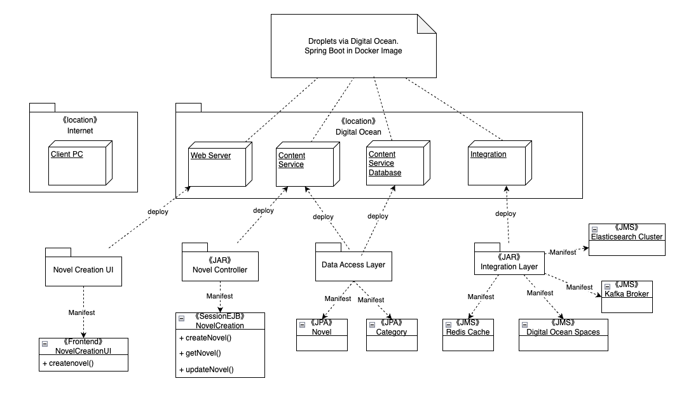
Detailed Deployment Elements for Novel Creation

Slide 31
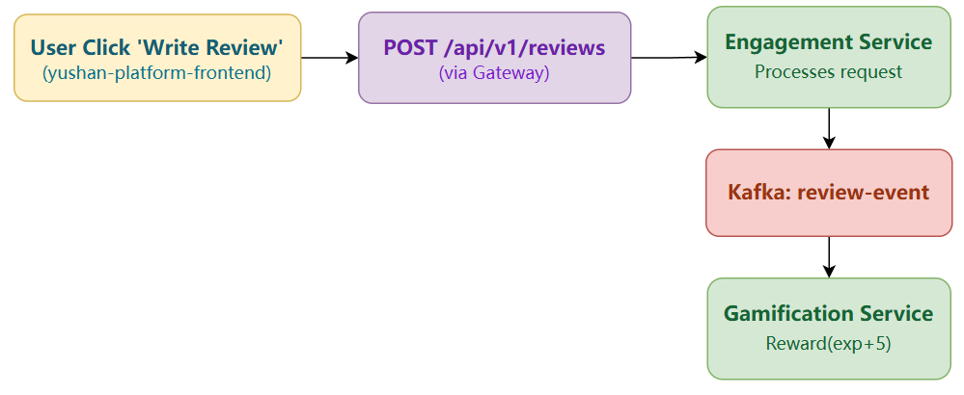
Detailed Design: Write review and add exp
Notes:
change
2min(All content of Detailed Design: Author Publishes New Chapter)
Okay, here are the English speaker notes corresponding to the 3-slide PPT plan for the "Detailed Design: Author Publishes New Chapter" use case.
Speaker Notes for Slide 1: Use Case: Author Publishes Chapter (1/3)
(Start Timer)
"Alright, for the final section, let's walk through a representative user case: 'Author Publishes a New Chapter,' to see how our system design works end-to-end.
(Point to Diagram/Slide Content)
The process begins when the author finishes writing and hits 'publish' in our React frontend. The frontend then sends a POST request containing the chapter data and the user's JWT authentication token to the /api/v1/chapters endpoint.
This request first hits our API Gateway. The gateway acts as the front door; it matches the path /api/v1/chapters, looks up a healthy instance of the Content Service using Eureka, and forwards the request to that instance.
Once the request reaches the Content Service, security checks kick in. It first validates the JWT token using the shared secret to confirm the user's identity. Then, Spring Security checks if the authenticated user has the necessary permissions – basically, confirming they are indeed the author of this novel."

Slide 32
Appendix A: Service endpoints & infra
Eureka registry: http://167.172.72.189:8761/
API Gateway (machine): https://yushan.duckdns.org/
Content: http://157.245.153.167:8082/swagger-ui/index.html
User: http://167.71.216.54:8081/swagger-ui/index.html
Engagement: http://167.172.65.76:8084/swagger-ui/index.html
Gamification: http://139.59.243.188:8085/swagger-ui/index.html
Analytics: http://139.59.243.188:8083/swagger-ui/index.html
Object storage: DigitalOcean Spaces (250GB tier)
Monitoring & Dashboards (internal)
  Grafana: http://157.245.61.206:3000/
  Prometheus: http://157.245.61.206:9090/
  Kibana: http://167.172.77.106:5601/
  Elasticsearch: http://167.172.77.106:9200/
Notes:
1. Grafana Dashboard
URL: http://157.245.61.206:3000/ Username: admin Password: yushan_grafana_password_2024
2. Kibana Dashboard
URL: http://167.172.77.106:5601/ Username: elastic Password: yushan_elasticsearch_password_2024
3. Elasticsearch
URL: http://167.172.77.106:9200/ Username: elastic Password: yushan_elasticsearch_password_2024
4. Prometheus
URL: http://157.245.61.206:9090/

Slide 33
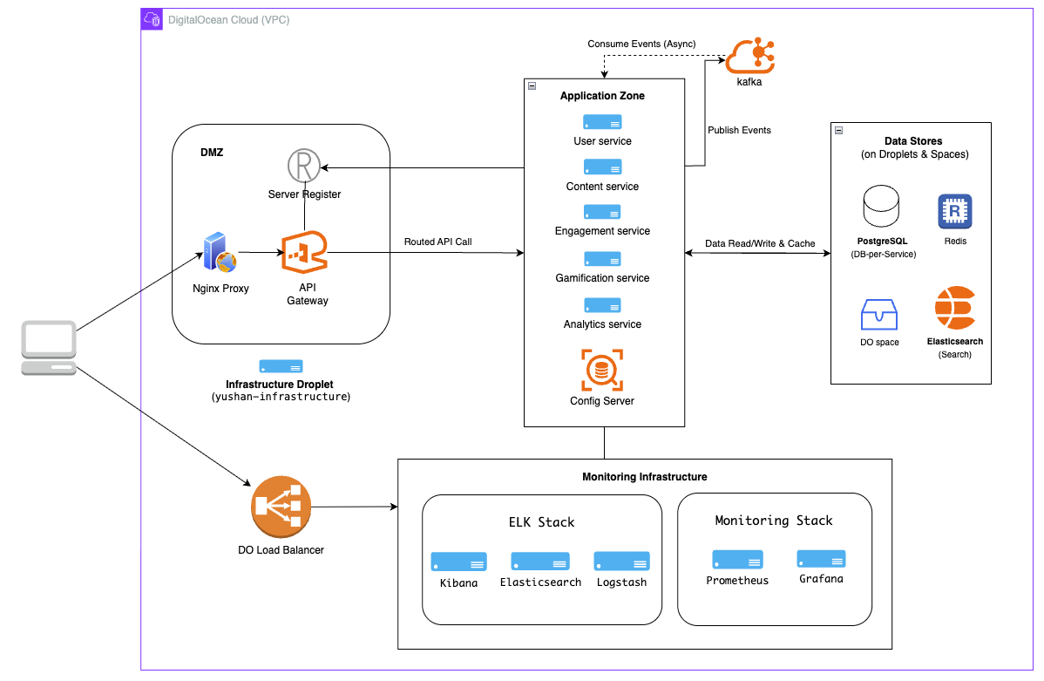
System Deployment Overview
Notes:
1min：from FE call nginx proxy -> api gateway -> call to registry services,

Slide 34
DevOps and Development Lifecycle
1. Repository Structure
Multi-Repository Pattern: Each microservice is in its own GitHub repository.
yushan-user-service
yushan-content-service
yushan-engagement-service
yushan-gamification-service
yushan-analytics-service
yushan-service-registry
yushan-config-server
yushan-api-gateway

Slide 35
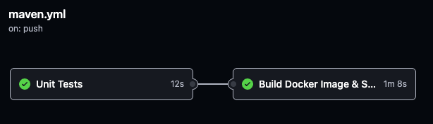
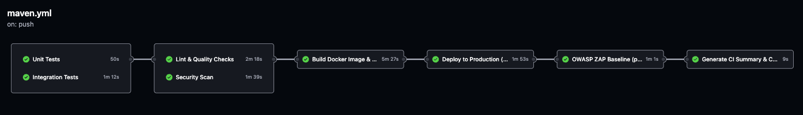
Benefit
Independent version control per service
Service-specific CI/CD pipelines
Team autonomy
Granular access control
Independent release cycles
Server Register CI/CD Pipeline
Content Service CI/CD Pipeline

Slide 36
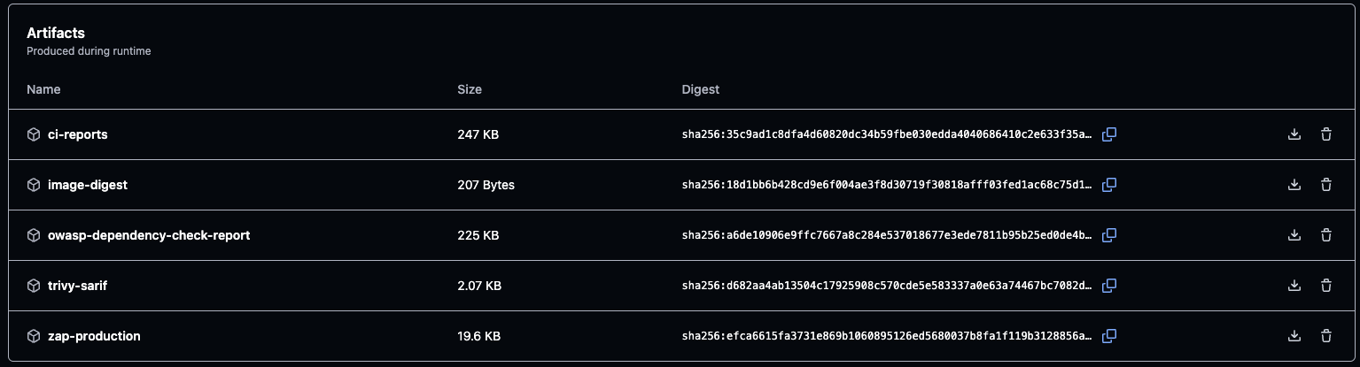
2. Artifact Management
Container Image Registry: GitHub Container Registry
Location: ghcr.io/maugus0/yushan-*
Multi-Platform Build:
  Platforms: linux/amd64, linux/arm64
  Push strategy: Push once, pull by platform
  Cache: GitHub Actions cache for faster builds
GitHub Actions artifacts

Slide 37
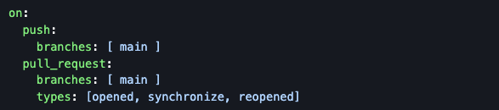

3. DevOps Pipeline & Procedures
Workflow File: .github/workflows/maven.yml in each service
Runner: ubuntu-latest (GitHub-hosted)
Trigger:
Concurrency Control:

Slide 38
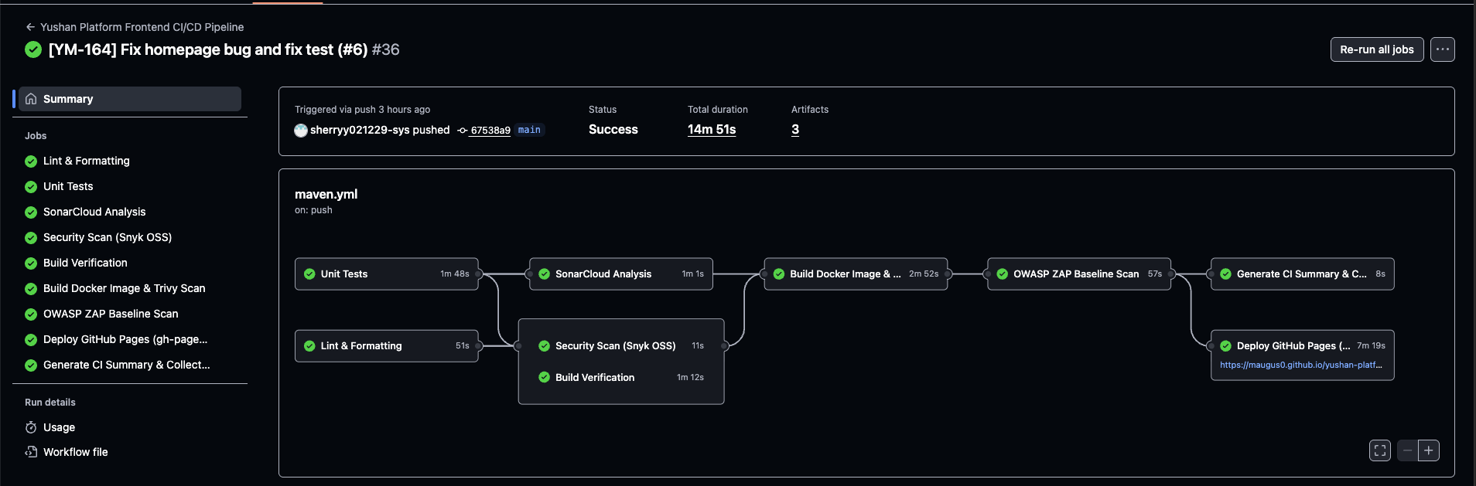
Yushan Platform Frontend CI/CD Pipeline
Test components, functions (Jest, React Testing Library)
Code quality gate (SonarCloud)
Build container image (Docker Buildx, Trivy)
Security scan running app (OWASP ZAP)
Collect all CI reports
Check code style, formatting (Prettier, ESLint)
Find dependency vulnerabilities (Snyk)
Verify production build (npm) -> Build artifacts
Deploy to GitHub Pages (gh-pages CLI, Playwright) - Health check + Auto rollback

Slide 39
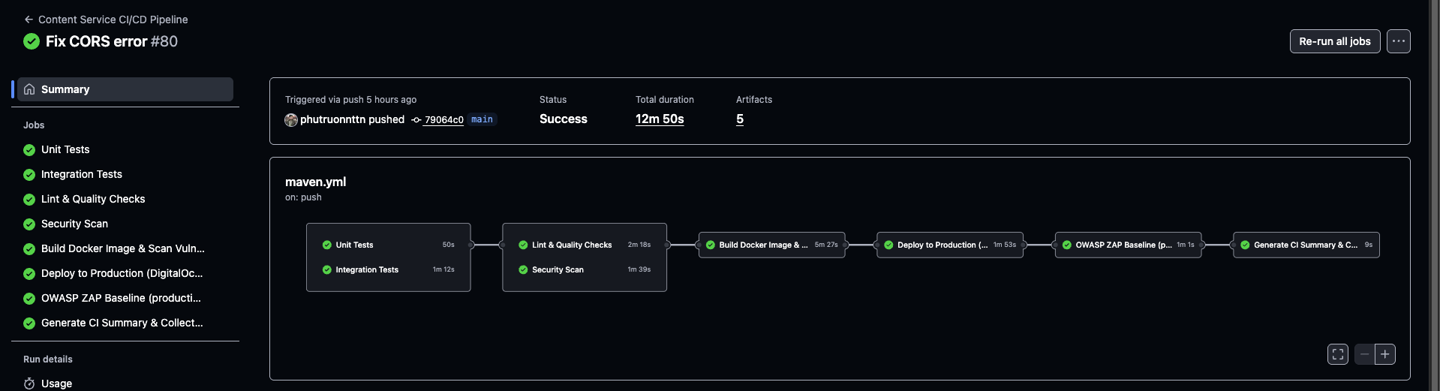
Content Service CI/CD Pipeline
Test business logic in isolation (Maven, JUnit, Mockito)
Check code quality and style (SpotBugs, Checkstyle, JaCoCo, SonarCloud)
Build multi-platform image (Docker Buildx, Trivy)
Deploy to DigitalOcean and health check
Test with real services (PostgreSQL, Redis, Kafka)
Find vulnerabilities (OWASP Dependency-Check, Snyk)
Security scan in production (OWASP ZAP)
Aggregate reports (GitHub Actions)

Slide 40
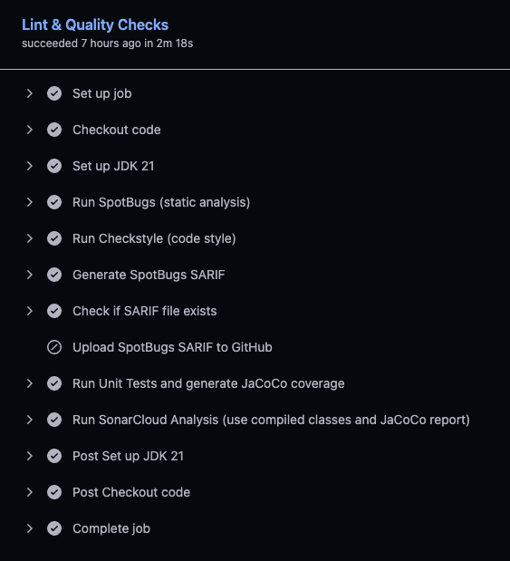
Lint & Quality Checks
SpotBugs: Static analysis for bugs
  Exclusions: spotbugs-exclude.xml
Checkstyle: Code style enforcement
  Config: checkstyle.xml
  Rules: Google Java Style Guide
JaCoCo: Code coverage
  Plugin: jacoco-maven-plugin:0.8.11
  Coverage report: target/site/jacoco/jacoco.xml
SonarCloud: Quality gate - SAST
  Project: maugus0_yushan-<service-name>
  Organization: yushan
  Uploads to: https://sonarcloud.io
Quality Metrics:
  Code Smells: Tracked via SonarCloud
  Duplicated Code: < 3%
  Test Coverage: > 80% (target)
  Vulnerabilities: 0 critical
Notes:
SAST (Static Application Security Testing)
SCA (Software Composition Analysis)
DAST (Dynamic Application Security Testing)

Slide 41
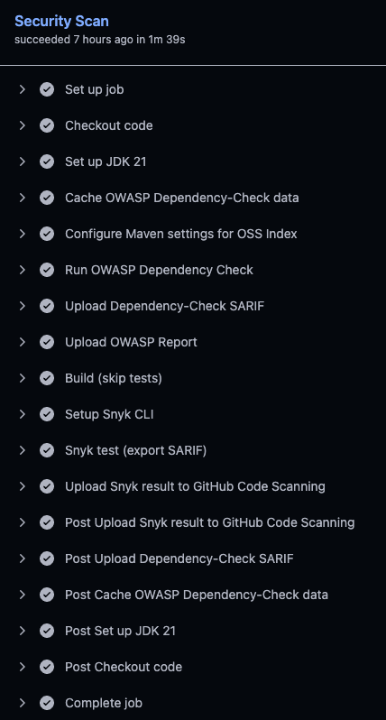
Security Scan
OWASP Dependency Check - SCA
  Plugin: dependency-check-maven:12.1.0
  NVD API: Scans against National Vulnerability Database
  OSS Index: Additional vulnerability database
  Output: HTML, XML, SARIF
  Fail on: CVSS >= 10 (critical)
Snyk - SCA
  Setup: snyk/actions/setup@master
  Severity: High+ vulnerabilities
  Output: SARIF format
  Upload: To GitHub Security tab
Notes:
SAST (Static Application Security Testing)
SCA (Software Composition Analysis)
DAST (Dynamic Application Security Testing)

Slide 42
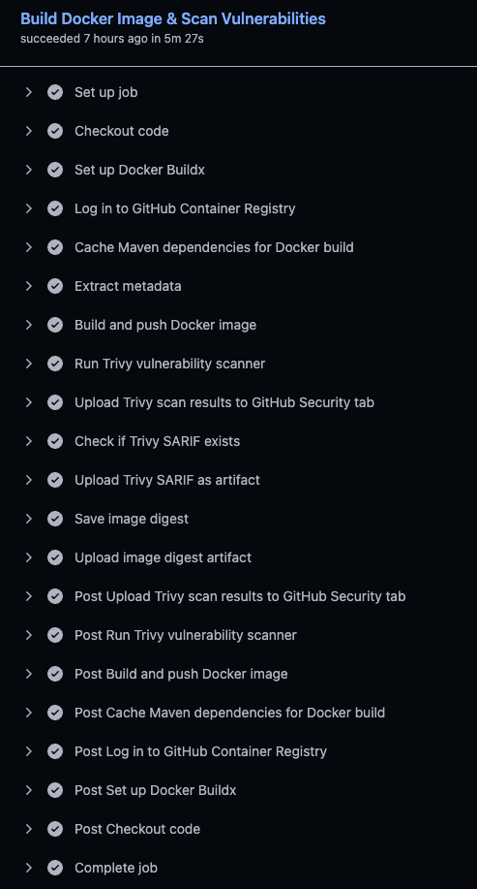
Build Docker Image & Scan Vulnerabilities
Docker Image Details
  Base Image: eclipse-temurin:21-jdk-alpine (builder),
  eclipse-temurin:21-jre-alpine (runtime)
  Multi-Stage Build: Reduces size by 70%
  Security: Non-root user (appuser, UID 1001)
  Health Check: Built-in Docker healthcheck
  Size: ~150-200MB (optimized from 500MB+)
Trivy Scanning
  Tool: aquasecurity/trivy-action@master
  Format: SARIF for GitHub Security tab
  Scans: OS packages, application dependencies
  Upload: Results uploaded as artifacts
Notes:
SAST (Static Application Security Testing)
SCA (Software Composition Analysis)
DAST (Dynamic Application Security Testing)

Slide 43
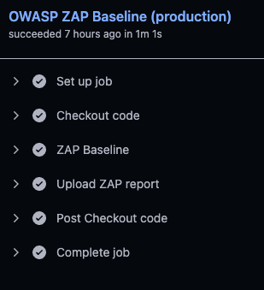
OWASP ZAP Baseline - DAST
What It Tests:
  SQL injection vulnerabilities
  XSS (Cross-Site Scripting)
  Authentication flaws
  Security misconfigurations
  Target: https://yushan.duckdns.org
Notes:
SAST (Static Application Security Testing)
SCA (Software Composition Analysis)
DAST (Dynamic Application Security Testing)

Slide 44
4. Improvements
Docker Build Optimization
  Before: Single-stage build, large images (500MB+)
  After: Multi-stage build with Alpine Linux
  Result: 70% smaller images (150-200MB)
Maven Dependency Caching
  Implementation: GitHub Actions cache for .m2/repository
  Result: Dependency download reduced from 5 minutes to 1 minutes
Test Execution Parallelization
  Implementation: Run unit and integration tests in separate jobs instead of sequentially. Same for Lint & Quality Checks and Security Scans
Logging Strategy (Monitoring & Observability)
  Implementation: Docker syslog driver for centralized logging
  Container → Docker Syslog Driver → Logstash (UDP 514) → Elasticsearch → Kibana
Notes:
SAST (Static Application Security Testing)
SCA (Software Composition Analysis)
DAST (Dynamic Application Security Testing)

Slide 45
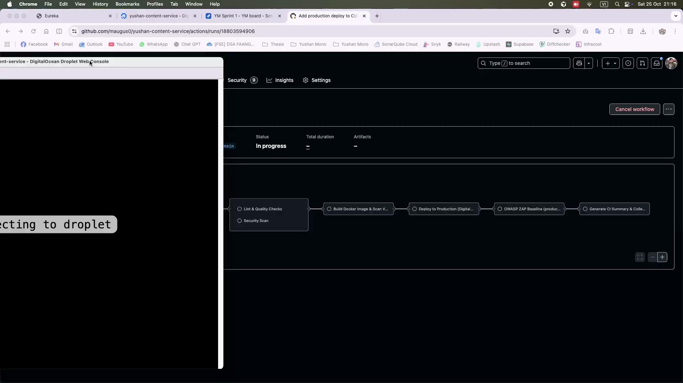
5. Demo CI/CD Pipeline - Demo 1

Slide 46
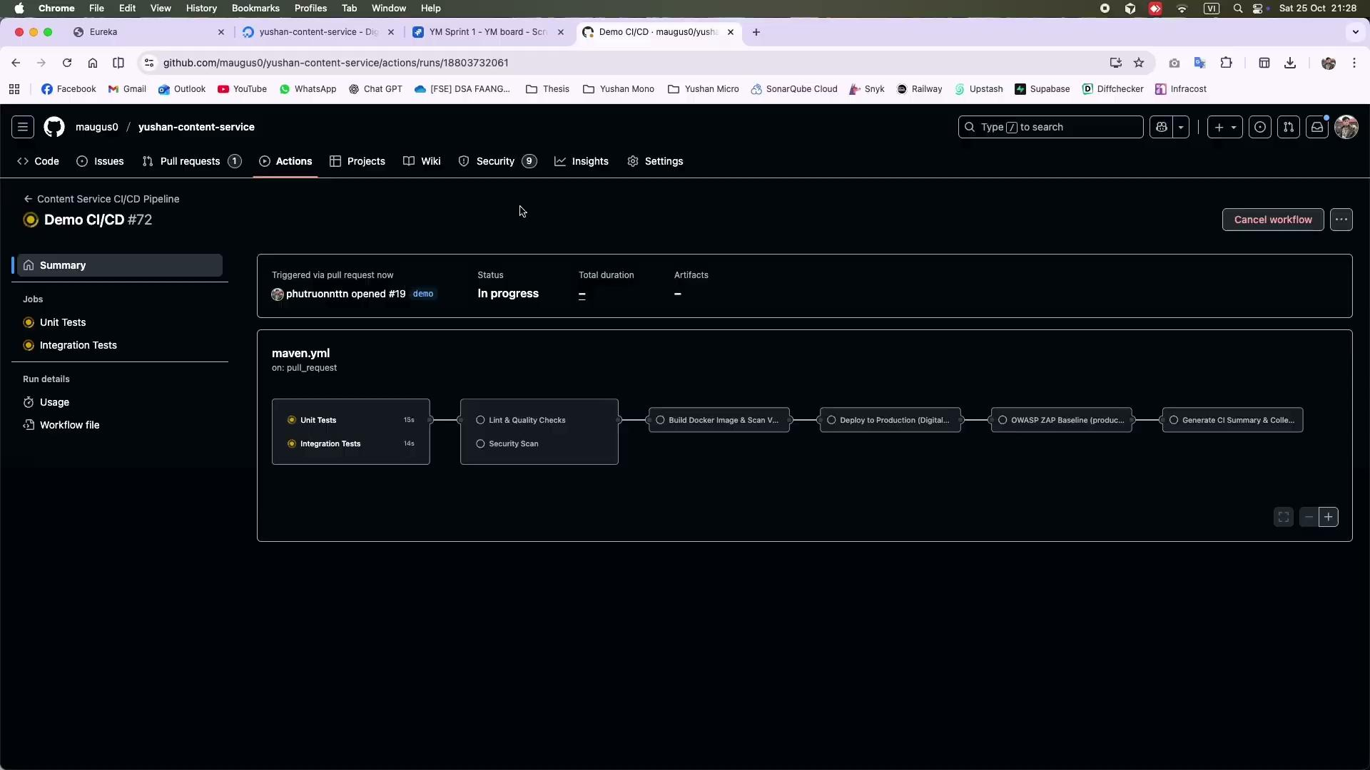
5. Demo CI/CD Pipeline - Demo 2

Slide 47
Thank you!
Now, we would like to move to the live demo of our application!

