Slide 1
Weekly report
Feb 22, 2024

Slide 2
AHB – master_port
Master
port
Master interface
- MCU/master
Slave interface
- master port
master
slave
slave

Slide 3
AHB – master_port
Slave interface
Name | Type | Width | Note
slv_HSEL_o | Output
slv_HADDR_o | Output | HADDR_SIZE
slv_HBURST_o | Output | 3
slv_HMASTLOCK_o | Output |  | //todo
slv_HPROT_o | Output | 7 | //todo
slv_HSIZE_o | Output | 3
slv_HNONSEC_o | Output |  | //todo
slv_HEXCL_o | Output |  | //todo
slv_HMASTER_o | Output |  | //todo
slv_HTRANS_o | Output | 2
slv_HWDATA_o | Output | HDATA_SIZE
slv_HWRITE_o | Output
slv_HADDR_mask_i | Input | HADDR_SIZE
slv_HADDR_base_i | Input | HADDR_SIZE
slv_HRDATA_i | Input | HDATA_SIZE
slv_HREADYOUT_i | Input
slv_HRESP_i | Input
slv_HEXOKAY_i | Input |  | //todo
Master interface
Name | Type | Width | Note
mst_HRDATA_o | Output | HDATA_SIZE
mst_HREADYOUT_o | Output
mst_HRESP_o | Output
mst_HEXOKAY_o | Output |  | //todo
mst_HADDR_i | Input | HADDR_SIZE
mst_HBURST_i | Input | 3
mst_HMASTLOCK_i | Input |  | //todo
mst_HPROT_i | Input | 7 | //todo
mst_HSIZE_i | Input | 3
mst_HNONSEC_i | Input |  | //todo
mst_HEXCL_i | Input |  | //todo
mst_HMASTER_i | Input |  | //todo
mst_HTRANS_i | Input | 2
mst_HWDATA_i | Input | HDATA_SIZE
mst_HWRITE_i | Input

Slide 4
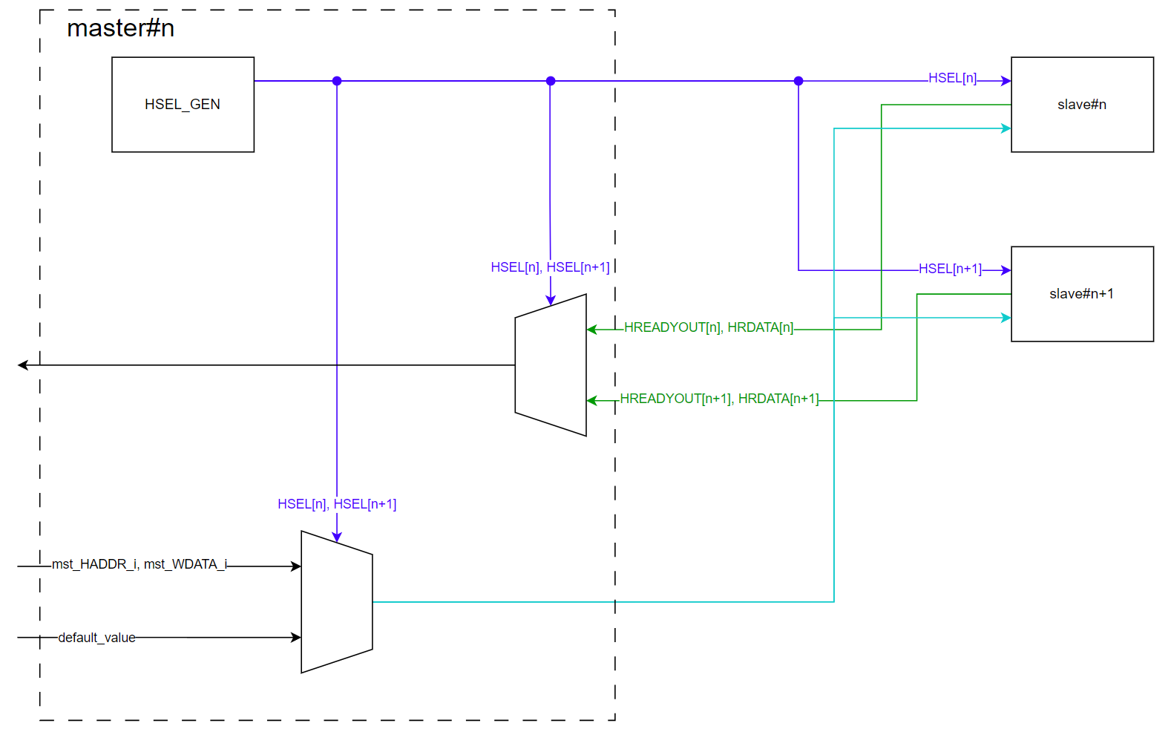
AHB – master_port

Slide 5
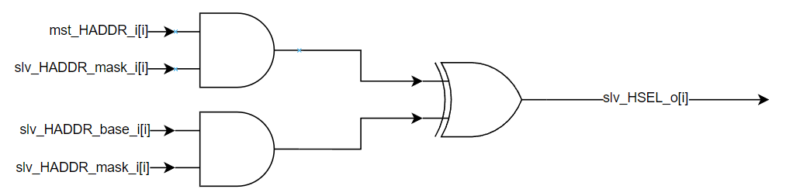
HSEL Gen
master
slave[i]
slv_HSEL_o[i]
Generate HSEL to each slave.
If mst_HADDR is in range of slave’s address -> HSEL = 1
slv_HSEL_o[i+1]
slave[i+1]

Slide 6
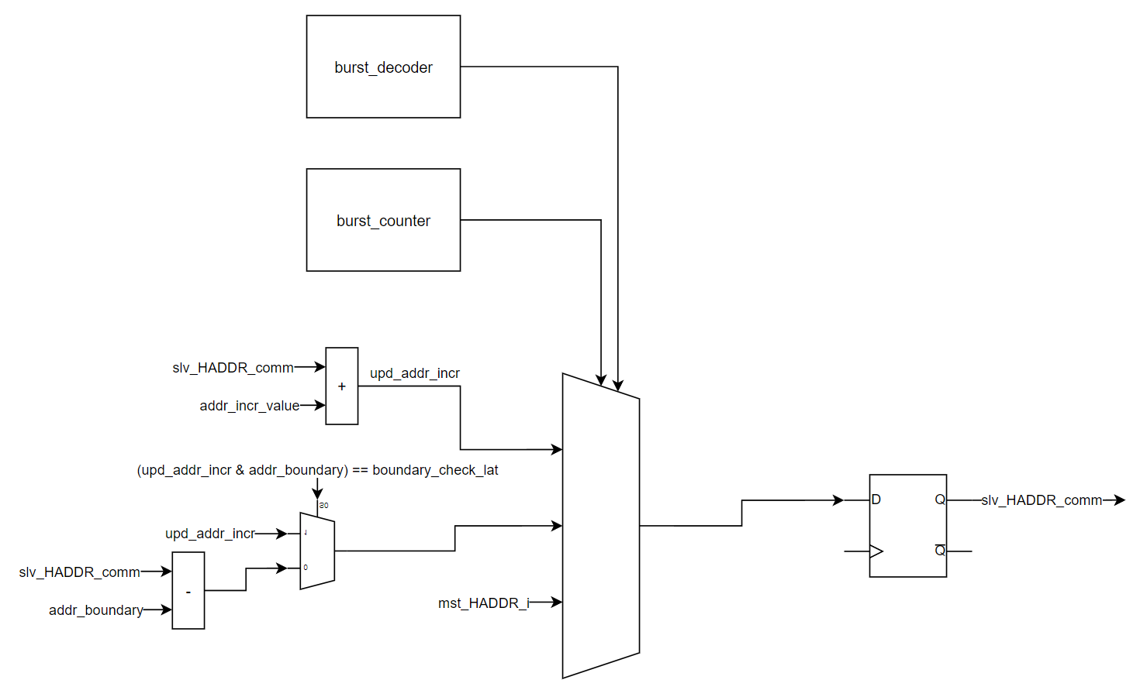
Next ADDR Gen
Generate next address for each SIZE/BURST
Condition | Next slv_ADDR_comm[HADDR_SIZE-1:0]
Burst counter = 0x0 | mst_HADDR_i[HADDR_SIZE-1:0]
Burst single | mst_HADDR_i[HADDR_SIZE-1:0]
Burst incr | + addr_incr_value
Burst wrap | Step size = addr_incr_value Loop in boundary
Default | No-change

Slide 7
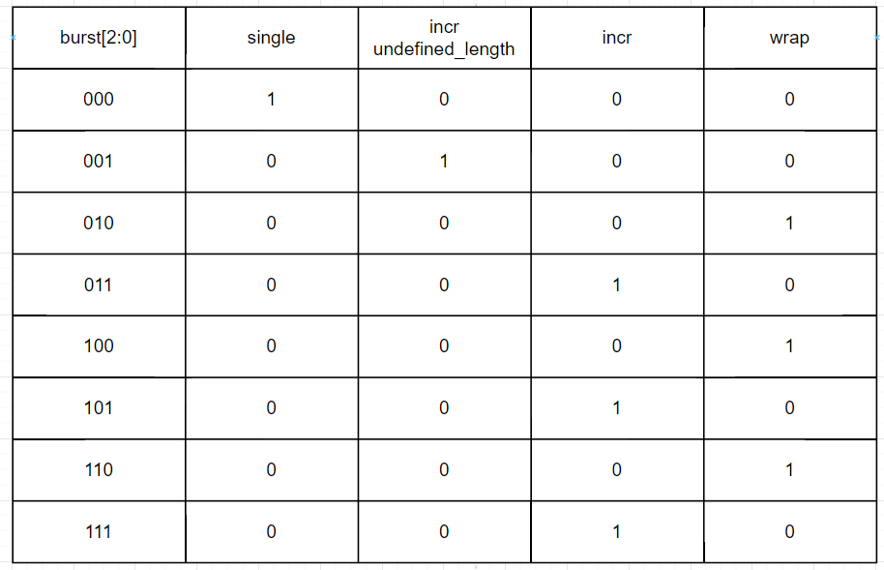
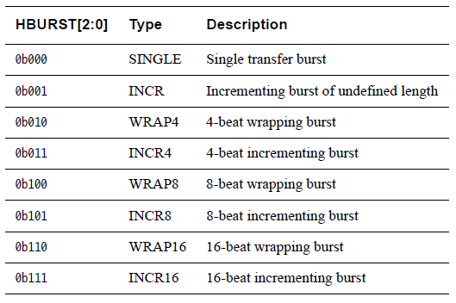
Burst decoder

Slide 8
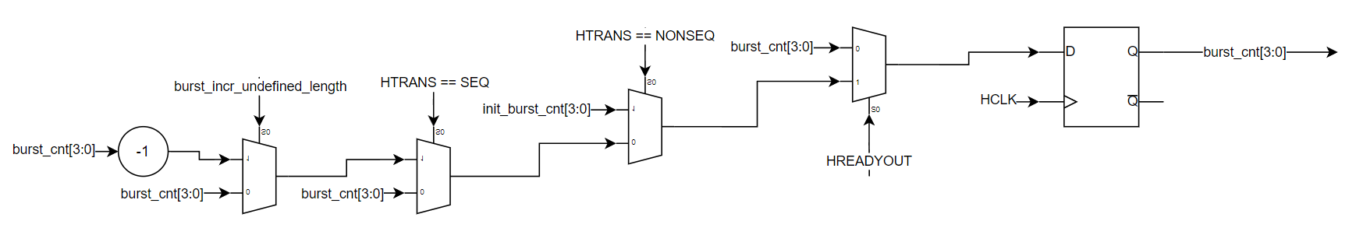
Burst counter
Condition | Next burst_cnt[3:0]
~HREADYOUT | No-change
HTRANS == NONSEQ | init_burst_cnt[3:0]
HTRANS_SEQ | upd_burst_cnt[3:0]
Default | No-change
burst_incr_undefined_length | upd_burst_cnt[3:0]
0 | burst_cnt[3:0]
1 | burst_cnt[3:0]--

Slide 9
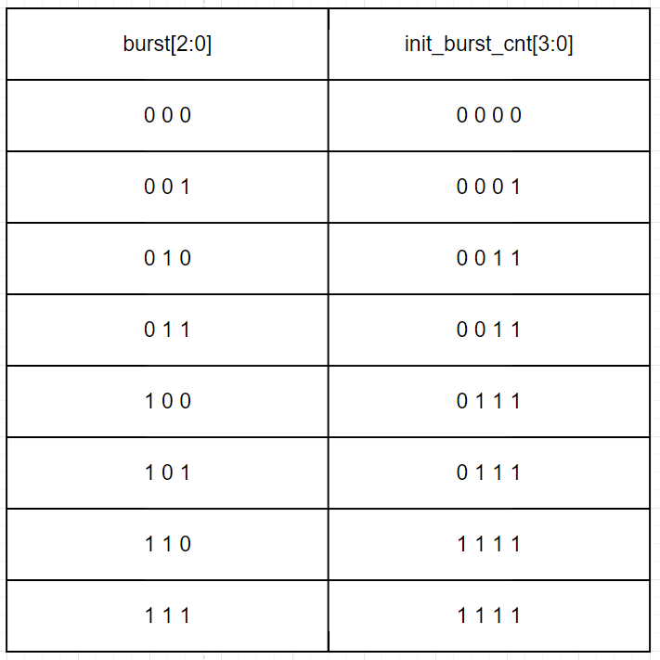
Burst counter
init_burst_cnt[3:0] is initial value of burst counter when HTRANS is NONSEQ – begging of new command.

Slide 10
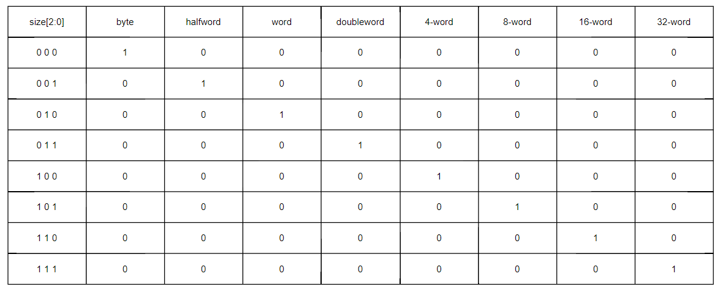
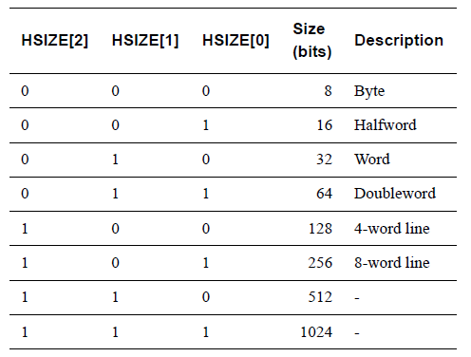
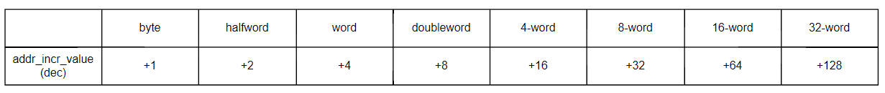
Size counter

Slide 11
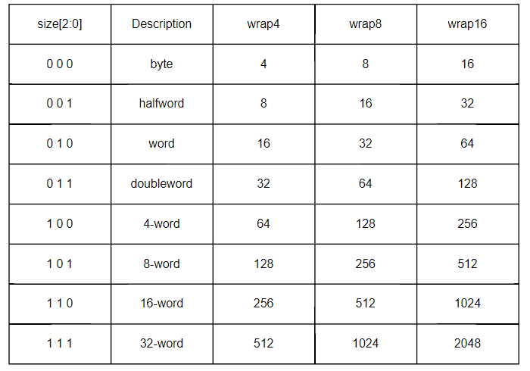
Address boundary decoder (dec)

