Slide 1
RTL APB protocol Phu Vuong

Slide 2
APB protocol
A part of the AMBA 3 protocol family
A low cost interface:
Optimize for minimal power consumption
Reduce interface complexity
Every transfer takes at least 2 cycles

Slide 3
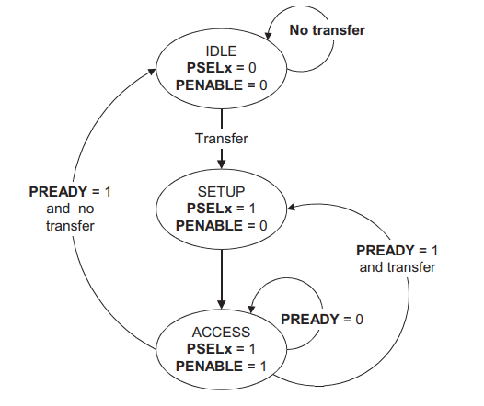
State diagram
States | Code
IDLE | 2’b00
SETUP | 2’b01
ACCESS | 2’b11

Slide 4
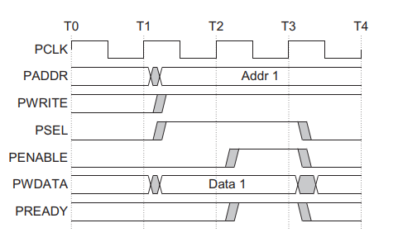
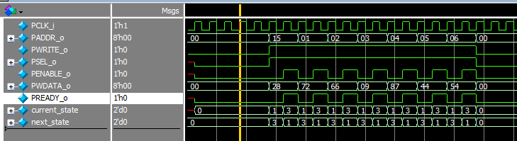
Write without wait states

Slide 5
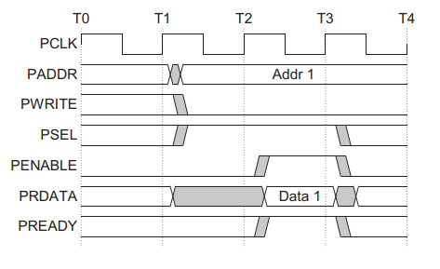
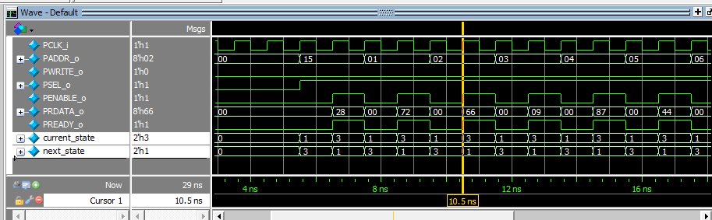
Read without wait states

