Slide 1
Direct Memory Access (DMA)
Feb 02, 2023

Slide 2
What is DMA?
DMA is a technology that allows data to be transferred directly from one memory location to another without the involvement of the CPU. This results in a significant improvement in the system's performance, as the CPU is freed up to perform other tasks while the DMA controller handles the data transfer.
In a DMA system, there are three main components: the CPU, the memory, and the DMA controller. The CPU initiates the transfer request and specifies the source and destination addresses in memory. The DMA controller then takes over, reading the data from the source memory location and writing it to the destination memory location.
The DMA controller has a dedicated channel for each peripheral device that needs to transfer data. Each channel has its own set of registers for specifying the source and destination addresses, as well as the transfer count and other control parameters. The DMA controller also has a dedicated bus interface to the memory, allowing it to access memory directly without the need for the CPU to be involved.
In conclusion, the DMA architecture provides a way for peripherals to transfer data to and from memory without involving the CPU, thereby improving system performance and efficiency.
AXI bus without DMA
I/O device
I/O device
I/O device
CPU
DMA Controller
Memory
AXI bus

Slide 3
How DMA works?
How a DMA transfer works:
The peripheral device initiates a DMA transfer request.
The CPU sets up the source and destination addresses in memory and the number of bytes to be transferred, and then gives control to the DMA controller.
The DMA controller takes over, reading the data from the source memory location and writing it to the destination memory location, without involving the CPU.
Once the transfer is complete, the DMA controller signals of the peripheral device and the CPU that the transfer is done.
I/O device
I/O device
I/O device
Handshake
Data
CPU
DMA Controller
Memory
Handshake
Master interface
Master interface
Slave interface
AXI bus

Slide 4
DMA controller block diagram
A DMA block diagram consists of the following components:
DMA Controller: The heart of the DMA, this component manages the entire data transfer process and is responsible for scheduling the transfers, calculating the transfer addresses, and generating the control signals.
AXI interface unit (AXI_IU): This component is responsible for interfacing with the system bus, specific is AXI bus.
Direct Memory Access Channel (DMAC): There can be one or more DMACs, depending on the number of peripheral devices that need to be supported. Each DMAC is responsible for a specific data transfer, and it communicates with the DMA controller to receive transfer instructions and control signals.
Address Generation Unit (AGU): The AGU generates the memory addresses for the data transfer, and it can also perform address calculations for scatter/gather operations.
Direct Memory Access Transfer Unit (DTU): This component is responsible for performing the actual data transfer, reading the data from the peripheral device and writing it to the memory or vice versa.
Peripheral Interface Unit (PIU): This component is responsible for interfacing with the peripheral device, and it provides the necessary control signals and data signals to initiate and control the data transfer.
I/O device
I/O device
I/O device
Handshake
Data
PIU
DMA controller
↔ | Control path
↔ | Data path
CPU
Handshake
AGU
DMA Controller
DMAC
DTU
Memory
AXI_IU
Master interface
Master interface
Slave interface
AXI bus

Slide 5
DMA handshake mode
DMA handshake mode transfers to coordinate the transfer of data between the peripheral device and the memory. It involves the exchange of control signals between the DMA controller and the peripheral device to initiate and control the transfer of data.
In DMA handshake mode, the peripheral device generates a request signal to indicate that it needs to transfer data. The DMA controller, upon receiving the request, generates a grant signal to indicate that the bus is available for the transfer. The peripheral device then initiates the transfer of data, and the DMA controller monitors the transfer to ensure that it is completed correctly. Upon completion, the DMA controller generates a transfer complete signal to indicate that the transfer is finished, and the peripheral device releases the bus.
The DMA handshake mode helps to ensure that the transfer of data is performed in a controlled and efficient manner, and it provides a mechanism for the peripheral device and the DMA controller to communicate and coordinate the transfer of data.

Slide 6
DMA normal mode
DMA normal mode is a mode where the transfers data from a peripheral device to memory or from memory to a peripheral device is performed in a single, continuous transfer. In this mode, the DMA controller acts as an intermediary between the peripheral device and memory, taking control of the bus and managing the transfer of data without the need for intervention from the processor.
In DMA normal mode, the peripheral device generates a request signal to initiate the transfer, and the DMA controller grants access to the bus. The DMA controller then performs the transfer of data from the peripheral device to memory or from memory to the peripheral device, and upon completion, releases the bus. The transfer is performed in a single transaction, without the need for repeated handshaking between the peripheral device and the DMA controller.
DMA normal mode is typically used for small data transfers or for transfers that occur infrequently. This mode provides a simple and efficient mechanism for transferring data between a peripheral device and memory, freeing up the processor to perform other tasks during the transfer.

Slide 7
DMA linked list mode
DMA linked list mode allows for the transfer of multiple blocks of data in a chain-like manner, with each block linked to the next block. In this mode, the DMA controller acts as an intermediary between the peripheral device and memory, taking control of the bus and managing the transfer of data without the need for intervention from the processor.
In DMA linked list mode, the data to be transferred is divided into blocks, and each block is described by a data structure stored in memory, called a "node". The nodes contain information about the source and destination addresses, the size of the transfer, and a pointer to the next node in the list. The DMA controller starts the transfer by fetching the first node in the list, performing the transfer described by the node, and then fetching the next node in the list, and so on, until all nodes have been processed.
DMA linked list mode provides a flexible and efficient mechanism for transferring multiple blocks of data between a peripheral device and memory, freeing up the processor to perform other tasks during the transfer. This mode is particularly useful for applications where the data to be transferred is dynamic or where the data transfer patterns are complex and change frequently.

Slide 8
DMA channel arbitration
DMA channel arbitration refers to the process of determining which DMA channel will be given access to the bus to perform a data transfer. When multiple peripheral devices are requesting a transfer at the same time, the DMA controller must decide which request to process first.
There are several methods of DMA channel arbitration, including:
Fixed Priority: In this method, each DMA channel is assigned a priority, and the channel with the highest priority is granted access to the bus first.
Round Robin: In this method, the DMA controller cycles through all the DMA channels, granting each one access to the bus in turn.
Sporadic: In this method, the DMA controller assigns access to the bus based on the frequency of requests from each channel. Channels that request transfers more frequently are given higher priority.
Weighted Round Robin: In this method, the DMA controller grants access to the bus based on a combination of channel priority and the frequency of requests.
The specific method used for DMA channel arbitration depends on the requirements of the system and the specific implementation of the DMA controller.
The choice of the best method for DMA channel arbitration in a system with 32 channels would depend on the specific requirements of the system and the data transfer patterns of the peripherals. However, if all the channels have roughly equal priority, the Round Robin method can be a good choice, as it provides a fair and balanced allocation of bus access to all the channels. This method can also help to avoid starvation of any individual channel if there are irregular bursts of requests.
If some channels have a higher priority, then a combination of Fixed Priority and Weighted Round Robin methods can be used, where the higher priority channels are granted bus access first and the remaining channels are granted access based on a weighted round-robin algorithm.
Ultimately, the best method for DMA channel arbitration would need to be evaluated and determined based on a detailed analysis of the system requirements and the performance characteristics of the DMA controller.

Slide 9
DMA channel locking
DMA channel locking reserves a particular DMA channel for exclusive use by a specific peripheral device. In a system with multiple DMA channels, channel locking allows a peripheral device to lock a particular channel for its own use, preventing other devices from accessing the same channel.
Channel locking is typically implemented by setting a "lock bit" associated with each DMA channel. When a peripheral device needs to transfer data, it sets the lock bit for the desired channel, indicating that the channel is reserved for its use. Other peripheral devices can then request other available channels, or they can wait until the locked channel is released.
Channel locking provides a mechanism for ensuring that the transfer of data from a peripheral device is performed in a timely and consistent manner, and it provides a mechanism for avoiding conflicts between different peripheral devices that might otherwise compete for access to the same DMA channel.
It's important to note that the mechanism for implementing channel locking may vary depending on the specific DMA controller and system architecture, so it's important to consult the documentation for the specific controller to determine the available options and methods for implementing channel locking.

Slide 10
DMA channel disabling without data loss
DMA channel disabling without data loss refers to the process of disabling a DMA channel while preserving the data that is being transferred. In a DMA transfer, data is moved from a peripheral device to memory or from memory to a peripheral device without the intervention of the processor. If the DMA channel is disabled while the transfer is in progress, it could result in loss of data.
To prevent data loss during the disabling of a DMA channel, the DMA controller typically provides a mechanism to pause the transfer, allowing the channel to be disabled without losing any data. Once the channel has been disabled, the transfer can be resumed from the point where it was paused. This mechanism helps to ensure that the transfer of data is performed in a consistent and reliable manner, even if the channel must be disabled during the transfer.
It's important to note that the mechanism for disabling a DMA channel without data loss may vary depending on the specific DMA controller and system architecture.

Slide 11
DMA hold function
DMA hold function allows the transfer of data to be temporarily suspended while the processor performs other tasks. The DMA hold function allows the processor to temporarily stop the DMA transfer, and then resume the transfer later, at the same place where it was stopped.
The DMA hold function is implemented by adding a "hold" signal to the DMA controller, which is controlled by the processor. When the processor wants to temporarily stop the DMA transfer, it asserts the hold signal. The DMA controller then pauses the transfer and waits for the processor to release the hold signal. When the hold signal is released, the DMA controller resumes the transfer from the point where it was stopped.
The DMA hold function provides a mechanism for ensuring that the processor has control over the DMA transfer, and it provides a mechanism for temporarily stopping the transfer when the processor needs to perform other tasks. This feature is particularly useful for applications where the processor needs to perform complex tasks or needs to temporarily halt the transfer in order to perform other functions.

Slide 12
DMAC status indication outputs
DMA (Direct Memory Access) controller status indication outputs are signals generated by the DMA controller that indicate the status of a DMA transfer. These signals provide information about the state of the transfer, such as whether the transfer is in progress, whether it has completed, or whether an error has occurred.
The specific status indication outputs provided by a DMA controller can vary depending on the specific controller and system architecture, but common status outputs include:
Transfer Complete: A signal that indicates when a DMA transfer has completed successfully.
Error: A signal that indicates that an error has occurred during the transfer.
Busy: A signal that indicates that the DMA controller is currently transferring data.
Transfer Request: A signal that indicates that a DMA transfer has been requested by a peripheral device.
The status indication outputs are used by the processor and other components in the system to monitor the status of the DMA transfer and to control the flow of data. For example, the processor may use the transfer complete signal to determine when a DMA transfer has finished, and then perform other tasks, or the processor may use the error signal to handle any errors that occur during the transfer.

Slide 13
AXI DMA feature supported list
Up to 32 channel
Up to two AXI master interfaces
Support normal/handshake/linked list mode
Up to 32 hardware handshaking interfaces/peripherals
Channel arbitration
Protection (optional)

Slide 14
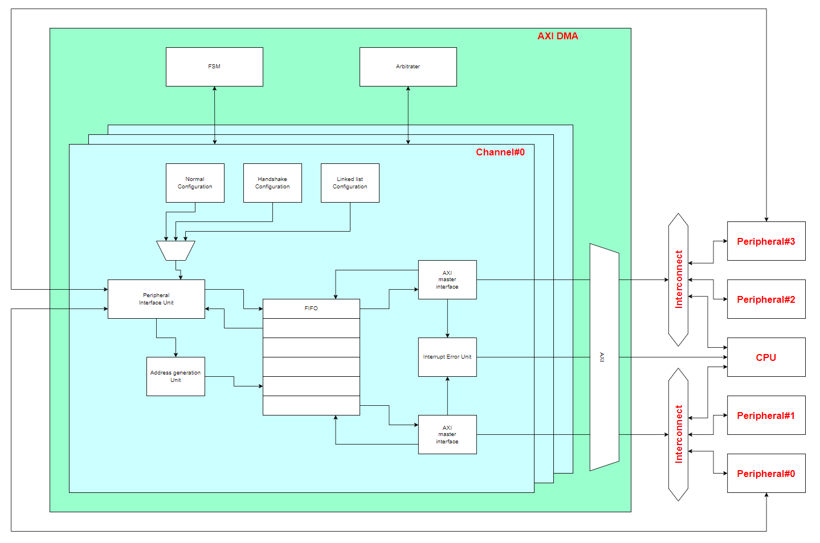
AXI DMA diagram

