Slide 1
Weekly report
Mar 14 2024

Slide 2
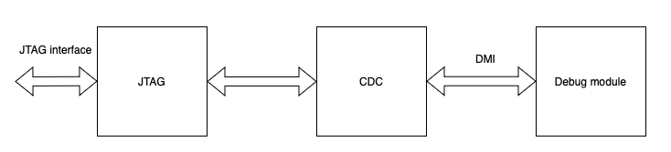
jtag and debug interface
1. JTAG: jtag interface, tap controller, some dmi register
2. CDC: synchronized jtag signal and DM signal
3. Debug module

Slide 3
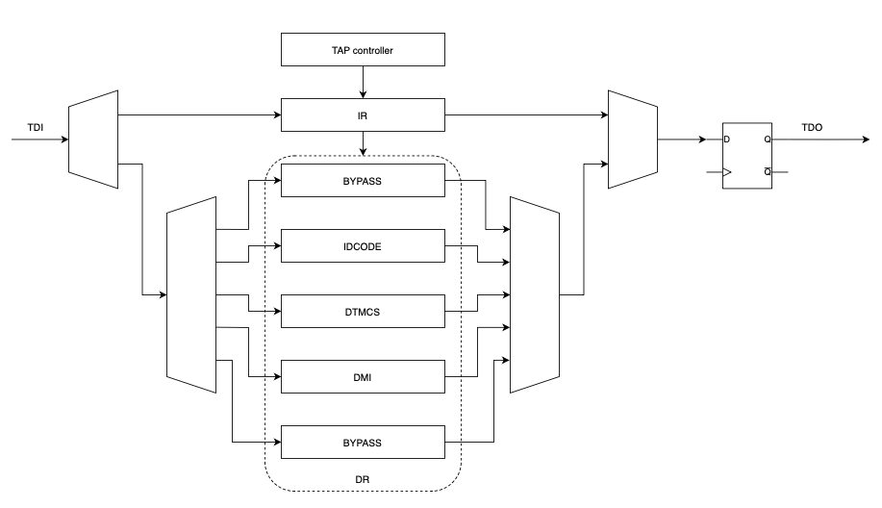
jtag architecture

Slide 4
jtag architecture
//jtag interface:
input jtag_trstn_i
input jtag_tck_i
input jtag_tms_i
input jtag_tdi_i
output jtag_tdo_o
output jtag_tdo_enable_o
//register dmi:
input: [2:0]dmi_op_i
input: [31:0]dmi_rdata_i
input: dmi_rdata_valid_i
input: dmi_ack_i
output: dmi_we_o
output: [31:0]dmi_addr_o
output: [31:0]dmi_wdata_o
output: dmi_req_o
//register dtmcs:
input [3:0]dtmcs_version_i
input [5:0]dtmcs_abits_i
input [1:0]dtmcs_dmistat_i
input [2:0]dtmcs_idle_i
output dtmcs_dmireset_o
output dtmcs_dmihardreset_o

Slide 5
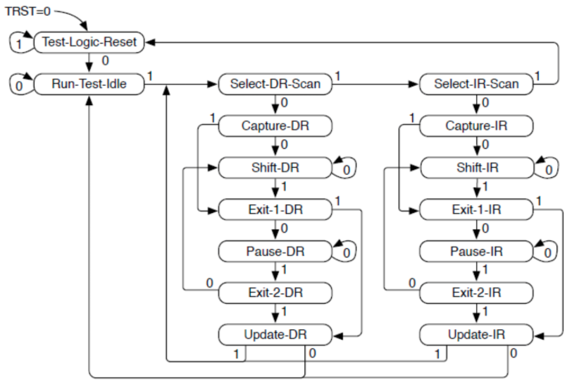
jtag - FSM

Slide 6
jtag - FSM
State | select_ir | select_dr | captuer_ir | shift_ir | update_ir | capture_dr | shift_dr | update_dr | tdo_enable
TEST_LOGIC_RESET | 0 | 0 | 0 | 0 | 0 | 0 | 0 | 0 | 0
RUN_TEST_IDLE | 0 | 0 | 0 | 0 | 0 | 0 | 0 | 0 | 0
SELECT_DR_SCAN | 0 | 0 | 0 | 0 | 0 | 0 | 0 | 0 | 0
SELECT_IR_SCAN | 0 | 0 | 0 | 0 | 0 | 0 | 0 | 0 | 0
CAPTURE_IR | 1 | 0 | 1 | 0 | 0 | 0 | 0 | 0 | 0
SHIFT_IR | 1 | 0 | 0 | 1 | 0 | 0 | 0 | 0 | 0
EXIT1_IR | 1 | 0 | 0 | 0 | 0 | 0 | 0 | 0 | 0
PAUSE_IR | 1 | 0 | 0 | 0 | 0 | 0 | 0 | 0 | 0
EXIT2_IR | 1 | 0 | 0 | 0 | 0 | 0 | 0 | 0 | 0
UPDATE_IR | 1 | 0 | 0 | 0 | 1 | 0 | 0 | 0 | 0
CAPTURE_DR | 0 | 1 | 0 | 0 | 0 | 1 | 0 | 0 | 0
SHIFT_DR | 0 | 1 | 0 | 0 | 0 | 0 | 1 | 0 | 0
EXIT1_DR | 0 | 1 | 0 | 0 | 0 | 0 | 0 | 0 | 0
PAUSE_DR | 0 | 1 | 0 | 0 | 0 | 0 | 0 | 0 | 0
EXIT2_DR | 0 | 1 | 0 | 0 | 0 | 0 | 0 | 0 | 0
UPDATE_DR | 0 | 1 | 0 | 0 | 0 | 0 | 0 | 0 | 1

Slide 7
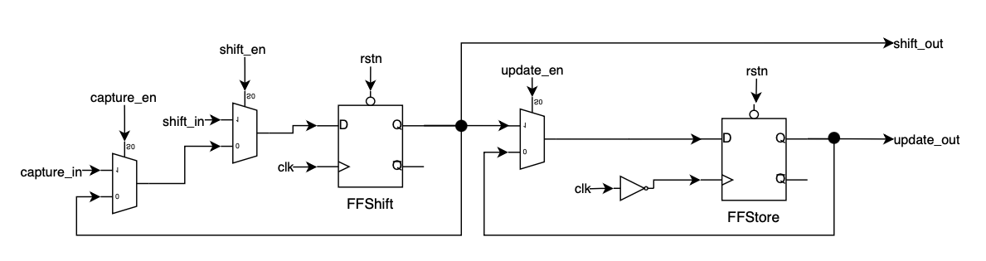
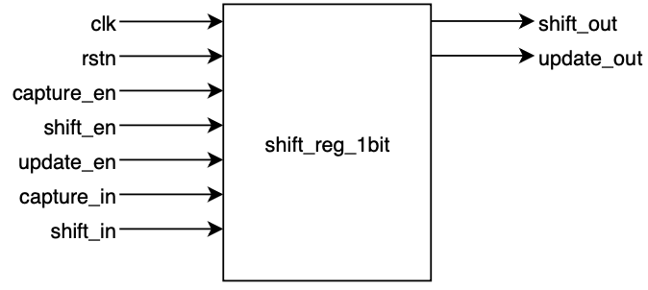
jtag - 1bit shift register

Slide 8
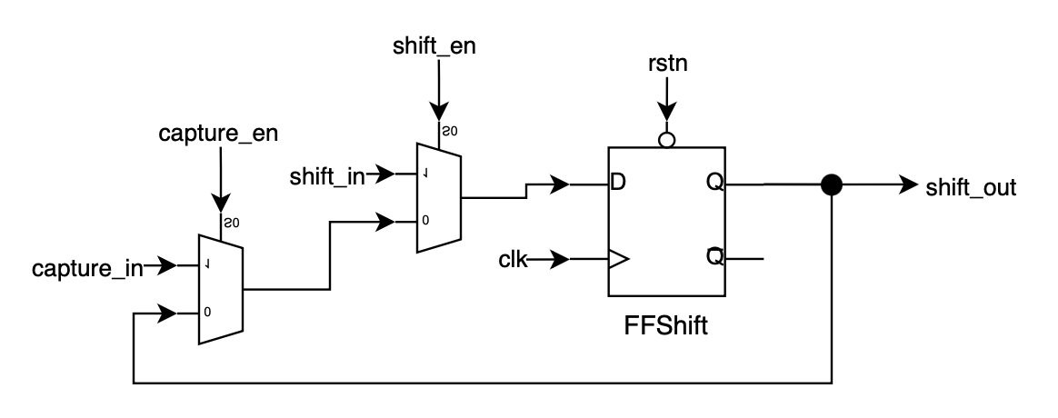
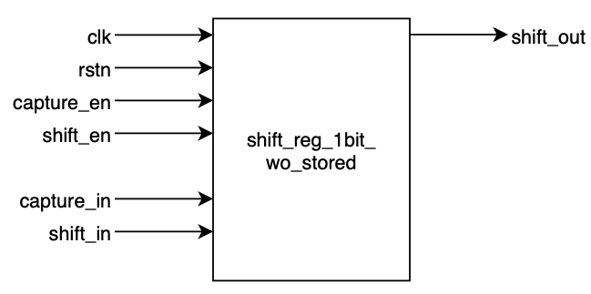
jtag - 1bit shift register w/o FFstore

Slide 9
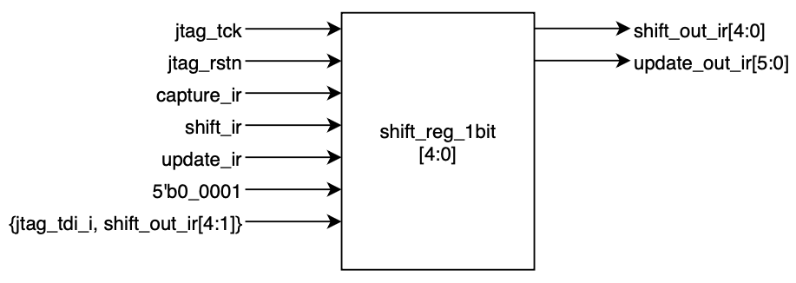
jtag - IR

Slide 10
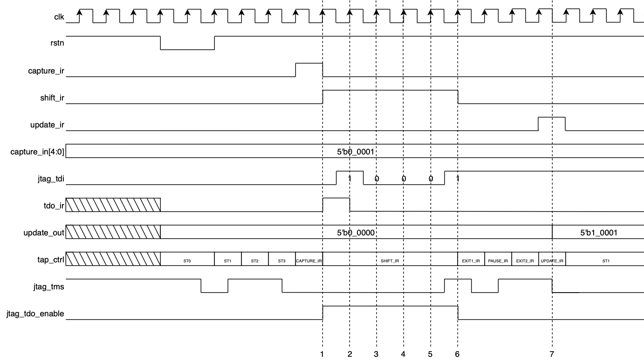
jtag - IR
1. capture default value (5'b0_0001)
2. shift 1st tdi
3. shift 2nd tdi
4. shift 3rd tdi
5. shift 4th tdi
6. shift 5th tdi
7. store shift data
ST0: TEST_LOGIC_RESET
ST1: RUN_TEST_IDLE
ST2: SELECT_DR_SCAN
ST3: SELECT_IR_SCAN
IR - decoder:
BYPASS: 5'b1_1111 or 5'b0_0000 -> select_bypass
IDCODE: 5'b0_0001 -> select_idcode
DTMCS: 5'b1_0000 -> select_dtmcs
DMI: 5'b1_0001 -> select_dmi

Slide 11
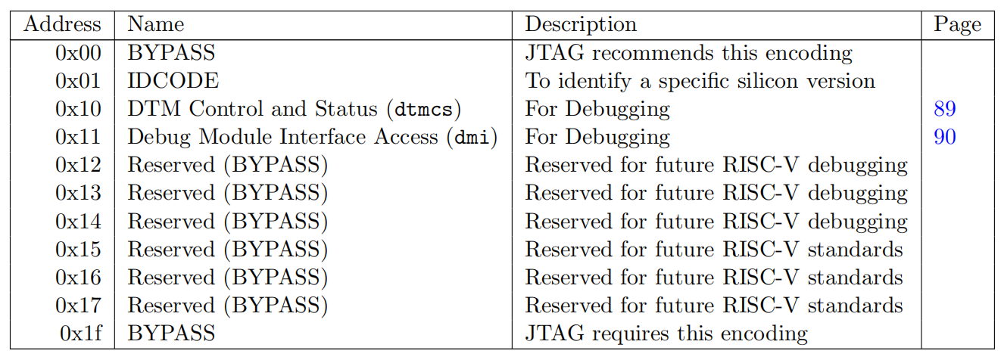
jtag - DR

Slide 12
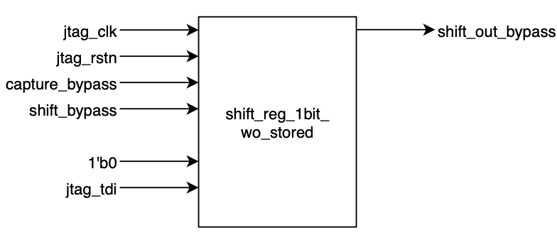
jtag - DR - BYPASS
capture_bypass = select_bypass & capture_dr
shift_bypass = select_bypass & shift_dr

Slide 13
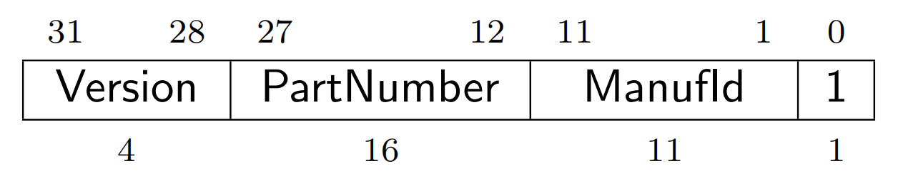
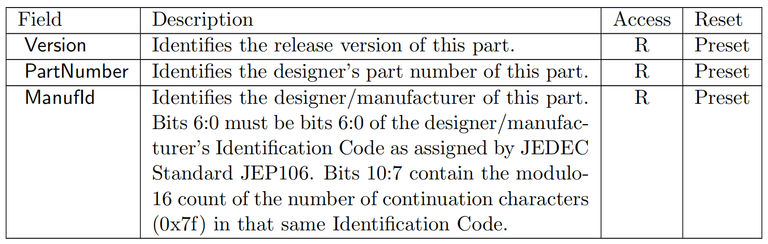
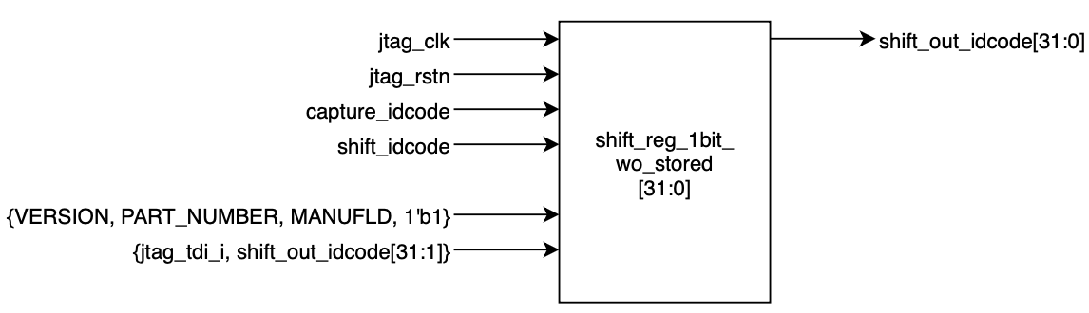
jtag - DR - IDCODE
capture_idcode = select_idcode & capture_dr
shift_idcode = select_idcode & shift_dr

Slide 14
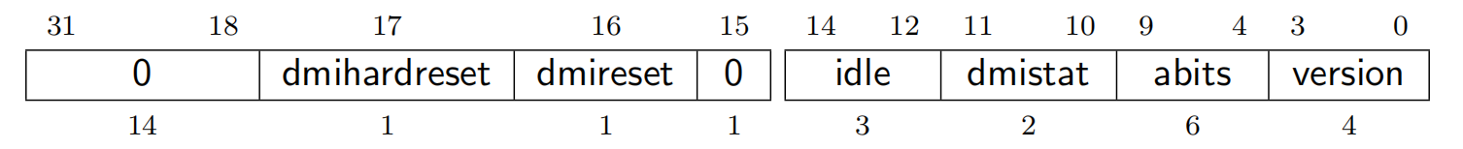
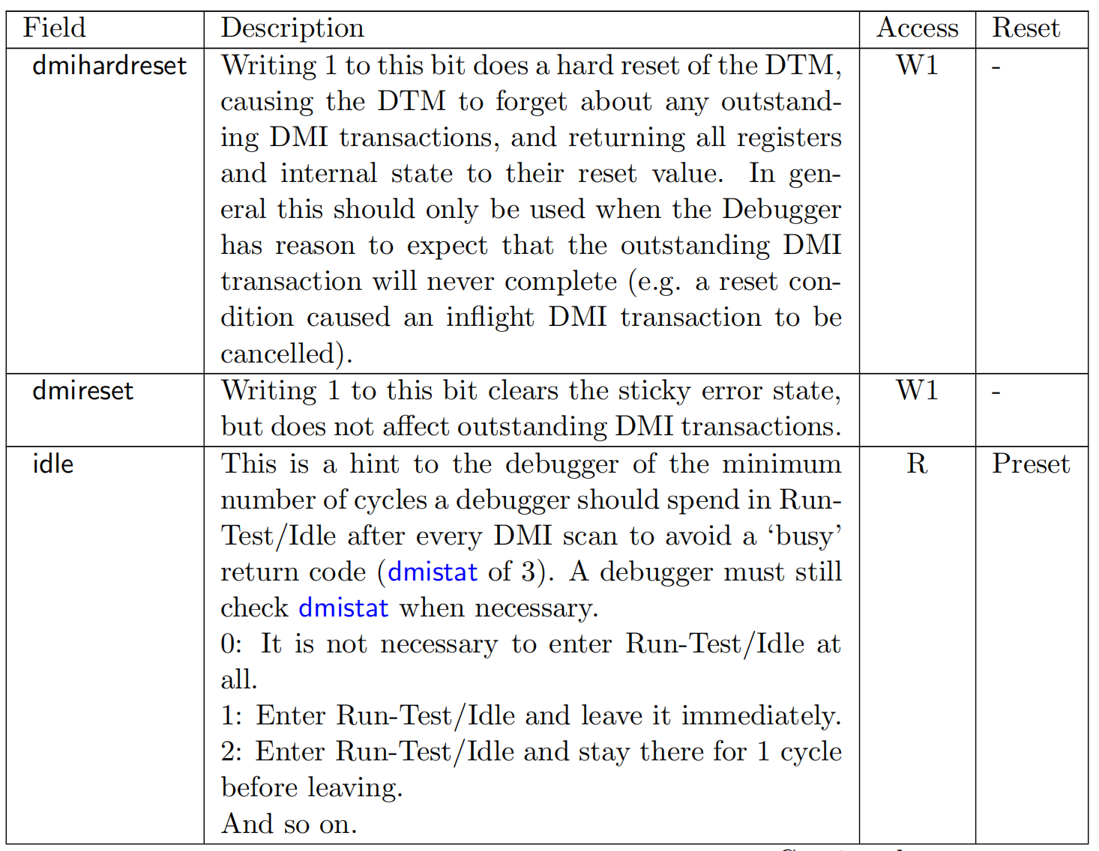
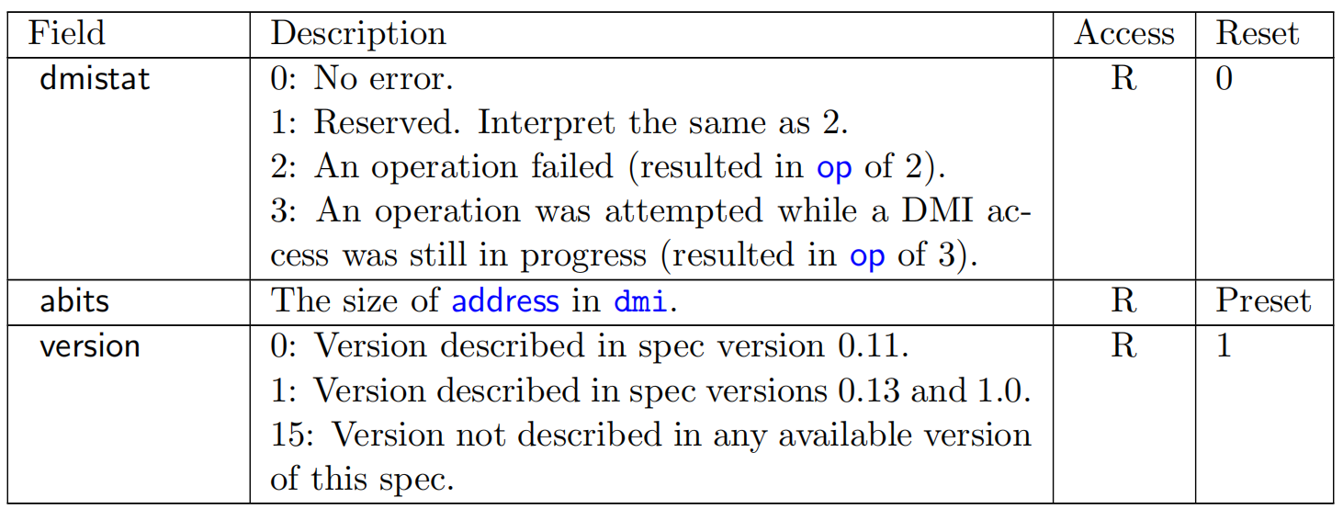
jtag - DR - DTMCS

Slide 15
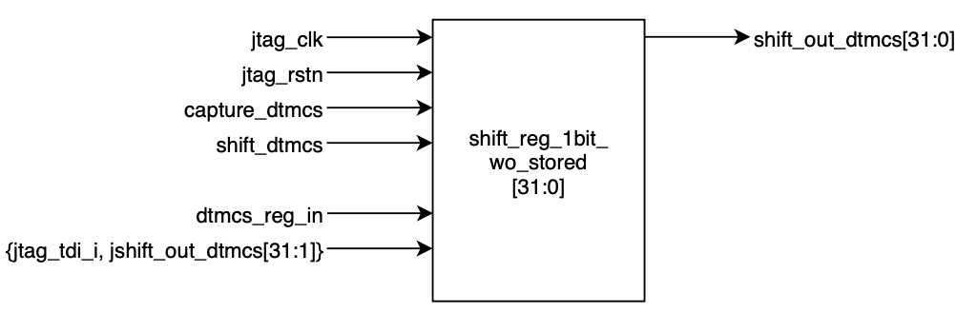
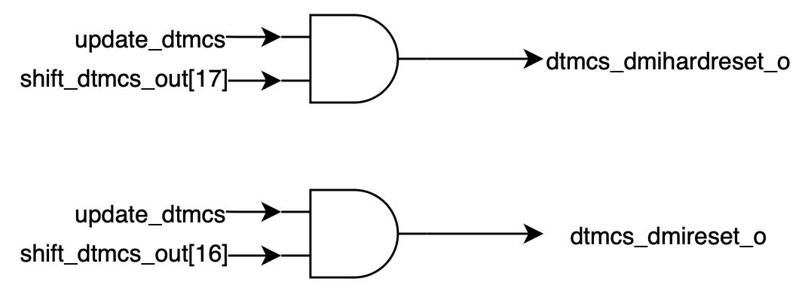
jtag - DR - DTMCS
capture_dtmcs = select_dtmcs & capture_dr
shift_dtmcs = select_dtmcs & shift_dr
dtmcs_reg_in[31:0] = { 14'h0, dtmcs_dmihardreset_o,
dtmcs_dmireset_o,
1'h0,
dtmcs_idle_i,
dtmcs_dmistat_i,
dtmcs_abits_i,
dtmcs_version_i}

Slide 16
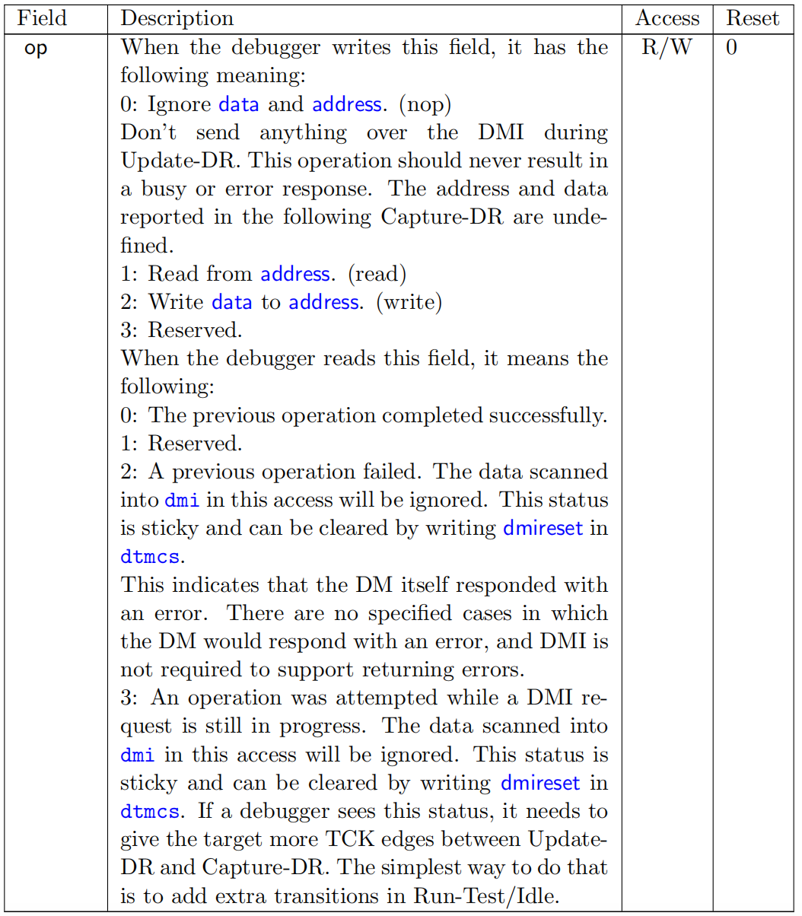
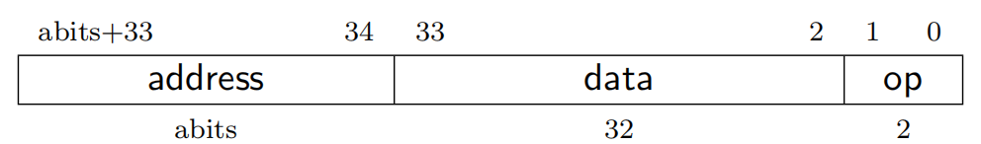
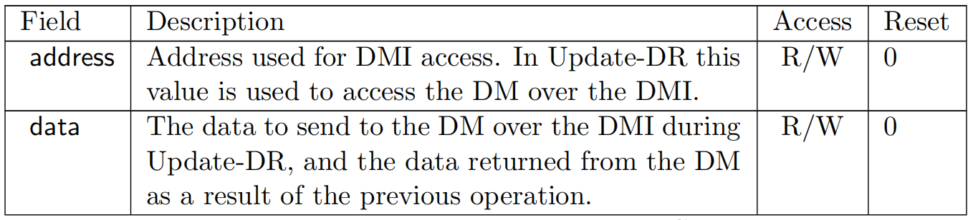
jtag - DR - DMI

Slide 17
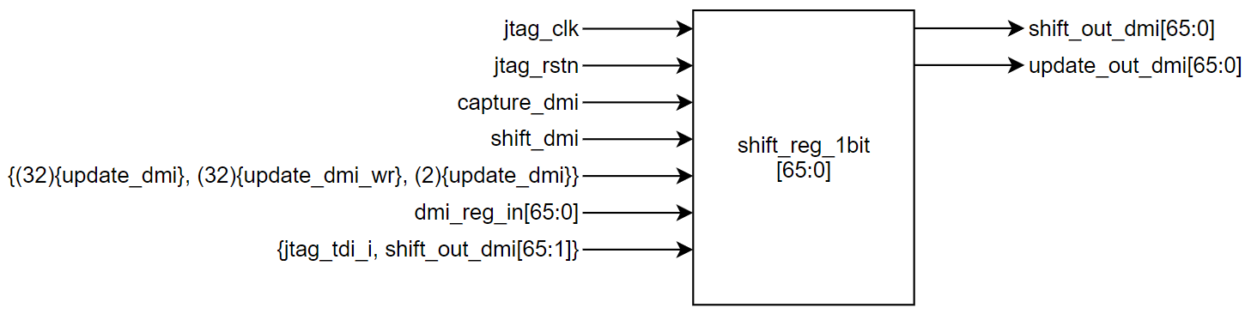
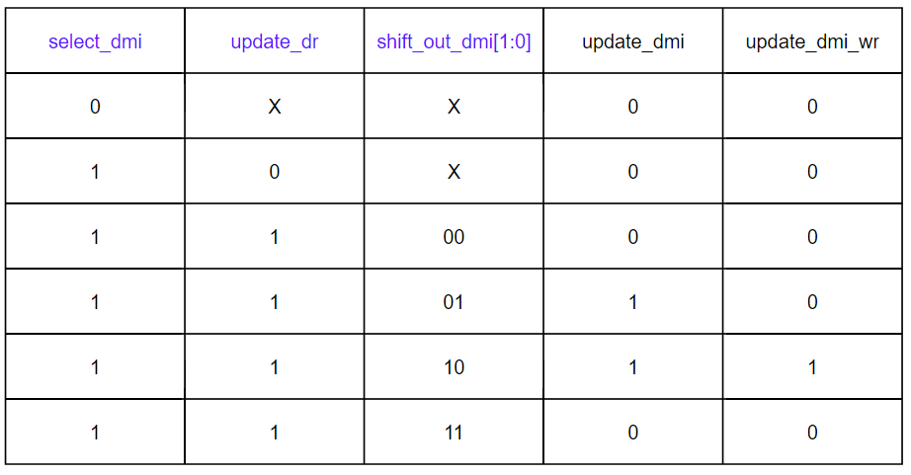
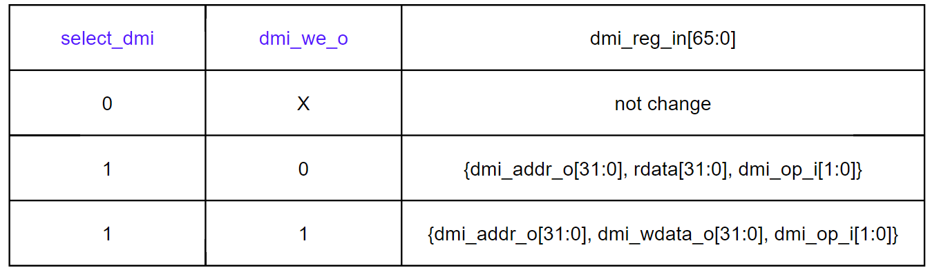
jtag - DR - DMI
capture_dmi = select_dmi & capture_dr
shift_dmi = select_dmi & shift_dr

Slide 18
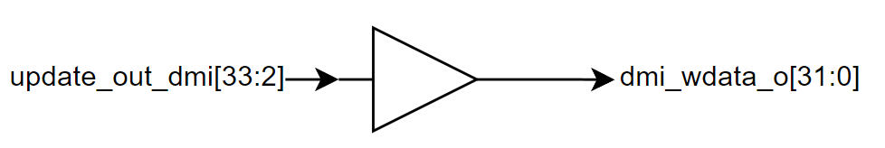
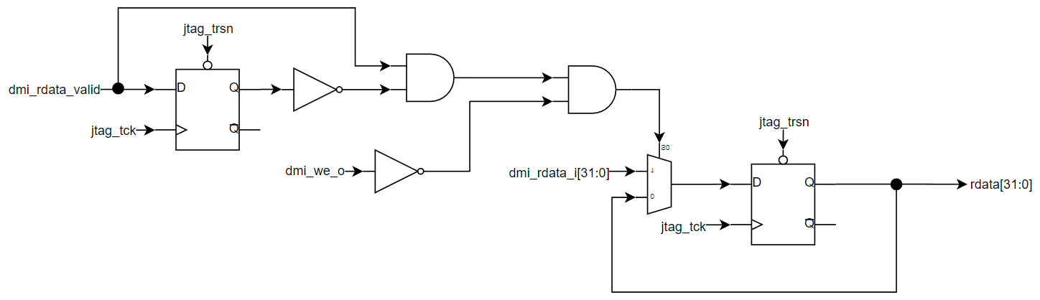
jtag - DR - DMI
update dmi_wdata_o @UPDATE_DR if opcode = 2'b10 (write)
get dmi_rdata_i @posedge dmi_rddata_valid_i if opcode = 2'b01 (read)

Slide 19
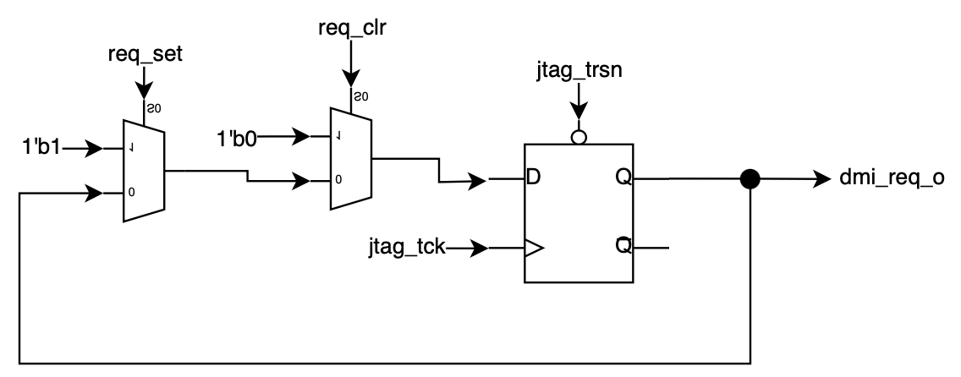
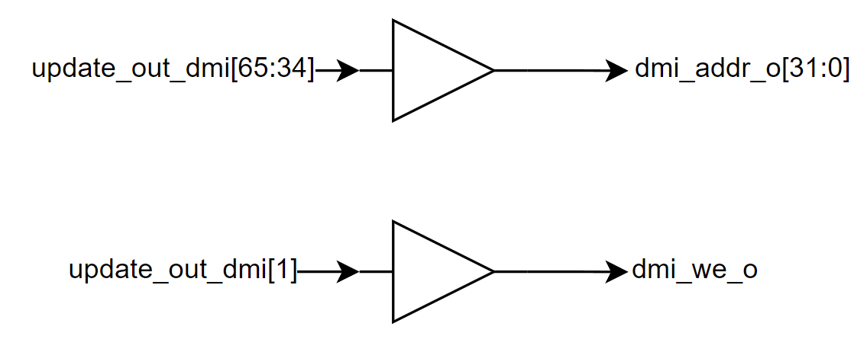
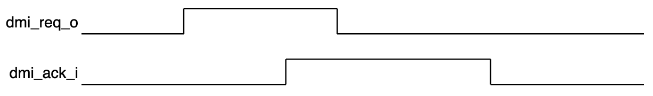
jtag - dmi handshake
req_set = update_dmi (1cycle) & dmi_ack_i -> request new read/write data if dmi bus is free
req_clr = @posedge dmi_ack_i -> acknowledge receipt of the request
update dmi_we_o and dmi_addr_o @UPDATE_DR if valid opcode (2'b01 -> read ; 2'b10 -> write)

Slide 20
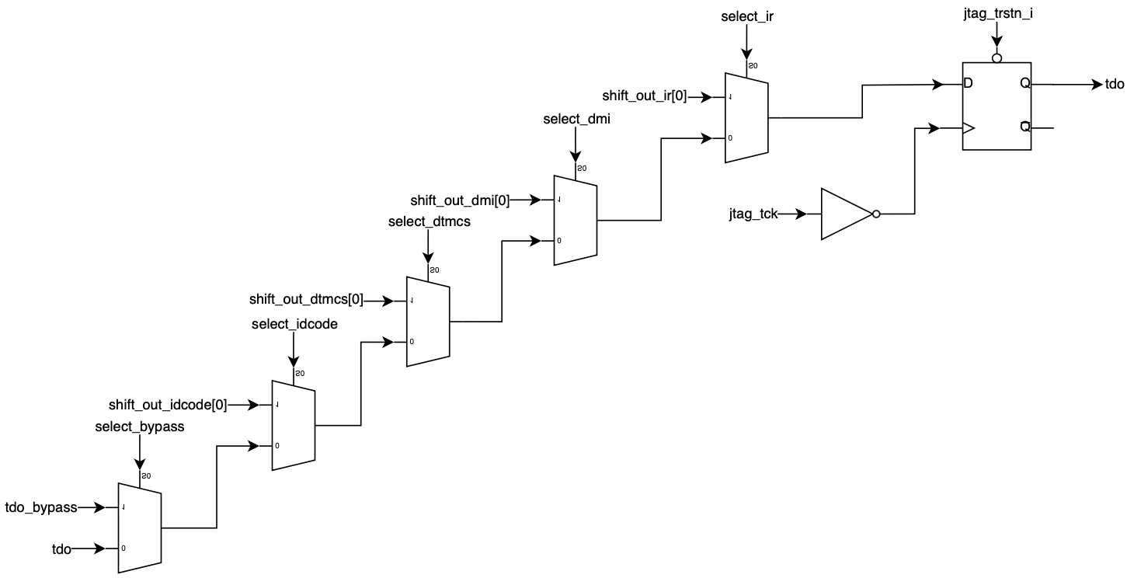
jtag - tdo
tdo is driven by negedge of tck

Slide 21
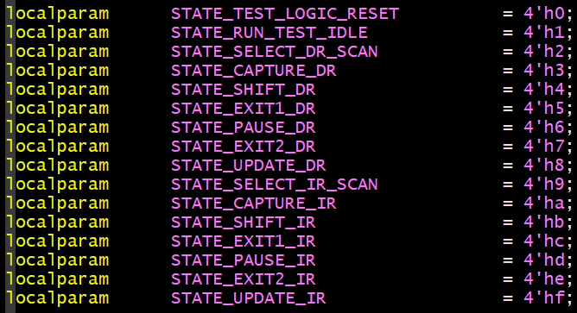
testbench
Tap control state machine:

Slide 22
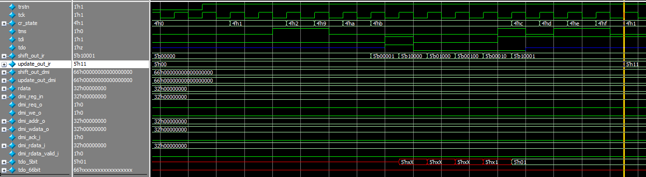
Testbench – IR select DMI
cr_state = 4’ha = STATE_CAPTURE_IR
cr_state = 4’hb = STATE_SHIFT_IR
cr_state = 4’hf = STATE_UPDATE_IR
(7)
(1)
(2)
(3)
(4)
(5)
(6)
Capture default IR (5’b0_0001) to IR’s shift register.
Shift tdi to tdo -> ir[0]
Shift tdi to tdo -> ir[1]
Shift tdi to tdo -> ir[2]
Shift tdi to tdo -> ir[3]
Shift tdi to tdo -> ir[4]
Update shift register to update register.
Address of DMI register = 5’h11 -> update_out_ir = 5’h11 @(7) is correct
tdo = 5’h01 (lsb first) = default value -> correct

Slide 23
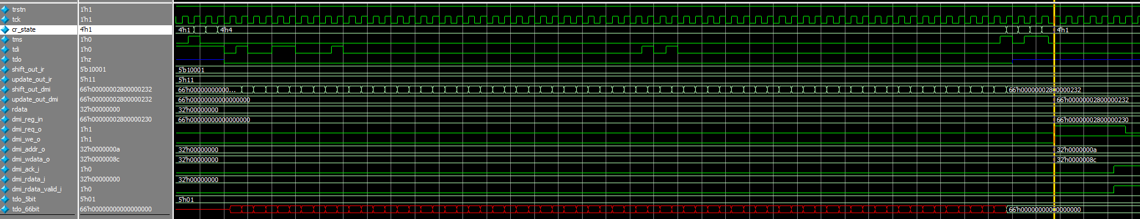
Testbench – DR – DMI WRITE
(1)
(2)
(3)
(4) (5)
Start to shift tdi
Complete shift 66bit. tdo = previous command (reset state) = 66’h0
UPDATE_DR – update data from shift register to stored register and request write to DM.
DM response acknowledge, read data and valid read data.
JTAG de-asserts request.
DMI WRITE command:
Address = 0xa
Write data = 0x8c
Write = 2’b10
0xa << 2 = 1010 << 2 = 10_1000 = 0x28
0x8c << 2 = 1000_1100 << 2 = 10_0011_0000 -> 10_0011_0010 = 0x232
=> tdo = 0x0..0280..0232
0xa << 2 = 1010 << 2 = 10_1000 = 0x28
0x8c << 2 = 1000_1100 << 2 = 10_0011_0000 -> 10_0011_0000 = 0x230
next tdo = 0x0..0280..0230

Slide 24
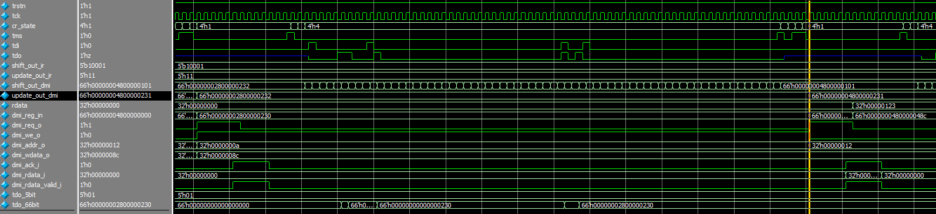
Testbench – DR – DMI READ
(1)
(2)
(3)
(4) (5)
Start to shift tdi
Complete shift 66bit. tdo = previous command (reset state) = 66’h00..0280…0230
UPDATE_DR – update data from shift register to stored register and request write to DM.
DM response acknowledge, read data and valid read data -> capture read data
JTAG de-asserts request.
0x12 << 2 = 1_0010 << 2 = 100_1000 = 0x48
0x40 << 2 = 100_0000 << 2 = 1_0000_0000 -> 1_0000_0001 = 0x101
=> tdo = 0x0..0480..0101
DMI READ command:
Address = 0x12
Ignore data= 0x40
Read = 2’b01
Read data = 0x123
0x12 << 2 = 1_0010 << 2 = 100_1000 = 0x48
0x123 << 2 = 1_0010_0011 << 2 = 100_1000_1100 -> 100_1000_1100 = 0x48c
next tdo = 0x0..0480..048c

Slide 25
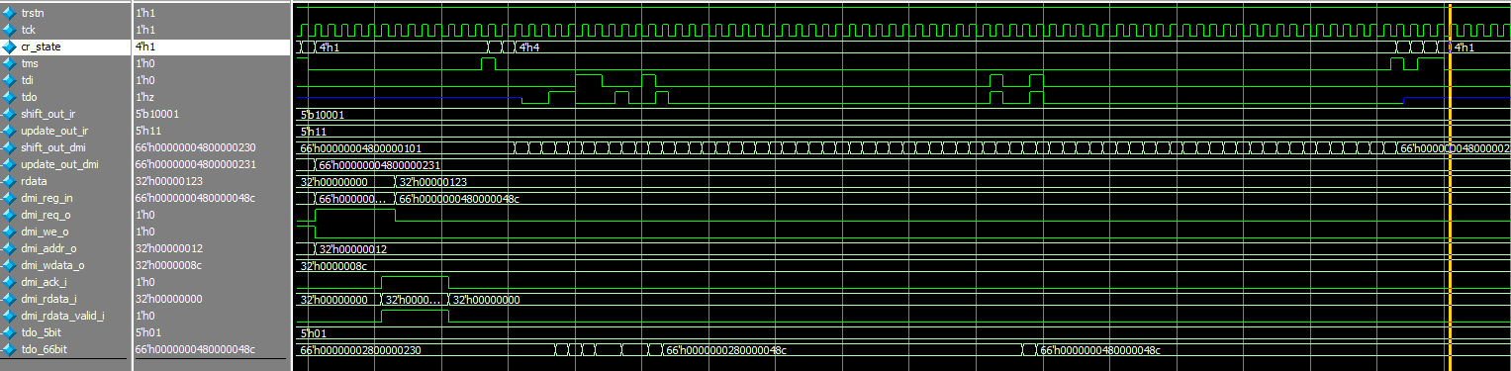
Testbench – DR – DMI NOP
(1)
(2)
(3)
Start to shift tdi
Complete shift 66bit. tdo = previous command (reset state) = 66’h00..0480…048c
UPDATE_DR – not any update to DMI register and not any request to DM.

Slide 26
Status
Task | Status | Note
study JTAG | done
RTL JTAG | done
Verify RTL JTAG | done | Use questasim. There is no license xrun in server from Mar 15, 2024.

