Slide 1
SYNC_FIFO

Slide 2
Agenda
Architecture
Testbench

Slide 3
FIFO architecture
MEMORY
Write
Control
int_wclk
int_rclk
Read
Control
rclk
wclk
rst_n
rst_n
int_wenable
int_renable
wenable
renable
wdata
int_wdata
int_rdata
rdata
full
empty
int_waddr
int_raddr

Slide 4
FIFO architecture
Write control
rst_n
wenable
int_enable
wenable_o
int_enable
wclk_o
wclk_i
wdata_i
wdata_o
Counter
wpnt_o
+1
=
full_o
DFF
rpnt_i

Slide 5
FIFO architecture
Read control
rst_n
int_enable
renable_o
renable
int_enable
rclk_o
rclk_i
rdata
rdata_o
Counter
rpnt_o
=
empty_o
DFF
wpnt_i

Slide 6
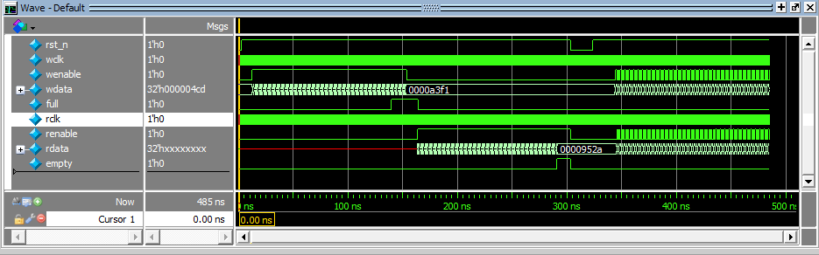
Testbench
(1)
(2)
(3)
(4)
(5)
Initial time and reset FIFO.
Check write function and full signal.
Check read function and empty signal.
Check reset
Check write and read parallel.

Slide 7
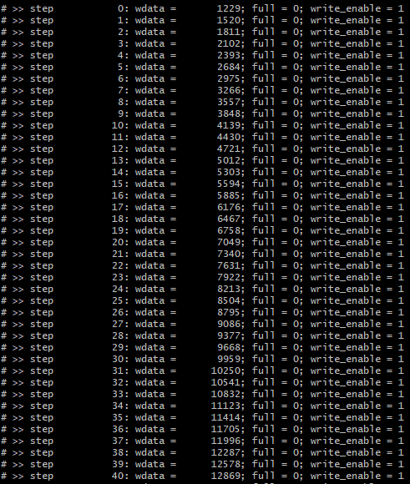
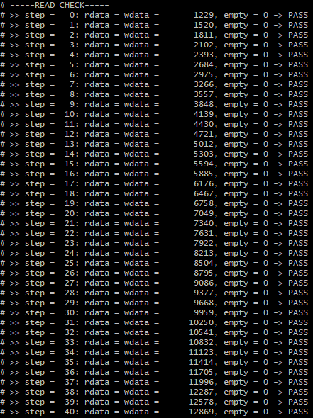
Testbench
Read data the same data written.

Slide 8
Testbench
Full will rise up when memory is full and fall down when read data out.
Empty will be 1 when data in memory are read and will be 0 when reset phase.

Slide 9
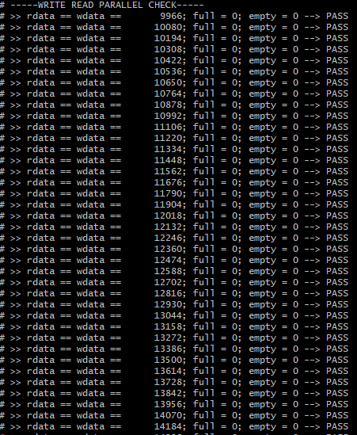
Testbench
Write and read parallel is correct.

