Slide 1
Algorithm
-By Bishal Phuyal

Slide 2
What is Algorithm ?
Simple steps written before the program is done to make complex problem break down into steps.
Precise specification of sequence of activities.

Slide 3
Characteristics of algorithm:
Algorithm should be simple, easy to interperate.
Atleast one input and output.
Algorithm should be finite.
Algorithm should be definite.

Slide 4
Pros and cons:
Pros:
Language independent.
No formulas.
Makes complex programming easy.
Helps write pseudo code.
Cons:
No compulsion to write.
Might not solve some problems.

Slide 5
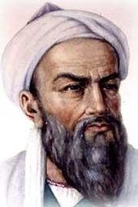
Origin of Algorithm:
Persian mathematician Abu Abdullah Muhammad ibn Musa Al-Khwarizmi.(inventor of Algorithm and algebra) during 9th century.
Ada Lovelace produced the very first "computer program" in the 1840's.
Alan Turing first formalized the concept of the algorithm in 1936 with his infamous Turing machine.

Slide 6
Uses of Algorithm:
Dissolving complex ideas into simple steps.
Solving mathematical problems.
Making Decision easier.
Solve the confusin of writing the program using steps.

Slide 7
Where Algorithm is used?
It is used in our daily life without knowing:
-Breath in looping Conditions.
All decisions taken in life as (if or else).
Or (if else) running in mind as gazillion thoughts.
Our day starts and set of algorithm and night ends.
Our plans and checklist drives the algorithm.

Slide 8
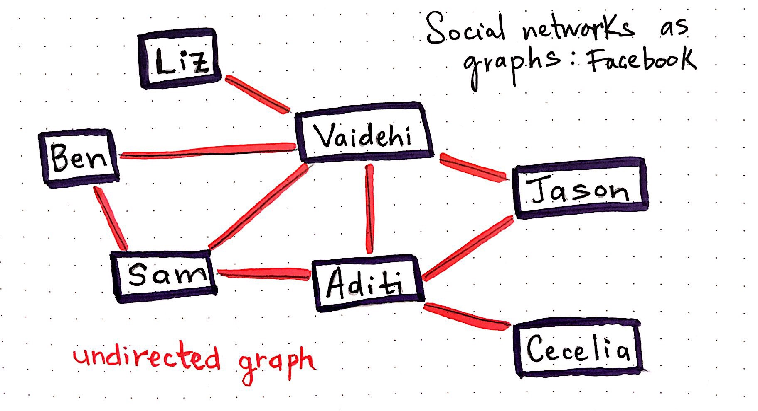
Algorithm In Facebook with Graph theory:
Algorithm sort who’s friend who’s in a big network with the use of graph theory. (especially in Facebook, Twitter, Whatsapp).

Slide 9
Algorithm Used in Youtube for advertisement.
YouTube use Algorithm to target the right audience for advertisement, recommended videos, collecting data, restrictions etcs.
Recently You tube's change in their terms of service is that they changed their Algorithm

Slide 10
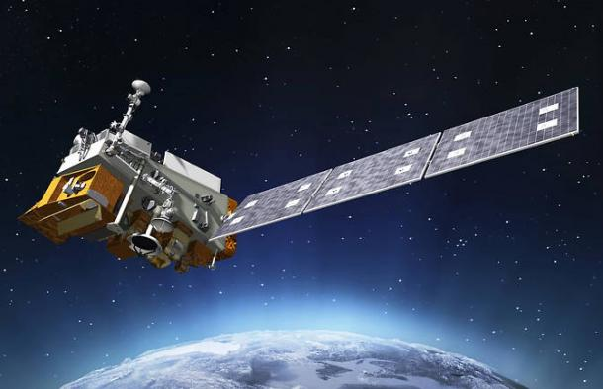
Algorithm used above Exosphere:
-Nasa Use the Algorithm to Rotate the solar panel according to the angle of sun.

Slide 11
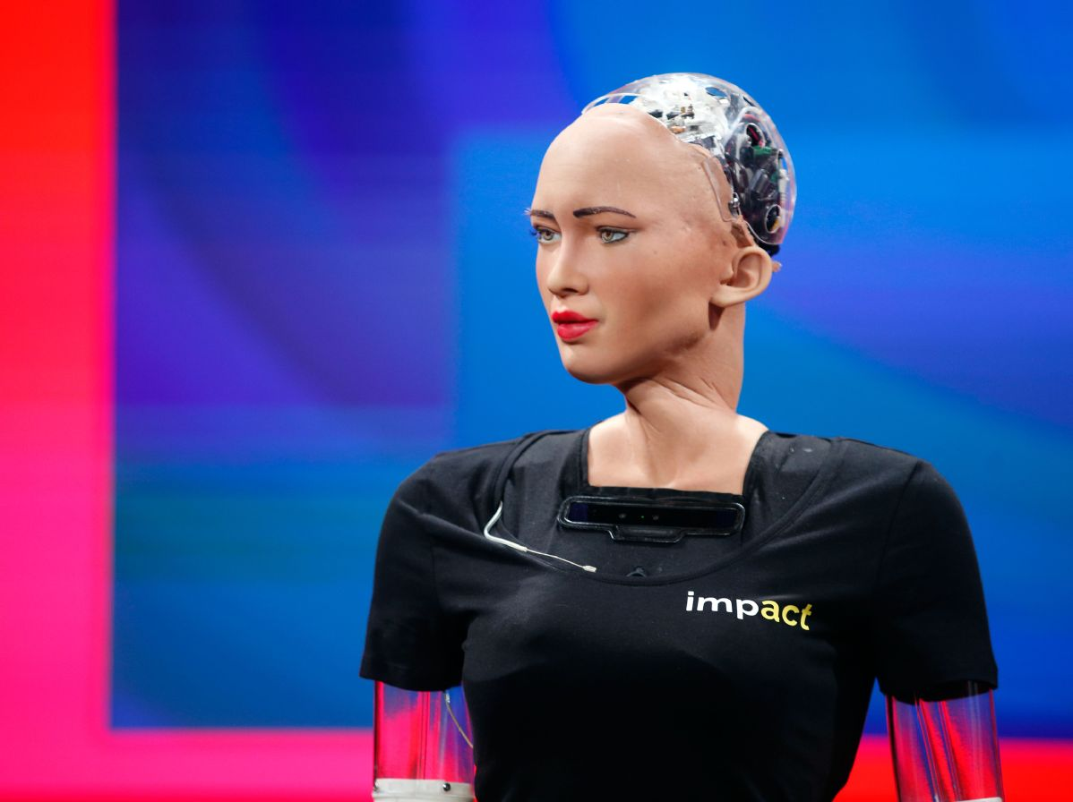
Algorithm in Sophia.
Good example of Decision making algorithms.
Algorithm is used in Machine learning and AI.

Slide 12

Algorithm in DataCenter’s:
Algorithm in databases to manage the enormous amount of data called Bigdata.
Serverside programming is nothing but creating a sort of algorithm to get and put data in some database.

Slide 13
Predict future in Economics and Investment.
Predict the weather condition.
To bring automation in a system.
To hack some machine.
To loop for endless.
Etcs…….
Only thing is Algorithm is used everywhere but we study it as another boring subject to crack on exam.

Slide 14
Thank you

