Slide 1
Presentation on Planning and Decision
-by Bishal Phuyal

Slide 2
Planning

Slide 3
Characteristics of a planning
Primary Function
Pervasive Function
Future Oriented
Continuous activity
Intellectual Work
Flexible and Accountable

Slide 4
Levels of Planning
Strategic
Tactical
Operational

Slide 5
Types of plan
Hierarchy
Use
flexibility
Corporate
Tactical
Operational
Single Use
Standing Use
Specific
Flexible

Slide 6
Planning Process
Analyze Opportunity
Setting Goals
Determine
Premises
Determining Alternatives
Evaluating Alternatives
Setting Course of action
Derivative Plans
Implementing and Reviving

Slide 7

Tools of Planning
Forecasting
-Process of Predicting future.

Slide 8
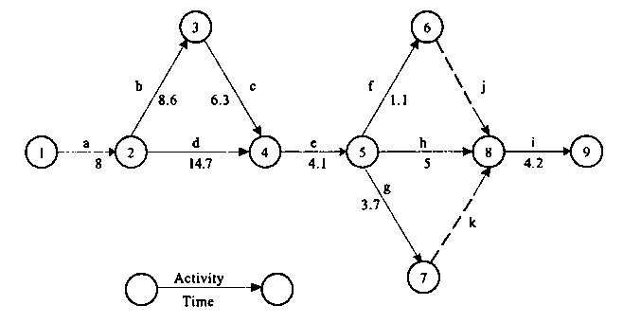
2. Network Technique
-Controls time and cost of projects

Slide 9
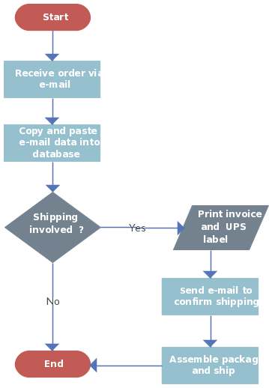
3. Flow Chart
-Simplify the arranging event in order of their desired occurrence.

Slide 10
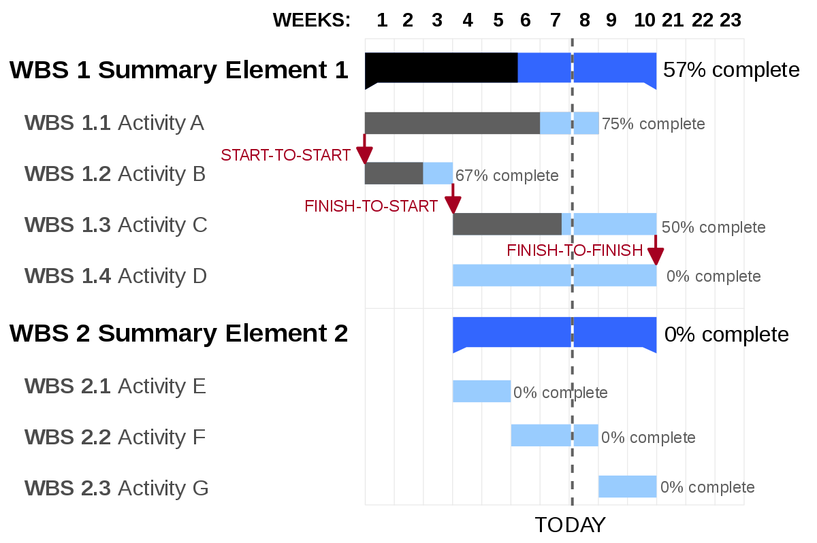
4. Gantt chart

Slide 11
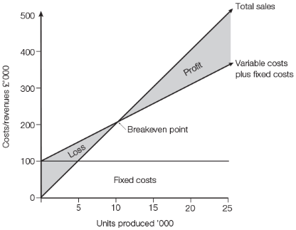
5. Break even Analysis
-estimates the volume of output and sales to earn profit

Slide 12
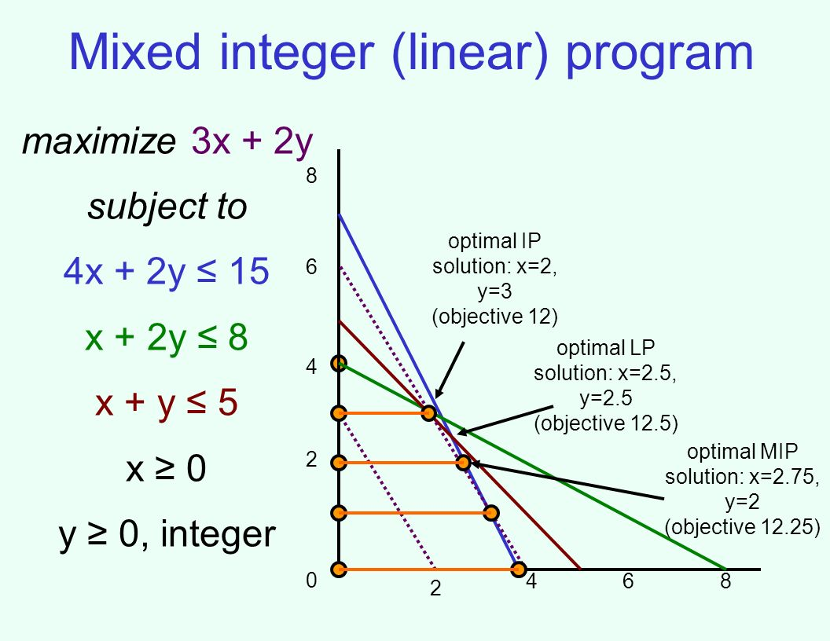

6. Linear Programming
7. Simulation

Slide 13
Importance of a planning
Focuses on goal
Minimize Uncernaity
Maintain effective control
Innovative and creativity

Slide 14
Orgnizational Effictiveness
Economy in operation
Facilities Coordination
Avoids Buisness failure

Slide 15
Pitfalls of Planning
Lack of Control
Expensive Process
Inflexibility
Certain Assumptions
Delay in action
Incomplete Information
Difficulty in Implementation
Difficult to change with time
Unwilling to change
Difficulty in Implementation unit level

Slide 16

Setting Organizational goals
Setting Subordinate goals
Matching Resources with objectives
Appraisal

Slide 17
Decision Making

Slide 18
Importance of a Decision making
Pervasive function
Indispensable component
Evaluation of managerial Function
Selection of best alternative
Successful operationof Business
Establishment of plans and policies

Slide 19
Types of Planning
Program
Routine
Formal
Policy
Group

Slide 20
Decision making Process
Identifying
Analysing
Developing
Evaluation
Selection
Review of Implementation
Implementation

Slide 21
Decision making Conditions
Certain
Uncertain
Risk

Slide 22
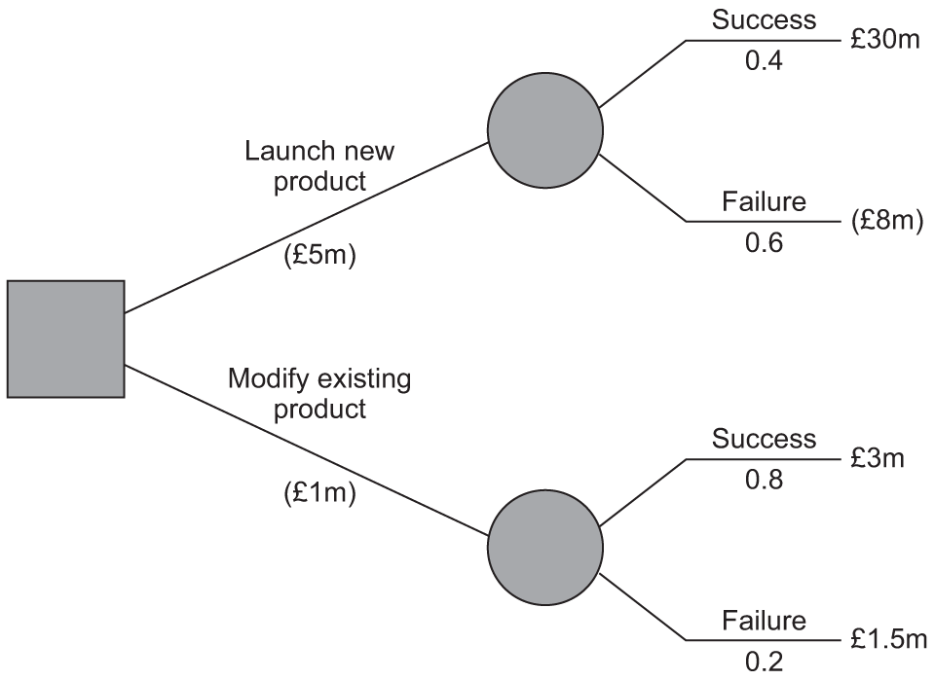
Decision making Tools
Linear Programming
Simulation
3. Payoff matrix
4. Decision tree
5. Game theory
6. Accounting Tools

Slide 23
Thank you for listening.

