Slide 1
Library Management System

Slide 2
Members
1.Sijan Maharjan
2.Sanish Maharjan
3.Prabin Buddhacharya
4.Ravi Singh
5.Bishal Phuyal

Slide 3
Introduction
Presented by:Prabin Buddhacharya
Library Management System is a database system created to have the record of books.
This system is made for community where any member can get membership.
The system is created using mysql and java.
This system follows MVC pattern in java.
Model
View
Controller

Slide 4
Background/ Purpose
Presented by:Prabin Buddhacharya
Different problems occur while managing datas of the library before.
Errors in data collection,loss of books, loss of data collection etc.
This system is made for the Librarian to keep record of books in a library.
This system is made for community library or schools to keep track on book borrowed.
People can get membership and get access to the book.

Slide 5
Function
Presented by: Sanish Maharjan
Librarian has the full authority of the system and members have only few access
In this system, Librarian can add and delete the books from the system.
Borrower can only check the books, search the available books, borror and reserve the book.
Librarian have to login with there ID or gmail to get access.
Member can set the date of submission.

Slide 6
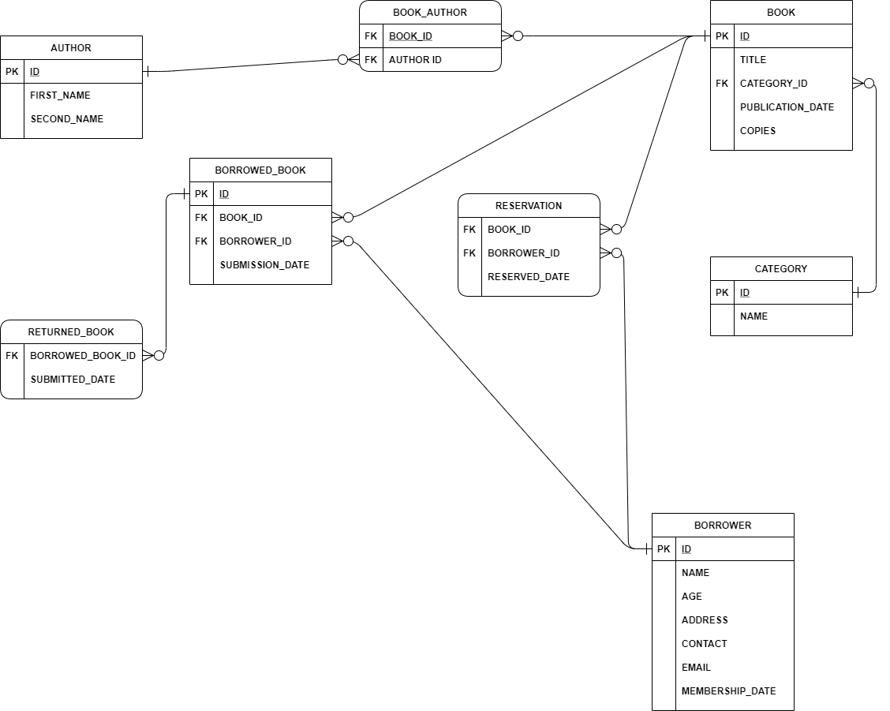
ER Diagram
Presented by: Sanish Maharjan
Total Table: 8

Slide 7
Flow of the program
Presented by: Sijan Maharjan

Slide 8
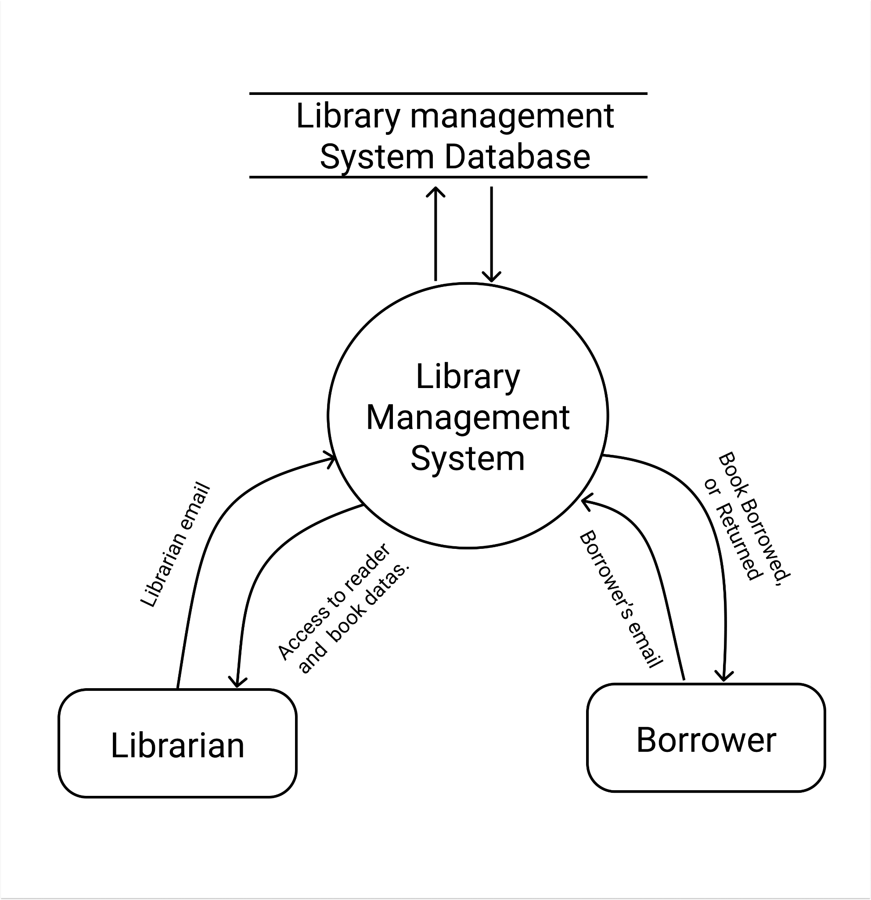
Presented by: Sijan Maharjan
Data Flow Diagram
Level 0

Slide 9
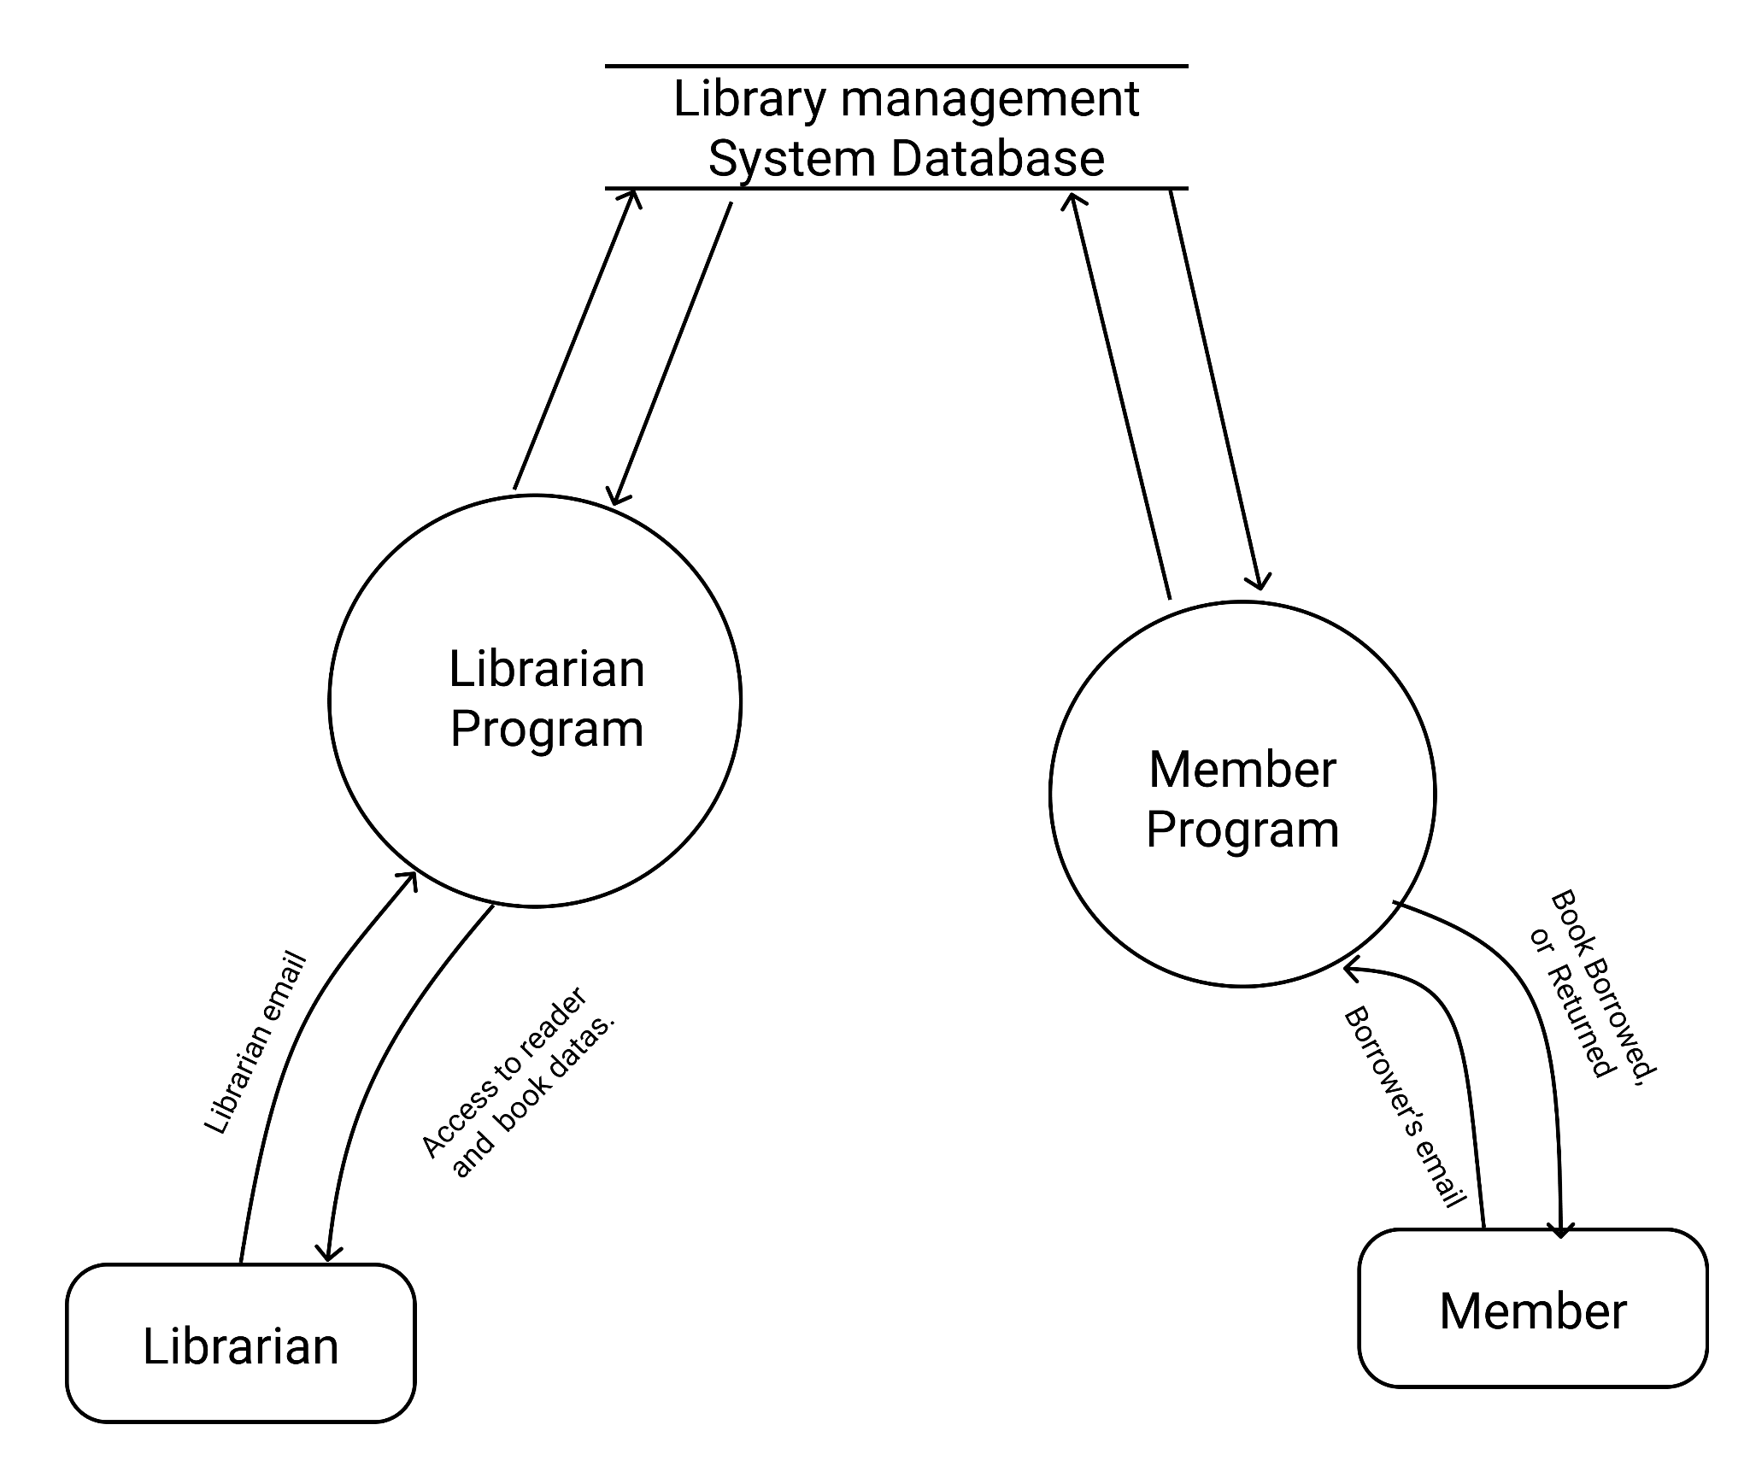
Presented by: Sijan Maharjan
Data Flow Diagram
Level 1

Slide 10
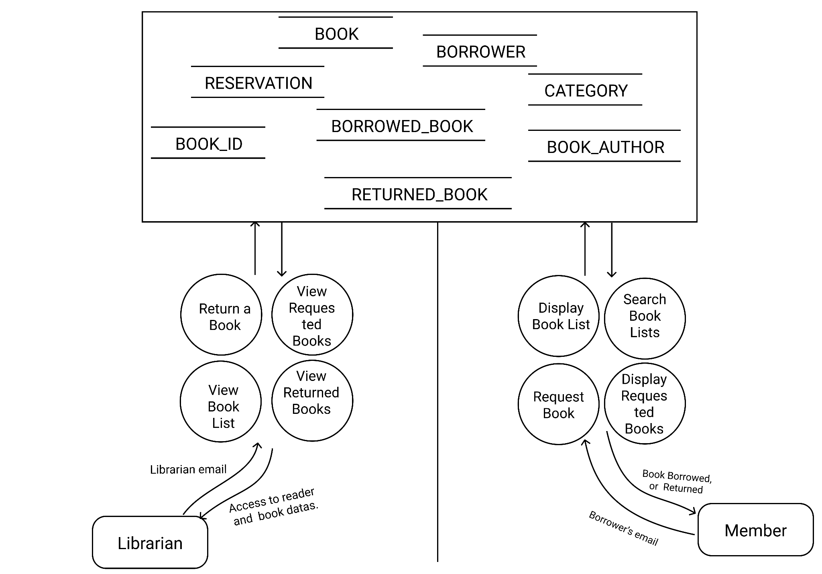
Presented by: Sijan Maharjan
Level 2

Slide 11
Demo
Presented by: Sijan Maharjan
Now, the demo of our Library Management System.
Showing the CRUD operation;
1.Create
2.Rename
3.Update
4.Delete

Slide 12
References/ Tools
Presented by: Bishal Phuyal
Tutorialspoint
GeeksforGeeks
StackOverFlow
Youtube Videos for understanding MVC, Java and SQL and other websites.
Google docs and slides for documentation
Figma for designing DFD and ERD
Github/Gitlab for java codes Version control
Eclipse, Netbeans and VSCode as main IDE.

Slide 13
Conclusion
Presented by: Bishal Phuyal
Traditional ways and its flaws
Data Loss and time consuming.
Used the best logic in database and the program.
Used the latest technologies and best practises to make user friendly.
Business Logic Part. Mostly for Non Profit. Code for Money transaction is not included.
But can be expanded to commercial if needed..

Slide 14
Thank you

