Slide 1
Hybrid index structures for location-based web search
Zhou, Y., Xie, X., Wang, C., Gong, Y., & Ma, W.-Y. (2005)
Proceedings of the 14th ACM international conference on information and knowledge management
Efficient query processing in geographic web search engines
Chen, Y. Y., Suel, T., & Markowetz, A. (2006)
Proceedings of the 2006 ACM SIGMOD international conference on Management of data
3rd Presentation
Plinio H. Vargas
November 3, 2016
Old Dominion University
Intro to Information Retrieval
CS734/834

Slide 2
Hybrid index structures for location-based web search

Slide 3
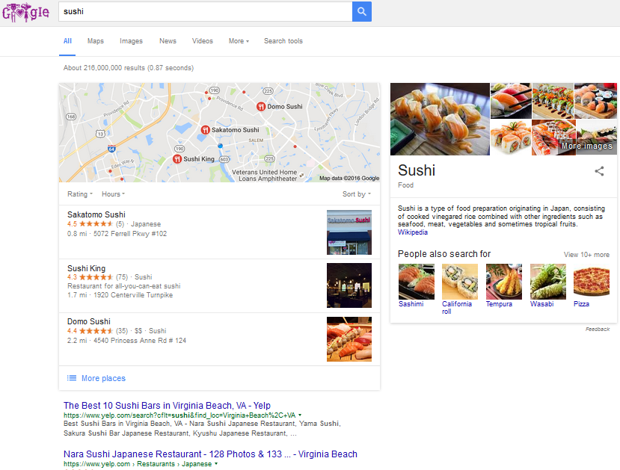
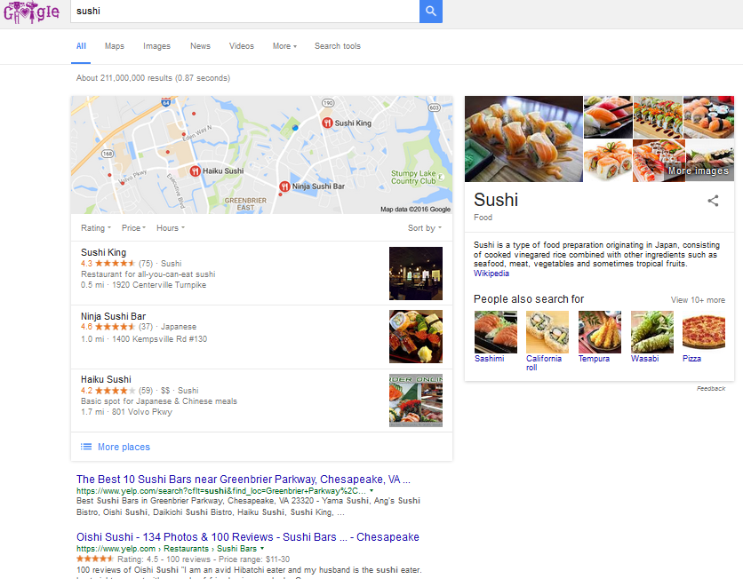
Location-Based Web Search Inherent Problem
Find web content topic related to location/region.
Search tethering laptop with mobile device
in border of Virginia Beach/Chesapeake
on Virginia Beach side
Search tethering laptop with mobile device
in border of Virginia Beach/Chesapeake
on Chesapeake side

Slide 4
Challenges
Simple keyword matching neglects spatial relationships.
the 1:1 2:1
best 1:1 2:1
sushi 1:1 2:1
in 1:1 2:1
virginia 1:1
beach 1:1
norfolk 1:1
Inverted Index
with counts
simple collection
In a location-base query for “sushi virginia beach” should include documents 1 and 2.

Slide 5
Approach
Design index structure considering spatial and
Inverted file features.
Inverted file and R*-trees.
First inverted file then R*-trees.
First R*-tree then inverted file.

Slide 6
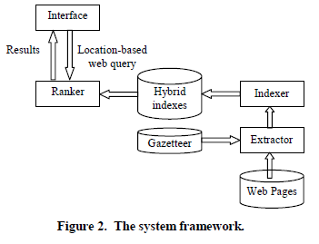
Location-Based WSE Framework
It has option for maps or text box
Builds hybrid index structure
Extracts geographical scope of pages
Returns pages relevant to keyword and query region
Translate location names to MBR

Slide 7
Important Definitions

Slide 8
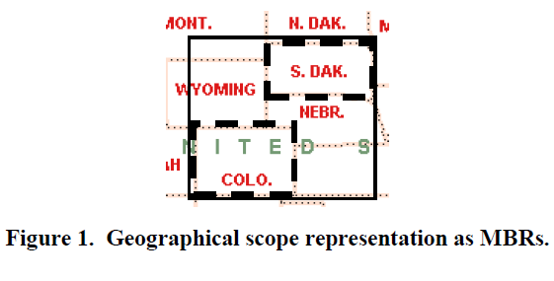
Minimum Bounding Rectangle (MBR)
2-D object used to indicate general
geographic area or dataset.
Figure 1 obtained from seminal paper.

Slide 9
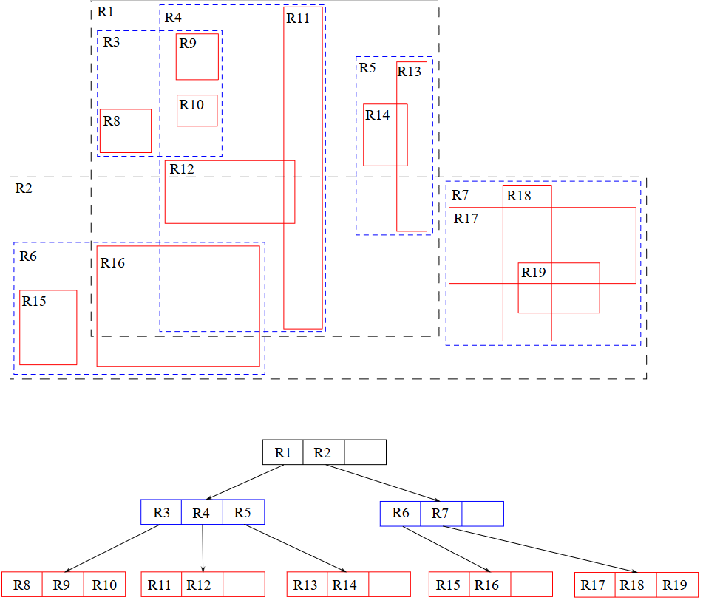
R-Tree
MBR dataset structure where the parent node contains all sub-MBR regions.
Image obtained from https://en.wikipedia.org/wiki/R-tree

Slide 10
Indexer Hybrid Method Study

Slide 11
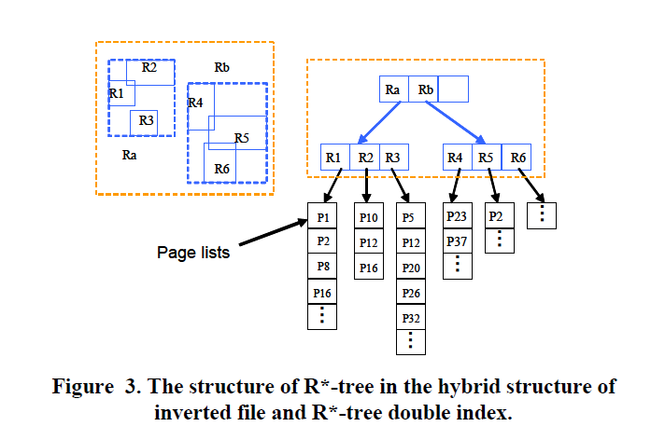
Inverted File and R*-Tree Double Index
Web pages are indexed separately twice, once by R*-Tree and once by inverted files.

Slide 12
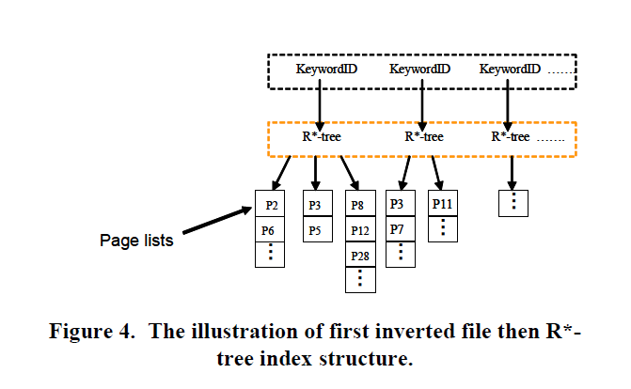
First Inverted File Then R*-Tree
Keyword points to an
R*-Tree. If a page includes a keyword and its scope includes the MBR the pair is defined as a geo-keyword

Slide 13
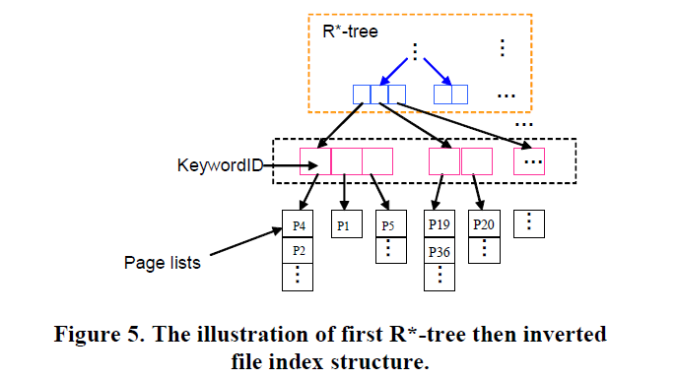
First R*-Tree Then Inverted File
An R*-Tree is built on all MBRs included in the scope of the web pages, then all pages for each MBR are indexed by keywords.

Slide 14
Dataset Performance

Slide 15
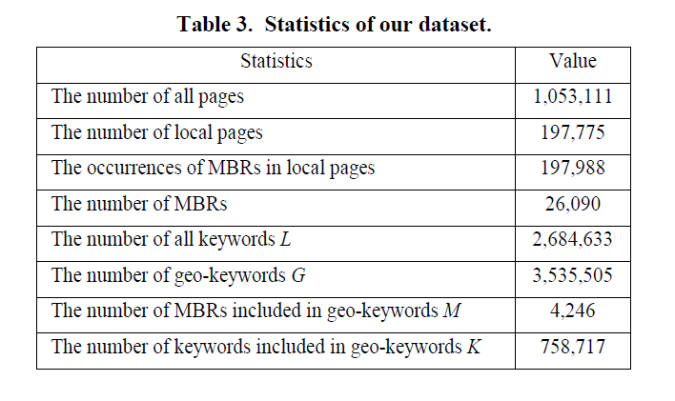
Dataset
.GOV data was used as a dataset benchmark

Slide 16
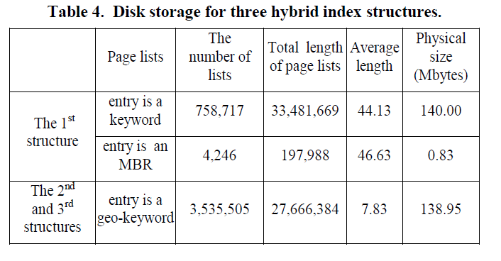
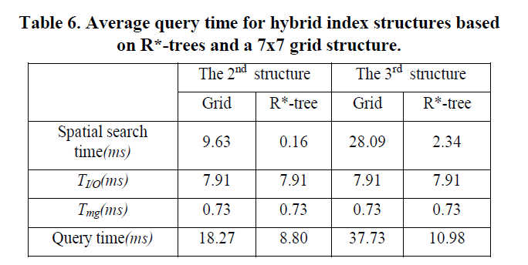
Hybrid Index Structures Comparison
Time cost of disk access
Time cost to merge x elements

Slide 17
Efficient Query Processing in Geographic
Web Search Engines

Slide 18
Stated Problem
“Query processing is the major performance bottleneck in current
standard web search engines”.

Slide 19
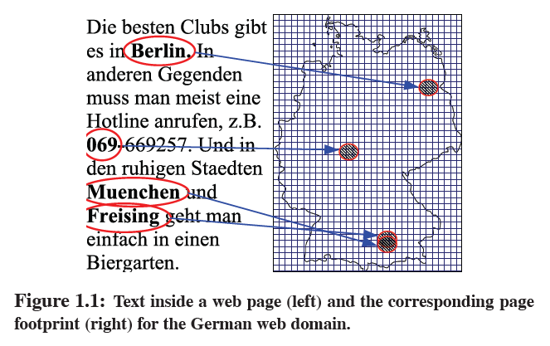
Geo Coding
Consist of three steps:
Geo extraction
Geo matching
Geo propagation

Slide 20
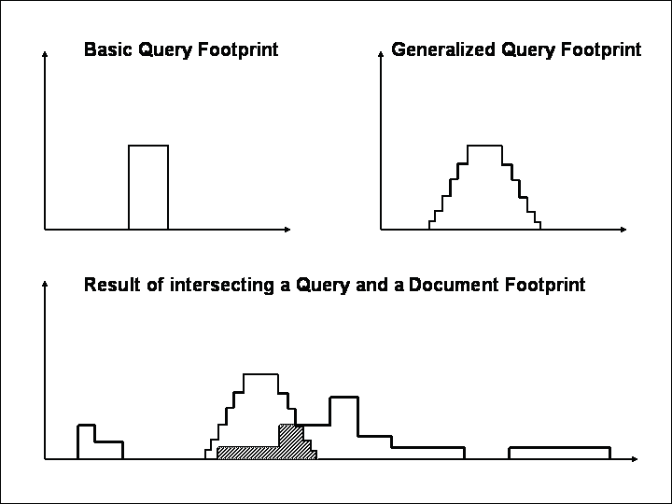
Contribution
“Study the problem of efficient query processing in geographic search engines”.

Slide 21
Experiment Dataset
Documents: 31 million distinct pages from .de domain in April 2004.
Index Construction: 3.9 million pages per machine. Index size 10 GB.

Slide 22
Query Processing Tests

Slide 23
Naive Algorithms
Text-First Baseline: similar to inverted file and R*-Tree Double Index.
The inverted file is accessed first retrieving a list of docIDs containing query terms.
Next, it retrieves footprints (geo-ranking) of these documents.
Geo-First Baseline: similar to First R*-Tree Then Inverted File.
The algorithm first access the R*-tree to obtain the docIDs containing query terms
of all documents whose footprint is likely to intersect the query footprint.

Slide 24
Improved Algorithms

Slide 25
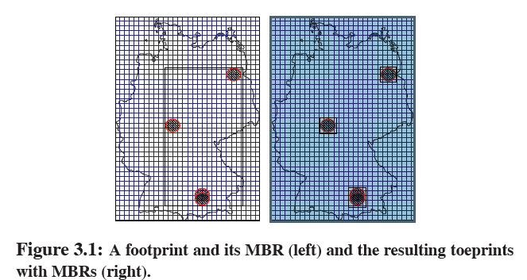
K-Sweep
(1) Retrieve the toeprint ID intervals of all tiles intersecting the query footprint.
(2) Perform up to k sweeps on disk, to fetch all toeprints in the union of intervals from Step (1).
(3) Sort the docIDs of the toeprints retrieved in Step (2) and access the inverted index to filter these docIDs.
(4) Compute the geo scores for the remaining docIDs using the toeprints retrieved in Step (2).

Slide 26
Tile Index
(1) Retrieve and sort the docIDs of all toeprints that are listed in
any of the tiles intersecting the query footprint.
(2) Access the inverted index to filter the docIDs and corresponding
toeprint IDs.
(3) Retrieve the toeprints of all remaining toeprint IDs in an efficient
sweep over the toeprint data, using both scans and
forward seeks, and compute geographic scores as toeprints
are retrieved.

Slide 27
Space-Filling Inverted Index
It may combine previous two approaches. It has a table that maps toeprint IDs to docIDs, allowing to eliminate duplicates and to combine the
geographic scores of toeprints belonging to the same document.

Slide 28
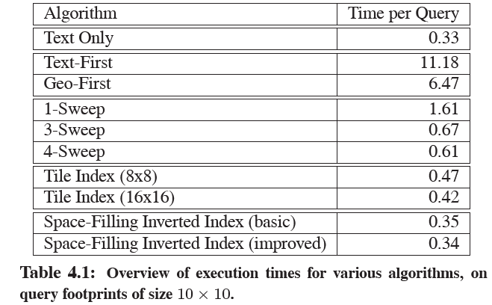
Evaluation

Slide 29
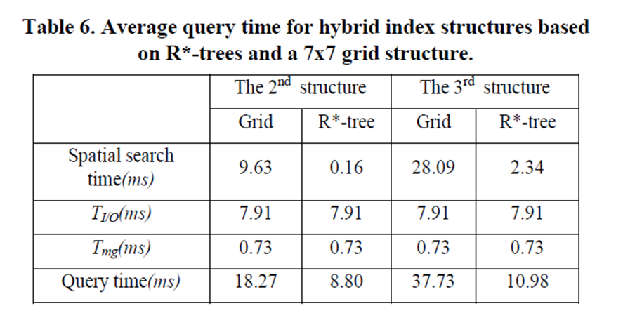
Papers Comparison
First Paper
Time cost of disk access
Time cost to merge x elements
Second Paper

Slide 30
Reference
[1]
Zhou, Y., Xie, X., Wang, C., Gong, Y., & Ma, W.-Y. (2005). Hybrid index structures
for location-based web search. In CIKM ’05: Proceedings of the 14th ACM
international conference on information and knowledge management
(pp. 155–162). ACM.
[2]
Chen, Y. Y., Suel, T., & Markowetz, A. (2006, June). Efficient query processing in
geographic web search engines. In Proceedings of the 2006 ACM SIGMOD
international conference on Management of data (pp. 277-288). ACM.

