Slide 1
Empirical Analysis of Predictive Algorithms for Collaborative Filtering
Breese, J., Heckerman, D., & Kadie.(1998)
Proceedings of the uncertainty in artificial intelligence conference
Eigentaste: A constant time collaborative filtering algorithm
Goldberg, K., Roeder, T., Gupta, D., & Perkins, C. (2001)
Information Retrieval 4.2
5th Presentation
Plinio H. Vargas
December 15, 2016
Old Dominion University
Intro to Information Retrieval
CS734/834

Slide 2
Empirical Analysis of Predictive Algorithms for Collaborative Filtering

Slide 3
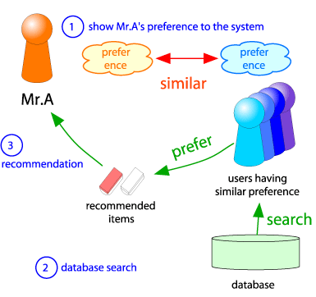
Collaborative Filtering Definition
Also referred as recommender systems.
“database about user preferences to
predict additional topics or products”

Slide 4
Goal
Evaluate
Collaborative Filtering
Algorithms
metric
Accuracy set of
Individual predictions
|mean σ|
Given a ranked list
Of suggested items
Probability of
user selection

Slide 5
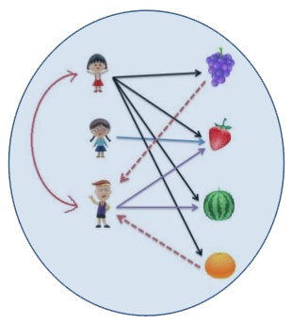
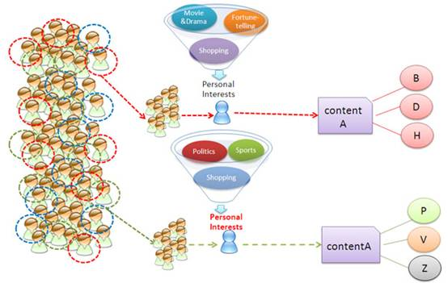
Type of Filtering Algorithm
Memory-Base: uses entire database to estimate predictions
Model-Based: uses user-database to estimate predictions

Slide 6
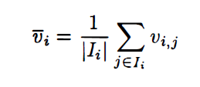

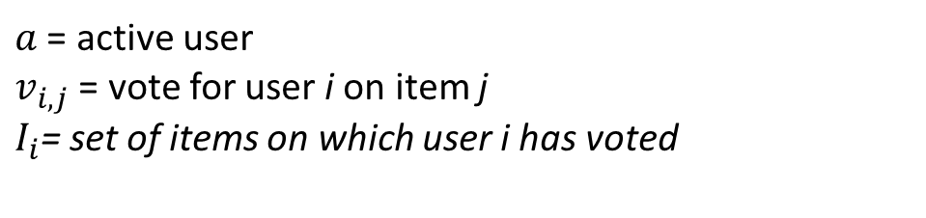
Memory-Based Algorithms
Task: predicts votes of a particular user from a database of user votes
from a sample or population of other users.
$a$ = active user
$v_{i,j}$ = vote for user i on item j
$I_{i}$= set of items on which user i has voted
Mean vote for user i:
Predicted vote of the active user for item j:

Slide 7
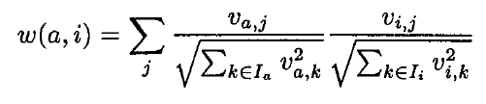
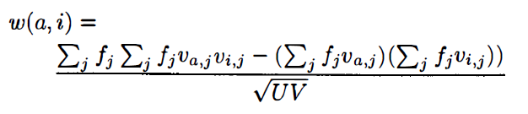
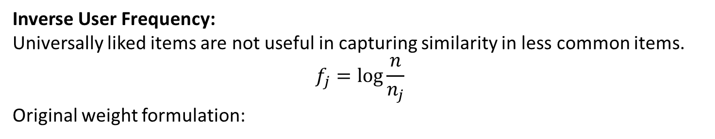
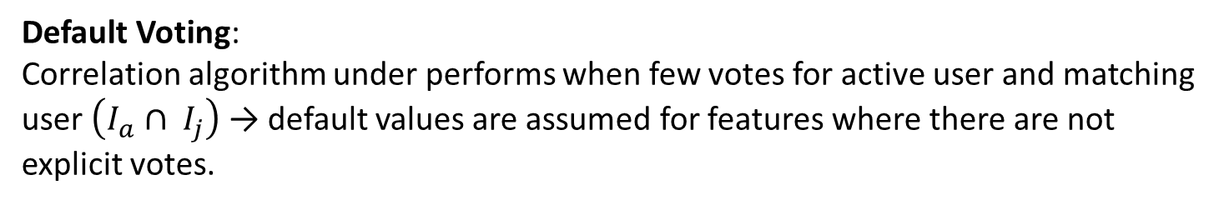
Extension Memory-Based Algorithms
Default Voting:
Correlation algorithm under performs when few votes for active user and matching user $\left(I_{a}{ ∩ I}_{j}\right)$ → default values are assumed for features where there are not
explicit votes.
Inverse User Frequency:
Universally liked items are not useful in capturing similarity in less common items.
$$f_{j}=log{\frac{n}{n_{j}}}$$
Original weight formulation:
Modified:

Slide 8

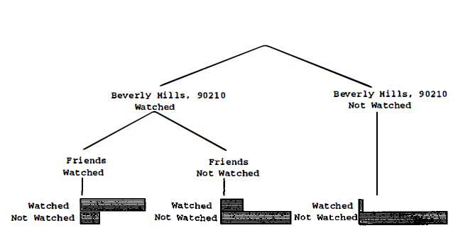
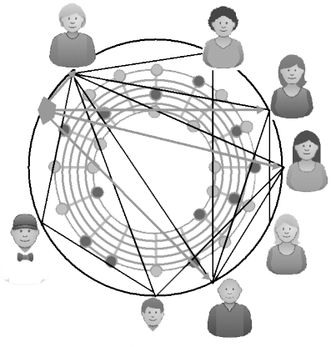
Model-Based Methods
Collecting what we know about a user, then we can calculate the expected value of
a vote of unobserved items. Assuming votes are integers 0 → m, then:
Cluster Models
Bayesian Network Model
Certain groups or types of users share a common set of preferences and tastes.
States of each node correspond to the possible vote values for each item.

Slide 9
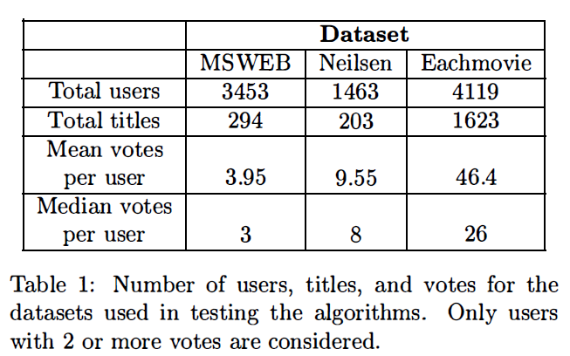
Datasets
MS Web: This dataset captures individual visits to various areas ( vroots) of the Microsoft corporate web site.
Television: This dataset uses Neilsen network television viewing data for individuals for a two week period in the summer of 1996.
EachMovie: Explicit voting example deployed by Digital Equipment Research Center from 1995 through 1997.

Slide 10
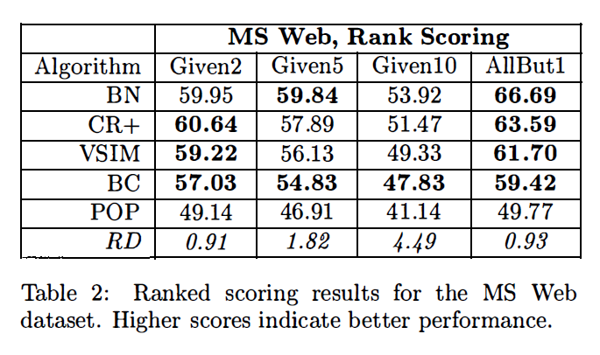
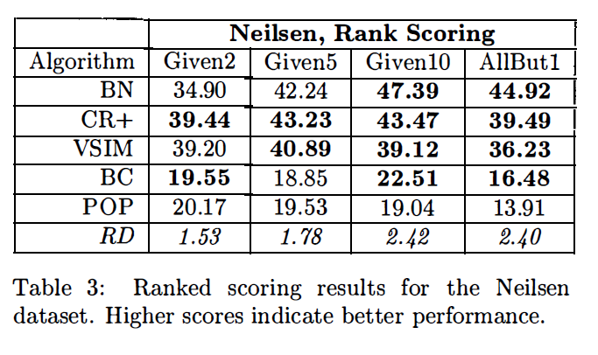
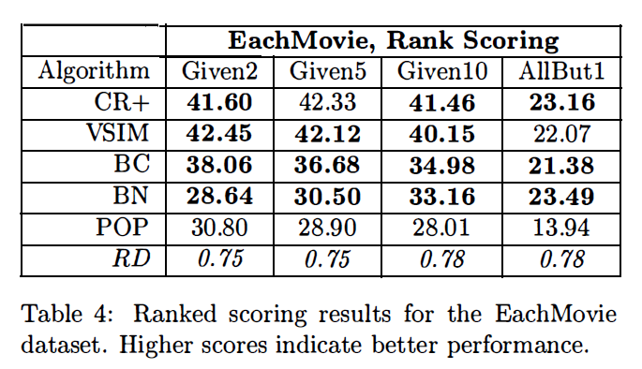
Results
CR+ = correlation technique with inverse user frequency
VSIM = vector similarity method with the inverse user
frequency transformation.
BN = Bayesian network.
BC = clustering model.
POP = zero order
RD = required difference

Slide 11
Conclusion
Bayesian networks with decision trees at each node and correlation methods outperform Bayesian clustering and vector similarity methods.
The preferred method depends on the nature of the dataset, nature of the application and the availability of votes with which to make predictions.
When there are relatively few votes, correlation and Bayesian networks have less of an advantage over the other techniques

Slide 12
Eigentaste: A Constant Time Collaborative Filtering Algorithm

Slide 13
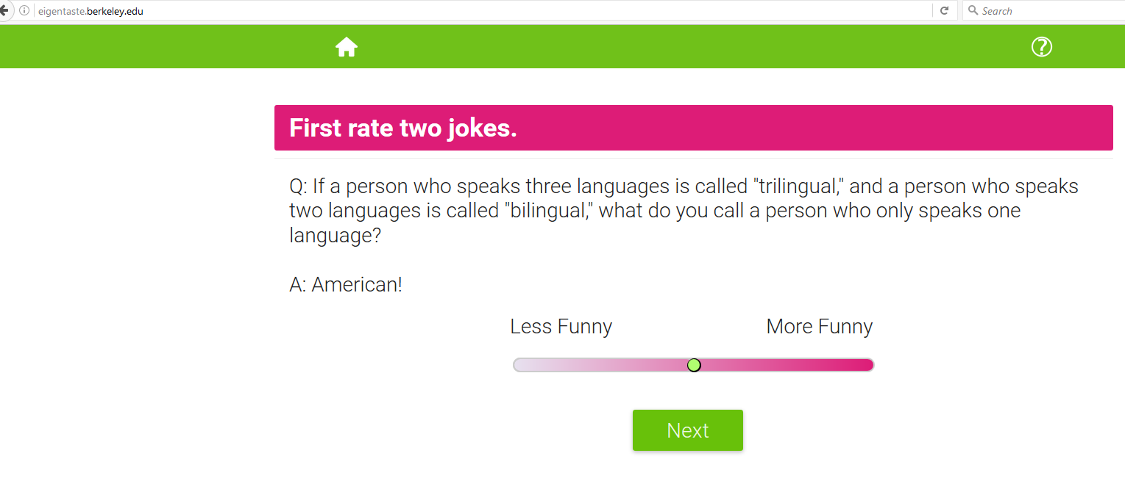
Goal
Reduce the user recommendation computation time complexity from O(n) to O(1). Its effectiveness was evaluated by comparing alternative algorithms using Jester, an online joke recommendation system, with Eigentaste. Jester had approximately 2,500,000 ratings from 57,000 users at the time the paper was written.

Slide 14

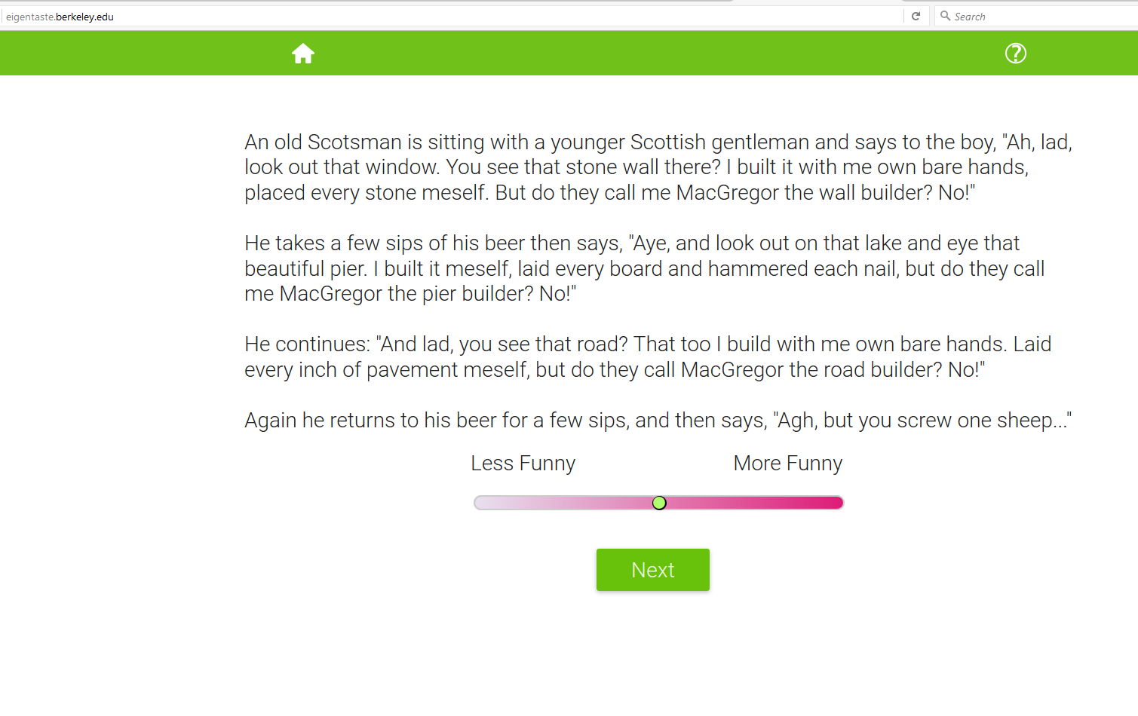
Universal vs User Selected Query
User Selected Queries
user chooses which items to rate, yielding a sparse ratings matrix with many null values.
Universal Queries
each item is presented with a
short unbiased description users can form an opinion and respond to any query

Slide 15
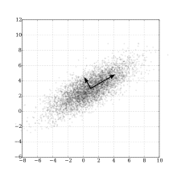
Eigentaste DNA
The use of universal queries ensures all users rate a common set of k items
The system gets a dense submatrix from the user
A square symmetric correlation matrix is applied
Principle Component Analysis (PCA) is used to obtain linear projection
Principal component analysis (PCA) is a statistical procedure that uses an orthogonal transformation to convert a set of observations of possibly correlated variables into a set of values of linearly uncorrelated variables called principal components.
https://en.wikipedia.org/wiki/Principal_component_analysis

Slide 16
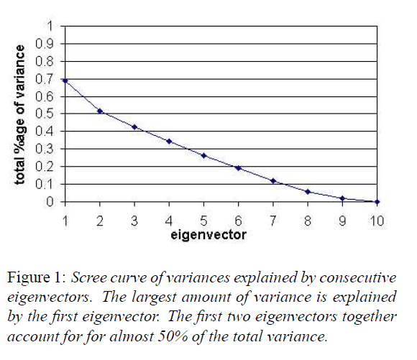
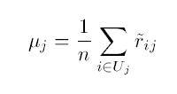

Selecting Number of Eigen Vector
Each rating is normalized by subtracting its mean rating over all user
The variance of the j^{th} gauge set item is

Slide 17
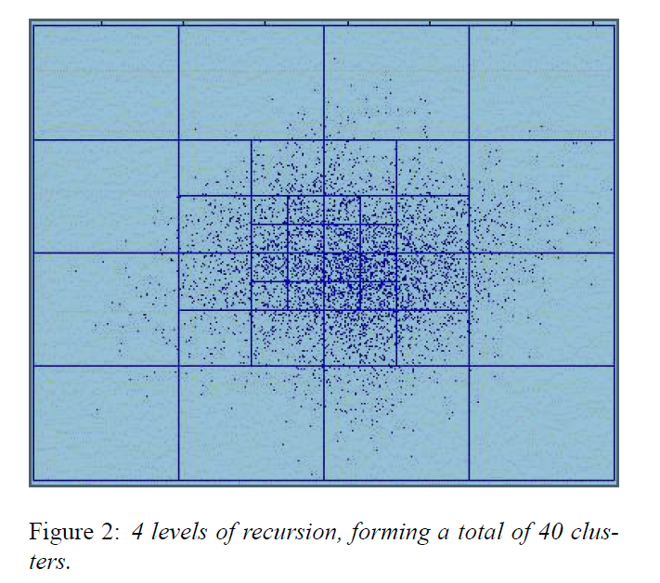
Eigentaste Clustering Algorithm
1. Start with the minimal rectangular cell that encloses all the points (user projections) in the eigenplane. This forms the outermost rectangular subdivision.
2. Bisect this cell along the x and y axes to yield 4 rectangular sub-cells.
3. For each new sub-cell that has the origin as one of its vertices, perform the operation in step 2 to generate sub-cells at the next hierarchical level.
4. Repeat Step 3 for each level until a desired depth is reached.

Slide 18
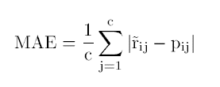
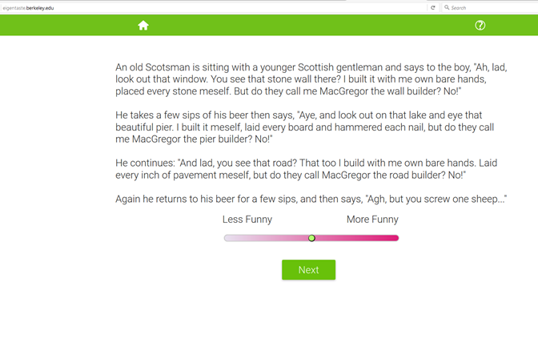
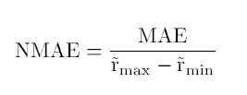
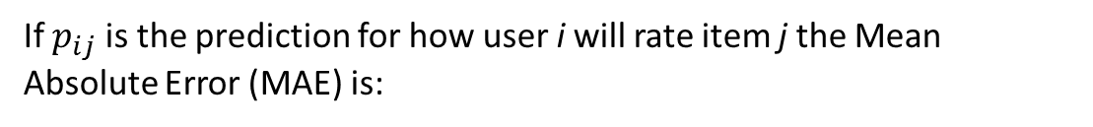
Metrics for Evaluation
If $p_{ij}$ is the prediction for how user i will rate item j the Mean Absolute Error (MAE) is:
Since Eigentaste numerical range scale is [-10, +10]
the MAE is normalized. The Normalized Mean
Absolute Error (NMAE) is:

Slide 19
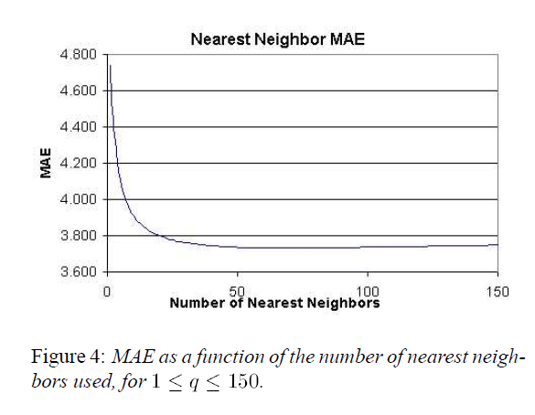
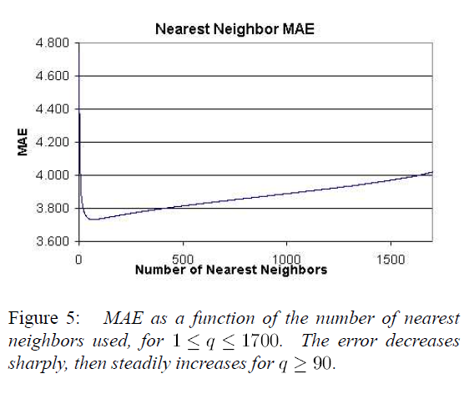
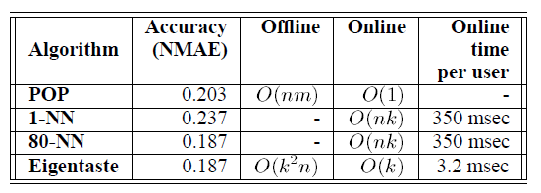
Results

Slide 20
Related Work to Seminal Paper
Eigentaste is considered a Model-Based
Used POP algorithm as a base for evaluation.
Note: POP algorithm treats all users as coming from the same global cluster.

