Slide 1
A stochastic parts program and noun phrase parser for unrestricted text
Church, K. W. , 1988, Association for Computational Linguistics.
Probabilistic part-of speech tagging using decision trees
Schmid, Helmut, 2013, "New methods in language processing".
2nd Presentation
Plinio H. Vargas
October 06, 2016
Old Dominion University
Intro to Information Retrieval
CS734/834

Slide 2
A Stochastic Parts Program and Noun Phrase Parser for Unrestricted Text

Slide 3
In this paper, Kenneth Church was involved in what is known in corpus linguistics as
“part of speech tagging” (POS tagging or POST). It is “the process of marking up a
word in a text (corpus) as corresponding to a particular part of speech, based on
both its definition and its context—i.e., its relationship with adjacent and related
words in a phrase, sentence, or paragraph”.
https://en.wikipedia.org/wiki/Part-of-speech_tagging

Slide 4
Ambiguity of Words
In all natural languages many isolated words may be ambiguous.
Their intended meaning may only be found in the context of a
sentence.

Slide 5

Ambiguity of Words - Example
Let’s use the word “Table”.

Slide 6
Subject Context
The table is ready

Slide 7
Table as a Noun
The/AT table/NN is/VB ready/JJ
PPS = subject pronoun; MD = modal; VB = verb; AT = article; NN = noun; JJ = adjective

Slide 8
Predicate Context
He will table the motion

Slide 9
Table as a Verb
He/PPS will/MD table/VB the/AT motion/NN
PPS = subject pronoun; MD = modal; VB = verb; AT = article; NN = noun; JJ = adjective

Slide 10
Another Predicate Context
Mary purchased a table lamp

Slide 11
Tables as an Adjective
Mary/PPS purchase/VB a/AT table/JJ lamp/NN
PPS = subject pronoun; MD = modal; VB = verb; AT = article; NN = noun; JJ = adjective

Slide 12
Application of Part-of-Speech Tagging
Speech Synthesis
Speech Recognition
Spelling Correction
Proof-reading
Information Retrieval

Slide 13
Paper Contribution
Church combined the use of “lexical” and “contextual” probabilities
with dynamic programming algorithm to find parts of speech tagging
in O(n).

Slide 14
Obtaining Frequencies
We can go to the corpus to find part-of-speech frequency.
Below, it is the part-of-speech frequency for phrase:
“I see a bird”.
Word | Parts of Speech
I | PPSS | 5837 | NP | 1
see | VB | 771 | UH | 1
a | AT | 23013 | IN (French) | 6
bird | NN | 26
Frequencies obtained from Tagged Brown Corpus
PPS = subject pronoun; NP = proper noun; VB = verb; AT = article; NN = noun; UH = interjection
IN = preposition

Slide 15

Lexical Probability Estimation
$$LP=Freq(WL)/Freq(W)$$
Word | Lexical Probabilities
I | Prob(PPSS|“I”) | 5837/5838 | Prob(NP|“I”) | 1/5838
see | Prob(VB|“see”) | 771/772 | Prob(UH|“see”) | 1/772
a | Prob(AT|“a”) | 23013/23019 | Prob(IN|“a”) | 6/23019
bird | Prob(NN|“bird”) | 26/26
Frequencies obtained from Tagged Brown Corpus
PPS = subject pronoun; NP = proper noun; VB = verb; AT = article; NN = noun; UH = interjection
IN = preposition

Slide 16
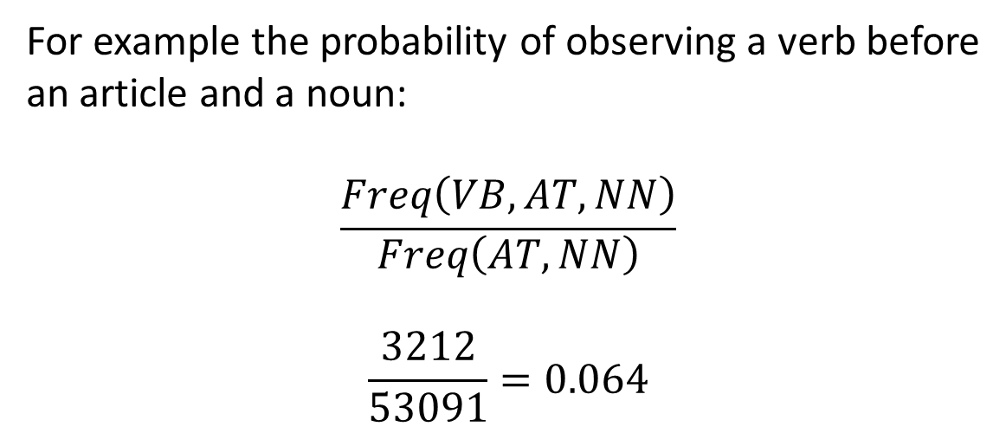
Contextual Probability Estimation
The contextual probability of observing part of speech X given the
following two parts of speech Y and Z is estimated by dividing the
trigram frequency XYZ by the bigram frequency YZ.
For example the probability of observing a verb before
an article and a noun:
$$\frac{Freq\left(VB,AT,NN\right)}{\begin{aligned}Freq\left(AT,NN\right) \\ \end{aligned}}$$
$$\frac{3212}{53091}=0.064$$
PPS = subject pronoun; MD = modal; VB = verb; AT = article; NN = noun; JJ = adjective

Slide 17
All Possible POST Assignments
Given a phrase, the Cartesian product of all its words lexical
values will provide all possible POST sets.
I | see | a | bird
PPSS | VB | AT | NN
PPSS | VB | IN | NN
PPSS | UH | AT | NN
PPSS | UH | IN | NN
NP | VB | AT | NN
NP | VB | IN | NN
NP | UH | AT | NN
NP | UH | IN | NN
POST assignments for phrase: “I see a bird”
PPS = subject pronoun; NP = proper noun; VB = verb; AT = article; NN = noun; UH = interjection
IN = preposition

Slide 18
Calculating Context Probabilities
All scores are interpreted as log probabilities:
bird:
(-4.848072 “NN”)
a bird:
(-7.4453945 “AT” “NN”)
(-15.01957 “IN” “NN”)
see a bird:
(-10.1914 “VB” “AT” “NN”)
(-18.54318 “VB” “IN” “NN”)
(-29.974142 “UH” “AT” “NN”)
(-36.53299 “UH” “IN” “NN”)
PPS = subject pronoun; NP = proper noun; VB = verb; AT = article; NN = noun; UH = interjection
IN = preposition

Slide 19
Calculating Context Probabilities Cont.
All scores are interpreted as log probabilities:
I see a bird:
(-12.92581 “PPSS” “VB” “AT” “NN”)
(-24.177242 “NP” “VB” “IN” “NN”)
(-35.667458 “PPSS” “UH” “AT” “NN”)
(-44.33943 “NP” “UH” “IN” “NN”)
Second iteration:
I see a bird :
(-13.262333 “” “PPSS” “VB” “AT” “NN”)
(-26.5196 “” “NP” “VB” “AT” “NN”)
PPS = subject pronoun; NP = proper noun; VB = verb; AT = article; NN = noun; UH = interjection
IN = preposition

Slide 20
Probabilistic part-of speech tagging using decision trees

Slide 21
The TreeTagger
This methodology is very similar to Church’s ngram tagger, but
it differs by estimating transition probabilities with a binary decision
tree. “The probability of a given trigram is determined by following
the corresponding path through the tree until a leaf is reached”.

Slide 22
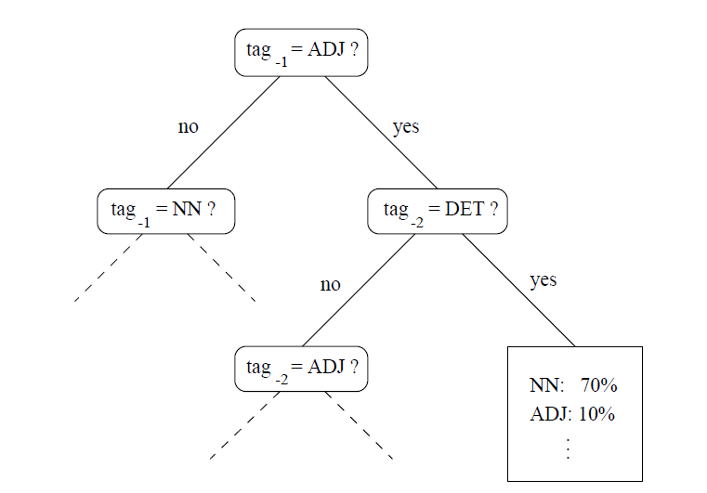
Decision Tree Construction
a test is created dividing
the trigram samples in two sets
The best one yielding most information is
attached to the current node
A modified ID3-algorithm is used to built recursively the decision tree from
a training set of trigrams.

Slide 23
Pruning TreeTagger
After the decision tree has been built, it will go through a
pruning process. It is here where all the sub-nodes which do
not meet a defined threshold are removed, making the parent
node a leaf.

Slide 24
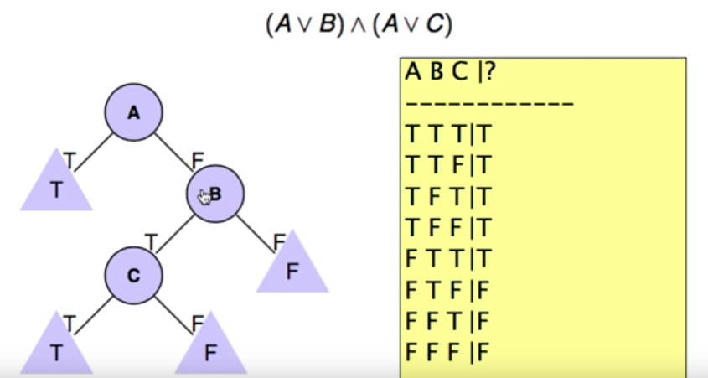
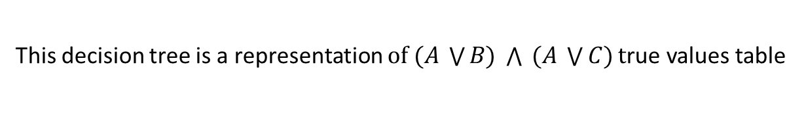
Why ID3 Algorithm?
This decision tree is a representation $of (A \bigvee{B) \bigwedge{ (A \bigvee{C)}}}\text{t}\text{rue} \text{values} \text{table}$
https://www.youtube.com/watch?v=eLlYSpVjH94 [Quinlan, 1983]

Slide 25
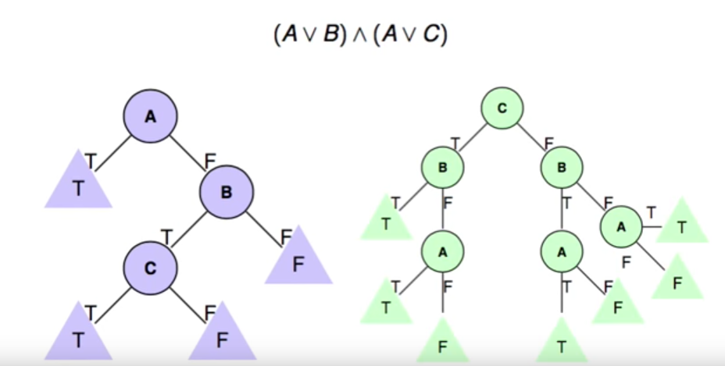
ID3 Algorithm Makes Efficient Trees
Both trees represent the same function, however the tree on the left is more
efficient.
https://www.youtube.com/watch?v=eLlYSpVjH94, [Quinlan, 1983]

Slide 26
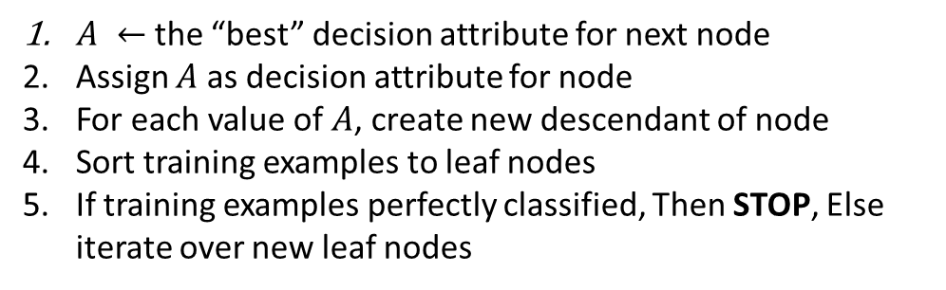
ID3 Algorithm
Building a tree Top-Down
$A ←$ the “best” decision attribute for next node
Assign $A$ as decision attribute for node
For each value of $A$, create new descendant of node
Sort training examples to leaf nodes
If training examples perfectly classified, Then STOP, Else iterate over new leaf nodes
[Quinlan, 1983]

Slide 27
TreeTagger Composition
fullform lexicon
Suffix lexicon
Default entry

Slide 28
TreeTagger Fullform Lexicon
It was created from a tagged training corpus. It includes
the number of occurrences of each word.
TreeTagger uses the fullform lexicon as its first option during
a word lookup.

Slide 29
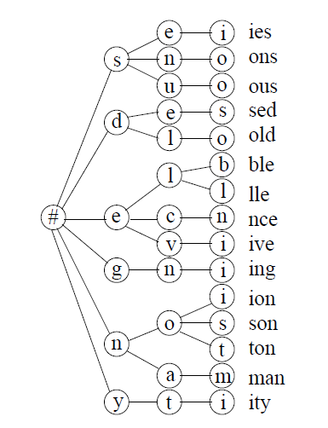
TreeTagger Suffix Lexicon
If the word was not found in its fullform, a search is performed
in the suffix lexicon which is organized as a tree.
A probability vector is
located at the leaf
level node. It was
automatically built
from training corpus
Looking for word: “Training”

Slide 30
TreeTagger Lexicon
Finally, if suffix lexicon fails the default entry is returned.

Slide 31
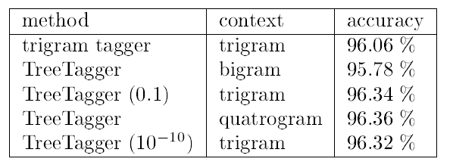
TreeTagger Test Results
We can notice all trigram results are better than the traditional
trigram tagger, and adding and additional decision in the tree
with a quatrogram makes a small improvement to TreeTagger
accuracy.

Slide 32
Reference
[1]
Church, K. W. (1988). A stochastic parts program and noun phrase parser for unrestricted text. In Proceedings of the second conference on applied natural language processing (pp. 136–143). Association for Computational Linguistics.
[2]
Schmid, Helmut. "Probabilistic part-of-Speech tagging using decision trees." New methods in language processing. Routledge, 2013.
[3]
Quinlan, J. R. (1983). “Learning efficient classification procedures and their
application to chess end games”. In Michalski, R., Carbonell, J., and Mitchell,
T. , editors, Machine Learning: An artificial intelligence approach, pages 463-
482. Morgan Kaufman, San Mateo, CA.
[4]
Part-of-speech tagging. (n.d.) Retrieved October 4, 2016 from
https://en.wikipedia.org/wiki/Part-of-speech_tagging

