Slide 1
Introduction to
Information Retrieval
Week 1: Administrivia
Old Dominion University
Department of Computer Science
CS 734/834 Fall 2016
Michael L. Nelson <mln@cs.odu.edu>
2015-09-01

Slide 2
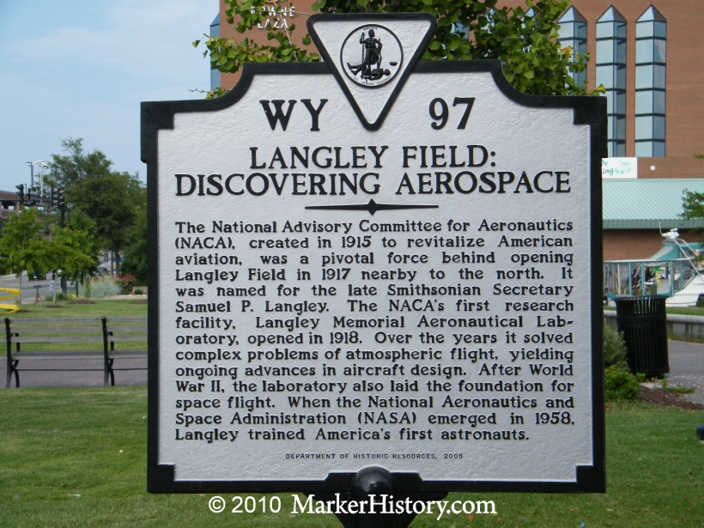
First Job: NASA Langley Research Center

Slide 3
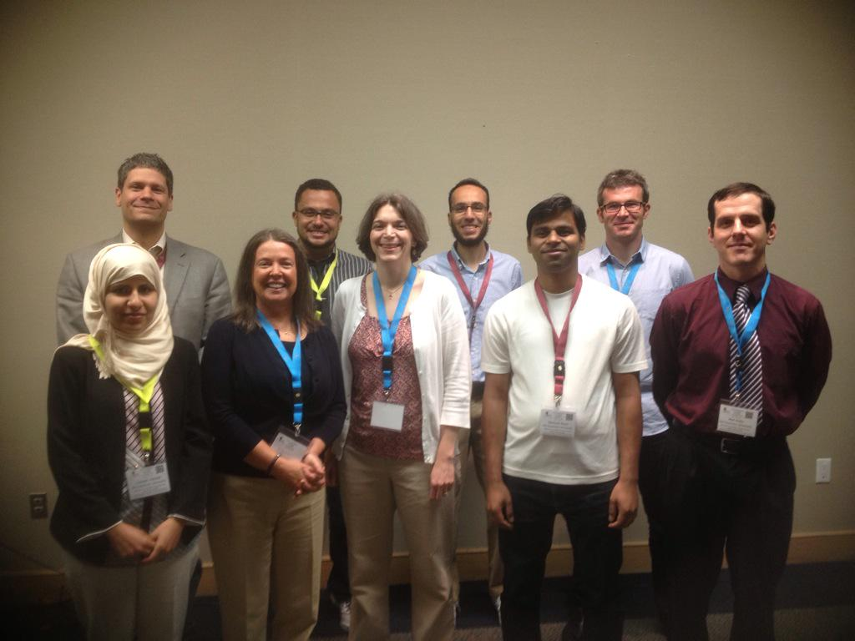
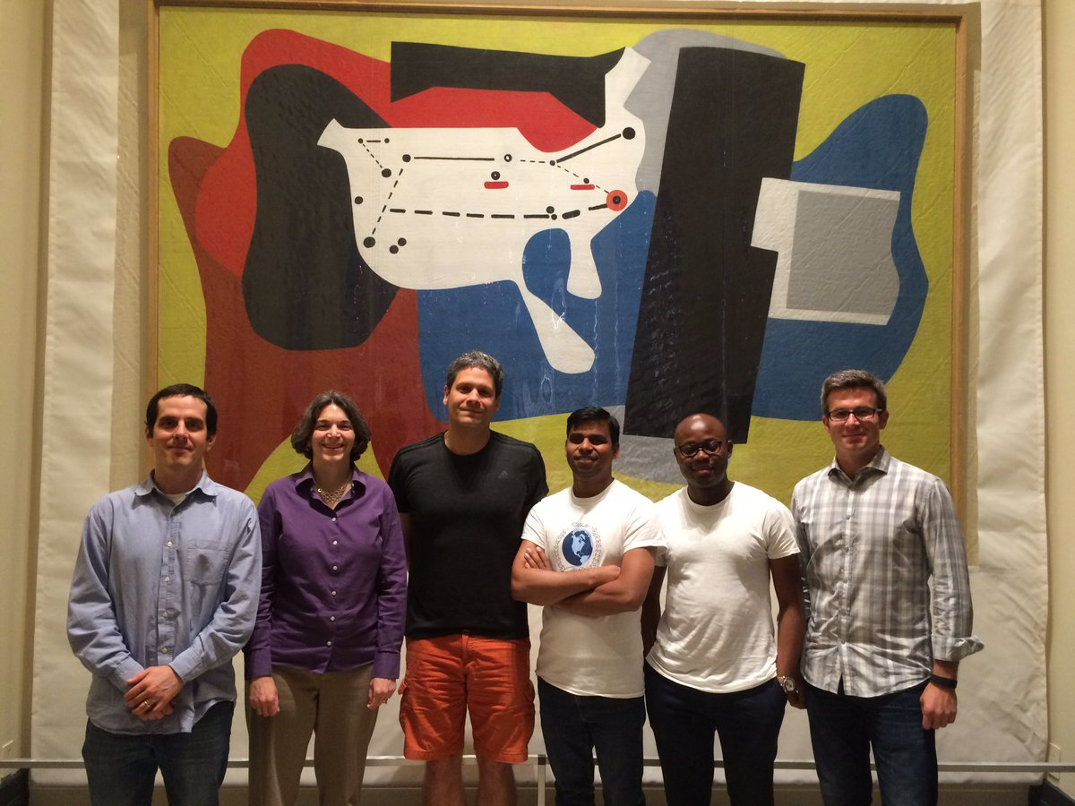
(a sampling of past & present)
WS-DL Research Group
WS-DL at JCDL 2015:
http://ws-dl.blogspot.com/2015/07/2015-06-21-jcdl2015-main-conference.html
WS-DL at JCDL 2016:
http://ws-dl.blogspot.com/2016/06/2016-06-23-joint-conference-on-digital.html
http://ws-dl.blogspot.com/
https://twitter.com/WebSciDL

Slide 4
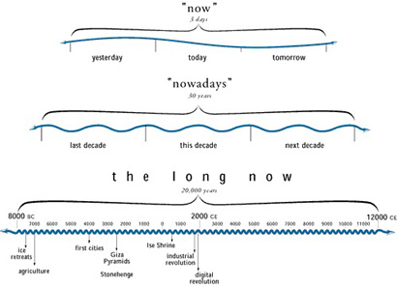
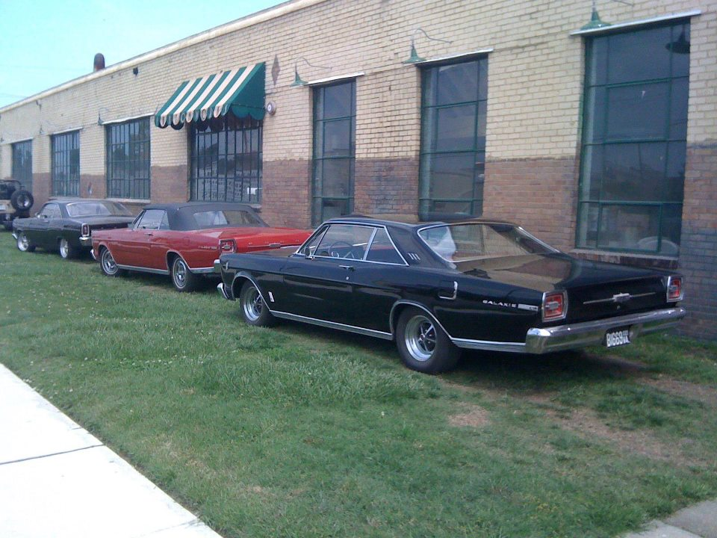
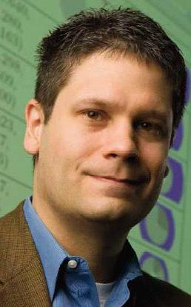
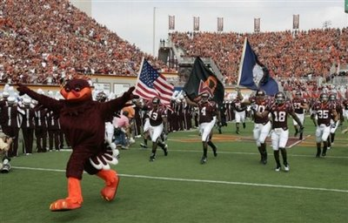
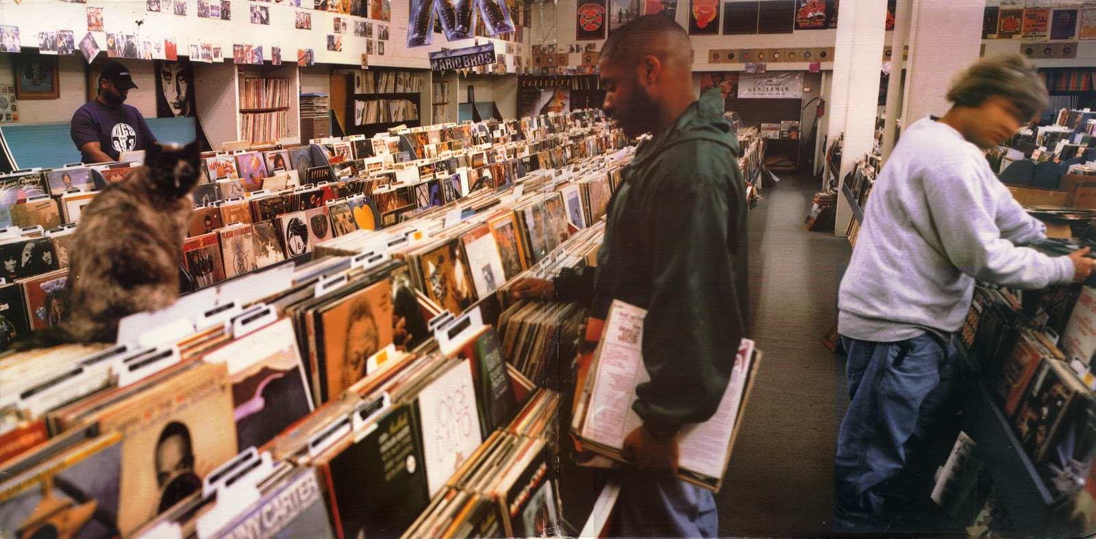

Slide 5
Class Administration
Important class URLs
  https://phonedude.github.io/cs834-f16/ http://groups.google.com/group/cs834-f16
Readings, syllabus, schedule, etc. are all available from the class home page

Slide 6
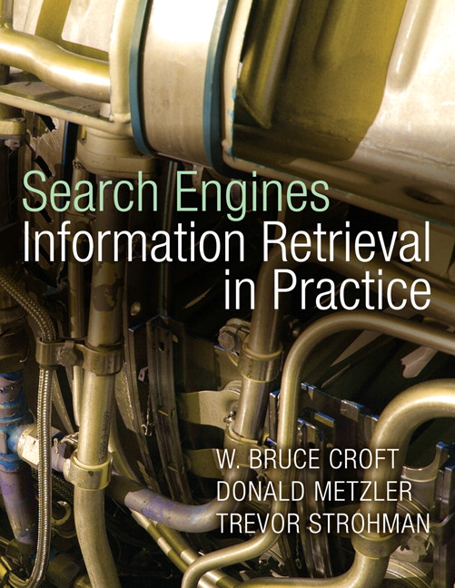
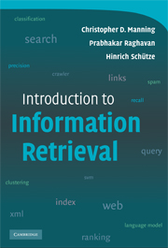

Books
required
(chapters numbers are
relative to this book)
recommended
recommended

Slide 7
Class Resources
Croft book & Manning book both have significant web sites with resources (code, test sets, slides, etc.)
  Croft book is now free for download!
Class slides will be from the Croft book site
  with occasional additions and annotations as the semester unfolds; check email list and class home page

Slide 8
Grading
Five written assignments based on end of chapter questions
  10 points for each assignment, 5 questions per assignment
Five in-class presentations based on end of chapter “further readings”
  10 points for each presentation

Slide 9
Written Assignments
Written like a report…
  using LaTeX and graphs done in R or Gnuplot
    Neither MS Word nor MS Excel graphs are acceptable!
  where necessary: references, screen shots, copy-n-paste of code output, etc.
Five questions chosen from an approved list (by me) from the end of each chapter, possibly with additional questions created by me
Due at beginning of class:
  all files uploaded to github: .tex, .r, .bib, .pdf, etc. files
  hard copy of report

Slide 10
Grading Written Assignments
For each of the five questions:
  0: understanding not demonstrated
  1: surface / practitioner understanding demonstrated
  2: deep / researcher understanding demonstrated
  “demonstration” means written down with examples, graphs, code, arguments, figures, tables, etc.
    It does not mean explaining to me verbally after you have received your grade
  Points will be deducted at my discretion for messy, unattractive, incomplete, etc. written reports

Slide 11
Presentations
Given in class, ~20-25 minutes each (we’ll adjust time based on final enrollment)
  note: summarizing two papers in 20 minutes is hard, not easy…
Pick one of the seminal research papers (i.e., not books, web sites, etc.) from the “references and further reading” section at end of chapters
Find a single paper that cites your chosen seminal paper
  I suggest using Google Scholar, MS Academic Search, etc.
  Citing paper must be from: WWW, SIGIR, ECIR, WSDM, CIKM, VLDB, SIGMOD, JCDL, TPDL, JASIST, ACM Transactions, IPM, or similarly high quality
    Contact me to see if another conf/journal is suitable

Slide 12
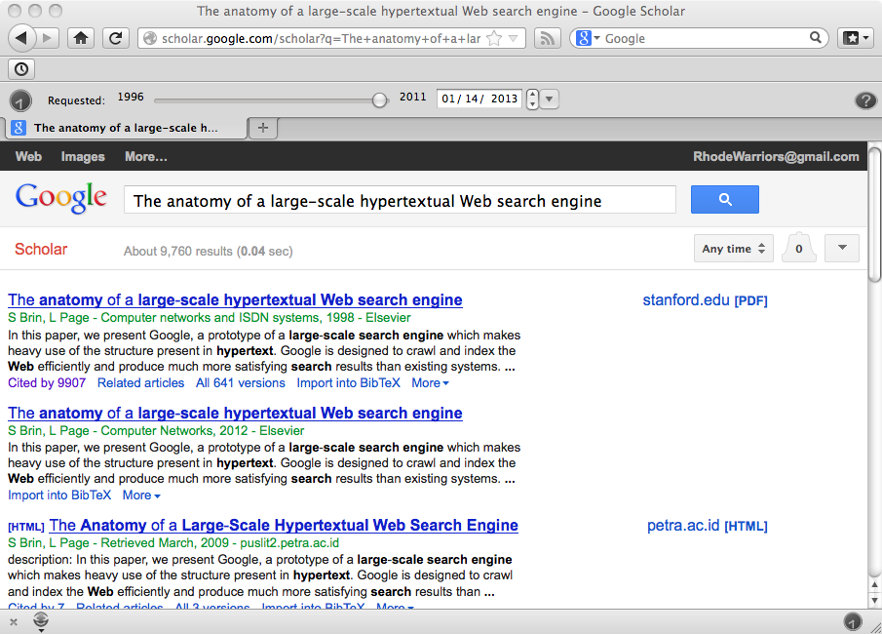
http://scholar.google.com/scholar?q=The+anatomy+of+a+large-scale+hypertextual+Web+search+engine&btnG=&hl=en&as_sdt=0%2C4 7

Slide 13
Picking Papers
Send to class email list to claim your seminal paper + citing paper
  There will be no overlap of seminal papers; first-come-first-served as determined by time received at the class email archives (i.e., not time of delivery to your client)
  Seminal papers without a chosen corresponding citing paper are not considered valid entries
  The only way you can change your entry is if you lose a tie with someone else (i.e., your email is 2nd in the list). Otherwise, you have to stick with the papers you’ve chosen

Slide 14
Presenting the Pair
You must present/explain the primary contribution of the seminal paper, and then explain how the citing paper extends/refutes/refines/etc. the original paper
  Purpose: understand/explain the primary contribution as well as the work that builds on it
  Examples: different architectures now possible, refined algorithms, different applications, efficiency improvements, additional evaluation, etc.
  Must demonstrate a fundamental & deep understanding of concepts and contributions

Slide 15
Deliverables
Immediately after your in-class presentation, email me your slides
  Slides must be your own work! You cannot reuse the slides of others!
  I will add your slides to class home page after your presentation
Scores based on:
  Demonstrated understanding of the original concept (0-4)
  Demonstrated understanding of the citing paper and how it builds on the original concept (0-4)
  Aesthetics (neat, no misspellings, pedagogically efficient, etc.) (0-2)

