Slide 1
Thumbs up? Sentiment Classification using Machine Learning Techniques
Pang, B., Lee, L., & Vaithyanathan. (2002)
Proceedings of ACL-02 conference on empirical methods in natural language processing
A Sentimental Education: Sentiment Analysis Using Subjectivity Summarization Based on Minimum Cuts
Pang, B., & Lee, L. (2004)
Proceedings of the 42nd annual meeting on Association for Computational Linguistics
4th Presentation
Plinio H. Vargas
December 1, 2016
Old Dominion University
Intro to Information Retrieval
CS734/834

Slide 2
Thumbs up? Sentiment Classification using Machine Learning Techniques

Slide 3

Sentiment-Classification Definition
Input: raw text over some topic
Output: opinion (+, -, 0)

Slide 4
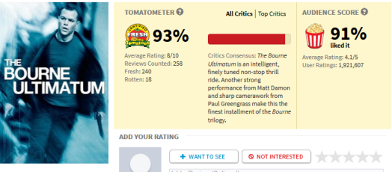




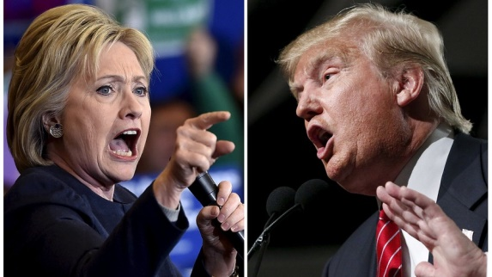


Sentiment-Categorization Application
Watch a movie based on consensus opinion: good vs bad.
Purchase a product using consumers’ reviews: useful vs useless.
What is the opinion people have about a candidate’s policy: favorable vs unfavorable.
Predict outcome of election based on people sentiment.
Expanding rail system
in Virginia Beach

Slide 5
Motivation
How effective is the application of machine learning techniques to the Sentiment-Categorization problem in comparison to Topical-Categorization.

Slide 6
Hypothesis
The identification of certain words people use to express their sentiment should be enough for a sentiment-based classification.
Positive = {good, awesome, great, outstanding, …}
Negative = {bad, low, useless, cheap, ….}

Slide 7
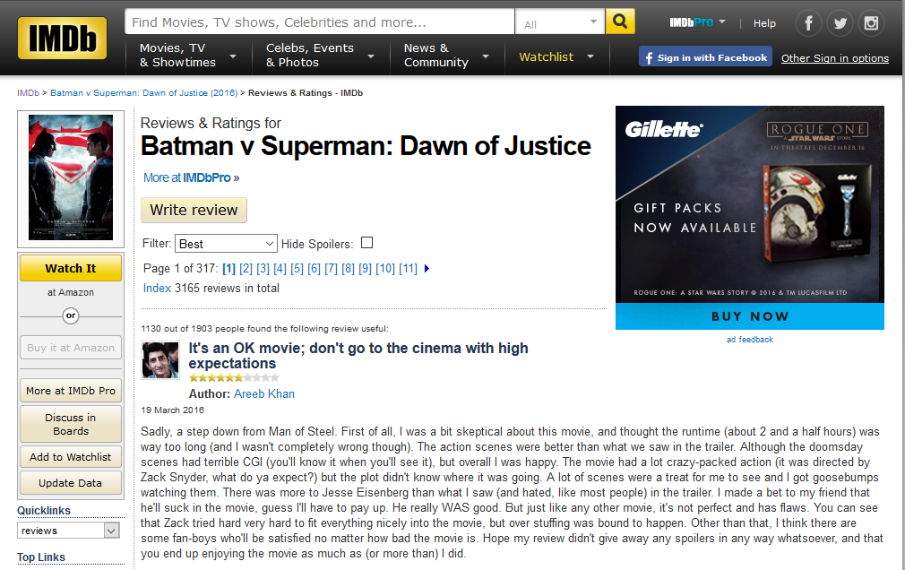
Dataset
Internet Movie Database (IMDb) archive
Corpus of 700 –ve, 700 +ve,
total 144 reviewers represented

Slide 8
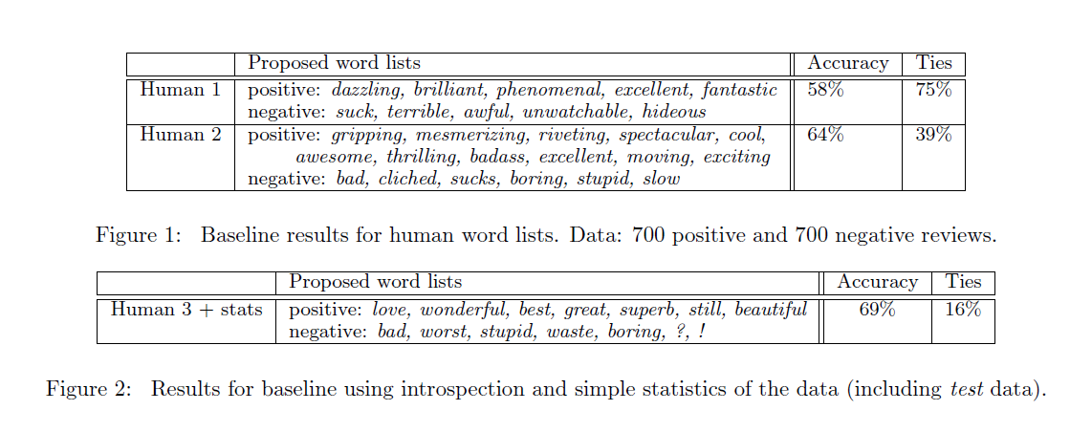
Experiment Baseline
Topics are identifiable by keywords. Sentiments can be expressed in a more subtle way:
“What was the director thinking?” or “Still, though, it was worth seeing”.

Slide 9
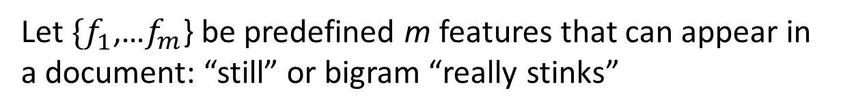
Machine Learning Methods
Let $\{f_{1}^{}$,…$f_{m}^{}$} be predefined m features that can appear in a document: “still” or bigram “really stinks”
Let $n_{i}^{}(d)$ be the number of times $f_{i}^{}$ occurs in document d
Document d is represented as $\overset{→}{d} ≔(n_{1}^{}(d)$, $n_{2}^{}(d)$ ,…, $n_{m}^{}(d))$

Slide 10


Naïve Bayes
Assign to a given document d in the class:
Naïve Bayes rule:
P(d) plays no role in selecting c*

Slide 11



Maximum Entropy
An alternative technique proven effective in natural
Language processing applications.
Z(d) is a normalization function
$F_{i,c}^{}$is a feature/class function for feature $f_{i}^{}$

Slide 12

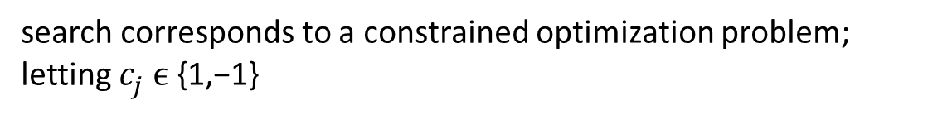
Support Vector Machine (SVM)
They are a large-margin classifier in contrast with
Naïve Bayer and MaxEnt which are probabilistic.
search corresponds to a constrained optimization problem; letting $c_{j}^{} ϵ$ {1,−1}
+
–
+
+
–
+
–
+
–
+
+
–
+
–
–
+
–
+
–
–

Slide 13
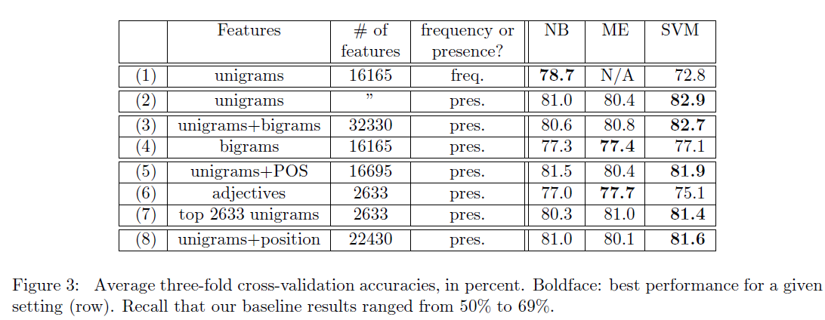
Evaluation and Results
randomly selected 700 positive-sentiment and 700 negative-sentiment documents
no stemming or stoplists were used
the tag NOT_ to was added to every word between a negation word (“not”, “isn’t”, “didn’t”, etc.)
Unigram presence turned out to be most effective.
It appears that presence information vs. feature frequency indicate the difference
between sentiment and topic categorization.

Slide 14
A Sentimental Education: Sentiment Analysis Using Subjectivity Summarization Based on Minimum Cuts

Slide 15
Motivation and Innovation
Novel machine learning method with the purpose of increasing sentiment-classification accuracy.

Slide 16
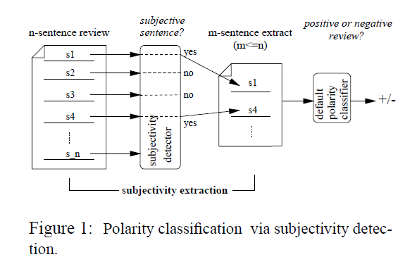
Architecture
“That was a good movie”
“The protagonist tries to protect her good name”
Polarity classification is text categorization with sentiment vs topic-based category.
Discarding objective sentence creates an extract that better represents review’s subjective content.

Slide 17
Obtaining Subjectivity Detection
Works of Wiebe (1994) states that “modeling proximity relationship between sentences would enable to leverage coherence. Text spans occurring near each other may share the same subjectivity status, other things being equal”.
Standard classification algorithm applies to each sentence in isolation.
Cut-based classification (proposed algorithm) is concerned with physical proximity between the items to be classified.

Slide 18
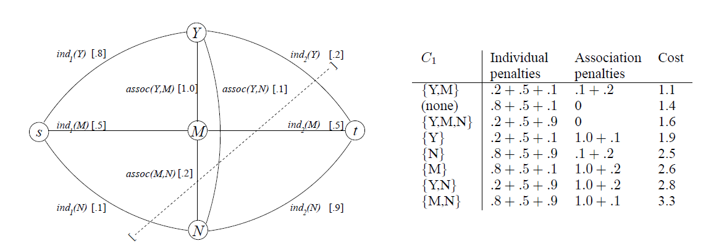
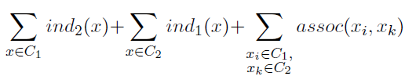
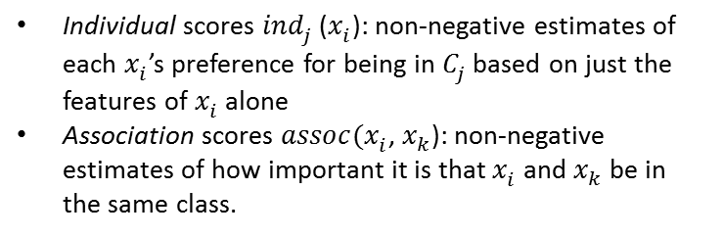
Cut-based Classification
Individual scores ${ind}_{j}^{}$($x_{i}^{}$): non-negative estimates of each $x_{i}^{}$’s preference for being in $C_{j}^{}$ based on just the features of $x_{i}^{}$ alone
Association scores ${assoc(x}_{i}^{}$, $x_{k}^{}$): non-negative estimates of how important it is that $x_{i}^{}$ and $x_{k}^{}$ be in the same class.
Can use maximum-flow algorithms with polynomial asymptotic running times

Slide 19
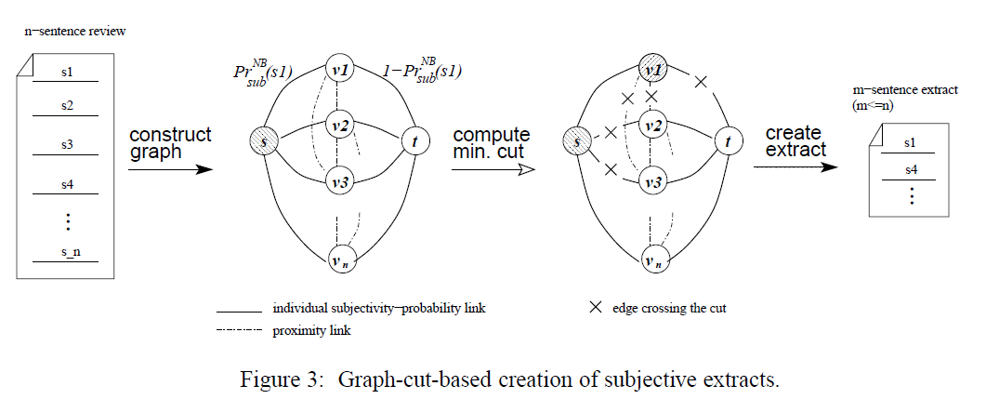

Subjectivity Detectors
Collected 5000 movie-review snippets from www.rottentomatoes.com
Collected 5000 sentences from the Internet Movie Database (www.imdb.com)
Sentences or snippets were at least ten words long and drawn from reviews release post-2001
Source s , sink t = class of subjective and objective respectively.
denotes Naive Bayes’ estimate of the probability that sentence s is subjective.

Slide 20
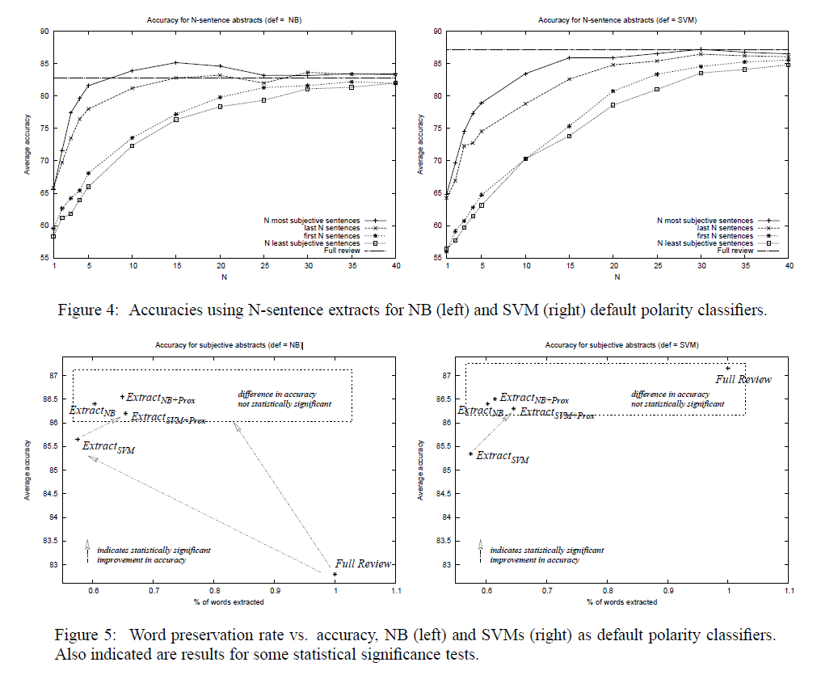
Results

Slide 21
Reference
[1]
Pang, B., Lee, L., & Vaithyanathan, S. (2002). Thumbs up?: sentiment classification using machine learning techniques. In EMNLP ’02: Proceedings of the ACL-02 conference on empirical methods in natural language processing (pp. 79–86). Association for Computational Linguistics.
[2]
Pang, B., & Lee, L. (2004, July). A sentimental education: Sentiment analysis using subjectivity summarization based on minimum cuts. In Proceedings of the 42nd annual meeting on Association for Computational Linguistics (p. 271). Association for Computational Linguistics

