Slide 1
Spatial Regression (Part 2)
Ricardo andrade

Slide 2
Previously
Spatial variation
Continuity in space
Smooth changes across space
Tools
GLM
GAM
C-V
K-fold C-V

Slide 3
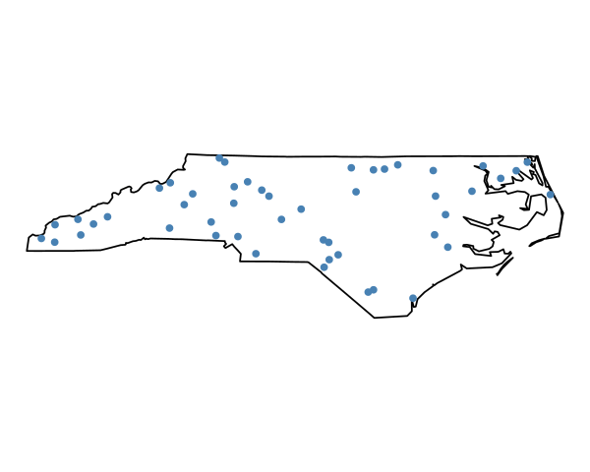
Point level data
A set of measurements at random locations (points) in a region

Slide 4
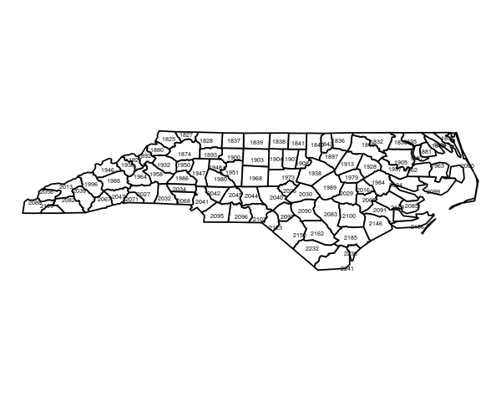
Areal data
Measurements aggregated by spatial units

Slide 5
It’s about spatial association
“Everything is related to everything else, but near things are more related than distant things” (Tobler’s Law)

Slide 6
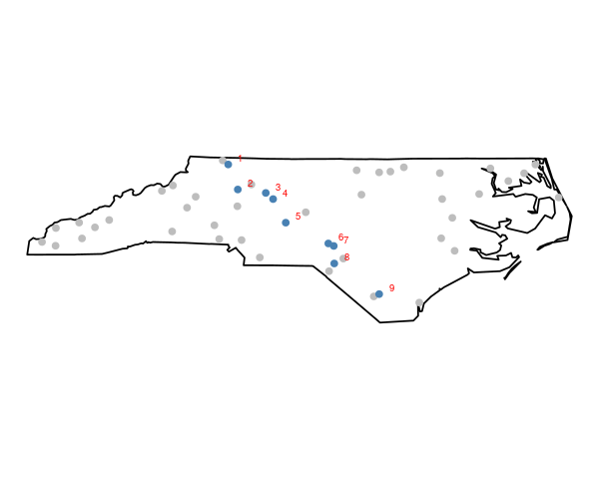
It’s about spatial association

Slide 7
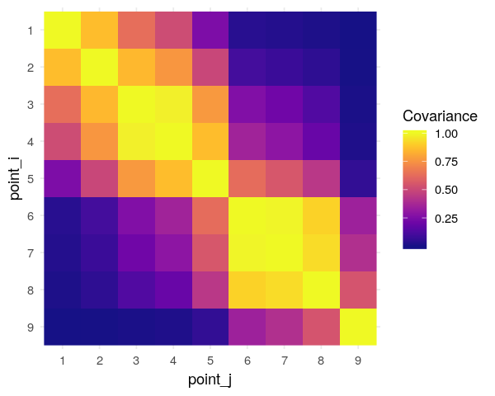
Spatial covariance

Slide 8
Spatial covariance

Slide 9
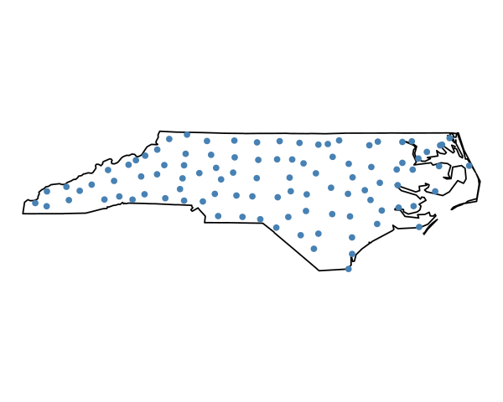
Spatial covariance

Slide 10
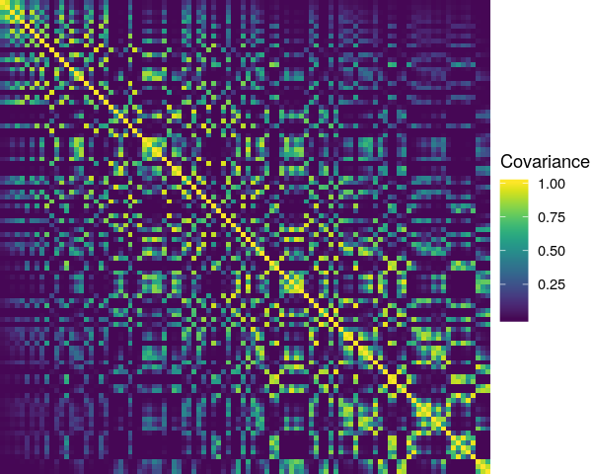
Spatial covariance

Slide 11
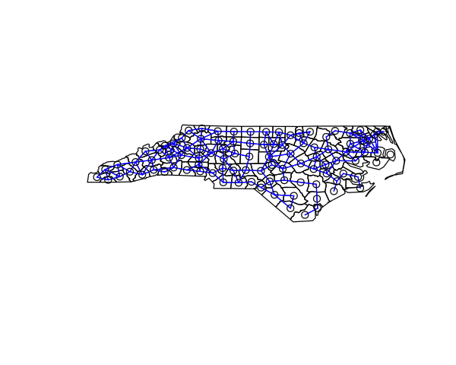
Adjacency matrix

Slide 12
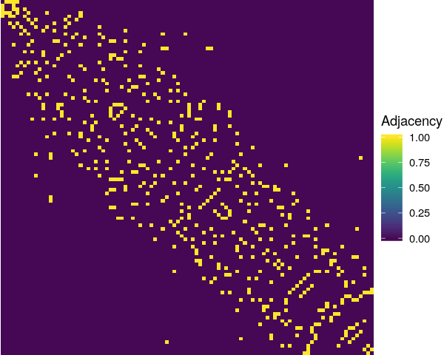
Adjacency matrix

Slide 13
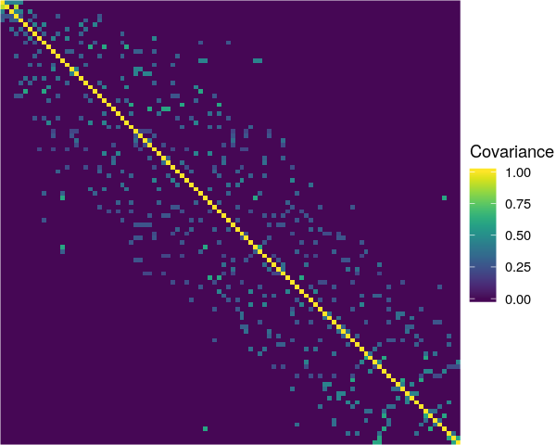
Sparse covariance

Slide 14
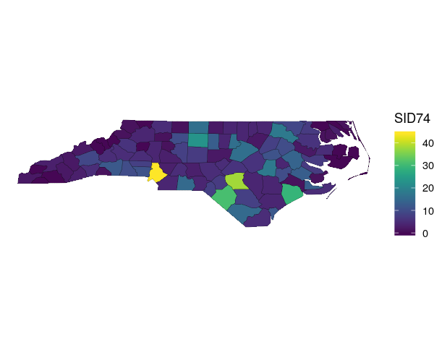
North Carolina SIDS data

Slide 15
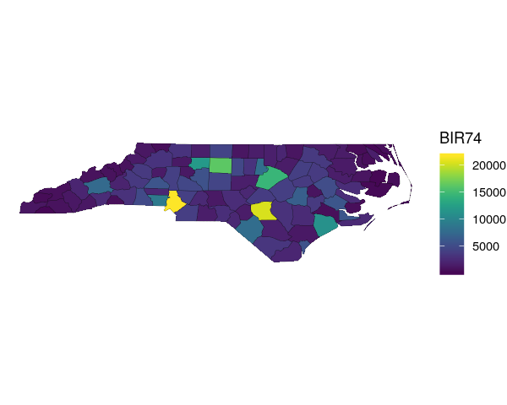
North Carolina SIDS data

Slide 16
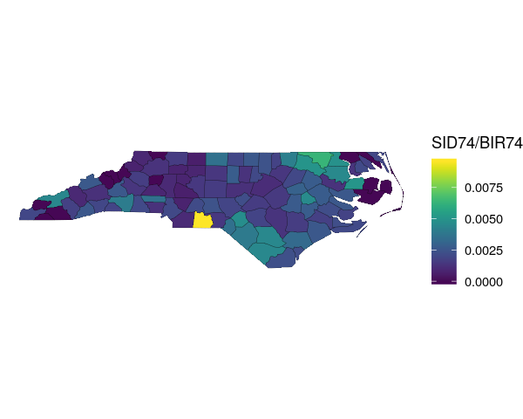
North Carolina SIDS data

Slide 17
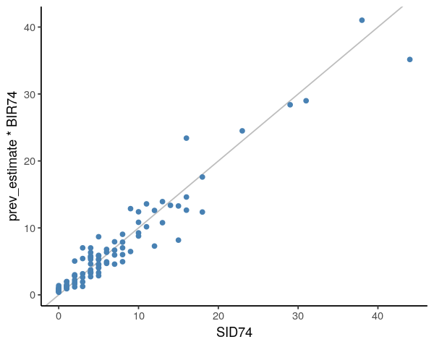
North Carolina SIDS data

Slide 18
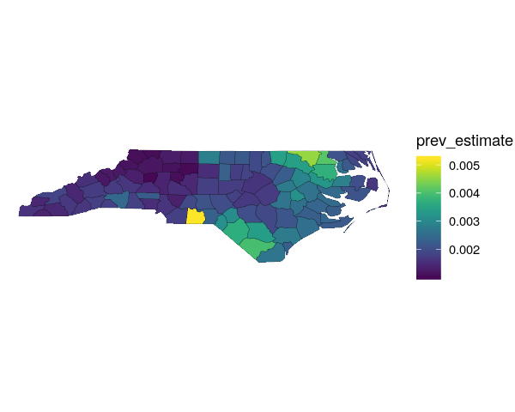
North Carolina SIDS data

