Slide 1

Orientação a Objetos (Herança)
Jose.wellington@uniceub.br
Aula 16
Notes:
Large enterprise applications - the ones that execute core business applications, and keep a company going - must be more than just a bunch of code modules. They must be structured in a way that enables scalability, security, and robust execution under stressful conditions, and their structure - frequently referred to as their architecture - must be defined clearly enough that maintenance programmers can (quickly!) find and fix a bug that shows up long after the original authors have moved on to other projects. That is, these programs must be designed to work perfectly in many areas, and business functionality is not the only one (although it certainly is the essential core). Of course a well-designed architecture benefits any program, and not just the largest ones as we've singled out here. We mentioned large applications first because structure is a way of dealing with complexity, so the benefits of structure (and of modeling and design, as we'll demonstrate) compound as application size grows large. Another benefit of structure is that it enables code reuse: Design time is the easiest time to structure an application as a collection of self-contained modules or components. Eventually, enterprises build up a library of models of components, each one representing an implementation stored in a library of code modules. When another application needs the same functionality, the designer can quickly import its module from the library. At coding time, the developer can just as quickly import the code module into the application.

Slide 2
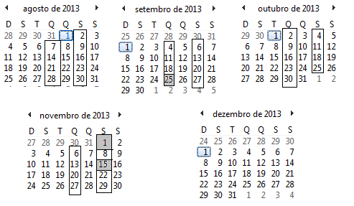
Calendário
Aula 16

Slide 3
Agenda
Herança
O que você ganha com herança
É um – Identificação
Superclasse
Subclasse
Prática
Exercício
Aula 16

Slide 4
Herança
Aula 16

Slide 5
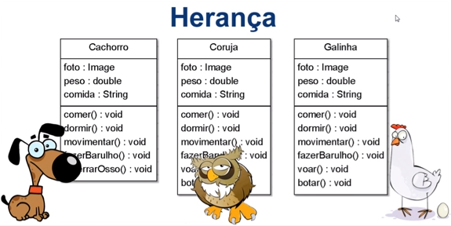
Herança
Aula 16

Slide 6
Herança
O que você ganha com herança
Evita código duplicado
Você generaliza o comportamento comum a um grupo de classe
Quando vc precisar alterar um grupo de comportamento em todas as classes só altera uma vez único local
Todas alterações elas serão aplicadas em todas subclasses
Aula 16

Slide 7
É um
Aula 16

Slide 8
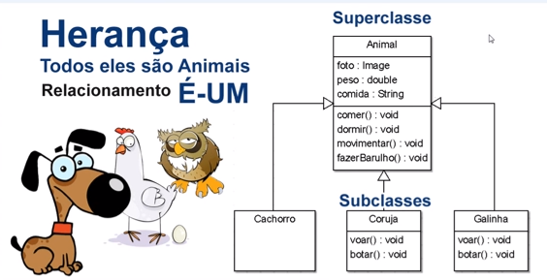
Herança
Aula 16

Slide 9
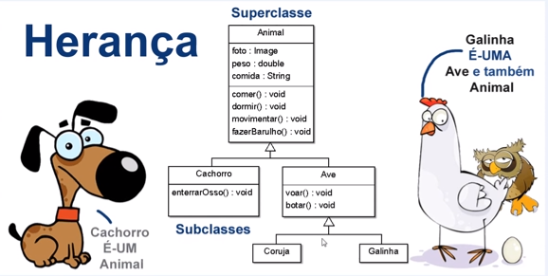
Herança
Aula 16

Slide 10
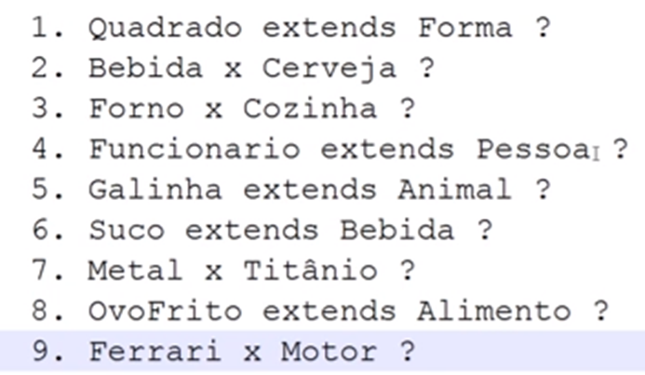
Herança – É um
Aula 16

Slide 11
Prática
Aula 16

Slide 12
Herança
Aula 16

Slide 13
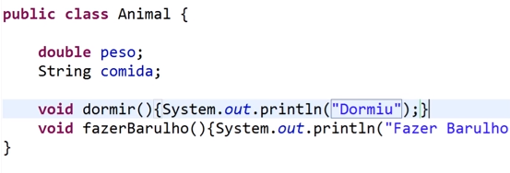
Herança
Aula 16

Slide 14

Herança
Aula 16

Slide 15

Herança
Aula 16

Slide 16
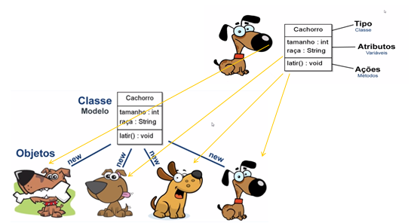
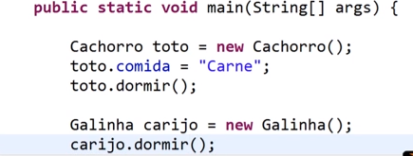
Herança
Aula 16

Slide 17
Demonstração
Aula 16

Slide 18
Exercicio
Aula 16

Slide 19
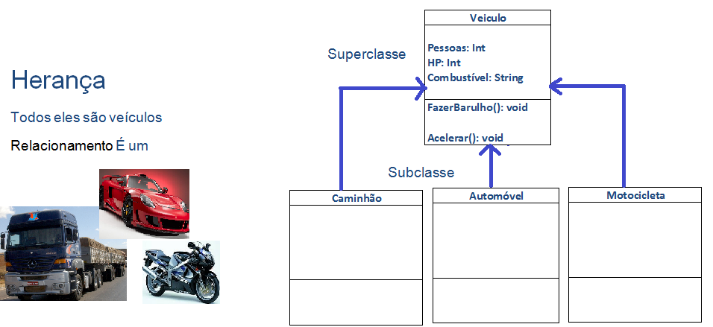
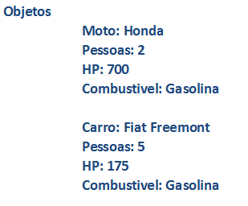
Exercício 16.0
Aula 16

Slide 20
Agenda
Herança
O que você ganha com herança
É um – Identificação
Superclasse
Subclasse
Prática
Exercício
Jose.wellington@uniceub.br
Aula 16

