Slide 1

GUI Graphical User Interface
Swing
CRUD (Create, Read, Update e Delete)
Jose.wellington@uniceub.br
Aula 24
Notes:
Large enterprise applications - the ones that execute core business applications, and keep a company going - must be more than just a bunch of code modules. They must be structured in a way that enables scalability, security, and robust execution under stressful conditions, and their structure - frequently referred to as their architecture - must be defined clearly enough that maintenance programmers can (quickly!) find and fix a bug that shows up long after the original authors have moved on to other projects. That is, these programs must be designed to work perfectly in many areas, and business functionality is not the only one (although it certainly is the essential core). Of course a well-designed architecture benefits any program, and not just the largest ones as we've singled out here. We mentioned large applications first because structure is a way of dealing with complexity, so the benefits of structure (and of modeling and design, as we'll demonstrate) compound as application size grows large. Another benefit of structure is that it enables code reuse: Design time is the easiest time to structure an application as a collection of self-contained modules or components. Eventually, enterprises build up a library of models of components, each one representing an implementation stored in a library of code modules. When another application needs the same functionality, the designer can quickly import its module from the library. At coding time, the developer can just as quickly import the code module into the application.

Slide 2
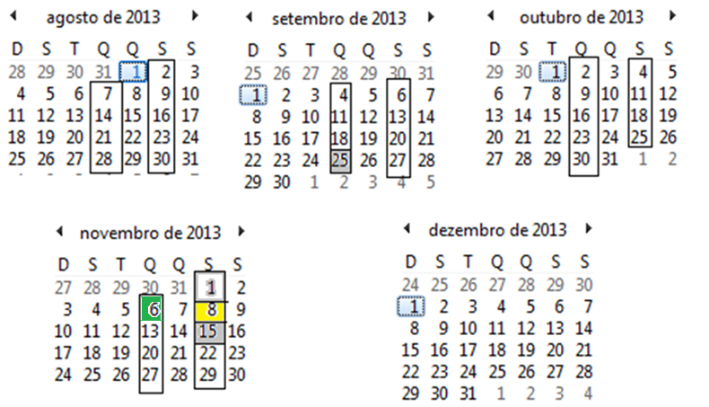
Calendário
Aula 24

Slide 3
Agenda
Revisão - GUI - Graphical User Interface
  Container
  JOptionPane
  JFrame
  Layout Frame
  Controles
  Exercício
  IDE – NetBeans
  Navegação do Sistema
SQL Server
  Comandos - DDL
NetBeans - Biblioteca de acesso – SqlServer
Comandos SQL (insert, update, delete, select)
Exercício
Aula 24

Slide 4
JOptionPane
Aula 24

Slide 5
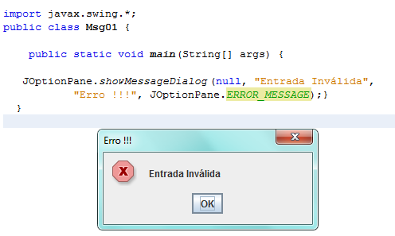
JOptionPane – showMessageDialog - exemplo 1
Aula 24

Slide 6
Controles
Aula 24

Slide 7
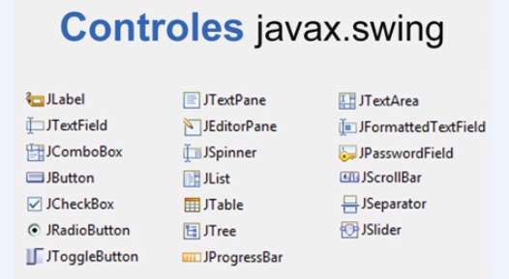
Controles
Aula 24

Slide 8
IDE - NetBeans
Aula 24

Slide 9
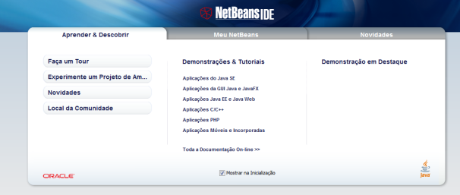
IDE - Integration Develop Enterprise
NetBeans IDE é um AMBIENTE DE DESENVOLVIMENTO INTEGRADO (IDE) gratuito para desenvolvedores de software nas linguagens Java, C, C++, PHP, Ruby.
O IDE é executado em muitas plataformas, como Windows, Linux, Solaris e MacOS.
O NetBeans IDE oferece aos desenvolvedores ferramentas necessárias para criar aplicativos profissionais de desktop, empresariais, Web e móveis multiplataformas.
Aula 24

Slide 10
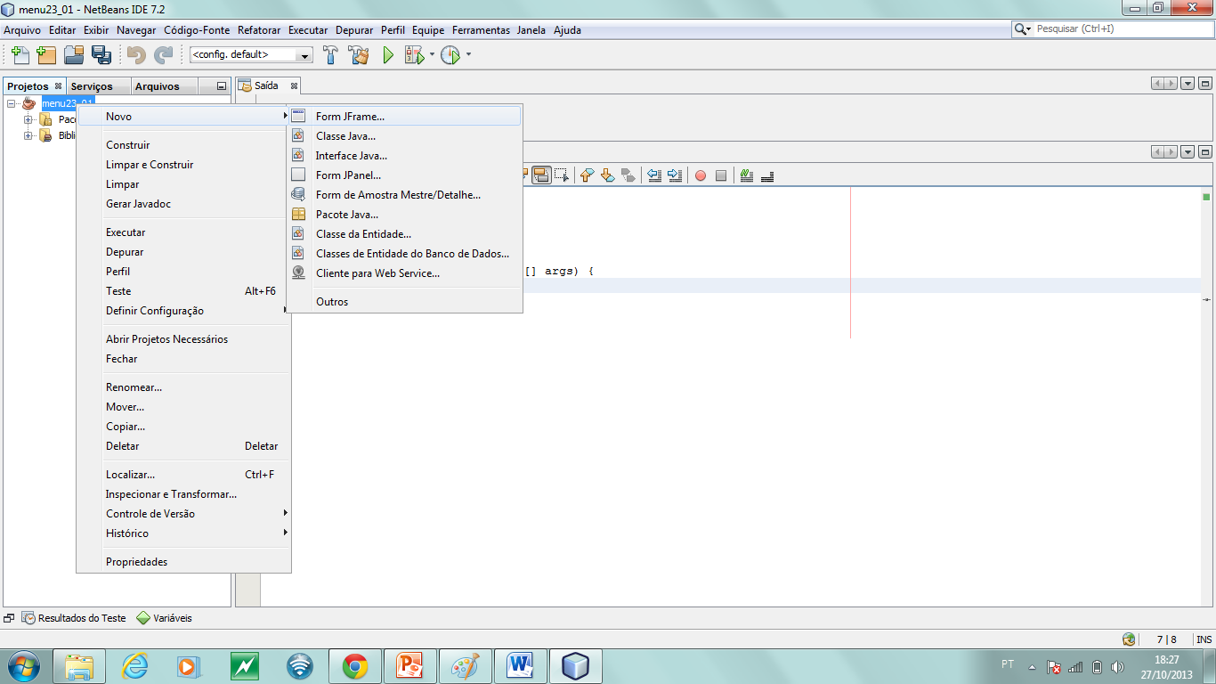
Navegação do Sistema
Criar formulário - Menu
Aula 24

Slide 11
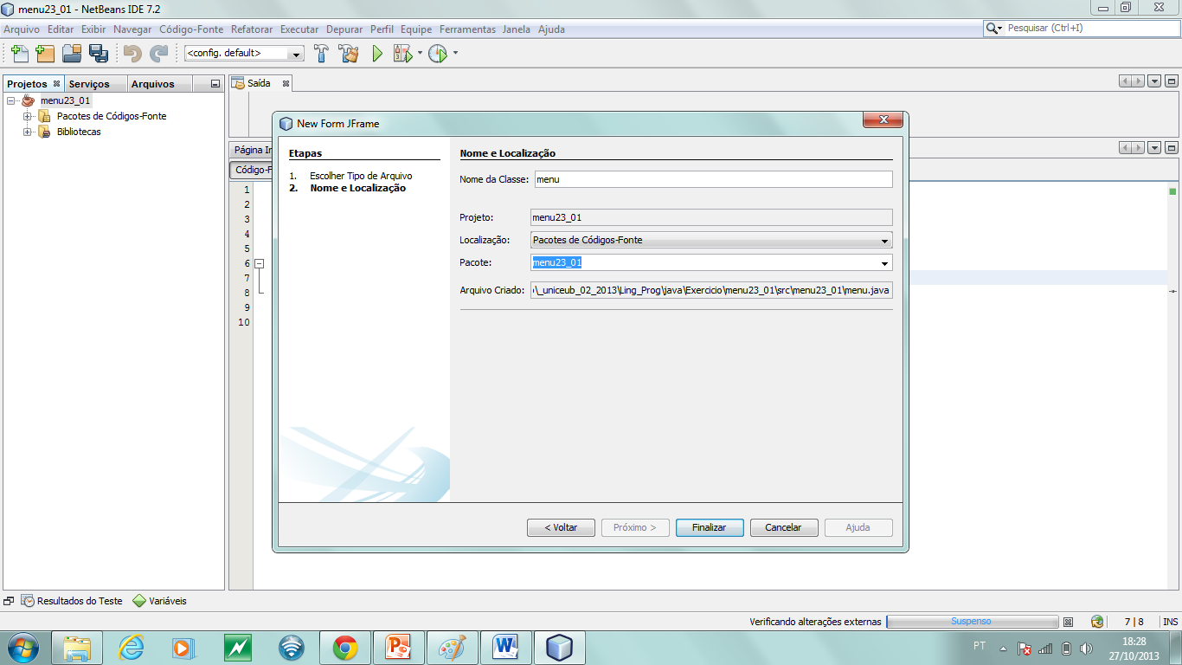
Navegação do Sistema
Criar formulário – Menu - NOME
Aula 24

Slide 12
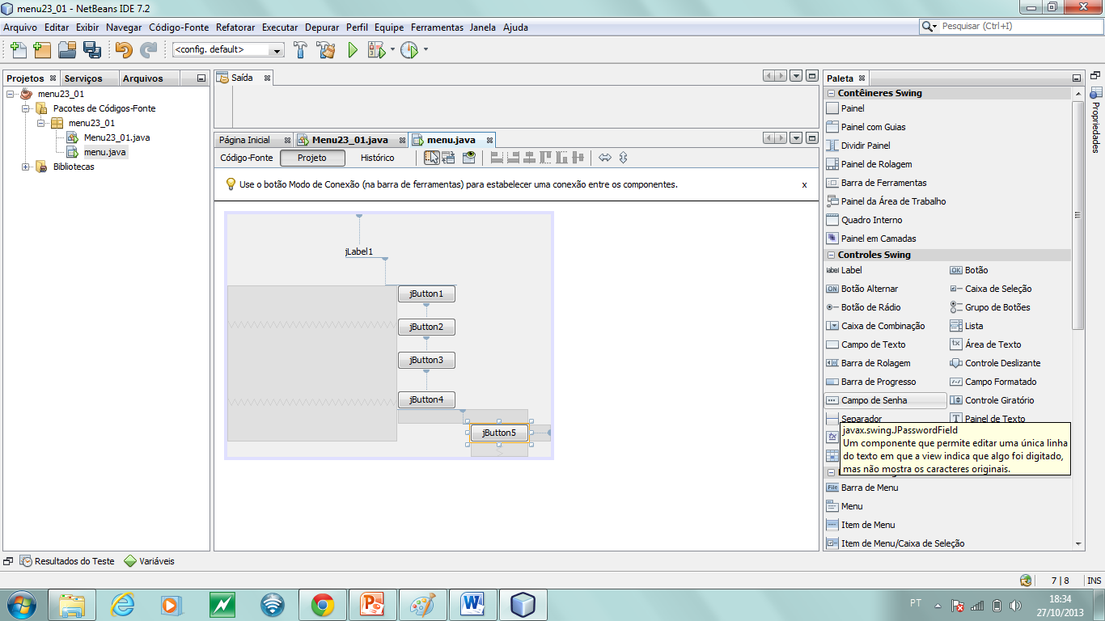
Navegação do Sistema
Controles – Botões e Label
Aula 24

Slide 13
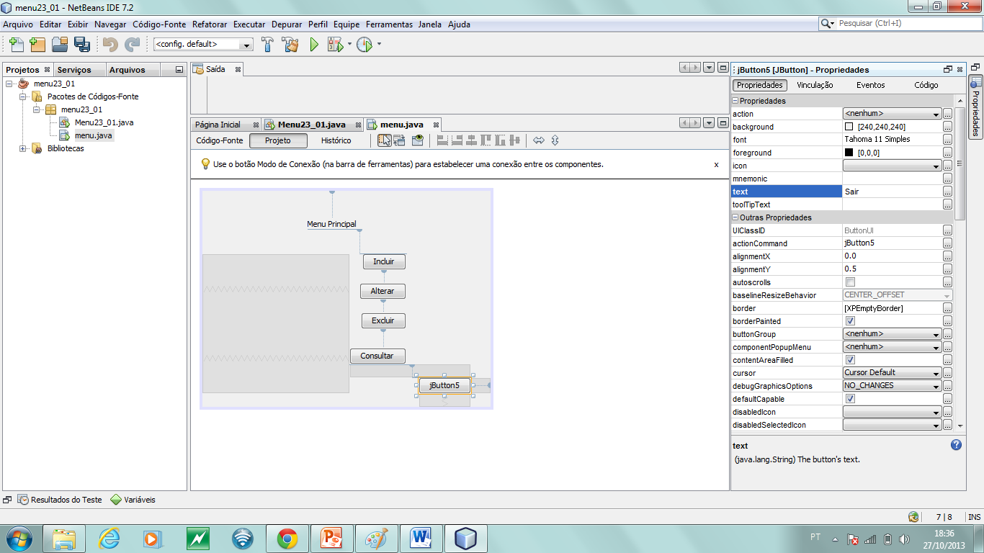
Navegação do Sistema
Propriedade dos Objetos (Botões, Label)
Aula 24

Slide 14

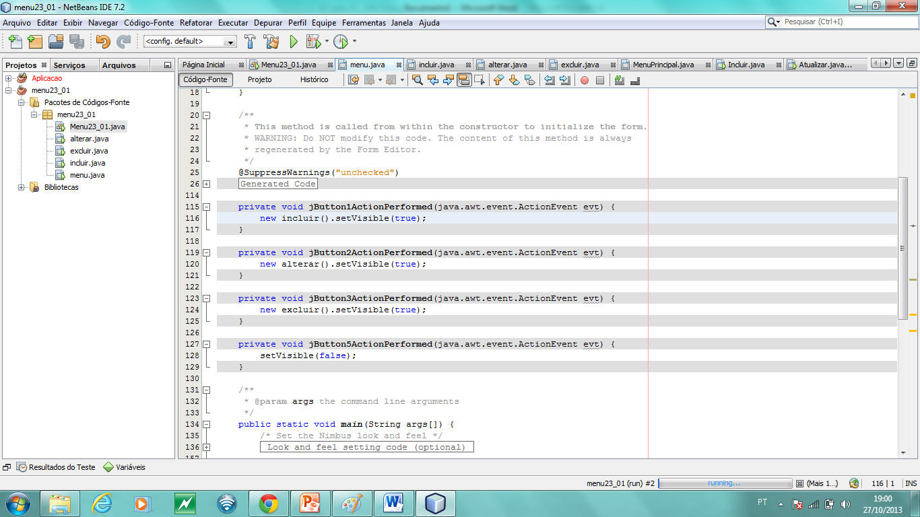
Navegação do Sistema
Executar os formulários (incluir, alterar, excluir, consultar)
Aula 24

Slide 15
Navegação do Sistema
Executar os formulários (incluir, alterar, excluir, consultar)
Aula 24

Slide 16
Navegação do Sistema
Main
package menu23_01;
public class Menu23_01 {
public static void main(String[] args) {
new menu().setVisible(true);
}
}
Aula 24

Slide 17
SQL Server
Aula 24

Slide 18
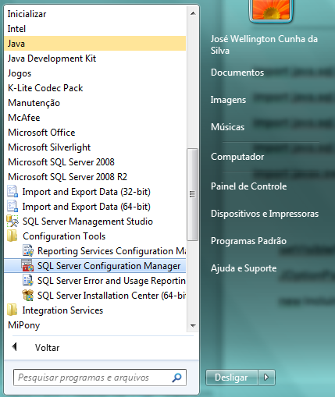
Ativar – porta TCP/IP
Aula 24

Slide 19
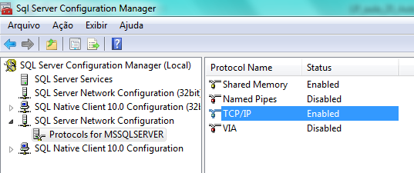
SQL Server habilitar tcp/ip
Aula 24

Slide 20
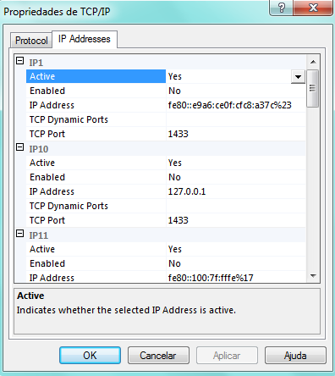
SQL Server habilitar tcp/ip
Aula 24

Slide 21
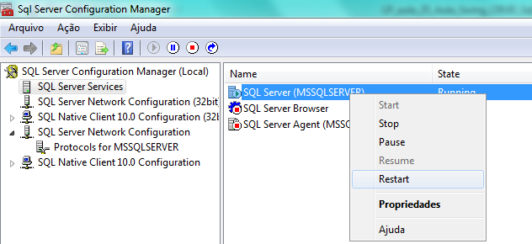
SQL Server habilitar tcp/ip
Aula 24

Slide 22
CRUD
Aula 24

Slide 23
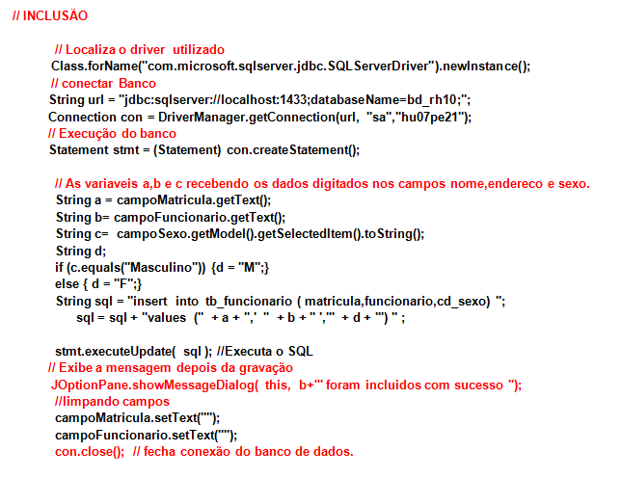
Aula 24

Slide 24
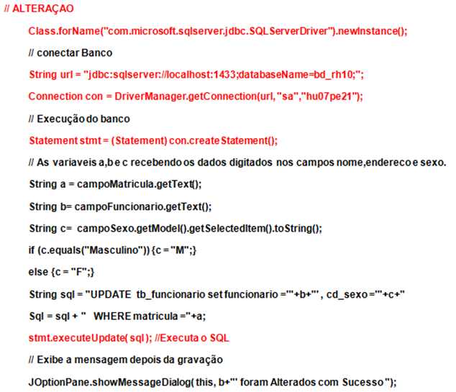
Aula 24

Slide 25
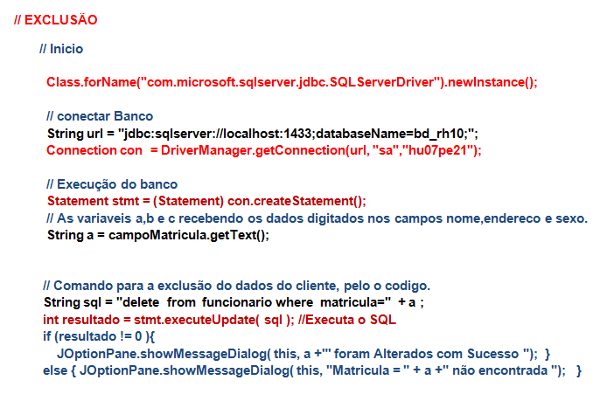
Aula 24

Slide 26
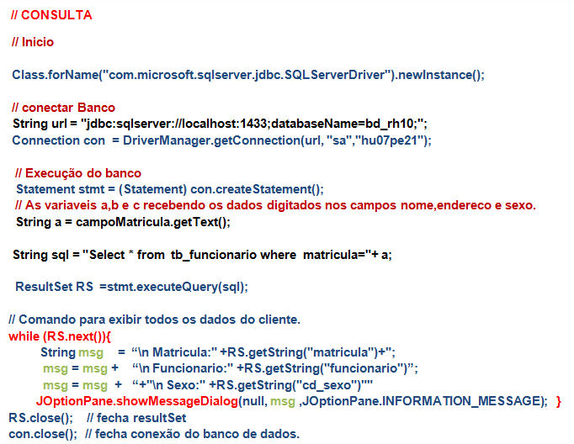
Aula 24

Slide 27
NetBeans
Biblioteca de acesso
SQL Server
Aula 24

Slide 28
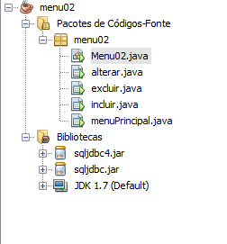
Jar – Biblioteca de acesso
O driver de conexão com o banco de dados SQL Server tem uma biblioteca jar (compactada)
Aula 24

Slide 29
Try catch
Aula 24

Slide 30
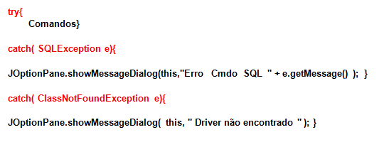
Exceção – try catch
Aula 24

Slide 31
Exercício
Aula 24

Slide 32
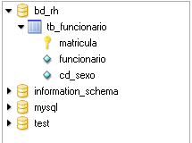
Exercício 25
Fazer CRUD – Create, Read, Update e Delete
No banco de dados bd_rh10 – tb_funcionario os Campos
matricula – int
funcionario – varchar(60)
cd_sexo char(01)
Aula 24

Slide 33
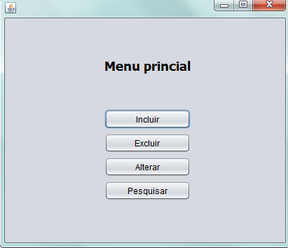
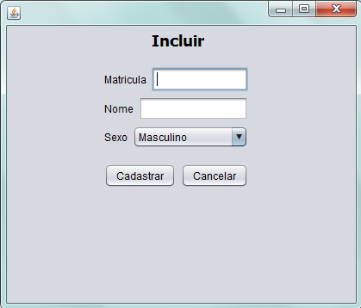
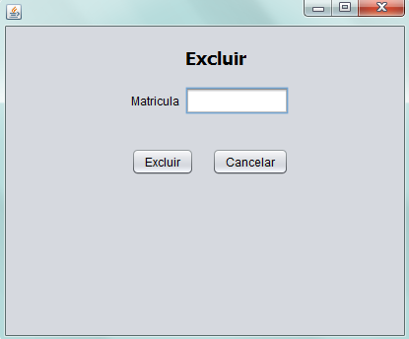
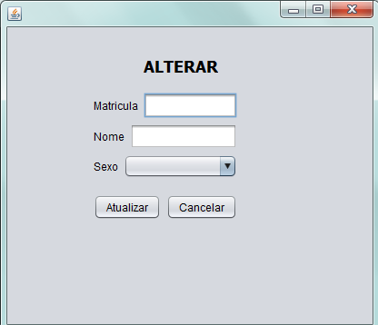
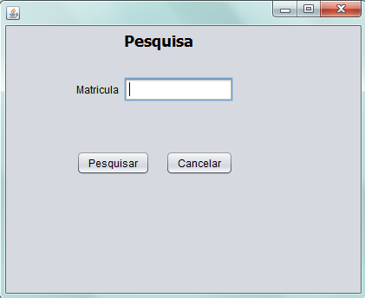
Exercício 25
Formulários
Aula 24

Slide 34
Agenda
Revisão - GUI - Graphical User Interface
  Container
  JOptionPane
  JFrame
  Layout Frame
  Controles
  Exercício
  IDE – NetBeans
  Navegação do Sistema
SQL Server
  Comandos - DDL
NetBeans - Biblioteca de acesso – SqlServer
Comandos SQL (insert, update, delete, select)
Exercício
Aula 24

