Slide 1

Mapeamento de Processo
Aula 22 BPMS_01
Prof Wellington
Jose.wellington@uniceub.br
Aula 22 BPMS_01
Notes:
Large enterprise applications - the ones that execute core business applications, and keep a company going - must be more than just a bunch of code modules. They must be structured in a way that enables scalability, security, and robust execution under stressful conditions, and their structure - frequently referred to as their architecture - must be defined clearly enough that maintenance programmers can (quickly!) find and fix a bug that shows up long after the original authors have moved on to other projects. That is, these programs must be designed to work perfectly in many areas, and business functionality is not the only one (although it certainly is the essential core). Of course a well-designed architecture benefits any program, and not just the largest ones as we've singled out here. We mentioned large applications first because structure is a way of dealing with complexity, so the benefits of structure (and of modeling and design, as we'll demonstrate) compound as application size grows large. Another benefit of structure is that it enables code reuse: Design time is the easiest time to structure an application as a collection of self-contained modules or components. Eventually, enterprises build up a library of models of components, each one representing an implementation stored in a library of code modules. When another application needs the same functionality, the designer can quickly import its module from the library. At coding time, the developer can just as quickly import the code module into the application.

Slide 2
Agenda
Bizagi - Exercício – RED – Regime de Ensino Domiciliar
Aula 22 BPMS_01

Slide 3
Introdução
" Processo Definido, Requisitos Identificados, Software com Qualidade e TI com governança.”
Lucia Bastos & Eduardo Castro
Desenvolver sistemas é automatizar processos de negócio.
Eduardo Castro
Aula 22 BPMS_01

Slide 4
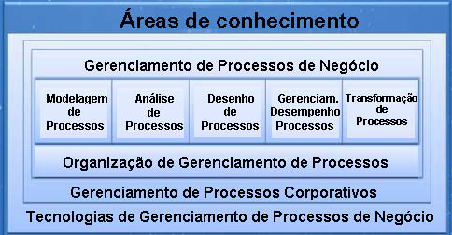
BPM CBOK®
Versão 2.0 – Terceira liberação em Português
Aula 22 BPMS_01

Slide 5
Bizagi – Xpress – Exercício Domiciliar
Aula 22 BPMS_01

Slide 6
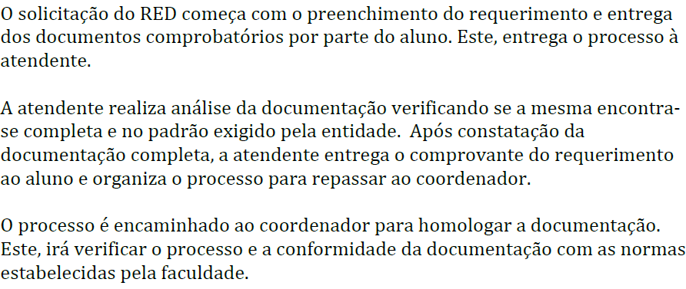
RED – Regime de Ensino Domiciliar
Aula 22 BPMS_01

Slide 7
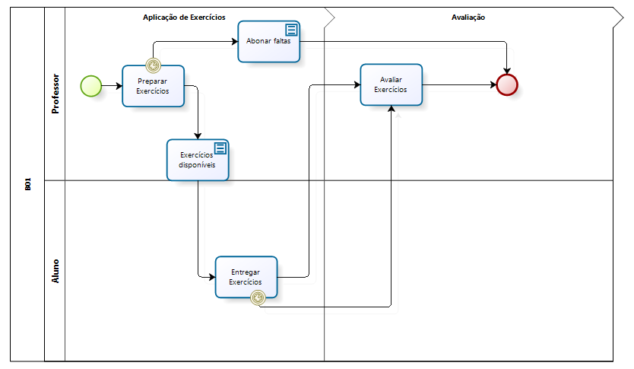
RED – Regime de Ensino Domiciliar
Aula 22 BPMS_01

Slide 8
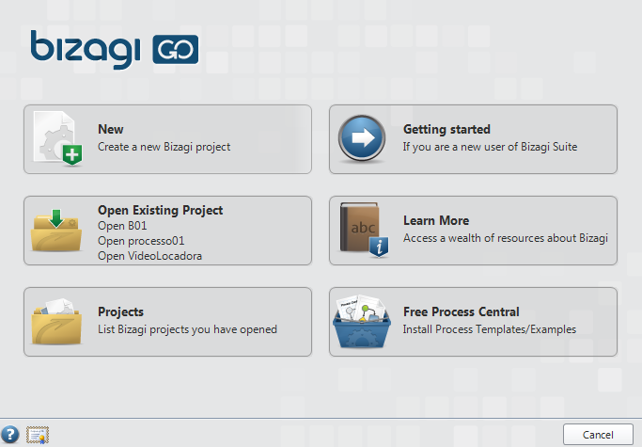
1) Criar Novo Projeto
Aula 22 BPMS_01

Slide 9
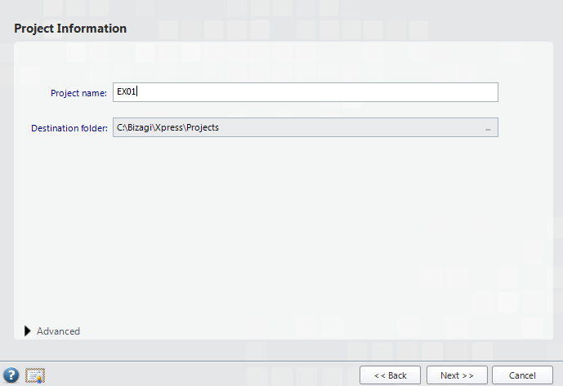
1) Criar Novo Projeto - EX01
Aula 22 BPMS_01

Slide 10
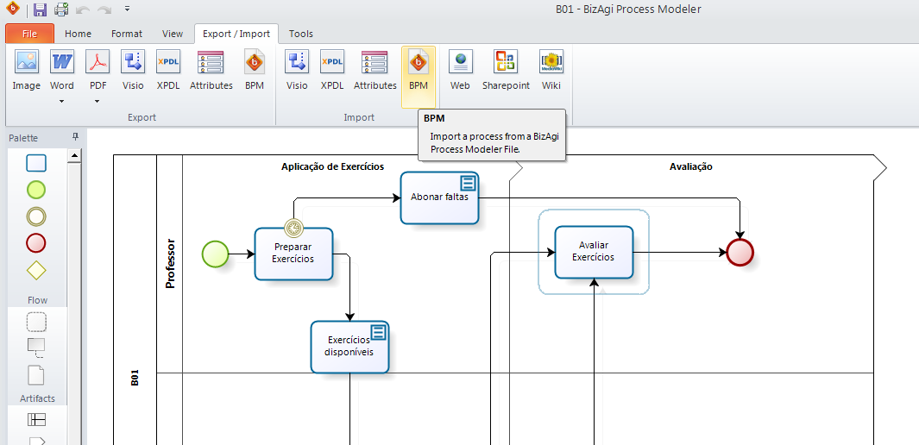
2) Importar - B01_Controle e Avaliação de Exercícios
Aula 22 BPMS_01

Slide 11
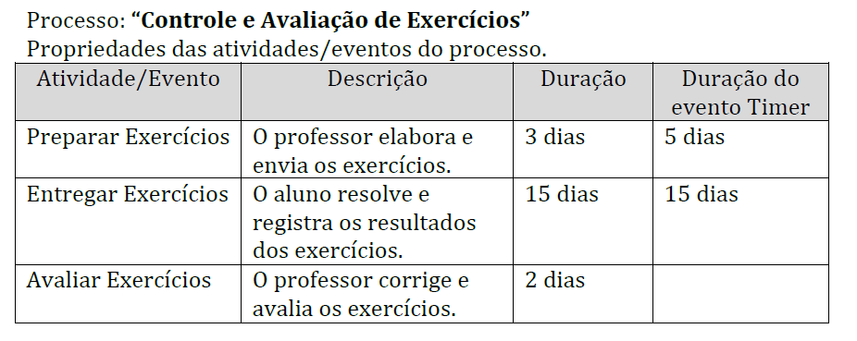
3) Defina a duração das atividades
Aula 22 BPMS_01

Slide 12
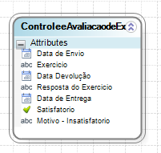
4) Crie o Modelo de Dados do Processo
Aula 22 BPMS_01

Slide 13
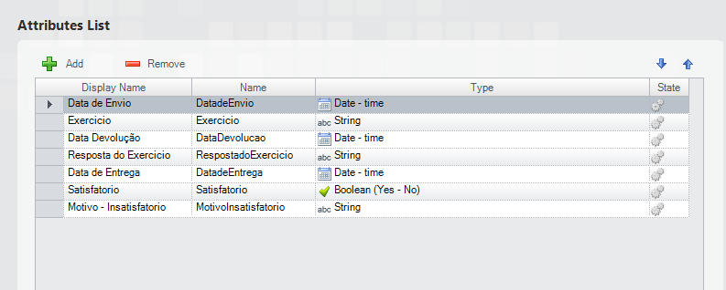
4) Crie o Modelo de Dados do Processo
Aula 22 BPMS_01

Slide 14
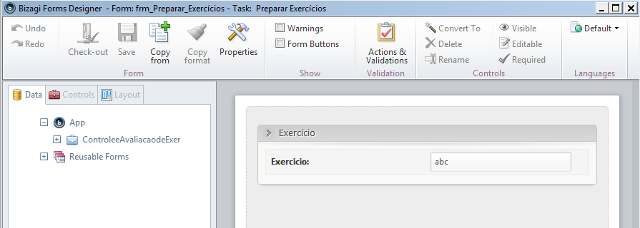
5) Crie o Formulário – Preparar Exercício
Aula 22 BPMS_01

Slide 15
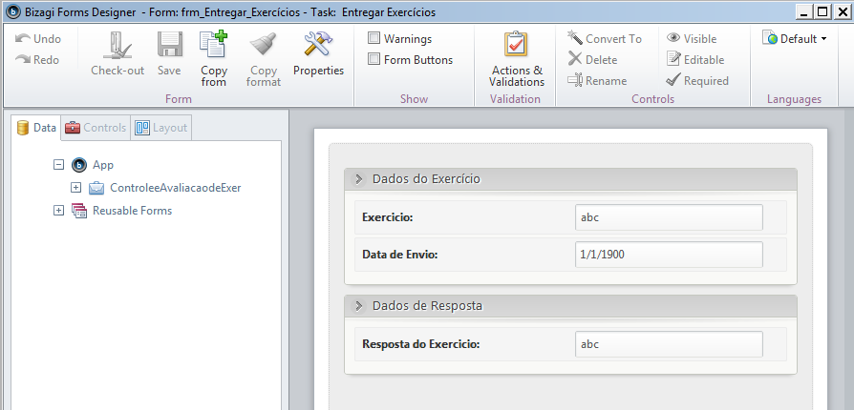
5) Crie o Formulário – Entregar Exercício
Aula 22 BPMS_01

Slide 16
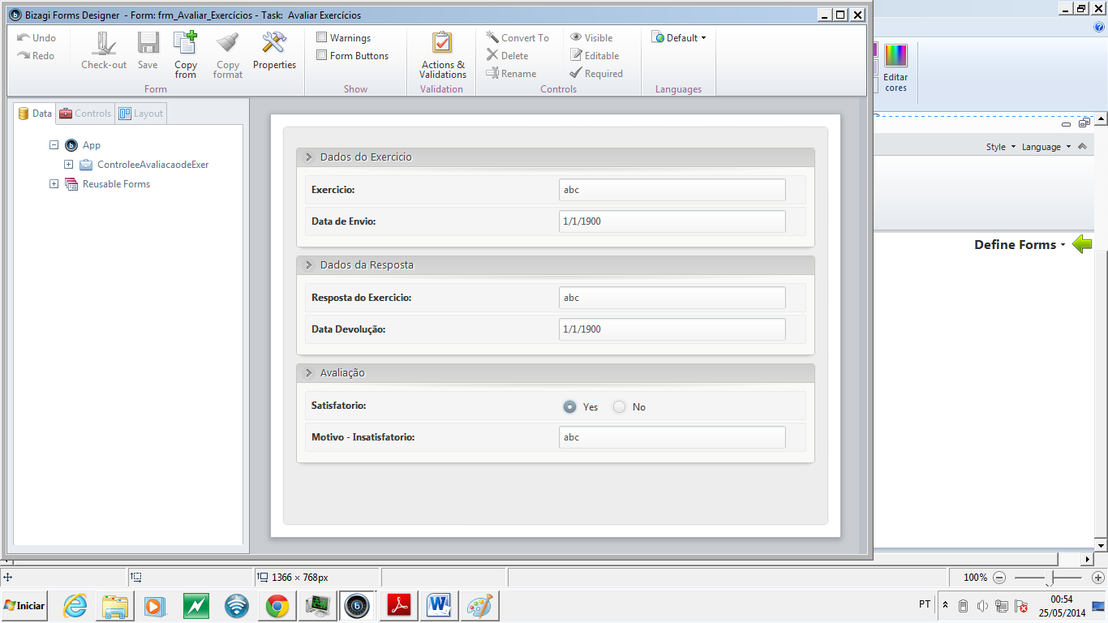
5) Crie o Formulário – Avaliar Exercício
Aula 22 BPMS_01

Slide 17
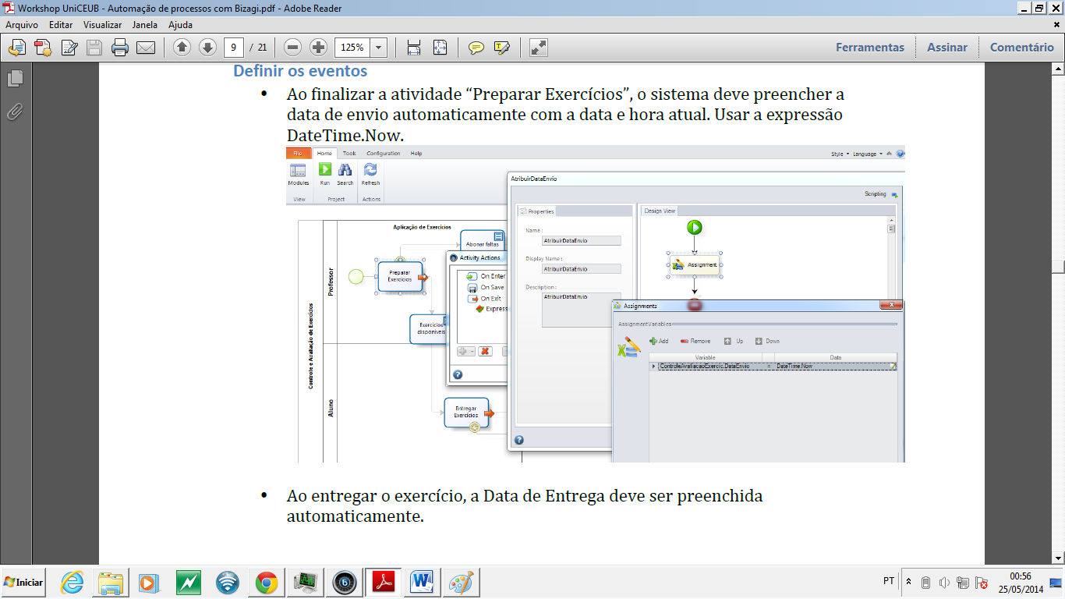
6) Regras de Negócio
Aula 22 BPMS_01

Slide 18
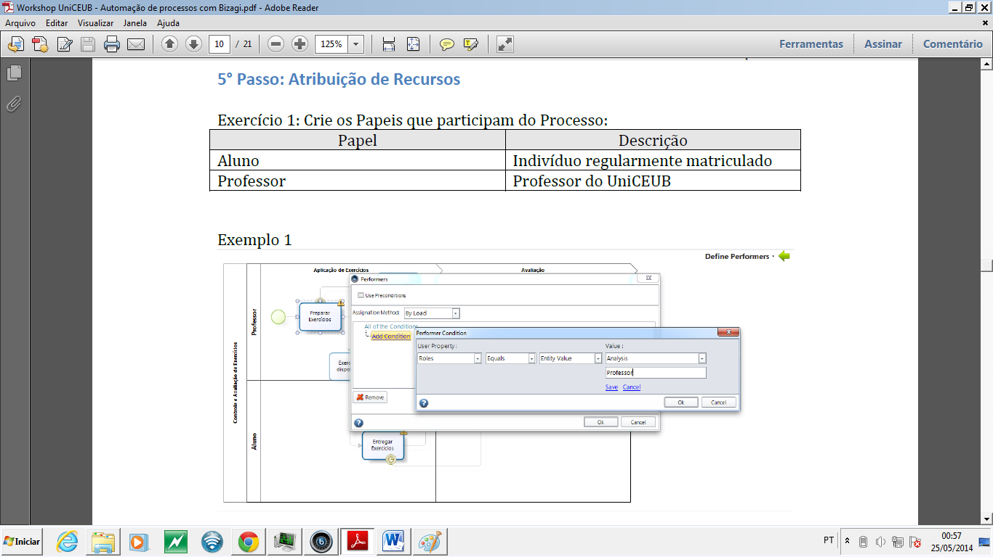
7) Atribuição de recursos (1..2)
Aula 22 BPMS_01

Slide 19
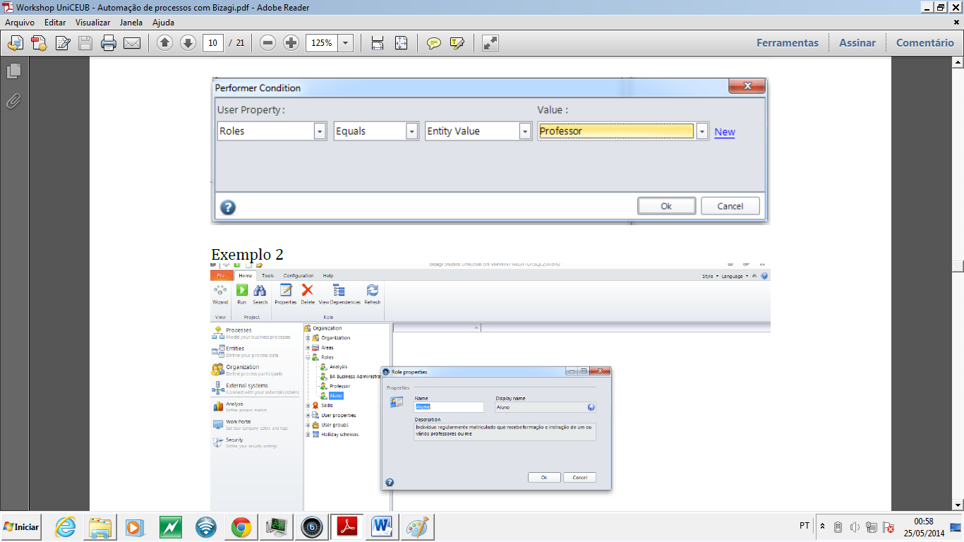
7) Atribuição de recursos (2..2)
Aula 22 BPMS_01

Slide 20
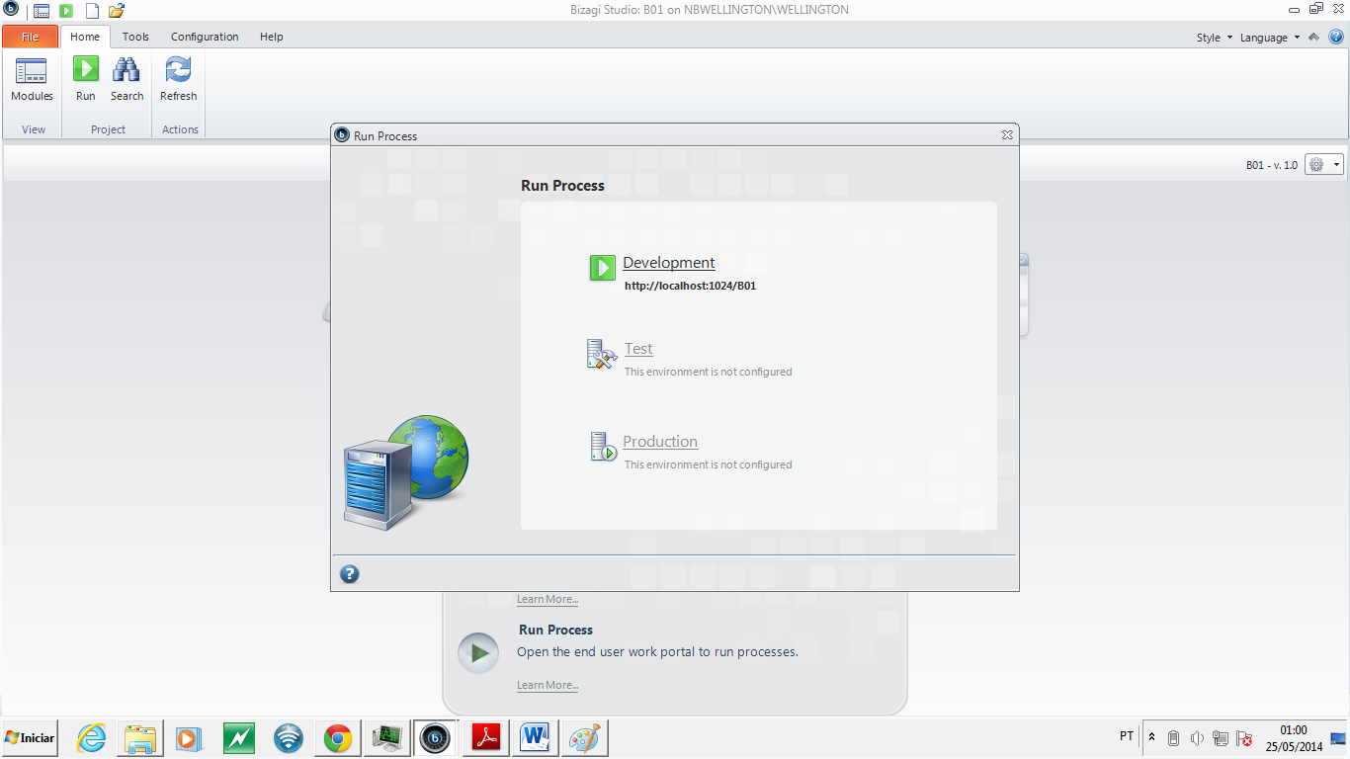
8) Rodar a aplicação
Aula 22 BPMS_01

Slide 21
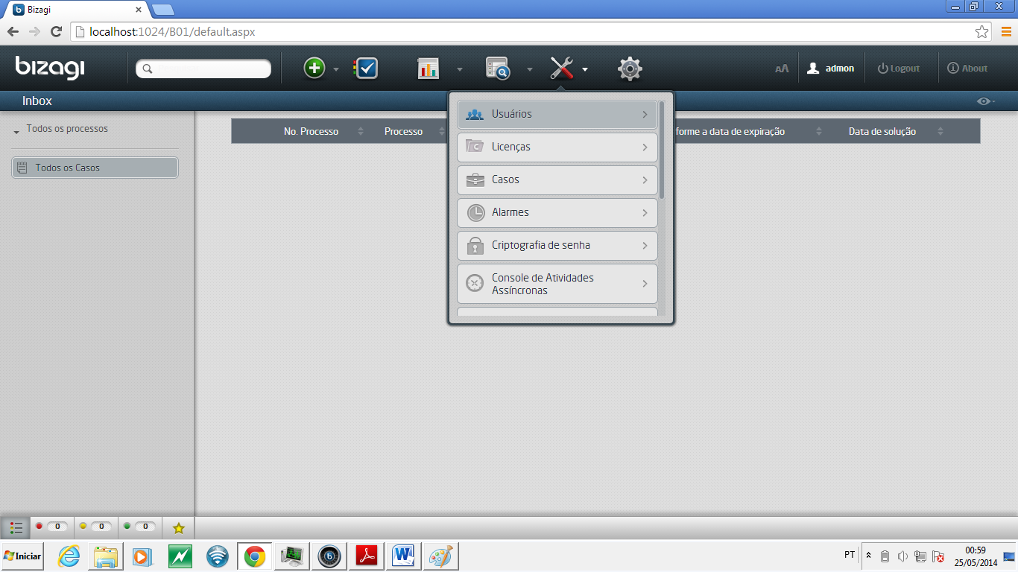
9)Criar Usuários – Aplicação (1..4)
Aula 22 BPMS_01

Slide 22
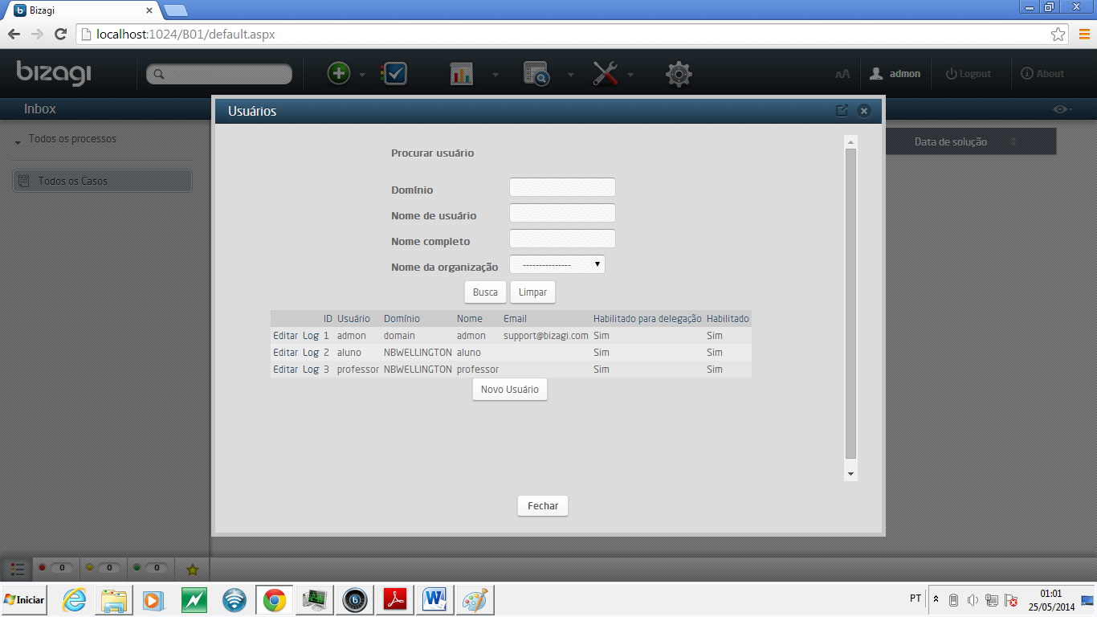
9)Criar Usuários – Aplicação (2..4)
Aula 22 BPMS_01

Slide 23
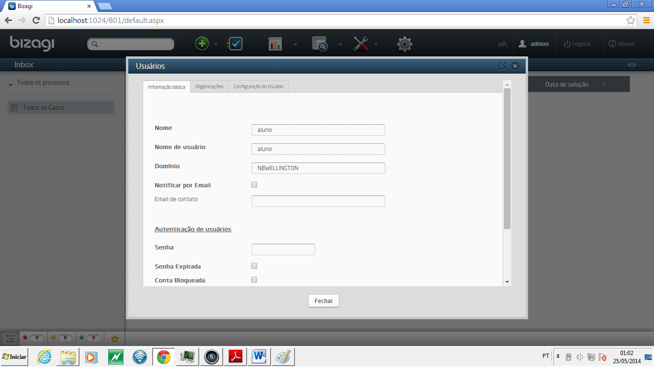
9)Criar Usuários – Aplicação (3..4)
Aula 22 BPMS_01

Slide 24
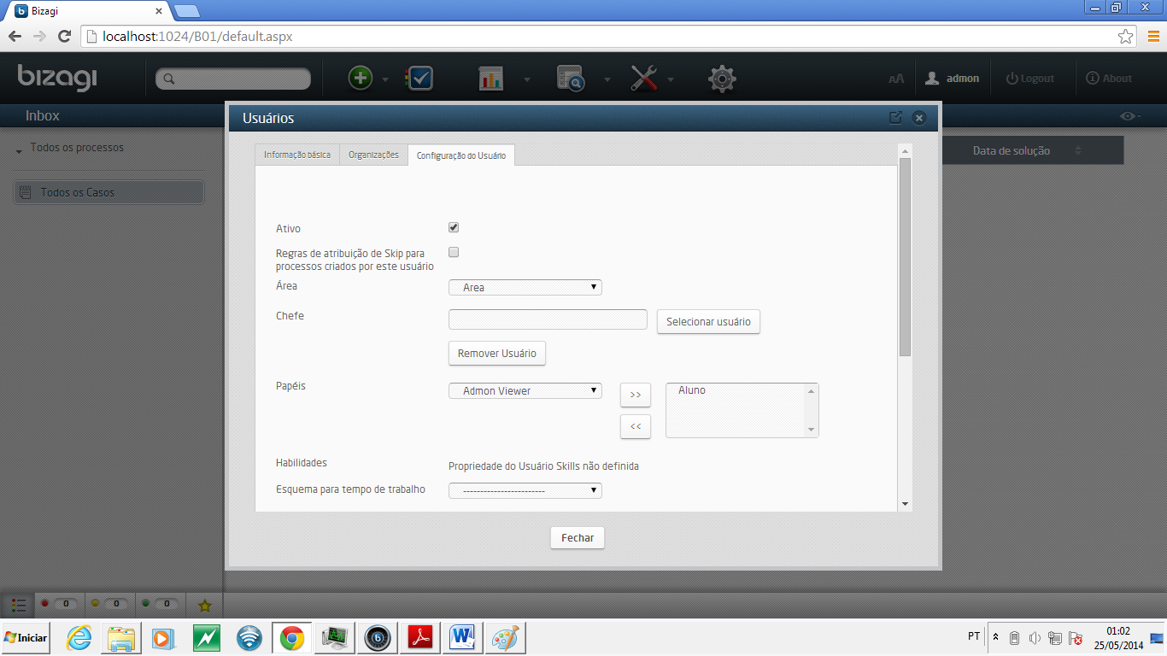
9)Criar Usuários – Aplicação (4..4)
Aula 22 BPMS_01

Slide 25
Dúvidas
Jose.wellington@uniceub.br
Aula 22 BPMS_01

