Slide 1

Conceitos de Modelagem de Dados Cardinalidade Máxima e Mínima
Prof Wellington
Jose.wellington@uniceub.br
Aula 07 - Card Minima Máxima
‹#›
Notes:
‹#›
Large enterprise applications - the ones that execute core business applications, and keep a company going - must be more than just a bunch of code modules. They must be structured in a way that enables scalability, security, and robust execution under stressful conditions, and their structure - frequently referred to as their architecture - must be defined clearly enough that maintenance programmers can (quickly!) find and fix a bug that shows up long after the original authors have moved on to other projects. That is, these programs must be designed to work perfectly in many areas, and business functionality is not the only one (although it certainly is the essential core). Of course a well-designed architecture benefits any program, and not just the largest ones as we've singled out here. We mentioned large applications first because structure is a way of dealing with complexity, so the benefits of structure (and of modeling and design, as we'll demonstrate) compound as application size grows large. Another benefit of structure is that it enables code reuse: Design time is the easiest time to structure an application as a collection of self-contained modules or components. Eventually, enterprises build up a library of models of components, each one representing an implementation stored in a library of code modules. When another application needs the same functionality, the designer can quickly import its module from the library. At coding time, the developer can just as quickly import the code module into the application.

Slide 2

Planejamento
Aula 07 - Card Minima Máxima
‹#›
‹#›
Notes:
‹#›

Slide 3
Agenda
Revisão
Outras Formas de Notações de Cardinalidade
Modelo de Dados - Níveis de abstração
Modelo de dados Conceitual
Modelo de dados Lógico
Modelo de dados Físico
Exercício MER – Conceitual / Lógico / Físico
Questionário
Aula 07 - Card Minima Máxima
‹#›
Notes:
‹#›

Slide 4
Revisão
Aula 07 - Card Minima Máxima
‹#›

Slide 5
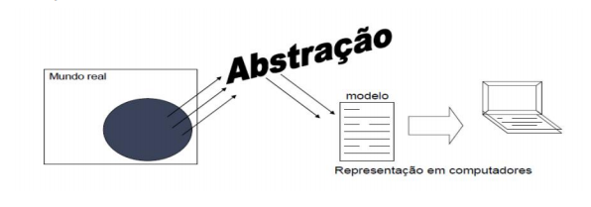
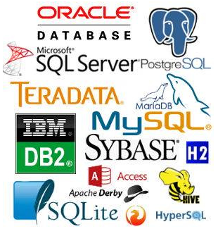
Abordagem ER para Projeto Lógico de Bancos de Dados
Aula 07 - Card Minima Máxima
‹#›

Slide 6

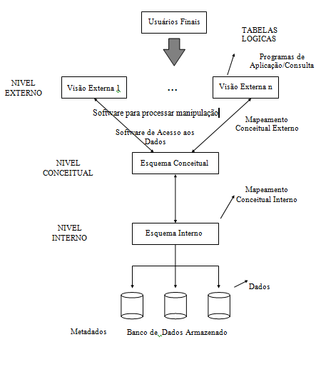
Representação Física do SGBD
Aula 07 - Card Minima Máxima
‹#›
‹#›

Slide 7
Cardinalidade
Aula 07 - Card Minima Máxima
‹#›
Notes:
‹#›
Large enterprise applications - the ones that execute core business applications, and keep a company going - must be more than just a bunch of code modules. They must be structured in a way that enables scalability, security, and robust execution under stressful conditions, and their structure - frequently referred to as their architecture - must be defined clearly enough that maintenance programmers can (quickly!) find and fix a bug that shows up long after the original authors have moved on to other projects. That is, these programs must be designed to work perfectly in many areas, and business functionality is not the only one (although it certainly is the essential core). Of course a well-designed architecture benefits any program, and not just the largest ones as we've singled out here. We mentioned large applications first because structure is a way of dealing with complexity, so the benefits of structure (and of modeling and design, as we'll demonstrate) compound as application size grows large. Another benefit of structure is that it enables code reuse: Design time is the easiest time to structure an application as a collection of self-contained modules or components. Eventually, enterprises build up a library of models of components, each one representing an implementation stored in a library of code modules. When another application needs the same functionality, the designer can quickly import its module from the library. At coding time, the developer can just as quickly import the code module into the application.

Slide 8
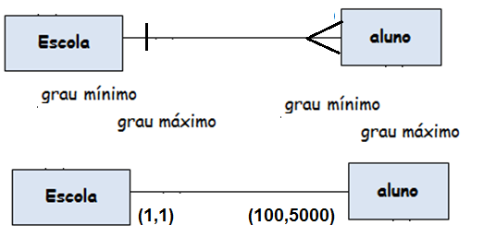
Outras Formas de Notações de Cardinalidade
Cardinalidade (mínima, máxima) de entidade em relacionamento.
Número (mínimo, máximo) de ocorrências de entidade associadas a uma ocorrência da entidade em questão através do relacionamento.
Aula 07 - Card Minima Máxima
‹#›

Slide 9
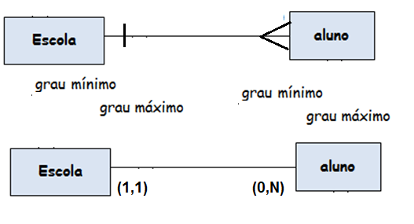
Cardinalidade máxima - valores
Dois valores de cardinalidades máximas são usados:
Cardinalidade máxima 1.
Cardinalidade máxima “muitos”, referida pela letra N.
Aula 07 - Card Minima Máxima
‹#›

Slide 10
Modelo de Dados - níveis de abstração
Aula 07 - Card Minima Máxima
‹#›
Notes:
‹#›
Large enterprise applications - the ones that execute core business applications, and keep a company going - must be more than just a bunch of code modules. They must be structured in a way that enables scalability, security, and robust execution under stressful conditions, and their structure - frequently referred to as their architecture - must be defined clearly enough that maintenance programmers can (quickly!) find and fix a bug that shows up long after the original authors have moved on to other projects. That is, these programs must be designed to work perfectly in many areas, and business functionality is not the only one (although it certainly is the essential core). Of course a well-designed architecture benefits any program, and not just the largest ones as we've singled out here. We mentioned large applications first because structure is a way of dealing with complexity, so the benefits of structure (and of modeling and design, as we'll demonstrate) compound as application size grows large. Another benefit of structure is that it enables code reuse: Design time is the easiest time to structure an application as a collection of self-contained modules or components. Eventually, enterprises build up a library of models of components, each one representing an implementation stored in a library of code modules. When another application needs the same functionality, the designer can quickly import its module from the library. At coding time, the developer can just as quickly import the code module into the application.

Slide 11
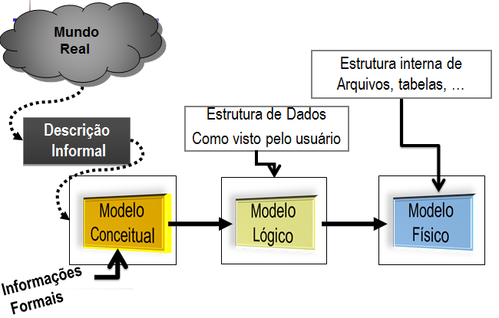
Modelo de Dados
Aula 07 - Card Minima Máxima
‹#›
‹#›

Slide 12
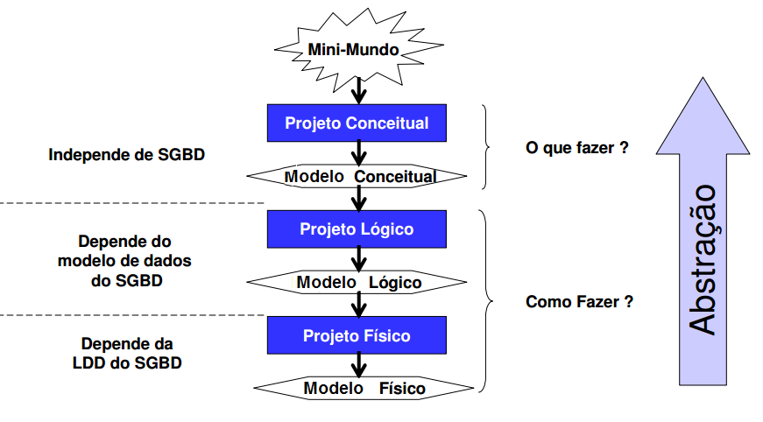
Modelo de dados:
Descrição formal da estrutura de um banco de dados
Aula 07 - Card Minima Máxima
‹#›

Slide 13

Modelos de Dados
Etapas da modelagem de dados
Aula 07 - Card Minima Máxima
‹#›
‹#›

Slide 14
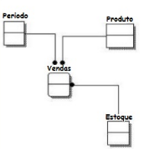
Modelos de Dados
Modelagem conceitual é a representação que considera exclusivamente o ponto de vista do usuário criador dos dados, levando em consideração fatores técnicos para sua implementação.
O nível conceitual especifica como os dados são armazenados e relacionados, independentemente de como serão implementados no banco de dados.
Aula 07 - Card Minima Máxima
‹#›
‹#›

Slide 15
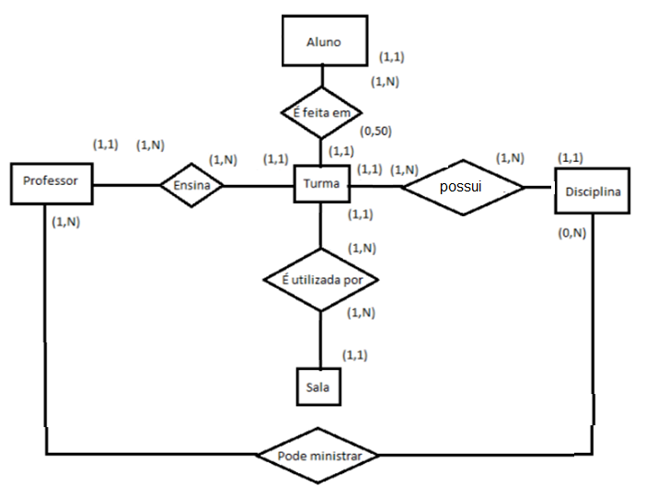
Modelos de Banco de Dados
1 - Modelo Conceitual
Aula 07 - Card Minima Máxima
‹#›

Slide 16
Modelo de dados Lógico
Aula 07 - Card Minima Máxima
‹#›
Notes:
‹#›
Large enterprise applications - the ones that execute core business applications, and keep a company going - must be more than just a bunch of code modules. They must be structured in a way that enables scalability, security, and robust execution under stressful conditions, and their structure - frequently referred to as their architecture - must be defined clearly enough that maintenance programmers can (quickly!) find and fix a bug that shows up long after the original authors have moved on to other projects. That is, these programs must be designed to work perfectly in many areas, and business functionality is not the only one (although it certainly is the essential core). Of course a well-designed architecture benefits any program, and not just the largest ones as we've singled out here. We mentioned large applications first because structure is a way of dealing with complexity, so the benefits of structure (and of modeling and design, as we'll demonstrate) compound as application size grows large. Another benefit of structure is that it enables code reuse: Design time is the easiest time to structure an application as a collection of self-contained modules or components. Eventually, enterprises build up a library of models of components, each one representing an implementation stored in a library of code modules. When another application needs the same functionality, the designer can quickly import its module from the library. At coding time, the developer can just as quickly import the code module into the application.

Slide 17
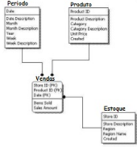
Modelos de Dados
O modelo lógico só deve ser inicializado após a conclusão do modelo conceitual. Diferentemente do modelo conceitual, o modelo lógico será criado com base em um tipo de banco de dados, em SGBD
Aula 07 - Card Minima Máxima
‹#›
‹#›

Slide 18
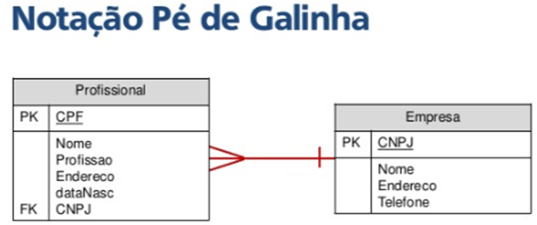

Modelos de Banco de Dados
1 - Modelo Lógico – James Martim
Aula 07 - Card Minima Máxima
‹#›

Slide 19
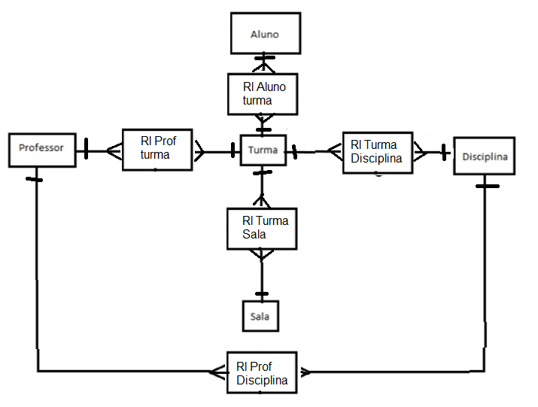
Modelos de Banco de Dados
1 - Modelo Lógico – James Martim
Aula 07 - Card Minima Máxima
‹#›

Slide 20
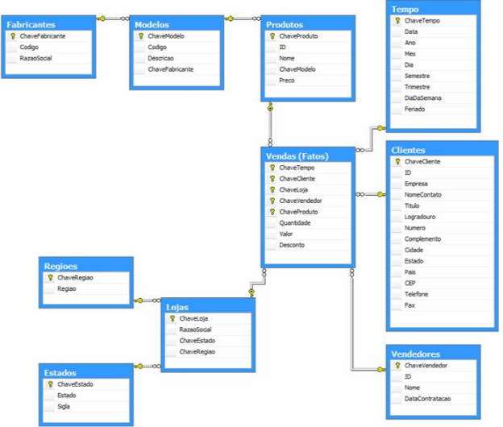
Modelos de Banco de Dados
1 - Modelo Lógico – James Martim
Aula 07 - Card Minima Máxima
‹#›

Slide 21
Modelo de dados Físico
Aula 07 - Card Minima Máxima
‹#›
Notes:
‹#›
Large enterprise applications - the ones that execute core business applications, and keep a company going - must be more than just a bunch of code modules. They must be structured in a way that enables scalability, security, and robust execution under stressful conditions, and their structure - frequently referred to as their architecture - must be defined clearly enough that maintenance programmers can (quickly!) find and fix a bug that shows up long after the original authors have moved on to other projects. That is, these programs must be designed to work perfectly in many areas, and business functionality is not the only one (although it certainly is the essential core). Of course a well-designed architecture benefits any program, and not just the largest ones as we've singled out here. We mentioned large applications first because structure is a way of dealing with complexity, so the benefits of structure (and of modeling and design, as we'll demonstrate) compound as application size grows large. Another benefit of structure is that it enables code reuse: Design time is the easiest time to structure an application as a collection of self-contained modules or components. Eventually, enterprises build up a library of models of components, each one representing an implementation stored in a library of code modules. When another application needs the same functionality, the designer can quickly import its module from the library. At coding time, the developer can just as quickly import the code module into the application.

Slide 22
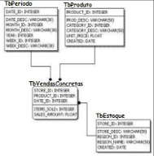
Modelos de Dados
O modelo físico é concebido por meio do modelo lógico. É nesse modelo que serão definidos os tipos de dados que serão armazenados, e ocorre a implementação da estrutura lógica em um sistema gerenciador de banco de dados (SGBD), que administra fisicamente os dados armazenados.
Aula 07 - Card Minima Máxima
‹#›
‹#›

Slide 23
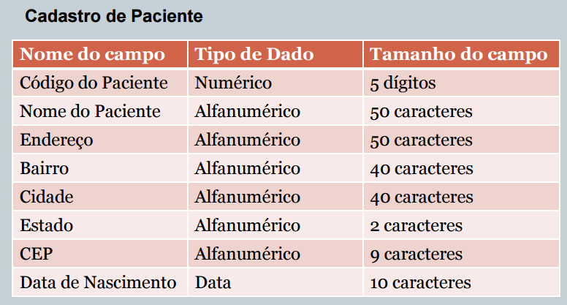
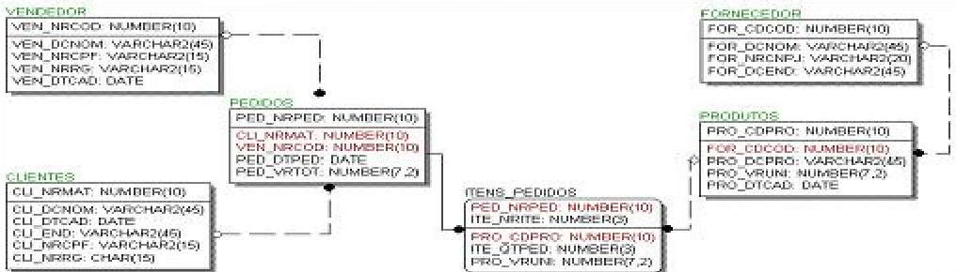
3 - Modelo Físico
Aqui são detalhados os componentes da estrutura física do banco, como tabelas, campos, tipos de valores, índices.
Aula 07 - Card Minima Máxima
‹#›

Slide 24
3 - Modelo Físico
Aqui são detalhados os componentes da estrutura física do banco, como tabelas, campos, tipos de valores, índices.
Aula 07 - Card Minima Máxima
‹#›

Slide 25
Relacionamentos
Exemplos de Relacionamentos
Peter Chan - Conceitual
ContaCliente
Cliente
Conta
Residência
Cliente
Conta
Cidade
James Martim - Lógico
Mora Cidade
Aula 07 - Card Minima Máxima
‹#›

Slide 26
Exercício
Aula 07 - Card Minima Máxima
‹#›
Notes:
‹#›
Large enterprise applications - the ones that execute core business applications, and keep a company going - must be more than just a bunch of code modules. They must be structured in a way that enables scalability, security, and robust execution under stressful conditions, and their structure - frequently referred to as their architecture - must be defined clearly enough that maintenance programmers can (quickly!) find and fix a bug that shows up long after the original authors have moved on to other projects. That is, these programs must be designed to work perfectly in many areas, and business functionality is not the only one (although it certainly is the essential core). Of course a well-designed architecture benefits any program, and not just the largest ones as we've singled out here. We mentioned large applications first because structure is a way of dealing with complexity, so the benefits of structure (and of modeling and design, as we'll demonstrate) compound as application size grows large. Another benefit of structure is that it enables code reuse: Design time is the easiest time to structure an application as a collection of self-contained modules or components. Eventually, enterprises build up a library of models of components, each one representing an implementation stored in a library of code modules. When another application needs the same functionality, the designer can quickly import its module from the library. At coding time, the developer can just as quickly import the code module into the application.

Slide 27
Modelagem de Dados - Regras
Entidade é o objeto do mundo real que só vai ter informação do objeto.
Toda Entidade tem um campo chave que diferencia e identifica.
Quando for um campo repetido estado civil solteiro cria uma tabela.
Quando o relacionamento é vários para vários cria uma tabela de relacionamento.
Toda chave estrangeira está relacionada com uma chave primária de outra tabela.
Cardinalidade é a frequência do relacionamento
Todo campo chave tem a cardinalidade 1 x N
Nunca criar no campo data uma tabela.
Aula 07 - Card Minima Máxima
‹#›
‹#›
‹#›

Slide 28
Exercício 03 – Fazer o Modelo Conceitual / Lógico / Físico
Vídeo Locadora
Uma vídeo locadora trabalha com aluguel DVD para os clientes cadastrados, com data do aluguel. Uma entrevista com o gerente da vídeo locadora resultou nas seguintes informações:
Precisa controlar os DVD alugados pelos clientes.
Precisa ter o cadastro de clientes.
Dados levantados:
Titulo do DVD, gênero, distribuidora.
Cliente, Data nascimento, endereço e telefone.
Data do aluguel
Regras de negócio
1 DVD pode ter 1 gênero
1 DVD pode ter 1 distribuidora
1 cliente pode alugar vários DVD em momentos distintos
Vídeo locadora, 1 titulo SÓ TEM UM DVD
‹#›
Aula 07 - Card Minima Máxima
‹#›
Notes:
‹#›
‹#›

Slide 29
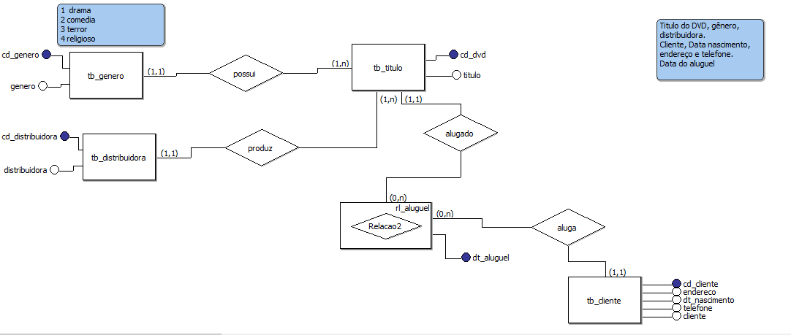
Exercício 03 – Fazer o Modelo Conceitual
‹#›
Aula 07 - Card Minima Máxima
‹#›
Notes:
‹#›
‹#›

Slide 30
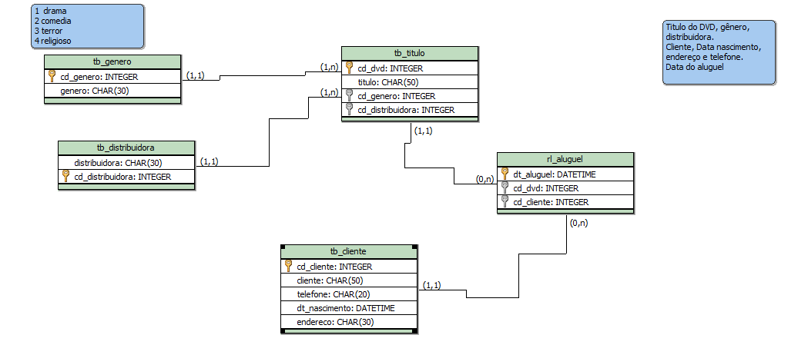
Exercício 03 – Fazer o Modelo Lógico
‹#›
Aula 07 - Card Minima Máxima
‹#›
Notes:
‹#›
‹#›

Slide 31
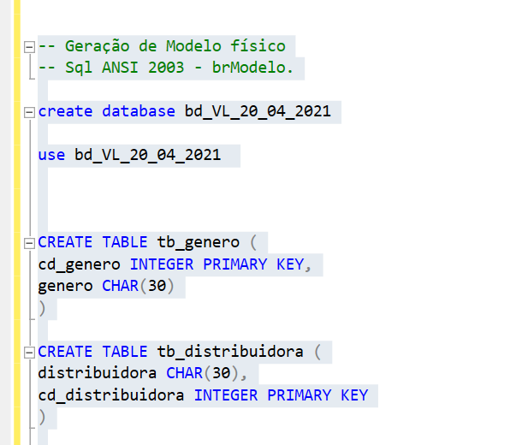
Exercício 03 – Fazer o Modelo Físico
‹#›
Aula 07 - Card Minima Máxima
‹#›
Notes:
‹#›
‹#›

Slide 32
Questionário
Aula 07 - Card Minima Máxima
‹#›
‹#›
‹#›

Slide 33


Questionário
https://kahoot.it/
Nome + RA
Aula 07 - Card Minima Máxima
‹#›
‹#›
‹#›

Slide 34
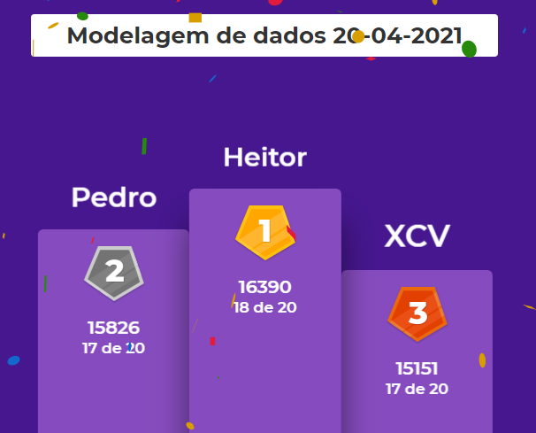
Questionário
https://kahoot.it/
Aula 07 - Card Minima Máxima
‹#›
‹#›
‹#›

Slide 35
Agenda
Revisão
Outras Formas de Notações de Cardinalidade
Modelo de Dados - Níveis de abstração
Modelo de dados Conceitual
Modelo de dados Lógico
Modelo de dados Físico
Exercício MER – Conceitual / Lógico / Físico
Questionário
Aula 07 - Card Minima Máxima
‹#›
Notes:
‹#›

Slide 36
Dúvidas
Jose.wellington@uniceub.br
Aula 07 - Card Minima Máxima
‹#›
Notes:
‹#›

