Slide 1

Normalização de dados 1. 2. 3. Forma Normal FNBC
Prof Wellington
Jose.wellington@uniceub.br
Aula 10 - 1 2 3 FN FNBC
‹#›
Notes:
‹#›
Large enterprise applications - the ones that execute core business applications, and keep a company going - must be more than just a bunch of code modules. They must be structured in a way that enables scalability, security, and robust execution under stressful conditions, and their structure - frequently referred to as their architecture - must be defined clearly enough that maintenance programmers can (quickly!) find and fix a bug that shows up long after the original authors have moved on to other projects. That is, these programs must be designed to work perfectly in many areas, and business functionality is not the only one (although it certainly is the essential core). Of course a well-designed architecture benefits any program, and not just the largest ones as we've singled out here. We mentioned large applications first because structure is a way of dealing with complexity, so the benefits of structure (and of modeling and design, as we'll demonstrate) compound as application size grows large. Another benefit of structure is that it enables code reuse: Design time is the easiest time to structure an application as a collection of self-contained modules or components. Eventually, enterprises build up a library of models of components, each one representing an implementation stored in a library of code modules. When another application needs the same functionality, the designer can quickly import its module from the library. At coding time, the developer can just as quickly import the code module into the application.

Slide 2
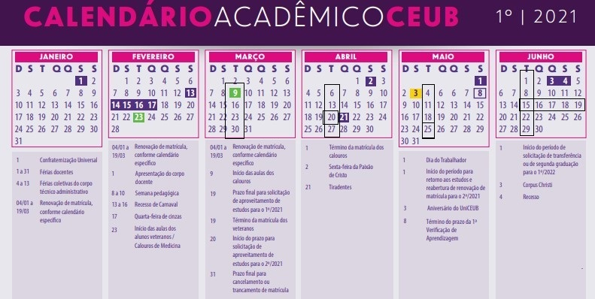
Planejamento
Aula 10 - 1 2 3 FN FNBC
‹#›
‹#›
‹#›
‹#›
‹#›
Notes:
‹#›

Slide 3
Agenda
Normalização
Anomalias
Dependência Funcional
Dependência Funcional Parcial
Dependência Funcional Transitiva
Forma Normal
1. FN
2. FN
3. FN
Contextualização de Normalização 1.FN 2.FN 3.FN
Chave Composta, Chave Primária, Chave Candidata
FNBC
Questionário – Kahoot
Exercício
Aula 10 - 1 2 3 FN FNBC
‹#›
Notes:
‹#›

Slide 4
Normalização de dados
Objetivos:
Entender os conceitos, características e regras de modelagem de dados.
Entender e fazer uso das regras de normalização.
Revisão 1.FN, 2.FN, 3FN e FNBC
Aula 10 - 1 2 3 FN FNBC
‹#›
Notes:
‹#›
‹#›

Slide 5

Normalização de dados
Decomposição de esquemas para evitar anomalias (redundância de dados e inconsistência)
Mecanismo formal para analisar esquemas de relações baseado nas suas chaves e nas dependências funcionais entre seus atributos.
Aula 10 - 1 2 3 FN FNBC
‹#›
Notes:
‹#›
‹#›

Slide 6
Normalização de dados
Esse processo causa a simplificação dos ATRIBUTOS dentro da respectiva TUPLA (Relação).
Eliminando:
grupos repetitivos.
Dependências funcional parcial de chaves concatenadas.
Dependências funcional transitivas.
Dependências funcional multivaloradas.
Aula 10 - 1 2 3 FN FNBC
‹#›
Notes:
‹#›
‹#›

Slide 7
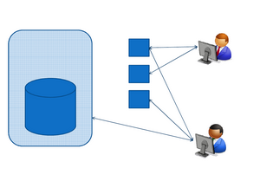
Tipos de Anomalias
Anomalias de Atualização de Tabelas, Arquivos ou Relações:
De modificação
De exclusão
De inclusão
‹#›
Aula 10 - 1 2 3 FN FNBC
Notes:
‹#›

Slide 8
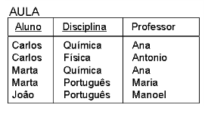
Anomalias de modificação
Ocorrem quando existirem valores redundantes de dados para um mesmo atributo em tabelas distintas
‹#›
Aula 10 - 1 2 3 FN FNBC
Notes:
‹#›

Slide 9
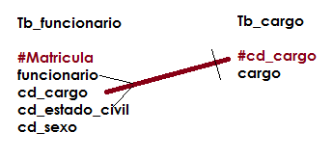
Anomalias de exclusão
Oriundas do fato de a exclusão de uma informação causar a eventual perda de outra informação.
Isto pode ocorrer quando o atributo perdido involuntariamente não possuir um entidade própria que armazene a informação e precise abrigar-se em tabelas de outras classes de entidades.
‹#›
Aula 10 - 1 2 3 FN FNBC
Notes:
‹#›

Slide 10
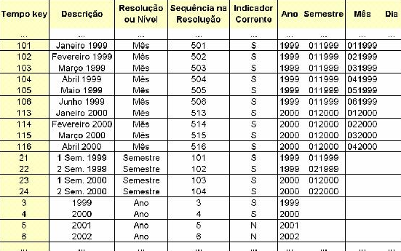
Anomalias de inclusão
Oriundas da inclusão de registros em tabela contendo informações incompletas, informações essas que devem ser parte de entidades ainda não definidas e que estejam se abrigando na tabela de outra classe de entidades.
‹#›
Aula 10 - 1 2 3 FN FNBC
Notes:
‹#›

Slide 11
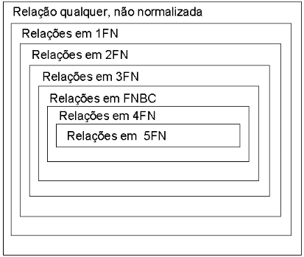
Normalização de dados
Regras:
1ª Forma Normal (1FN).
2ª Forma Normal (2FN).
3ª Forma Normal (3FN).
4ª Forma Normal (4FN).
5ª Forma Normal (5FN).
Aula 10 - 1 2 3 FN FNBC
‹#›
Notes:
‹#›
‹#›

Slide 12
Conceitos
Aula 10 - 1 2 3 FN FNBC
‹#›
Notes:
‹#›
Large enterprise applications - the ones that execute core business applications, and keep a company going - must be more than just a bunch of code modules. They must be structured in a way that enables scalability, security, and robust execution under stressful conditions, and their structure - frequently referred to as their architecture - must be defined clearly enough that maintenance programmers can (quickly!) find and fix a bug that shows up long after the original authors have moved on to other projects. That is, these programs must be designed to work perfectly in many areas, and business functionality is not the only one (although it certainly is the essential core). Of course a well-designed architecture benefits any program, and not just the largest ones as we've singled out here. We mentioned large applications first because structure is a way of dealing with complexity, so the benefits of structure (and of modeling and design, as we'll demonstrate) compound as application size grows large. Another benefit of structure is that it enables code reuse: Design time is the easiest time to structure an application as a collection of self-contained modules or components. Eventually, enterprises build up a library of models of components, each one representing an implementation stored in a library of code modules. When another application needs the same functionality, the designer can quickly import its module from the library. At coding time, the developer can just as quickly import the code module into the application.

Slide 13

Dependência funcional
Ocorre quando um atributo ou conjunto de atributos depende funcionalmente de outro atributo.
Aula 10 - 1 2 3 FN FNBC
‹#›
Notes:
‹#›
‹#›

Slide 14

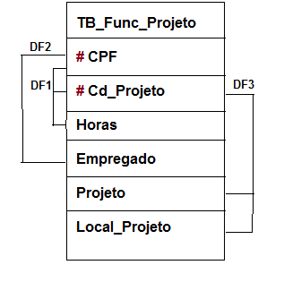
Dependência funcional parcial
Ocorre quando em um identificador composto (concatenado), um atributo ou conjunto de atributos depende de forma parcial deste identificador composto (concatenado), ou seja apresenta dependencia de parte do identificador composto.
Aula 10 - 1 2 3 FN FNBC
‹#›
Notes:
‹#›
‹#›

Slide 15
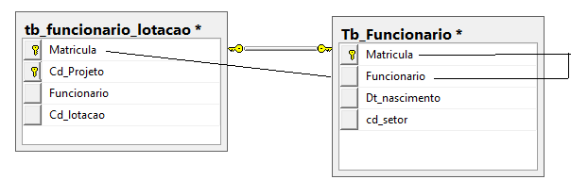
Dependência funcional transitiva
Uma dependência funcional transitiva ocorre quando uma coluna, além de depender da chave primária da tabela, e depende de outra coluna.
Aula 10 - 1 2 3 FN FNBC
‹#›
Notes:
‹#›
‹#›

Slide 16
Forma Normal
Aula 10 - 1 2 3 FN FNBC
‹#›
Notes:
‹#›
Large enterprise applications - the ones that execute core business applications, and keep a company going - must be more than just a bunch of code modules. They must be structured in a way that enables scalability, security, and robust execution under stressful conditions, and their structure - frequently referred to as their architecture - must be defined clearly enough that maintenance programmers can (quickly!) find and fix a bug that shows up long after the original authors have moved on to other projects. That is, these programs must be designed to work perfectly in many areas, and business functionality is not the only one (although it certainly is the essential core). Of course a well-designed architecture benefits any program, and not just the largest ones as we've singled out here. We mentioned large applications first because structure is a way of dealing with complexity, so the benefits of structure (and of modeling and design, as we'll demonstrate) compound as application size grows large. Another benefit of structure is that it enables code reuse: Design time is the easiest time to structure an application as a collection of self-contained modules or components. Eventually, enterprises build up a library of models of components, each one representing an implementation stored in a library of code modules. When another application needs the same functionality, the designer can quickly import its module from the library. At coding time, the developer can just as quickly import the code module into the application.

Slide 17
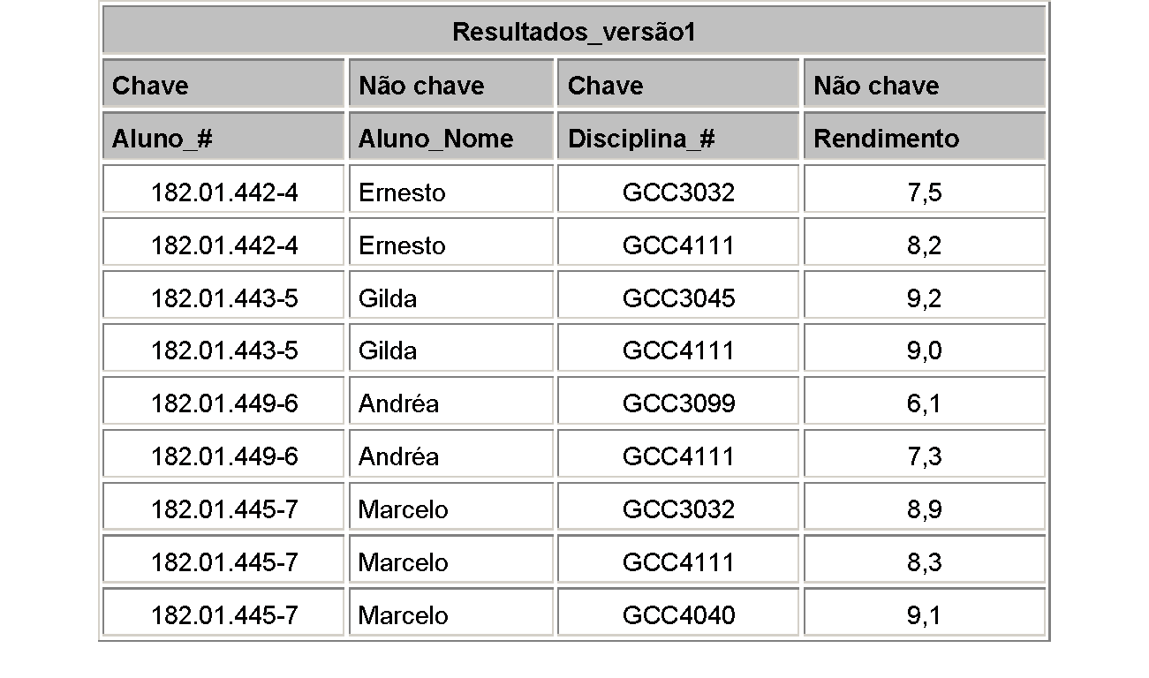
1. Forma Normal
- Foi definida para não permitir atributos multivalorados ou atributos compostos.
- Uma está em 1FN se e somente se todos os seus atributos contêm apenas valores atômicos (simples, indivisíveis)
- 1 domínio é atômico se os elementos desse domínio são considerados como unidades indivisíveis.
Aula 10 - 1 2 3 FN FNBC
‹#›
Notes:
‹#›
‹#›

Slide 18
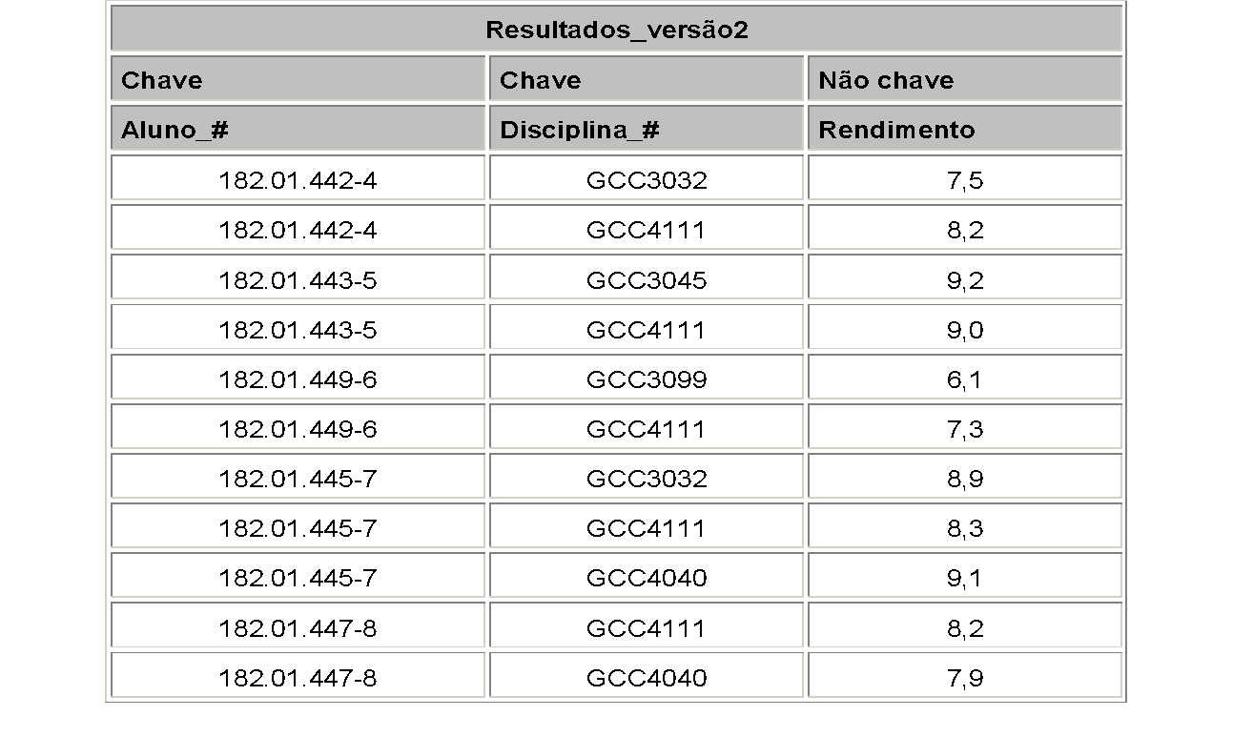
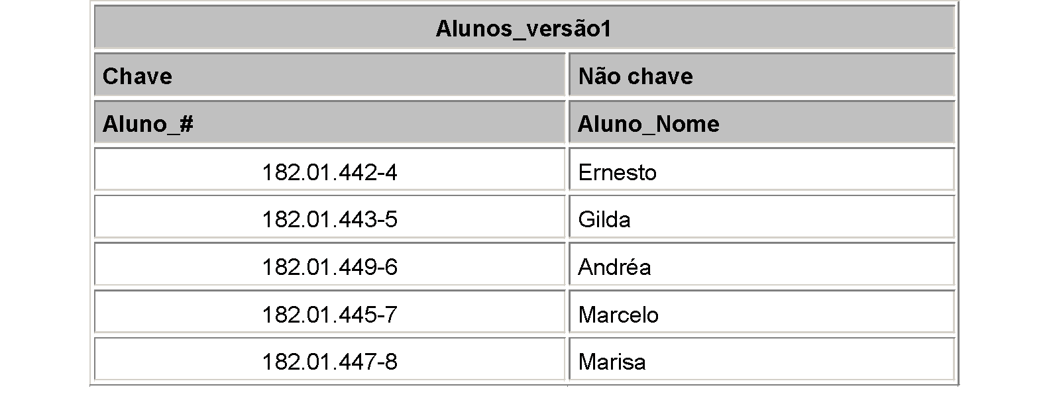
1. Forma Normal
Aula - Normalização de Dados - 1FN 2FN 3FN
‹#›
Notes:
‹#›
‹#›

Slide 19
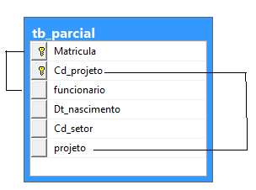
2. Forma Normal
- Estar na 1FN e todos atributos não chave forem totalmente dependentes da chave Primária.
- Estar na 1.FN e todos atributos não chave Não tem dependência Parcial.
Aula - Normalização de Dados - 1FN 2FN 3FN
‹#›
Notes:
‹#›
‹#›

Slide 20
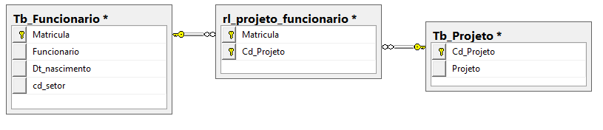
2. Forma Normal
- Estar na 1FN e todos atributos não chave forem totalmente dependentes da chave Primária.
- Estar na 1.FN e todos atributos não chave Não tem dependência Parcial.
Aula - Normalização de Dados - 1FN 2FN 3FN
‹#›
Notes:
‹#›
‹#›

Slide 21
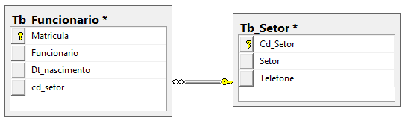

3. Forma Normal
- Uma relação está em 3FN se e somente se estiver na 1FN e na 2FN e, não contém dependência funcional transitiva.
Aula - Normalização de Dados - 1FN 2FN 3FN
‹#›
Notes:
‹#›
‹#›

Slide 22
Conceitos
Aula 10 - 1 2 3 FN FNBC
‹#›
Notes:
‹#›
Large enterprise applications - the ones that execute core business applications, and keep a company going - must be more than just a bunch of code modules. They must be structured in a way that enables scalability, security, and robust execution under stressful conditions, and their structure - frequently referred to as their architecture - must be defined clearly enough that maintenance programmers can (quickly!) find and fix a bug that shows up long after the original authors have moved on to other projects. That is, these programs must be designed to work perfectly in many areas, and business functionality is not the only one (although it certainly is the essential core). Of course a well-designed architecture benefits any program, and not just the largest ones as we've singled out here. We mentioned large applications first because structure is a way of dealing with complexity, so the benefits of structure (and of modeling and design, as we'll demonstrate) compound as application size grows large. Another benefit of structure is that it enables code reuse: Design time is the easiest time to structure an application as a collection of self-contained modules or components. Eventually, enterprises build up a library of models of components, each one representing an implementation stored in a library of code modules. When another application needs the same functionality, the designer can quickly import its module from the library. At coding time, the developer can just as quickly import the code module into the application.

Slide 23
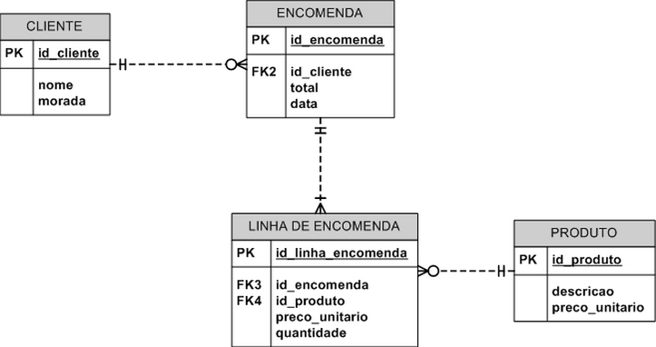
Atributos
Campo Chave - Campo em uma estrutura de registro, ou um atributo em uma tabela relacional, que foi designado como parte de uma chave.
Alguns campos podem ser indicados como chave, ou indexados para melhorar ou simplificar o desempenho das operações de recuperação e/ou atualização.
Aula 10 - 1 2 3 FN FNBC
‹#›

Slide 24
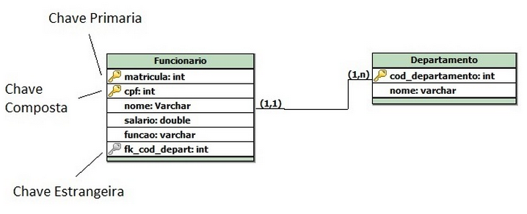
Atributos
Chave Composta é chave (primária ou extrangeira) que compõe 2 ou mais campos. A concatenação de todos eles indica a chave única .
Aula 10 - 1 2 3 FN FNBC
‹#›

Slide 25
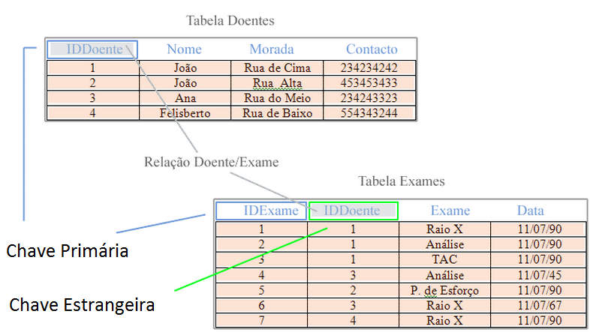
Atributos
Aula 10 - 1 2 3 FN FNBC
‹#›

Slide 26
Atributos
"Chaves primárias" (em inglês "Primary Keys" ou "PK")
Chave primária é simples, ou seja, é formada por um único campo da tabela, esse campo não pode ter dois ou mais registros de mesmo valor, e também não pode conter nenhum registro nulo.
Aula 10 - 1 2 3 FN FNBC
‹#›

Slide 27
Atributos
Chave estrangeira ou Chave secundária
Sempre em chave estrangeira vai haver relacionamentos entre tabelas, sempre com a Chave Primária de outra tabela.
Esse tipo de atributo não permite exclusão, modificação e/ou inserção de dados em tabelas que estejam dependentes umas das outras("foreign key")
Aula 10 - 1 2 3 FN FNBC
‹#›

Slide 28
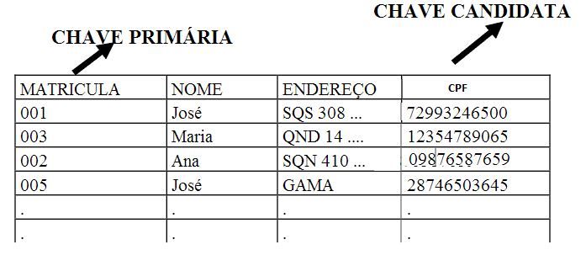
Atributos
Chave candidata
Chave candidata é um atributo ou um conjunto de atributos de uma tabela que identifica uma única linha da tabela.
A chave primária é extraída a partir do conjunto de chaves candidatas de uma tabela.
Aula 10 - 1 2 3 FN FNBC
‹#›

Slide 29
FNBC – Forma Normal de Boyce-Codd
Aula 10 - 1 2 3 FN FNBC
‹#›
Notes:
‹#›
Large enterprise applications - the ones that execute core business applications, and keep a company going - must be more than just a bunch of code modules. They must be structured in a way that enables scalability, security, and robust execution under stressful conditions, and their structure - frequently referred to as their architecture - must be defined clearly enough that maintenance programmers can (quickly!) find and fix a bug that shows up long after the original authors have moved on to other projects. That is, these programs must be designed to work perfectly in many areas, and business functionality is not the only one (although it certainly is the essential core). Of course a well-designed architecture benefits any program, and not just the largest ones as we've singled out here. We mentioned large applications first because structure is a way of dealing with complexity, so the benefits of structure (and of modeling and design, as we'll demonstrate) compound as application size grows large. Another benefit of structure is that it enables code reuse: Design time is the easiest time to structure an application as a collection of self-contained modules or components. Eventually, enterprises build up a library of models of components, each one representing an implementation stored in a library of code modules. When another application needs the same functionality, the designer can quickly import its module from the library. At coding time, the developer can just as quickly import the code module into the application.

Slide 30
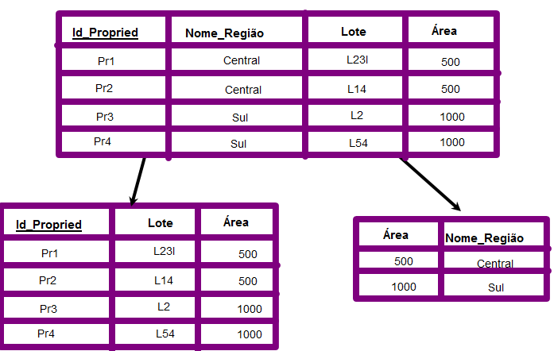
FNBC – Forma Normal de Boyce-Codd
É quando na normalização só tem um atributo que é chave candidata e por sua vez é chave primária.
Aula 10 - 1 2 3 FN FNBC
‹#›
Notes:
‹#›
‹#›

Slide 31
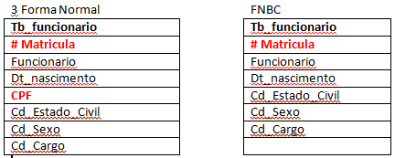
FNBC – Forma Normal de Boyce-Codd
Uma tabela está na forma normal de Boyce-Codd quando todo determinante existente na tabela é chave candidata.
Aula 10 - 1 2 3 FN FNBC
‹#›
Notes:
‹#›
‹#›

Slide 32
Questionário
Aula 08 - MER - Estendido
‹#›
‹#›

Slide 33


Questionário
https://kahoot.it/
Nome + RA
Aula 08 - MER - Estendido
‹#›
‹#›

Slide 34
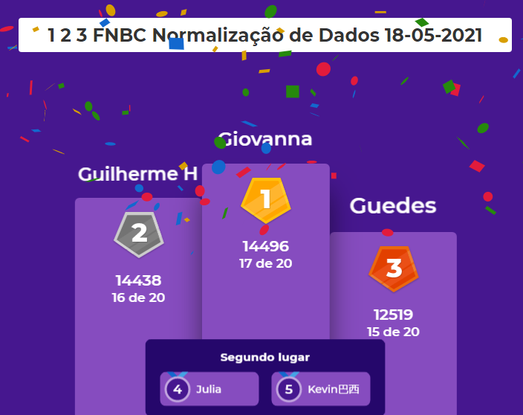
Questionário
Aula 08 - MER - Estendido
‹#›
‹#›

Slide 35
Exercício
MER – Conceitual / Lógico / Físico
Aula 10 - 1 2 3 FN FNBC
‹#›
Notes:
‹#›
Large enterprise applications - the ones that execute core business applications, and keep a company going - must be more than just a bunch of code modules. They must be structured in a way that enables scalability, security, and robust execution under stressful conditions, and their structure - frequently referred to as their architecture - must be defined clearly enough that maintenance programmers can (quickly!) find and fix a bug that shows up long after the original authors have moved on to other projects. That is, these programs must be designed to work perfectly in many areas, and business functionality is not the only one (although it certainly is the essential core). Of course a well-designed architecture benefits any program, and not just the largest ones as we've singled out here. We mentioned large applications first because structure is a way of dealing with complexity, so the benefits of structure (and of modeling and design, as we'll demonstrate) compound as application size grows large. Another benefit of structure is that it enables code reuse: Design time is the easiest time to structure an application as a collection of self-contained modules or components. Eventually, enterprises build up a library of models of components, each one representing an implementation stored in a library of code modules. When another application needs the same functionality, the designer can quickly import its module from the library. At coding time, the developer can just as quickly import the code module into the application.

Slide 36
MER – Conceitual / Lógico / Físico
Sistema de Biblioteca
Uma Universidade está querendo controlar o empréstimo dos livros da Biblioteca. Uma entrevista com a Bibliotecária Responsável resultou nas seguintes informações:
Precisa controlar o empréstimo dos livros e o tempo de aluguel.
Precisa controlar os alunos
Dados levantados:
Aluno, telefone e endereço.
Cada Titulo do Livro pode ter vários livros na biblioteca
Cada titulo tem um ISBN (Internacional standard book number)
Titulo, ISBN, editora, ano
Editora, telefone
Autor
Regras de Negócio
1 titulo pode ter vários livros na biblioteca da Universidade
Um titulo pode ter vários autores
Um titulo pode ter somente uma editora
O livro pode ser emprestado para vários alunos em momento distintos
Controle de empréstimo de livro (dt_empréstimo e dt_devolução)
Um Livro pode ser alugado várias vezes em momentos distintos
‹#›
Notes:
‹#›
‹#›

Slide 37
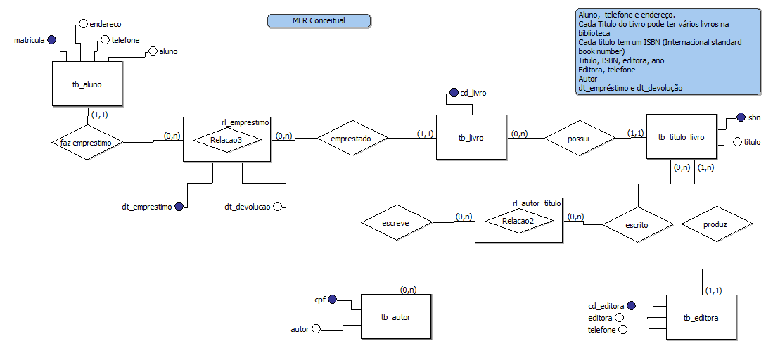
MER – Conceitual
‹#›
Notes:
‹#›
‹#›

Slide 38
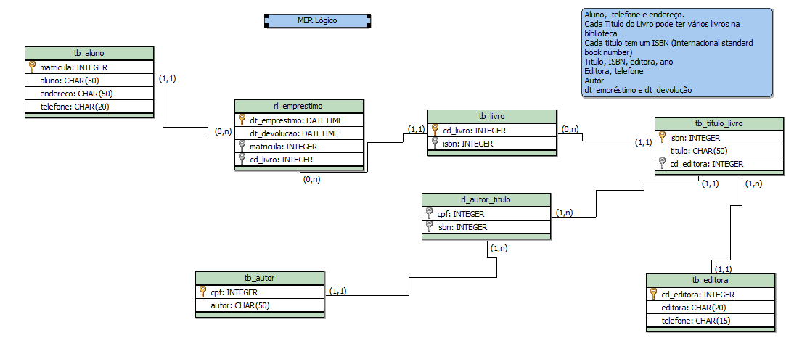
MER – Lógico
‹#›
Notes:
‹#›
‹#›

Slide 39
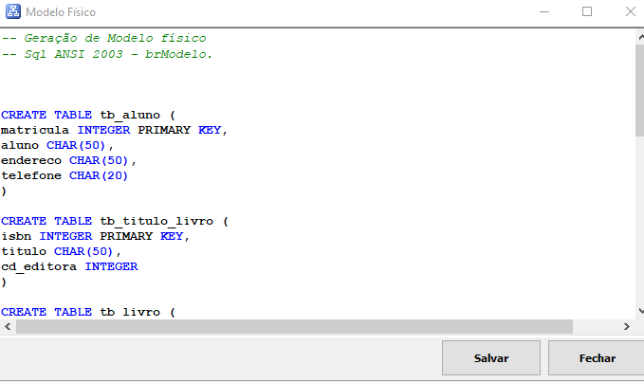
MER – Físico
‹#›
Notes:
‹#›
‹#›

Slide 40
Agenda
Normalização
Anomalias
Dependência Funcional
Dependência Funcional Parcial
Dependência Funcional Transitiva
Forma Normal
1. FN
2. FN
3. FN
Contextualização de Normalização 1.FN 2.FN 3.FN
Chave Composta, Chave Primária, Chave Candidata
FNBC
Questionário – Kahoot
Exercício
Aula 10 - 1 2 3 FN FNBC
‹#›
Notes:
‹#›

Slide 41
Dúvidas
Jose.wellington@uniceub.br
Aula 10 - 1 2 3 FN FNBC
‹#›
Notes:
‹#›

