Slide 1

Revisão de Normalização BI – Business Intelligence
Prof Wellington
Jose.wellington@ceub.edu.br
Aula 12 - BI – Business Intelligence
‹#›
Notes:
‹#›
Large enterprise applications - the ones that execute core business applications, and keep a company going - must be more than just a bunch of code modules. They must be structured in a way that enables scalability, security, and robust execution under stressful conditions, and their structure - frequently referred to as their architecture - must be defined clearly enough that maintenance programmers can (quickly!) find and fix a bug that shows up long after the original authors have moved on to other projects. That is, these programs must be designed to work perfectly in many areas, and business functionality is not the only one (although it certainly is the essential core). Of course a well-designed architecture benefits any program, and not just the largest ones as we've singled out here. We mentioned large applications first because structure is a way of dealing with complexity, so the benefits of structure (and of modeling and design, as we'll demonstrate) compound as application size grows large. Another benefit of structure is that it enables code reuse: Design time is the easiest time to structure an application as a collection of self-contained modules or components. Eventually, enterprises build up a library of models of components, each one representing an implementation stored in a library of code modules. When another application needs the same functionality, the designer can quickly import its module from the library. At coding time, the developer can just as quickly import the code module into the application.

Slide 2

Planejamento
‹#›
‹#›
‹#›
Aula 12 - BI – Business Intelligence
‹#›
Notes:
‹#›

Slide 3
Agenda
Normalização
Conceitos Básicos
Forma Normal
1. FN
2. FN
3. FN
BI – Business Intelligence
Normalização do BI
Tabela dimensão
Tabela Fato
Questionário - Kahoot
Exercício
Aula 12 - BI – Business Intelligence
‹#›
Notes:
‹#›

Slide 4
Normalização de dados
Objetivos:
Entender os conceitos, características e regras de modelagem de dados – B.I. (Business Intelligence)
Metodologia em que se utiliza um conjunto de ferramentas tecnológicas para transformar dados “aleatórios” em informações valiosíssimas para a empresa.
Aula 12 - BI – Business Intelligence
‹#›
Notes:
‹#›
‹#›

Slide 5
BI – Business Intelligence
Aula 12 - BI – Business Intelligence
‹#›
Notes:
‹#›
Large enterprise applications - the ones that execute core business applications, and keep a company going - must be more than just a bunch of code modules. They must be structured in a way that enables scalability, security, and robust execution under stressful conditions, and their structure - frequently referred to as their architecture - must be defined clearly enough that maintenance programmers can (quickly!) find and fix a bug that shows up long after the original authors have moved on to other projects. That is, these programs must be designed to work perfectly in many areas, and business functionality is not the only one (although it certainly is the essential core). Of course a well-designed architecture benefits any program, and not just the largest ones as we've singled out here. We mentioned large applications first because structure is a way of dealing with complexity, so the benefits of structure (and of modeling and design, as we'll demonstrate) compound as application size grows large. Another benefit of structure is that it enables code reuse: Design time is the easiest time to structure an application as a collection of self-contained modules or components. Eventually, enterprises build up a library of models of components, each one representing an implementation stored in a library of code modules. When another application needs the same functionality, the designer can quickly import its module from the library. At coding time, the developer can just as quickly import the code module into the application.

Slide 6
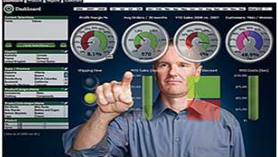
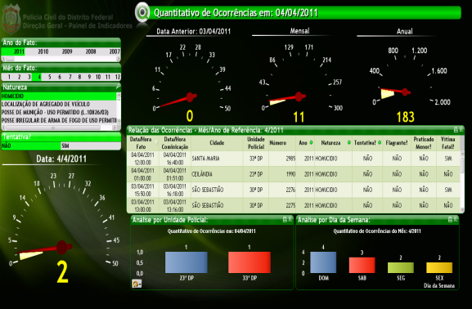
BI – Business Intelligence
Business Intelligence o relacionamento entre os dados é automático, extraído diretamente dos bancos de dados via interface. Desenvolvido sobre um ambiente interativo e amigável.
Aula 12 - BI – Business Intelligence
‹#›
Notes:
‹#›

Slide 7
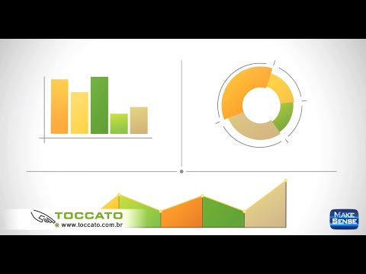
BI – Business Intelligence
https://www.youtube.com/watch?v=1Bo2pT8T-nc
Aula 12 - BI – Business Intelligence
‹#›
Notes:
‹#›

Slide 8
Conceitos Básicos
Aula 12 - BI – Business Intelligence
‹#›
Notes:
‹#›
Large enterprise applications - the ones that execute core business applications, and keep a company going - must be more than just a bunch of code modules. They must be structured in a way that enables scalability, security, and robust execution under stressful conditions, and their structure - frequently referred to as their architecture - must be defined clearly enough that maintenance programmers can (quickly!) find and fix a bug that shows up long after the original authors have moved on to other projects. That is, these programs must be designed to work perfectly in many areas, and business functionality is not the only one (although it certainly is the essential core). Of course a well-designed architecture benefits any program, and not just the largest ones as we've singled out here. We mentioned large applications first because structure is a way of dealing with complexity, so the benefits of structure (and of modeling and design, as we'll demonstrate) compound as application size grows large. Another benefit of structure is that it enables code reuse: Design time is the easiest time to structure an application as a collection of self-contained modules or components. Eventually, enterprises build up a library of models of components, each one representing an implementation stored in a library of code modules. When another application needs the same functionality, the designer can quickly import its module from the library. At coding time, the developer can just as quickly import the code module into the application.

Slide 9

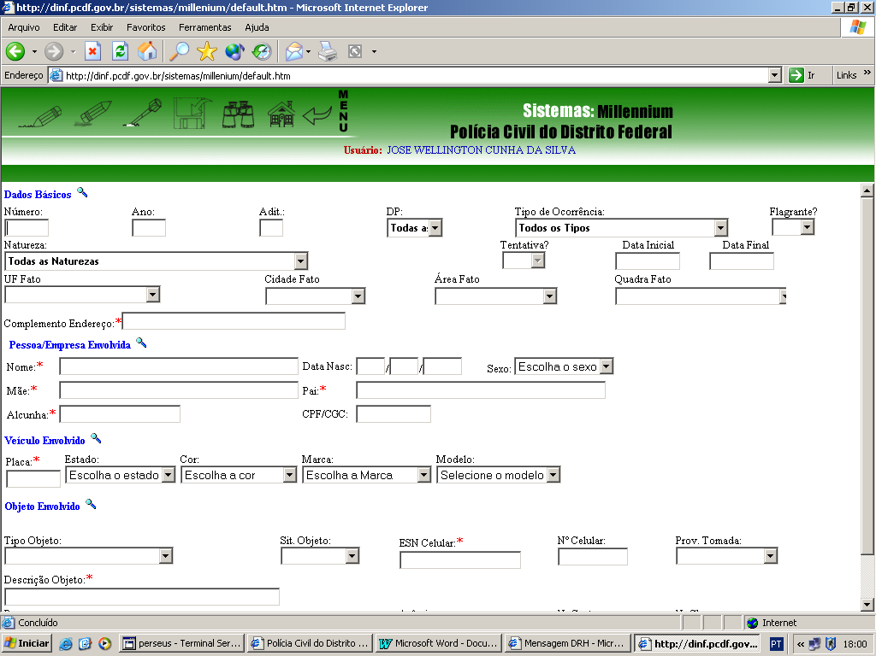
Dados
Os dados representam a matéria-prima a ser utilizada na produção de informações.
Uma definição bem simples de dado é "uma abstração formal que pode ser representada e transformada por um computador" (SETZER, 1999), ou seja a sequência de símbolos quantificados ou quantificáveis.
Aula 12 - BI – Business Intelligence
‹#›

Slide 10
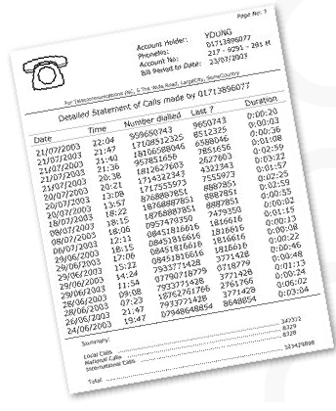
Informação
O processo de transformação envolve a aplicação de procedimentos, que incluem formatação, tradução, fusão, impressão e assim por diante.
A maior parte deste processo pode ser executada automaticamente
Aula 12 - BI – Business Intelligence
‹#›

Slide 11
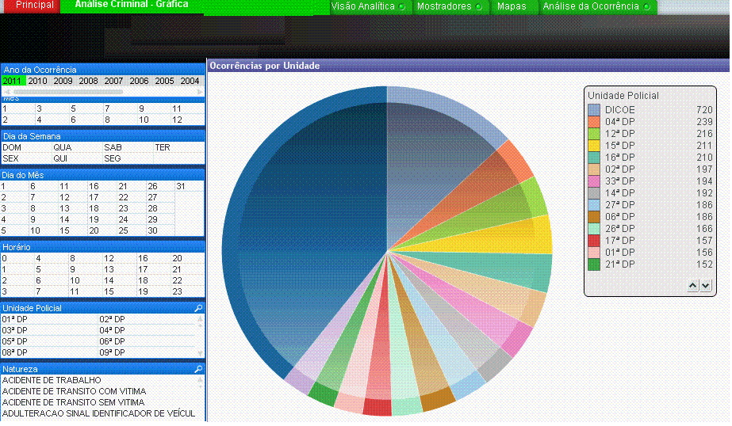
Conhecimento
É obtido pela interpretação e integração de vários dados e informações.
O processo de transformação é realizado por meio de avaliação de dados e informações.
Aula 12 - BI – Business Intelligence
‹#›

Slide 12

Inteligência
Busca identificar tendências do mercado, desenvolver análises estratégicas, descobrir oportunidades e mapear riscos através de metodologias científicas.
- A Inteligência é o processo contínuo de monitoramento e análise estratégica dos cenários e conjunturas mercadológicas em que determinada empresa está inserida.
Aula 12 - BI – Business Intelligence
‹#›

Slide 13
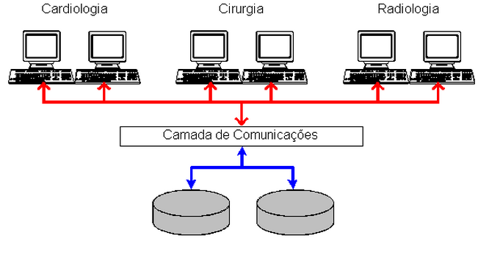
Dados Operacionais - Dados Persistentes
Qualquer empresa tem necessariamente de manter uma quantidade de dados sobre suas operações.
São os dados em um banco de dados com persistentes (por persistir muito tempo no banco de dados).
Dados sobre produtos, contabilidade, paciente e estudante.
Aula 12 - BI – Business Intelligence
‹#›

Slide 14

Sistemas de Informação
É a expressão utilizada para descrever um sistema automatizado ou manual, que envolve pessoas, máquinas, e métodos para organizar, coletar, processar e distribuir dados para os usuários do sistema envolvido.
Um Sistema de Informação poder ser usado então para prover informação, qualquer que seja o uso feito dessa informação.
Aula 12 - BI – Business Intelligence
‹#›

Slide 15
Forma Normal
Aula 12 - BI – Business Intelligence
‹#›
Notes:
‹#›
Large enterprise applications - the ones that execute core business applications, and keep a company going - must be more than just a bunch of code modules. They must be structured in a way that enables scalability, security, and robust execution under stressful conditions, and their structure - frequently referred to as their architecture - must be defined clearly enough that maintenance programmers can (quickly!) find and fix a bug that shows up long after the original authors have moved on to other projects. That is, these programs must be designed to work perfectly in many areas, and business functionality is not the only one (although it certainly is the essential core). Of course a well-designed architecture benefits any program, and not just the largest ones as we've singled out here. We mentioned large applications first because structure is a way of dealing with complexity, so the benefits of structure (and of modeling and design, as we'll demonstrate) compound as application size grows large. Another benefit of structure is that it enables code reuse: Design time is the easiest time to structure an application as a collection of self-contained modules or components. Eventually, enterprises build up a library of models of components, each one representing an implementation stored in a library of code modules. When another application needs the same functionality, the designer can quickly import its module from the library. At coding time, the developer can just as quickly import the code module into the application.

Slide 16
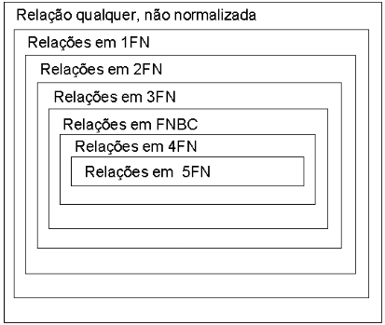
Normalização de dados
Regras:
1ª Forma Normal (1FN).
2ª Forma Normal (2FN).
3ª Forma Normal (3FN).
4ª Forma Normal (4FN).
5ª Forma Normal (5FN).
Aula 12 - BI – Business Intelligence
‹#›
Notes:
‹#›
‹#›

Slide 17
Regras
Aula 12 - BI – Business Intelligence
‹#›
Notes:
‹#›
Large enterprise applications - the ones that execute core business applications, and keep a company going - must be more than just a bunch of code modules. They must be structured in a way that enables scalability, security, and robust execution under stressful conditions, and their structure - frequently referred to as their architecture - must be defined clearly enough that maintenance programmers can (quickly!) find and fix a bug that shows up long after the original authors have moved on to other projects. That is, these programs must be designed to work perfectly in many areas, and business functionality is not the only one (although it certainly is the essential core). Of course a well-designed architecture benefits any program, and not just the largest ones as we've singled out here. We mentioned large applications first because structure is a way of dealing with complexity, so the benefits of structure (and of modeling and design, as we'll demonstrate) compound as application size grows large. Another benefit of structure is that it enables code reuse: Design time is the easiest time to structure an application as a collection of self-contained modules or components. Eventually, enterprises build up a library of models of components, each one representing an implementation stored in a library of code modules. When another application needs the same functionality, the designer can quickly import its module from the library. At coding time, the developer can just as quickly import the code module into the application.

Slide 18

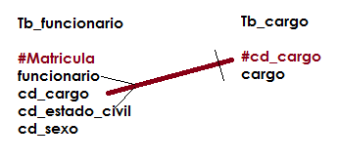
Dependência funcional
Ocorre quando um atributo ou conjunto de atributos depende funcionalmente de outro atributo para ter significado.
Aula 12 - BI – Business Intelligence
‹#›
Notes:
‹#›
‹#›

Slide 19

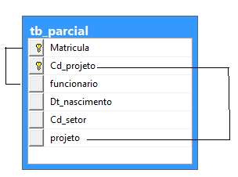
Dependência funcional parcial
Ocorre quando em um identificador composto (concatenado), um atributo ou conjunto de atributos depende de forma parcial deste identificador composto (concatenado), ou seja apresenta dependência de parte do identificador composto.
Aula 12 - BI – Business Intelligence
‹#›
Notes:
‹#›
‹#›

Slide 20
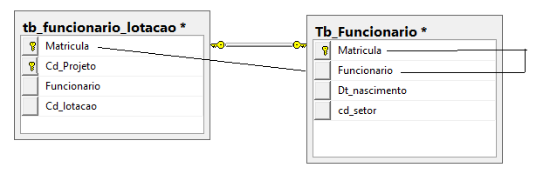
Dependência funcional transitiva
Uma dependência funcional transitiva ocorre quando uma coluna, além de depender da chave primária da tabela, e depende de outra coluna também Chave Primária para ter significado.
Aula 12 - BI – Business Intelligence
‹#›
Notes:
‹#›
‹#›

Slide 21
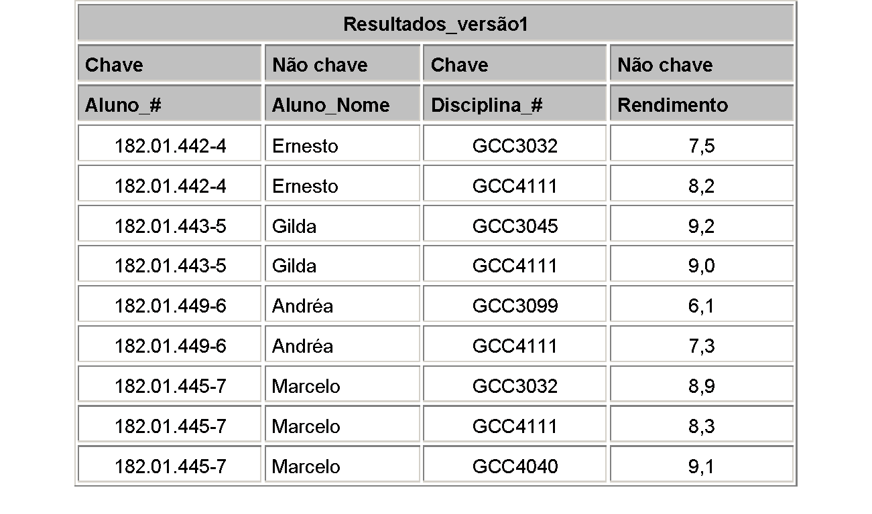
1. Forma Normal
- Foi definida para não permitir atributos multivalorados ou atributos compostos.
- Uma está em 1FN se e somente se todos os seus atributos contêm apenas valores atômicos (simples, indivisíveis)
- 1 domínio é atômico se os elementos desse domínio são considerados como unidades indivisíveis.
Aula 12 - BI – Business Intelligence
‹#›
Notes:
‹#›
‹#›

Slide 22
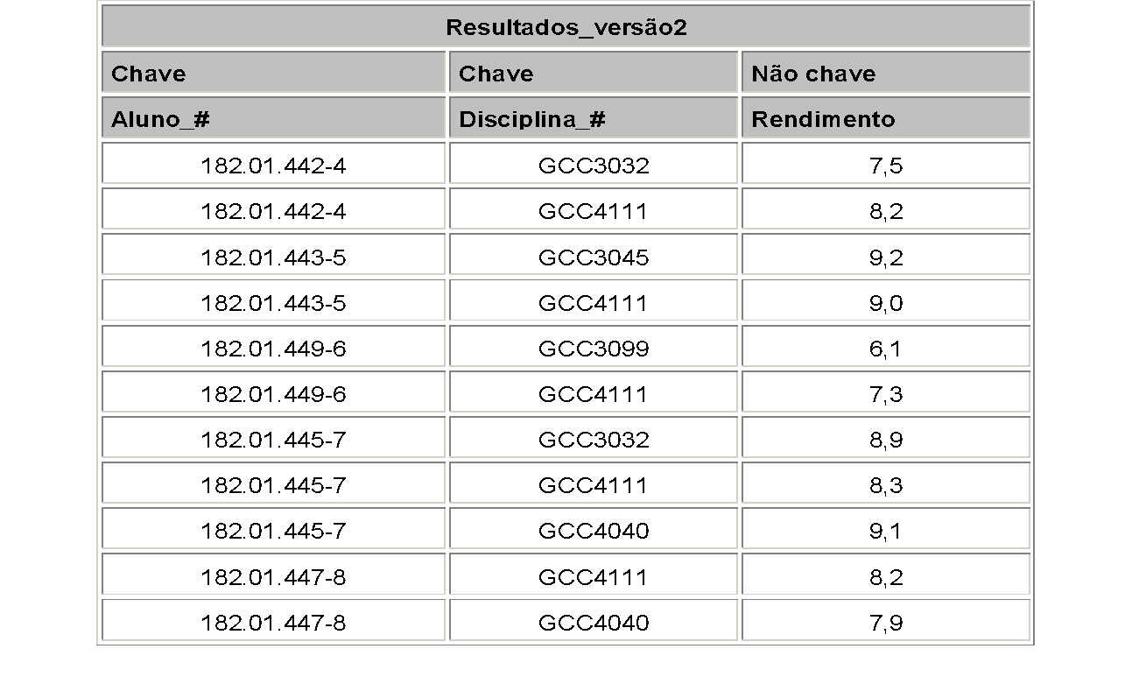
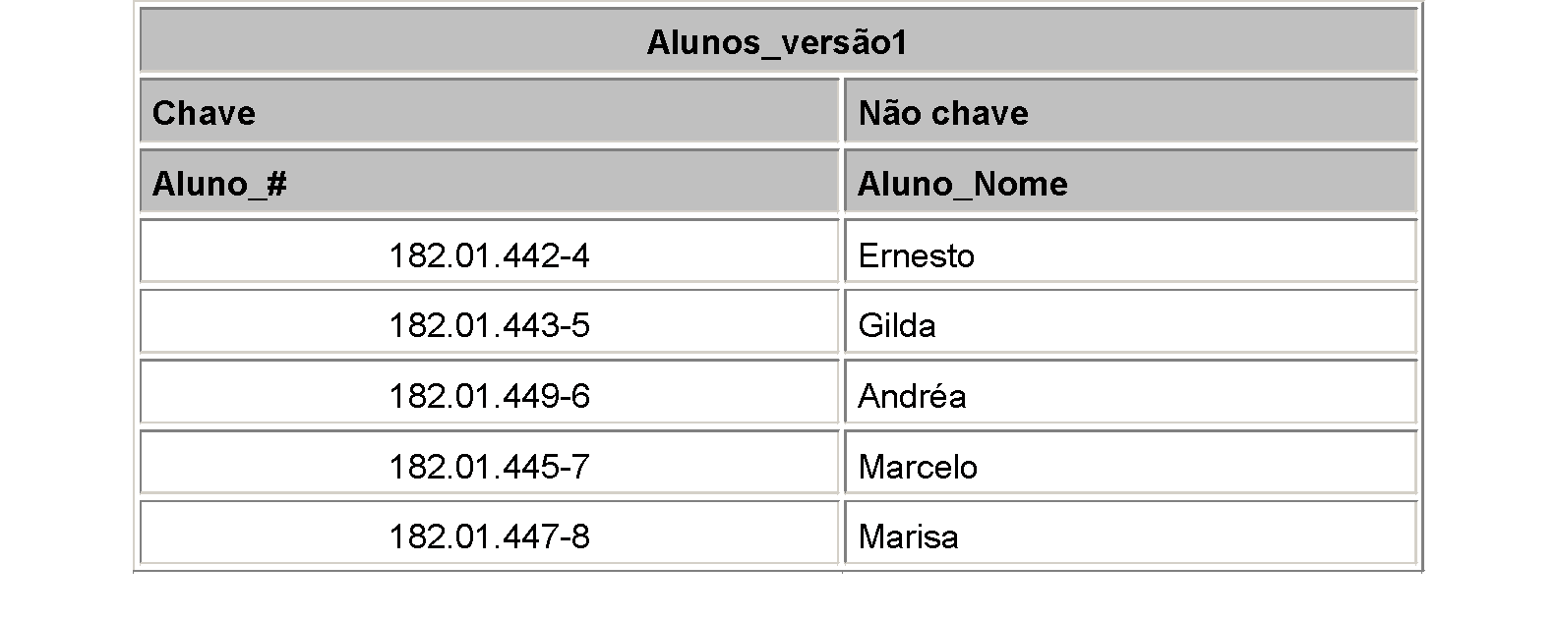
1. Forma Normal
Aula 12 - BI – Business Intelligence
‹#›
Notes:
‹#›
‹#›

Slide 23
2. Forma Normal
- Estar na 1FN e todos atributos não chave forem totalmente dependentes da chave Primária.
- Estar na 1.FN e todos atributos não chave Não tem dependência Parcial.
Aula 12 - BI – Business Intelligence
‹#›
Notes:
‹#›
‹#›

Slide 24
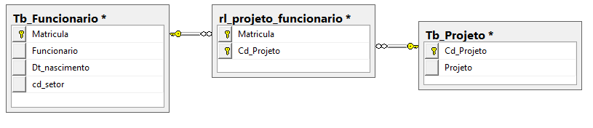
2. Forma Normal
- Estar na 1FN e todos atributos não chave forem totalmente dependentes da chave Primária.
- Estar na 1.FN e todos atributos não chave Não tem dependência Parcial.
Aula 12 - BI – Business Intelligence
‹#›
Notes:
‹#›
‹#›

Slide 25
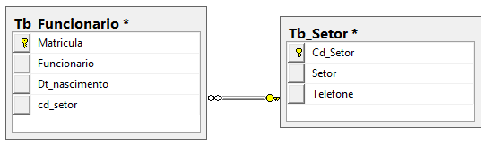

3. Forma Normal
- Uma relação está em 3FN se e somente se estiver na 1FN e na 2FN e, não contém dependências transitivas.
Aula 12 - BI – Business Intelligence
‹#›
Notes:
‹#›
‹#›

Slide 26
BI – Business Intelligence
Aula 12 - BI – Business Intelligence
‹#›
Notes:
‹#›
Large enterprise applications - the ones that execute core business applications, and keep a company going - must be more than just a bunch of code modules. They must be structured in a way that enables scalability, security, and robust execution under stressful conditions, and their structure - frequently referred to as their architecture - must be defined clearly enough that maintenance programmers can (quickly!) find and fix a bug that shows up long after the original authors have moved on to other projects. That is, these programs must be designed to work perfectly in many areas, and business functionality is not the only one (although it certainly is the essential core). Of course a well-designed architecture benefits any program, and not just the largest ones as we've singled out here. We mentioned large applications first because structure is a way of dealing with complexity, so the benefits of structure (and of modeling and design, as we'll demonstrate) compound as application size grows large. Another benefit of structure is that it enables code reuse: Design time is the easiest time to structure an application as a collection of self-contained modules or components. Eventually, enterprises build up a library of models of components, each one representing an implementation stored in a library of code modules. When another application needs the same functionality, the designer can quickly import its module from the library. At coding time, the developer can just as quickly import the code module into the application.

Slide 27
BI – Business Intelligence
Business Intelligence o relacionamento entre os dados é automático, extraído diretamente dos bancos de dados via interface. Desenvolvido sobre um ambiente interativo e amigável.
Aula 12 - BI – Business Intelligence
‹#›
Notes:
‹#›

Slide 28

BI – Business Intelligence
É o processo de transformar dados em informações e através da descoberta, transformar informação em conhecimento.
Aula 12 - BI – Business Intelligence
‹#›
Notes:
‹#›

Slide 29
BI – Business Intelligence
Pode ser definido como um conjunto de técnicas utilizadas para extrair inteligência a partir de dados sobre um determinado negócio.
Aula 12 - BI – Business Intelligence
‹#›
Notes:
‹#›

Slide 30
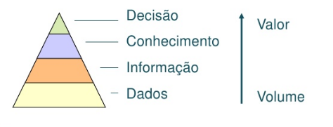
BI – Business Intelligence
Propósito
Objetivo é converter o volume de dados em informações relevantes ao negócio, através de relatórios
Aula 12 - BI – Business Intelligence
‹#›
Notes:
‹#›

Slide 31
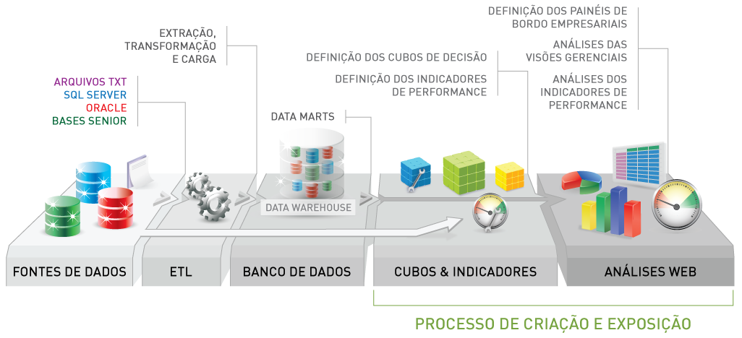
Business Intelligence
Capacitar as organizações com a visão necessária para tomar decisões melhores, fornecendo todos os funcionários com uma visão precisa de uma organização e itens acionáveis ​​com base na chave de desempenho claramente definidos indicadores.
Aula 12 - BI – Business Intelligence
‹#›

Slide 32
Business Intelligence
Data Warehouse é um processo que extrai os dados de sistemas operacionais e transacionais, limpando, transformando em informações organizadas permitindo analises dessas informações
Aula 12 - BI – Business Intelligence
‹#›

Slide 33

Business Intelligence
Data Mining – São softwares responsáveis por analisar uma massa de dados, coletando informações sobre seu comportamento.
Quando utilizado com outros dados, podem ser utilizados para determinar comportamento esperados e analise preditiva.
Existem técnicas para Data Mining, como redes neurais, árvore de decisão.
Aula 12 - BI – Business Intelligence
‹#›

Slide 34
Dashboard
É a apresentação visual das informações mais importantes e necessárias para alcançar um ou mais objetivos do negócio, consolidadas e ajustadas em uma única tela para que a informação possa ser monitorada de forma ágil.
Aula 12 - BI – Business Intelligence
‹#›
Notes:
‹#›

Slide 35
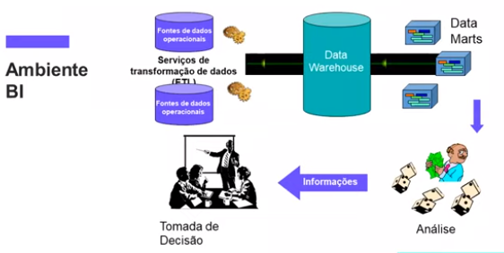
Business Intelligence
Aula 12 - BI – Business Intelligence
‹#›

Slide 36
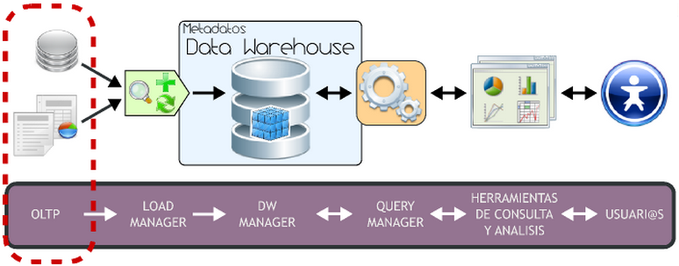
OLTP On-Line Transaction Processing
Processamentos que executam as operações do dia-a-dia da organização
Ex: movimento bancário
SQL - Select, Insert, Update e Delete
Aula 12 - BI – Business Intelligence
‹#›

Slide 37
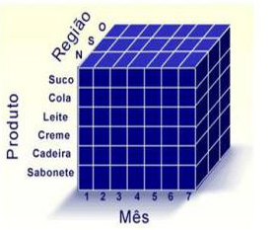
OLAP On Line Analytical Processing
A ferramenta mais popular para exploração de um data warehouse.
São geralmente desenvolvidas para trabalhar com banco de dados de-normalizados.
Aula 12 - BI – Business Intelligence
‹#›

Slide 38
Normalização do BI
Aula 12 - BI – Business Intelligence
‹#›
Notes:
‹#›
Large enterprise applications - the ones that execute core business applications, and keep a company going - must be more than just a bunch of code modules. They must be structured in a way that enables scalability, security, and robust execution under stressful conditions, and their structure - frequently referred to as their architecture - must be defined clearly enough that maintenance programmers can (quickly!) find and fix a bug that shows up long after the original authors have moved on to other projects. That is, these programs must be designed to work perfectly in many areas, and business functionality is not the only one (although it certainly is the essential core). Of course a well-designed architecture benefits any program, and not just the largest ones as we've singled out here. We mentioned large applications first because structure is a way of dealing with complexity, so the benefits of structure (and of modeling and design, as we'll demonstrate) compound as application size grows large. Another benefit of structure is that it enables code reuse: Design time is the easiest time to structure an application as a collection of self-contained modules or components. Eventually, enterprises build up a library of models of components, each one representing an implementation stored in a library of code modules. When another application needs the same functionality, the designer can quickly import its module from the library. At coding time, the developer can just as quickly import the code module into the application.

Slide 39
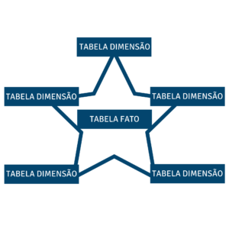
Modelo Multidimensional
Star schema ou esquema estrela, idealizado por Ralph Kimball, é o modelo mais utilizado na modelagem dimensional para dar suporte à tomada de decisão e melhorar a performance de sistemas voltados para consulta.
‹#›
Aula 12 - BI – Business Intelligence

Slide 40
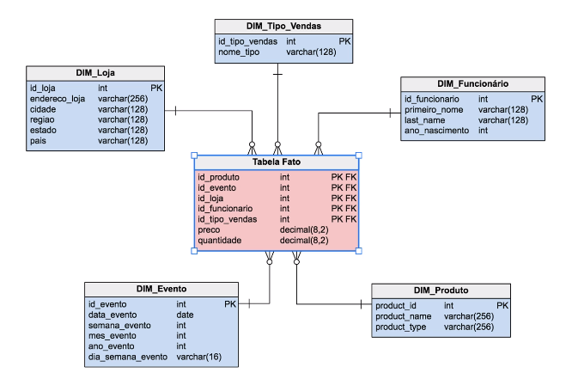
Modelo Multidimensional
tabela fato armazena o que ocorreu, é o fato propriamente dito, por isso ela tem esse nome, porque é o fato ocorrido. A tabela fato está sempre ligada a duas ou mais dimensões, não existe tabela fato com menos de duas dimensões.
Aula 12 - BI – Business Intelligence
‹#›

Slide 41
Modelo Multidimensional
As tabelas dimensão contêm as características de um evento. Por exemplo, quando eu faço uma venda, quero saber por onde a venda foi feita, que produto foi vendido, ou para quem. A fato é a principal tabela do Data Warehouse, e você pode ter uma ou mais tabelas fato.
Aula 12 - BI – Business Intelligence
‹#›

Slide 42
Principais vantagens do Business Intelligence
Maior assertividade nas tomadas de decisão;
Processo mais eficientes;
Melhoria no relacionamento com o cliente;
Aumento das receitas;
Maior vantagem competitiva;
Gestão de risco mais aprimorada;
Maior facilidade na identificação de falhas processuais;
Aumento da produtividade;
Redução de custos operacionais;
Aprimoramento das estratégias de marketing e de vendas.
Aula 12 - BI – Business Intelligence
‹#›
Notes:
‹#›

Slide 43
Questionário
Aula - Normalização de Dados - 4 e 5 FN
‹#›
‹#›
‹#›

Slide 44


Questionário
https://kahoot.it/
Nome + RA
Aula - Normalização de Dados - 4 e 5 FN
‹#›
‹#›
‹#›

Slide 45
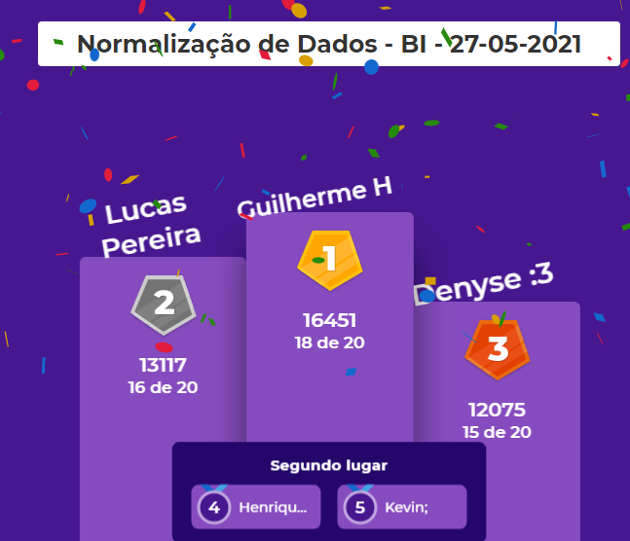
Questionário
‹#›
‹#›
‹#›
Aula - Normalização de Dados - 4 e 5 FN

Slide 46
Exercício
Aula 12 - BI – Business Intelligence
‹#›
Notes:
‹#›
Large enterprise applications - the ones that execute core business applications, and keep a company going - must be more than just a bunch of code modules. They must be structured in a way that enables scalability, security, and robust execution under stressful conditions, and their structure - frequently referred to as their architecture - must be defined clearly enough that maintenance programmers can (quickly!) find and fix a bug that shows up long after the original authors have moved on to other projects. That is, these programs must be designed to work perfectly in many areas, and business functionality is not the only one (although it certainly is the essential core). Of course a well-designed architecture benefits any program, and not just the largest ones as we've singled out here. We mentioned large applications first because structure is a way of dealing with complexity, so the benefits of structure (and of modeling and design, as we'll demonstrate) compound as application size grows large. Another benefit of structure is that it enables code reuse: Design time is the easiest time to structure an application as a collection of self-contained modules or components. Eventually, enterprises build up a library of models of components, each one representing an implementation stored in a library of code modules. When another application needs the same functionality, the designer can quickly import its module from the library. At coding time, the developer can just as quickly import the code module into the application.

Slide 47
Modelagem de Dados - Regras
Entidade é o objeto do mundo real que só vai ter informação do objeto.
Toda Entidade tem um campo chave que diferencia e identifica.
Quando for um campo repetido estado civil solteiro cria uma tabela.
Quando o relacionamento é vários para vários cria uma tabela de relacionamento.
Toda chave estrangeira está relacionada com uma chave primária de outra tabela. Dependência Funcional.
Cardinalidade é a frequência do relacionamento
Todo campo chave tem a cardinalidade 1 x N
Nunca criar no campo data uma tabela.
Aula 12 - BI – Business Intelligence
‹#›
‹#›
‹#›

Slide 48
Exercício - MER Conceitual / Lógico / Físico
Loja de Departamento
Quer fazer um B.I. Business Inteligence para verificar as oportunidades, riscos
Requisito Funcional
Verificar as vendas
Dados levantados:
Produto, valor, dt_venda
Filial – loja
Vendedor
Estado
Cidade
Regras de Negócio
1 venda só tem um vendedor
1 venda só tem uma loja
1 venda só tem um produto
1 venda só tem uma cidade e seu estado
Aula 12 - BI – Business Intelligence
‹#›
Notes:
‹#›
‹#›

Slide 49
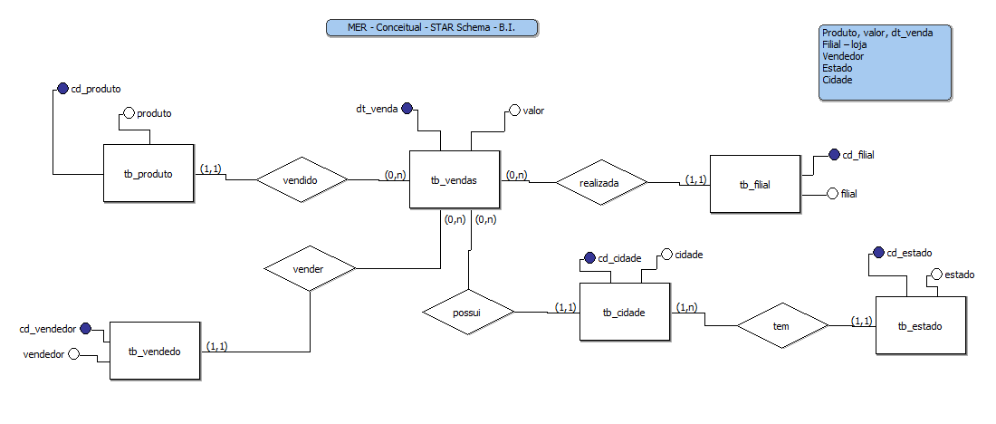
Exercício - MER Conceitual
Aula 12 - BI – Business Intelligence
‹#›
Notes:
‹#›
‹#›

Slide 50
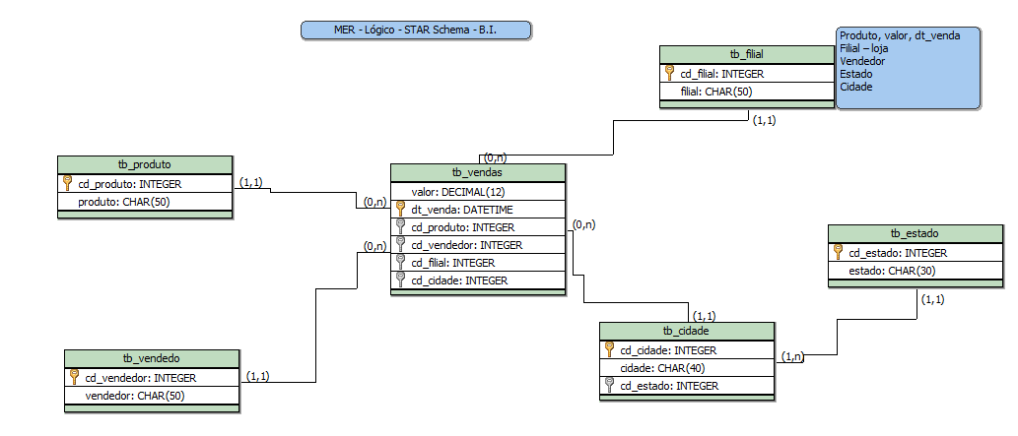
Exercício - MER Lógico
Aula 12 - BI – Business Intelligence
‹#›
Notes:
‹#›
‹#›

Slide 51
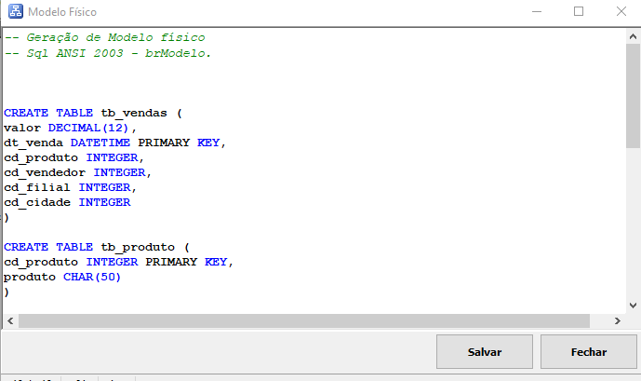
Exercício - MER Físico
Aula 12 - BI – Business Intelligence
‹#›
Notes:
‹#›
‹#›

Slide 52
Agenda
Índice
Constraints - Regras
Tipo de SGBD
Relacionamento
Cardinalidade
Exercício
Aula 12 - BI – Business Intelligence
‹#›
Notes:
‹#›

Slide 53
Dúvidas
Jose.wellington@uniceub.br
Aula 12 - BI – Business Intelligence
‹#›
Notes:
‹#›

