Slide 1

GlassDoor Job Listings Analysis
April - May '24
Mark Scott

Slide 2

Job listings by location
18
9
8
6
3
Washington(DC)
McClean (VA) Chantily (VA) Plano (TX) Tampa (FL)
0
5
10
15

Slide 3

Job listing by industry
Hardware Dev | 8
National Agencies | 8
Aerospace & Defence |  | 12
Business Consulting |  | 13
IT |  |  |  | 48
0
10
20
30
40

Slide 4

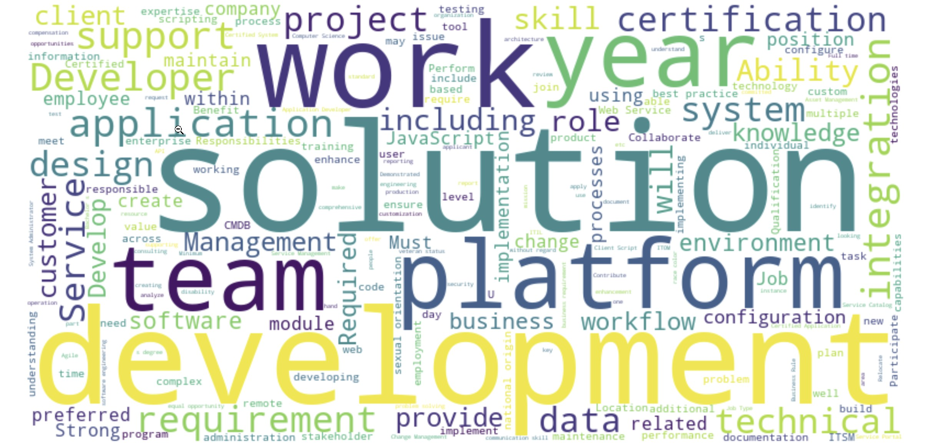

Commonly Found Words

Slide 5
I love you all, but I'm not going to transpose all of that. The values on the very right side are hourly and can be ignored.

Slide 6

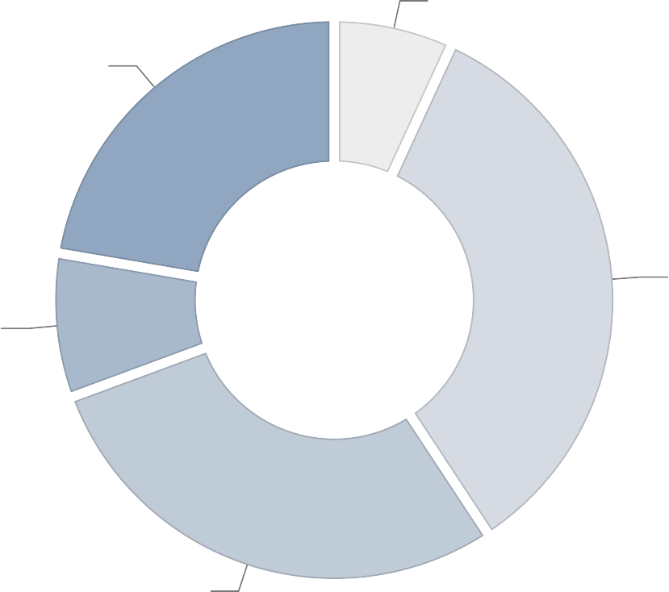
Experience Level
0-2 years
Unknown
6.5%
22.4%
34.3%
3-5 years
10+ years
8%
28.9%
6-8 years

Slide 7

8.8%
14.67%
9.4%
3.5%
12.3%
17.5%
Company Size
16.4%
17.5%
5001 to 10000 Employees (8.8%)
1001 to 5000 Employees (9.4%)
201 to 500 Employees (12.3%)
51 to 201 Employees (16.4%)
1 to 50 Employees (17.5%)
100000+ Employees (17.5%)
501 to 1000 Employees (3.5%)
Unknown (14.67%)

Slide 8

Technical Skills and Pro ciency:
Highlight your experience with ServiceNow development and implementation.
Mention speci c ServiceNow applications or modules you have worked on.
Include any relevant programming languages and technologies, such as JavaScript, HTML, CSS, and REST/SOAP APIs.
Emphasize your experience with web development and integration.
Education and Certi cations:
Clearly state your educational background, including degrees in Computer Science or related
elds.
List any relevant certi cations, such as ServiceNow Certi ed Application Developer or ServiceNow Certi ed System Administrator.
Mention any additional training or courses related to ServiceNow or software development.
Resume
Writing
GUIDANCE

Slide 9


Professional Experience:
Detail your work experience, focusing on roles where you developed and implemented ServiceNow solutions.
Describe speci c projects you have worked on, including the scope, your role, and the outcomes.
Highlight your ability to work collaboratively within a team of developers and with key stakeholders.
Problem-Solving and Innovation:
Provide examples of how you have developed innovative solutions to optimize processes and create business value.
Mention any challenges you faced and how you overcame them. 4.3.Emphasize your ability to consult with stakeholders to gather
requirements and develop effective solutions.
Soft Skills and Attributes:
Highlight your communication skills, both written and verbal, as these are crucial for consulting with stakeholders and documenting requirements.
Mention your ability to work in a fast-paced environment and manage multiple tasks simultaneously.
Emphasize your attention to detail, analytical skills, and commitment to continuous learning and improvement.

Slide 10

Links
You can download this presentation and the
les used to generate these graphs in the Repo for this document: GitHub - phxdev1/job-report-may-24

