Slide 1
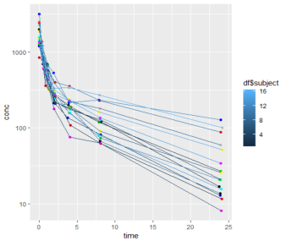
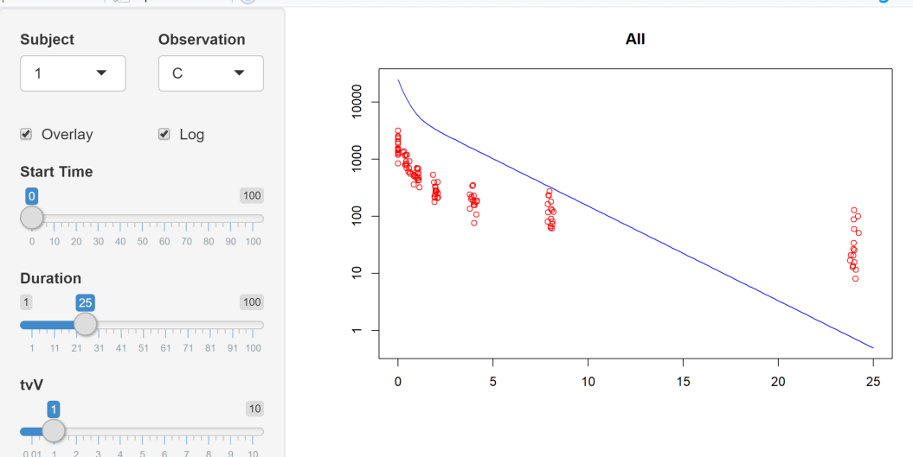
PK/PD Modeling with RsNLME : : CHEAT SHEET
Basics
Input Options
Customizing the model
RsNLME is an R package to define NLME models as R native objects.
NLME engine is used for Fitting/Simulation
R style help available via ?method
All methods have sensible default values
model2 = addReset(model, low, hi)
model2 = addExtraDose(model, doseType, doses)
Dose Types : SteadyStateDose | AddlDose
Residual error model
residualEffect(model,"C")=c(errorType=Multiplicative,SD="0.16“,
isFrozen=FALSE,isBQL=TRUE,bqlStatic=0.75,
doBefore=“”,doAfter=“”))
Error model types :
Additive | LogAdditive | Multiplicative | AdditiveMultiplicative | MixRatio | Power | Custom
structuralParam(model,“V") = c(style=Custom, code="stparm(V=10^(tvlog10V + nlog10V))")
Model covariates
Model Creation
sex=categoricalCovariate("sex",c(1,2),c("female","male"))
weight=NlmeCovariateParameter("weight",centerValue="70",
continuousType =CovarNumber,
direction=Forward)
age=NlmeCovariateParameter("age")
occ=occasionCovariate("OCC", c(1,2), c("OCC1","OCC2"),
direction=Forward)
model=addCovariates(model, c(sex,weight,age,occ),
c("V"="weight,age", "Cl"="sex,weight"))
newModel = resetCovariateEffects(model)
covariateEffect(model,"wt","Cl")=COVAR_EFF_YES
pk = pkmodel(numComp = 1, absorption=Intravaneous,…)
pd = emaxmodel(checkBaseline=TRUE,…)
pd = linearmodel(type = LinearAlpha,… )
pkpd = pkemaxmodel(numComp = 2, absorption=Extravascular
isTlag = TRUE,…)
pkpd = pkindirectmodel(isClosedForm=FALSE,
indirectType = LimitedStimulation,…)
pkpd = pklinearmodel(parameterization= Micro,
linearModelType=LinearBeta, …)
model = blankmodel(modelName, …)
Random effects
initRandomEffects(model)=c(Block, FALSE, "nV,nCl,nKa,nV2", "0.2, 0, 0.2, 0, 0, 0.2, 0, 0, 0, 0.1") initRandomEffects(model)=c(Diagonal, FALSE,"nV,nCl","0.1, 0.02") initRandomEffects(model)=c(
Diagonal, FALSE,"nV,nCl","0.1, 0.02",
Block, TRUE, "nCl2,nV2","0.2, 0, 0.2")
initOccasionRandomEffect(model,"Occasion") = c(0.1,0.02,0.1)
Add more components to the model
Input dataset
model2 = addCountObservation(model, observationName,
expression, structuralParameters)
model2 = addCategoricalObservation(model, observationName, offsetArray, structuralParameters)
model2 = addContinuousObservation(model, observationName,effect, hasRandomEffect)
model2 = addLLObservation(model,observationName,
expression,dobefore,doafter, structuralParameters,
isFrozen, hasRandomEffect,simulationCode)
model2 = addEventObservation(model,observationName,
epression,dobefore,doafter,structuralParameters,
isFrozen, hasRandomEffect)
model2 = addParameters(model,name,…)
model2= addExpression(model,blockName
,structuralParameters, codeLine, isFrozen, override)
Visualize the data with R
Initial estimates for fixed effects
input=read.csv("16subjects.csv")
ggplot(data=input,aes(x=time,y=conc))+
scale_y_log10()+
geom_point(colour=df$subject)+
geom_line(aes(x=df$time,y=df$conc,
group=df$subject,colour=df$subject))
estimatesUI(model,unique(input$Subject),host)
Map columns to model variables
dataset=NlmeDataset()
initColMapping(model)=input
print(modelColumnMapping(model))
modelColumnMapping(model)=c(id="Subject",
CObs="Conc",A1="Amount”)
effects=getInitialEstimates()
initFixedEffects(model) = effects

Slide 2
Platform/Engine defintion
Covariate Search
Analyzing Results
method=NlmeParallelMethod(method=“MULTICORE”|”MPI”|”TORQUE”|”TORQUE_MPI”|”SGE”|”SGE_MPI”|”LSF”|”LSF_MPI”)
host = NlmeParallelHost(sharedDirectory=“C:/Shared”,
parallelMethod=method,
hostName=“MPI”,
numCores=4)
stepwiseSearch(hostPlatform, dataset, params,
covariateModel, stepwiseParams, model, runInBackground)
shotgunSearch(hostPlatform, dataset, params, covariateModel, model, runInBackground)
Example
sp = NlmeStepwiseParams(0.01, 0.001, "-2LL") job=stepwiseSearch(host, dataset, params, covariateModel(model), sp, model)
VPC
library(vpc)
simData = getSimData(input,stratifyColumns=“sex”)
obsData = getObsData(input)
vpcdb = vpc(sim=simData, obs = obsData, vpcdb = TRUE)
plot_vpc(vpcdb,
show = list(obs_dv = TRUE, obs_ci = FALSE),
xlab = “Time(hours)”, ylab = “Concentration”,
title = “VPC!”)
Fitting Engines Definition
Bootstrap
engineParams = NlmeEngineExtraParams(
PARAMS_METHOD=METHOD_FOCE_ELS,
PARAMS_NUM_ITERATIONS=1000,
PARAMS_SAND="TRUE")
bootstrap(hostPlatform, dataset, params, bootParams, model, runInBackground)
Ex.
bootParams = NlmeBootstrapParams(
numReplicates=5, randomNumSeed=1234)
job = bootstrap(defaultHost,dataset,params,
bootParams,model,TRUE)
Diagnostic plots
xp = xposeNlme(dir="./",modelName="Initial Model")
list_vars(xp)
doexpose(xp)
dv_vs_pred(xp)
res_vs_pred(xp,res="CWRES",type="ps")
ind_plots(xp)
eta_distrib(xp)
eta_qq(xp)
METHOD_QRPEM
METHOD_IT2S_EM
METHOD_FOCE_LB
METHOD_FIRST_ORDER
METHOD_LAPLACIAN
METHOD_NAIVE_POOLED
Model Fitting
Job = fitmodel(hostPlatform, dataset, params , model, runInBackground )
Ex.
job = fitmodel(host,dataset,engineParams)
status = read.csv(“Overall.csv”)
print(status)
VPC
vpcmodel(hostPlatform, dataset, vpcParams, model, …)
Ex.
obsVars = GetObservationVariables(dataset) observationParameters(obsVars[[1]])=c(xaxis=VPC_XAXIS_T, binningMethod=VPC_BIN_NONE,
quantilesValues ="5,50,95") vpcParams = NlmeVpcParams(numReplicates=2, seed=1234, observationVars=obsVars)
job = vpcmodel(defaultHost,dataset,vpcParams,model)
Bootstrap
out=read.csv("out.csv")
View(out)
overall=read.csv("BootOverall.csv")
View(overall)
theta=read.csv("BootTheta.csv")
View(theta)
varCovar=read.csv("BootVarCoVar.csv")
View(varCovar)
omega=read.csv("BootOmega.csv")
View(omega)
Model Simulation
Job = simmodel(hostPlatform, dataset, simParams , model , runInBackground )
Ex.
SimTableObs = NlmeSimTableDef("SimTableObs.csv", "0,1,2,4,4.9,55.1,56,57,59,60", "C, CObs", FALSE)
simParams = NlmeSimulationParams(numReplicates = 50, seed = 3527, simulationTables = c(SimTableObs))
job = simmodel(defaultHost,dataset,simParams,model)
Scenario Fitting
scenario1=NlmeScenario("SC0001","1")
scenario2=NlmeScenario("SC0002","1,2")
scenarios = c(scenario1,scenario2)
sortColumns=NlmeSortColumns("group,sex")
job = sortfit(defaultHost,dataset,params,
sortColumns,scenarios,model)
Covariate Search
overall = read.csv(“Overall.csv”)
View(overall)
stepwiseLines=readLines(“Stepwise.txt)
View(stepwiseLines)

