Slide 1
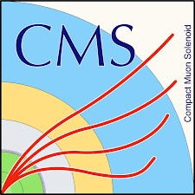

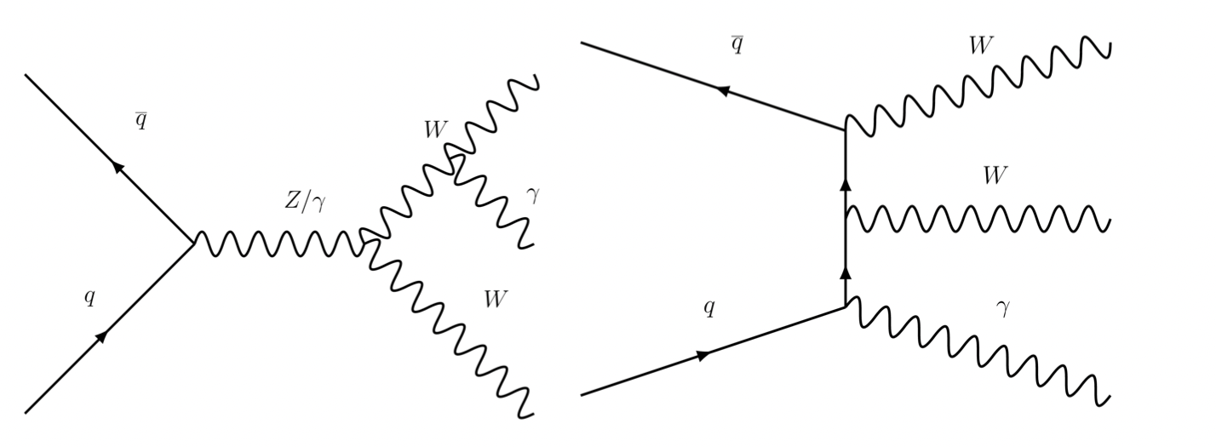
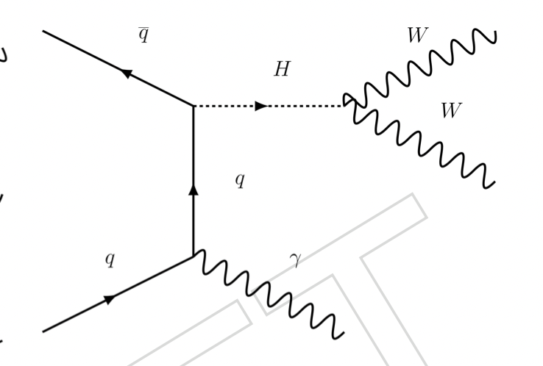

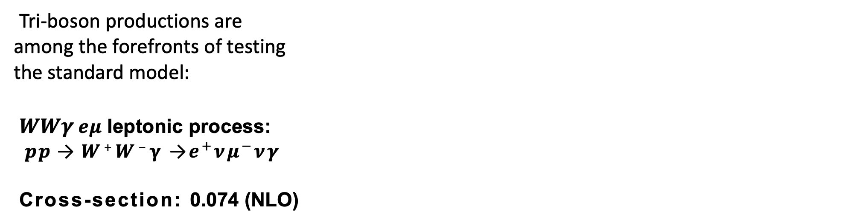
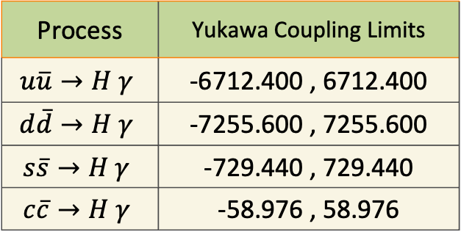
A New Tri-boson Process Search
and Measurement at CMS
Zhe Guan
State Key Laboratory of Nuclear Physics and Technology, Peking University, Beijing, 100871
Email : zhe.guan@cern.ch
Indroduction
c
Feynman Diagrams
WHAT
Tri-boson productions are among the forefronts of testing the standard model:
𝑾𝑾𝜸$eμ$ leptonic process:
𝒑𝒑 → 𝑾⁺𝑾⁻𝛄 →$e^{+}νμ^{−}νγ$
Cross-section: 0.074 (NLO)
Representative Feynman Diagrams for 𝑾𝑾𝜸 Process.
The last diagram can be used to measure Higgs couplings to light SM quarks.
Backgrounds
Physics Object
Events Selection
MC:
QCD Zγ+jets
ZZ/WZ/WW
tt+jets
ttγ+jets
QCD Wγ+jets
Data Driven:
Nonprompt photon
Nonprompt lepton
Good Electrons
Good Photon
Baseline Selection
pT > 25 GeV, |η|< 2.5
MVA Fall17V2Iso ID
Cut-based Medium ID
Conversion-safe electron veto
pT > 20 GeV, |η|< 2.5, |η|< 1.4442
or 1.566 or |η|< 2.5
Two leptons with pTμ/e> 20 (25) GeV, |η| < 2.4 (2.5)
Pass HLT paths
mll> 20 GeV and ptll> 30 GeV
ETmiss(Puppi) > 20 GeV
pTγ> 20 GeV in the barrel or endcap
Good Muons
HOW
Cut-Based Medium ID
mvaTTH>-0.2 [1]
miniPFRelIso_all < 0.4
pT > 20 GeV, |η|< 2.4
Good Jets
Top γ Region
PF tight ID
AK4CHS
JEC correction
Two opposite sign leptons
At least one b-jet (medium DeepJet WP)
MET
Signal Region
PuppiMET+ type-I correction
JES/JER correction
Two opposite sign leptons
mT > 50 GeV
b-jet veto (medium DeepJet WP)
Significance (expected)
Fiducial cross-section
Top γ Region
Signal Region
year | Theoretical XS | µ ± ∆µ | ∆σ | σ
2016 | 5.91 fb | 1 (−0.413 +0.436) | 2.44fb | 5.91 fb
2017 | 5.94 fb | 1 (−0.507 +0.515) | 2.97fb | 5.94 fb
2018 | 5.82 fb | 1 (−0.448 +0.462) | 2.60fb | 5.82 fb
The fitting procedure is the same as the significance, but the events satisfying the signal selection but out of the fiducial region are regarded as one of the background.
Results
 | 2016(pre+post) | 2017 | 2018 | Combined
0Jet | 2.41387 | 2.35994 | 3.06809 | 4.86808
1Jet | 1.3367 | 1.50904 | 1.65621
Higgs to quark couplings
$$m_{T}^{WW}−m_{llγ}$$
Process | Yukawa Coupling Limits
$$u\overline{u}→H γ$$ | -6712.400 , 6712.400
$$d\overline{d}→H γ$$ | -7255.600 , 7255.600
$$s\overline{s}→H γ$$ | -729.440 , 729.440
$$c\overline{c}→H γ$$ | -58.976 , 58.976
A simultaneous fit using events in the signal and Top γ control regions with the corresponding categories are used.
2022/05 Zhong Shen Biao forum

