Slide 1
Take-home Assessment

Slide 2
Introduction
Problem Statement
Data Loading and Preprocessing
Data Cleaning
Modelling and Validation
Result Analysis
Bot & Performance Analysis
Conclusion

Slide 3
Problem Statement
To create a chatbot that can direct visitors to correct page (unknown inputs to be handled by human).
Design tools to estimate the workload reduction and map a process to ensure bot's accuracy over time.

Slide 4
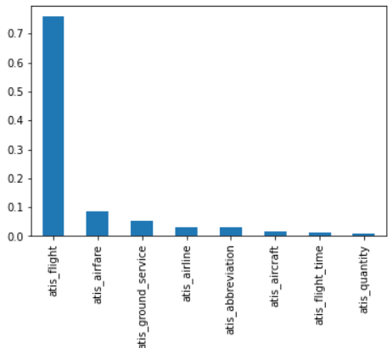
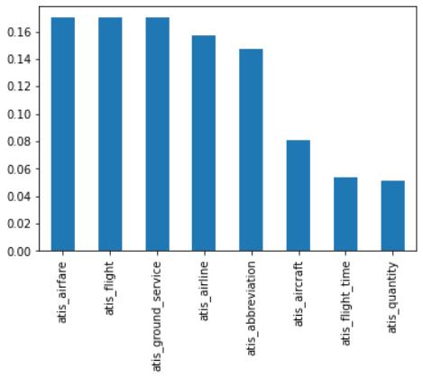
Data Loading and Preprocessing
The original training data is imbalanced
Undersampling strategy is used to balance classes
Training data after loading
Training data after resampling

Slide 5
Data Loading and Preprocessing
The resampled training data is used to train model.
A json file is created to store the :
Intent (as tag)
Train & test dataset
Store the response for each intent

Slide 6
Data Cleaning
Tokenize the input data
Ignore special characters (symbols, numbers, char+numbers)
Lemmatize the words
Create bag of words
Save the train and test datasets

Slide 7
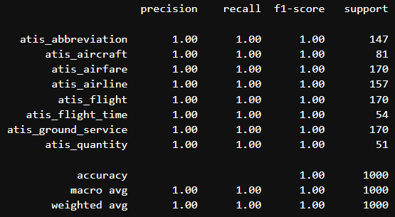
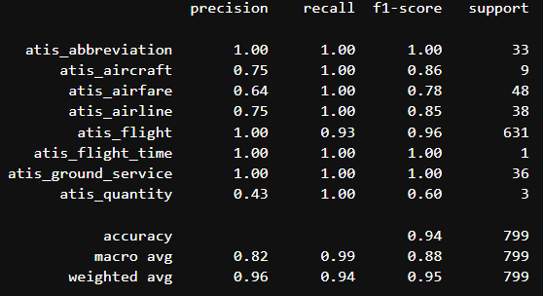
Modelling and Validation
Random Forest model is used
Accuracy on train data is 1.0 & on test data it is 0.94
Classification report of train data
Classification report of test data

Slide 8
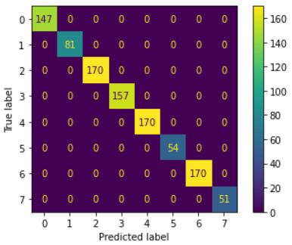
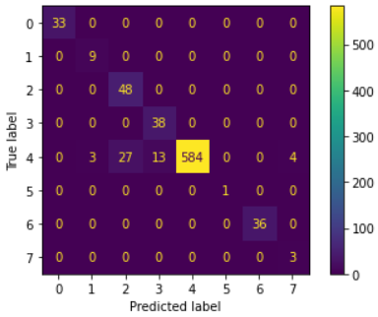
Result Analysis
Train Dataset
The model predicts all the intents accurately on train data.
(The model seems to be overtrained, however this hypothesis should be confirmed by analyzing the results from different types of models and optimizing the hyperparameters)
Test Dataset
Some predictions are mislabeled by the model on test data.
Label 4 i.e., atis_flight has been misclassified as atis_aircraft, atis_airfare, atis_airline, atis_quantity.
The probable reason for wrong prediction can be attributed to undersampling strategy (increased variance).
The original size of atis_flight category was 3665, which was decreased to 170 to reduce the imbalance in dataset.
However, this strategy should be revised, ensemble of different sampling technique and models could be used to address this.

Slide 9
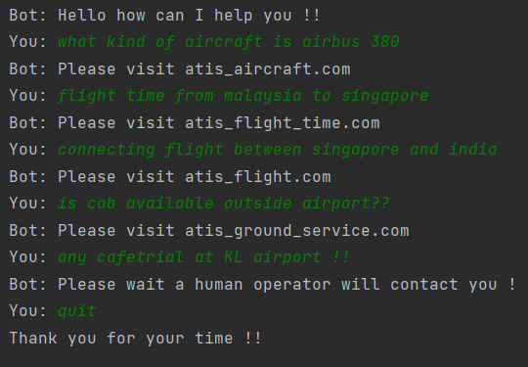
Bot

Slide 10
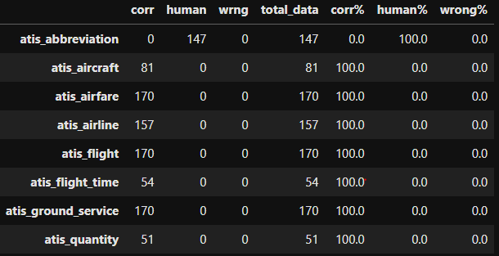
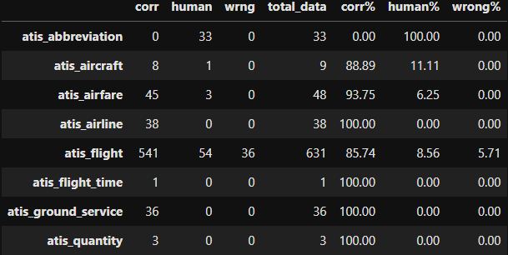
Bot Performance
Train Data
Test Data
NOTE : Tolerance value of 0.5 is used to filter out results with lower probability, i.e., sent to human operator due to low confidence.
The percentage of correct, sent to human and wrong predition for each category for train and test is shown above.
The train data had good score in most category but, the confidence probability is very low for the atis_abbreviation in both train and test data (100%).
(The probable reason for such low confidence could be due to the similarity of this particular category with other intents. To mitigate such behaviour the testing must be conducted on different models such as SVM, ANN. Additionally feature engineering should implemented to enhance the contents of each intent.)

Slide 11
Conclusion
To estimate the workload reduction:
Log the user interaction time with bot for each session.
Log the user interaction time with human operator for each session.
To ensure the bot accuracy over time:
Continuously monitor the correct, incorrect and chats transferred to human due to low confidence for given pair of datasets.
Update the train and test datasets with varying linguistics/slangs/demography and retrain the model and test accordingly.
Perform feature engineering using PCA to improve classifications results.
Optimize the lower probability confidence limit to increase correct intent prediction and lower the count of chat transfer to human operator.
Create ensemble of different models with varying sampling techniques

