Slide 1
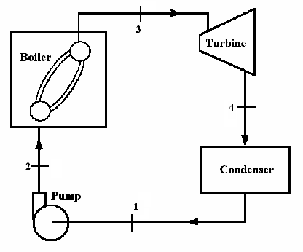
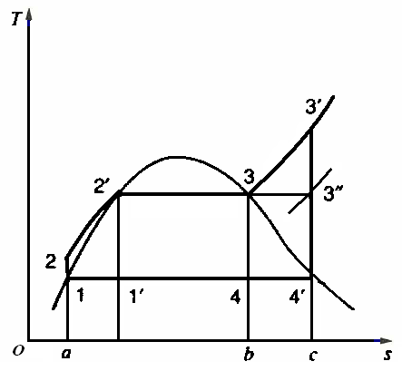
A466167英
In a Rankine cycle steam leaves the boiler and enters the
turbine at 4MPa and 400℃. The condenser pressure is 10
kPa. Determine the cycle efficiency.
Analysis
To determine the cycle
efficiency, we must calculate
theturbine work, the pump
work, and the heat transfer to
the steam in the boiler. We do
these by considering a control
surface around each of these
components in turn. In each
case the process is steady state
with negligible changes in
kinetic and potential energies.

Slide 2
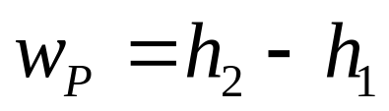
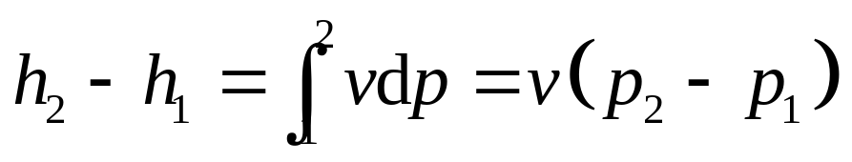
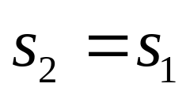
Solution
Fog the pump we have
Control volume: Pump
Inlet state: p₁known,
saturated liquid; state fixed
Exit state: p₂known.
From the first law, we have
The Second law gives

Slide 3
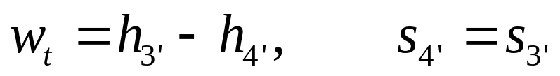
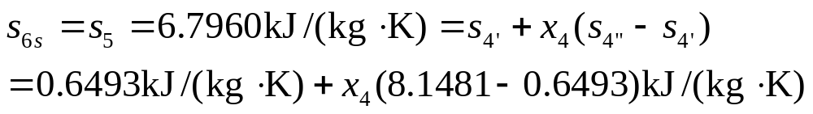
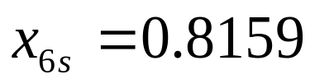
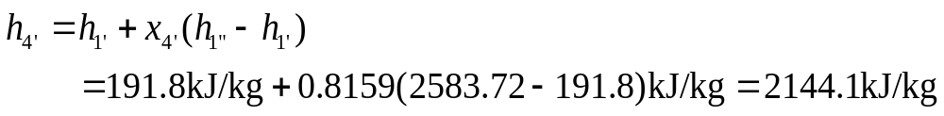
· For the turbine we have
Control volume: turbine
Inlet state: p₃,T₃known; state fixed
Exit state: p₄known.
The first and the second laws are

Slide 4
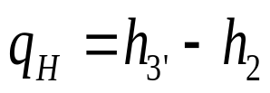
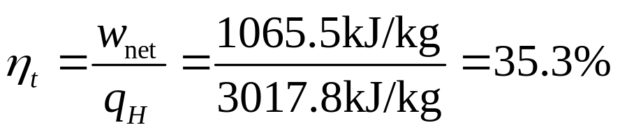
Finely fog the boiler we get
Control volume: Boiler
Inlet state: p₂,h₂known; state fixed
Exit state:State 3fixed(as given) .
Substituting, we obtain
The first law is
Substituting gives

Slide 5
The net work could also be determined by calculating the
heat rejected in the condenser, q_{L},
And noting , from the first law, that the net work for the
cycle is equal to the net heat transfer , therefore
back

