Slide 1
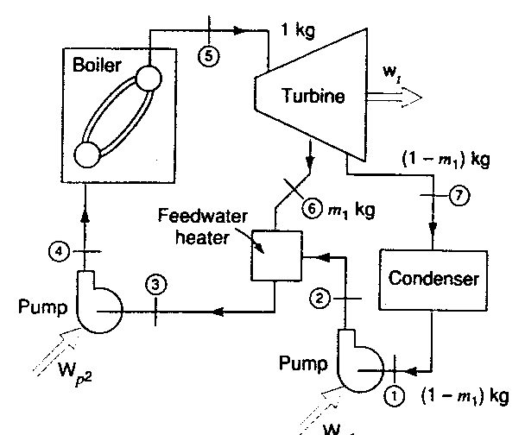
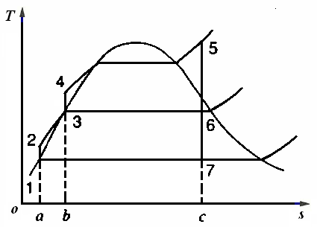
Consider a regenerative cycle using steam as the
workingfluid. Steam leaves the boiler and enters the turbine
at 4 MPaand 400 ℃. After expansion to 400kPa, some of the
steam isextracted from the turbine for purpose of heating the
feedwater in an open feedwater heater.The pressure in the
feedwater heater is 400kPa and the water leaving it is
saturated liquid at 400kPa. The steam not extracted expands
to 10kPa.Determine the cycle efficiency.
A466167英

Slide 2
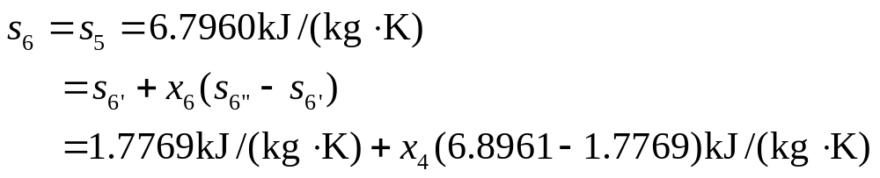

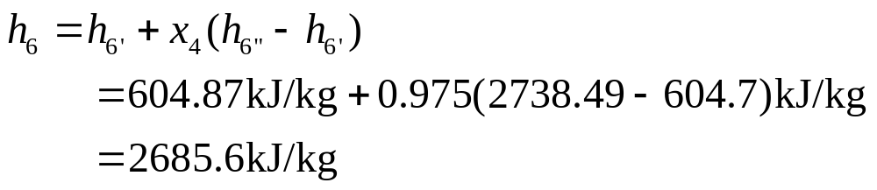
Analysis
As in example A466167, the process is steady state and kinetic and potential energy changes are negligible. And from the example we have the following properties:
Also, at p₆=400kPa, from the second law,

Slide 3
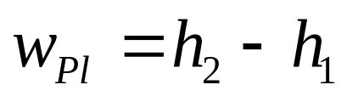
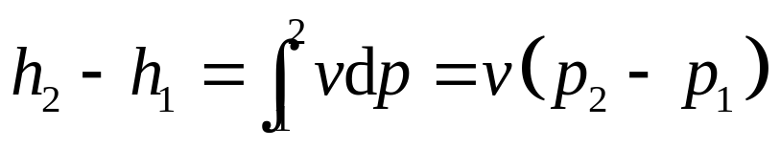
Solution
First consider the low-pressure pump
Control volume: Low-pressure pump
Inlet state: p₁known, saturated liquid; state fixed
Exit state: p₂known.
The first law is
Therefore
Next consider the feedwater heater
Control volume: Feedwater heater.
Inlet states: States2 and 6 both known(as given).
Exit state: p₃known, saturated liquid; state fixed

Slide 4


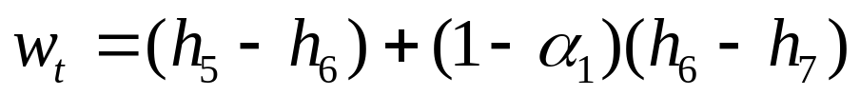
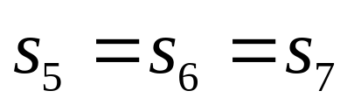
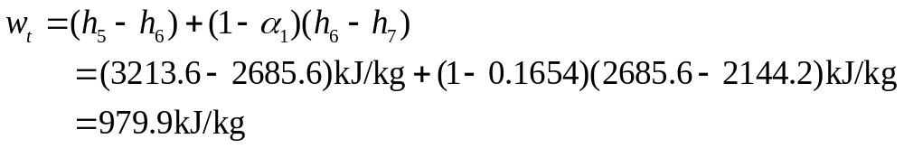
The first law gives us
Substituting, we obtain
· For the turbine we have
Control volume: turbine
Inlet state: p₅,T₅known; state fixed
Exit state: p₆known; p₇known.
The first and the second laws are
We can calculate the turbine work

Slide 5
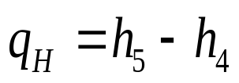
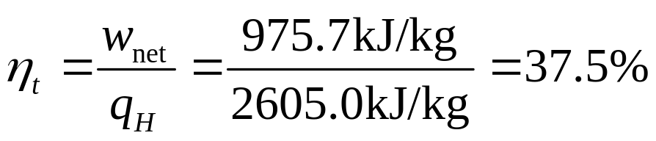
Finally for the boiler
Control volume: Boiler
Inlet state: p₄,h₄known(as given);
state fixed.
Exit state:State 5 fixed(as given) .
The first law is
Substituting gives
Therefore,
Note the increase in efficiency over the efficiency of the
Rankine cycle of example A4

Slide 6
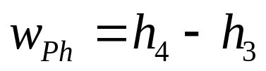
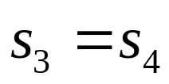
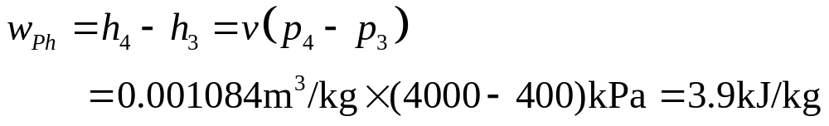
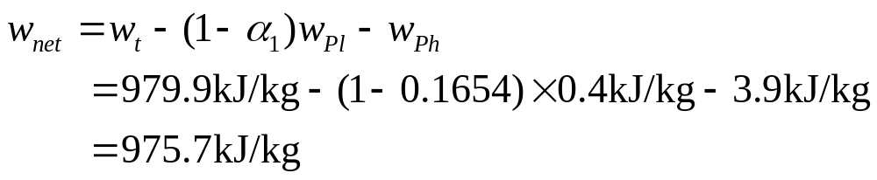
Let us turn now to the high-pressure pump
Control volume: High-pressure pump.
Inlet state: state 3 known(as given).
Exit state: p₄known.
The first and the second laws are
Substitution leads to
Therefore,

