Slide 1
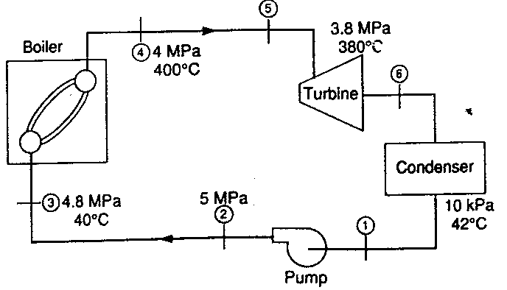
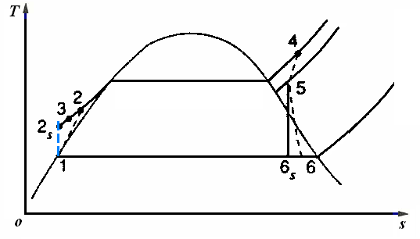
A466398（英）
A steam power plant operates on a cycle with pressures and
temperature as designated in following Fig. The efficiency
of the turbine is 86% and the efficiency of the pump is 80%.
Determine the thermal efficiency of this cycle. Assume that
Each process is steady state with no changes in kinetic or
potential energy.

Slide 2
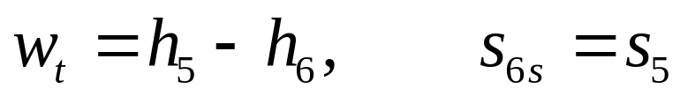
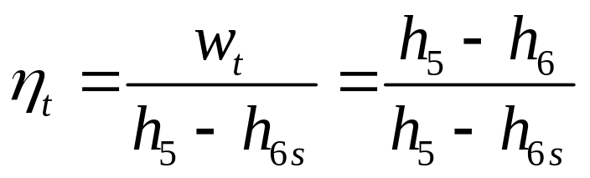
Analysis
This cycle is an actual one deviates from an ideal cycle. The
most important of the losses are due to the turbine, the pump,
the pipes, and the condenser.
· For the turbine we have
Control volume: Turbine
Inlet state: p₅,T₅known; state fixed
Exit state: p₆known.
From the first and the second laws we have
The efficiency of the turbine is

Slide 3
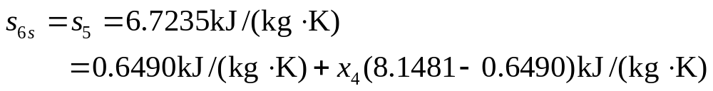

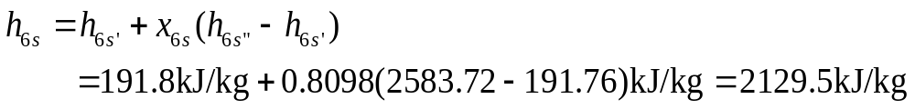
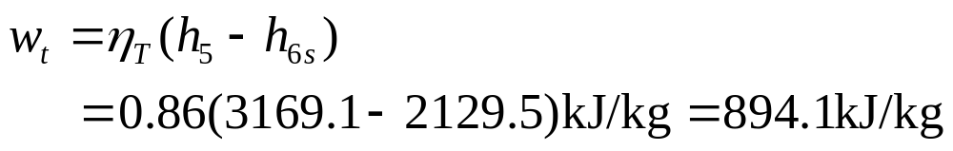
From the steam tables we get
Fog the pump we have
Control volume: Pump
Inlet state: p₁,T₁ known; state fixed
Exit state: p₂known.

Slide 4

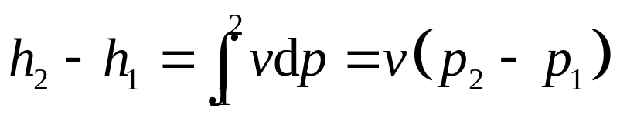
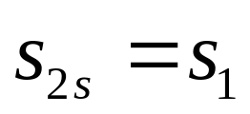
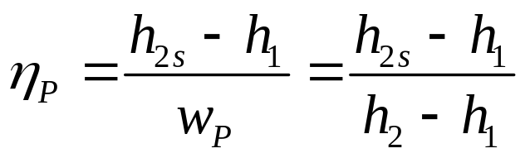
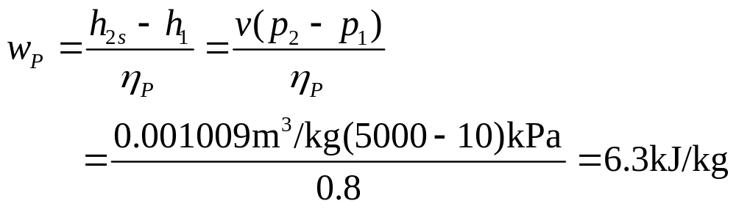
The first law gives
The Second law gives
The pump efficiency is
Therefore

Slide 5
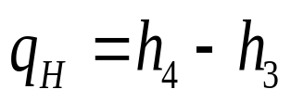
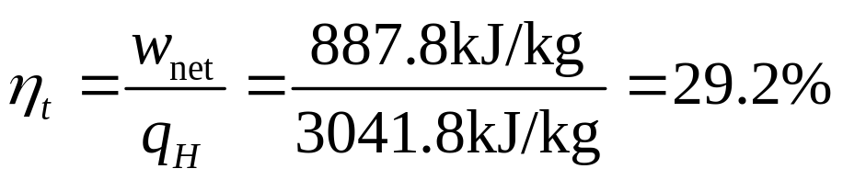
Finely, fog the boiler :
Control volume: Boiler
Inlet state: p₃,T₃known; state fixed.
Exit state: p₄,T₄known; state fixed.
The first law is
Substituting gives

