Slide 1
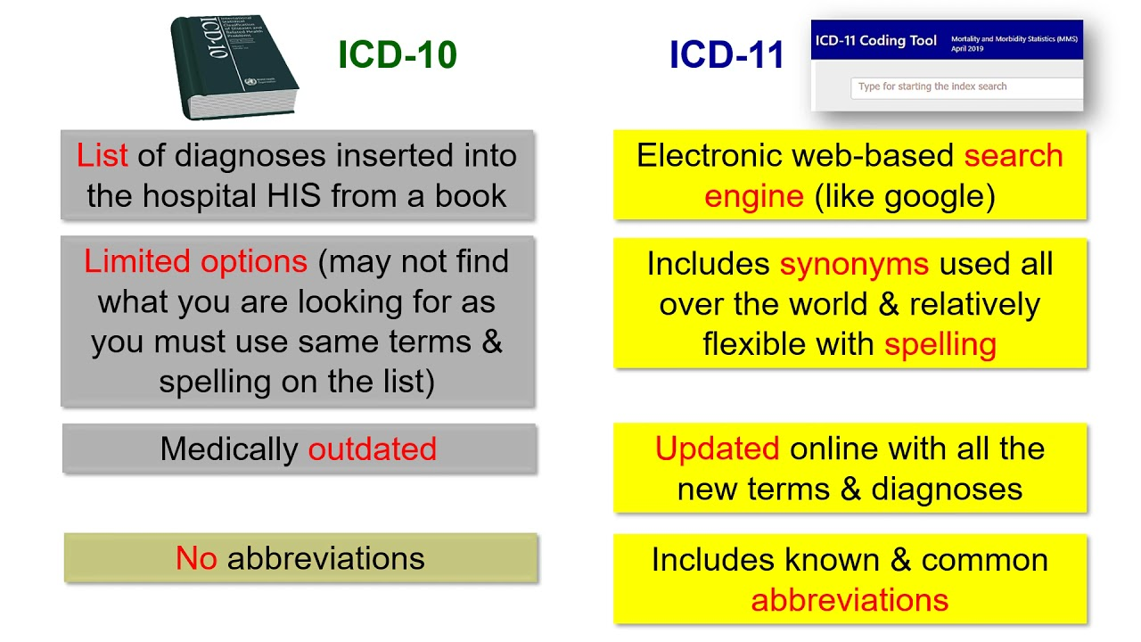

Slide 2
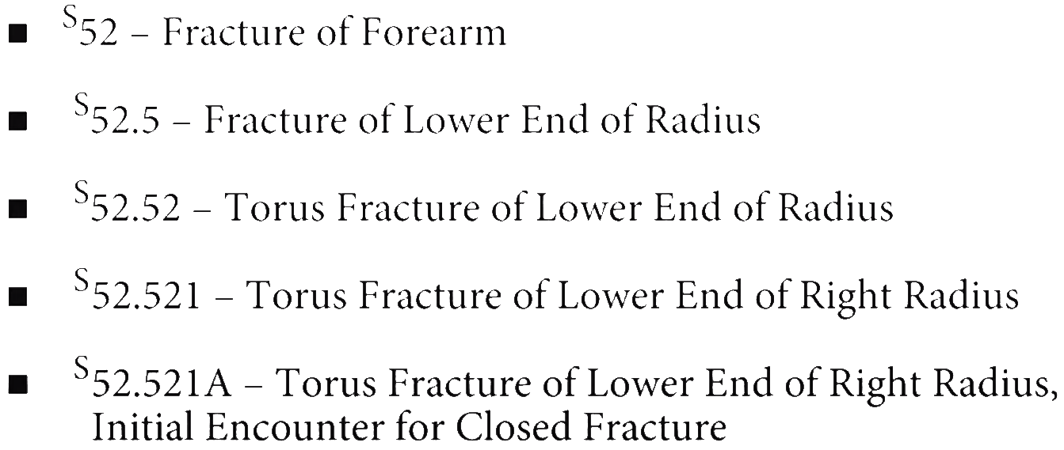

Slide 3
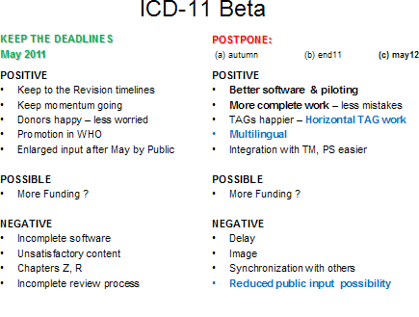

Slide 5
NEC Not elsewhere classifiable
NOS Not otherwise specified
A00-B99 Certain infections and parasitic diseases
C00-D49 Neoplasms
D50-D89 Diseases of the blood and blood-forming organs and certain disorders involving the immune mechanism
E00-E89 Endocrine, nutritional and metabolic diseases
F01-F99 Mental, Behavioral and Neurodevelopmental disorders
G00-G99 Diseases of the nervous system
H00-H59 Diseases of the eye and adnexa
H60-H95 Diseases of the ear and mastoid process
I00-I99 Diseases of the circulatory system
J00-J99 Diseases of the respiratory system
K00-K95 Diseases of the digestive system
L00-L99 Diseases of the skin and subcutaneous tissue
M00-M99 Diseases of the musculoskeletal system and connective tissue
N00-N99 Diseases of the genitourinary system
O00- O9A Pregnancy, childbirth, and puerperium
P00-P96 Certain conditions originating in the perinatal period
Q00-Q99 Congenital malformations, deformations and chromosomal abnormalities
R00-R99 Symptoms, signs, and abnormal clinical laboratory findings, not elsewhere classified
S00-T88 Injury, poisoning, and certain other consequences of external causes
V00-Y99 External causes of morbidity
Z00-Z99 Factors influencing health status and contact with health services
DISEASES
INJURIES
EXTERNAL
NEOPLASMS
ADULT
KID
condition/injury/disease

Slide 6
Diseases of the eye and adnexa H00-H59
Use an external cause code following the code for the eye condition, if applicable, to identify the cause of the eye condition
Type 2 Excludes
certain conditions originating in the perinatal period (P04-P96)
certain infectious and parasitic diseases (A00-B99 )
complications of pregnancy, childbirth and the puerperium (O00-O9A )
congenital malformations, deformations, and chromosomal abnormalities (Q00-Q99 )
diabetes mellitus related eye conditions (E09.3-, E10.3-, E11.3-, E13.3-)
endocrine, nutritional and metabolic diseases (E00-E88)
injury (trauma) of eye and orbit (S05.-)
injury, poisoning and certain other consequences of external causes (S00-T88 )
neoplasms (C00-D49 )
symptoms, signs and abnormal clinical and laboratory findings, not elsewhere classified (R00-R94)
syphilis related eye disorders (A50.01, A50.3-, A51.43, A52.71)
Codes
H00-H05 Disorders of eyelid, lacrimal system and orbit
H10-H11 Disorders of conjunctiva
H15-H22 Disorders of sclera, cornea, iris and ciliary body
H25-H28 Disorders of lens
H30-H36 Disorders of choroid and retina
H40-H42 Glaucoma
H43-H44 Disorders of vitreous body and globe
H46-H47 Disorders of optic nerve and visual pathways
H49-H52 Disorders of ocular muscles, binocular movement, accommodation and refraction
H53-H54 Visual disturbances and blindness
H55-H57 Other disorders of eye and adnexa
H59-H59 Intraoperative and postprocedural complications and disorders of eye and adnexa, not elsewhere classified
A00-Z99

Slide 7
Disorders of eyelid, lacrimal system and orbit
Type 2 Excludes
open wound of eyelid (S01.1-)
superficial injury of eyelid (S00.1-, S00.2-)
H00 Hordeolum and chalazion
H01 Other inflammation of eyelid
H02 Other disorders of eyelid
H04 Disorders of lacrimal system
H05 Disorders of orbit
Disorders of conjunctiva
H10 Conjunctivitis
H11 Other disorders of conjunctiva

Slide 8
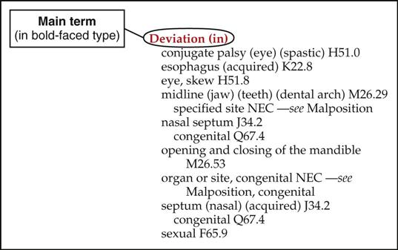
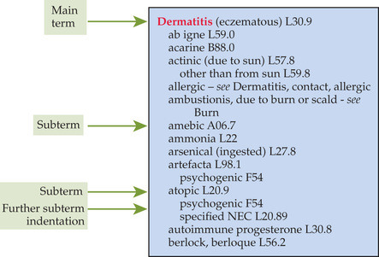
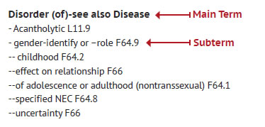
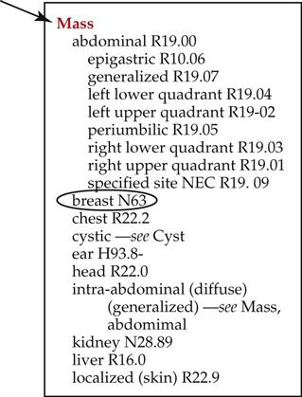

Slide 9
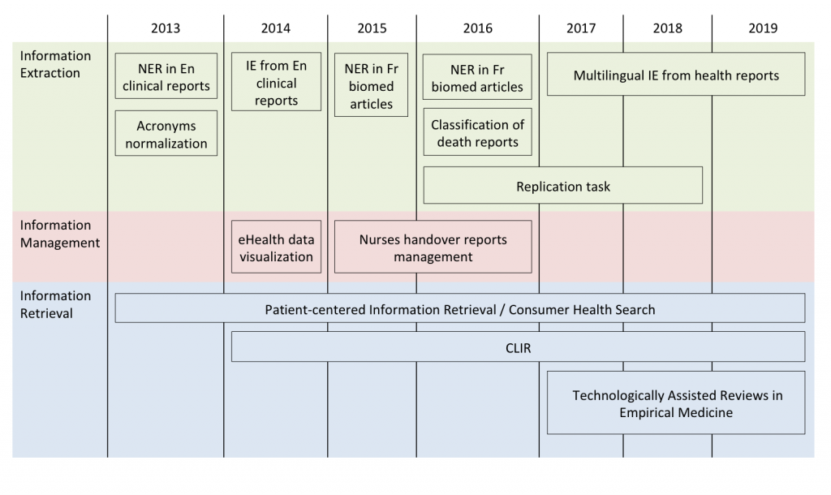

Slide 10
(icd10-py3.12) [josh@DEEP 10.221.252.12 ~]git clone https://huggingface.co/bert-base-uncased
Cloning into 'bert-base-uncased'...
remote: Enumerating objects: 85, done.
remote: Counting objects: 100% (85/85), done.
remote: Compressing objects: 100% (48/48), done.
remote: Total 85 (delta 32), reused 82 (delta 31), pack-reused 0
Unpacking objects: 100% (85/85), done.
Downloading coreml/fill-mask/float32_model.mlpackage/Data/com.apple.CoreML/weights/weight.bin (532 MB)
Downloading flax_model.msgpack (438 MB)
Downloading model.onnx (532 MB)
Downloading model.safetensors (440 MB)
Downloading pytorch_model.bin (440 MB)
Downloading rust_model.ot (534 MB)
Downloading tf_model.h5 (536 MB)
Checking out files: 100% (16/16), done.

Slide 11
NLP & MultiLabel Classification
NER: Named Entity Recognition
IE: Information extraction
IR: Information Retrieval
CLIR: Cross Language Information Retrieval
Data processing
Training model definition
Train the model on data
Evaluate the results
Save the trained Model

Slide 12
Bert is a transformers model pretrained on a large corpus of English data in a self-supervised fashion.
DistillBert is a transformers model, smaller and faster than BERT, which was pretrained on the same corpus in a self-supervised fashion, using the BERT base model as a teacher.
FlauBert is a French BERT trained on a very large and heterogeneous French corpus. Models of different sizes are trained using the new CNRS (French National Centre for Scientific Research)
BioBert is a biomedical language representation model designed for biomedical text mining tasks
ICD-10 code extraction using NLP is a real challenge. The previous work of CLEF researchers and our contribution confirms us in the idea of the full accomplishment of this project. The lack of corpus in French is a challenge that can be overcome with good partners such as French hospitals when we can guarantee the confidentiality of data and the protection of privacy. As a perspective, we want to introduce anonymization in our learning models. But learning on anonymized data typically results in a significant degradation in accuracy. We address this challenge by guiding our anonymization by using the best techniques, our target will be to minimize the impact on the model’s accuracy.

Slide 13
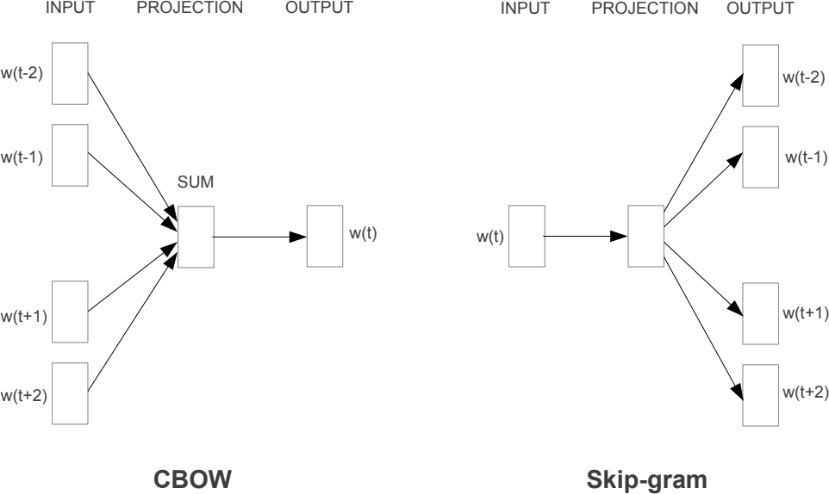
其中CBOW使用待預測詞語周圍的詞語 來進行預測 Skipgram則正好相反 它使用當前詞語 來預測它的周圍詞語 可以看到 與嚴格參照統計語言模型設計的NNLM不同 每個詞語的出現概率 只與它前面的詞語有關 Word2Vec在結構上更加自由 訓練目標也更多地是爲獲得詞向量服務 特別是其提出的同時通過上文和下文 來預測當前詞語的CBOW訓練方法 打破了語言模型的固定思維 爲後續一系列神經語言模型的發展奠定了基礎 Word2Vec取得了巨大的成功 但是無法處理多義詞問題 一詞多義正是語言靈活性和高效性的體現 但Word2Vec卻對此束手無策 無論詞語的上下文如何 Word2Vec對于一個詞語只能提供一個詞向量 即多義詞被編碼到了完全相同的參數空間 而事實上 早在上世紀90年代初 Yarowsky就給出了一個非常簡單又有效的解決方案 運用詞語之間的互信息 具體地 對于一個多義詞 分別從大量文本中找出這個詞在表示不同語義時 同時出現的互信息最大的一些詞 當在判別詞語語義時 只需要看看上下文中哪些詞語出現的多就可以了 即通過上下文來判斷這個詞語當前表達的語義
香農與信息論 1948 年香農 Claude Elwood Shannon 在著名的論文通信的數學原理中 提出了信息熵的概念 解決了信息的度量問題 并且量化出信息的作用 上面提到的互信息就來自于信息論 如果你對此感興趣 博文信息的度量和作用 信息論基本概念 因此在後來的幾年中 標準NLP流程都是將 Word2Vec 預訓練好的詞向量作為模型的輸入 然後通過 LSTM CNN 等模型來重新對句子中的詞語進行編碼 以便捕獲到詞語的上下文信息

Slide 14
