Slide 1
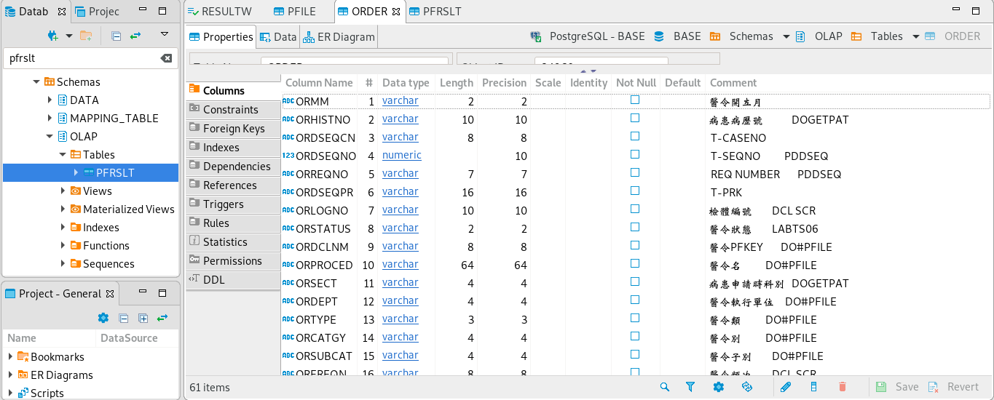

Slide 2
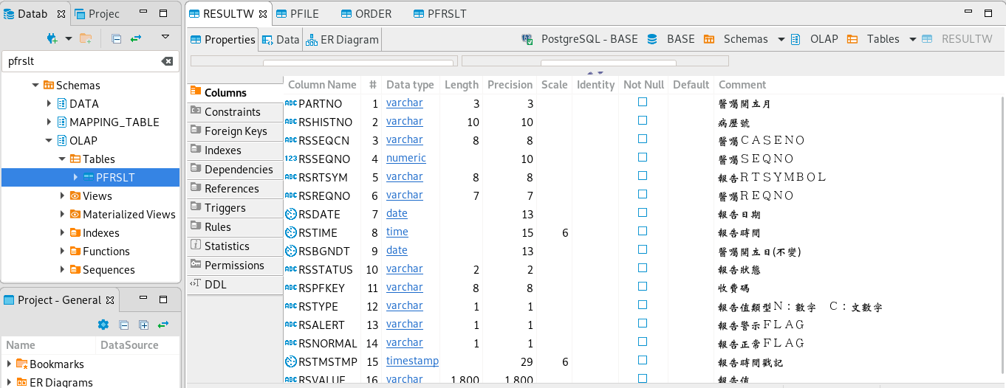

Slide 3
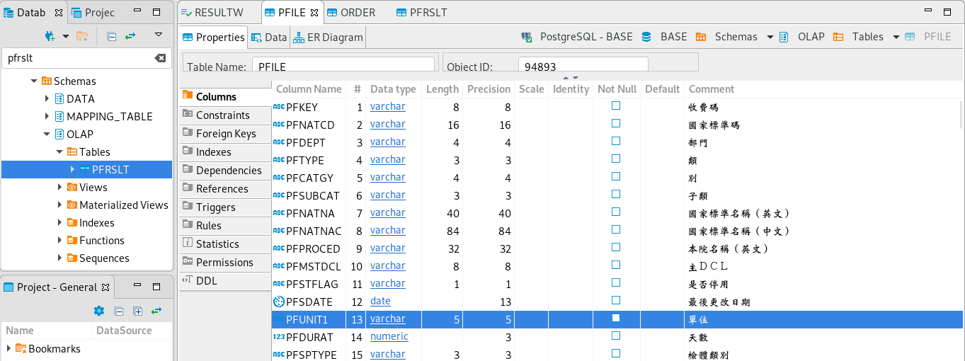

Slide 4
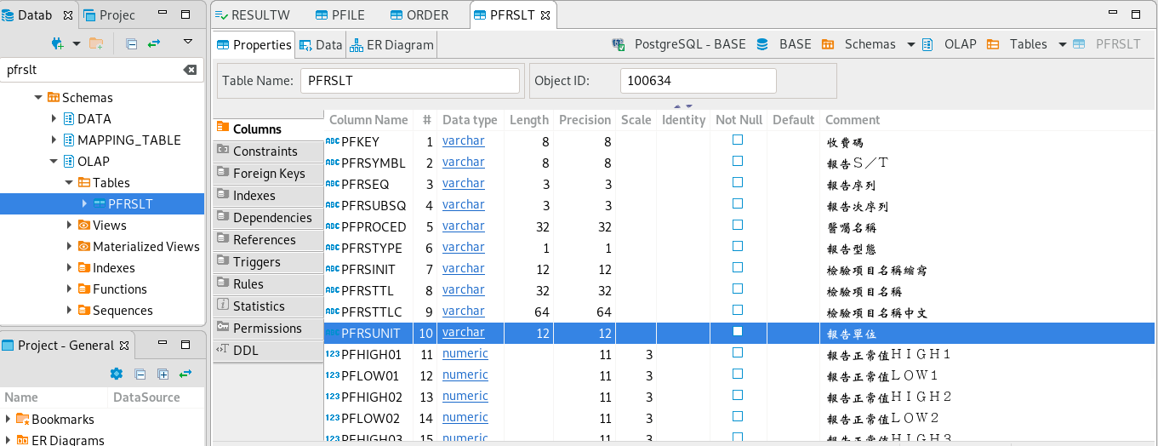

Slide 5
select O."ORHISTNO", O."ORDSEQCN", O."ORREQNO", O."ORPROCED", O."ORTYPE", trim(R."RSRTSYM"), R."RSPFKEY", R."RSVALUE", R."RSTMSTMP", PF."PFNATNA", PF."PFNATNAC", PF."PFUNIT1", PF."PFPROCED", PF."PFNHICD", PR."PFRSYMBL", PR."PFRSINIT", PR."PFRSTTL", PR."PFRSTTLC", PR."PFRSUNIT", PR."PFREFER" FROM "OLAP"."ORDER" O, "OLAP"."RESULT" R, "OLAP"."PFILE" PF, "OLAP"."PFRSLT" PR WHERE O."ORHISTNO" = R."RSHISTNO" AND O."ORDSEQCN"= R."RSSEQCN" AND O."ORREQNO" = R."RSREQNO" AND R."RSPFKEY" = PF."PFKEY" AND R."RSPFKEY" = PR."PFKEY" AND O."ORTMSTMP"<R."RSTMSTMP" AND O."ORSTATUS" >= '64' AND O."ORSTATUS" <='68';
-- PR."PFKEY", PR."PFPROCED",

Slide 6
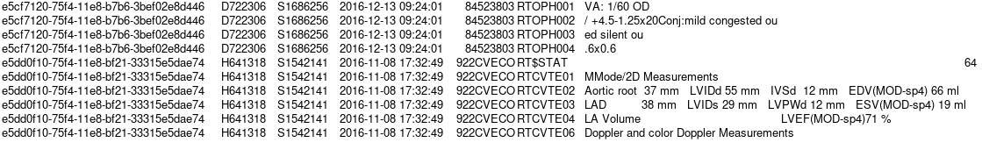
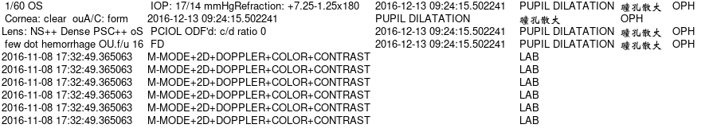

Slide 7
\copy (select trim(O."ORHISTNO"), trim(O."ORDSEQCN"), trim(O."ORREQNO"), O."ORTMSTMP", trim(R."RSRTSYM"), trim(R."RSPFKEY"), trim(R."RSVALUE"), R."RSTMSTMP", trim(PF."PFNATNA"), trim(PF."PFNATNAC"), trim(PF."PFUNIT1"), trim(PF."PFPROCED"), trim(PF."PFNHICD"), trim(PR."PFRSYMBL"), trim(PR."PFRSINIT"), trim(PR."PFRSTTL"), trim(PR."PFRSTTLC"), trim(PR."PFRSUNIT"), trim(PR."PFREFER") FROM "ORDER3" O, "RESULT" R, "PFILE" PF, "PFRSLT" PR WHERE O."ORHISTNO"=R."RSHISTNO" AND O."ORDSEQCN"=R."RSSEQCN" AND O."ORREQNO"=R."RSREQNO" AND R."RSPFKEY"=PF."PFKEY" AND R."RSPFKEY"=PR."PFKEY" and R."RSRTSYM"=PR."PFRSYMBL" AND O."ORTMSTMP"<R."RSTMSTMP" AND O."ORSTATUS" >= '64' AND O."ORSTATUS" <='68') to /mnt/isilon/order3LBDT.tsv with(format csv, delimiter E'\x06');

Slide 8
SELECT M."UUID", O."ORDSEQCN", O."ORREQNO", O."ORPROCED", O."ORTMSTMP",
R."RSPFKEY", trim(R."RSRTSYM"), R."RSVALUE", R."RSTMSTMP",
PF."PFTYPE", PF."PFNATNA", PF."PFNATNAC", trim(PF."PFPROCED")
FROM "MAPPING_TABLE"."MAPPING_PHISTNUM" M, "OLAP"."ORDERW" O, "OLAP"."RESULTW" R, "OLAP"."PFILE" PF WHERE O."ORHISTNO"=R."RSHISTNO" AND O."ORDSEQCN"= R."RSSEQCN" AND O."ORREQNO" = R."RSREQNO" AND R."RSPFKEY" = PF."PFKEY" AND R."RSSTATUS" >= '64' AND R."RSSTATUS" <='68' AND O."ORTMSTMP"<R."RSTMSTMP" AND O."ORHISTNO" = M."PHISTNUM"

Slide 9
select trim(O."ORHISTNO"), trim(O."ORDSEQCN"), trim(O."ORREQNO"), O."ORTMSTMP", trim(R."RSRTSYM"), trim(R."RSPFKEY"), trim(R."RSVALUE"), R."RSTMSTMP", trim(PF."PFNATNA"), trim(PF."PFNATNAC"), trim(PF."PFUNIT1"), trim(PF."PFPROCED"), trim(PF."PFNHICD"), trim(PR."PFRSYMBL"), trim(PR."PFRSINIT"), trim(PR."PFRSTTL"), trim(PR."PFRSTTLC"), trim(PR."PFRSUNIT"), trim(PR."PFREFER") FROM "ORDER3" O, "RESULT" R, "PFILE" PF, "PFRSLT" PR WHERE O."ORHISTNO"=R."RSHISTNO" AND O."ORDSEQCN"=R."RSSEQCN" AND O."ORREQNO"=R."RSREQNO" AND R."RSPFKEY"=PF."PFKEY" AND R."RSPFKEY"=PR."PFKEY" and R."RSRTSYM"=PR."PFRSYMBL" AND O."ORTMSTMP"<R."RSTMSTMP" AND O."ORSTATUS" >= '64' AND O."ORSTATUS" <='68')

Slide 10
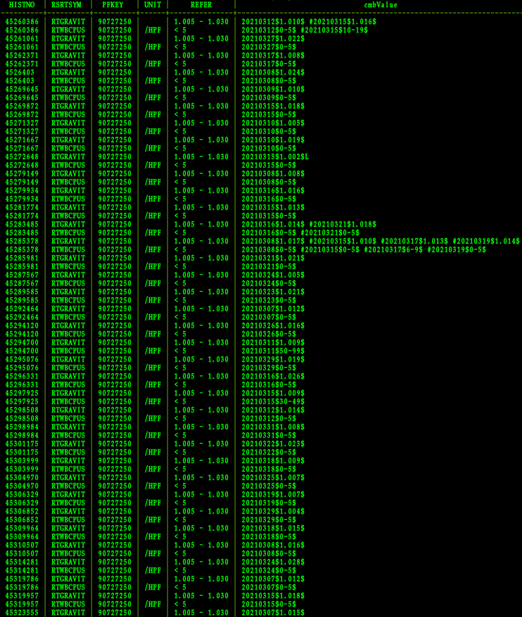
select cmb."HISTNO", cmb."RSRTSYM", cmb."PFKEY", cmb."UNIT", cmb."REFER", string_agg(concat(cmb."RSDATE", '$',cmb."RSVALUE", '$', cmb."RSNORMAL"), '#'order by cmb."RSDATE") "cmbValue" from (select trim(R."RSHISTNO") "HISTNO", R."RSREQNO" "REQNO", R."RSSEQCN" "SEQCN", R."RSRTSYM" "RSRTSYM", R."RSPFKEY" "PFKEY", R."RSNORMAL" "RSNORMAL", replace("RSDATE"::varchar,'-','')::integer "RSDATE", R."RSVALUE" "RSVALUE", PR."PFRSUNIT" "UNIT", PR."PFREFER" "REFER" from nhird."latestRESULT" R inner JOIN "PFRSLT" PR on R."RSPFKEY"=PR."PFKEY" and R."RSRTSYM"=PR."PFRSYMBL" where "RSSTATUS"<='68' and "RSSTATUS">='64' and "PFRSTYPE"='N')cmb where cmb."RSRTSYM"!~'COMENT' group by (cmb."HISTNO", cmb."RSRTSYM", cmb."PFKEY", cmb."REFER", cmb."UNIT") order by 1 ;

Slide 11
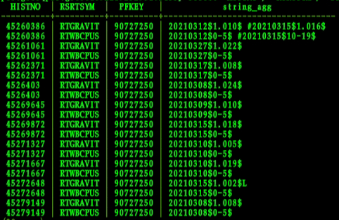
select "HISTNO", "RSRTSYM", "PFKEY", string_agg(concat("RSDATE", '$',"RSVALUE", '$', "RSNORMAL"), '#'order by "RSDATE")from nhird."symLBDT2021"where "RSRTSYM"!~'COMENT' group by ("HISTNO", "RSRTSYM", "PFKEY") order by 1 limit 20;

Slide 12
select cmb."HISTNO", cmb."RSRTSYM", cmb."PFKEY", cmb."UNIT", cmb."REFER", string_agg(concat(cmb."RSDATE", '$',cmb."RSVALUE", '$', cmb."RSNORMAL"), '#'order by cmb."RSDATE")from (select trim(R."RSHISTNO") "HISTNO", R."RSREQNO" "REQNO", R."RSSEQCN" "SEQCN", R."RSRTSYM" "RSRTSYM", R."RSPFKEY" "PFKEY", R."RSNORMAL" "RSNORMAL", replace("RSDATE"::varchar,'-','')::integer "RSDATE", R."RSVALUE" "RSVALUE", PR."PFRSUNIT" "UNIT", PR."PFREFER" "REFER" from nhird."latestRESULT" R inner JOIN "PFRSLT" PR on R."RSPFKEY"=PR."PFKEY" and R."RSRTSYM"=PR."PFRSYMBL" where "RSSTATUS"<='68' and "RSSTATUS">='64' and "PFRSTYPE"='N')cmb where cmb."RSRTSYM"!~'COMENT' group by (cmb."HISTNO", cmb."RSRTSYM", cmb."PFKEY", cmb."REFER", cmb."UNIT") order by 1 ;

Slide 13
PFILE
ORDER
PFKEY
PFNATNA
PFNATNAC
PFUNIT1
PFPROCED
PFNHICD
RESULT
ORHISTNO
ORREQNO
ORSEQCN
ORPROCED
ORTMSTMP
RSHISTNO
RSREQNO
RSSEQCN
RSPFKEY
RSRTSYM
RSVALUE
RSTMSTMP
PFRSLT
PFNATNA 國家標準名稱（英文）
PFNATNAC 國家標準名稱（文字）
PFPROCED 本院名稱英文 相當於 OO 檔的ARNHPNAM (檢驗或藥品名稱)
PFNHICD
PFKEY
PFRSYMBL
PFRSINIT
PFRSTTL
PFRSTTLC
PFRSUNIT
PFREFER
LEFT JOIN

Slide 14
select distinct p."PHISTNUM",p."PGROUP1" "PGRP", c."PHYSDATE" from "PBCANCER"p join "CISIPHY"c on p."PHISTNUM"= c."PHISTNUM" where "PGROUP1"~'GIST';
RESULT
病理報告
PBCANCER
PHISTNUM
PGROUP1
HISTNO
RSTMSTMP
aggrRTSYM
REPORT
TRUNCATE
RSHISTNO
RSTMSTMP
RSRTSYM
RSVALUE
CISIPHY
PHISTNUM
PHYSDATE
INNER JOIN

Slide 15
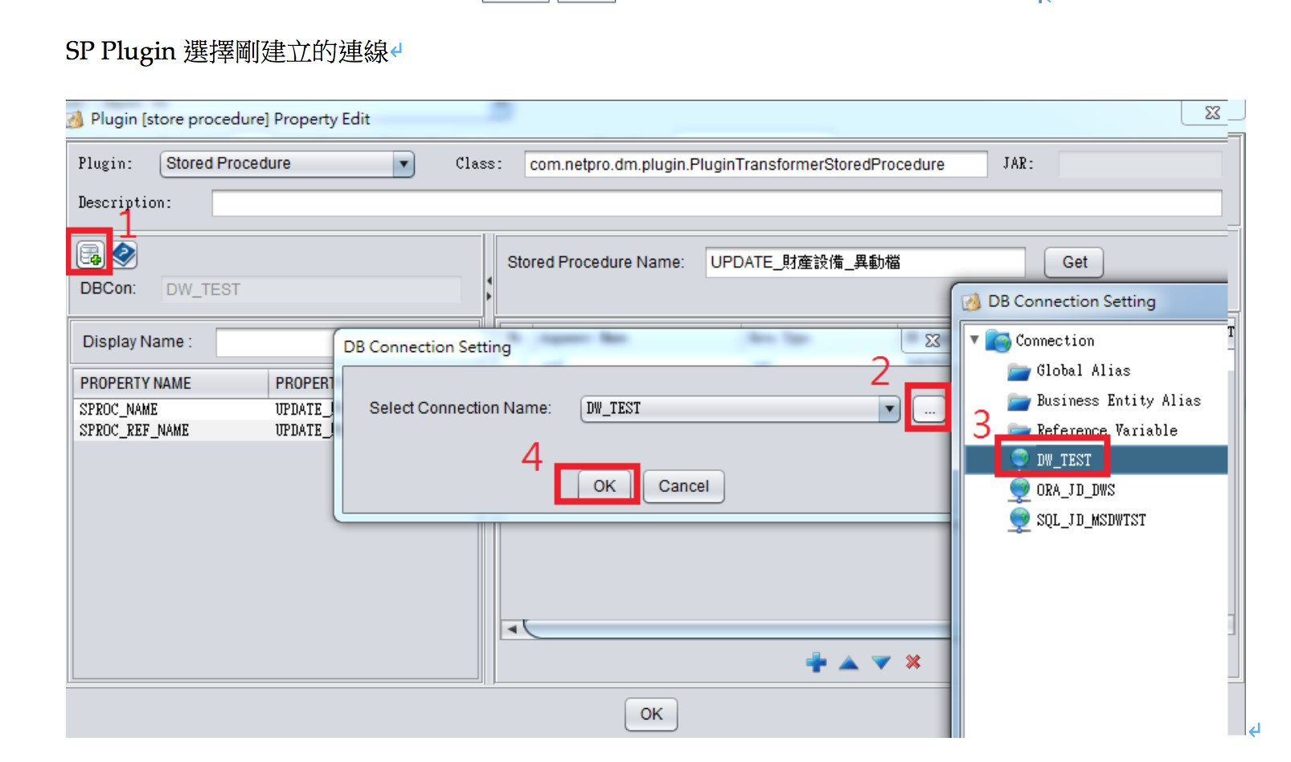

Slide 16
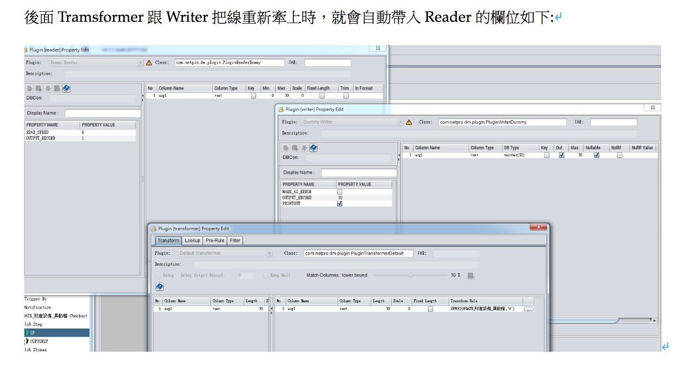

Slide 17
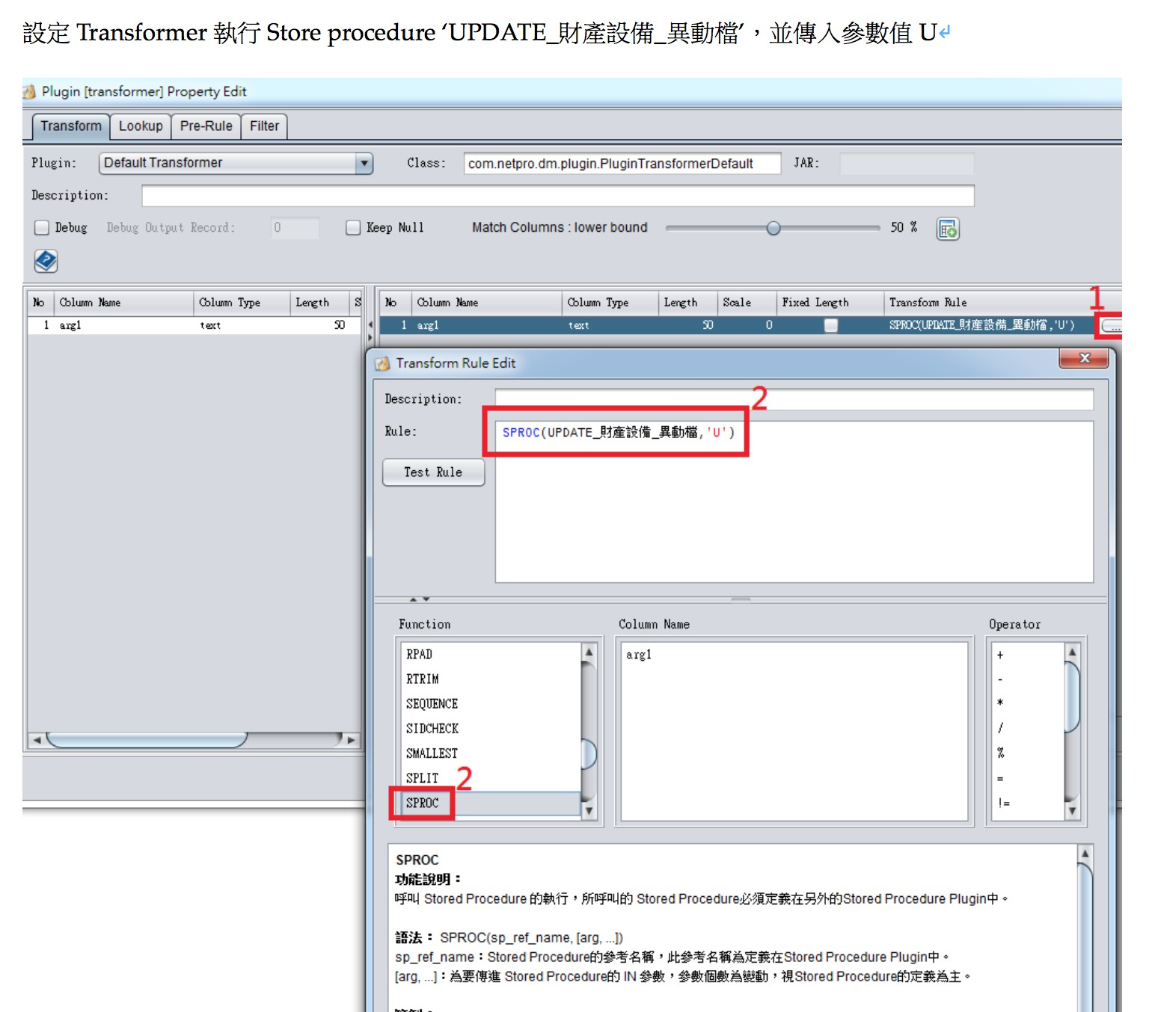

Slide 18
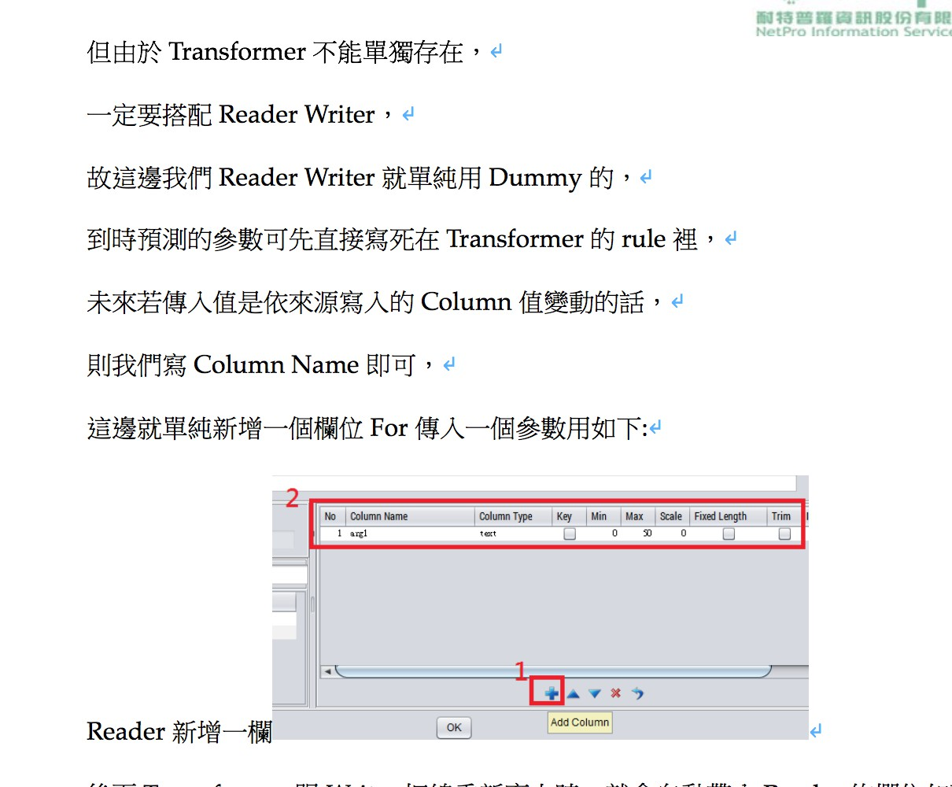

Slide 19
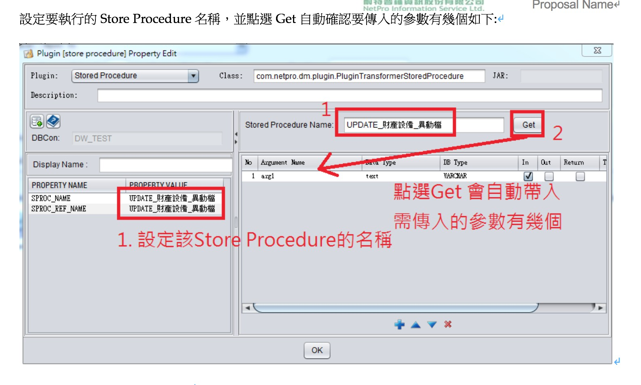

Slide 20
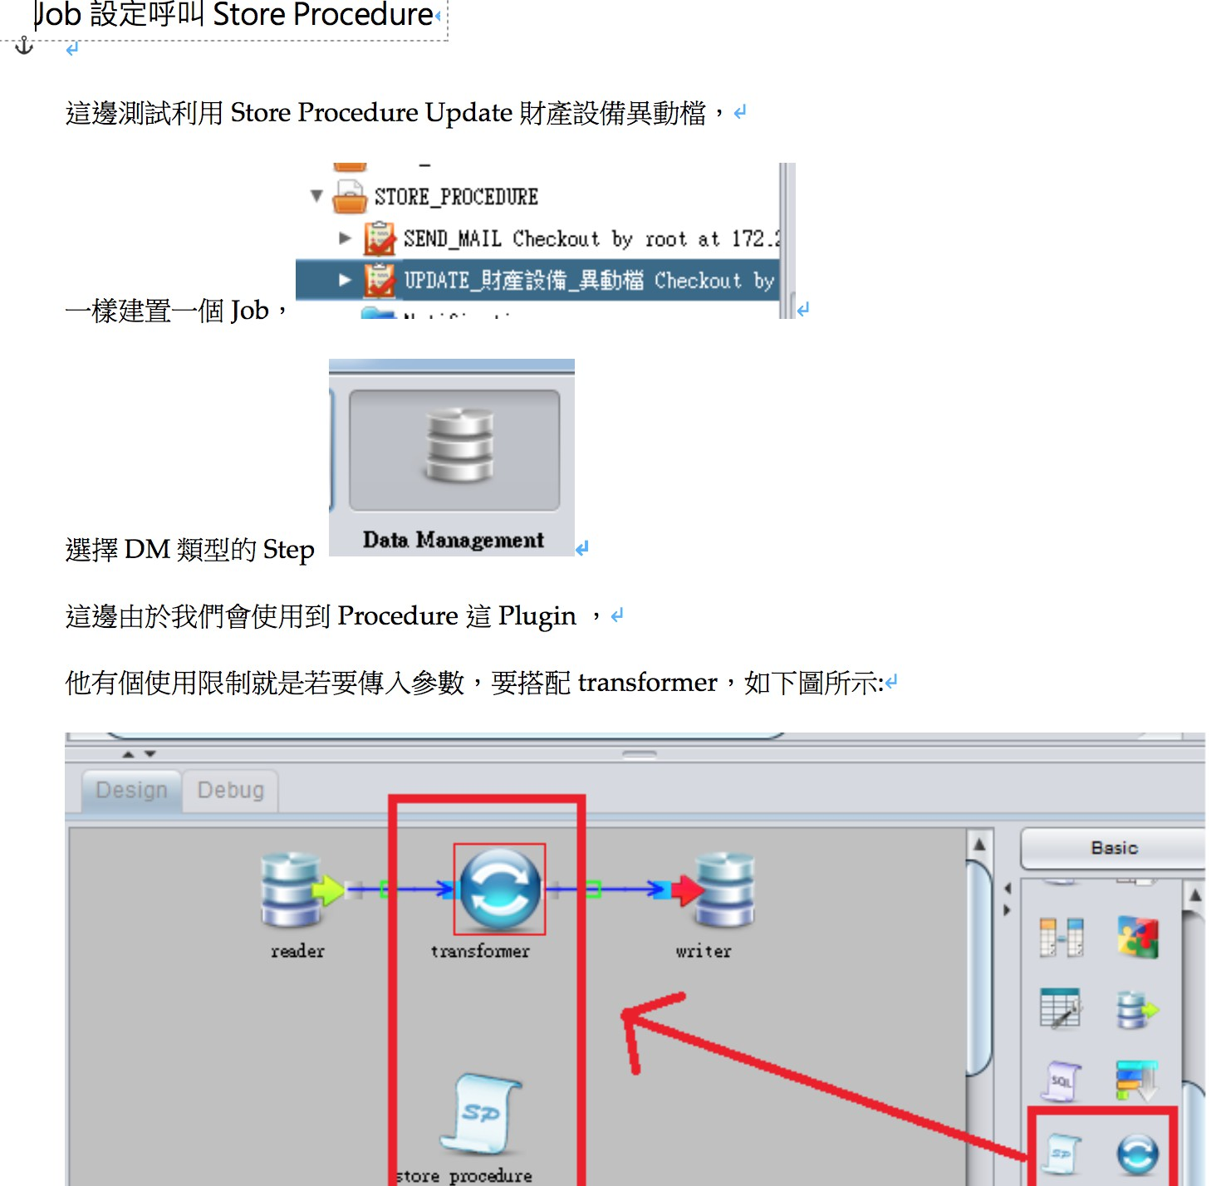

Slide 24
SELECT "PBVD01" AS "height", "PBVD02" AS "weight", "PBVD04" AS "bmi" FROM "OLAP"."PBVDATA" WHERE "PBTYPE" = 'HWS' AND "PBVSTAT" = 'Y' LIMIT 10;
ID
CD
PIDNO
PHISTNUM
PIDNO
PSEX
PBIRTHDT
PPATZIP
PFSTVDT
PPBLOOD
ID
ARNHIST
UUID
PIDNO
PHISTNUM
UUID
PHISTNUM
INNER JOIN

