Slide 1
Web Socket over Stomp
Way of Bidirectional Communication

Slide 2
What is Socket?
A socket is a protocol that enables bidirectional communication between programs. Through an open socket, programs can exchange data, much like passing information through a pipe.

Slide 3
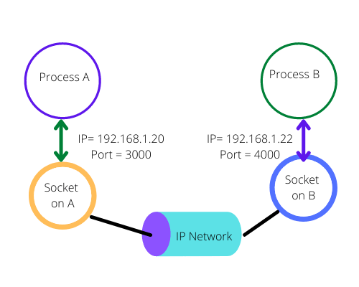

Slide 4
What is WebSocket?
WebSocket is a bidirectional, full-duplex protocol used to establish communication between a client and a server.

Slide 5
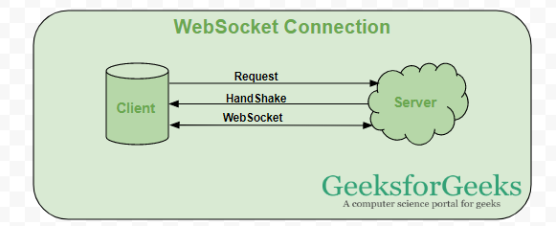

Slide 6
Use cases of WebSocket
Real-time web application: Real-time web application uses a web socket to show the data at client end, which is continuously being sent by the backend server. In WebSocket, data is continuously pushed/transmitted into the same connection which is already open, that is why WebSocket is faster and improves the application performance. e.g. in a trading website or bitcoin trading, for displaying the price fluctuation and movement data is continuously pushed by the backend server to the client end by using a WebSocket channel.

Slide 7
Use cases of WebSocket
Gaming application: In a Gaming application, you might focus on that, data is continuously received by the server, and without refreshing the UI, it will take effect on the screen, UI gets automatically refreshed without even establishing the new connection, so it is very helpful in a Gaming application.

Slide 8
Use cases of WebSocket
Chat application: Chat applications use WebSockets to establish the connection only once for exchange, publishing, and broadcasting the message among the subscribers. It reuses the same WebSocket connection, for sending and receiving the message and for one-to-one message transfer.

Slide 9
Differences between HTTP and Websocket
HTTP | WebSockets
It’s unidirectional ensuring that only a request or a response is taking place at a time | The bidirectional nature of WebSocket makes to and from data transmission possible. Many responses for one request can be shared.
The connection isn’t open for long | Connection can remain open for an indefinite time
The connection is terminated automatically as soon as a response is shared | Connection continues till the time client/server decides to end it.
It’s perfect for stateless RESTful applications. | Preferred for the development of real-time, gaming, and chat applications.
As it used TCP, the connection tends to get slow | As the connection doesn’t take a break, data delivery is quick.
It’s not an event-driven protocol. | WebSocket is highly event-driven.

Slide 10
Differences between HTTP and Websocket
 | HTTP | WebSockets
Technology used | Full duplex | Half duplex
Data type handled | Static and stagnant data | Real time and continuously updated data
Latency overheads | High | Low
Operational overheads | High as you need to generate fresh request for each unique/next response | Relatively low as one request can generate multiple responses as long as a connection is open
Speed | Slow as it takes time to establish a new connection for every request | Fast as connection remains open as long as it’s not terminated by one party
Ability to handle frequent request | Frequent requests will reduce the performance of the connection | Frequent requests will have no impact on the connection they can be handled easily

Slide 11
What is Stomp?
STOMP (Streaming Text Oriented Messaging Protocol) is a messaging protocol that can be used over WebSocket. It defines topics (public or private) for communication, allowing clients to subscribe, unsubscribe, send, and receive messages. STOMP standardizes the message format exchanged between clients and servers, enabling bidirectional communication.

Slide 12
Pros
Real-time and dynamic updates: STOMP allows real-time communication between clients and servers, making it ideal for applications that require instant data updates.
Easy to implement on the client side: STOMP can be easily integrated with WebSocket libraries, and many client libraries exist to simplify implementation.
Protocol agnostic messaging: STOMP allows a higher-level abstraction for messaging, making it easier to work with different brokers (e.g., RabbitMQ, ActiveMQ) that support the protocol.
Support for multiple message patterns: STOMP supports pub/sub and point-to-point messaging, making it flexible for different use cases.

Slide 13
Cons
Scaling across clusters can be complex: While STOMP can work well for simple setups, scaling it across multiple servers or in a clustered environment requires additional infrastructure, like message brokers or Redis for session sharing.
No built-in load balancing: STOMP lacks built-in load balancing or clustering mechanisms, so external solutions (like message brokers) are required to handle large-scale deployments.
Higher overhead than native WebSocket: STOMP adds extra overhead due to its messaging format and protocol, which can be unnecessary for lightweight applications or simple WebSocket communication.
Limited security features: STOMP itself doesn't provide advanced security features. Security mechanisms (e.g., authentication and authorization) need to be implemented separately.

Slide 14
What’s Pub/Sub
Pub/Sub is an asynchronous and scalable messaging service that decouples services producing messages from services processing those messages.
Pub/Sub lets you create systems of event producers and consumers, called publishers and subscribers. Publishers communicate with subscribers asynchronously by broadcasting events, rather than by synchronous remote procedure calls (RPCs).

Slide 15
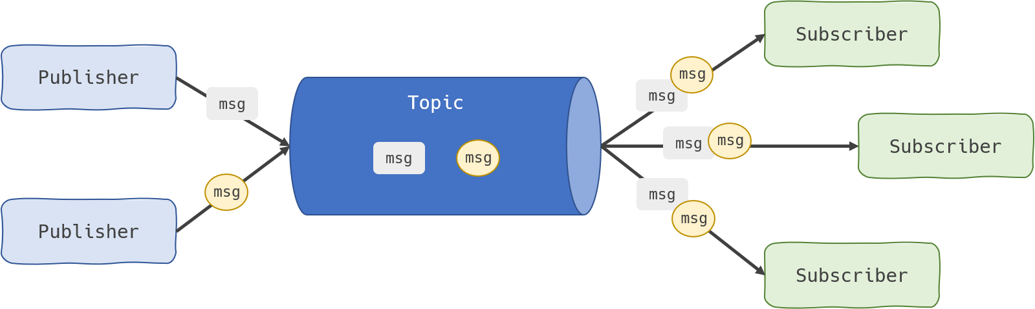

Slide 16
So what did we accomplish?
Typically, we implement pub/sub over Redis, but other technologies like Kafka or RabbitMQ can also be used. In a STOMP-based system, each pod communicates with others to relay messages, which are then delivered to subscribed clients.

Slide 17
References
https://cloud.google.com/pubsub/docs/overview
https://tsh.io/blog/how-to-scale-websocket/
https://www.ibm.com/docs/en/zos/2.4.0?topic=services-what-is-socket
https://www.geeksforgeeks.org/what-is-web-socket-and-how-it-is-different-from-the-http/
https://www.geeksforgeeks.org/socket-in-computer-network/
https://developer.mozilla.org/en-US/docs/Web/API/WebSockets_API
https://stackoverflow.com/questions/40988030/what-is-the-difference-between-websocket-and-stomp-protocols
https://www.geeksforgeeks.org/stomp-protocol/
https://www.wallarm.com/what/websocket-vs-http-how-are-these-2-different#:~:text=HTTP%20is%20better%20suited%20for,and%20typical%20request%2Dresponse%20cycles.&text=Which%20one%20is%20faster%20%2D%20WebSocket,need%20for%20new%20HTTP%20requests.
https://ably.com/topic/websockets-vs-http
https://stackoverflow.com/questions/38140849/stomp-over-websockets-vs-plain-stomp-which-one-is-better

Slide 18
Thank you for your attention!
Feel free to reach out if you have any questions or need further clarification.
Halit Burak Yeşildal
Email: burak.yesildal@tigahealth.com
LinkedIn: https://www.linkedin.com/in/burakyesildal/
We appreciate your time and interest!

