Slide 1

Note: The data and information in this document is reflective of a hypothetical situation and client. This document is to be used for KPMG Virtual Internship purposes only.
Sprocket Central Pty Ltd
Data analytics approach
[Data Division - Phyllis Nabangi]

Slide 2
Note: The data and information in this document is reflective of a hypothetical situation and client. This document is to be used for KPMG Virtual Internship purposes only.
Agenda
Introduction
Data Exploration
Model Development
Interpretation

Slide 3

Note: The data and information in this document is reflective of a hypothetical situation and client. This document is to be used for KPMG Virtual Internship purposes only.
Introduction
Building a recommendation system for the marketing strategy
Task
Perform exploratory data analysis and build machine learning models that will be used for making recommendations for Sprocket marketing strategy.
Tools
Python Libraries (Matplotlib, Seaborn, Numpy, Pandas)
Power Bi

Slide 4

Note: The data and information in this document is reflective of a hypothetical situation and client. This document is to be used for KPMG Virtual Internship purposes only.
Data Exploration
Perform Explanatory Data Analysis on the 3 Datasets after pre-processing the data.
Data Pre-processing Tasks
Data Cleaning: fixing / removing anomalies in the data. Anomalies include incorrect data, missing data, duplicates, irrelevant data
Data Integration: mapping the data attributes and entities.
Data transformation: smoothing (remove noise or identify important features), normalization and aggregation.

Slide 5

Note: The data and information in this document is reflective of a hypothetical situation and client. This document is to be used for KPMG Virtual Internship purposes only.
Model Development
Build three machine learning models and select the best
Model development and Evaluation steps:
Feature Engineering: using forward stepwise approach to select the significant features.
Models: Build 3 models (Random Forest, Logistic Regression and Naives bayes) and evaluate them
Performance metric: Cross-validation will be used as the performance evaluation metric
Model selection: The model that performs best will be recommended for use.

Slide 6
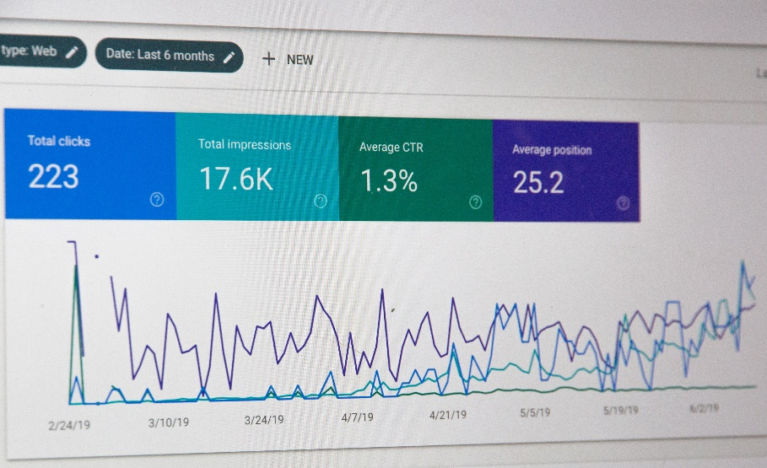
Note: The data and information in this document is reflective of a hypothetical situation and client. This document is to be used for KPMG Virtual Internship purposes only.
Interpretation
Findings will be presented in infographics and visuals
The following data visualization tools will be used.
Graphs, Visualizing statistical analysis using Python Libraries(matplotlib, seaborn)
Interactive report using Power Bi

Slide 7
Note: The data and information in this document is reflective of a hypothetical situation and client. This document is to be used for KPMG Virtual Internship purposes only.
Any Questions?

