Slide 1


DL4Phylo
A Deep Learning Approach to Phylogenetic Analysis
Miguel Raposo, Gonçalo Silva
Supervisor: Cátia Vaz
July 2024

Slide 2
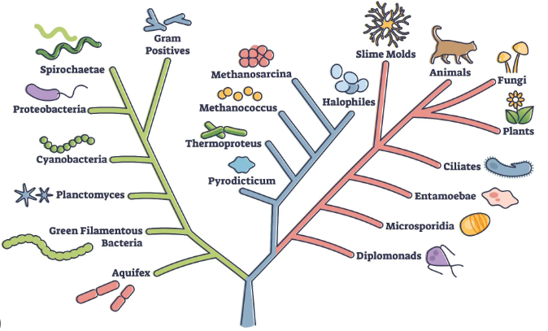
What is DL4Phylo?
It is a project encompassed in one of the fastest growing areas - Artificial Intelligence
It is a tool designed for estimation and generation of phylogenetic trees.
It uses Deep Learning techniques to achieve this functionality.
It covers the review and reproduction of recent approaches, and extends them to different input data, such as Typing Data.
Notes:
A IA é um dos temas mais discutidos ultimamente e esta área que está a crescer a um grande ritmo só tenderá a evoluir mais nos anos que se seguem.
São imensas as empresas que começam a investir de forma séria nesta área e são imensas as utilidades e aplicações que a IA tem e com certeza virá a ter em outras áreas da engenharia e da ciência.

Slide 3


What’s DL4Phylo purpose?
Acquire knowledge about the area in question.
Adapt an existing platform to a new type of input.
Analyze the results of this adaptation.
Notes:
Estudar uma porção desta área em crescimento, no nosso caso, com aplicação à bioinformática.
Através deste estudo conseguir adaptar uma plataforma já existente a um novo tipo de input.
Verificar se conseguimos obter uma melhoria ou não nos resultados com a nossa solução

Slide 4
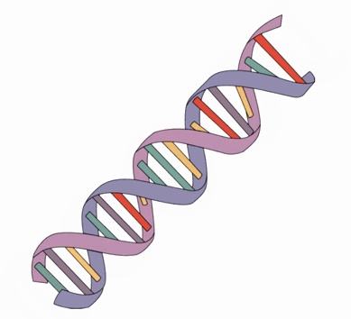

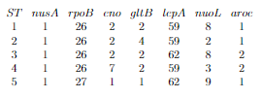
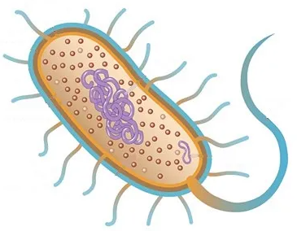
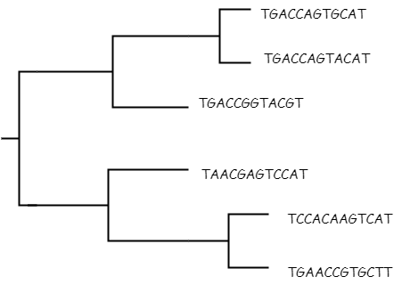


What is Phylogenetic Inference
Bacteria
DNA
Typing Data
DNA Sequences
Tree
Isolate Data
Distance Matrix
Notes:
Inferencia filogenética é a ciência q estuda a diversidade biológica. Isto é feito através da analise e caracterização dos diferentes organismos consoante a sua historia de evolução

Slide 5
Typing Data
It is usually the result of a molecular typing technique, such as Multi Locus Sequence Typing (MLST).
The comparison of the profiles is done between lines, analyzing whether the identifier between them is equal or not.
ST | nusA | rpoB | eno | gltB | lepA | nuoL | aroc
1 | 1 | 26 | 2 | 2 | 59 | 8 | 1
2 | 1 | 26 | 2 | 4 | 59 | 2 | 1
3 | 1 | 26 | 2 | 2 | 62 | 8 | 2
4 | 1 | 26 | 7 | 2 | 59 | 3 | 2
5 | 1 | 27 | 1 | 1 | 62 | 9 | 1

Slide 6
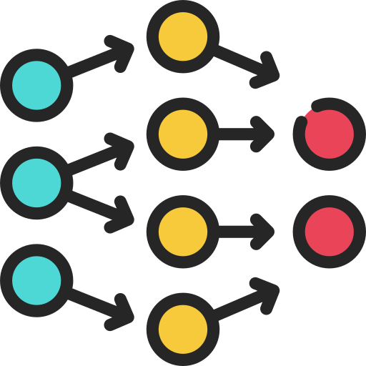
Pipelines
DL4Phylo includes two main execution flows, which we will refer to as pipelines:
Training Phase
Prediction Phase

Slide 7
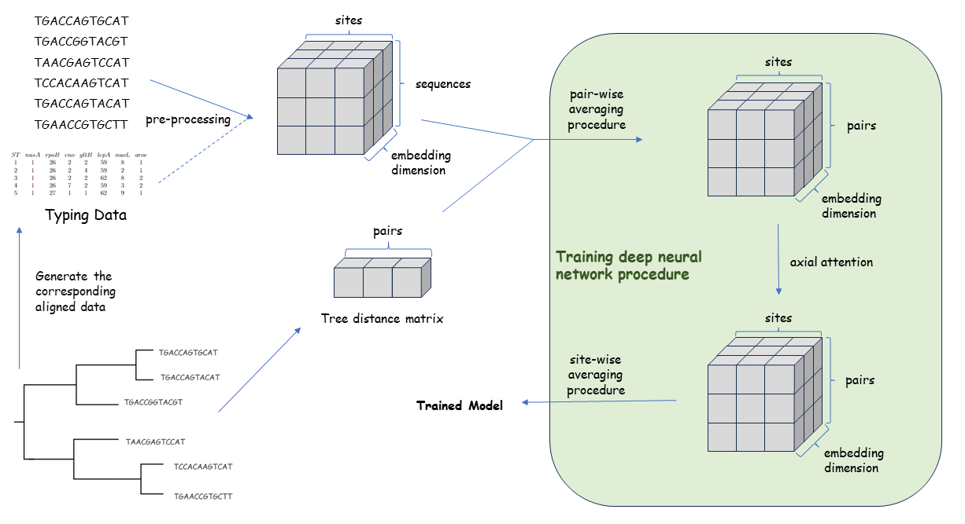
Training Phase

Slide 8
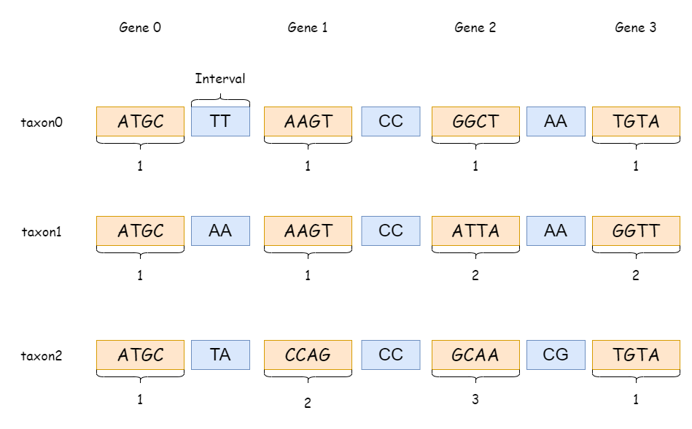
From Sequences to Typing Data
ATGCTTAAGTCCGGCTAATGTA
ATGCAAAAGTCCATTAAAGGTT
ATGCTACCAGCCGCAACGTGTA

Slide 9
Pre-processing
A T G C
1 | 0 | 0 | 0
0 | 1 | 0 | 0
0 | 0 | 0 | 1
0 | 0 | 1 | 0
0 | 0 | 0 | 1
1 | 0 | 0 | 0
0 | 0 | 0 | 1
NUCLEOTIDES
taxon0 | ATCGCAC
taxon1 | ATGGCAT
taxon2 | GCACCTC
One-hot encoding taxon0
32 … 5 4 3 2 1
TYPING DATA
0 | … | 0 | 0 | 0 | 0 | 1
0 | … | 0 | 0 | 0 | 0 | 1
0 | … | 0 | 0 | 1 | 0 | 0
0 | … | 0 | 0 | 1 | 0 | 1
0 | … | 0 | 0 | 1 | 1 | 0
0 | … | 0 | 1 | 0 | 0 | 0
0 | … | 0 | 0 | 0 | 0 | 1
ST 1 | 1145681
ST 2 | 2188161
ST 3 | 1275117
Binary encoding ST 1

Slide 10
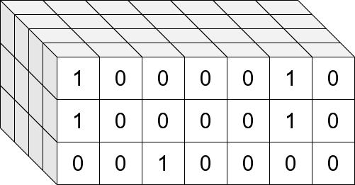
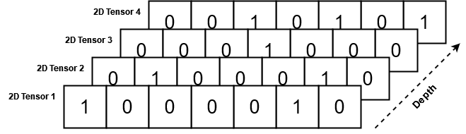
Pre-processing
Reshaped into a 3-dimensional tensor
Data length
Number of Sequences
Encoding dimension
Each tensor has a shape of:
encoding size * 1 * data length
The tensor from every sequence is concatenated

Slide 11
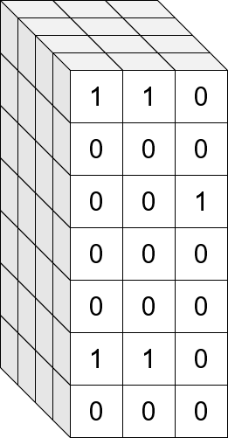
Number of Sequences
Pre-processing
It's transposed the number of sequences and sequence length in this tensors shape.
This final tensor represents all the sequences in the alignment encoded into values, allowing the machine to process them.
Data length
Encoding dimension

Slide 12
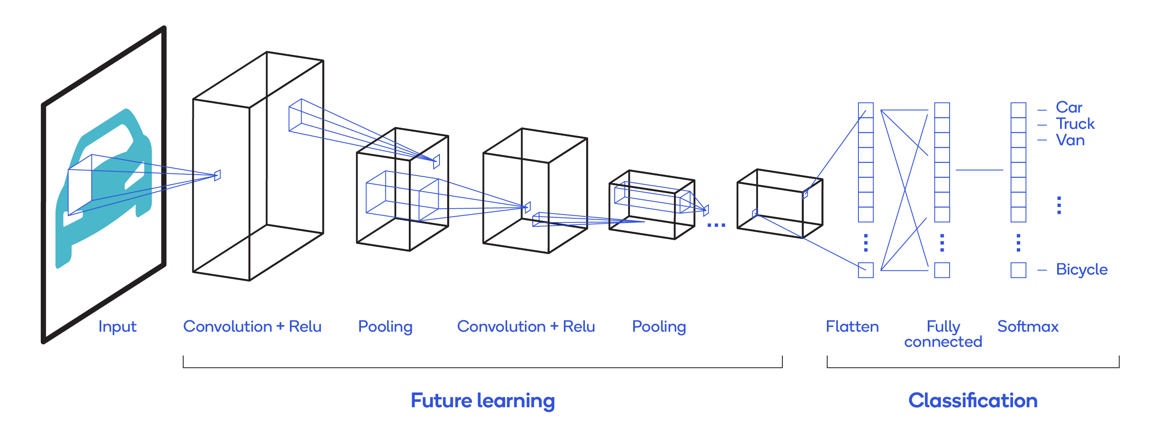
Convolutional Neural Network
https://towardsdatascience.com/a-comprehensive-guide-to-convolutional-neural-networks-the-eli5-way-3bd2b1164a53

Slide 13
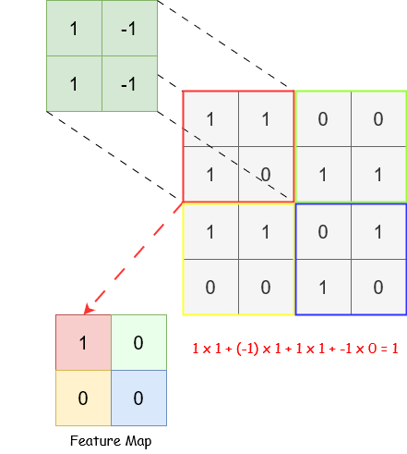
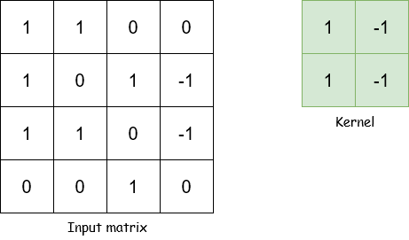
Convolutional Neural Network

Slide 14
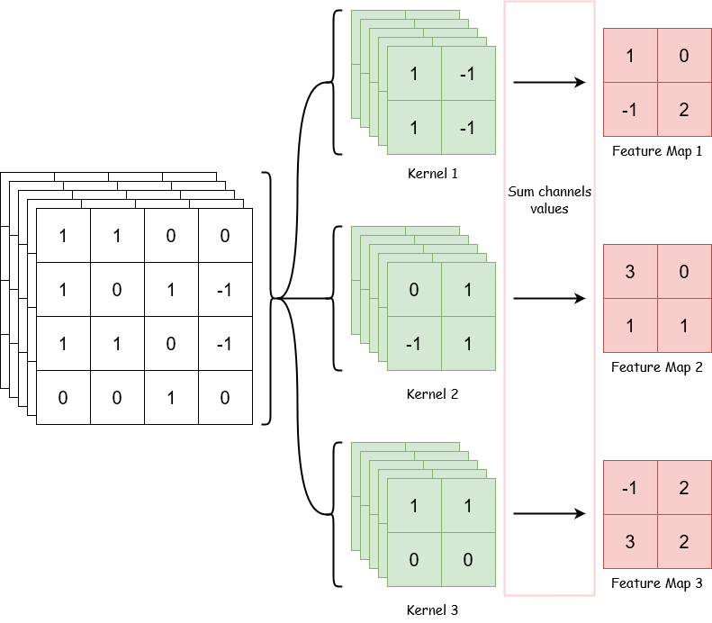
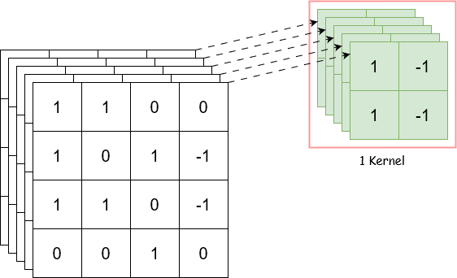
Convolutional Neural Network

Slide 15
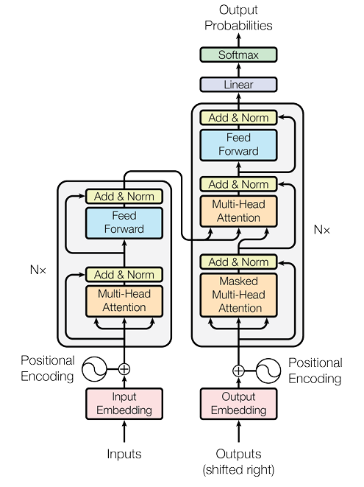
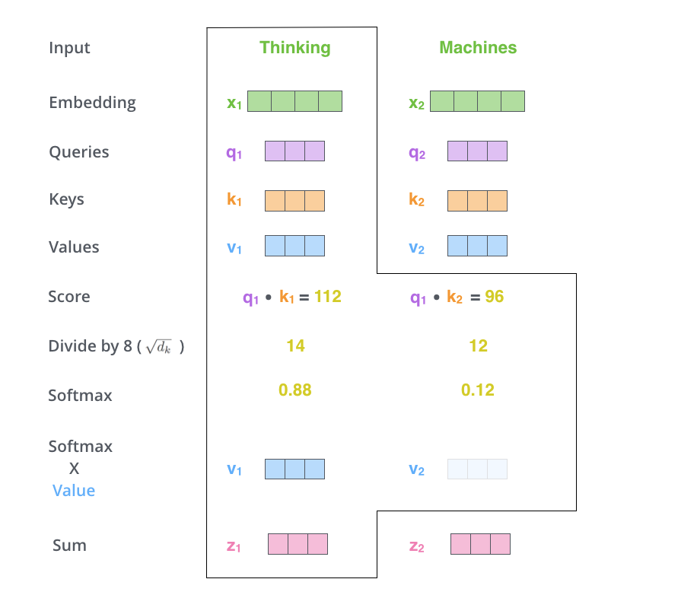
Transformer and attention
Ashish Vaswani et al. “Attention is all you need”. In: Advances in neural information processing systems 30 (2017).

Slide 16
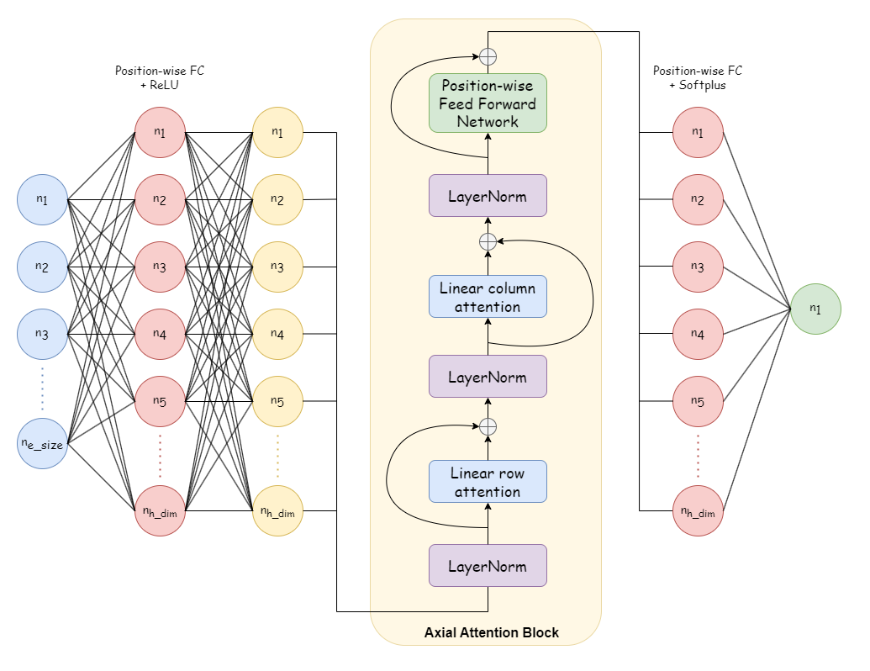
Training Deep Neural Network Procedure

Slide 17
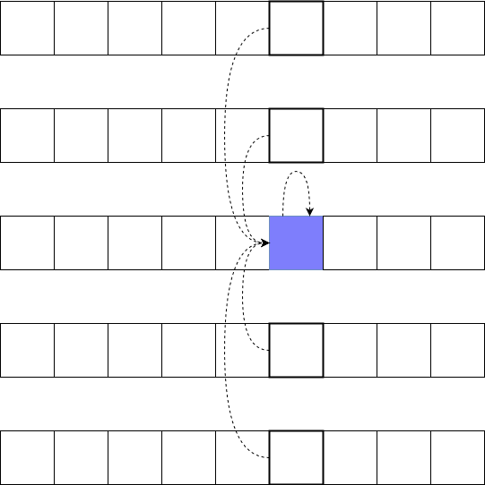
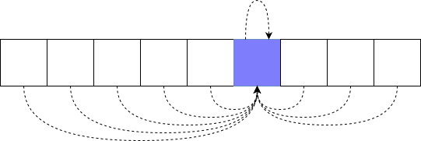
Training Deep Neural Network Procedure
Pair-level attention
Site-level attention

Slide 18
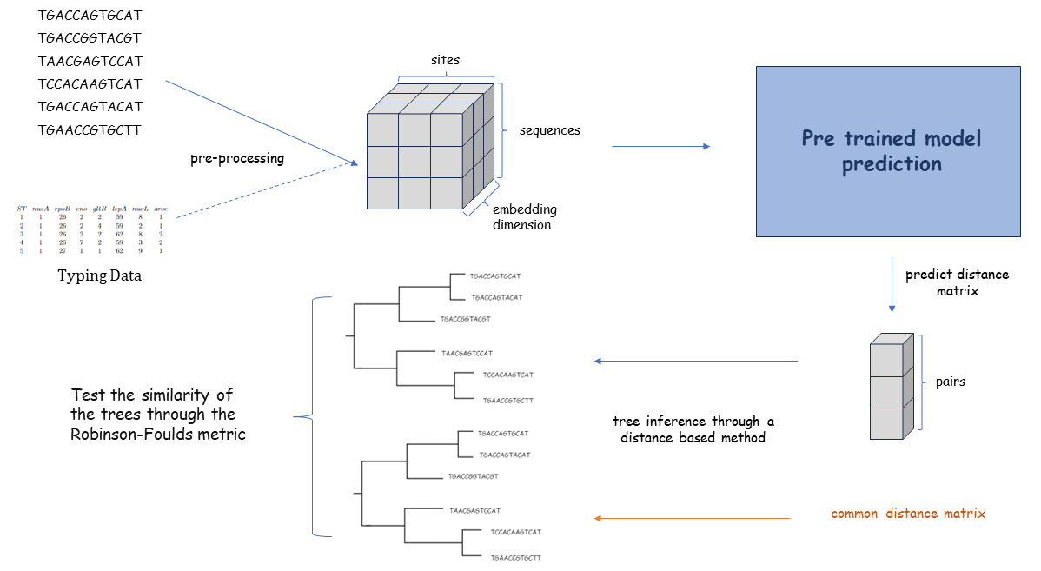
Prediction Phase

Slide 19
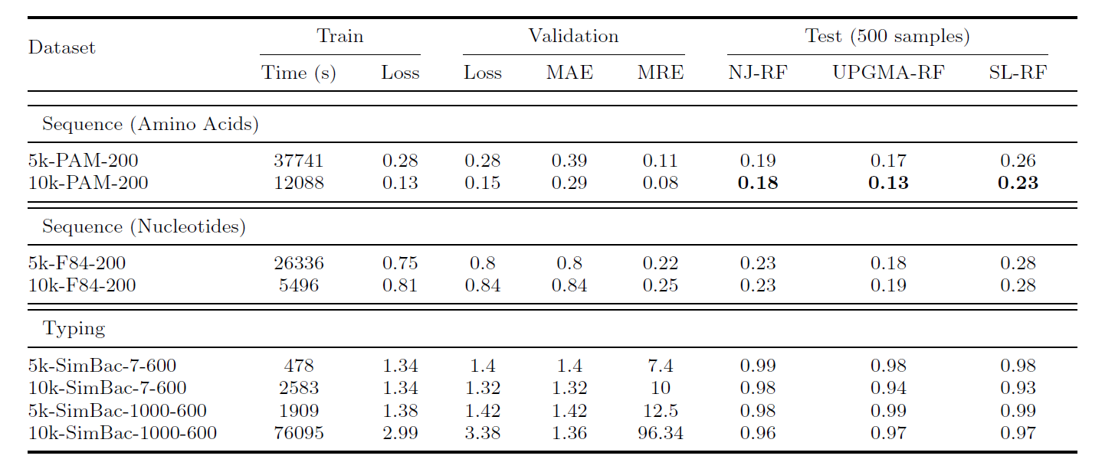
Experimental Evaluation
Notes:
When observing the difference between the results of the 5k datasets and the 10k datasets we can conclude that more data does lead to better results overall.

Slide 20
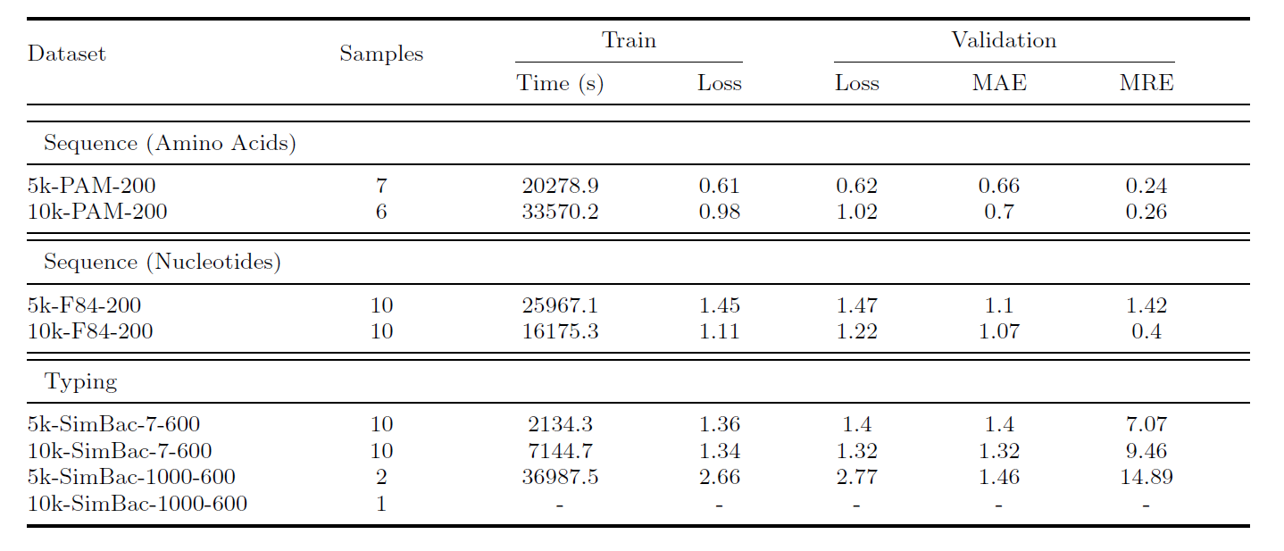
Experimental Evaluation
Notes:
Whilst sequence data tends to generate the best results using the L2 loss, typing data tends to generate the best results using L1 loss. The latter is somewhat expected due the increased complexity of the typing data in comparison to the sequence data use.

Slide 21
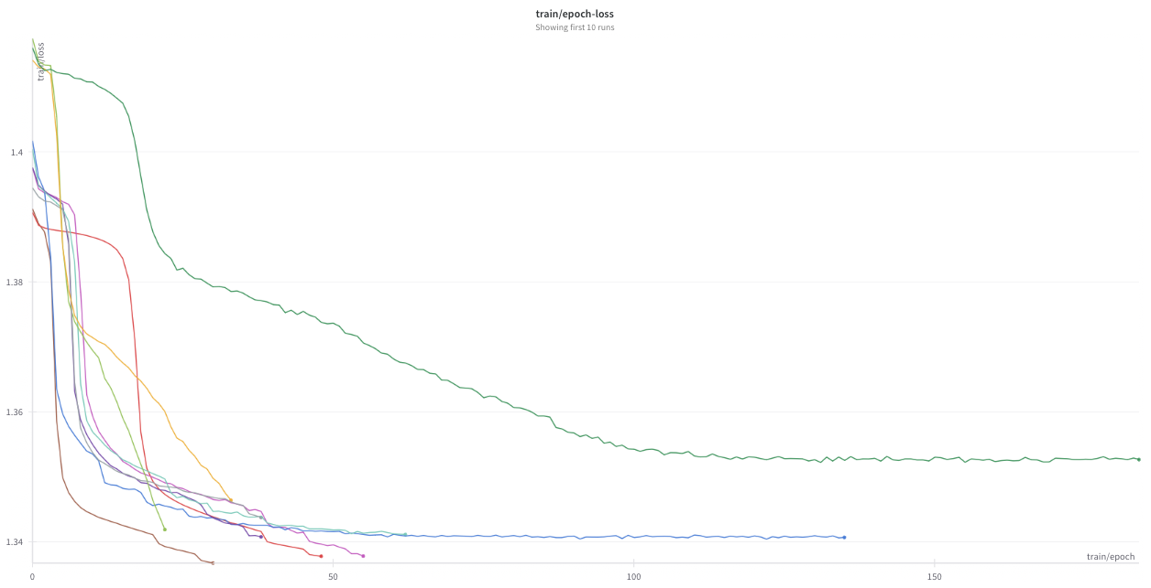
Experimental Evaluation
The obtained results for the typing data are significantly worse from the ones obtained for the sequence data.
Nearly all the typing data trained models show a training loss graph with a fairly steep negative slope, i.e., exhibiting the potential to further decrease their losses.

Slide 22

Experimental Evaluation
The site-specific rate of internal recombination and the site-specific mutation rate of the sequence generator used which were both set to 0.001.
We were capable of attesting the Phyloformer results since the amino acids produced the best results overall.
The results for the nucleotides were also high in quality with only a difference in the normalized Robinson-Foulds of about 0.05 or 0.06.

Slide 23
Alignment Blocks Extension
‘-’ as a separator
In addition to adapting Typing Data, it is also possible to use the same format, but instead of using the corresponding gene identifier, the sequence associated with that identifier is used.
Encoding each block

Slide 24
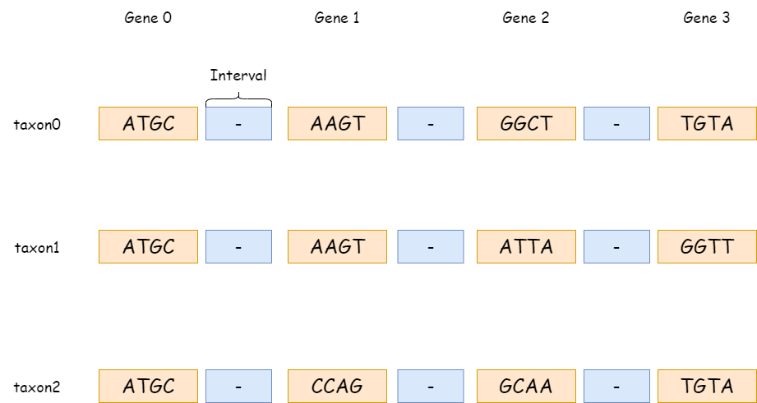
Alignment Blocks Extension
ATGCTTAAGTCCGGCTAATGTA
ATGCAAAAGTCCATTAAAGGTT
ATGCTACCAGCCGCAACGTGTA

Slide 25

Alignment Blocks Extension
A T G C
1 | 0 | 0 | 0
0 | 1 | 0 | 0
0 | 0 | 1 | 0
0 | 0 | 0 | 1
0 | 0 | 0 | 1
1 | 0 | 0 | 0
0 | 0 | 0 | 1
0 | 1 | 0 | 0
NUCLEOTIDES
taxon0 | ATGCCACT
taxon1 | ATGGCATT
taxon2 | GCACCTCT
One-hot encoding taxon0
block size = 3 interval size = 2
1 | 0 | 0 | 0 | 0 | 1 | 0 | 0 | 0 | 0 | 1 | 0
1 | 0 | 0 | 0 | 0 | 0 | 0 | 1 | 0 | 1 | 0 | 0

Slide 26
Demo
https://youtu.be/jpxc0JFlv30

Slide 27

Conclusion
Having concluded the development of DL4Phylo, we made the use of Typing Data a possibility.
Unfortunately, the results obtained were far from ideal. Since only minimal testing was conducted, further testing is necessary.
We will continue working on this by trying different recombination and mutation rate values for various data sets.
Alignment Blocks extensions presented some challenges. Hardware limitations made it impossible to test realistic sets of values, and only very small dimensions could be tested.

Slide 28



THANKS!
An article on this project was submitted to the Inforum.
GitHub Repository: https://github.com/phyloLearn/DL4Phylo
PyPi package: https://pypi.org/project/DL4Phylo/

