Slide 1
Issues on github
Priority = high
Done!
#43 add how-to page with instructions
See next slide
#44 bug: alert box “echo” effect
alert box appears if user makes valid choice after making invalid choice
#45 ability to delete name from list
We talked about this already
#46 export tree
Provide a way for user to get the Newick tree (email self, tweet, send to browser)
Done!
Done!
Done!

Slide 2
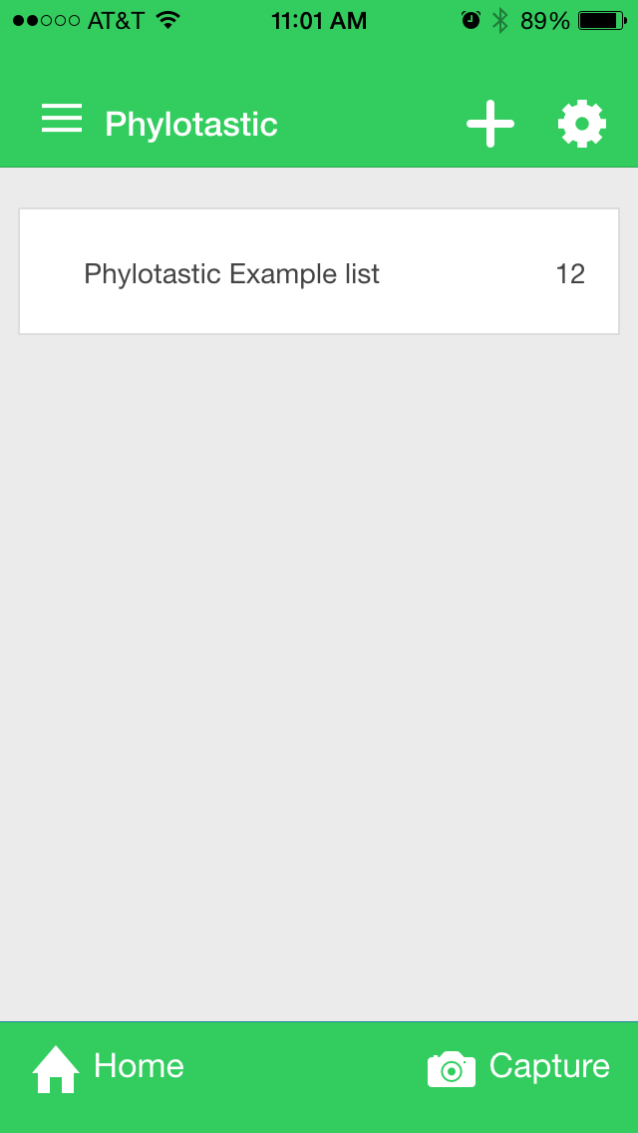


Done!
Priority = high
Home page
Add help button
Links to ‘howto’ view
use content from github file in design/howto_page.html
We don’t know which icon to use

Slide 3


Priority = medium
Use logo. Change top strip background color to grey so that logo is fully visible.
Add list
+
Add list
Buttons do nothing.
Suggestion: remove them, or add an alert that says “Sorry, this feature is not yet implemented!”
Most apps use tiny 8 or 9 pt text under icon
Home
Capture
Home
Help
Capture

Slide 4
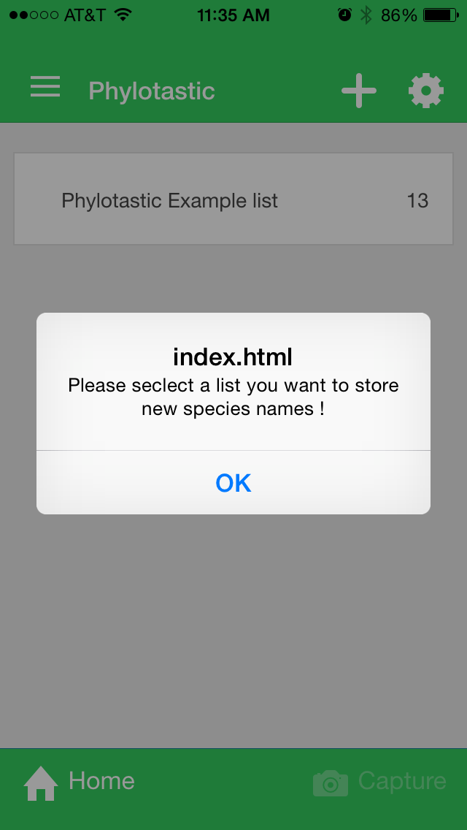
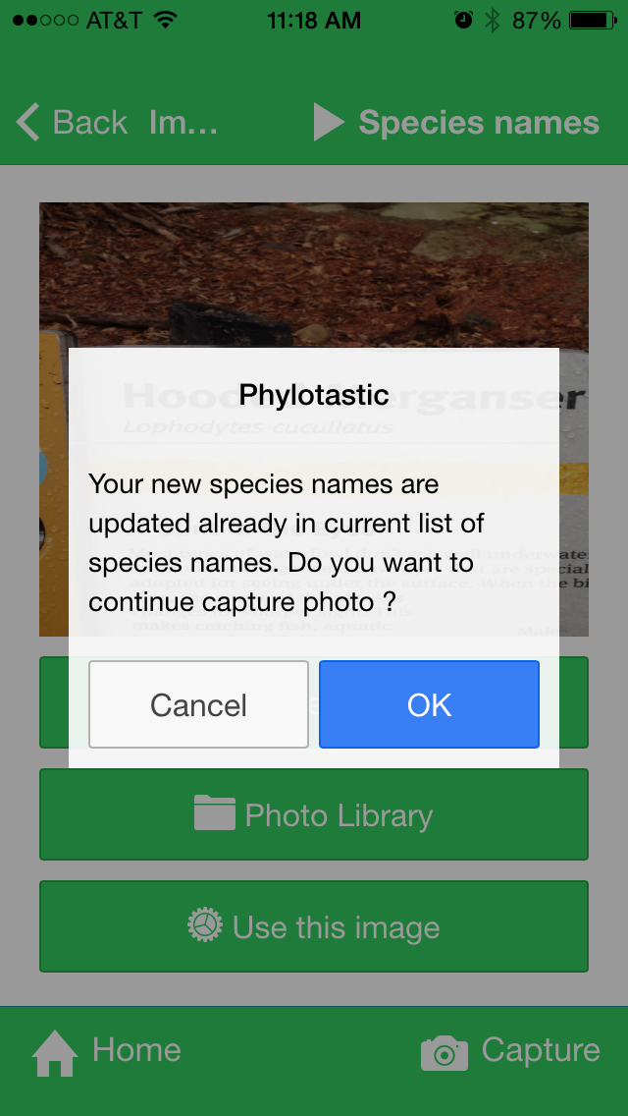
Priority = medium
Suggestions
change index.html to “Oops!”
text: “Select (or create) a list first, before trying to capture names”
We need to explain to the user how the routing works here
Note: the rounded corners look better, but some of the alert boxes have square corners

Slide 5
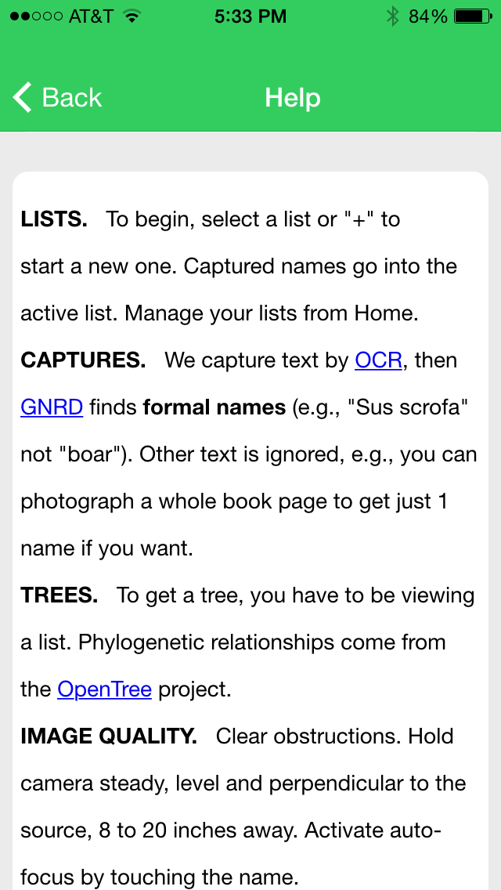
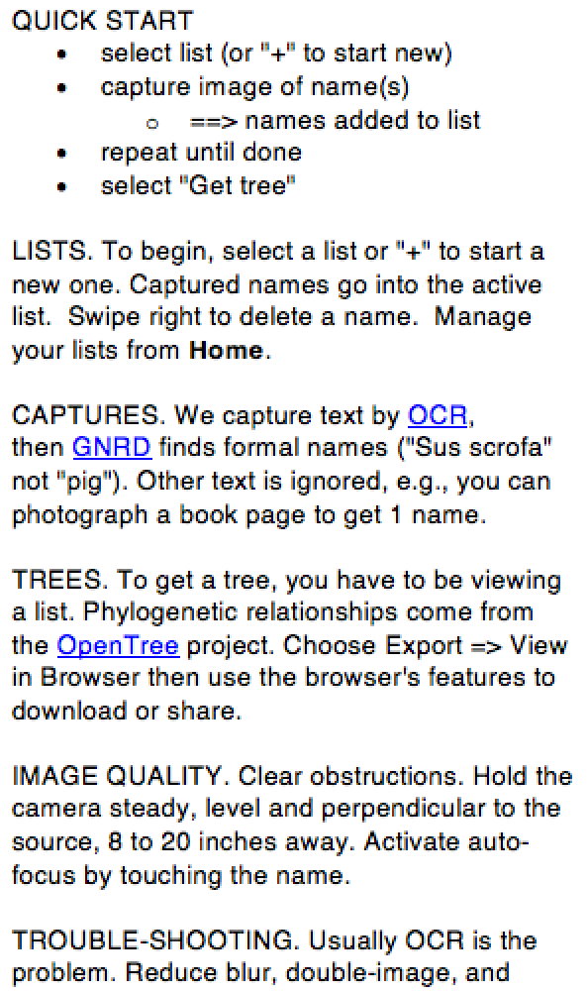
Priority = medium
1. Too much whitespace. Can you find a font and line-spacing that makes this more compact? You may have to tweak the css.
2. Insert after “list.”:
Swipe right to delete a name.
3. Insert:
To share or export, choose “view in browser”, then use the browser’s sharing features (e.g., mailto).

Slide 6
Priority = medium
Swipe feature
The swipe feature works, but the graphics do not show any actual swiping movement, only the end result of the swiping. This will confuse users.

Slide 7
Priority = medium
Go to list
Replace “Species names” with “Go to list”
Don’t allow cancel. The usual workflow is to repeat the capture step. When done, the user will choose “Go to list” to see the results. See the next slide for the capture message.

Slide 8
Priority = medium
Use alert box to tell the user what was added to the list.
1 name
Success!
Names added: Lophodytes cucullatus
OK
Success!
Names added: Lophodytes cucullatus and X others
> 1 names:
Tell user how many
OK

Slide 9
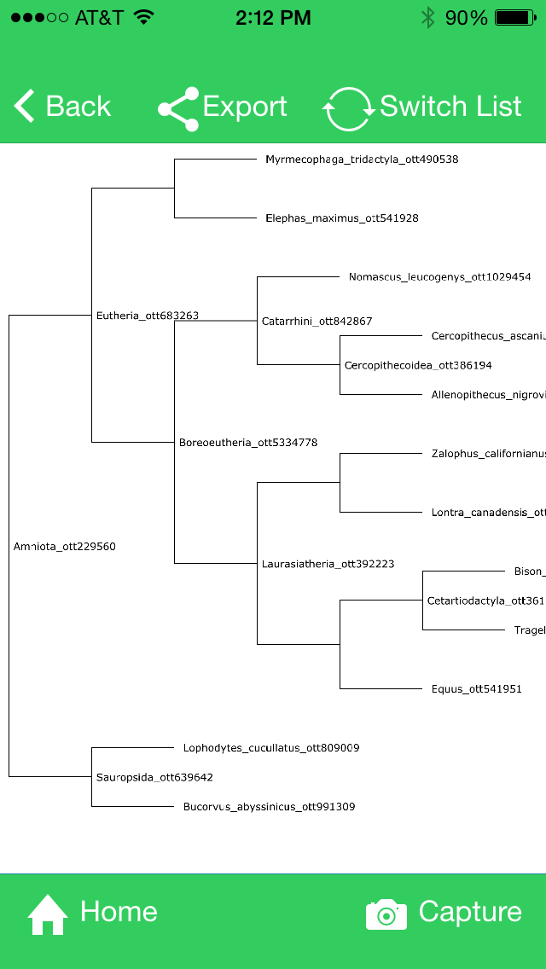
Priority = medium
Remove ottIds from labels
Remove internal node labels– they are confusing and sometimes overlap tip labels

Slide 10
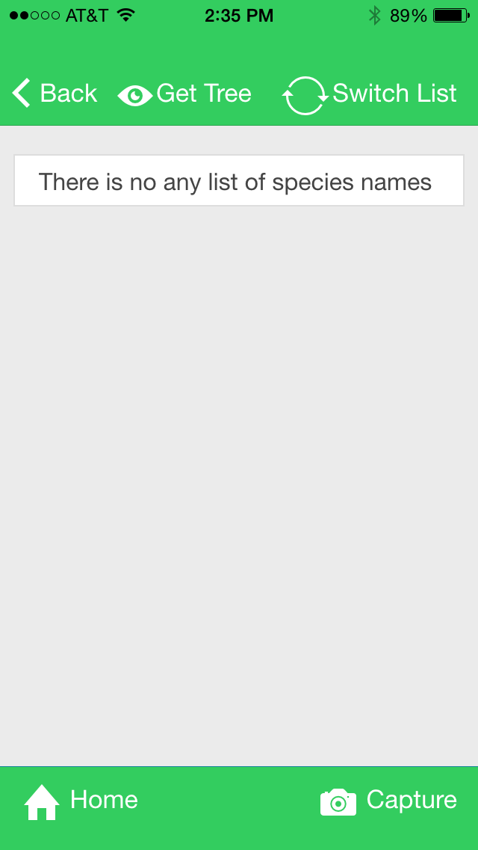
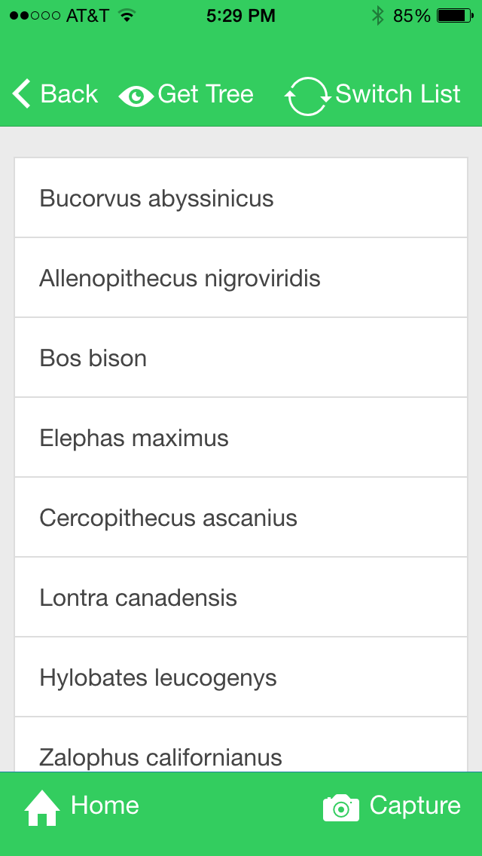
Priority = medium
Add help button to bottom strip of every view

Slide 11
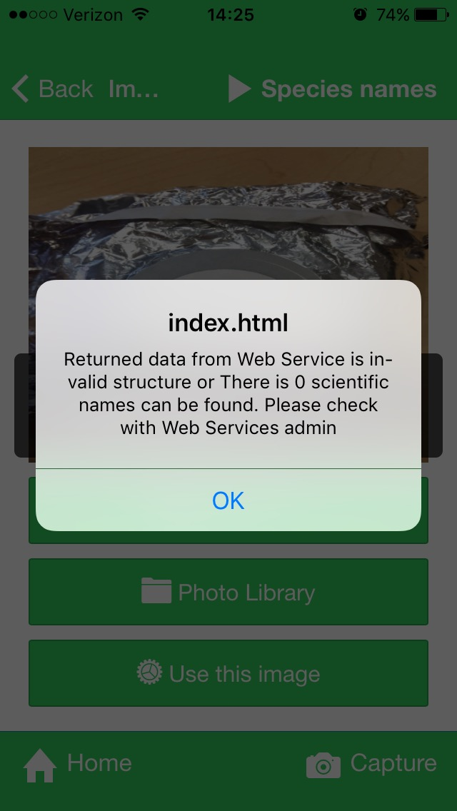
Priority = medium
User action:
choose image with no scientific names
Response:
app alerts user
Suggestion:
change index.html to “Oops!”
change message to: ‘’No scientific name was found. Please try again.’’

Slide 12
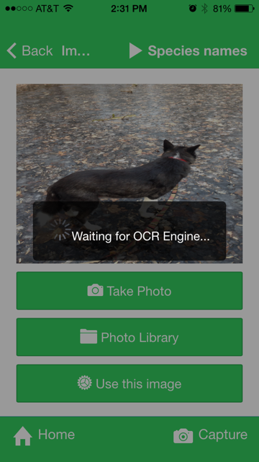
Priority = low
User: choose image with no text at all
We don’t know why it sometimes runs GNRD or sometimes doesn’t
app runs OCR
App runs GNRD
App doesn’t run GNRD
App shows alert
(No alert)
Suggestion: alert user “Oops! No text found in image”

Slide 13
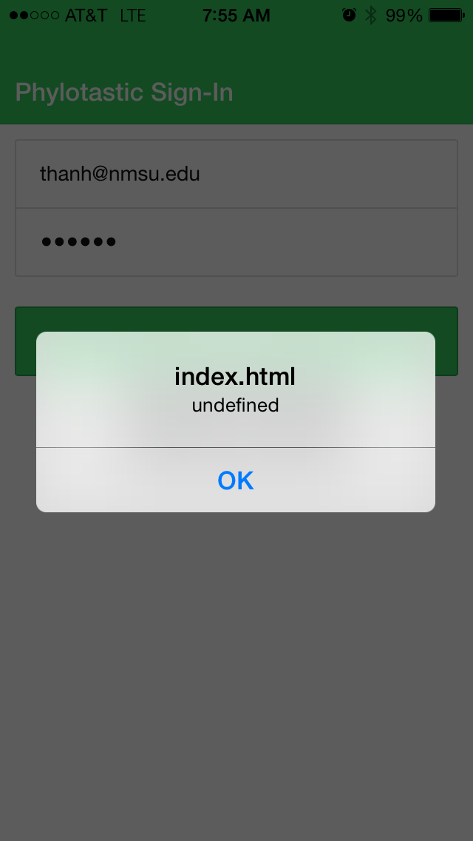
Priority = low
User action:
Enter wrong name or password
Response:
alert box
Suggestion:
change index.html to “Oops!”
‘’Username or password error. Please try again.’’

Slide 14
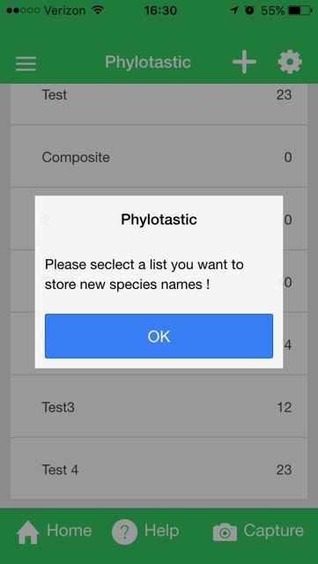
Priority = low
Suggestion:
* Simpler: “Please select a list to store new species names”
* Be sure not to use “seclect”

Slide 15
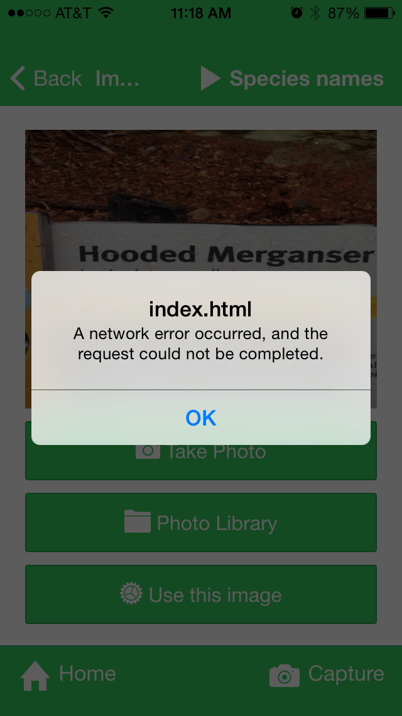
Priority = low
User action:
select “Use this image”
Response:
network error alert
Suggestion:
change index.html to “Oops!”
“Network error. Please check your connection and try again.”

