Slide 1
Issues on github
Priority = high
Done!
#43 add how-to page with instructions
See next slide
#44 bug: alert box “echo” effect
alert box appears if user makes valid choice after making invalid choice
#45 ability to delete name from list
We talked about this already
#46 export tree
Provide a way for user to get the Newick tree (email self, tweet, send to browser)
Done!
Done!
Done!

Slide 2
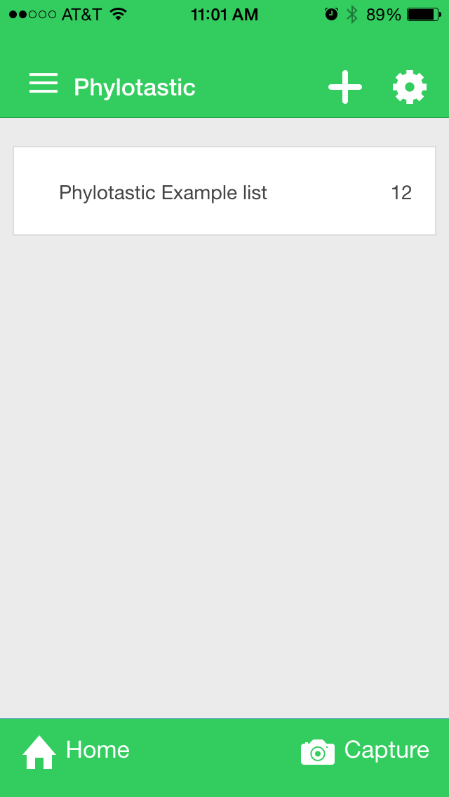


Done!
Priority = high
Home page
Add help button
Links to ‘howto’ view
use content from github file in design/howto_page.html
We don’t know which icon to use

Slide 3
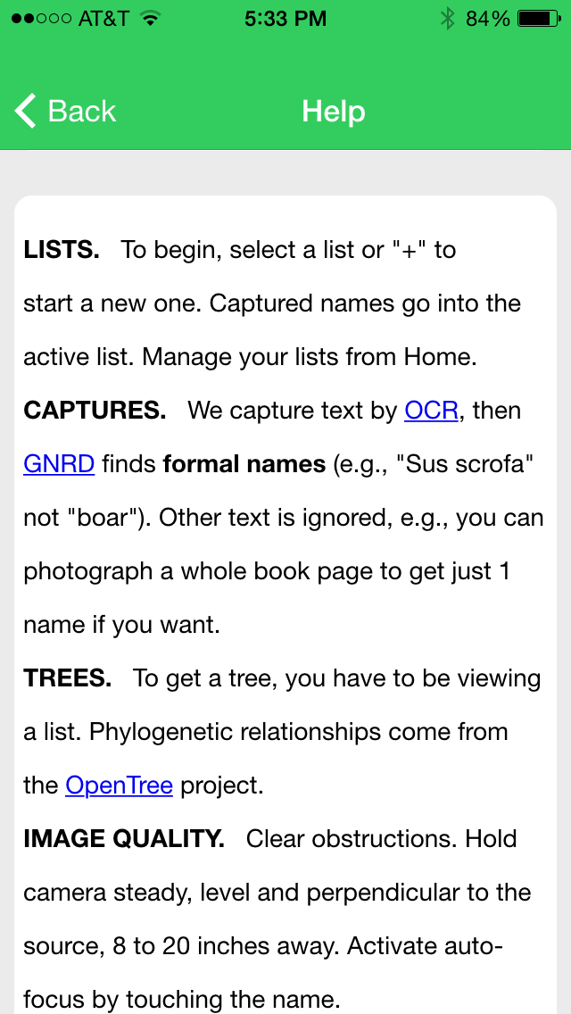
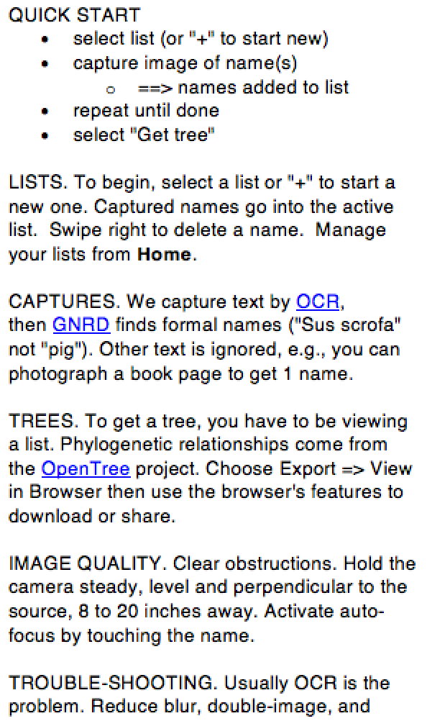
1. Add help on 2 new features
Priority = medium
1. Too much whitespace. Do we have a font and line-spacing that makes this more compact? You may have to tweak the css.
2. Insert after “list.”:
Swipe right to delete a name.
3. Insert:
To share, choose Export ➔ Open in Browser, then use the browser’s sharing features.

Slide 4
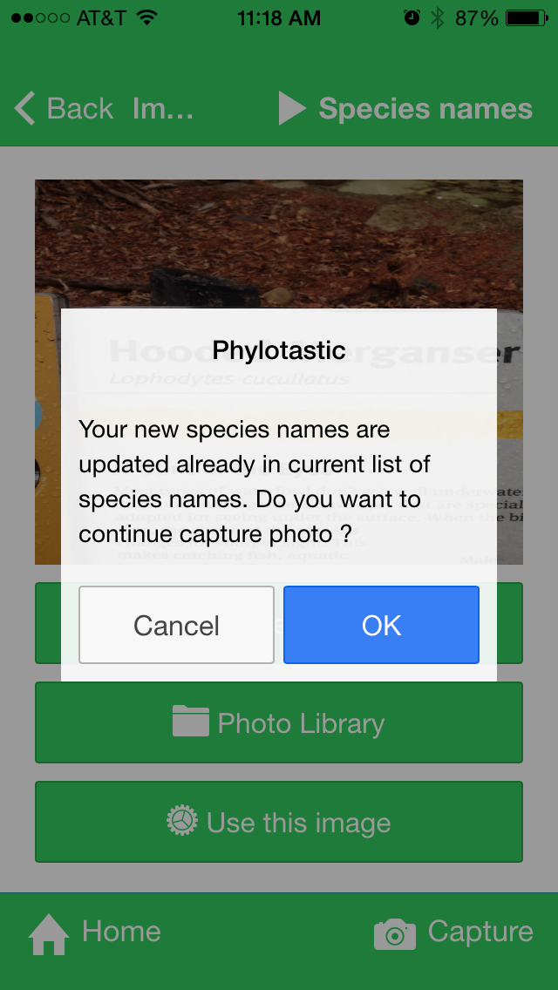
2. Inform user of captured names
Priority = medium
Use alert box to tell the user what was added to the list.
1 name
Success!
Names added: Lophodytes cucullatus
OK
Success!
Names added: Lophodytes cucullatus and X others
> 1 names:
Tell user how many
OK

Slide 5
3. Clarify expected flow in Capture view
Priority = medium
Go to list
Replace “Species names” with “Go to list”
Don’t allow cancel, just “OK” (see previous slide). The usual workflow is to repeat the capture step. When done, the user will choose “Go to list” to see the results. See the next slide for the capture message.

Slide 6
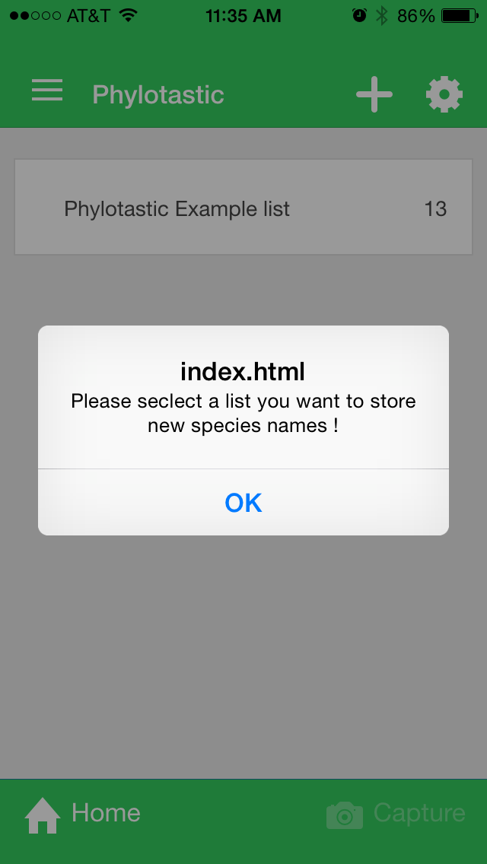
4. Clarify expected flow to user in Home view
Priority = medium
Suggestions
alert text: “Please select a list first, before trying to capture names”
alert title: “Oops!”

Slide 7
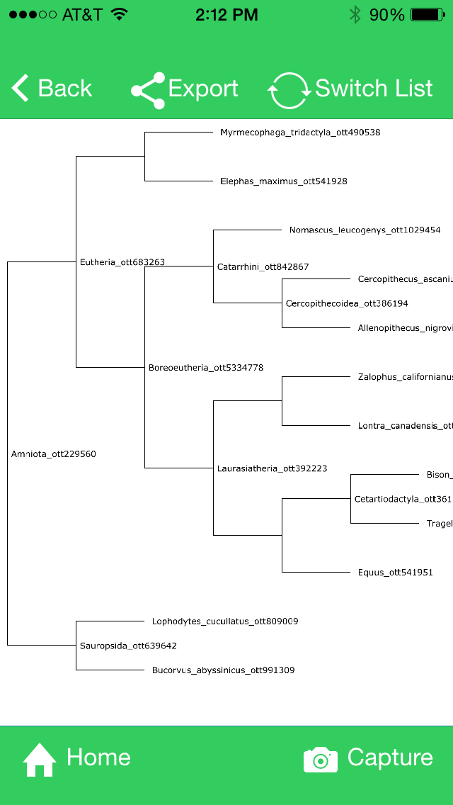
5. De-clutter tree view
Priority = medium
Remove ottIds from labels
Remove internal node labels– they are confusing and sometimes overlap tip labels

Slide 8
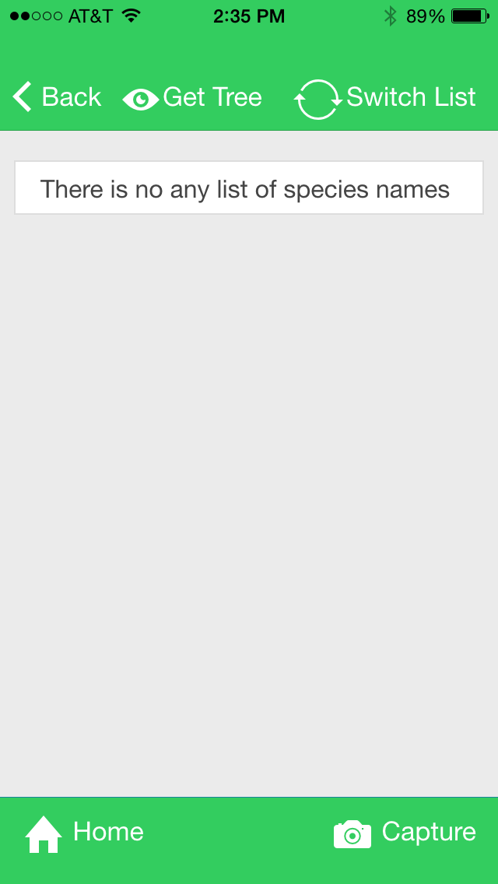
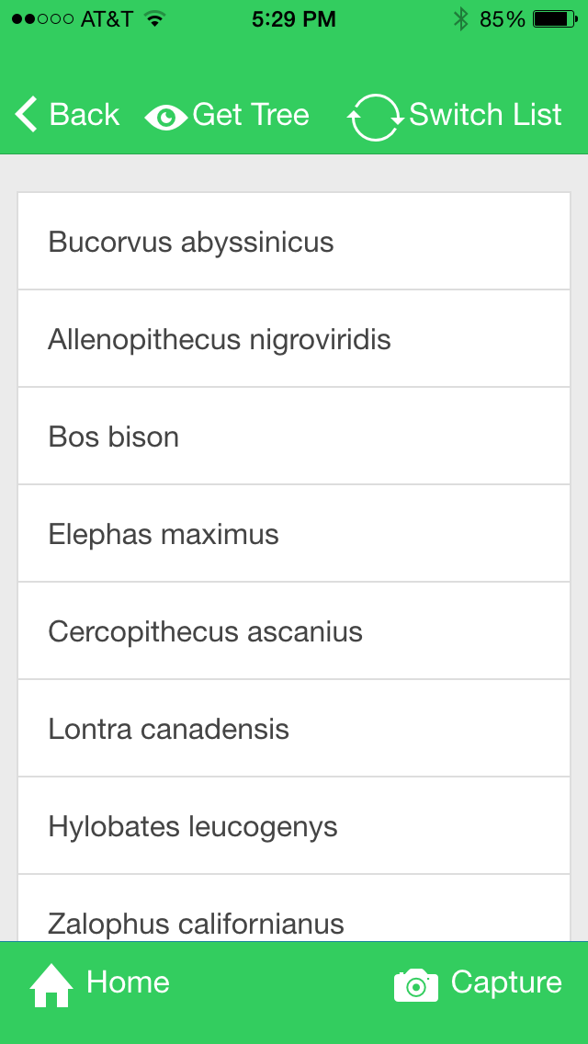
Add help button to every view
Priority = medium
Add help button to bottom strip of every view

Slide 9


7. Improve Home view appearance
Priority = medium
2. Use logo. Change top strip background color to grey so that logo is fully visible.
+
Add list
Add list
1. Remove buttons (or add an alert that says “Sorry, this feature is not yet implemented!”)
3. Text under icons, not to the side. Most apps use 8 or 9 pt text
Home
Help
Capture
Home
Capture

Slide 10
Complete implementation of swipe-to-delete
Priority = medium
Swipe feature
The swipe feature works, but the graphics do not show any actual swiping movement, only the end result of the swiping. This will confuse users.

Slide 11
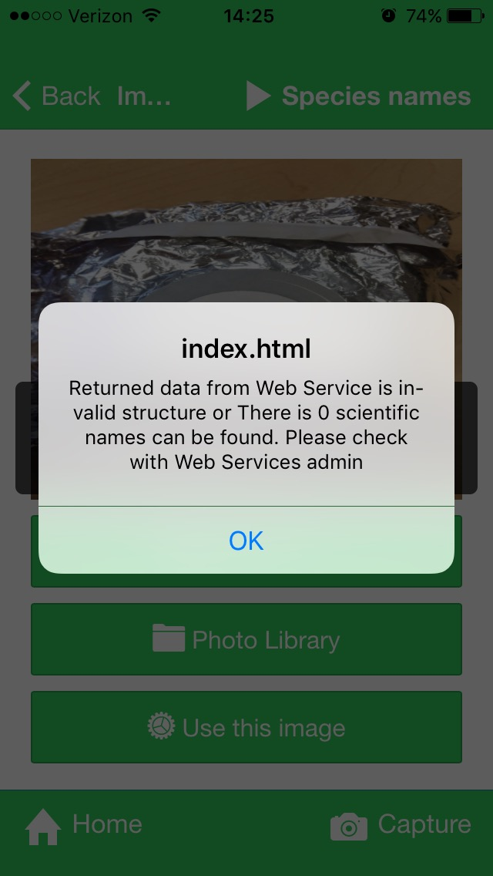
9. Instruct user in empty capture alert
Priority = low
User action:
choose image with no scientific names
Response:
app alerts user
Suggestion:
change index.html to “Oops!”
change message to: ‘’No scientific name was found. Please try again. The Help page has tips on getting good photos.’’

Slide 12
10. Consistent styling on alerts
Priority = low
Suggestions
rounded corners on alert boxes
Note: the rounded corners look better, but some of the alert boxes have square corners

Slide 13
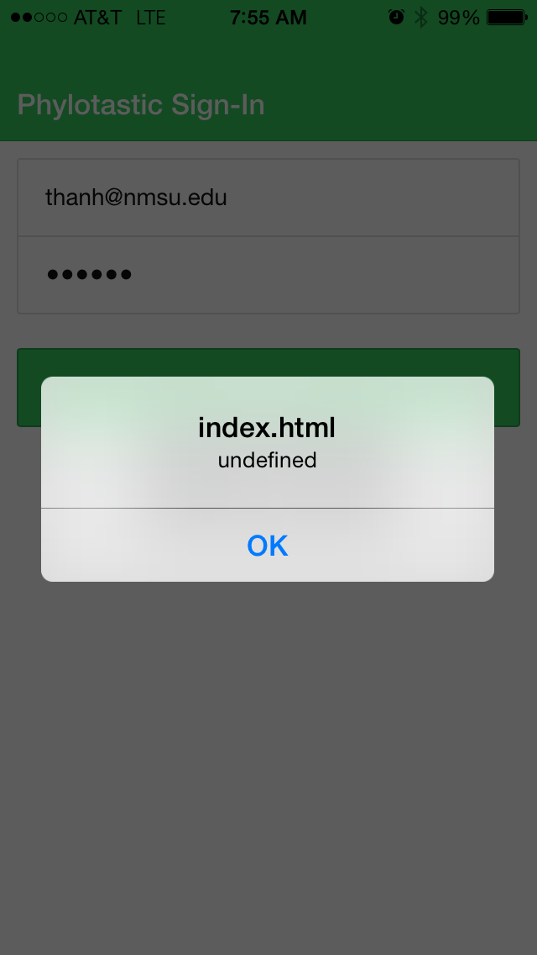
11. More informative alert on login fail
Priority = low
User action:
Enter wrong name or password
Response:
alert box
Suggestion:
change index.html to “Oops!”
‘’Username or password error. Please try again.’’

Slide 14
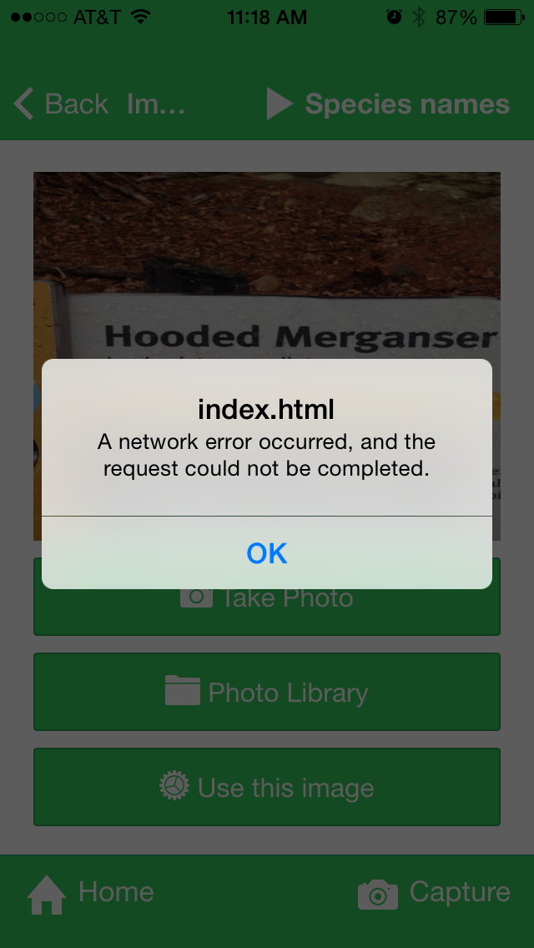
Suggest action to user on network fail
Priority = low
User action:
select “Use this image”
Response:
network error alert
Suggestion:
change index.html to “Oops!”
“Network error. Please check your connection and try again.”

Slide 15
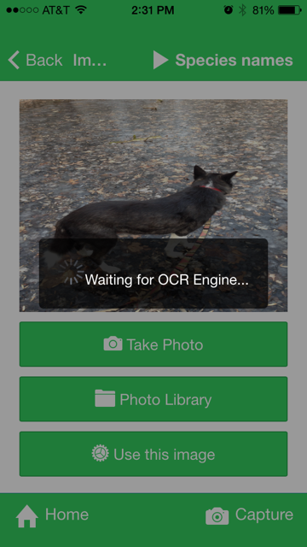
Alert for no-text-found
Priority = low
User: choose image with no text at all
We don’t know why it sometimes runs GNRD or sometimes doesn’t
app runs OCR
App runs GNRD
App doesn’t run GNRD
App shows alert
(No alert)
Suggestion: alert user “Oops! No text found in image”

