Slide 1
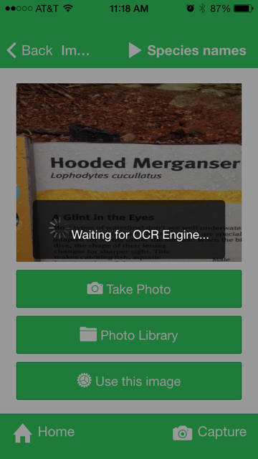
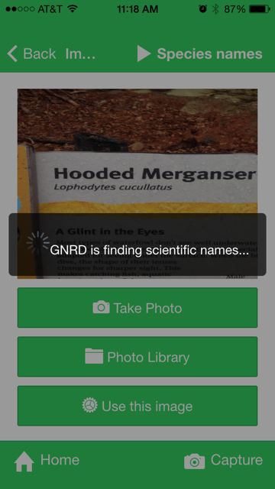
Nice status messages!

Slide 2
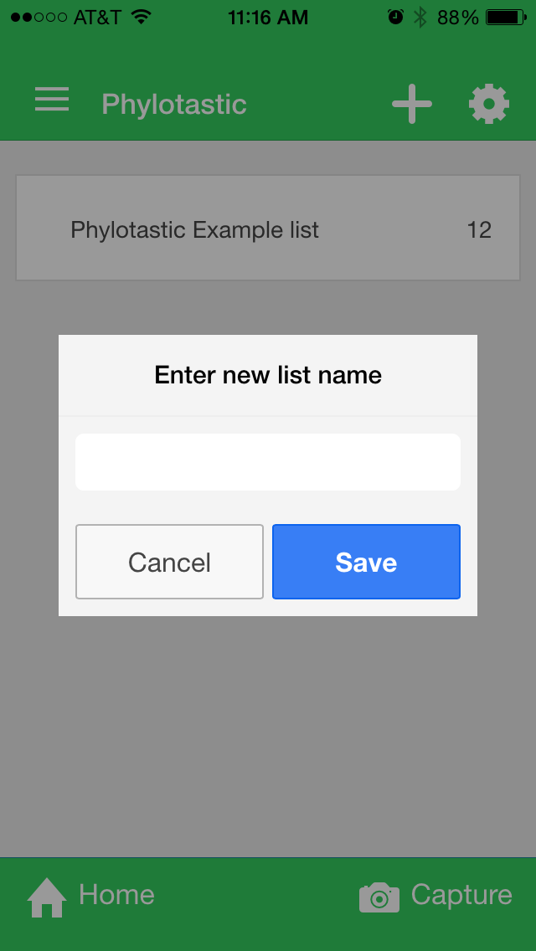
This is good

Slide 3
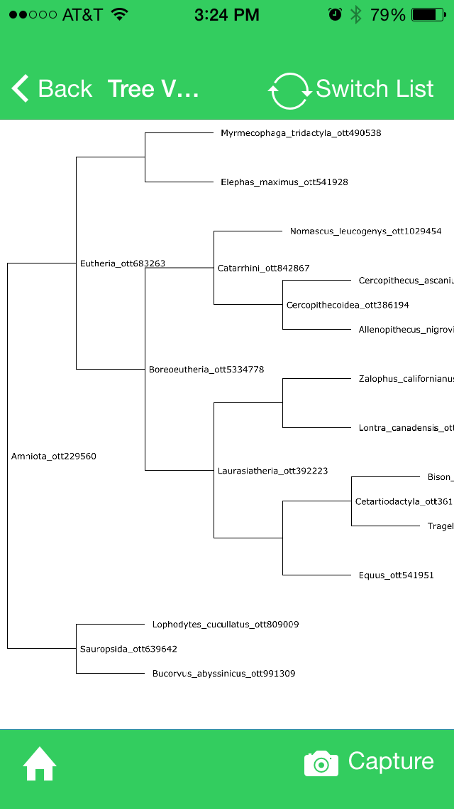
Issues on github
Priority = high
#44 bug: alert box “echo” effect
alert box appears if user makes valid choice after making invalid choice
#45 ability to delete name from list
We talked about this already
#46 export tree
Provide a way for user to get the Newick tree (email self, tweet, send to browser)

Slide 4
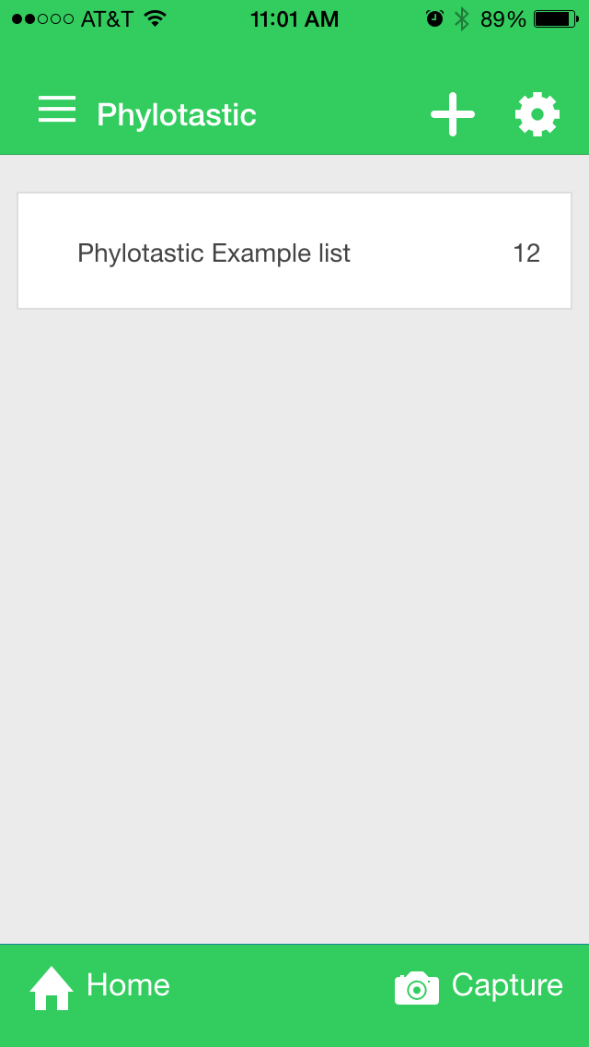


Priority = high
Home page
Add help button
Links to ‘howto’ view
use content from github file in design/howto_content.html
We don’t know which icon to use

Slide 5

Priority = medium
Use logo. Change top strip background color to grey so that logo is fully visible.
+
Why so much empty space?
Settings and list buttons do nothing.
Suggestion: remove them, or add an alert that says “Sorry, this feature is not yet implemented!”
Most apps use tiny 8 or 9 pt text under icon
Home
Capture

Slide 6
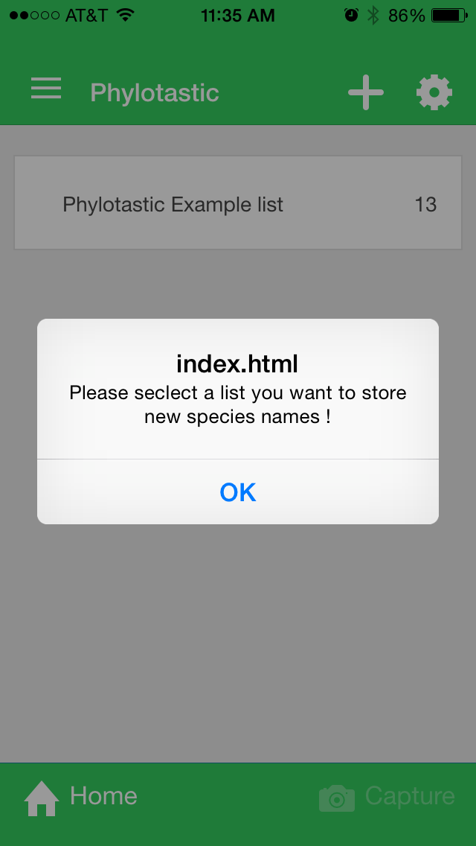
Priority = medium
Suggestions
change index.html to “Oops!”
text: “Select (or create) a list first, before trying to capture names”

Slide 7
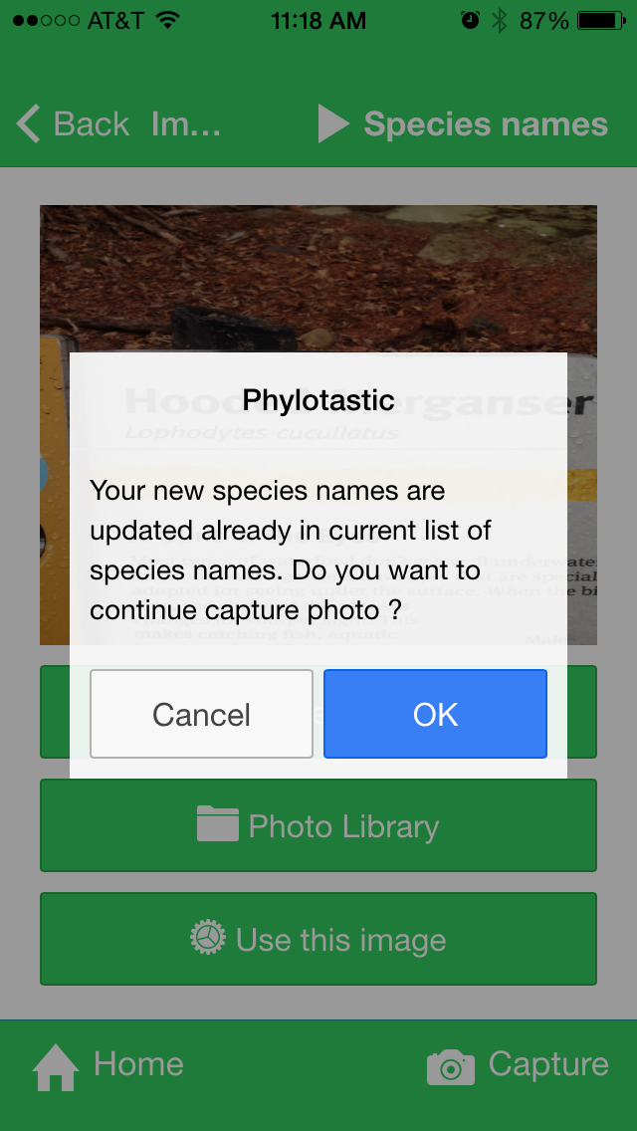
Priority = medium
Use alert box to tell the user what was added to the list.
1 name
Success!
1 name added: Lophodiytes cucullatus
OK
Success!
2 names added: Lophodiytes cucullatus, Bos bison
2 names
OK
Success!
X names added: Lophodiytes cucullatus, Bos bison, …
X > 2 names
OK

Slide 8
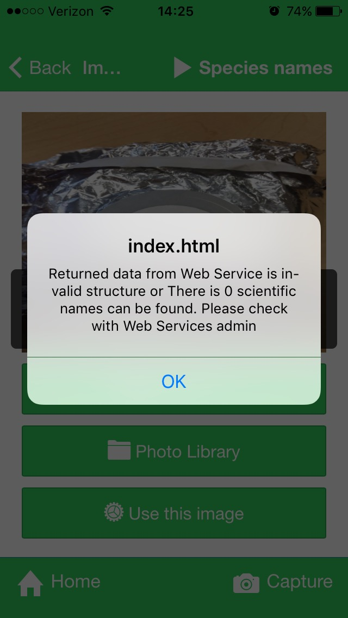
Priority = medium
User action:
choose image with no scientific names
Response:
app alerts user
Suggestion:
change index.html to “Oops!”
change message to: ‘’No scientific name was found. Please try again.’’

Slide 9
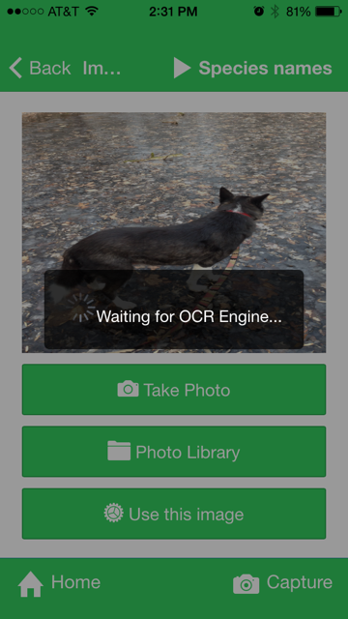
Priority = low
User: choose image with no text at all
We don’t know why it sometimes runs GNRD or sometimes doesn’t
app runs OCR
App runs GNRD
App doesn’t run GNRD
App shows alert
(No alert)
Suggestion: alert user “no text found”

Slide 10
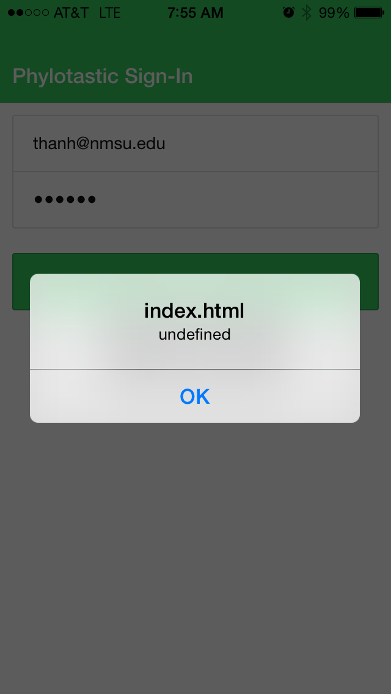
Priority = low
User action:
Enter wrong name or password
Response:
alert box
Suggestion:
change index.html to “Oops!”
‘’Username or password error. Please try again.’’

Slide 11
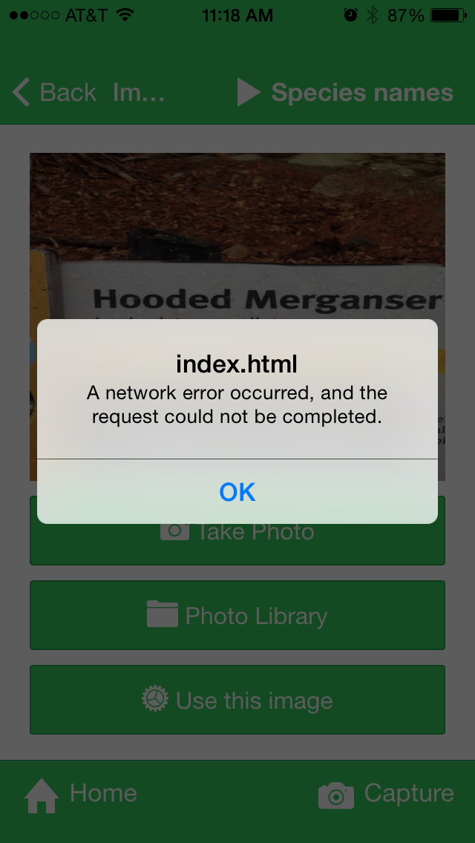
Priority = low
User action:
select “Use this image”
Response:
network error alert
Suggestion:
change index.html to “Oops!”
“Network error. Please check your connection and try again.”

Slide 12
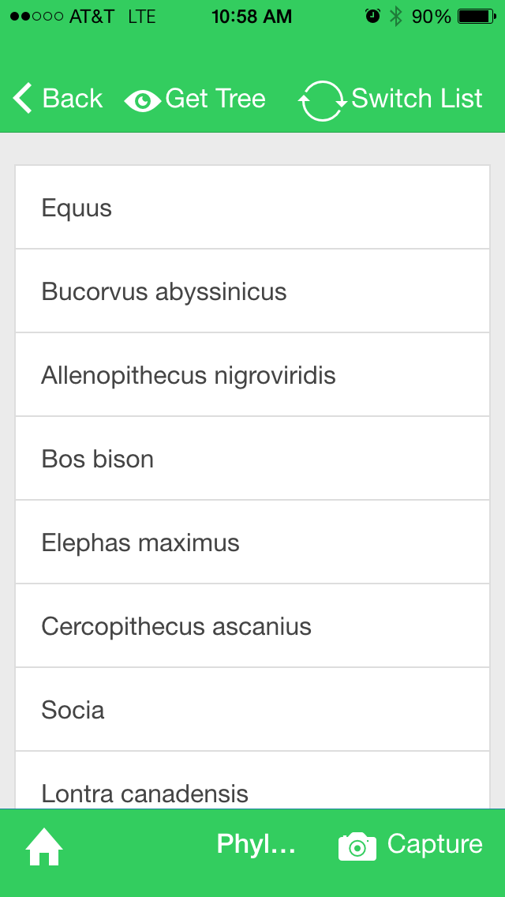
Priority = low
“Home” is missing
Name is cut off

