Slide 1
Priority 1 features

Slide 2
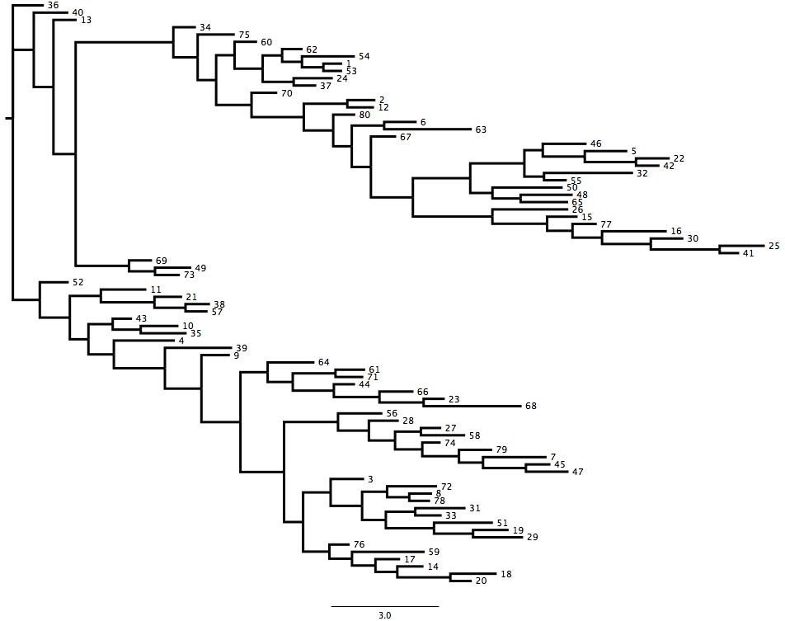
Clean square trees, economical with space

Slide 3
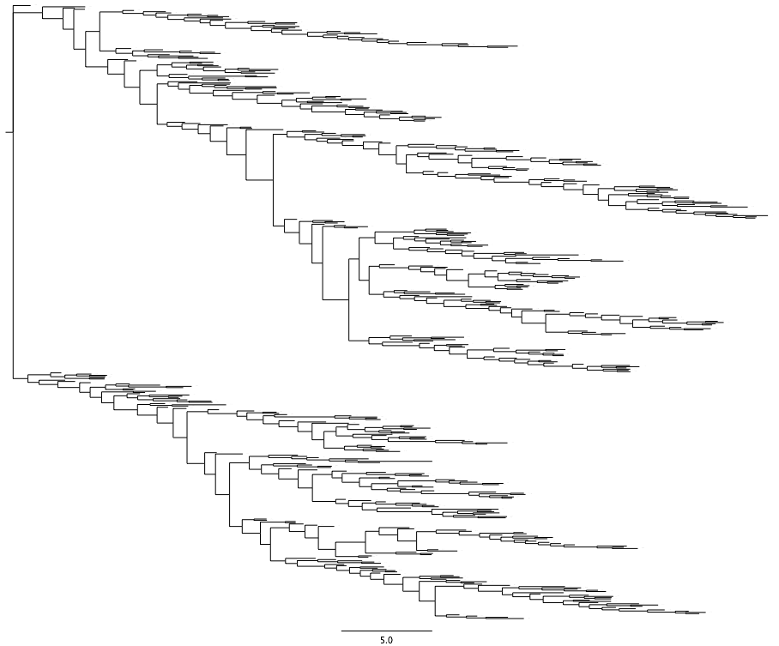
Capacity up to 500 tips easily displayed

Slide 4

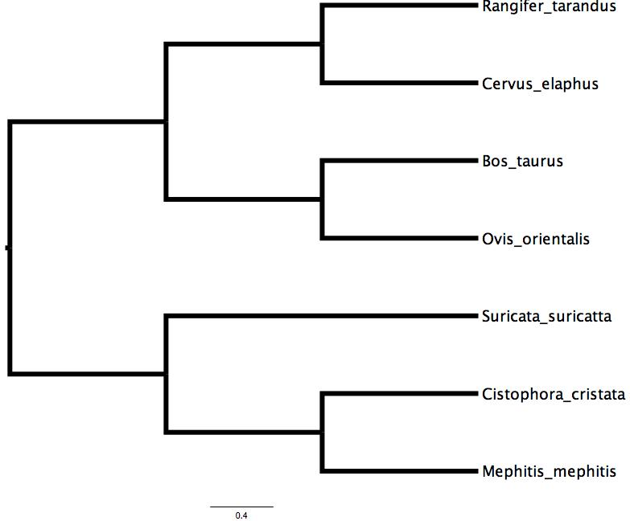






Images on tips

Slide 5

Link-outs at the tips
Live link to eol

Slide 6
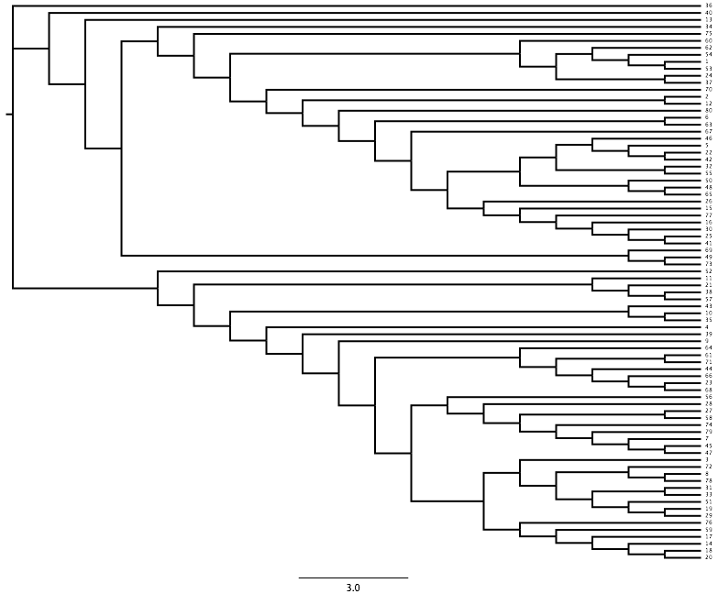
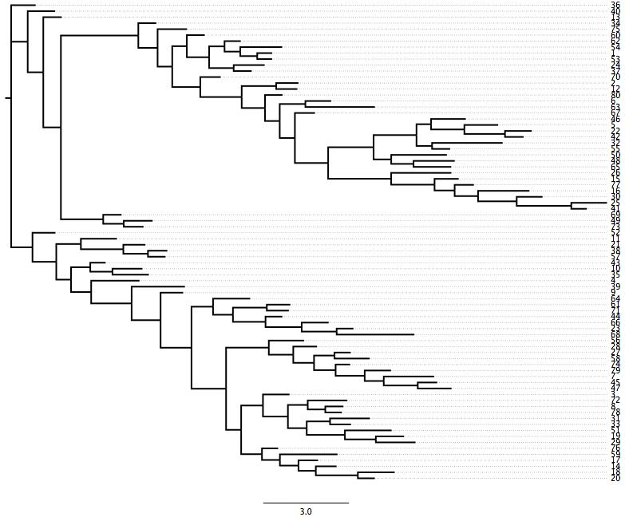
Align tips

Slide 7
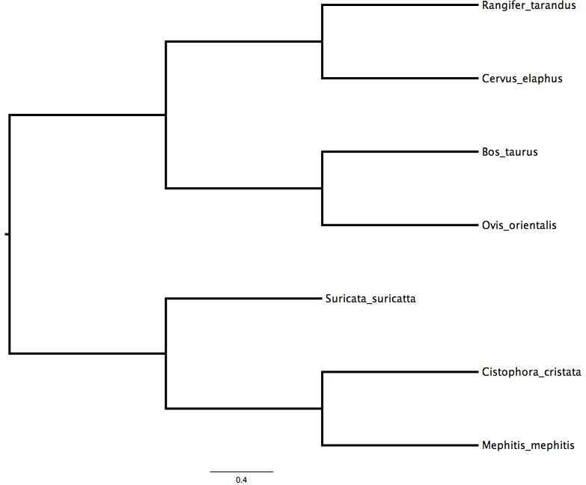
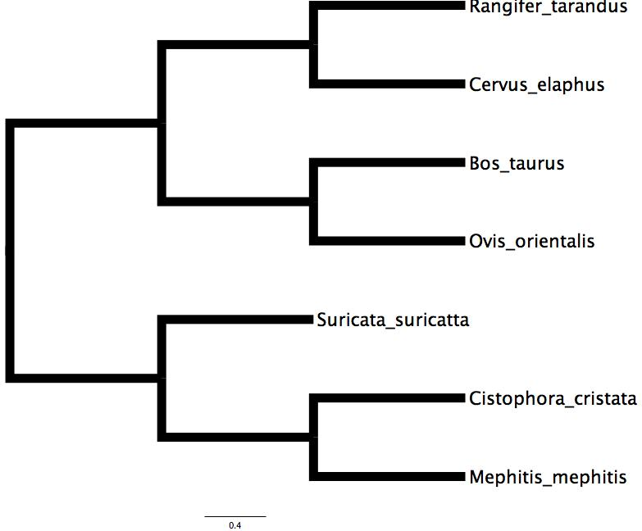
Line Thickness

Slide 8
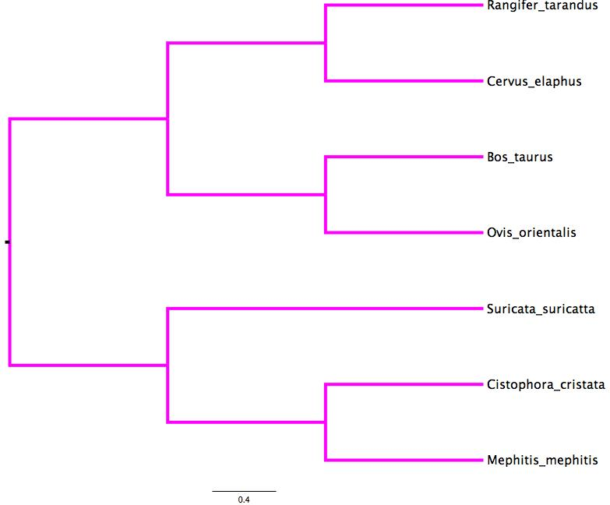
Line color

Slide 9
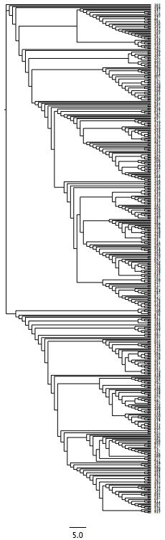
Support high-resolution graphics
For high-resolution see:
capacity_test.svg
Low-resolution

Slide 10
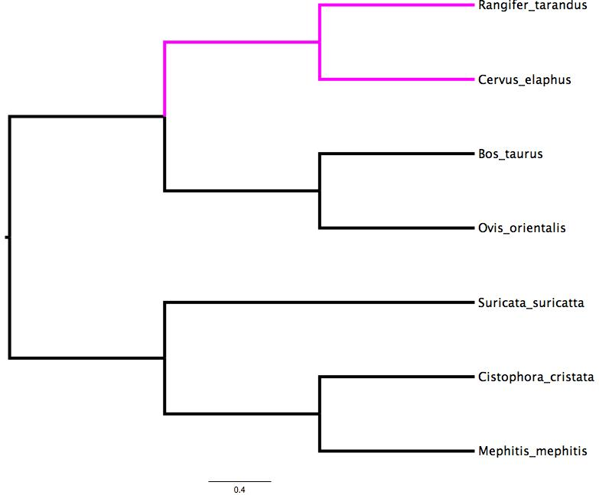
Highlighting individual clades

Slide 11
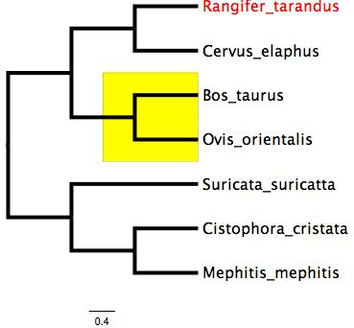
Highlighting individual clades: boxes

Slide 12
Highlighting clades: Tip bars
Cervidae
Bovidae
Carnivora

Slide 13
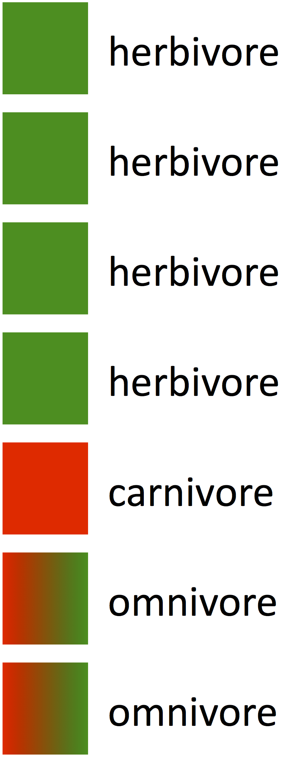
Categorical data at tips

Slide 14
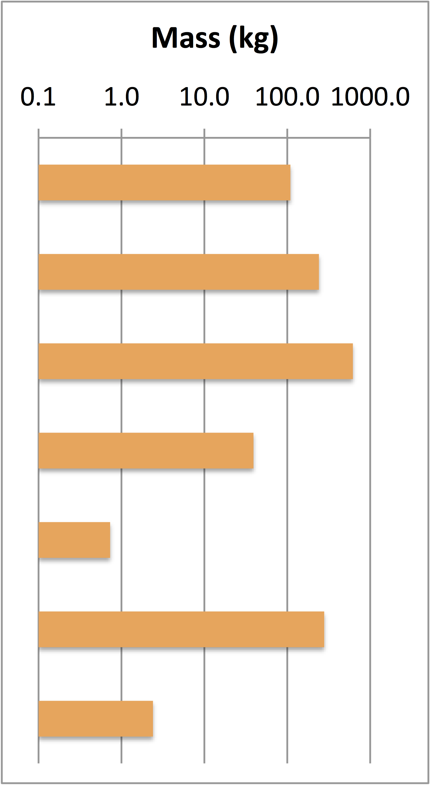
Numeric data at tips

Slide 15
Priority 2 features

Slide 16
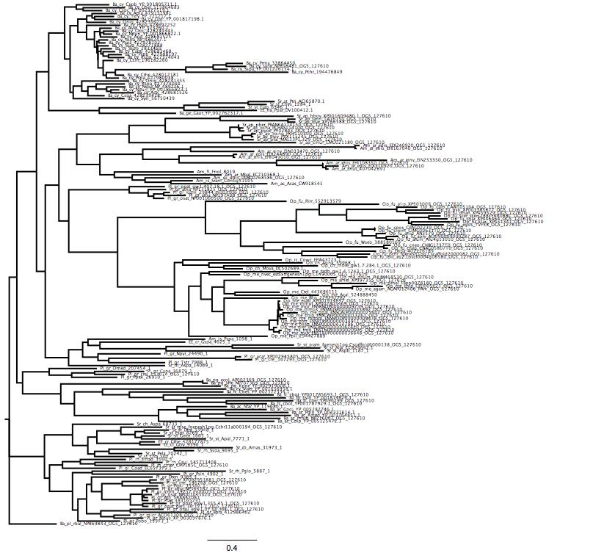
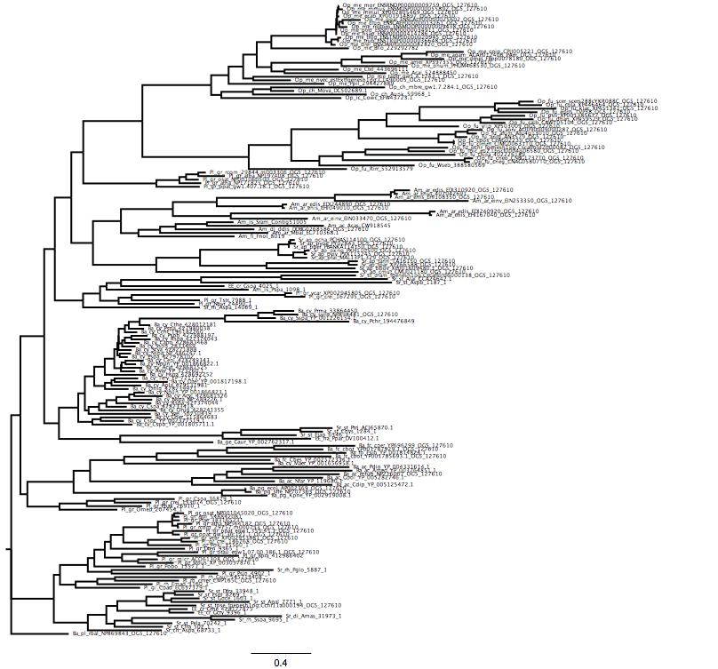
Non-Ladderized vs. ladderized

Slide 17
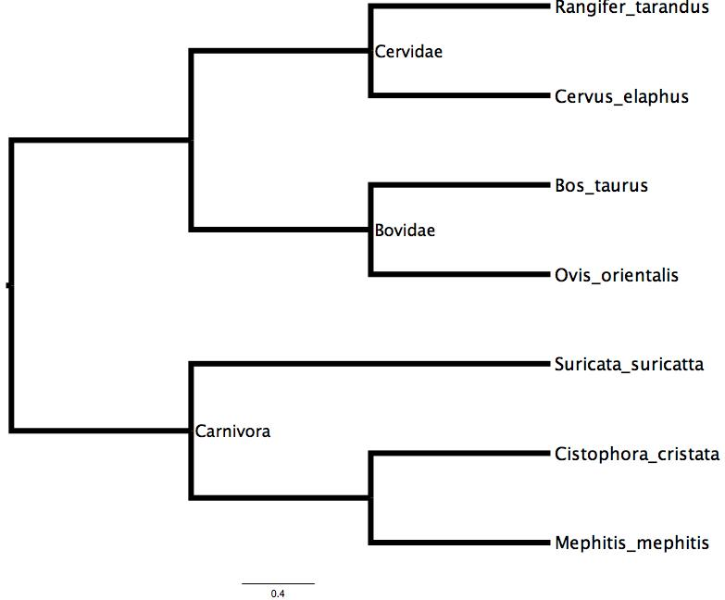
Node labels

Slide 18
Associate information with branch
7 steps

Slide 19
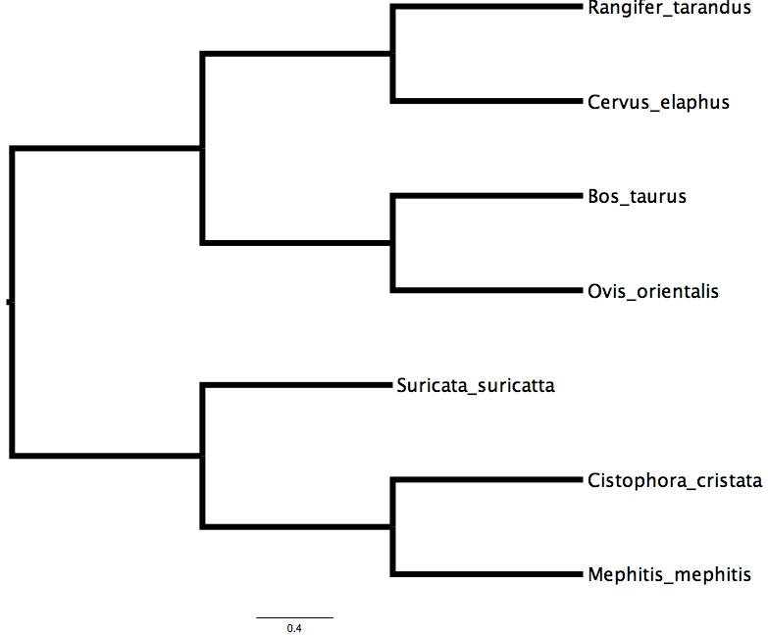
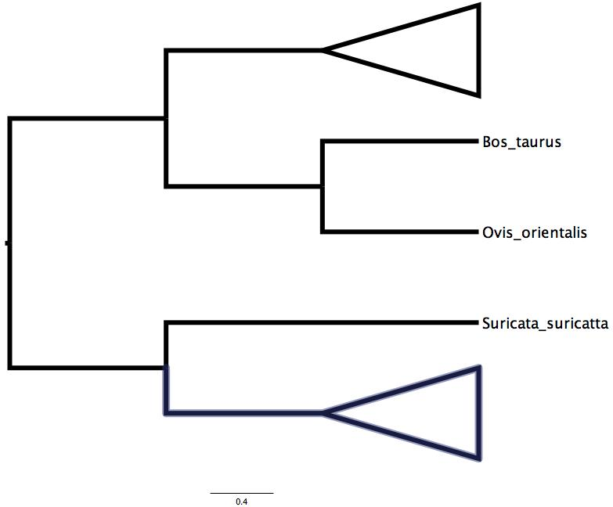
Collapsing clades

Slide 20
Vector graphics
Ability to export vector graphics

Slide 21
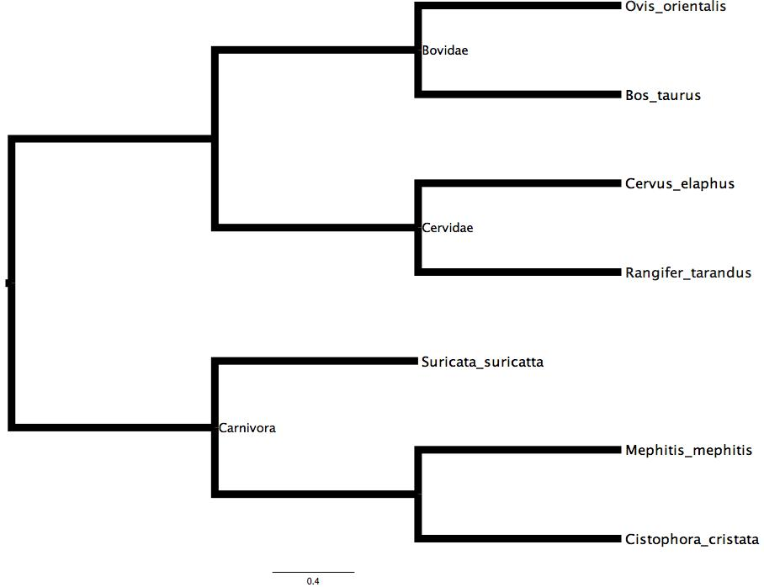
Re-order clades

Slide 22
Priority 3
Priority 3 targets in: viz_targets.md are not needed at this moment

