Slide 1


THE POWER OF
TIKTOK MEDIA
Presentation of Professional English (Eng-4101)
Presented by
Group-2
Members List
Aung Khan Sint
Aung Myint Myat
Htoo Aung Khant
Htet Aung Khant
Shine Ko Ko
Paing Pyae Moe
Mg Phyoe Min San
Nann Hsu Myat Phyo
Nang Phway Phway Laung
Nang Awam Hein
Ma Myo ThiDar Po
Ma Pann Ei Zin Zin Thaw

Slide 2
THE POWER OF
TIKTOK MEDIA
Presentation of Professional English (Eng-4101)
Presented by
Group-2
Outline
Members List
Aung Khan Sint
Aung Myint Myat
Htoo Aung Khant
Htet Aung Khant
Shine Ko Ko
Paing Pyae Moe
Mg Phyoe Min San
Nann Hsu Myat Phyo
Nang Phway Phway Laung
Nang Awam Hein
Ma Myo ThiDar Po
Ma Pann Ei Zin Zin Thaw
Abstract
1.Introduction
2.TikTok Revolution
3.Algorithm
4.Shift in Content Creation
5.Cultural & Global Impact
6.New Era of Marketing & Commerce
7.Information & Learning
8.Challenges & Ethical Concerns
9.Future Landscape of TikTok
10.Power of Sound and Music
11.Trust in Real User Content
12.Security
Conclusion

Slide 3
Members List
Aung Khan Sint
Aung Myint Myat
Htoo Aung Khant
Htet Aung Khant
Shine Ko Ko
Paing Pyae Moe
Mg Phyoe Min San
Nann Hsu Myat Phyo
Nang Phway Phway Laung
Nang Awam Hein
Ma Myo ThiDar Po
Ma Pann Ei Zin Zin Thaw
Abstract
1.Introduction
2.TikTok Revolution
3.Algorithm
4.Shift in Content Creation
5.Cultural & Global Impact
6.New Era of Marketing & Commerce
7.Information & Learning
8.Challenges & Ethical Concerns
9.Future Landscape of TikTok
10.Power of Sound and Music
11.Trust in Real User Content
12.Security
Conclusion
Outline
Abstract
TikTok is now the top app for fun, creative, and short-form entertainment.
We explore how it grew from a small platform into a global sensation used by billions of people.
This presentation explains the AI "Secret Weapon" that shows you videos you love in just a few minutes.
We show how ordinary people can become stars using only a smartphone and simple editing tools.
Finally, we look at important issues like data privacy and how to keep young users safe online.

Slide 4
Abstract
1.Introduction
2.TikTok Revolution
3.Algorithm
4.Shift in Content Creation
5.Cultural & Global Impact
6.New Era of Marketing & Commerce
7.Information & Learning
8.Challenges & Ethical Concerns
9.Future Landscape of TikTok
10.Power of Sound and Music
11.Trust in Real User Content
12.Security
Conclusion
Outline
Abstract
TikTok is now the top app for fun, creative, and short-form entertainment.
We explore how it grew from a small platform into a global sensation used by billions of people.
This presentation explains the AI "Secret Weapon" that shows you videos you love in just a few minutes.
We show how ordinary people can become stars using only a smartphone and simple editing tools.
Finally, we look at important issues like data privacy and how to keep young users safe online.
Introduction
Social Media
the heart of the digital era
how we talk, share ideas, and stay connected with friends
the King of Digital Fun and Creativity. (TikTok)

Slide 5
Abstract
TikTok is now the top app for fun, creative, and short-form entertainment.
We explore how it grew from a small platform into a global sensation used by billions of people.
This presentation explains the AI "Secret Weapon" that shows you videos you love in just a few minutes.
We show how ordinary people can become stars using only a smartphone and simple editing tools.
Finally, we look at important issues like data privacy and how to keep young users safe online.
Introduction
Cont’d
Social Media
the heart of the digital era
how we talk, share ideas, and stay connected with friends
the King of Digital Fun and Creativity. (TikTok)
TikTok
Today's most popular video app.
Short, fun, and easy-to-make videos for everyone.
Growing fast in entertainment, learning, and business.
People spend more time on TikTok than other apps.
Connecting billions of users across the world every day.

Slide 6
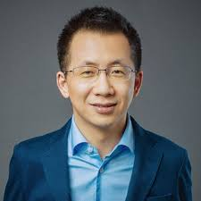
Introduction
Cont’d
Social Media
the heart of the digital era
how we talk, share ideas, and stay connected with friends
the King of Digital Fun and Creativity. (TikTok)
TikTok
Today's most popular video app.
Short, fun, and easy-to-make videos for everyone.
Growing fast in entertainment, learning, and business.
People spend more time on TikTok than other apps.
Connecting billions of users across the world every day.
History
Zhang Yiming (ByteDance).
started as Douyin in 2016.
bought Musical.ly in 2017 and rebranded to TikTok in 2018.
the world's fastest-growing social media app.
TikTok Revolution

Slide 7
Cont’d
TikTok
Today's most popular video app.
Short, fun, and easy-to-make videos for everyone.
Growing fast in entertainment, learning, and business.
People spend more time on TikTok than other apps.
Connecting billions of users across the world every day.
Cont’d
TikTok Revolution
Currently status
downloaded app for entertainment globally.
young people use TikTok more than Google for searching information.
users spend more daily time on TikTok than on any other social app.
facing legal challenges and bans in some countries (e.g., USA, Indian).
History
Zhang Yiming (ByteDance).
started as Douyin in 2016.
bought Musical.ly in 2017 and rebranded to TikTok in 2018.
the world's fastest-growing social media app.

Slide 8
Cont’d
TikTok Revolution
Cont’d
Currently status
downloaded app for entertainment globally.
young people use TikTok more than Google for searching information.
users spend more daily time on TikTok than on any other social app.
facing legal challenges and bans in some countries (e.g., USA, Indian).
History
Zhang Yiming (ByteDance).
started as Douyin in 2016.
bought Musical.ly in 2017 and rebranded to TikTok in 2018.
the world's fastest-growing social media app.
Algorithm
Magic of Viral Videos
"For You Page" shows exactly what users love to watch.
A user doesn't need to be famous or have followers to go viral.
Video is fun, TikTok shares it with millions of people.
A normal user can become a global star overnight.

Slide 9
Currently status
downloaded app for entertainment globally.
young people use TikTok more than Google for searching information.
users spend more daily time on TikTok than on any other social app.
facing legal challenges and bans in some countries (e.g., USA, Indian).
Cont’d
Algorithm
Cont’d
Magic of Viral Videos
"For You Page" shows exactly what users love to watch.
A user doesn't need to be famous or have followers to go viral.
Video is fun, TikTok shares it with millions of people.
A normal user can become a global star overnight.
S
E
C
R
E
T
Secret Weapon (AI)
tracks user likes and skipped content.
learns people’s hobbies and interests in just a few minutes.
shows great videos so viewers never get bored.
AI technology is the reason why TikTok is the 1 app.

Slide 10
Algorithm
Shift Content Creation
Cont’d
New Era of Creators
high-quality videos no longer need expensive cameras, a phone is enough.
ordinary people are replacing professional actors and celebrities.
built-in filters and music make editing easy for everyone.
Magic of Viral Videos
"For You Page" shows exactly what users love to watch.
A user doesn't need to be famous or have followers to go viral.
Video is fun, TikTok shares it with millions of people.
A normal user can become a global star overnight.
S
E
C
R
E
T
Secret Weapon (AI)
tracks user likes and skipped content.
learns people’s hobbies and interests in just a few minutes.
shows great videos so viewers never get bored.
AI technology is the reason why TikTok is the 1 app.

Slide 11
Shift Content Creation
Cont’d
New Era of Creators
high-quality videos no longer need expensive cameras, a phone is enough.
ordinary people are replacing professional actors and celebrities.
built-in filters and music make editing easy for everyone.
S
E
C
R
E
T
Secret Weapon (AI)
tracks user likes and skipped content.
learns people’s hobbies and interests in just a few minutes.
shows great videos so viewers never get bored.
AI technology is the reason why TikTok is the 1 app.
Cont’d
Changing How We Watch
audiences now prefer 15-60 second videos instead of long shows.
content is made for vertical phone screens, not wide TV screens.
people love real, raw, and unedited moments more than perfect studio clips.

Slide 12

Shift Content Creation
New Era of Creators
high-quality videos no longer need expensive cameras, a phone is enough.
ordinary people are replacing professional actors and celebrities.
built-in filters and music make editing easy for everyone.
Cont’d
Changing How We Watch
audiences now prefer 15-60 second videos instead of long shows.
content is made for vertical phone screens, not wide TV screens.
people love real, raw, and unedited moments more than perfect studio clips.
Culture &
Global impact
Cultures
No Language Barrier: Music and dance are universal. People connect even if they don't speak the same language.
Global Trends: A trend starting in one country can spread to the whole world in hours.
Sharing Traditions: Users share their local food, clothes, and festivals with a global audience.

Slide 13
Cont’d
Cont’d
Global Impact
Hit Maker: Songs that go viral on TikTok often become #1 on world music charts.
Changing How We Watch
audiences now prefer 15-60 second videos instead of long shows.
content is made for vertical phone screens, not wide TV screens.
people love real, raw, and unedited moments more than perfect studio clips.
New Life for Old Songs: Classic songs from the past become popular again through new challenges.
Artist Discovery: Unknown singers can find a massive audience without a big music label.
Culture &
Global impact
Cultures
No Language Barrier: Music and dance are universal. People connect even if they don't speak the same language.
Global Trends: A trend starting in one country can spread to the whole world in hours.
Sharing Traditions: Users share their local food, clothes, and festivals with a global audience.

Slide 14
Cont’d
New Era of
Marketing &
Commerce
Global Impact
Hit Maker: Songs that go viral on TikTok often become #1 on world music charts.
TikTok Shop
Users can buy products directly inside the app while watching videos.
Real reviews from ordinary people make products sell out in minutes.
Creators show products in real-time, answering questions from the audience instantly.
New Life for Old Songs: Classic songs from the past become popular again through new challenges.
Artist Discovery: Unknown singers can find a massive audience without a big music label.
Culture &
Global impact
Cultures
No Language Barrier: Music and dance are universal. People connect even if they don't speak the same language.
Global Trends: A trend starting in one country can spread to the whole world in hours.
Sharing Traditions: Users share their local food, clothes, and festivals with a global audience.

Slide 15
Commerce
Successful brands make fun videos, not boring commercials.
People trust the advice of their favorite creators more than big movie stars.
users use TikTok like Google to find places and facts.
Small businesses can reach millions of people without spending a lot of money on TV ads.
Cont’d
Cont’d
New Era of
Marketing &
Commerce
Global Impact
Hit Maker: Songs that go viral on TikTok often become #1 on world music charts.
TikTok Shop
Users can buy products directly inside the app while watching videos.
Real reviews from ordinary people make products sell out in minutes.
Creators show products in real-time, answering questions from the audience instantly.
New Life for Old Songs: Classic songs from the past become popular again through new challenges.
Artist Discovery: Unknown singers can find a massive audience without a big music label.

Slide 16
Information
get the latest world news in seconds.
.
Cont’d
Commerce
Successful brands make fun videos, not boring commercials.
People trust the advice of their favorite creators more than big movie stars.
Information
& Learning
users use TikTok like Google to find places and facts.
discover smart tips for daily problems.
Small businesses can reach millions of people without spending a lot of money on TV ads.
see what is happening globally right now.
New Era of
Marketing &
Commerce
TikTok Shop
Users can buy products directly inside the app while watching videos.
Real reviews from ordinary people make products sell out in minutes.
Creators show products in real-time, answering questions from the audience instantly.

Slide 17
Cont’d
Information
get the latest world news in seconds.
.
Commerce
Successful brands make fun videos, not boring commercials.
Cont’d
People trust the advice of their favorite creators more than big movie stars.
Information
& Learning
Learning
learn cooking, coding, or art in under 60 seconds.
professionals share knowledge in a simple way.
watch and learn new languages from native speakers.
users use TikTok like Google to find places and facts.
discover smart tips for daily problems.
Small businesses can reach millions of people without spending a lot of money on TV ads.
see what is happening globally right now.

Slide 18

Information
get the latest world news in seconds.
.
Challenges &
Ethical Concerns
Cont’d
People trust the advice of their favorite creators more than big movie stars.
Data Privacy: Many governments worry about how TikTok saves user data.
Legal Battles: TikTok is fighting in court to stay online in many places.
Cyberbullying: Managing mean comments and online hate is a big struggle.
Information
& Learning
Learning
learn cooking, coding, or art in under 60 seconds.
professionals share knowledge in a simple way.
watch and learn new languages from native speakers.
discover smart tips for daily problems.
see what is happening globally right now.

Slide 19
Challenges &
Ethical Concerns
Cont’d
Data Privacy: Many governments worry about how TikTok saves user data.
Legal Battles: TikTok is fighting in court to stay online in many places.
Cyberbullying: Managing mean comments and online hate is a big struggle.
Learning
learn cooking, coding, or art in under 60 seconds.
professionals share knowledge in a simple way.
watch and learn new languages from native speakers.
Cont’d
Safety for Kids: Protecting young viewers from dangerous content is a top priority.
Fake News: Misinformation and "Deepfakes" can spread very quickly.
Mental Health: Comparing real life to "perfect" videos can affect self-esteem.

Slide 20

Challenges &
Ethical Concerns
Data Privacy: Many governments worry about how TikTok saves user data.
Legal Battles: TikTok is fighting in court to stay online in many places.
Cyberbullying: Managing mean comments and online hate is a big struggle.
Cont’d
Future Landscape
of TikTok
Worries about how personal data is collected and used.
Concerns over app addiction and its effect on teenagers.
Lack of transparency in how videos are shown to people.
Cont’d
Safety for Kids: Protecting young viewers from dangerous content is a top priority.
Fake News: Misinformation and "Deepfakes" can spread very quickly.
Mental Health: Comparing real life to "perfect" videos can affect self-esteem.
Strict rules and national security concerns in many countries.
Fighting for users against Instagram Reels and YouTube Shorts.
Difficulties in stopping misinformation and harmful content.

Slide 21
Challenges &
Ethical Concerns
Data Privacy: Many governments worry about how TikTok saves user data.
Legal Battles: TikTok is fighting in court to stay online in many places.
Cyberbullying: Managing mean comments and online hate is a big struggle.
Power of
Sound & Music
Power of Sound & Music
Cont’d
Future Landscape
of TikTok
Worries about how personal data is collected and used.
Concerns over app addiction and its effect on teenagers.
Lack of transparency in how videos are shown to people.
Cont’d
Safety for Kids: Protecting young viewers from dangerous content is a top priority.
Fake News: Misinformation and "Deepfakes" can spread very quickly.
Mental Health: Comparing real life to "perfect" videos can affect self-esteem.
Strict rules and national security concerns in many countries.
Fighting for users against Instagram Reels and YouTube Shorts.
Difficulties in stopping misinformation and harmful content.
2.Music Discovery
1.Audio Branding

Slide 22
Future Landscape
of TikTok
Cont’d
Cont’d
Worries about how personal data is collected and used.
Concerns over app addiction and its effect on teenagers.
Lack of transparency in how videos are shown to people.
Audio Branding - Brands use "audio memes" and original sounds for instant recognition.
Music Discovery - Viral trends push new hits and old classics to the Billboard charts.
Participatory Culture - Users "remix" and "duet," making the audience part of a song's success.
Strict rules and national security concerns in many countries.
Fighting for users against Instagram Reels and YouTube Shorts.
Difficulties in stopping misinformation and harmful content.
Power of
Sound & Music
1.Audio Branding
2.Music Discovery
3.Participatory

Slide 23
Cont’d
Power of
Trust in
Real User
Content
1.Audio Branding
Sound & Music
Power of UGC
(User-Generated Content)
Audio Branding - Brands use "audio memes" and original sounds for instant recognition.
Music Discovery - Viral trends push new hits and old classics to the Billboard charts.
Participatory Culture - Users "remix" and "duet," making the audience part of a song's success.
Authenticity is Key
Ad Fatigue
2.Music Discovery
Modern audiences ignore high-budget, polished commercials.
Simple videos from real people are more effective than celebrity ads.
Showing real life and flaws builds a stronger bond with followers.
3.Participatory

Slide 24
Cont’d
Cont’d
Trust in
Real User
Content
Audio Branding - Brands use "audio memes" and original sounds for instant recognition.
Music Discovery - Viral trends push new hits and old classics to the Billboard charts.
Participatory Culture - Users "remix" and "duet," making the audience part of a song's success.
Ad Fatigue
Power of UGC
(User-Generated Content)
Authenticity is Key
Peer-to-Peer Advice
Users see creators as "digital friends," not salespeople..
Problem Solving
Real reviews show how products work in everyday life.
Digital Word-of-Mouth
Recommendations feel like advice from a friend, not a sales pitch.
Modern audiences ignore high-budget, polished commercials.
Simple videos from real people are more effective than celebrity ads.
Showing real life and flaws builds a stronger bond with followers.

Slide 25
Cont’d
Cont’d
Trust in
Real User
Content
Audio Branding - Brands use "audio memes" and original sounds for instant recognition.
Music Discovery - Viral trends push new hits and old classics to the Billboard charts.
Participatory Culture - Users "remix" and "duet," making the audience part of a song's success.
Authenticity is Key
Power of UGC
(User-Generated Content)
Ad Fatigue
Peer-to-Peer Advice
Users see creators as "digital friends," not salespeople..
Problem Solving
Real reviews show how products work in everyday life.
Digital Word-of-Mouth
Recommendations feel like advice from a friend, not a sales pitch.
Modern audiences ignore high-budget, polished commercials.
Showing real life and flaws builds a stronger bond with followers.
Simple videos from real people are more effective than celebrity ads.
Security
Check if there is any unusual activity or unauthorized logins.
See all phones and computers where your account is logged in.
Make your account unhackable by adding an extra layer of security.

Slide 26
Security
Cont’d
Power of UGC
(User-Generated Content)
Check if there is any unusual activity or unauthorized logins.
See all phones and computers where your account is logged in.
Make your account unhackable by adding an extra layer of security.
Ad Fatigue
Peer-to-Peer Advice
Users see creators as "digital friends," not salespeople..
Problem Solving
Real reviews show how products work in everyday life.
Digital Word-of-Mouth
Recommendations feel like advice from a friend, not a sales pitch.
Modern audiences ignore high-budget, polished commercials.
Simple videos from real people are more effective than celebrity ads.
Cont’d
Data Encryption - TikTok uses advanced technology to hide your data from hackers.
Privacy Controls - Tools to decide who can see your videos, comment, or send messages.
Proactive Monitoring - The system blocks millions of fake accounts and phishing links daily.

Slide 27
Security
Check if there is any unusual activity or unauthorized logins.
See all phones and computers where your account is logged in.
Make your account unhackable by adding an extra layer of security.
Cont’d
Conclusion
Data Encryption - TikTok uses advanced technology to hide your data from hackers.
Privacy Controls - Tools to decide who can see your videos, comment, or send messages.
Proactive Monitoring - The system blocks millions of fake accounts and phishing links daily.
TikTok is a very powerful platform that connects people through music and short videos. It has changed the world of business and learning because it focuses on real people and honest content rather than famous celebrities. Although there are some worries about privacy and fake news, the app provides tools like privacy controls and encryption to keep accounts safe. TikTok’s future is bright as it continues to give a voice to everyone and creates new ways for us to experience the world through our screens.

Slide 28
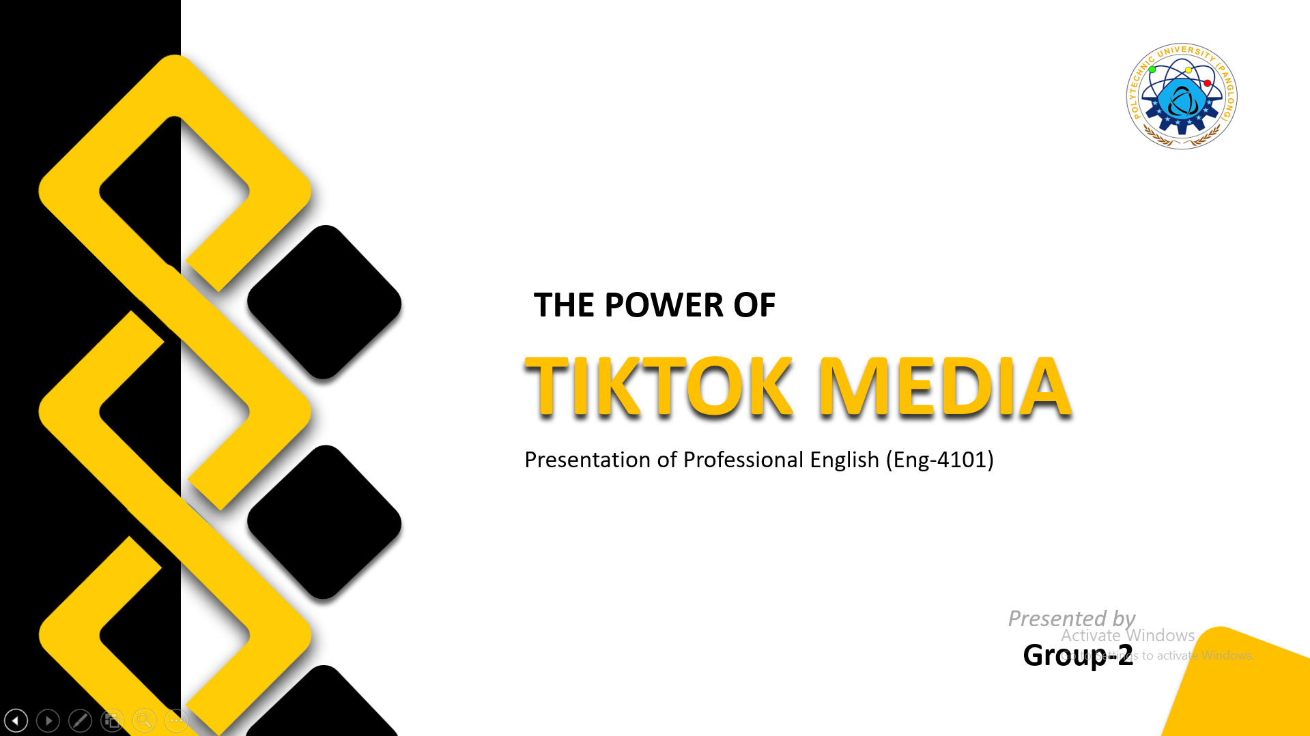
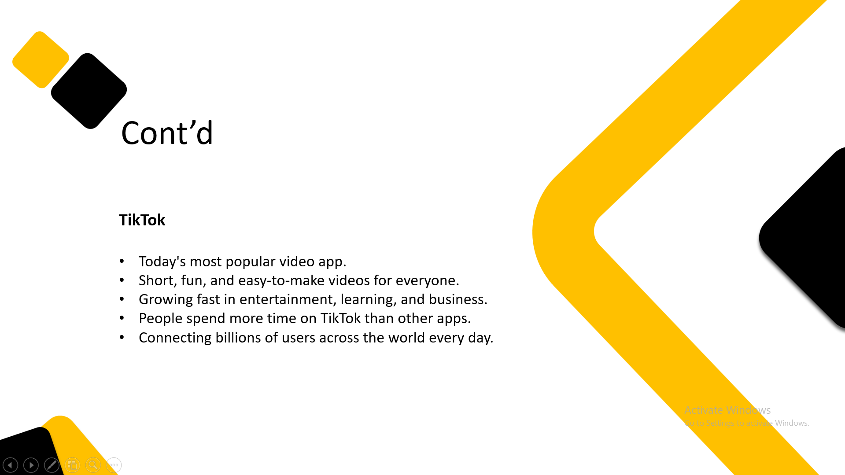
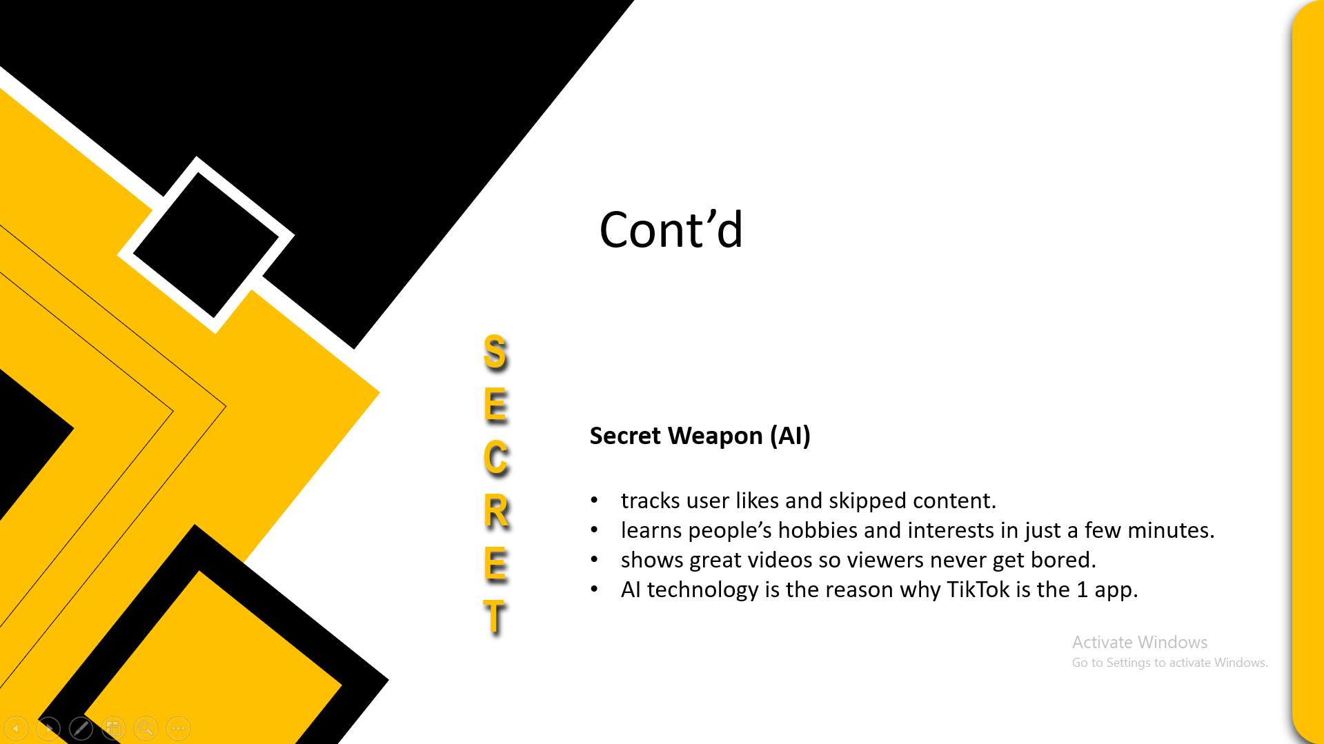
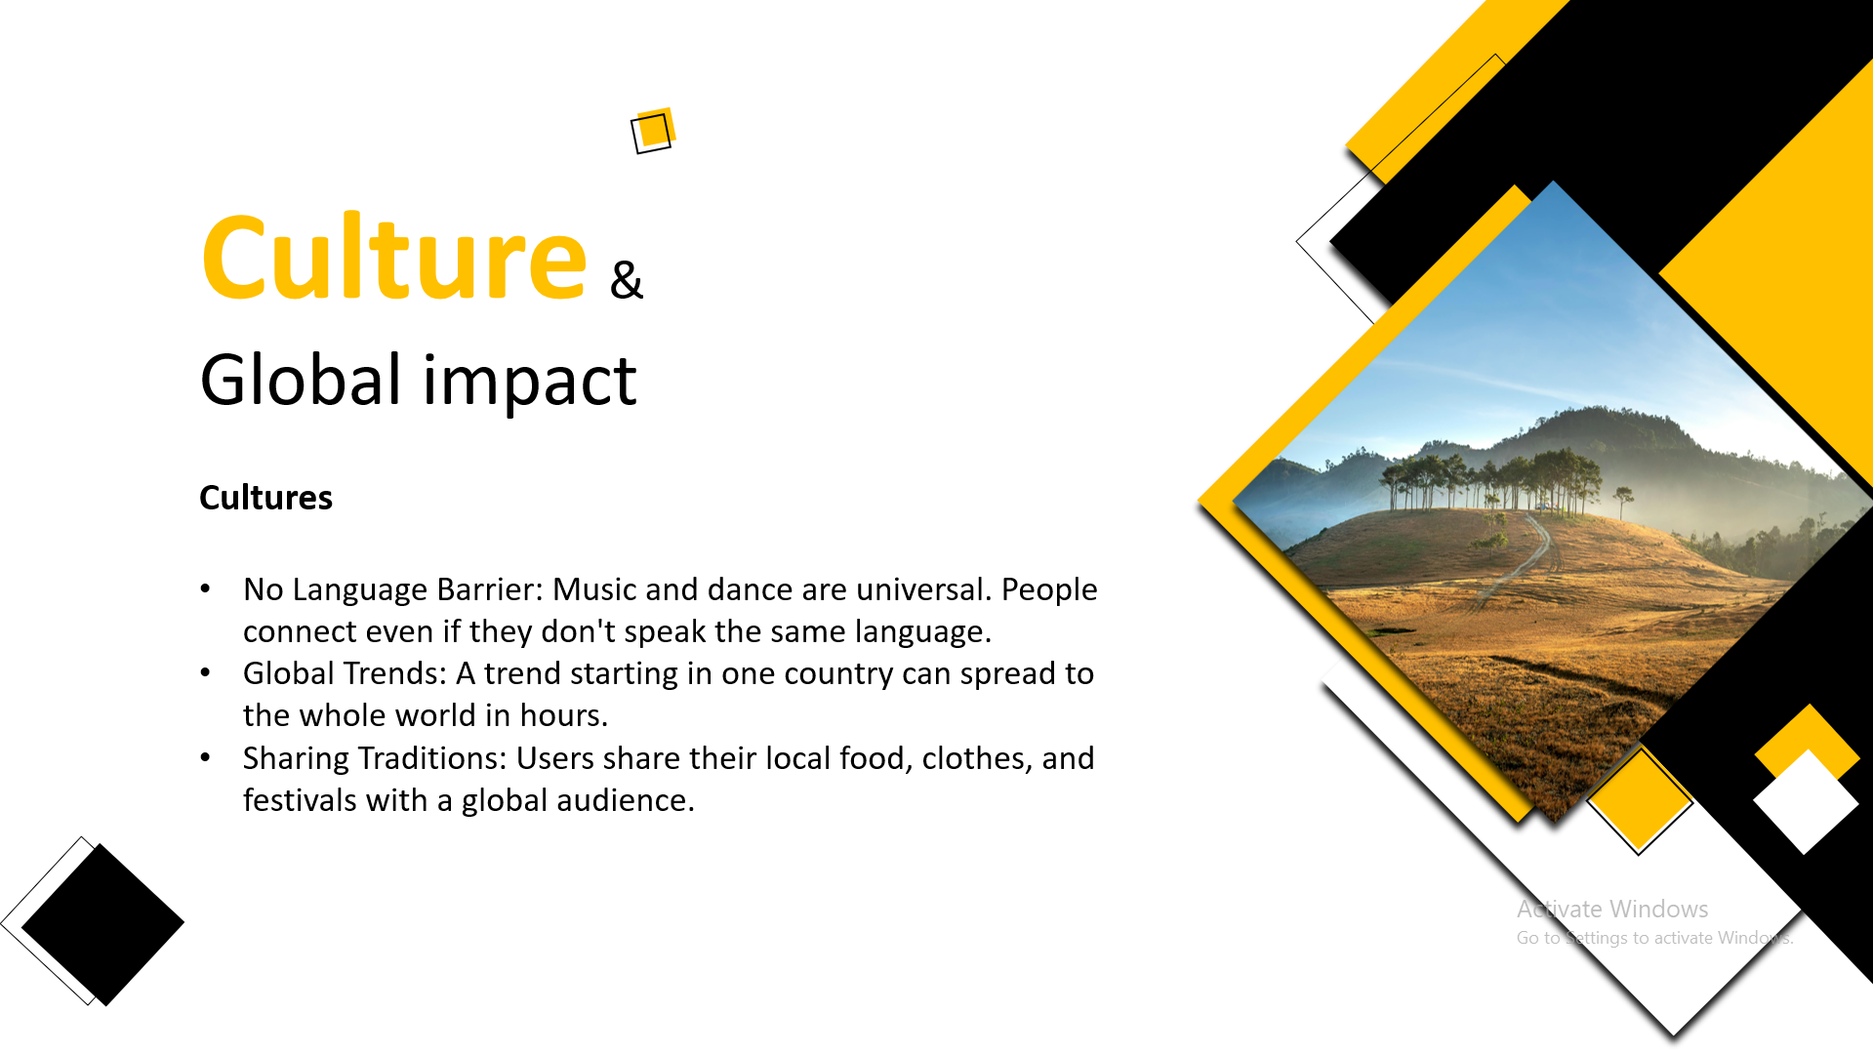
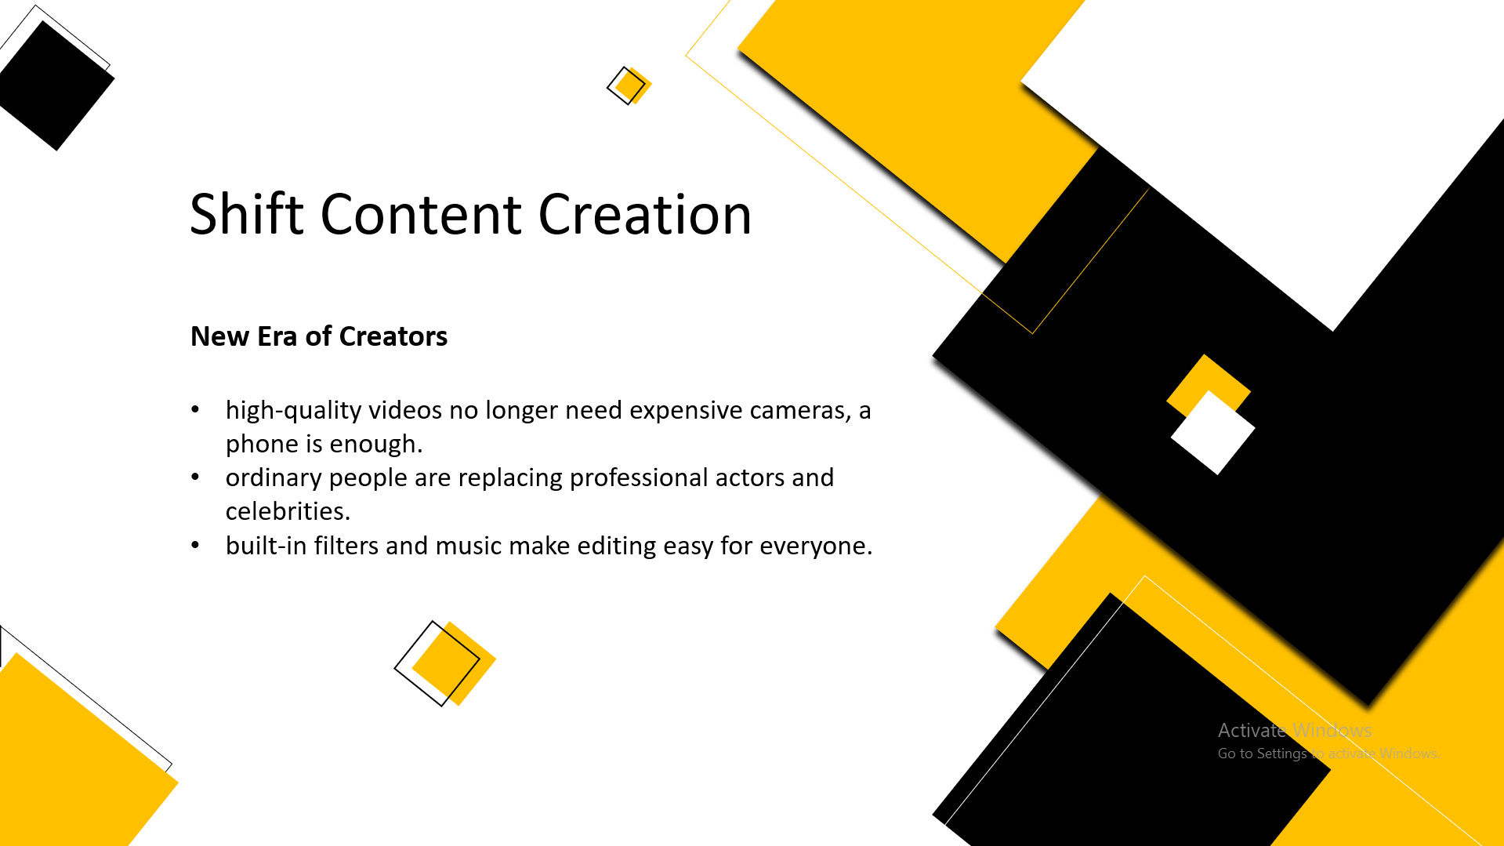
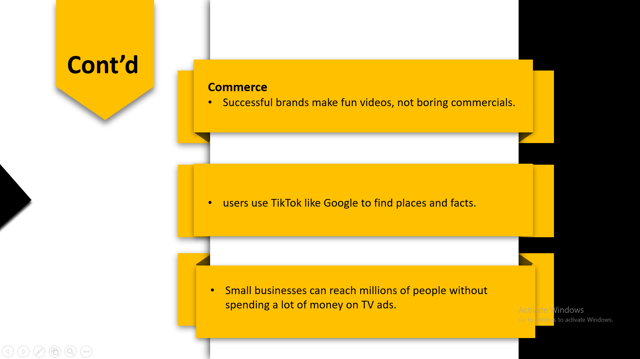
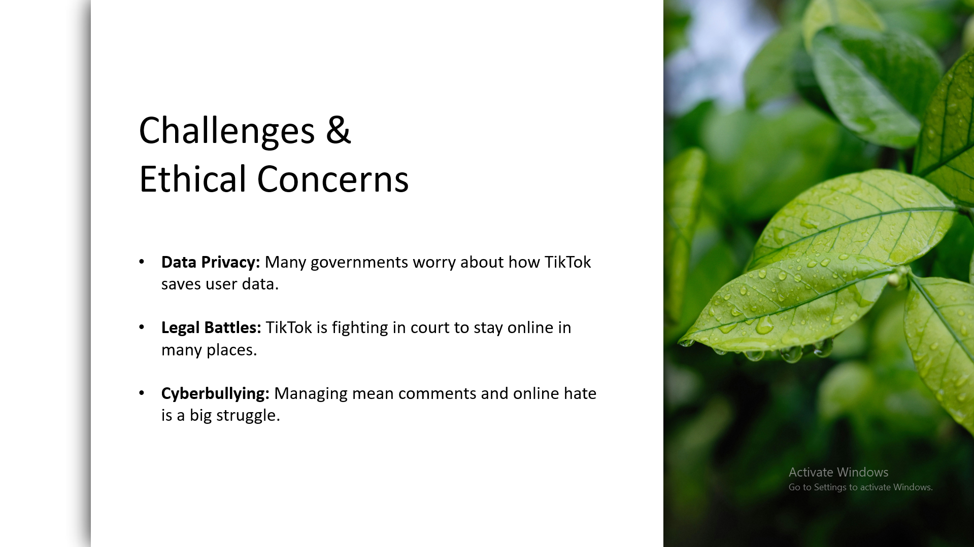
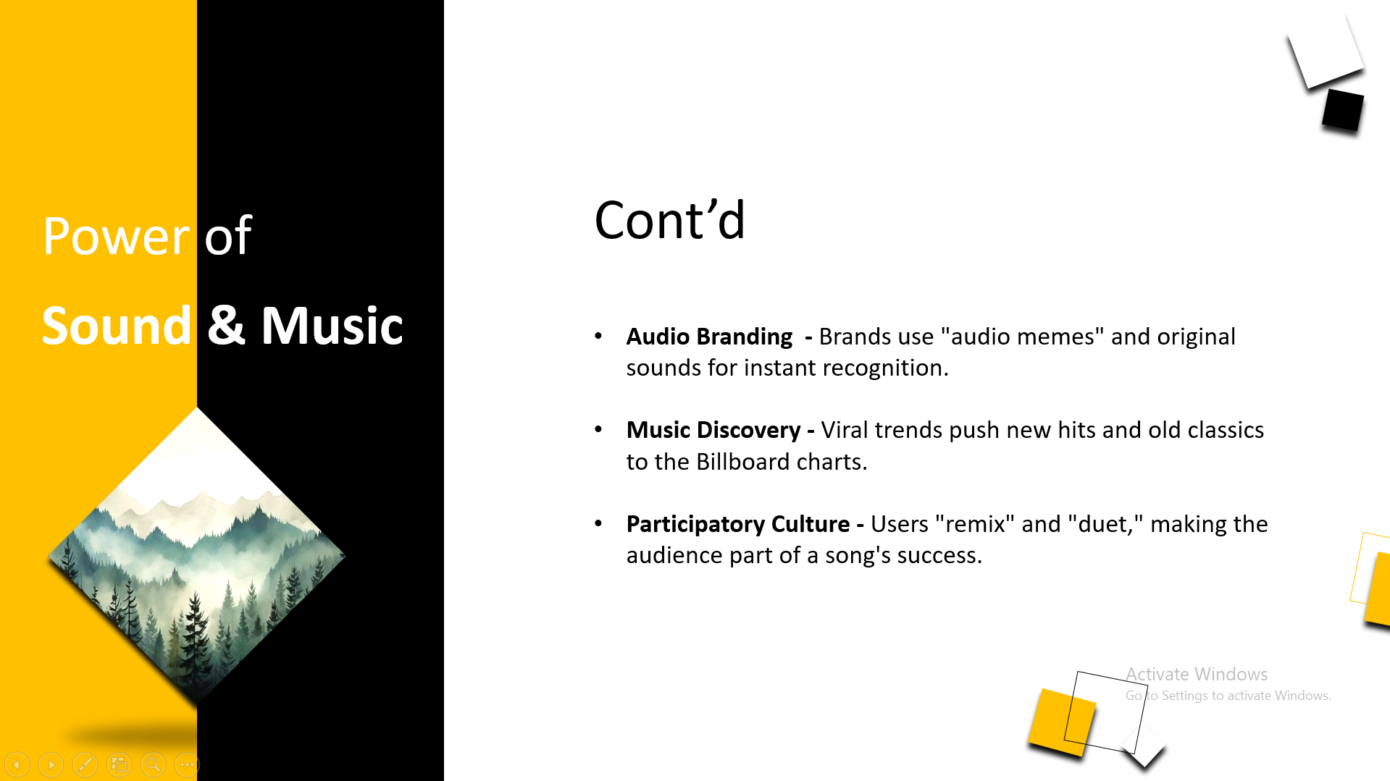
Cont’d
Conclusion
Data Encryption - TikTok uses advanced technology to hide your data from hackers.
Privacy Controls - Tools to decide who can see your videos, comment, or send messages.
Proactive Monitoring - The system blocks millions of fake accounts and phishing links daily.
TikTok is a very powerful platform that connects people through music and short videos. It has changed the world of business and learning because it focuses on real people and honest content rather than famous celebrities. Although there are some worries about privacy and fake news, the app provides tools like privacy controls and encryption to keep accounts safe. TikTok’s future is bright as it continues to give a voice to everyone and creates new ways for us to experience the world through our screens.

Slide 29
Conclusion
TikTok is a very powerful platform that connects people through music and short videos. It has changed the world of business and learning because it focuses on real people and honest content rather than famous celebrities. Although there are some worries about privacy and fake news, the app provides tools like privacy controls and encryption to keep accounts safe. TikTok’s future is bright as it continues to give a voice to everyone and creates new ways for us to experience the world through our screens.
Thank You

