Slide 1

Distributed version control system
(AdVANCED)

Slide 2
Advanced Topics Overview
Comparing Differences
Branching, Merging and Conflict Resolution
Milestones
Work In Progress
Time Travels
Working with Remote

Slide 3
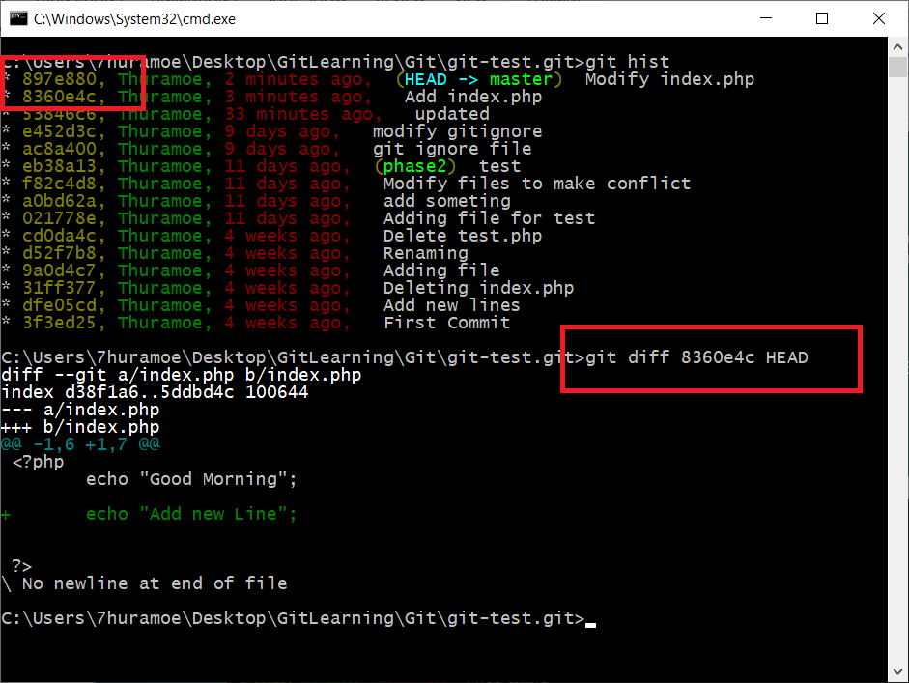
Comparing Differences
Sometimes, we need to check the differences of what we write in the previous commit and our latest source code of same file. At this time, we need to check the differences by using `git diff` command.
git diff [commit hash] [commit hash] git diff 9a0d4c7 HEAD

Slide 4
Install Helix Visual Merge Tool
When using `git diff` command, it will be difficult to see what is the differences because it can only show differences in command prompt. But, Git allow us to use other comparing tools to see the differences clearly.
So, we will use `P4Merge`. By using this tool, we can make comparing and merging very easily.
Go to https://www.perforce.com/downloads and only download Helix Visual Merge Tool. When click download, registration form will show, click skip registration. (Note: this website design is changed very often.)
And then install that application.

Slide 5
Integrate P4Merge as Diff tool
Before integrate P4Merge with Git, we will need to know the install location of P4Merge because we will need to used that location in later.(May be in C:\Program Files\Perforce)
So, let’s start integrate P4Merge as diff tool. Type following command in command prompt.
git config --global diff.tool p4merge
Then, we need to add actual path of P4Merge tools. Note: you will need to used forward slash(/), when writing path.
git config --global difftool.p4merge.path “C:/Program Files/Perforce/p4merge.exe”
By default, when we use difftool command, git will confirm you to open or not the application, that you set as difftool(P4Merge). To skip this question, we can set prompt setting as shown in below.
git config --global difftool.prompt false

Slide 6
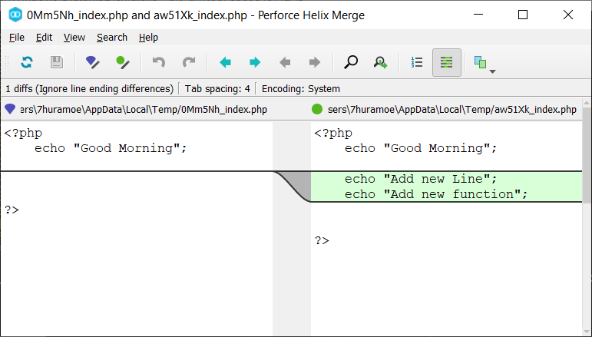
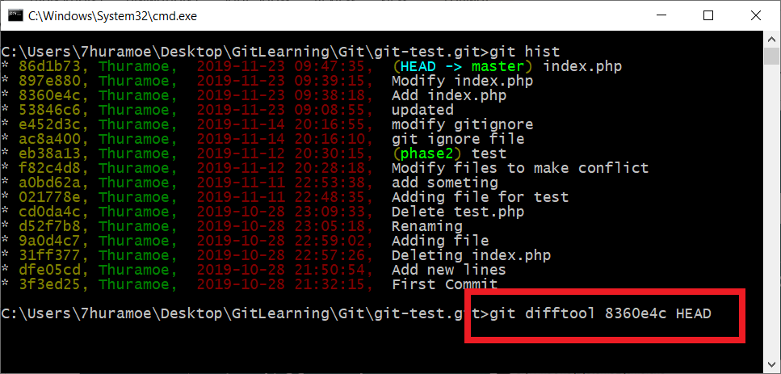
Comparing by P4Merge
Now, its time to use our comparing tool. When you type difftool command and press enter, you will see differences of your file via P4Merge tool.
git difftool 8360e4c HEAD

Slide 7
Branching
A branch is just a timeline of commits. It means, branches are the names or labels we give timeline in git. We can create or deleting branches without effecting timelines.
Feature Branch
Master Branch
New Merge Commit

Slide 8
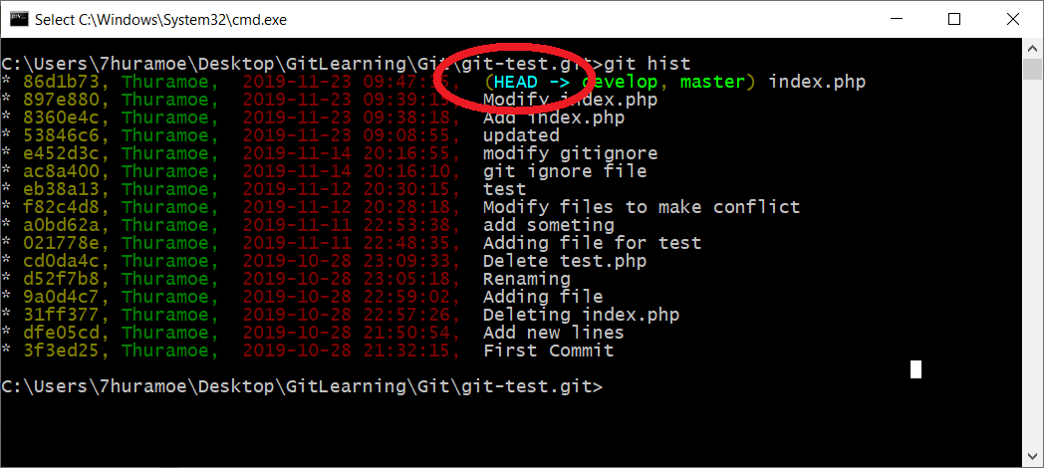
Special Marker (HEAD)
Before we move on to creating branch, we need to know git special markers or pointers called `HEAD`.
HEAD is normally the last commit of current branch. And also, it can be move.
That means, when you switch to another branches, the location of HEAD moves to the last commit location of that branch.
Even you can move HEAD pointer to another commit instead of last commit.

Slide 9
Creating Branch
A branch is a timeline of commits. Branches are a labels or names we give timelines in Git. We can create or delete branches without effecting timelines. When we start initialize a Git repository, all of works are start doing in ‘master’ branch. This is also the default branch of Git.
So, Lets start to create branch.
git branch [branch-name]
git branch features
You can use following command to see which branch now you are working with.
git branch
If you want to switch between already created branches, then use
git checkout features
You can also create branch and switch immediately by using following command.
git checkout –b updates
If you want to delete a branch. (Note: you can’t delete branch that you are currently checkout.)
git branch –d features

Slide 10
Integrate P4Merge as Merge tool
Before integrate P4Merge with Git, we will need to know the install location of P4Merge because we will need to used that location in later.(May be in C:\Program Files\Perforce)
So, let’s start integrate P4Merge as merge tool. Type following command in command prompt.
git config --global merge.tool p4merge
Then, we need to add actual path of P4Merge tools. Note: you will need to used forward slash(/), when writing path.
git config --global mergetool.p4merge.path “C:/Program Files/Perforce/p4merge.exe”
By default, when we use mergetool command, Git will confirm you to open or not the application, that you set as mergetool(P4Merge). To skip this question, we can set prompt setting as shown in below.
git config --global mergetool.prompt false

Slide 11
Simple Merge (Fast-Forward Merge)
While merging Git tries to automatically merge when possible, if there is no additional work is detected on the parent branch (master branch), Git will simply apply all commits from the other branch directly onto the parent branch.
Let’s try to test Git Merge with following scenarios.
1. Modify a file (eg. ‘index.php’) and then create a branch called ‘updates’ or anything you want and switch to that branch.
2. When you are on new branch ‘updates’, then commit ‘index.php’.
3. After that, switch back to ‘master’ branch and merge with following merge command.
git merge updates
Note: When you want to merge your branches into master branch, firstly you should be on master branch and then merge.

Slide 12
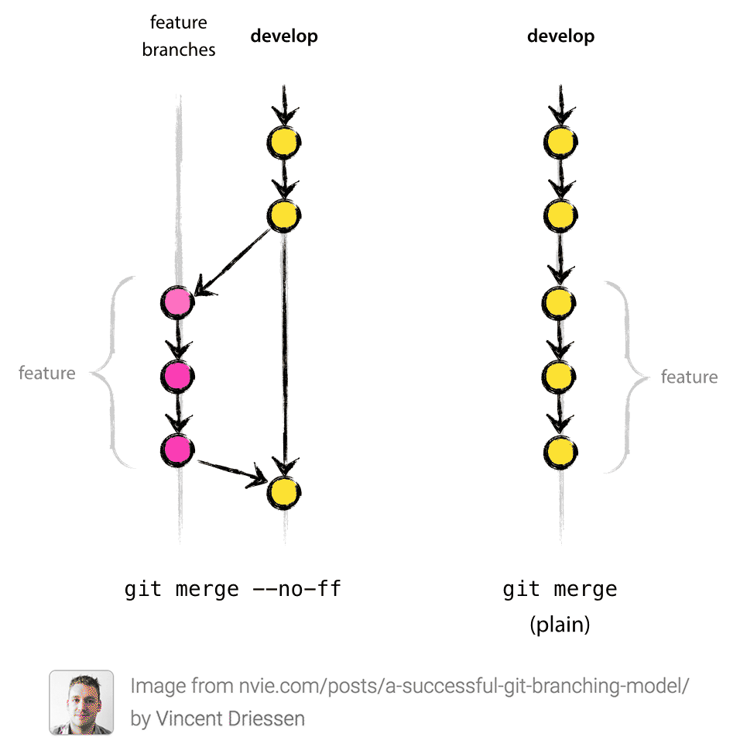
Fast-Forward VS No Fast-Forward Merge
In Fast-Forward merge, Git will simply apply all commits from the other branch directly onto the parent branch.
The --no-ff flag causes the merge to always create a new commit object, even if the merge could be performed with a fast-forward. This avoids losing information about the historical existence of a feature branch and groups together all commits that together added the feature.
git merge --no-ff updates

Slide 13
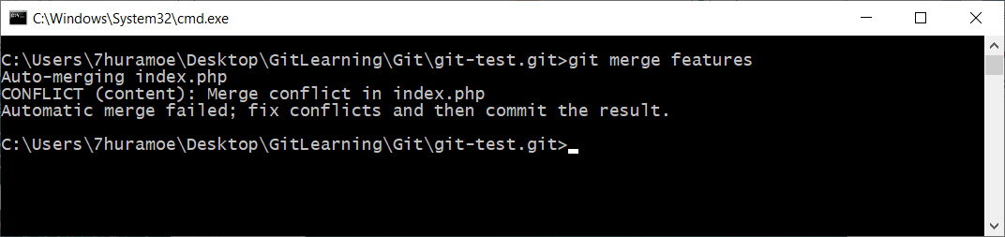
Merge with Resolving Conflict
When Git unable to automatically resolve any conflict, then you have to resolve that conflict with manual merge. Let’s try to test Git Manual Merge with following scenarios.
1. Create a branch called ‘features’ or anything you want and switch to that branch. Then modify already existing a file (eg. index.php or whatever you have) and commit.
2. Then switch to master branch and modify same file and same line of code that you already edit like in ‘features’ branch and commit.
3. Let’s try to merge these ‘features’ branch into ‘master’ branch.
git merge features
At this time, modification line number of ‘index.php’ is same in both branches. So, Git cannot auto merge and you will see the result of conflict.

Slide 14
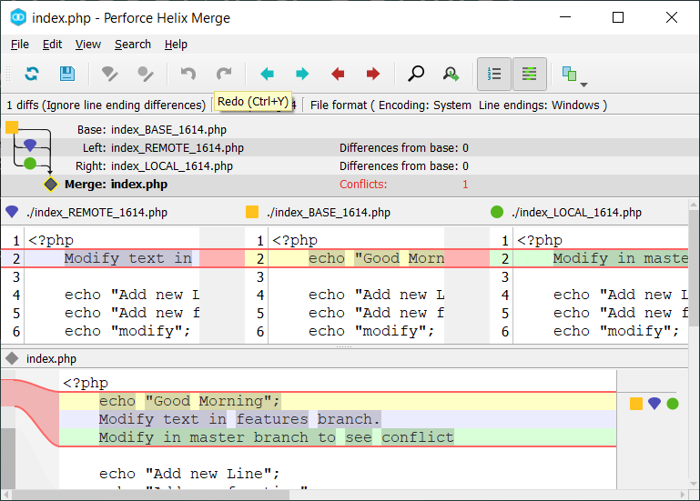
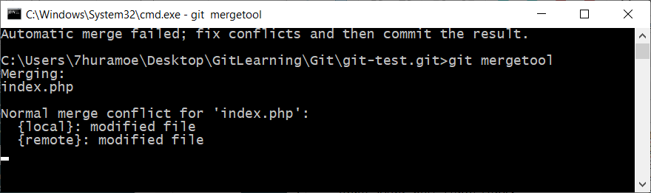
Merge with Resolving Conflict
So, we will try to merge by using our mergetool that we already created. Type ‘git mergetool’, then merge tool will open and you can resolve conflict and save file. Then close mergetool and make commit.
Note: After resolve a conflict, our merge tool(Perforce Helix Merege) will leave original file (eg. ‘index.php.orig’). You can delete that file and no need to adding into Git.

Slide 15
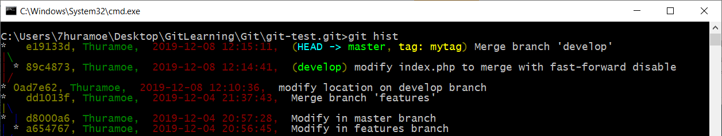
Milestone (Tagging)
We can mark some of the important commit of timeline with tagging. Tags are just labels that you can put at any arbitrary commit point. There are two types of tags: lightweight tags, which you can just give a name.
git tag [tag_name]
git tag mytag
You can see all of you tag list with git tag --list command. This is a lightweight tag and there is no associated information wit it. If you want to delete tags,
git tag -d mytag

Slide 16
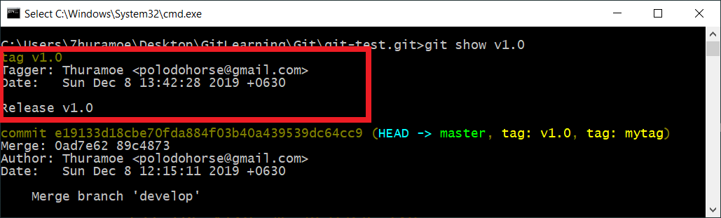
Milestone (Tagging)
Another kind of tagging is annotated tag. By using this kind of tag, you can put some additional message with tag.
git tag -a [tag_name] -m [Commit Message]
git tag v1.0 -m “Release 1.0”
When you see with git tag --list command, there is nothing special like lightweight tag. But, with following command, you will see some additional information.
git show [tag_name]
git show v1.0

Slide 17
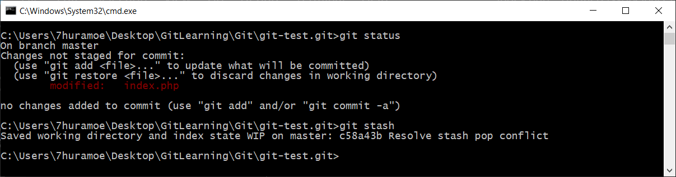
Saving Work In Progress (Stashing)
When you working some modification in one of your files (lets assume index.php) and not yet finished and commit, at this time you need to work on an urgent bug fix on another file and you need to get these changes out of the way. You shouldn't just commit index.php, of course, because it's unfinished work.
This is where "git stash" comes in handy:
“git stash” command will save your current working state temporary and then you can fix your bugs or do what you want to do in another files.

Slide 18
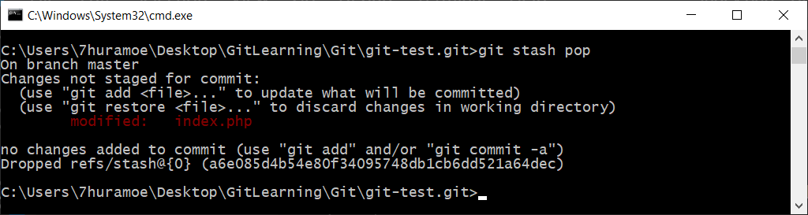
Saving Work In Progress (Apply or Pop)
When you're ready to continue where you left off, you can restore the saved state easily, you have two options: apply or pop.
Apply will take the stashed changes, apply them to your working directory, and keep the changes saved as a stash.
Pop will do the exact same thing for the first two steps, but it will permanently delete the stash.
(Note: If you haven’t good reason to store current state, you should use ‘pop’ instead of ‘apply’.

Slide 19
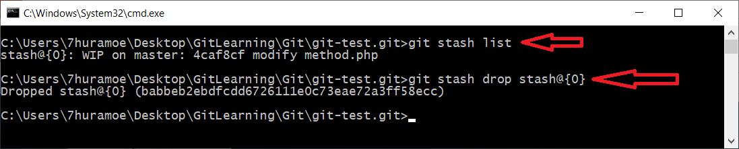
Work In Progress (List & Drop)
You can see your WIP list with ‘git stash list’ command. And you can delete your stash with ‘git stash drop stash@{n}’.
Caution:
While stashing will be helpful in temporarily saving files for later access, If you are constantly utilizing this feature, you will likely lose track of which saved changes are where, making your project increasingly chaotic.

Slide 20
Working with Remote Repository
Time to work with remote repository.
To test with remote repository, I will use GitHub (https://github.com) .

Slide 21
Connect Local Repo with Remote Server
Go to your local repository and open by using CMD. We can link our local repository to remote server by using following command.
git remote add [remote_reference_name] [remote_url]
git remote add origin https://github.com/ThuraMoe/myserver.git
As we want to add remote link to our repository, we used `git remote add` command. `add` command takes two parameters: remote reference name(in here origin but you can give any name that you want) and the second parameter is the full URL of the remote repository.
To check your remote link, use following command.
git remote –v
To delete a remote link, you can use `git remote remove` command.
git remote remove origin

Slide 22
Pushing local changes to Server
By using `git push` command, you can send your local changes to remote server.
git push [parameter] [remote_reference_name] [branch_name]
git push -u origin master
The above command will push local `master` branch to remote repository. The `-u` parameter is to create tracking relationship(upstream) between local branch and remote branch. So, you can only use `git pull` or `git push` and git will automatically pull or push to their related branch.
If you want to push all of your branches into remote repository, use `--all` flag.
git push -u origin --all
When pushing, `tag` is not push by default. You can push all tags (by using `--tags` flag) or specific tag to remote repository.
git push origin --tags
git push origin v1.0

Slide 23
Clone Repository
You can clone remote repository into your local machine.
git clone [remote_url]
git clone https://github.com/ThuraMoe/myserver.git
So, you will get `myserver` repository in your local machine. If you wish to set any other name to your repository while cloning, you can clone as shown in below.
git clone [remote_url] [repository_name]
git clone https://github.com/ThuraMoe/myserver.git mytest
The above code will clone from `myserver` repository as `mytest` repository into your local machine.
Note: After cloning, when you see branch list with `git branch` command, you will only see `master` branch even remote repository has one or more branches. So, please see all branches with `git branch -a` command.
You can also clone with only one branch.
git clone –b [branch_name] --single-branch [remote_url]
git clone –b develop --single-branch https://github.com/ThuraMoe/myserver.git

Slide 24
Getting Changes from remote (Pull)
Let’s assume you have made some changes in your local repository after cloning from remote repository and you need to push your changes back to remote repository.
Before you push your changes, you need to get changes from remote repository because if remote repository have some changes, Git won’t allow you to push your changes to remote repository.
To get remote repository changes into your local repository, you can use `pull` or `fetch` command. Now we start using with `pull` command.
git pull [remote_reference_name] [branch_name]
git pull origin master
`pull` command will automatically merge remote changes into your local repository and it will make changes your current local branch directly.

Slide 25
Getting Changes from remote (Fetch)
`fetch` command is a little bit different from `pull` command. It will only fetch data from remote repository and won’t merge directly into your current branch. it has absolutely no effect on your local development work until you merge.
You can also checkout as new branch base on fetch data. Following is the fetch command.
git fetch [remote_reference_name] [branch_name]
git fetch origin master
After `fetch`, you can merge these remote content into your local branch.
git fetch [remote_reference_name/branch_name]
git merge origin/master

Slide 26
Deleting a remote branch from local repository
Sometimes you will need to delete not only local but also remote branch.
So, you need to delete your local branch and push that branch name with full colon `:` prefix.
git branch -d [branch_name]
git push origin :[branch_name]
Pushing already deleted branch name with colon `:` will delete the remote branch of remote repository.
git branch -d develop
git push origin :develop

Slide 27
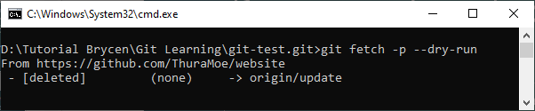
Remove already deleted remote reference in local repository
If you want to check a remote branch is already deleted or not you can use following command.
git fetch -p --dry-run
As you use `--dry-run` flag, it will only show what would be done, without making any changes. And you will see which branch is happened what. Now, in the picture you will see `update` branch is deleted in remote repository.
So, you can delete that remote reference by using fetch command with `-p` flag. `-p` flag will remove any remote tracking references that no longer exist on the remote repository.
git fetch –p
After fetching with above command, if you see all remote branch with `git branch -a` command, you will no longer see remote reference that no longer exists on the remote repository.

Slide 28
Bare or Non-bare Repository
Git has options to create repository as `bare (git init)` or `non-bare (git init --bare)` repository. So, we need to know when to use bare and when not to use.
Bare repository is a Git repository without a working directory. Everything in the directory is now what was contained in the `.git` folder. Bare repositories are usually central repositories where everyone push back their works to. There is no need to manipulate the actual work. It's a way to synchronize efforts between multiple people. You will not be able to directly see your project files.
Use a non-bare repository to work locally. You can edit files, commit or anything else git command can work inside non-bare repository.
Summary: use a non-bare repository to work locally and a bare repository as a central server/hub to share your changes with other people.

Slide 29
Time Travel

Slide 30
Three Trees of Git
To properly understand git reset usage, we must first understand Git's internal state management systems. Sometimes these mechanisms are called Git's "three trees". But, this is not like a tree data-structure. This is just a workflow of Git.
The working directory
Staging Index
Commit History (HEAD)

Slide 31
The Working Directory
The working directory is a Git Repository and all of your files under this Repo is controlled by Git. It is just a local file system.
You can see any changes by using `git status` command. These command will show you if there is some changes and it is the “first tree” of Git.

Slide 32

Staging Index
Next step is `Staging Index` tree. This tree is tracking `Working Directory` changes, that have been added with `git add` command. This staging index will be stored in the next commit.
If you want to see the accurate staging index, you need to use `git ls-files -s` command.
Above picture, you will see real staging index metadata of a file. The staged content mode bits, object name, and stage number. We just only interested in the object name, the second value (c3b7d484df32a5c7b2e4d26d1cbd688f55bd032c).
This is a standard Git object SHA-1 hash. It is a hash of the content of the files. The Commit History(HEAD) stores its own object SHA's for identifying pointers to commits and refs and the Staging Index has its own object SHA's for tracking versions of files in the index.
You need to know one thing about `git status` command. That command only displays changes between Commit History and the Staging Index.

Slide 33
Commit History (HEAD)
The final tree is a Commit History. The `git commit` command added changes to a permanent snapshot that lives in the Commit History. This snapshot also includes the state of the Staging Index at the time of commit.

Slide 34
How It Works
The `git reset` command is a complex tool for undoing changes. It is not the same process like SVN. Before we dive into `git reset`, you need to know how HEAD and branch ref changes happened when reset.
Lets demonstrate with following example. In this example, we have a sequence of commits on a master branch. HEAD ref and master branch ref currently point to commit d.
When we make a reset to commit b, both the HEAD ref and branch ref will move to specified commit.
In addition to updating the commit ref pointers, git reset will modified `three trees` state. The ref pointer modification always happens and is update to the third tree, the Commit History.
a
b
c
d
HEAD, Master
a
b
c
d
HEAD, Master

Slide 35
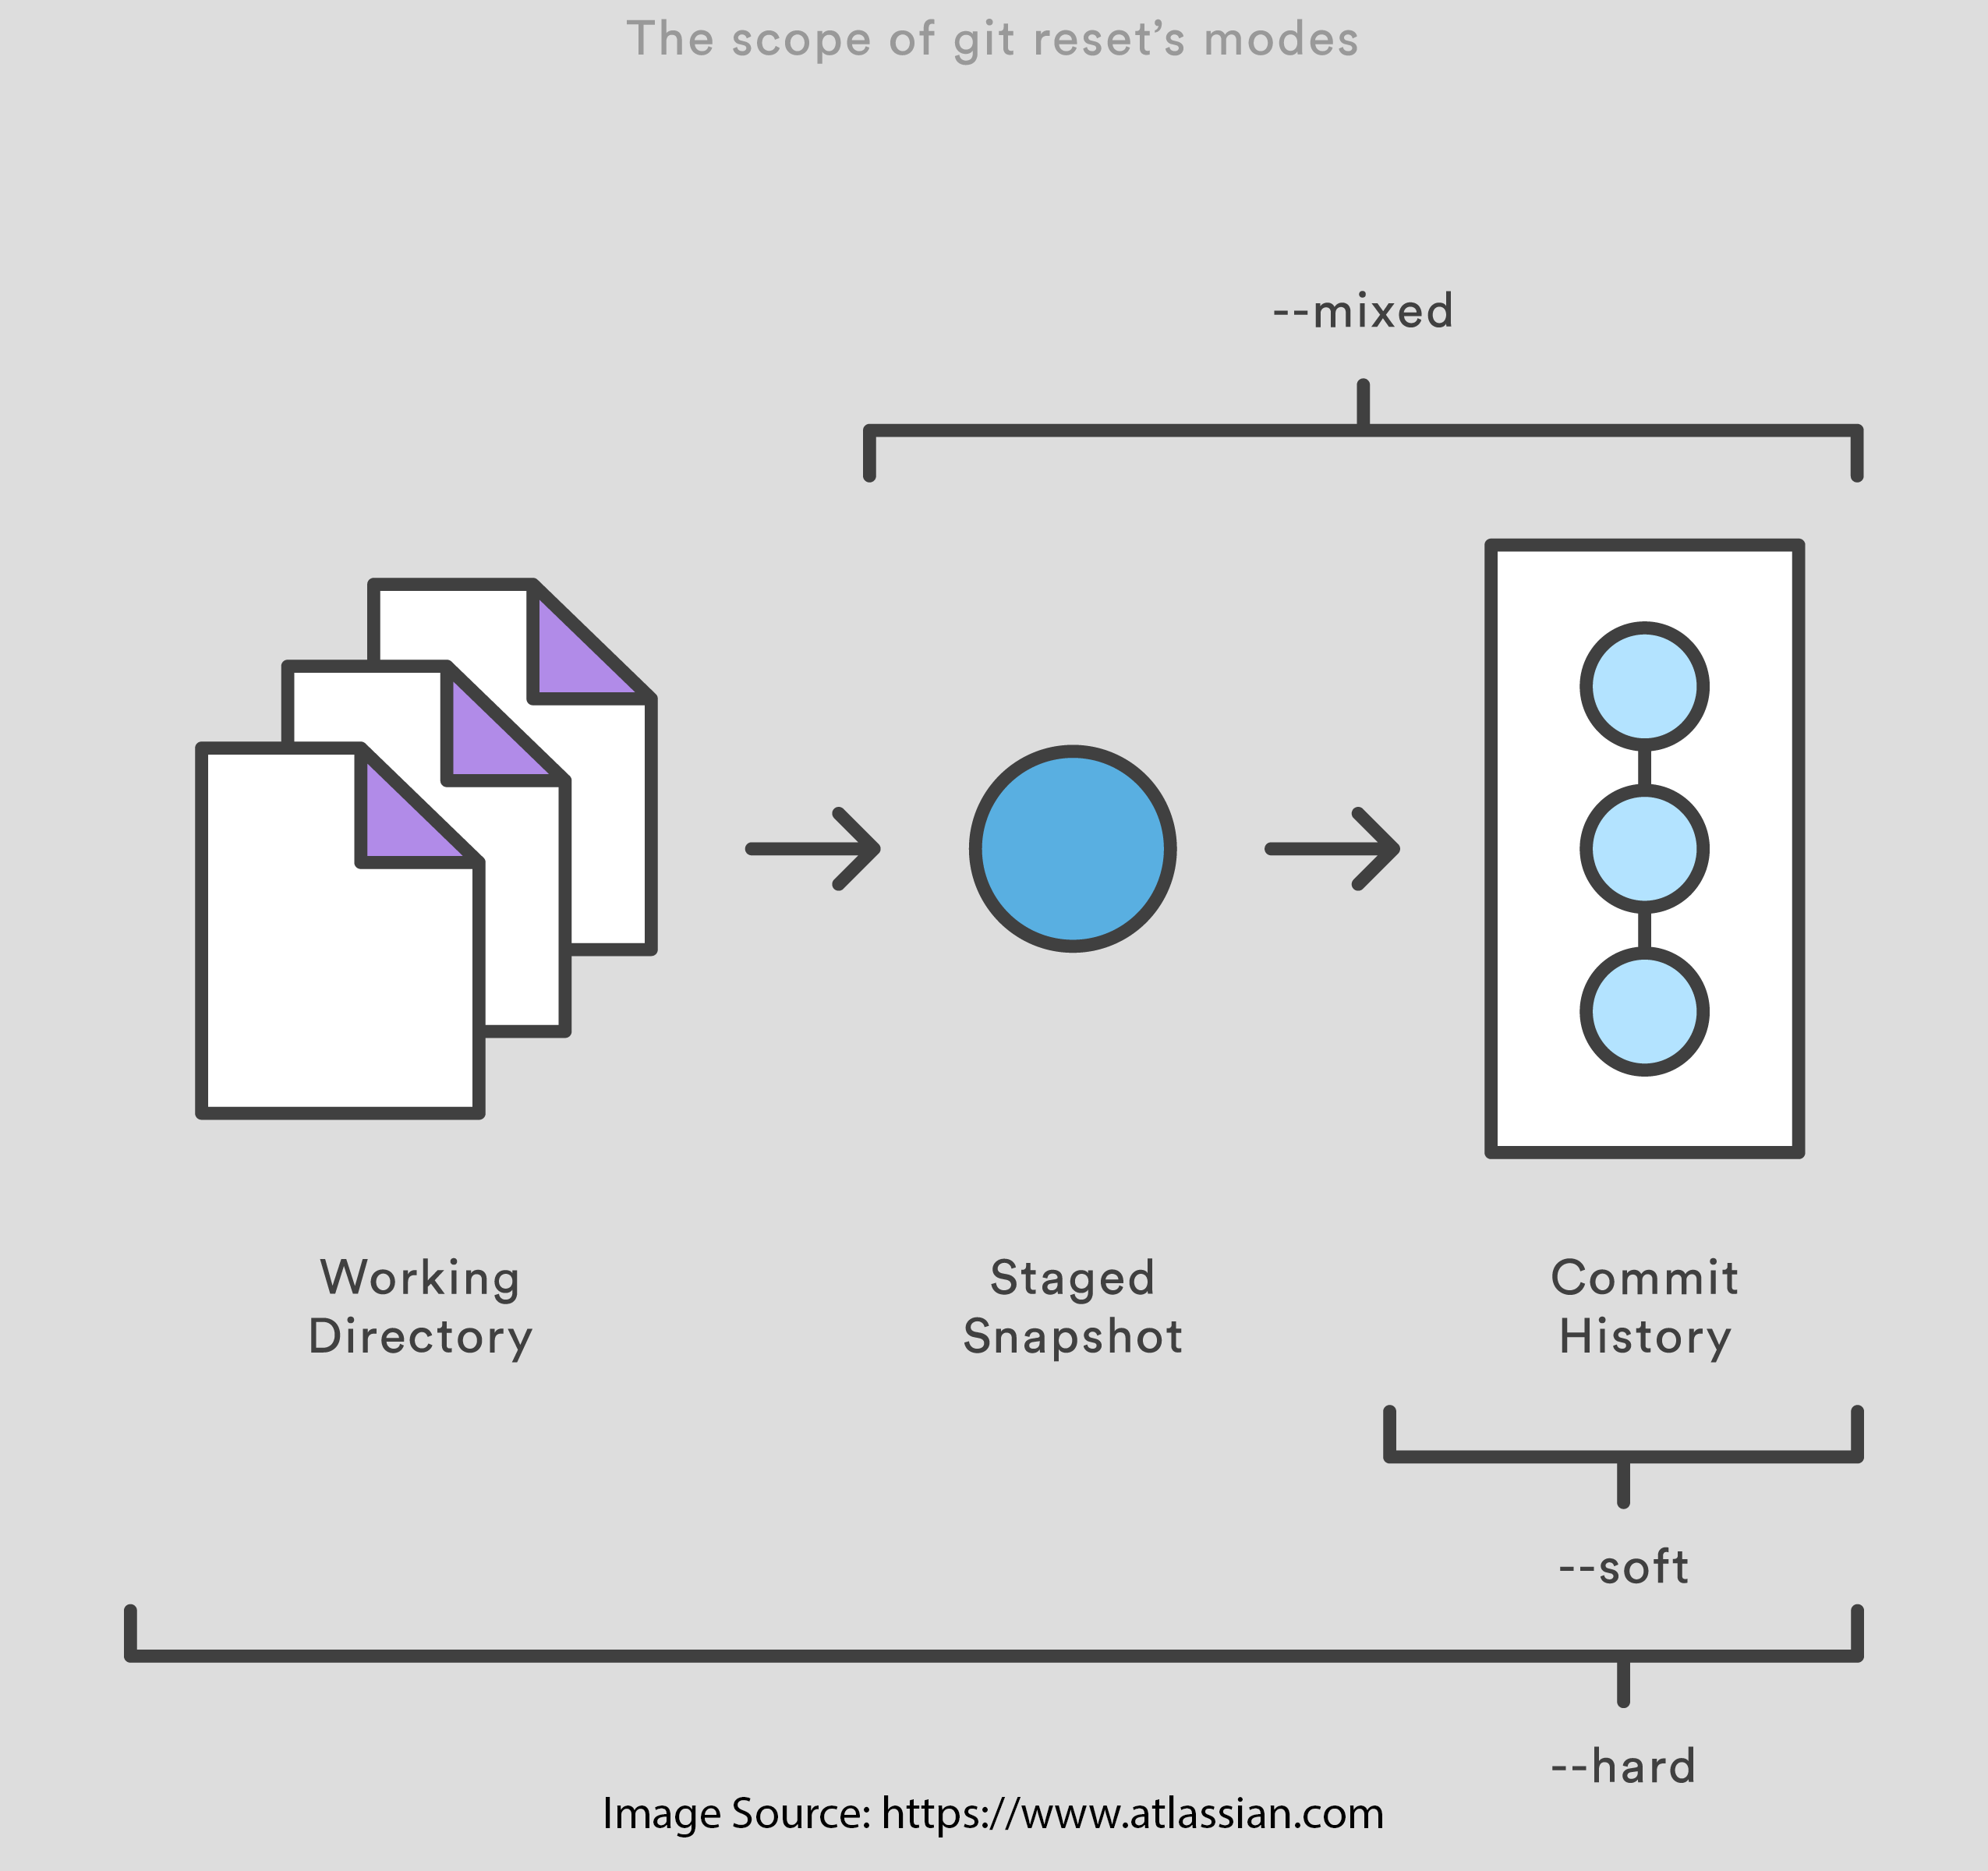
Git Reset
`git reset` has three options --soft, --mixed, --hard. The brief explanation of each of these options are:
--soft
uncommitted changes, changes are left staged (index).
--mixed (default)
uncommitted + unstage changes, changes are left in
working tree.
--hard
uncommitted + unstage + delete changes, nothing left.

Slide 36
git reset --soft
When reset with `--soft`, the ref pointers are updated into specific commit hash. And all commit state changes to uncommitted state. This option only change Commit History. The Staging Index and the Working Directory are left untouched.
Assume you have four commit and your ref pointer is pointed to latest commit(D).
Now, you want to soft reset to commit(B) `git reset --soft <commit-hash>`.
After you reset, when you see `git log`, you will see only two commit left in your commit history. Commit C and D are disappear from Commit History and all commit states of C and D are changes to uncommitted state(you can see it by `git status` command).
As Staging Index doesn’t change, everything is still in staged state. you can check it by `git ls-files -s` command.
All files and it contents are nothing changed. It means Working Directory is not changed.
A
B
C
D
HEAD, Master
A
B
HEAD, Master

Slide 37
git reset --mixed
`git reset` and `git reset --mixed <commit-hash>` is the same process because it is the default operating mode. This options change Commit History and Staging Index.
When reset with `--mixed`, the ref pointers are updated into specified commit. Staging Index are changes to the state of specified commit. Working Directory is not changed.
Assume you have four commit and your ref pointer is pointed to latest commit(D).
After you --mixed reset to commit B, when you see `git log`, you will see only two commit left in your commit history.
As Staging Index is also changes to commit B, some of your files might be unstage or untrack state.
But, all files and it contents are nothing changed. It means Working Directory is not changed.
A
B
C
D
HEAD, Master
A
B
HEAD, Master

Slide 38
git reset --hard
The most dangerous mode. This options change Commit History, Staging Index and also Working Directory.
When reset with `--hard`, the ref pointers are updated into specified commit. Staging Index are changes to the state of specified commit. All files in your Working Directory are reset to specified commit.
Assume you have four commit and your ref pointer is pointed to latest commit(D).
After you --hard reset to commit B, when you see `git log`, you will see only two commit left in your commit history.
Any pending changes to the Staging Index will be lost and Staging Index is reset to commit B.
As all files and file contents is also reset to commit B, any modification that you have made changes will be lost in Working Directory.
A
B
C
D
HEAD, Master
A
B
HEAD, Master

Slide 39
Reference
https://nvie.com/posts/a-successful-git-branching-model/
https://dzone.com/articles/learning-git-what-is-stashing
https://stackoverflow.com/questions/5737002/how-to-delete-a-stash-created-with-git-stash-create
https://hackernoon.com/git-merge-vs-rebase-whats-the-diff-76413c117333
https://dev.to/timabell/should-you-rebase-or-merge-to-update-feature-branches-in-git-1aee
https://stackoverflow.com/questions/1407638/git-merge-removing-files-i-want-to-keep
https://www.atlassian.com/git/tutorials/merging-vs-rebasing
https://www.atlassian.com/git/tutorials/syncing/git-fetch
https://www.atlassian.com/git/tutorials/undoing-changes/git-reset
https://ohshitgit.com/
Rockstar-Developer-by-Ei.Maung.pdf
github-ultimate course (Udemy Course)

