Slide 1
Technology Trends & Analysis Presentation
Phyo Paing Than
Jun - 2023

Slide 2
Outline
Introduction
Methodology
Visualization-Charts
Dashboard
Conclusion

Slide 3
Introduction
Analyze prominent trends in software development
Identify skill requirements for future
Figure out what are the top programing languages in demand?
What are the top database skills in demand?

Slide 4
Methodology
Data Collection Sources
Data Exploration
Data Wrangling
Data Visualization
Presentation

Slide 5
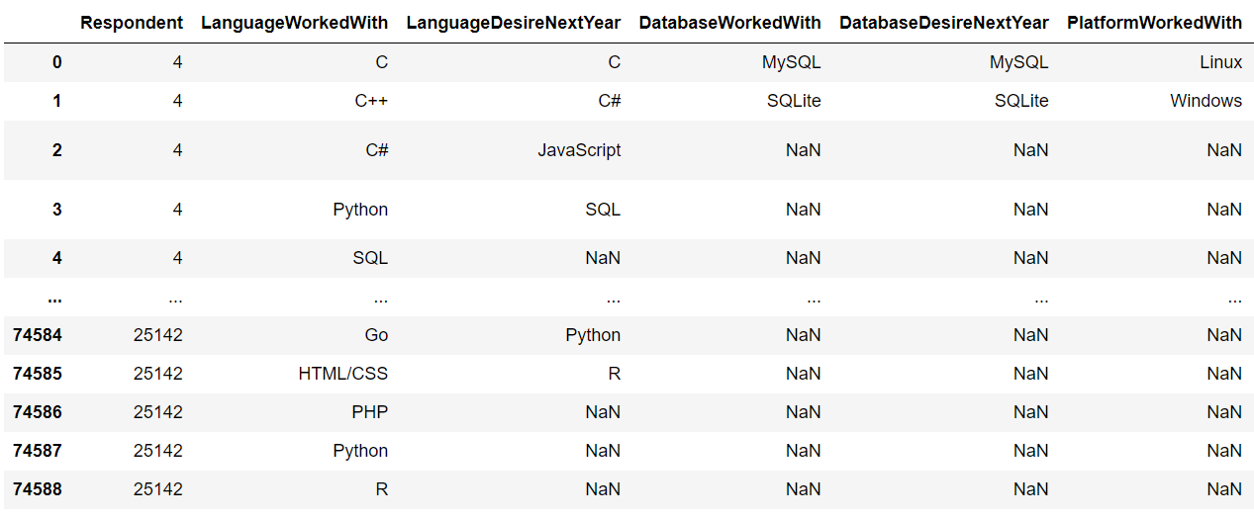
Outcomes

Slide 6
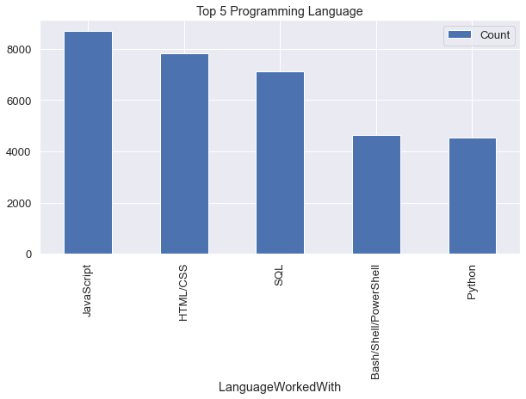
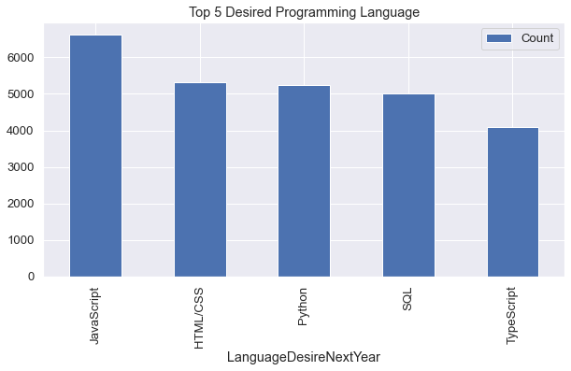
Programming Language Trends
Current Year
Next Year

Slide 7
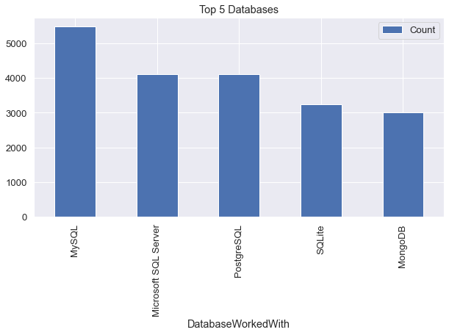
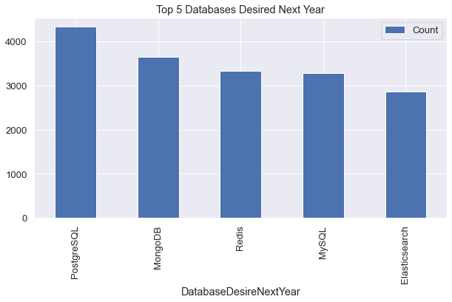
Database Trends
Current Year
Next Year

Slide 8
Dashboard

Slide 9
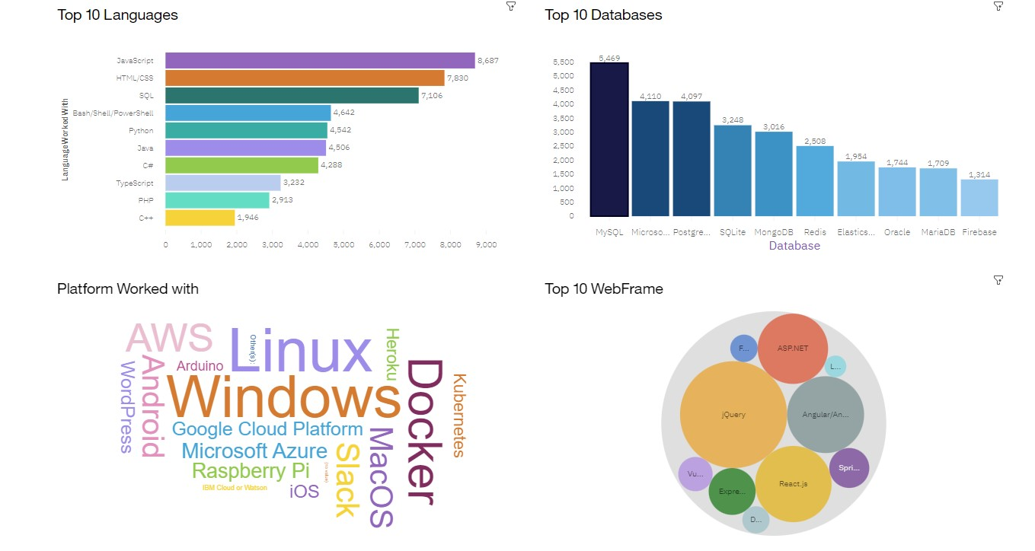
Current Technology Usage

Slide 10
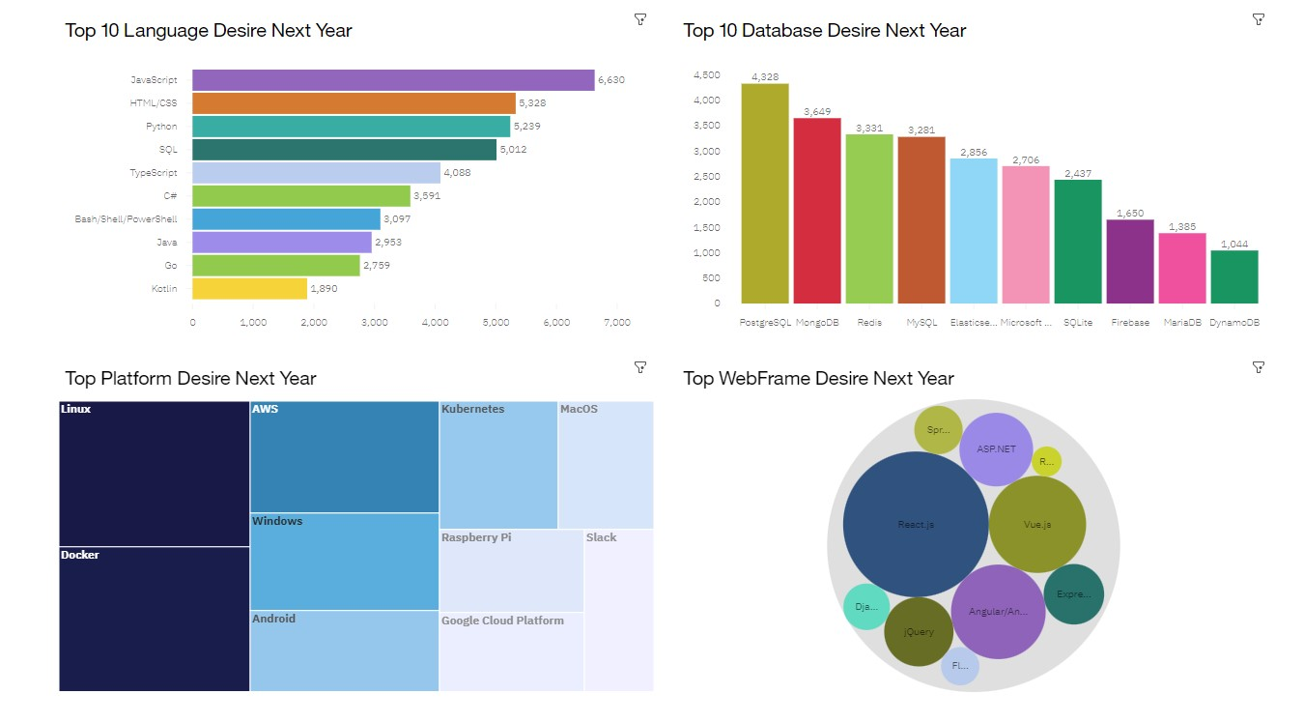
Future Technology Trend

Slide 11
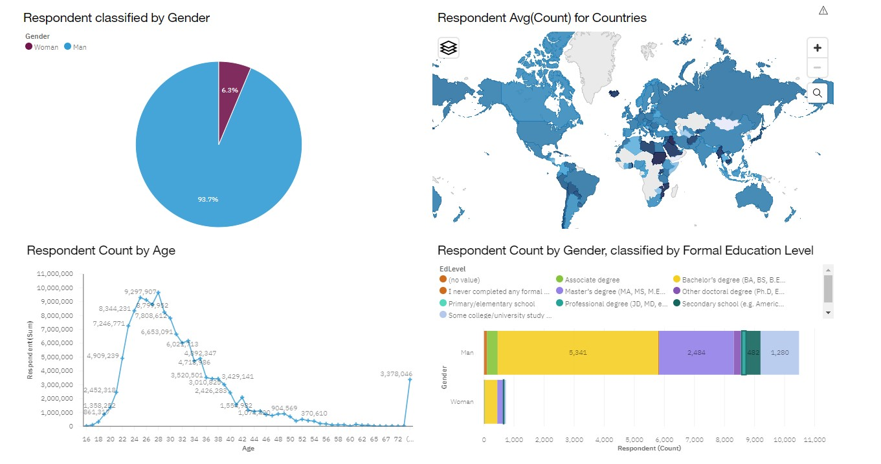
Demographics

Slide 12
Conclusion
Technology Trends for current and next year
Programming Languages, Database and Platform overview
Demographics overview

Slide 13
Thanks!

