Slide 1
Homework8 Advanced algorithm
许涵博 11749252

Slide 2
Exercise 25: Design your own good neighborhood structure for the knapsack problem.
if we choose a greedy solution as initial solution
How much this initial solution can improve

Slide 3
Exercise 25: Design your own good neighborhood structure for the knapsack problem.
Situation1
Item num = 10
ratio para= 5
Weight para = 5
Capacity = 15
Situation2
Item num = 20
ratio para= 5
Weight para = 5
Capacity = 35
Opt weight = 15.00
Opt value = 45.47
Greedy weight = 12.11
Greedy value = 39.84
Opt weight = 35.00
Opt value = 114.03
Greedy weight = 32.57
Greedy value = 111.59
Situation1
Item num = 50
ratio para= 10
Weight para = 5
Capacity = 100
Opt weight = 100.00
Opt value = 662.97
Greedy weight = 99.79
Greedy value = 662.32
When the number of item is large, the algorithm behave really, so we only talk about the less item situation using local search

Slide 4
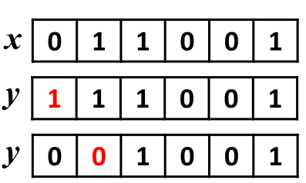
Exercise 25: Design your own good neighborhood structure for the knapsack problem.
method1 | weight | value
opt | 30 | 103
greedy | 29 | 102
neighbor | 25 | 99
neighbor | 28 | 99
neighbor | 25 | 91
neighbor | 29 | 102
neighbor | 25 | 83
neighbor | 28 | 99
neighbor | 26 | 91
neighbor | 27 | 95
neighbor | 27 | 98
neighbor | 24 | 84
neighbor | 26 | 95
neighbor | 29 | 101
neighbor | 27 | 91
Conclusion: it behave well to exchange 2 choice

Slide 5
Exercise 25: Design your own good neighborhood structure for the knapsack problem.
if we choose a greedy solution as initial solution
How much this initial solution can improve

Slide 6
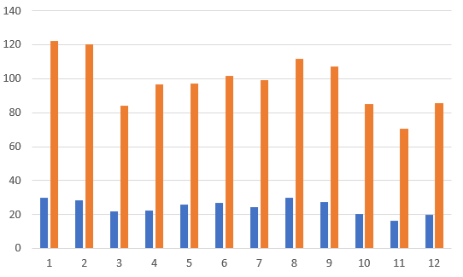
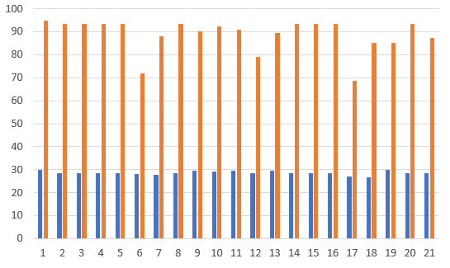
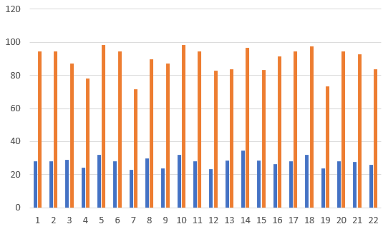
Exercise 25: Design your own good neighborhood structure for the knapsack problem.
The first term is optimal by linear programming
The second term is greedy local optimal
It’s hard to find better neighbor
Method 1
Method 2
Method 3

Slide 7
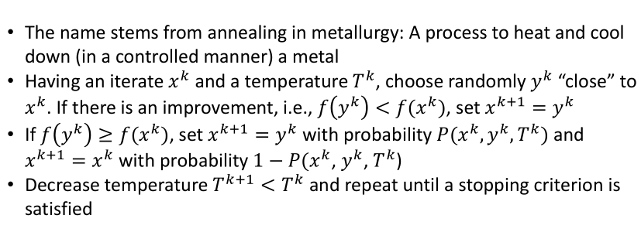
Exercise 25: Design your own good neighborhood structure for the knapsack problem.

Slide 8
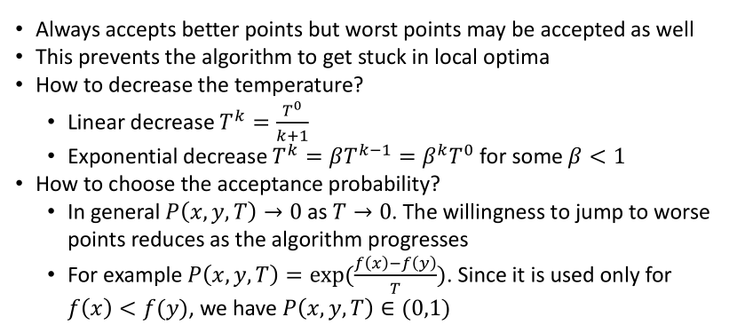
Exercise 25: Design your own good neighborhood structure for the knapsack problem.

Slide 9
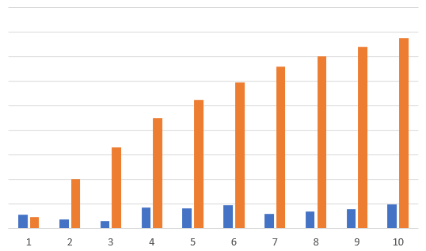
Exercise 25: Design your own good neighborhood structure for the knapsack problem.
Relative improvent = (local seach value – greedy
value) / (optimal value – greedy value )
move strategy: exchange 2 item selection
Relative improvement 0.1618

Slide 10
Exercise 25: Design your own good neighborhood structure for the knapsack problem.
Concerning about the data
If the ratio parameters is very low, near to 1, the problem will be more difficult,and simulated anneal still work
Concerning about the algorithm
It would be better using Particle swarm optimization or add Mutation idea in evolution algorithm
Item number
ratio para
Weight para
Capacity

Slide 11
Thanks
Hanbo Xu 11749252

