Slide 1
G& G Revamp
Solution Architecture Proposal
Solution Architect :Phyo Thu Han
Date:4-March-2026

Slide 2
Executive Summary
G&G Eservice provides a wide range of digital services, including Top-up, YPS Billing, Cash Transactions, Meter Billing, Canal+, Skynet subscriptions, and MMBus integration, through the CCN EService Middleware. Sales data is synchronized with Microsoft AX and D365.
With the increasing transaction volume and system usage, the current platform faces challenges in performance,operations, scalability, and data loss which lead to financial lost, primarily due to synchronous processing and growing data size.
Following services are selected for revamp and enhancement to align with business needs and cover problems.
YPS Services (Revamp): Full redesign of the service flow to improve response time and prevent data loss by using Redis, Rabbit MQ and separate service
Bill & Subscription Services (Enhancement): Improve processing efficiency by optimizing existing logic and system flow with the use of Redis, Rabbit MQ and process separation.
Sale Data Synchronization (Enhancement): Improve synchronization with Microsoft AX and D365 by introducing asynchronous jobs for parallel processing and using batch inserts instead of single inserts.
Data Management: Implement data archiving(change to hot-cold table strategy)to manage increasing data volume and maintain system performance

Slide 3
Objectives
To optimize the G&G Eservice platform for higher efficiency, faster processing, and long-term scalability through strategic revamp and enhancements, enabling sustainable service expansion.

Slide 4
About Revamp & Enhancement
About YPS Services
Currently, sales staff operate YPS POS devices to perform YPS bill top-ups.This service is available in 96 stores, including G&G and Capital.
In the future, the YPS top-up service will be expanded to more than 500 stores using Sunmi POS devices.
Problem with Current YPS Services
Performance Issues - YPS sale transaction saving experiences delays.
Data Lost Issues – From YPS side , their few time out seconds and lack of retry is the major cause of data lost up.
Financial Issues- In G&G side , due to current implementation , it is hard to handle concurrent request which lead to missing API call from YPS side and occur error. in worst case scenario data lost between 40% and 60% , which make yps service temporarily stop and cause financial impact via fraud
Scalability Issues-Current design may not suit for future expansion to provide fast response rate and reliable process which can occur fail in sale transaction.

Slide 5
About Revamp & Enhancement
About G&G Bill ,eserrvices
Currently Sale staff operate G&G Eservice to provide top up , electric bill and subscription
Among each service top up( bill) is the pain point
Key Problem with Current G&G Services
Financial Lost – Although top up success at CCN Eservice middleware , G&G side does not receive success due to time out which suffer financial lost per month
Data Lost Issues – Data duplication and some transaction data lost (print summary) may happen in G&G , although it does not impact much on business due to low volume rate.

Slide 6
About Revamp & Enhancement
About Sale Data Sync Services
Currently sale data sync to Ax (Capital Sale Data) and D365 (G&G Data) with scheduler with 15 min interval
After all transaction finish sync , it end work shift.
Key Problem with Sale Data Sync Services
Operation & Data Reliability Issues -Due to delay in data sync , data does not reach to erp system in time and also hard to end workshift.
Scheduler dependency on synchronous processing The current flow waits for sync completion, which increases delay and reduces reliability.

Slide 7
Design Principles
Principle | Description
Simplicity | Use a microservice Spring Boot backend to keep architecture straightforward, minimizing complexity and easing maintenance.
Clean Code Architecture & SOLID Principle | Each service will develop by applying modular monolithic with each component will develop by using clean code architecture by applying solid design principle
Security First | Use JWT/OAuth2 for user authentication and authorization. Apply role-based access control (RBAC) for business functions and sensitive data access. Implement API Gateway security controls, including rate limiting, request validation, IP allowlist where required, and centralized authentication. Enable audit logging and monitoring for authentication failures, access violations, and suspicious activity.
Centralized API Management | APIs are centrally managed and published via WSO2 API. Frontend-to-backend communication is secured via WSO2 API Gateway.

Slide 8
Propose Scope
YPS Service
New YPSService to handle transactions, sale preparation, and failure recovery
Use separate YPS database for transactions, imports, and configs
Send raw sale data to RabbitMQ → DataService for processing
DataService finalizes YPS sale and integrates with G&G operations
G&G Bill & Subscription Service
Enhance sale flow using Redis + RabbitMQ (async processing)
Split processing into sale, commission, print to reduce failure impact
DataService consumes and completes full transaction flow
Implement retry + rollback to prevent data loss and duplication
Schedule Service
Convert AX & D365 operations from sync → async
Use batch insert (30 rows per transaction) for efficiency

Slide 9
Solution Boundaries
Archival applies only to selected tables; archived data requires manual query access
Retry mechanism applies only to sale operations (G&G Bill, Subscription, Eservices, YPS)
Improvements focus on code optimization + Redis + RabbitMQ for performance and stability
External telecom failures/timeouts are outside system control
Data sync is near real-time (not real-time)
Incomplete YPS data may fail and require manual reconciliation/upload
Reprint function required for devices without built-in printers
No infrastructure changes (e.g., hardware upgrades) included
Future enhancements/modules are not part of this phase

Slide 10
Assumptions
YPS Revamp
Adopt RabbitMQ (async) to split prepare & process → faster response
Use Redis caching for high-frequency data access in place of fetching store/bill/product
Introduce separate YPS service (microservice-ready)
G&G Services
Use queue-based async processing for sale & completion flow
Implement retry mechanism to prevent data loss in processing sale related operations(commission ,prefunding)
Apply Redis caching for high-frequency data access
Use status check to CCNEservice middle ware for top up time out issues
Sale Scheduler
Replace single insert → batch insert (30 records) to process more faster
Enable async sync to AX & D365 → faster processing and prevent delay in sync

Slide 11
Constraints
Eventual consistency model → temporary data mismatch possible
Queue dependency → requires DLQ, retry, and monitoring
Retry mechanism → risk of duplication without idempotency control
Redis dependency → cache failure may impact performance
Increased system complexity → requires monitoring & operational readiness
External system dependency (YPS, AX, D365) → limited control over failures

Slide 12
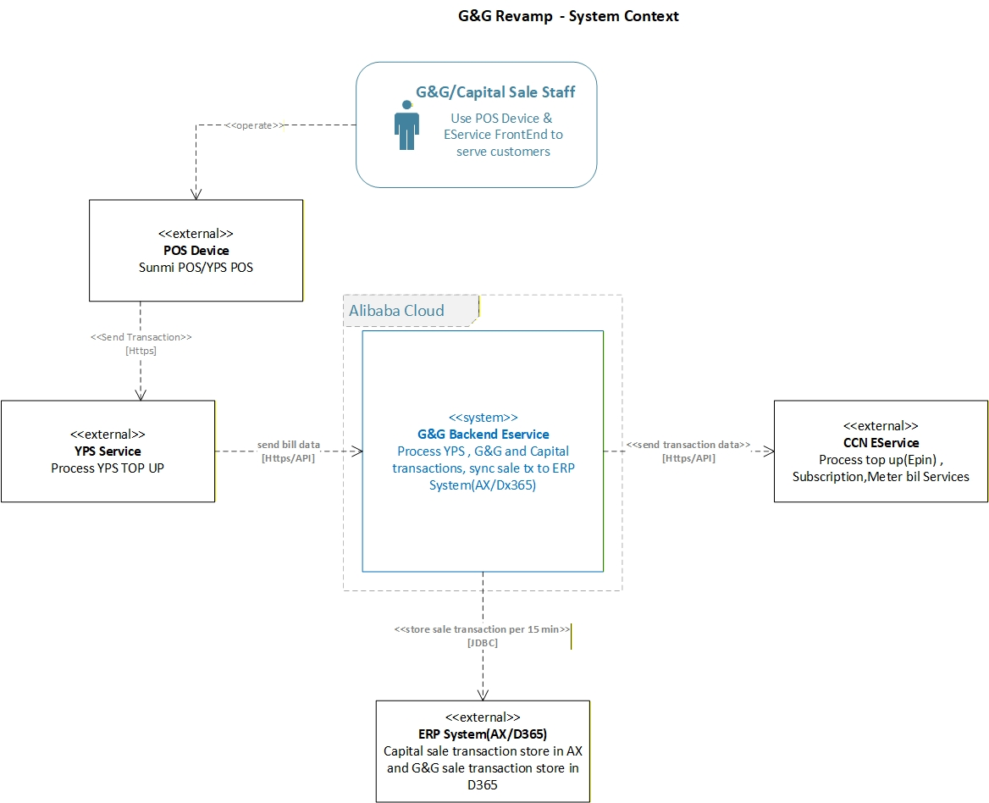
System Overview

Slide 13
High Level Architecture (Existing System)

Slide 14
High Level Architecture

Slide 15
Key Components (Component Diagram for YPS)

Slide 16
Key Components (Component Diagram for G&G)

Slide 17
Key Components (Component Diagram for TXData Service)

Slide 18
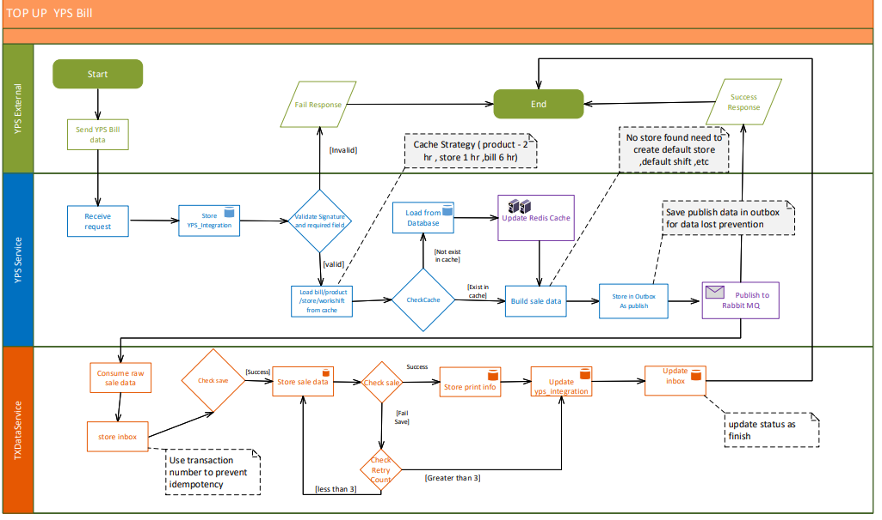
Swimlane for YPS

Slide 19
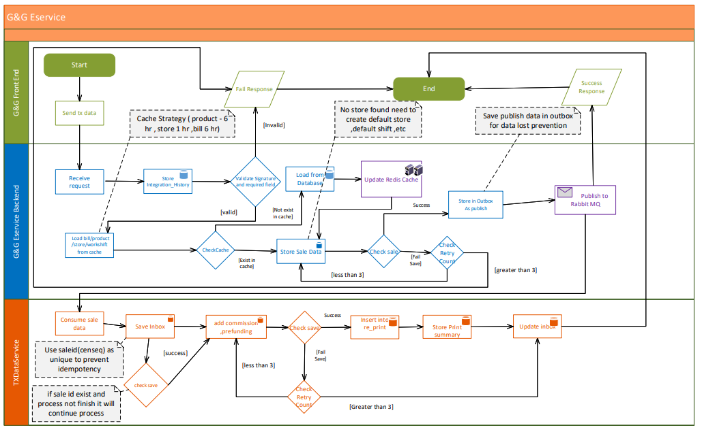
Swimlane for G&G

Slide 20
Sequence Diagram for SaleScheduler Async Process

Slide 21
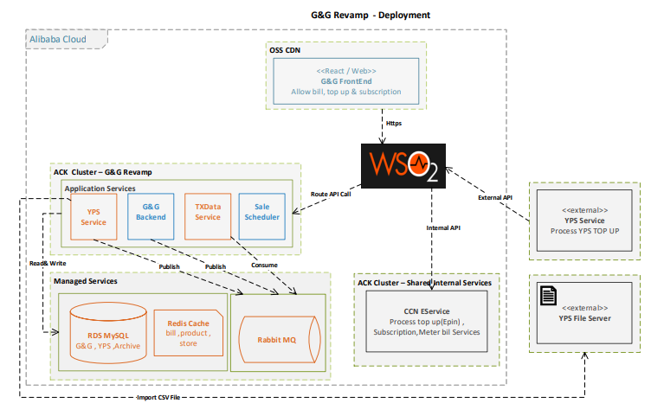
Deployment Diagram

Slide 22
Transaction Strategy
Phase 1 – Stabilization
Move historical data from low business-dependency tables to history tables first.
Add required indexes for high-frequency queries
Refactor and optimize current voucher, subscription, MMBus ticket, and cash in/out flows
Align with business stakeholders on the required data availability period in active working tables for sale data.
Outcome: immediate performance improvement and reduced database pressure
Phase 2 – YPS Revamp
Implement separate YPS service with dedicated database
Introduce RabbitMQ and Redis for YPS processing
Establish archival and access strategy for sale-related YPS data
Outcome: reduce YPS timeout/data-loss risk and improve scalability

Slide 23
Transaction Strategy
Phase 3 – Scheduler Enhancement
Enhance scheduler flow with async processing
Implement batch insert for AX and D365 synchronization
Outcome: faster and more reliable ERP sync with less operational delay
Phase 4 – G&G Eservice Enhancement
Introduce queue-based processing for G&G Eservice flows
Apply Redis caching for high-frequency reference data access
Outcome: improve transaction response time, resilience, and future scalability

Slide 24
Tech Stack
Layer | Component | Technology/Tools | IDE
Frontend |  | React Native | VSCode
Application Platform Infra | Backend Service | Java(Spring Boot) | Intellij, VSCode
 | Runtime | Ali Cloud Kubernetes Cluster
Data Storage | Backend DB | ApsaraDB For MySQL
 | Message Broker | Rabbit MQ
 | Cache Management | Redis Cache
Integration Service | API Gateway | WSO2
 | Interfacing System | REST
Documentation | API docs | Swagger

Slide 25
BOM
Non-Prod
No. | Description | vCPU(Cores) | Memory(GB) | Storage (GB) | Qty | Remark
1. | ACK(Kubernetes Cluster) | 4 | 16 | 200 | 1 | 3 nodes cluster
2. | ALB(Kubernetes ingress) |  |  |  | 1
3. | Pod | 0.5 | 0.256 | 200 | 4
4. | Cloud Backup |  |  | 200 | 1
5. | WSO2-Internal (Shared Service) |  |  |  | 1
6. | WSO2-External (Shared Service) |  |  |  | 1
7. | Redis | 1 | 1 | 10 GB | 1
8. | Rabbit MQ | 1 | 2 | 10 GB | 1

Slide 26
BOM
Production
No. | Description | vCPU (Cores) | Memory(GB) | Storage (GB) | Qty | Remark
1. | ACK(Kubernetes Cluster) | 4 | 16 | 200 | 1 | 3 nodes cluster
2. | Pod | 0.5 | 0.256 | 200 | 4
3. | ALB (Kubernetes ingress) |  |  |  | 1
4. | WSO2-Internal(Shared Service) |  |  |  | 1
5. | WSO2-External(Shared Service) |  |  |  | 1
6. | Redis | 1 | 1 | 10 GB | 1
7. | Cloud Backup |  |  | 200 | 1
8. | Rabbit MQ | 2 | 4 | 20 GB | 1

Slide 27
Required APIs For refactoring & revamp
No | API Name | Description
1 | billprocess/payvoucher | To top up mobile number
2 | /billprocess/paysubscritption | To pay bill for meter ,Skynet and canal plus
3 | /cashin/confirm
4 | /cashout/confirm
5 | addprefunding
6 | /yps/push_money | Top up yps

Slide 28
G& G Data Management Updated Proposal (Revised after Review)

Slide 29
Current Database Situation
About Large Data Volume & Increasing Transaction Load
The G&G Eservice database contains several high-volume tables that are continuously growing due to daily transaction processing.
The system processes 8,000–14,000 transactions per day
Around 280,000 records are inserted monthly into sale_transaction
Each transaction affects multiple related tables:
commission_transaction , integration_history , yps_integration , re_print , prefunding_log ,print_summary ,workshift_action
Key Problem with Large Data Volumes
Performance & Scalability issues -Growing data volume impacts on query performance , ERP sync performance , report generation speed and system scalability.

Slide 30
Key Performance Issue
Example: Print Summary Bottleneck
For each sale transaction:
System performs lookup on print_summary
Condition: product_id + session_id
Current issue:
These columns are not indexed
Table size: ~2 million rows
Result:
Each lookup triggers full table scan
At 500 transactions:
2,000,000 × 500 = 1 billion row scans
Impact:
Severe database load
Increased latency
Risk of system slowdown

Slide 31
Near-Term Stabilization (Immediate Action)
Approach
Replace traditional archiving with Hot–Cold Table Strategy
Separate:
Hot Data (active transactions) → main table
Cold Data (historical data) → history table
Maintain identical schema for consistency and easy querying
Monitor data volume per month and move data as proposal data moving plan
Storage Design
History Data stored in :
Dedicated history tables within the same database
Data Retention
No change to existing data retention policy (aligned with IT Governance)
Doc Ref:
https://cdsgmm.sharepoint.com/sites/QMSInformationSecurityManagement/Shared%20Documents/Forms/AllItems.aspx?id=%2Fsites%2FQMSInformationSecurityManagement%2FShared%20Documents%2FCDSG%2FPolicy%2FPolicy%20Retention%20and%20Archival%2Epdf&parent=%2Fsites%2FQMSInformationSecurityManagement%2FShared%20Documents%2FCDSG%2FPolicy&p=true&ga=1

Slide 32
Large Volume table status with propose data moving plan
Business Impact | Table Name (immediate archive) | Row Count | After Moving data | Propose Retention Period | Uses
 | print_summary | 2,246,923 | 600 K | 3 month | Shop level sale check
 | yps_integration | 51,677 |  | 3 month | YPS Entry
 | integration_history | 6,887,279 | 600 K | 3 month | G&G Eservice Entry
 | re_print | 6,655,344 | 100 K | 1 month | Print
 | prefunding_log | 1,649,836 | 516 K | 3 month | prefunding
 | work_shift_action | 596,665 | 100 K | 2 month | Workshift info
 | trigger_log | 2,647,377 | 300 K | 2 month
To optimize performance, large-volume tables such as Sale_Transaction (~7.3M) and Commission_Transaction (~7.1M) will adopt a hot–cold data strategy. Active tables will retain only the latest 6 months of data, while older records will be offloaded to history tables. Historical data will remain accessible through on-demand reporting, ensuring no impact to business operations.
High
Medium
Low

Slide 33
Why Data Management is required
Current Challenges
Continuous data growth in transactional tables
Large tables degrade query performance
Increased database resource consumption
Difficult to scale with future expansion (500+ stores)
Conclusion:
Without data archiving/hot-cold table strategy and indexing, system performance will continue to degrade as transaction volume increases.

Slide 34
Future Propose Enhancement
1. Unified Historical Reporting
Build a reporting mechanism to fetch data from both active working tables and history tables.
Support business reporting without impacting live transaction processing.
2. Role-Based Access Control for Historical Data
Implement RBAC to control access to old historical data.
Restrict sensitive historical reports based on user role and permission level.
3. Archive Database Strategy
Introduce a separate archive database for long-term data storage.
Move older history records from history tables to archive tables based on IT Governance retention policy.

Slide 35
G& G Data Management
Initial Proposal (Not Approved)

Slide 36
Why Archiving is required
Current Challenges
Continuous data growth in transactional tables
Large tables degrade query performance
Increased database resource consumption
Difficult to scale with future expansion (500+ stores)
Conclusion:
Without data archiving and indexing, system performance will continue to degrade as transaction volume increases.

Slide 37
Large Volume table status with propose retention plan
Business Impact | Table Name (immediate archive) | Row Count | After Archive | Propose Retention Period | Uses
 | print_summary | 2,246,923 | 600 K | 3 month | Shop level sale check
 | yps_integration | 51,677 |  | 3 month | YPS Entry
 | integration_history | 6,887,279 | 600 K | 3 month | G&G Eservice Entry
 | re_print | 6,655,344 | 100 K | 1 month | Print
 | prefunding_log | 1,649,836 | 516 K | 3 month | prefunding
 | work_shift_action | 596,665 | 100 K | 2 month | Workshift info
 | trigger_log | 2,647,377 | 300 K | 2 month
* Sale_Transaction(7,338,714) , commission_transaction(7,118,764) need to align with business and does not include in current archiving & retention
High
Medium
Low

Slide 38
Propose Index for require table
Problem
Frequent full table scans due to missing indexes
Solution
Create indexes aligned with query patterns:
Table Name (immediate archive) | Index Column | Uses
sale_transaction | Store_code | Core sale
print_summary | Product_id + Session_id | Use in selecting record for updating summary record
work_shift_action | Store_code + status | Use in creating sale and sync to erp

Slide 39
Near-Term Stabilization (Immediate Action)
Approach
Move data older than retention period to archive schema
Maintain same table structure for consistency
Ensure no impact on live transaction processing
Storage Design
Archive stored in:
Same DB instance (separate schema) OR table in existing database
Data Cleanup
Remove low-value data from archive DB at clean period

Slide 40
Thank You!

