Slide 1
Sample Slide
Solution Architecture Proposal
Solution Architect :Phyo Thu Han

Slide 2
Executive Summary
Provides a wide range of services, including search engine ,record searching and search with images.
Following services are included in system.
Search Service
Enable image, video, and text search with fast response using Redis caching and RabbitMQ async processing
(Example: Customer Screening Customer uploads PEP data (CSV/Excel), and the system processes and indexes the data, making it available for search and external system API integration for screening.)
Search Data Service
Process and index search data efficiently using queue-based ingestion and batch processing
Browser Caching
Improve user experience and reduce backend load using browser caching and CDN

Slide 3
Objectives
Provide accurate search results within acceptable response time while supporting multiple search formats and capturing search data for future performance optimization.

Slide 4
Design Principles
Principle | Description
Simplicity | Use a .NET modular microservice architecture to keep the system straightforward, scalable, and easy to maintain.
Clean Code Architecture & SOLID Principle | Develop each service using Clean Architecture, modular design, and SOLID principles to improve maintainability, testability, and future enhancement.
Security First | Use JWT/OAuth2 for authentication and authorization. Apply RBAC for business functions and sensitive data access. Implement API Gateway security controls including rate limiting, request validation, IP allowlist, and centralized authentication.
Audit trail | Log all user and system actions at detailed action level for traceability, compliance, and issue investigation.

Slide 5
Propose Scope
Search Service
Handle user search requests (image, video, text) with fast response using Redis caching and RabbitMQ async processing
Retrieve cached results from Redis and query search index for real-time data
Publish search activity to RabbitMQ for logging and analytics processing
Return ranked search results and cache frequent queries for performance improvement
Search Data Service
Ingest raw data and publish to RabbitMQ for asynchronous indexing
Process and index data into search engine database for fast retrieval
Update Redis cache with frequently accessed search data
Execute batch indexing to handle large-scale data updates efficiently

Slide 6
Propose Scope
Browser Caching
Cache search responses using browser caching (Cache-Control, ETag)
Reduce repeated backend requests by serving cached results
Use CDN to deliver content closer to users
Validate cached data before making backend calls

Slide 7
Solution Boundaries
Indexing and archival apply only to selected datasets; historical data may require manual query access
Retry mechanism applies only to search processing and data ingestion (indexing pipeline)
External data source failures/timeouts (e.g., third-party content providers) are outside system control
Data synchronization is near real-time (not real-time) due to end of data uplod
Incomplete or failed data ingestion may require manual reprocessing or re-upload
Browser caching behavior depends on client configuration and cannot be fully controlled by backend
No infrastructure changes (e.g., hardware upgrades, CDN expansion) are included in this scope
Advanced features (e.g., AI ranking, recommendation engine) are excluded from this phase

Slide 8
Assumptions
Search Platform
Search data sources are valid and consistently available for indexing and querying
User search patterns are predictable and suitable for caching and optimization
Data volume is within manageable limits for indexing and retrieval performance
Data Synchronization
External systems provide accessible APIs or data feeds for synchronization
Data synchronization frequency supports near real-time (not real-time) updates
Batch processing is sufficient to handle incoming data volume
Example
Data Integration
Upload PEP data via CSV/Excel → system processes and indexes for search
Configure rules via form or Excel for screening logic
Upload T+1 data to file server for batch ingestion
Customer screening
Customer data received → system checks blacklist and transaction patterns → returns screening result

Slide 9
Assumptions
Caching & Messaging
Redis is available for high-frequency data caching and low-latency access
RabbitMQ is stable and supports asynchronous processing for search and indexing flows
Queue processing latency is within acceptable limits for near real-time behavior
Client & Performance
Client applications (browser/mobile) support caching mechanisms (Cache-Control, ETag)
Network latency between services is within acceptable range
Monitoring and logging mechanisms are available for system observability

Slide 10
Constraints
Eventual consistency model → temporary mismatch between source data and search index is possible
Retry mechanism → risk of duplicate indexing or duplicate processing without idempotency control
Redis dependency → cache failure may impact search response time
Search index dependency → index failure may affect search accuracy and result availability
External data source dependency → limited control over third-party API/feed failures
Browser caching limitation → cached results may be outdated until cache refresh or invalidation
Increased system complexity → requires monitoring, alerting, and operational readiness
Near real-time synchronization → search results may not reflect latest data immediately

Slide 11
In diagram , although this sample diagram is acceptable(not 100% correct due to unclear scenario) but I don’t like much but I add as sample .what I prefer is only following C4 url diagram
https://c4model.com/diagrams/system-context

Slide 12
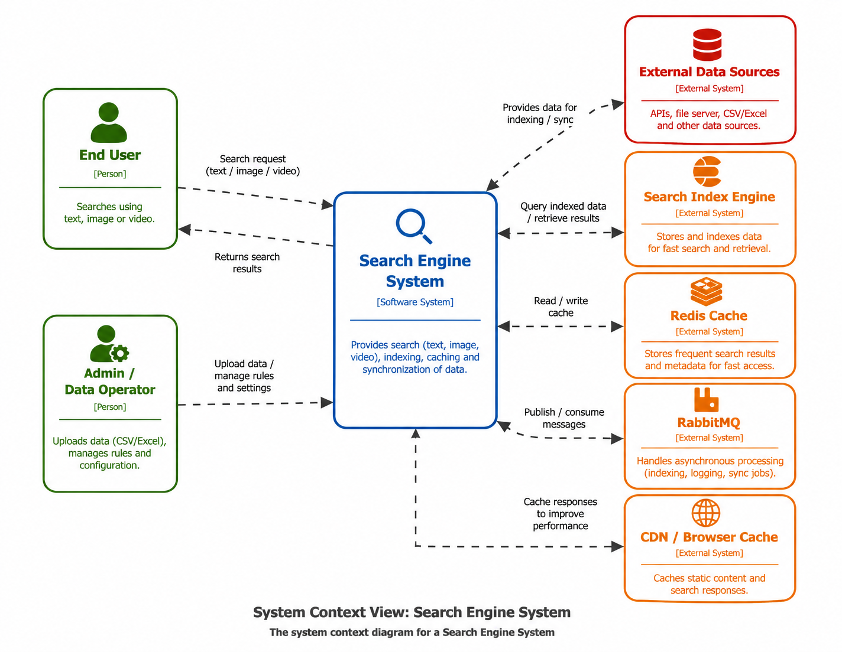
System Overview C4 System context

Slide 13
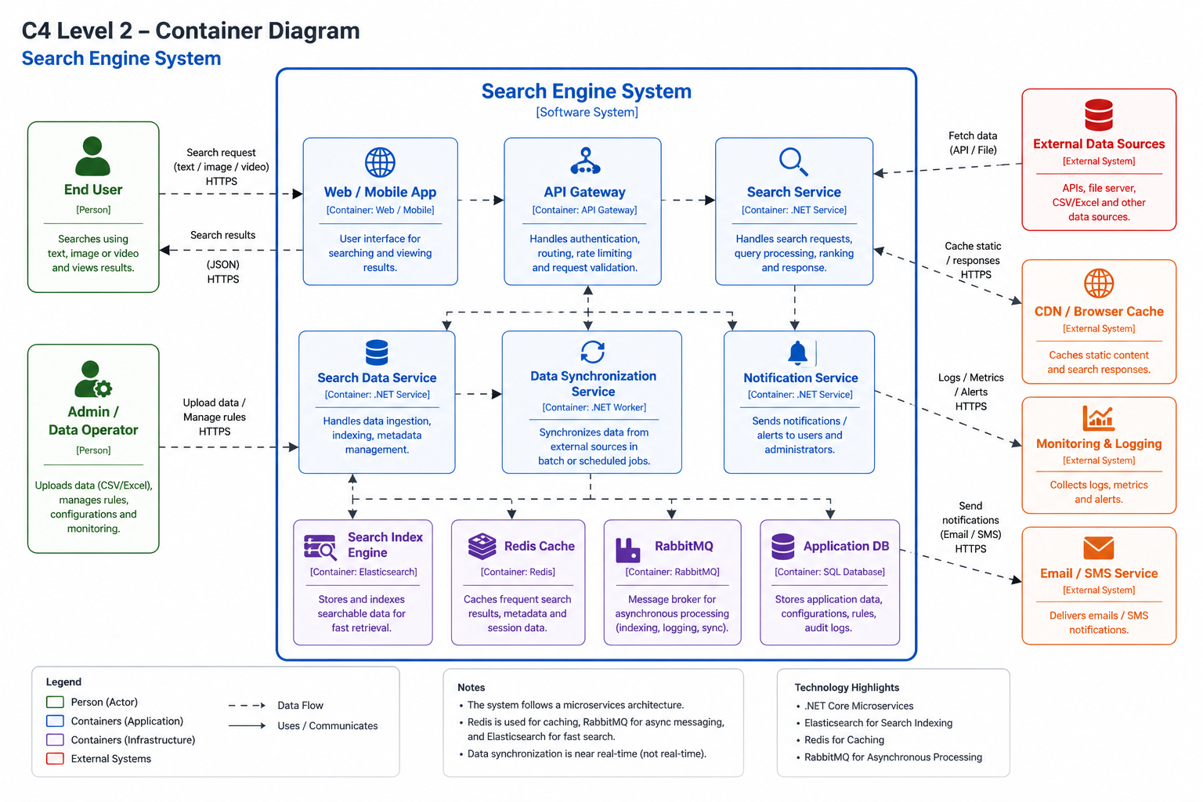
High Level Architecture (C4 Container Diagram)

Slide 14
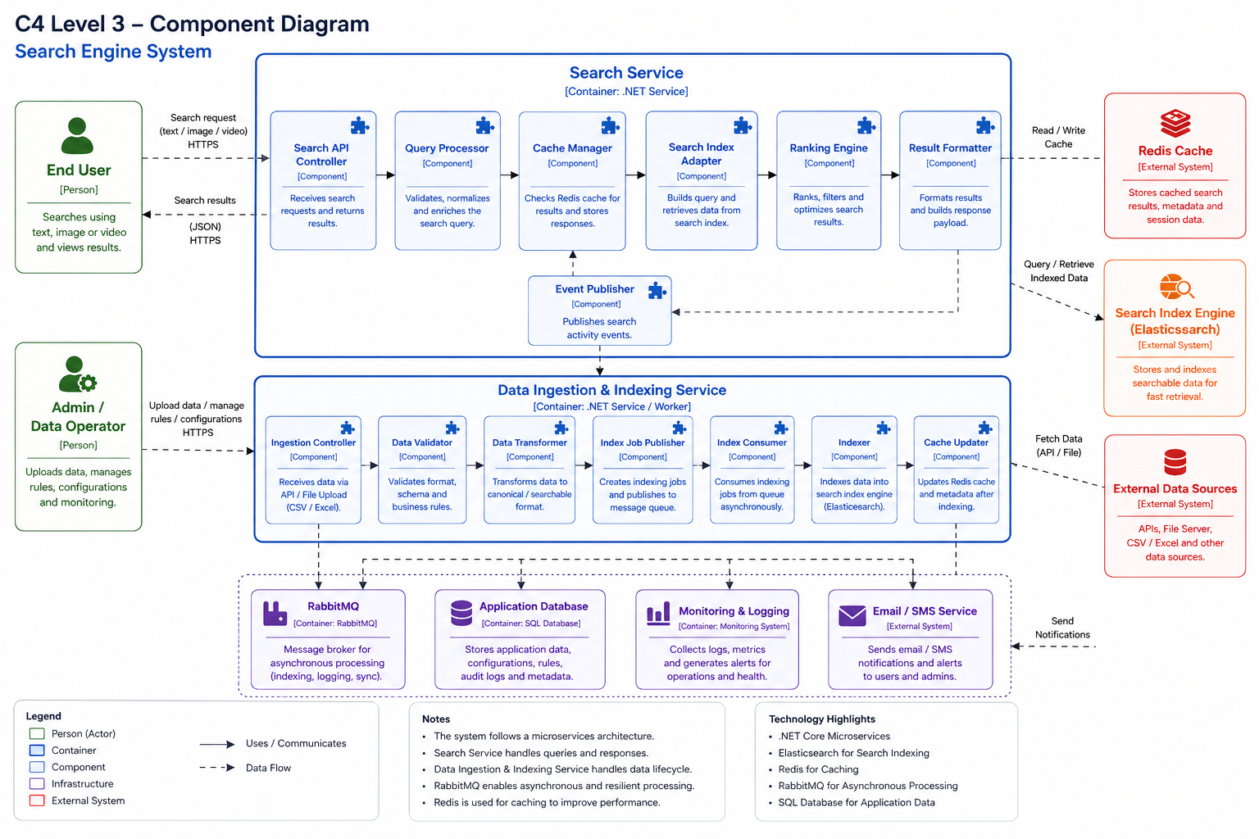
Key Components (C4 Component Diagram for Search Service)

Slide 15
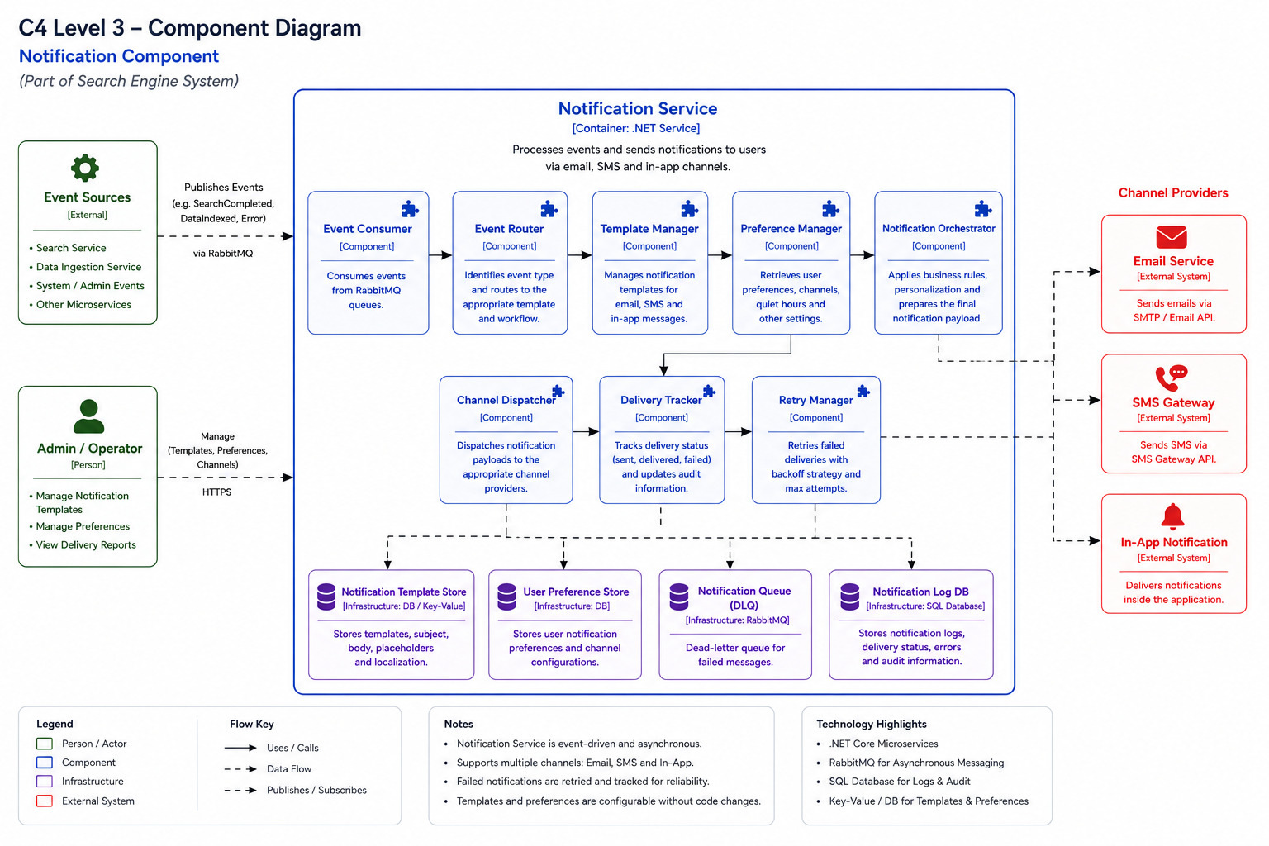
Key Components (Component Diagram for Notification Service)
you need to add more than one diagram if you need to explore more detail for each component

Slide 16
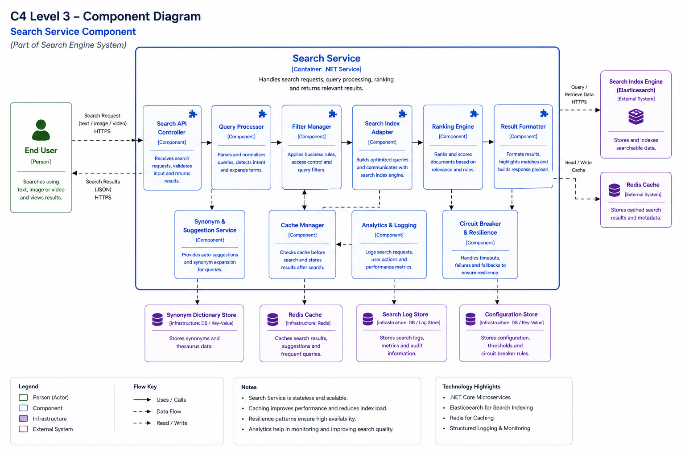
Key Components (Component Diagram for Search Service)

Slide 17
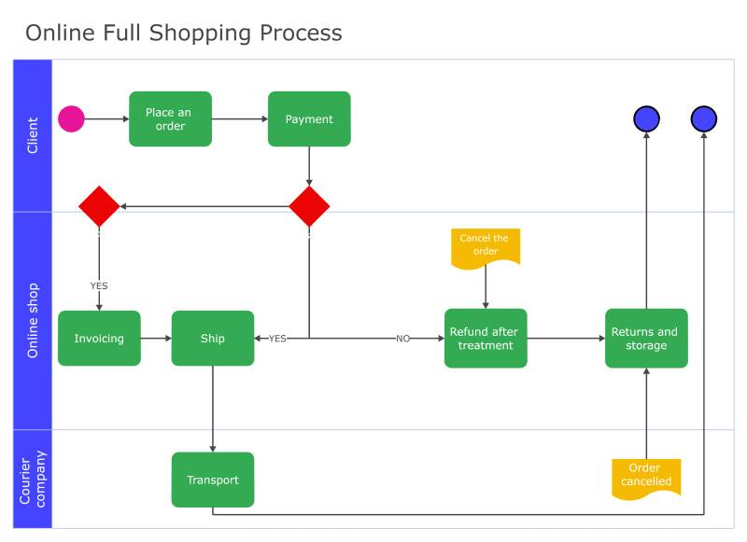
Swimlane Example( Add more than one diagram base on process which you high light screening diagram , report diagram , alert diagram)

Slide 18
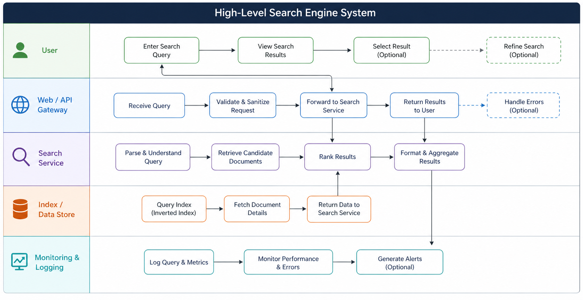
Swimlane Diagram Diagram
Swimlane diagram
In your swimlane you should add ctz pay(in place of user) ,yoursystemsearch engine , ruleengine ,etc

Slide 19
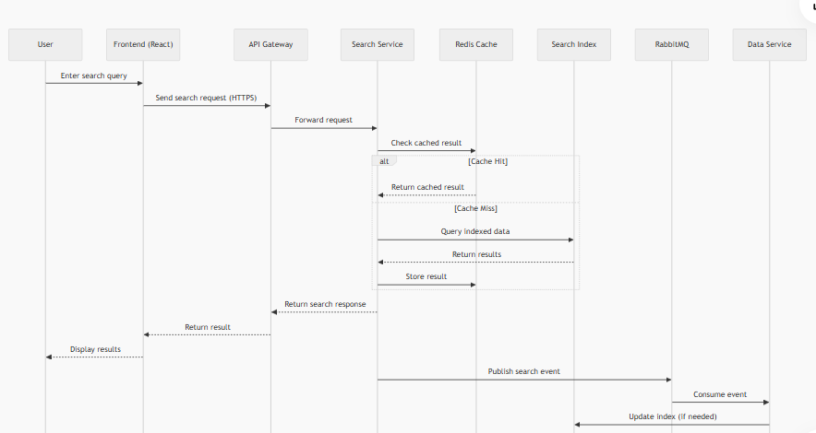
Sequence Diagram Diagram

Slide 20
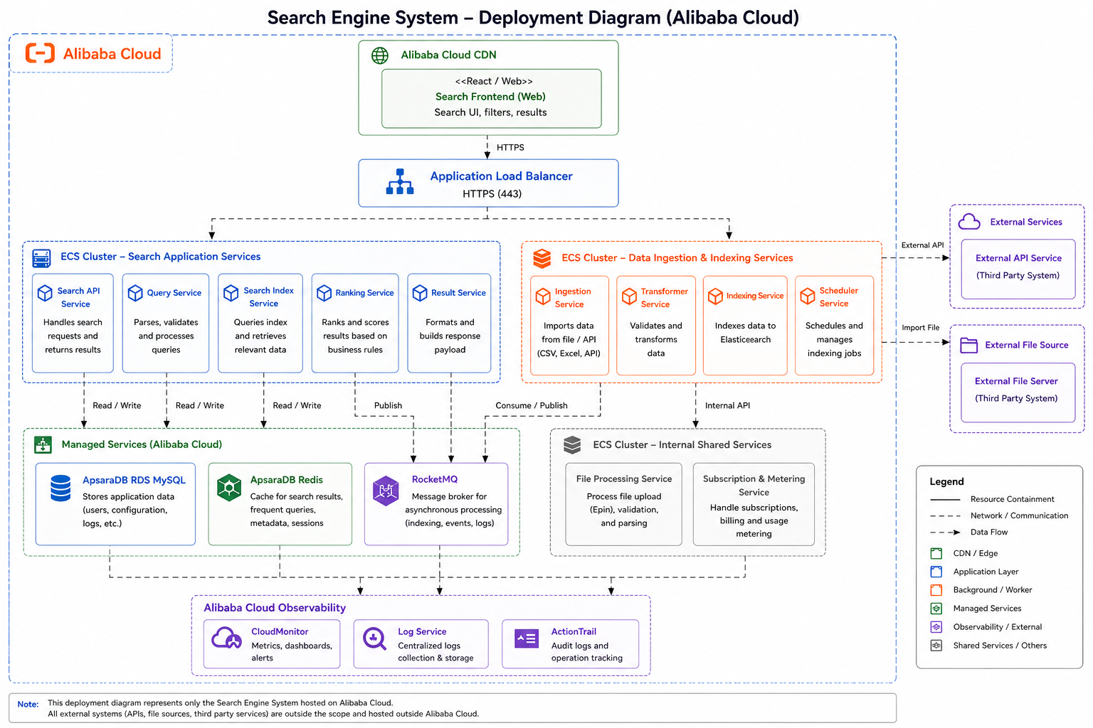
Deployment Diagram

Slide 21
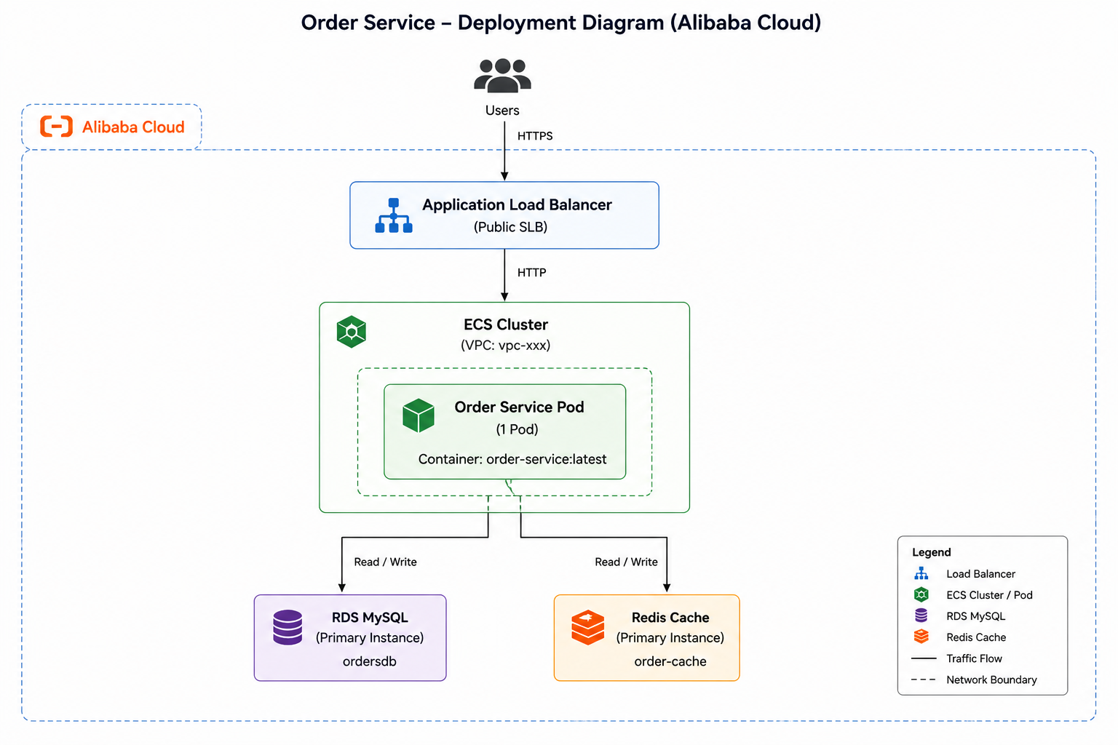
Deployment Diagram ( Another Example for another System not search engine simple deployment)

Slide 22
Tech Stack
Layer | Component | Technology/Tools | IDE
Frontend |  | React Native | VSCode
Application Platform Infra | Backend Service | Java(Spring Boot) | Intellij, VSCode
 | Runtime | Ali Cloud Kubernetes Cluster
Data Storage | Backend DB | ApsaraDB For MySQL
 | Message Broker | Rabbit MQ
 | Cache Management | Redis Cache
Integration Service | API Gateway | WSO2
 | Interfacing System | REST
Documentation | API docs | Swagger

Slide 23
BOM
Non-Prod
No. | Description | vCPU(Cores) | Memory(GB) | Storage (GB) | Qty | Remark
1. | ACK(Kubernetes Cluster) | 4 | 16 | 200 | 1 | 3 nodes cluster
2. | ALB(Kubernetes ingress) |  |  |  | 1
3. | Pod | 0.5 | 0.256 | 200 | 4
4. | Cloud Backup |  |  | 200 | 1
7. | Redis | 1 | 1 | 10 GB | 1
8. | Rabbit MQ | 1 | 2 | 10 GB | 1

Slide 24
BOM
Production
No. | Description | vCPU (Cores) | Memory(GB) | Storage (GB) | Qty | Remark
1. | ACK(Kubernetes Cluster) | 4 | 16 | 200 | 1 | 3 nodes cluster
2. | Pod | 0.5 | 0.256 | 200 | 4
3. | ALB (Kubernetes ingress) |  |  |  | 1
6. | Redis | 1 | 1 | 10 GB | 1
7. | Cloud Backup |  |  | 200 | 1
8. | Rabbit MQ | 2 | 4 | 20 GB | 1

Slide 25
Required APIs For External Api
No | API Name | Description
1 | check/AML | To top up mobile number

Slide 26
Thank You!

