Slide 1
Purpose & Code Style
Purpose of Standard Guidelines
Guide developer to understand code development quality
Ensure maintainability and efficiency in code
Provide a standard reference for development and review
Act as a guideline for code writing and used during code reviews
Ensures consistent coding practices across teams
Remark : Always consult with team lead or solution architect or senior developers if you misunderstand or unclear topic.
Code Styles
For Java development, developers must install Google Java Code Style Template on IDEs.
Rule for Code Style: https://google.github.io/styleguide/javaguide.html

Slide 2
Coding Standard Overview
Write clean, readable, and maintainable code
Apply proper design principles (SRP, layering, separation of concerns)
Ensure robust error handling and logging
Follow secure coding practices (validation, authentication, data protection)

Slide 3
Naming Convention
General Rules for Naming Convention 1.Use Intention-Revealing Names. Example:
**Bad
int d; //elapsed time in days
**Good
int elapsedTimeInDays;
Int daysSinceCreation;
/** The name d reveals nothing. Always choose the name that reveals that can make it easier to understand and change the code. */

Slide 4
Naming Convention
General Rules for Naming Convention 2. Be careful of using short cut names and prefer pronounceable names. Example:
**Bad
**Good
class DtaRcrd102 {
private Date genymdhms;
private Date modymdhms;
private final String pszqint = "102";
/* ... */
};
class Customer {
private Date generationTimestamp;
private Date modificationTimestamp;;
private final String recordId = "102";
/* ... */
};
Note: You can use single-letter variables only when the scope is very small

Slide 5
Specific Naming Convention Rules
Packages names should start with com.yomabank and should be all lowercase, with consecutive words simply concatenated together (no underscores)
Example: com.companyname.sendmoneytobank(Notice, it is not com.companyname.sendMoneyToBank or com. companyname.send_money_bank)
Classes names should be written in UpperCamelCase and in nouns. In mixed case with the first letter of each word capitalized.
Example: class PaymentProcessor;
Test Classes are named starting with the name of the class they are testing, and ending with Test.
Example: SendMoneyIntegrationTest
Interfaces names should be capitalized like class names.
Example: interface CreditCard;
Methods names should be written in lowerCamelCase and in verbs.
Example: repaymentCalculationDays()
Variables names should start with lowercase letter and the first letter of internal words capitalized.
Variables names should not start with underscore “_” or dollar sign “$” characters

Slide 6
Specific Naming Convention Rules
For Booleans, use the prefixes such as “is”, “has” and “can”.
Example: “isRetriable”, “hasAccess”, “canIgnore”
Constants names should all be in capital letters and separate each word with underscore “_”.
Example: private static final String ACCESS_DENIED = “Access Denied.”;
Avoid misleading abbreviations and names.
Do not use names with similar meanings for different objects in your programs.
Example:"StudentNum" to hold an individual student's ID number. "NumStudents" and "StudentNum" are too similar.
Do not reuse existing standard library routine names in your program unless you are specifically
replacing that routine with one that has similar semantics.
Avoid misspelled words and names that are often misspelled in identifiers

Slide 7
Naming Convention Cheat Sheet
Name Convention | Rule | Camel Case / Format
Package Name | Start with com.cdsg | All lowercase
Class Names | Nouns | UpperCamelCase
Interface Name | Nouns | UpperCamelCase
Method Name | Verbs | lowerCamelCase
Constant Names | Nouns | All uppercase, words separated by '_'
Parameter Names | Nouns | lowerCamelCase
Local Variable Names | Nouns | lowerCamelCase

Slide 8
Functions
Function should be small (generally less than 75 lines) and serve for single purposes only.
Function Name should be compliant to what it really does in the code and no hidden function.
Loops should have single entry and single exit point
Maintain one level of abstraction
Follow step-down approach (top → detail)
Keep function arguments minimal
Wrap arguments into object/class
Prefer try/catch with exceptions over error codes
Remove dark code / commented code
Avoid mutating input objects unexpectedly
Use proper access modifiers (private, protected, public)

Slide 9
Functions
Example:
// Bad /** * No readable code **/
public void transferFunds(Account source, Account target, BigDecimal amount) {
if (source == null || target == null) {
throw new RuntimeException("Invalid account");
}
if (source.getBalance().compareTo(amount) < 0) {
throw new RuntimeException("Insufficient balance");
}
source.debit(amount);
target.credit(amount);
saveTransaction(source, target, amount);
}

Slide 10
Functions
**Good Example Easy to Read, Neat and Tidy, One Responsibility per function ...
public void transferFunds(FundTransferTxn txn) {
Account source = validateAccount(txn.getSource());
Account target = validateAccount(txn.getTarget());
checkBalance(source, txn.getAmount());
makeTransfer(source, target, txn.getAmount());
}
private Account validateAccount(Account acc) {
if (acc == null) throw new InvalidAccountException();
return acc;
}
private void checkBalance(Account acc, BigDecimal amount) {
if (acc.getBalance().compareTo(amount) < 0)
throw new InsufficientBalanceException();
}

Slide 11
Class and Object Design Guidelines
Class should have Single Responsibility
Keep class small, cohesive, and focused
Use encapsulation → hide internal data
Expose behavior through methods, not direct data access
Avoid tight coupling between classes
Keep number of instance variables minimal
Use meaningful class and method names

Slide 12
Class and Object Design Guidelines
Example:
// Bad /** * Multiple responsibilities , No encapsulation (public fields),Tight coupling ,Not cohesive**/
class UserManager {
public String name;
public String email;
public double balance;
public void processUser() {
if (email == null) {
throw new RuntimeException("Invalid email");
}
balance -= 100;
System.out.println("Saving user");
System.out.println("Sending email");
}
}

Slide 13
Class and Object Design Guidelines
**Good
class User {
private String name;
private String email;
private double balance;
public void debit(double amount) {
if (balance < amount) {
throw new RuntimeException("Insufficient balance");
}
balance -= amount;
}
public String getEmail() {
return email;
}
}
class UserService {
private EmailService emailService;
public void processPayment(User user, double amount) {
user.debit(amount);
emailService.send(user.getEmail());
}
}
class EmailService {
public void send(String email) {
System.out.println("Sending email");
}
}
Single Responsibility
Encapsulation (private fields)
Behavior via methods
Loose coupling
Small & focused classes
Meaningful naming

Slide 14
Object Usage & Design Practices
Prefer Objects over raw data structures
Avoid mixing data + business logic without structure
Use objects to encapsulate behavior and state
Use Static only for:
Utility methods
Stateless operations
Use Non-Static (Instance) when:
Behavior depends on object state
Dependency Injection is required
Future extension/testing is needed
Avoid overuse of static methods (reduces flexibility and testability)
Example:
// Bad /** * Multiple responsibilities , No encapsulation (public fields),Tight coupling ,Not cohesive**/
class OrderUtil {
public static double calculateTotal(double price, int qty) {
return price * qty;
}
public static void processOrder(double price, int qty) {
double total = calculateTotal(price, qty);
System.out.println("Processing order: " + total);
}
}
No object → no encapsulation
Business logic in static methods
Hard to extend / test

Slide 15
Object Usage & Design Practices
**Good
class Order {
private double price;
private int quantity;
public Order(double price, int quantity) {
this.price = price;
this.quantity = quantity;
}
public double calculateTotal() {
return price * quantity;
}
}
class OrderService {
public void process(Order order) {
double total = order.calculateTotal();
System.out.println("Processing order: " + total);
}
}
Avoid mixing logic in static utility class
Use instance methods when behavior
depends on state
Better for extension & testing

Slide 16
Commenting and Documentation
Source code itself should be self-explanatory and developer should put comment only if the function
or variable naming convention is not clear enough.
CDSG enforces Java Doc to be used for commenting. All public methods must be commented on.
The code must have comments with as clear information as possible. Don’t over comment on it though.
Comments should only be in English language. It will help future maintainers to understand the code easily.
Explanation of Business Logic must be explained in comments or documentations for the methods
which executes Business Logic such as loan interest calculation, financial formulas.
Source of Information and explanation should be described in comments for functions which are
coded based on specific platform or language’s version.
Avoid the following types of comment.
Too Obvious and Redundant Comments
Don’t write comments just because you can write them.
HTML Comments

Slide 17
Commenting and Documentation
Example:
// Bad /** * No readable code **/
/**
Utility method that returns when this.closed is true. Throws an exception
if the timeout is reached.
*/
public synchronized void waitForClose(final long timeoutMillis)
throws Exception {
if(!closed){
wait(timeoutMillis);
if(!closed)
throw new Exception("MockResponseSender could not be closed");}}
/* @param title The title of the CD
* @param author The author of the CD
* @param tracks The number of tracks on the CD
* @param durationInMinutes The duration of the CD in minutes
*/
public void addCD(String title, String author,
int tracks, int durationInMinutes) {
CD cd = new CD();
cd.title = title;cd.author = author;cd.tracks = tracks;cd.duration = duration;
cdList.add(cd);
}

Slide 18
Exception Handling
Code must be properly wrapped in the try-catch-finally blocks.
Catch only the Exception that you expect and handle it appropriately.
Generic Exception must be caught after the check exceptions and logs properly.
Never Catch Throwable Class preferable not Exception Class
Always do the clean up after exception Handling.
Never return object or throw exception at finally block. Don’t Return Null and Don’t Pass Null to avoid NullPointerExceptions Error.
Always return immutable object or special object rather than Null
Always check whether passed argument objects are null.
Example:
public void parseFile(String filePath) {
try {
// some code
} catch (IOException ex) {
// handle
} catch (NumberFormatException ex) {
// handle
}

Slide 19
Error Handling
Always consider all error codes that API can throw.
Example: HTTP Status Code: 500: How to handle that situation?
REST API Error Template: Refer to API Standardization Document - Error Handling Section
REST API Error Codes: Refer to API Standardization Document - Error Handling Section
Do not disclose sensitive information in error responses, including system details, session identifiers or account information.
Use error handlers that do not display debugging or stack trace information.
Implement generic error messages and use custom error pages.
The application should handle application errors and not rely on the server configuration.
Properly free allocated memory when error conditions occur.
Error handling logic associated with security controls should deny access by default.

Slide 20
Logging
Standard
Use @Slf4j annotation for logging using Lombok library.
Console.log must be removed when the code is deployed to production.
Example console.log(user); //Remove this line.
Log meaningful information that can support the operation requirement, troubleshooting and
analytics.
Example: user action, anomalies, system triggers
Don’t log any PII (Personally Identifiable Information) and sensitive data, including:
Personal Information (Name, Address, Email, Phone)
Identity Documents (NRC, Passport, Driving License, Government IDs)
Financial Information (Bank Account, Credit/Debit/Prepaid/Virtual Card, Transactions)
Authentication Data (Password, OTP, API Key, Security Token)
Biometric Data (Fingerprint, Voice, Retina, DNA)
Logging of transactional data should be avoided and where necessary, should be minimized to the identifier that could be used to reference the user, transaction record etc.
Example: Customer ID, Transaction Reference ID

Slide 21
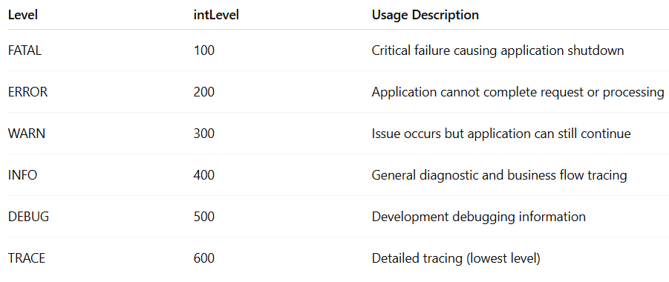
Logging
Standard
Log4J logging levels in ordered and their usages.
i.e.,
✓ If the application log level is ‘DEBUG’, messages for DEBUG, INFO, WARN, ERROR and FATAL
log levels will be logged.
✓ If the application log level is ‘WARN’, messages for WARN, ERROR and FATAL log levels will be
logged.

Slide 22
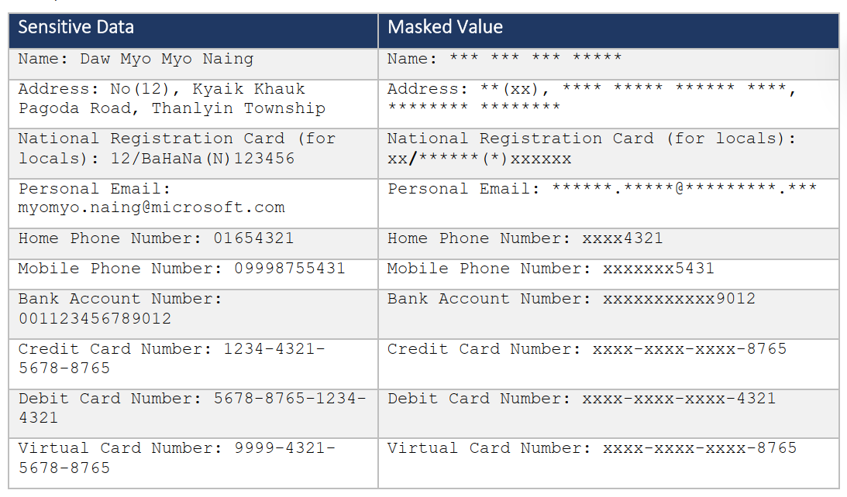
Logging
Example
log.error("Missing cif in access token, cifClaim is null");
log.warn("SKIPPING validation for this field because current FieldName is not present as `key` / `hint` / `mappingColumn` in Wave's data");
log.info("Starting to generate report from database.");
log.debug("Post Bill Info request with billId " + request.getBillId())
When sensitive data needs to be logged inevitably for debugging purpose, APPLY MASKING.
Example:

Slide 23
Logging Practices
Standard
Implement logging on a trusted system (server)
Support success and failure of security events
Ensure un-trusted data does not execute as code
Restrict logs to authorized individuals
Use centralized logging system (Example: Graylog)
Log all input validation failures and cryptographic module failures.
Log all authentication attempts, especially failures.
Log all access control failures, system exceptions and backend TLS connection failures.
Log all apparent tampering events, including unexpected changes to state data.
Log attempts to connect with invalid or expired session tokens.
Log all administrative functions, including changes to the security configuration settings.
Use a cryptographic hash function to validate log entry integrity.

Slide 24
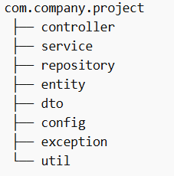
Spring Boot Layered Architecture
Architecture Flow
Client → Controller → Service → Repository → Database
Responsibilities
Notes
*Each Layer has Single Responsibility ,
*No Direct Access:
❌Controller→Repository , ❌Controller→DB
Controller
Handle HTTP request/response
Input validation
Service
Business logic
Transaction handling
Repository
Data access (JPA / JDBC)
Database
Persistent storage
Sample Project Structure

Slide 25
Transaction Management
Use @Transactional for business operations
Auto rollback on failure (runtime exception by default)
Do NOT swallow exceptions
Always rethrow or use custom exception
Not Suitable for
Simple read-only operations
Long-running processes (batch, report)
**Bad
**Good
@Transactional
public void processOrder(Order order) {
try {
repository.save(order);
} catch (Exception e) {
log.error("Error occurred", e);
// Exception swallowed → NO rollback
}
}
@Transactional
public void processOrder(Order order) {
try {
repository.save(order);
} catch (Exception e) {
log.error("Error occurred", e);
throw e; // rethrow → rollback happens
}
}
Remark: When using transaction please consider Performance overhead , Long-running transaction problem, Not suitable for external calls , Memory / connection usage(connection pool exhausted)

Slide 26
Secure Coding Guidelines
Input Validation
Validate on trusted system (backend server)
Classify trusted vs untrusted data sources
Validate all untrusted sources (DB, file streams)
Use centralized validation routine
Apply UTF-8 / canonicalization
Reject all validation failures
Validate client data (params, URLs, headers, cookies)
Validate data type, range, length
Use whitelist validation
Handle hazardous characters (< > ' % etc.)
Check null bytes, new line, path traversal (../)

Slide 27
Secure Coding Guidelines
Access Communication Security
Use TLS encryption for all sensitive data and TLS for external systems
Ensure valid certificates
Do not fallback to insecure connection
Use bcrypt / Argon2 / PBKDF2
Filter sensitive data from referrer
Disable client-side caching for sensitive data
Use:
Cache-Control: no-store
Pragma: no-cache
Apply HTTP Security Headers:
HSTS
CSP
XSS Protection

Slide 28
Secure Coding Guidelines
Database Security
Use ORM or parameterized queries; stored procedures are optional
Apply input validation + encoding
Use least privilege DB access
Encrypt connection strings / credentials
Remove default accounts & configs
Close DB connections properly and avoid hardcoding credentials

Slide 29
Secure Coding Guidelines
General Coding Practices
Use approved libraries / APIs
Avoid direct OS command execution
Use hash/checksum for integrity
Handle concurrency (locking)
Initialize variables explicitly
Prevent race conditions
Avoid dynamic execution of user input

Slide 30
Summary Concept
Use meaningful and consistent naming conventions
Write small, clear, and focused methods
Keep code simple and easy to understand
Avoid unnecessary comments – prefer self-explanatory code
Handle exceptions properly with clear error messages
Implement meaningful and centralized logging
Follow secure coding practices (validation, authentication, access control)
Ensure code is consistent, maintainable, and reusable

Slide 31
Code Review Checklist
Naming is clear, meaningful, and consistent
Methods are small and focused (single responsibility)
Code is easy to read and understand
Comments are used only when necessary
Exceptions are handled properly (no swallowing errors)
Error messages are clear and useful
Logging is implemented for key operations and failures
Sensitive data is not exposed in logs
Input validation is properly implemented
Access control and authentication are properly enforced
Code follows consistent formatting and structure

Slide 32
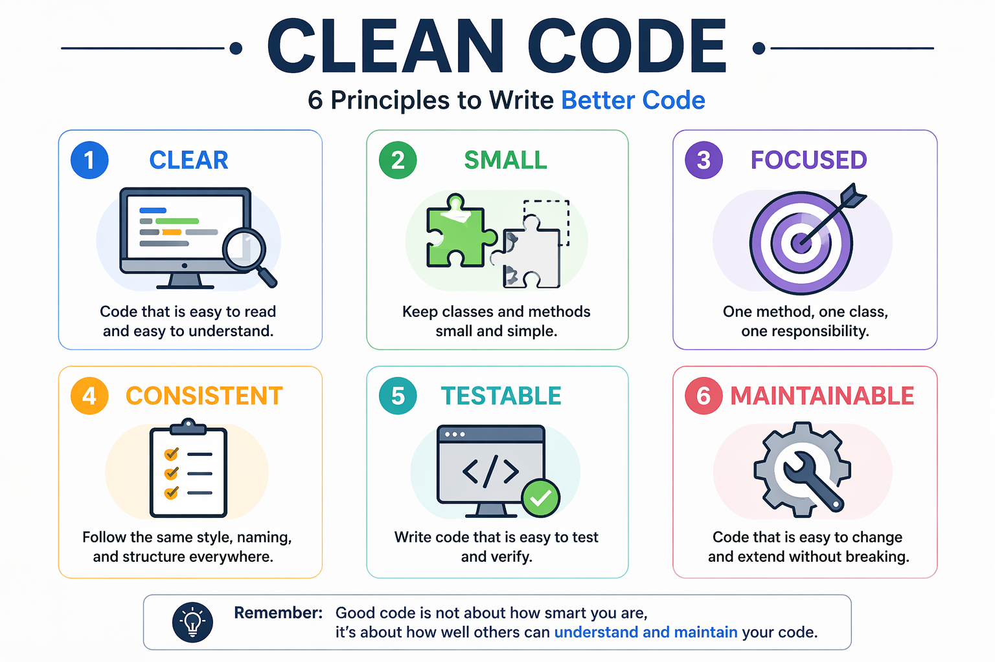
Final Idea

Slide 33
Thank You!

Slide 34
Appendix
Practical Examples - Applying Code Standards

Slide 35
Practical Examples- Applying Variable Practices
Rule
Avoid magic numbers
Replace hard-coded values with constants or enums
Why
Reduce misunderstanding , debugging more easier which lead to easier maintenance.
Example
✅ Do
if (status== Status.ACTIVE);
private static final String PRODUCT_BSC="BSC"; private static final
int MAX_RETRY_COUNT = 3; retryOrder(PRODUCT_BSC,MAX_RETRY_COUNT);, MAX_RETRY_COUNT);
❌ Don’t if(status==1);
retryOrder(”BSC”,3)

Slide 36
Improvement Examples – Methods Practices
Rule
Small , Single Purpose Less arguments ( max 3 better )
Why
Easier to maintain and enhance reusability and debugging
Example
✅ Better
pushMoney();
//inside pushMoney call following methods
validate();
verifyProduct();
doSale();
printData();
commissionSave();
❌ Bad
//put validate , product verification ,sale , print ,commission logic inside one method
pushMoney();

Slide 37
Practical Examples - Applying Class & Object Design Practices
Rule
Single Responsibility , slim ,cohesive
Hide internal Structure
Why
Easier to maintain and understand and reduce tight coupling
Example
❌ Don’t (Expose internal Structure)
class Order { public Customer customer; } order.customer.getAddress().getCity();
✅ Do (encapsulation)
class Order { private Customer customer; public String getCustomerCity() { return customer.getAddress().getCity(); } }
Law of Demeter

Slide 38
Code Standard Example- Object vs Data Structure
Rule
Prefer Objects over raw data structure
Avoid hybrid ( half object + half data)
Why
Objects aims for behavior expose where as data structure expose data so mixing both creates confusion

Slide 39
Code Standard Example- Object vs Data Structure
Example
❌ Bad (Hybrid bad design)
class User { public String name; public String email; public void sendEmail() {// logic here}
}
✅ Better (Proper Separation)
class User { private String name; private String email; public String getEmail() { return email;}
}
class EmailService { public void sendEmail(User user) {// logic here}}
}

Slide 40
Practical Examples- Applying Inheritance & Design
Rule
Base class should not depend on child classes
Prefer composition over inheritance
Why
Reduce tight coupling and avoiding fragile design

Slide 41
Practical Examples- Applying Inheritance & Design Practices
Example
✅ Better (polymorphism +clean design) interface Noti { void send(); }
class EmailNoti implements Noti {
public void send() {
System.out.println("Send Email");
}
} class SmsNoti implements Noti {
public void send() {
System.out.println("Send SMS");
}
}
String type = "EMAIL"; Noti noti; if ("EMAIL".equals(type)) { noti = new EmailNoti(); } else{e { noti = new SmsNoti(); }
noti.send(); notification.send();
❌ Bad (tight coupling) class NotiService {
public void send(String type) {
if ("EMAIL".equals(type)) {
sendEmail();
} else if ("SMS".equals(type)) {
sendSms();
}}
}
private void sendEmail(){
System.out.println(“email send”);
}
private void sendSms(){
System.out.println("Send SMS");
}

Slide 42
Code Standard Example- Exception
Rule
Catch specific exceptions , don’t swallow exceptions silently
Log actionable context without exposing sensitive data(see more on document about log)
Wrap low-level exceptions with domain-relevant exceptions when appropriate
Avoid using finally blocks for business logic; use them only for cleanup and logging
❌ Bad (useless info)
catch (Exception e) { log.info("Payment failed: {}", request); // may log sensitive data throw new RuntimeException("Error"); }
public void processPayment(PaymentRequest request) { try { paymentRepository.save(request); // fail to catch DB operation } catch (Exception e) { log.error("Error:{}“,e); // useless log } }

Slide 43
Code Standard Example- Exception
✅ Good
public void processPayment(PaymentRequest request) {
try {
paymentRepository.save(request); // DB operation
log.info("Payment successful for orderId={}", request.getOrderId());
} catch (DataAccessException ex) {
// DB-specific error
log.error("Database error while processing payment. orderId={}",
request.getOrderId(), ex);
throw new PaymentProcessingException( "Payment failed due to database issue", ex);
} catch (Exception ex) {
// unexpected error
log.error("Unexpected error while processing payment. orderId={}",
request.getOrderId(), ex);
throw new PaymentProcessingException(
"Unexpected error occurred while processing payment", ex);
}
}
public class PaymentProcessingException extends RuntimeException {
public PaymentProcessingException(String message, Throwable cause) {
super(message, cause);
}
}

Slide 44
Code Standard Example- Sourcecode structure formatting
Group related methods together
Keep consistent indentation and spacing
Follow logical order : fields ,constructors ,public methods ,private methods
Separate responsibilities (Controller / Service / Repository)
✅ Good (use important info) public class UserService { private int count; public UserService() {} public void saveUser(User user) { validateUser(user); // business logic } private void validateUser(User user) { // validation logic } }
❌ Bad (useless info)
public class UserService { public void save() {} private int count; public UserService() {} private void helper() {} }

