Slide 1
YPS Data Lost Containment Action
Phyo Thu Han
05-March-2026

Slide 2
Objective
Prevent data loss between YPS and G&G systems by addressing the following areas:
Ensure YPS transaction data is received by G&G in real time without interruption
Enable recovery of failed transactions caused by invalid or incomplete data
Provide manual recovery mechanisms for transactions that do not reach the system

Slide 3
Context
Currently, YPS transaction data is sent to the G&G backend and stored in the Integration Table, with an average of approximately 4,000 transactions per day.
However, some transactions fail to reach the system and return a 499 error.
On normal days, 1–10 transactions (less than 1%) may be missing
On certain days(worse case scenario), the missing rate can reach between 40% and 60%
To address this issue and ensure data reliability and recovery, improvements need to be implemented on both the YPS side and the G&G side.

Slide 4
Proposed Plan on YPS Side
Transaction Handling
Maintain 15-second timeout for YPS transaction requests.
If a request fails, apply automatic retry mechanism:
Retry delay: 5 minutes
Maximum retries: 4 attempts
If success response (000000) is received → stop retry immediately.
Failure Recording
If transaction still fails after max retries:
Store transaction in failure list as JSON payload.
End-of-Day Recovery
Scheduler generates failed transaction file (Excel/CSV).
File is stored in Failed Transaction Folder on File Server.
G&G system will later import this file for recovery processing.

Slide 5
Proposed Plan on G&G Side Failed Tx(End Of Date Import) at real time
Failed Transaction Import
Scheduler runs 1:30 AM daily.
Fetch failed transaction CSV file from file server.
Retry file access 3 times (15-minute interval)
Prevent duplicate import using import_record table and send email for failed import
Insert CSV records into yps_integration (fromOnline = false).
Shift Ending
Shift Ending scheduled processes at 8:00 AM:
Fetch shift which still open although sale transaction finish
End shift and update shift ending status
Failed Transaction Alert
Fetch failed transaction from yps integration table at 8:00 AM
Send email with failed transaction number

Slide 6
Proposed Plan on G&G Side for YPS Retry
Import Processing Detail
Create yps_integration table to record all YPS transaction with following key fields
censeq – Unique transaction key
transaction_frequency – Number of times transaction received
last_transaction_time – Latest transaction timestamp
YPS sends transaction to G&G.
System checks censeq in yps_integration.
If record exists:
Update transaction_frequency
Update last_transaction_time
Process transaction and return 000000 success code.

Slide 7
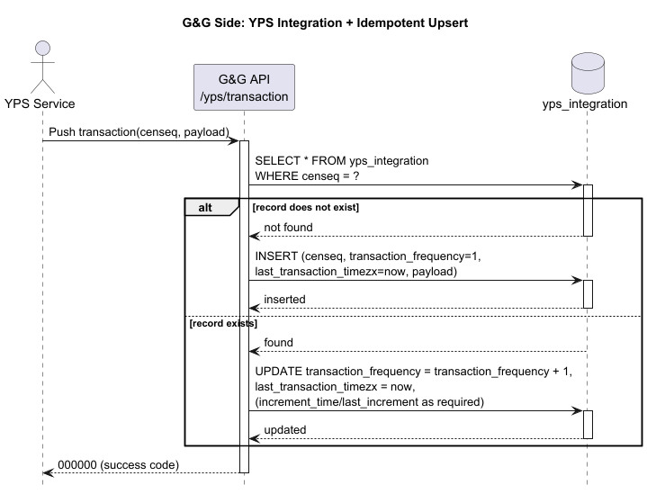
Sequence Diagram for retry flow

Slide 8
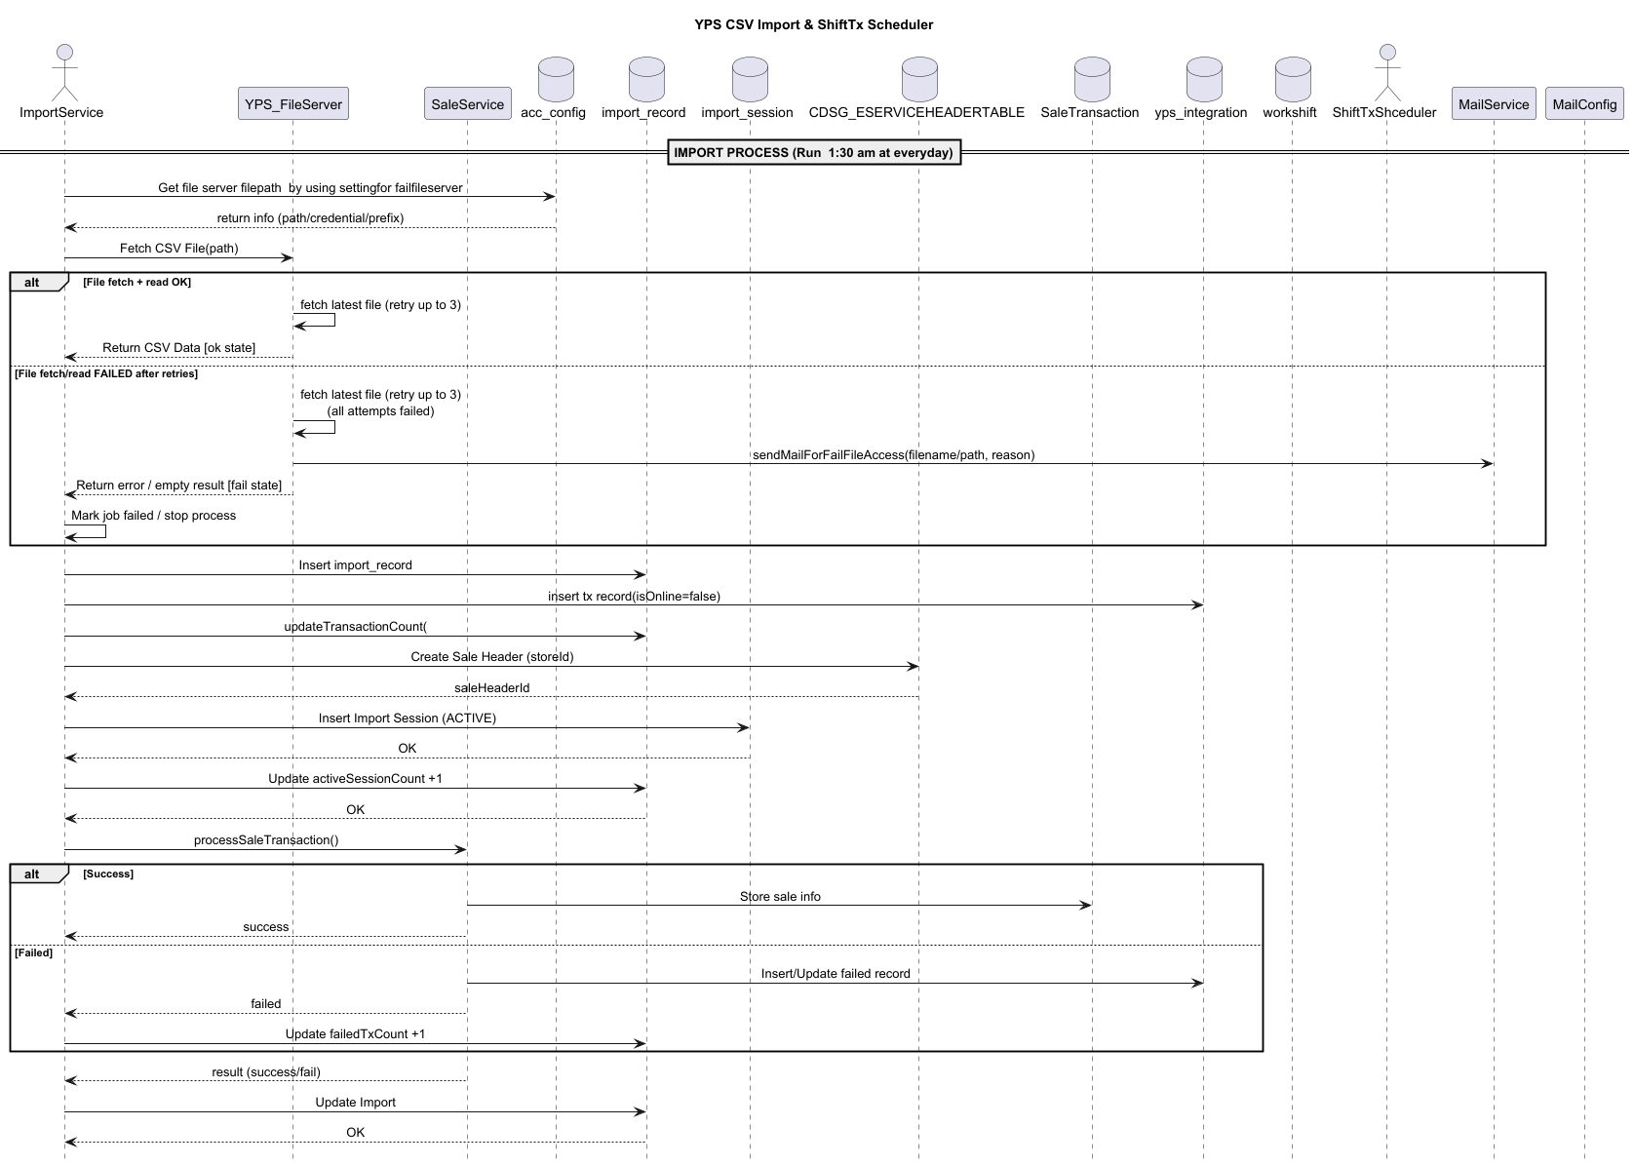
Sequence Diagram for import flow

Slide 9
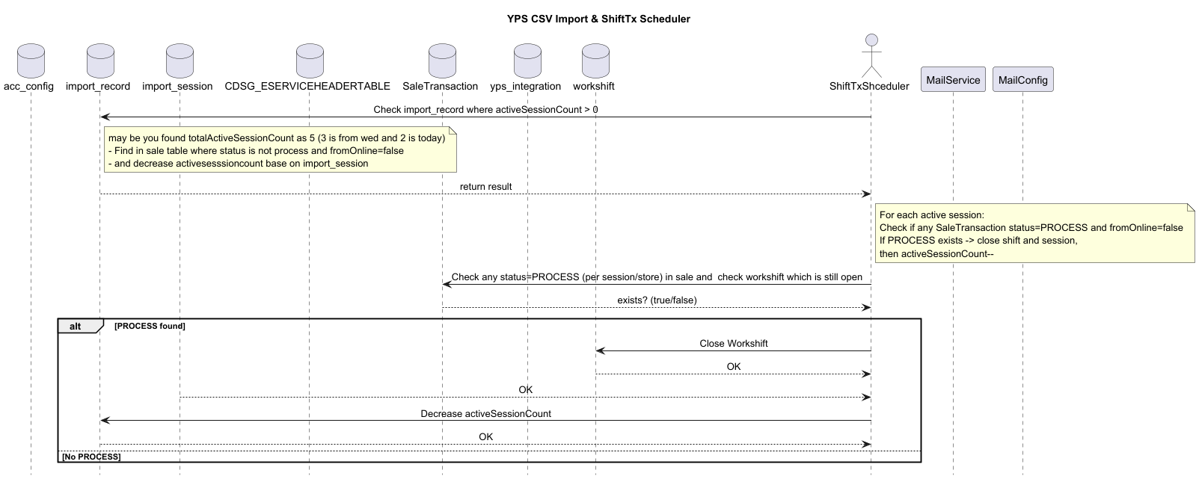
Sequence Diagram for Ending shift

Slide 10
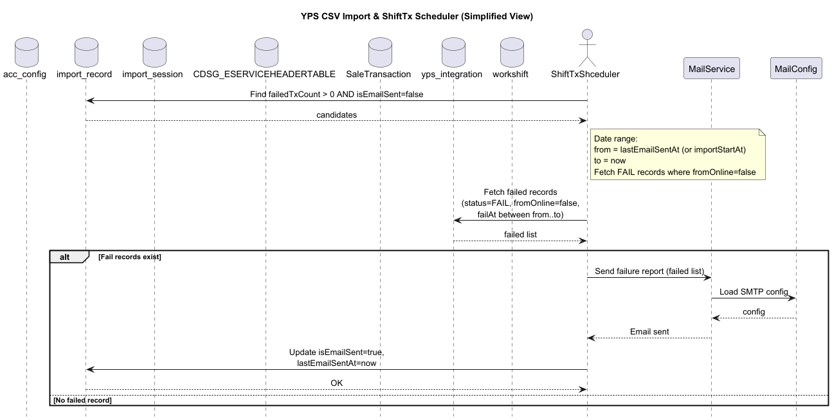
Sequence Diagram for FailedTx Email Sending

Slide 11
Question by KK
What kk said
Separate yps service for processing yps
Create new yps schema with table like import_record ,import_session , file_config, yps_integration table
What he expect is only sending data require for sale transactions and not hold or store yps data
He expect g&g revamp should pin point area which need to revamp and we have to point out step by step revamp.
Currently my pain point is targeting yps part it is good but kk pain point is top up point which does not match in balance
According to ko nyi(technical own) , there is no top up issues and accounting match ,problem happen due to time out issues.Ko Thura sugges to check log to know time out issues
Current flow is g_gendpoint connect to CCN Eservice(middlieware) which connect to third party top up.
Problem happen when top up does not response in time so that CCN Eervice cant response in time so that g&g end point receive timeout so transaction fail and user return home.at that time transaction success at phone bill provider and success return to eservice middleware but at that time no transaction wait at g&g part but customer receive phone bill .so money lost at CCN Eservice side.

Slide 12
Thank You!

