Slide 1
YPS REVAMP

Slide 2
Large Data Volume & Increasing Transaction Load
Current Problems
E-Service transactions (Top-up, YPS, etc.) are processed slowly.
Sale transaction saving experiences delays.
ERP synchronization process is slow.
Sale transaction table is continuously growing in size.
Business Expansion Impact
YPS E-Service will expand to all G&G stores via Sunmi devices.
Real-time transaction volume is expected to increase significantly.
Future load may multiply across all stores.

Slide 3
Large Data Volume & Increasing Transaction Load
Data & Reporting Requirements
Sale database must retain 2 years of transaction data.
All-store reports require up to 2 months of data.
Individual stores must access reports up to 180 days.
Concern
Growing data volume impacts:
Query performance
ERP sync performance
Report generation speed
System scalability
Current architecture may not sustain projected transaction growth.

Slide 4
Option C – Dedicated YPS + Sale Service (Recommended)
Approach:
Separate YPS Service for YPS transactions.
G&G E-Service for other E-Services.
Dedicated Sale Service consumes and stores sale data.
RabbitMQ as event backbone.
Benefits:
Clear service separation.
Independent scaling (YPS / E-Service / Sale).
Future-ready for microservices.
Consideration:
Higher initial development time.

Slide 5
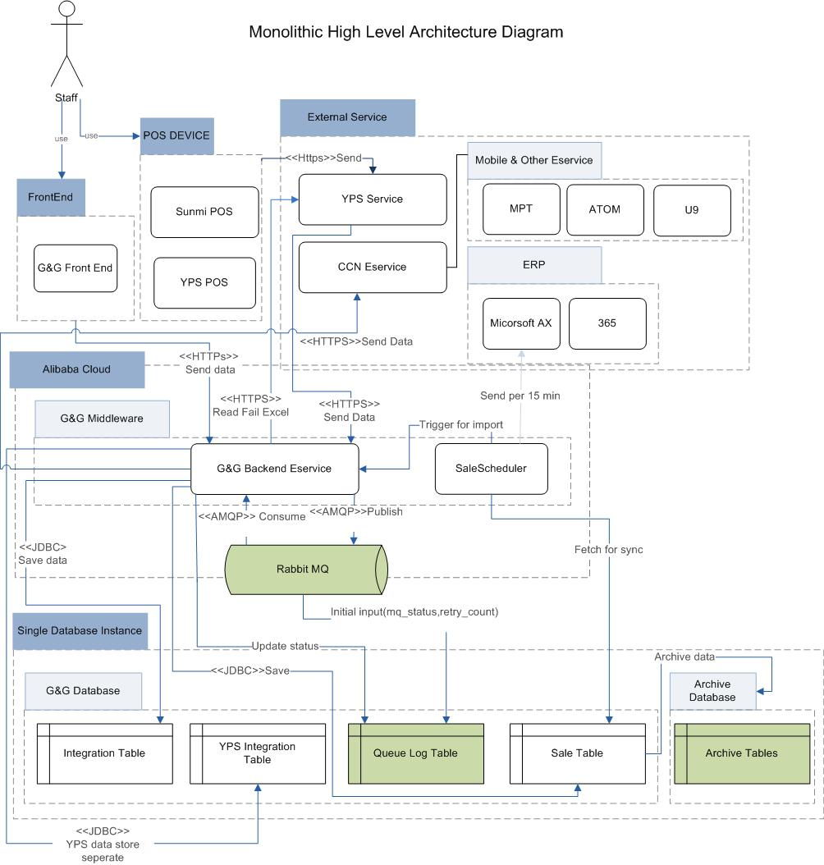
High Level

Slide 6
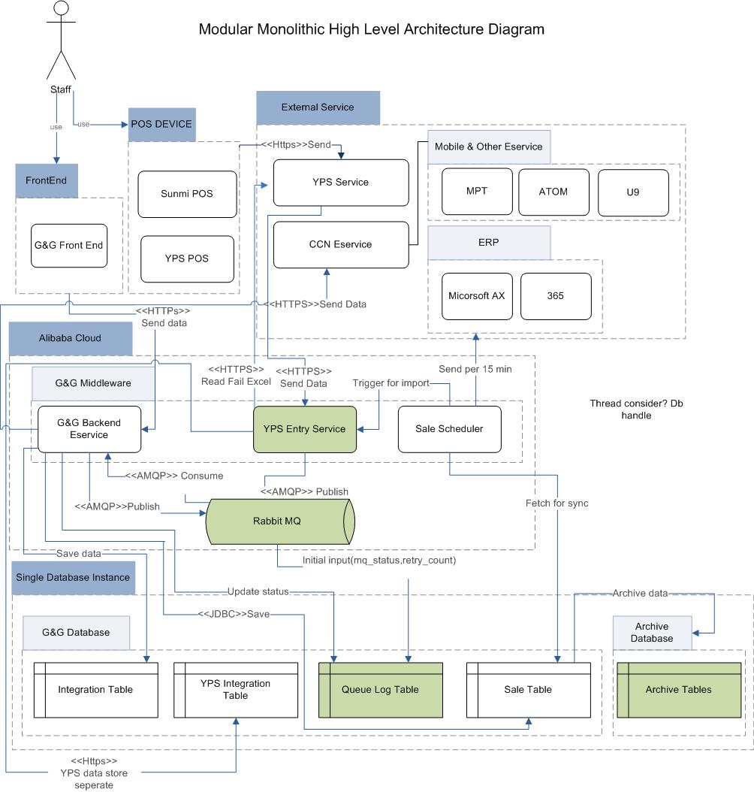
Presetation Title

Slide 7
Option B – Separate YPS Service + RabbitMQ
Approach:
Dedicated YPS Entry Service for YPS transactions.
G&G E-Service handles other E-Services.
RabbitMQ used for async processing.
Benefits:
Independent scaling for YPS.
Better transaction isolation.
Limitation:
More development effort than Option A.

Slide 8
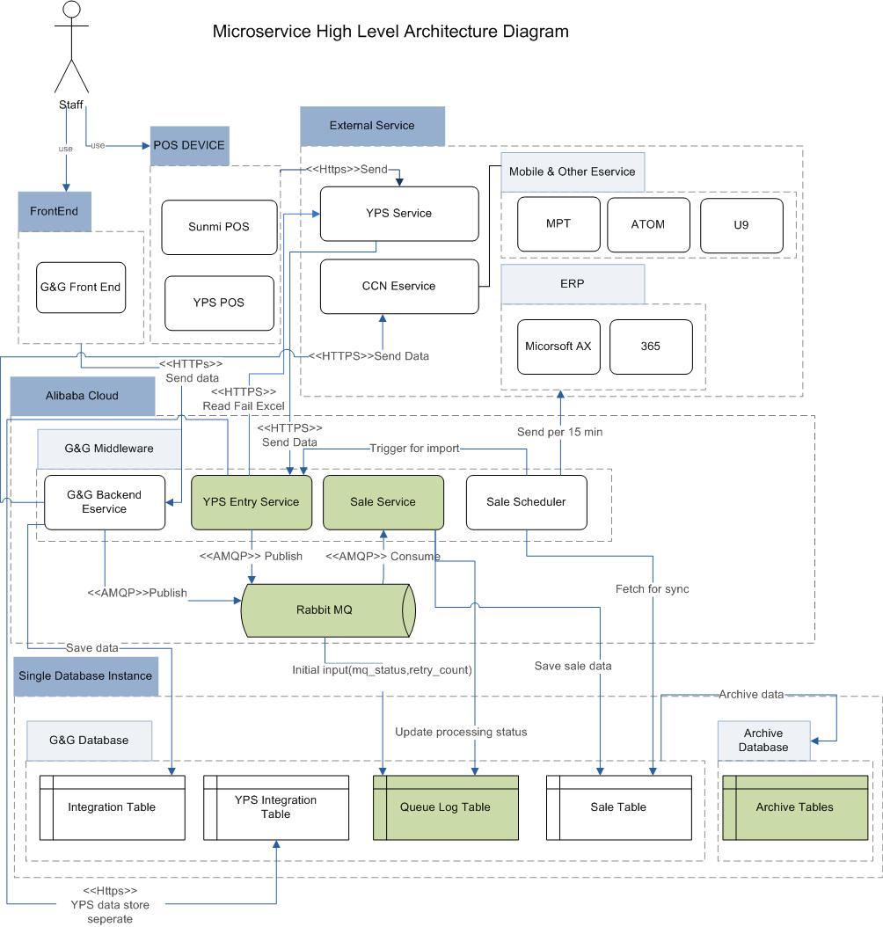

Slide 9
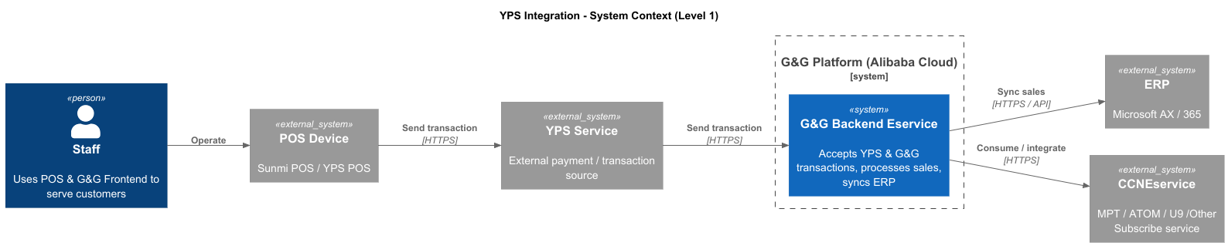
System Context

Slide 10
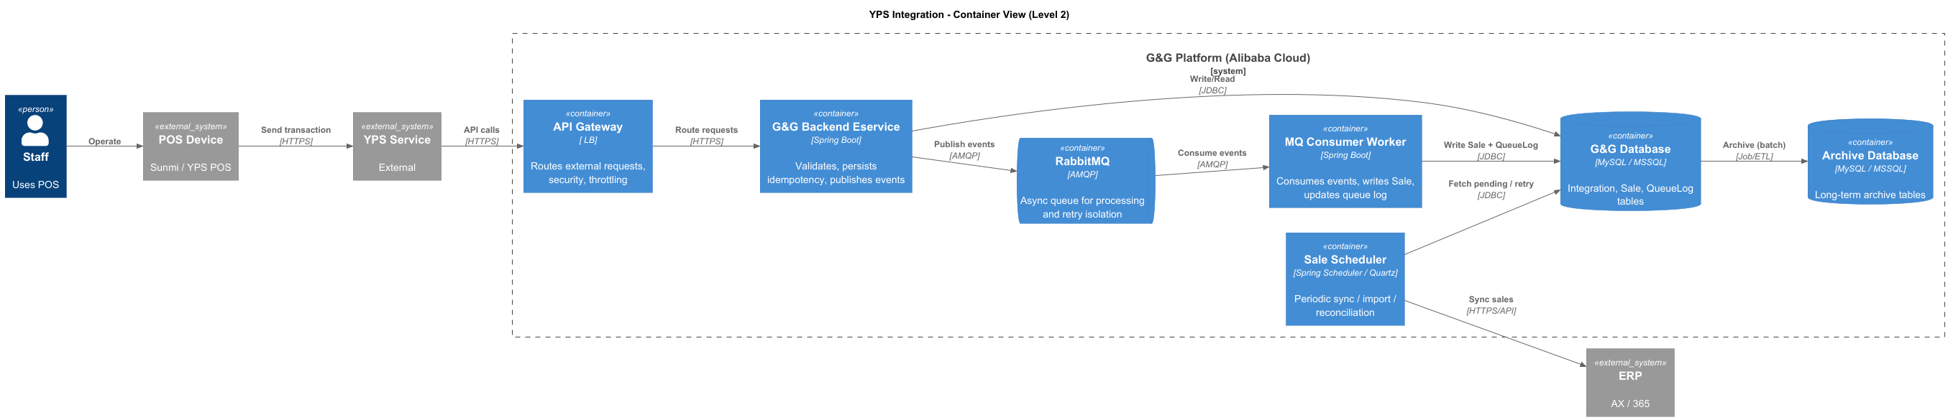
Container Diagram

Slide 11
Option A – RabbitMQ-Based Processing (Quick Improvement)
Approach:
Use RabbitMQ to store E-Service transactions.
Backend consumes messages asynchronously.
Sale data saved after consumption.
Benefits:
Fast POS response (non-blocking).
Minimal architecture change.
Short development time.
Limitation:
Limited long-term scalability.

Slide 12
Questions
How end to end work(g&G backend connection ,sync flow detail)? Code study, flow research
Sale database size –more than 7 million
How sale flow align with rabbit mq & how top up & print flow align.(what data store ,how process without non blocking)
MQ support event store stream play like Kafka and how it support in Alibaba
Which external service connect to g&g backend
Is queue process table is extra or not

