Slide 1



You fell for the Trojan Horse!
A type of malware that is disguised as a useful piece of software or data file
Enables hackers to spy on you, steal sensitive data, and gain access to your system
Preventive Measures:
Install anti-malware software
Avoid installing suspicious software
Avoid downloading email attachments from unknown senders

Slide 2
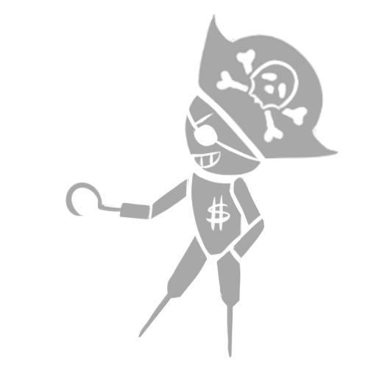
Your computer has been hijacked by Ransomware!
A type of malware that locks a computer or hijacks a user’s files
Demands a ransom from the victim to restore access to the data upon payment
Preventive Measures:
Install anti-malware software
Regularly back up your files (make sure always have a copy available)

Slide 3
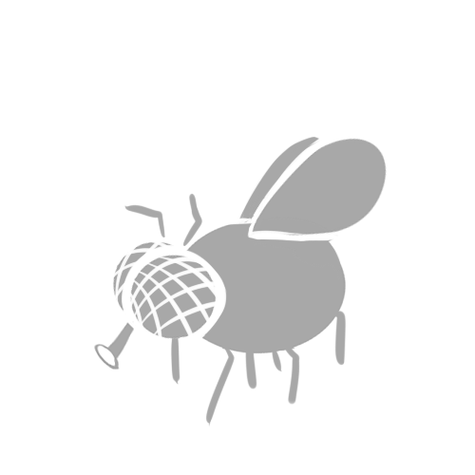
Your computer has joined the Botnet swarm!
A network of computers whose access has been compromised and controlled remotely
Compromised computers are used to conduct malicious attacks against other networks
Preventive Measures:
Regularly run antivirus scans on your computer

Slide 4

You’ve been Phished!
Hackers exploit people’s gullibility and trust in phishing attacks
Emails/messages that mimic real companies — banks, PayPal, Amazon, Apple, etc. — trick you into logging into your account through poisoned links
Preventive Measures:
Install anti-phishing software
Avoid sharing private information online or typing passwords when directed to websites from links

Slide 5
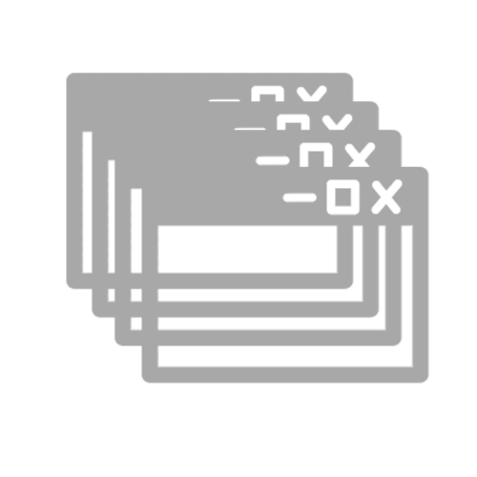
You’ve been spammed by Adware!
A type of malware that bombards you with endless ads and pop-up windows
Causes inconvenience and sometimes
Preventive Measures:
Install anti-phishing software
Avoid sharing private information online or typing passwords when directed to websites from links

Slide 6
