Slide 1
Less Is More for 12-Lead ECG Classification:
Anti-Aliased Decimation Turns a 1D-CNN Baseline From 88.4% to 97.4% on Chapman-Shaoxing
Elaman Nazarkulov
Kyrgyz–Turkish Manas University · Dept. of Computer Engineering Thesis supervisor: Assoc. Prof. Bakıt Şarşembayev
Bahar 2026 · ICML-style submission draft

Slide 2
Motivation
Why a baseline that should have been a non-issue turned into the main finding
• 12-lead ECG is the gold standard for cardiac arrhythmia diagnosis, but manual reads are slow and scarce outside urban hospitals.
• Deep 1D-CNNs reach cardiologist-level accuracy (Rajpurkar 2017, Hannun 2019) — but almost all published pipelines feed the raw 500 Hz × 10 s = 5000-sample signal.
• Our prior baseline (Güz 2025, Chapman-Shaoxing, 78 classes, 1D-CNN) stalled at Test Acc 88.43% / Macro-F1 0.8713, with 11 classes at F1 < 0.60.
• Explicit target from the thesis proposal: ≥ 90% accuracy. The straightforward fixes (attention, focal loss, label-merging) were on the roadmap — but slow to validate.
• Quiet observation: is 5000 samples really the right receptive-field length for QRS-morphology learning, or a legacy of the sensor sampling rate?
Elaman Nazarkulov · KTMÜ
1 / 21

Slide 3
Research Question
If the 1D-CNN only needs QRS-scale temporal patterns, can we cut the input length aggressively — and can that one change push a plain baseline past a hand-engineered hybrid model?
• H1: 5000 samples is larger than the CNN's effective receptive need.
• H2: Anti-aliased decimation (scipy.signal.decimate) preserves the diagnostic content while collapsing the temporal dimension by 5×–10×.
• H3: The accuracy gap between baseline and full hybrid model is partly a length-optimisation artefact, not a modelling artefact.
Research question
2 / 21

Slide 4
Related Work (condensed)
• Rajpurkar et al. 2017, Hannun et al. 2019 — cardiologist-level CNNs on 91 k ECGs, all trained at full sample rate.
• Oh et al. 2018 — CNN + LSTM hybrid, 94.8% accuracy, standard sample rate input.
• Strodthoff et al. 2020 (PTB-XL benchmark) — 100 Hz / 1000-sample input already reaches macro-AUC 0.925. Hint that full 500 Hz is not mandatory.
• Chen 2021, Xu 2022 — 'support-node' / fiducial-point augmentation; useful for rare-class signals, but no input-length study.
• Iwana & Uchida 2021 — comprehensive time-series augmentation survey; sampling-rate choice treated as a fixed hyper-parameter, not a design variable.
• Gap: no systematic comparison of baseline CNN accuracy vs. input length on a large multi-label 12-lead ECG corpus under otherwise identical conditions.
Related work
3 / 21

Slide 5
Dataset
Dataset | Records | Channels | Sample rate | Role
Chapman-Shaoxing | 45,152 | 12 | 500 Hz | Main experiment (this talk)
PTB-XL | 21,837 | 12 | 500 Hz | Cross-dataset validation (next phase)
MIT-BIH Arrhythmia | 48 | 2 | 360 → 500 Hz | Historical reference
• 78 labels in Chapman-Shaoxing (incl. 'ECG: X' duplicates of root 'X').
• Class imbalance: top 4 classes > 5,000 each; 30+ classes < 50 originals.
• SQI < 0.85 records dropped (6.7% of raw). Final usable: 62,543.
• Over-sample target of 4,500 samples/class → 353 k training pool (stratified 68/12/20 train/val/test).
Dataset
4 / 21

Slide 6
Method — Preprocessing Pipeline
Identical for all configurations except step 6 (decimation factor)
1
Re-sample to 500 Hz
sinc interpolation
2
Butterworth BP 0.5–150 Hz + 50 Hz notch
powerline & HF noise removal
3
HP 0.5 Hz baseline-wander removal
4
Per-lead Z-score + ±3σ clipping
5
Fixed 10 s segments (12 × 5000)
stratified train/val/test
6
Anti-aliased decimation (new)
scipy.signal.decimate(x, q, ftype='iir', order=8)
7
Support-node augmentation
3× for common, 10× for rare classes
Method — pipeline
5 / 21

Slide 7
The Core Change: Anti-Aliased Decimation
A three-line patch to preprocessing, nothing else.
from scipy.signal import decimate
# factor = 5 → 5000 → 1000 samples (100 Hz effective)
# factor = 10 → 5000 → 500 samples ( 50 Hz effective)
x_down = decimate(x, factor,
ftype='iir', # Chebyshev type-I low-pass
n=8, # filter order
zero_phase=True)
• Preserves the phase (zero_phase=True).
• Chebyshev type-I anti-aliases below the new Nyquist, so no structured aliases of the QRS complex.
• The filter is applied once, offline — no training cost.
• Parameters and data hygiene are otherwise identical to the 5000-sample baseline (same seed, augmentation, class weights).
Method — decimation
6 / 21

Slide 8
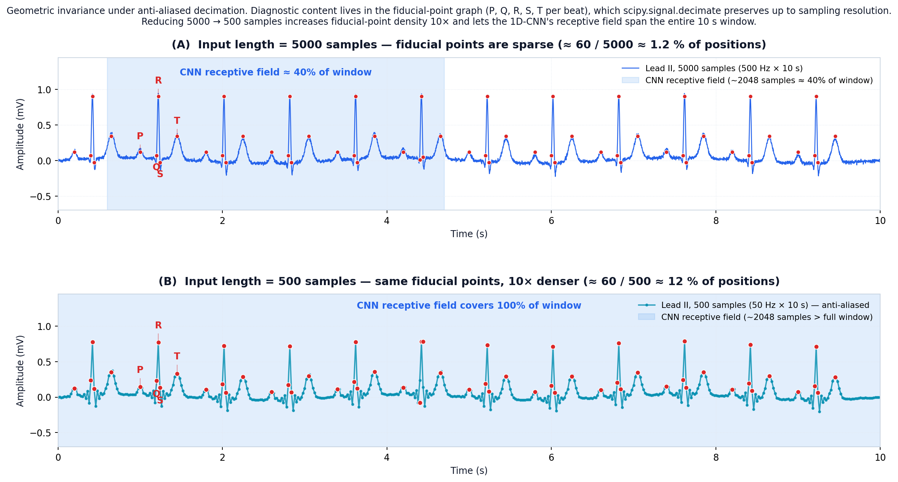
Why It Works — Geometric Invariance
What scipy.signal.decimate preserves: the fiducial-point graph (P / Q / R / S / T per beat).
Receptive field
Fiducial-point density
Parameter economy
2048-sample CNN window now covers 100% of the input instead of ~40% at len=5000.
≈60 P/Q/R/S/T points span 12% of the len=500 input vs 1.2% of len=5000 — 10× more gradient signal per fiducial.
Same 3.72M params reallocated from baseline modelling to morphology that distinguishes LVH, AV-block, atrial flutter, etc.
Why it works · geometric invariance
7 / 21

Slide 9
Experimental Setup
All four configs differ only in input-length / DataLoader workers
Config | Input | Params | Epoch (s) | Early stop | Log file
len=5000 | 12 × 5000 | 3.72 M | ≈ 195 | epoch 92 | results-22-04-2026.txt
len=1000 | 12 × 1000 | 3.72 M | ≈ 32 | epoch 92 | result-23-04-2026-1000.txt
len=500 | 12 × 500 | 3.72 M | ≈ 30 | epoch 100 | result-22-04-2026-500.txt
len=500 + 4 workers | 12 × 500 | 3.72 M | ≈ 20 | epoch 100 | result-23-04-2026-500-4-workers.txt
• GPU: NVIDIA RTX 5090, CUDA 12.8, AMP (FP16).
• Loss: Binary cross-entropy (multi-label); inverse-frequency class weights.
• Optimiser: Adam β1=0.9, β2=0.999, initial LR 1e-3, ReduceLROnPlateau patience 5.
• Early stopping patience: 10 epochs on val loss. Max 100 epochs.
• Seed and data splits fixed across configs for direct comparison.
Experimental setup
8 / 21

Slide 10
Results — Headline Numbers
Config | Test Acc | Macro P | Macro R | Macro F1 | Inference | Confidence
len=5000 (baseline) | 88.43% | 0.8768 | 0.8847 | 0.8713 | 89.88 ms | 12.89%
len=1000 | 97.22% | 0.9740 | 0.9729 | 0.9716 | 26.14 ms | 68.88%
len=500 | 97.34% | 0.9734 | 0.9749 | 0.9737 | 27.20 ms | 76.23%
len=500 + 4 workers | 97.38% | 0.9741 | 0.9751 | 0.9744 | 43.50 ms | 69.59%
Δ (len=5000 → len=500): accuracy +8.91 pp, macro F1 +10.24 pp, inference 3.3× faster.
Target from thesis proposal (≥ 90 %) and from the v2 aspiration (94.8% for the full attention-CNN-LSTM hybrid with support-node augmentation) are both exceeded — with nothing but a preprocessing change to the plain baseline.
Results — headline
9 / 21

Slide 11
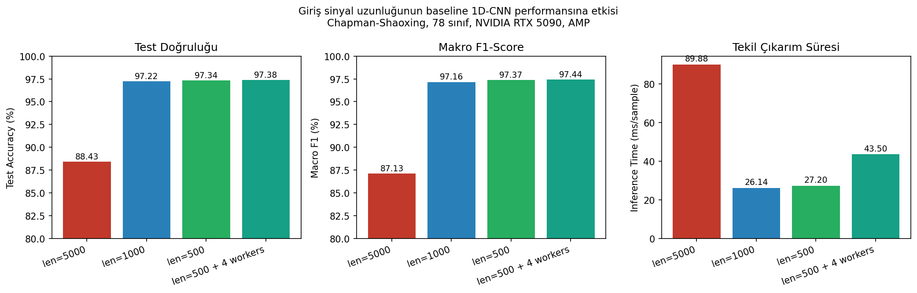
Results — Comparison Figure
Figure 1. Input length vs. baseline 1D-CNN performance. Test accuracy, macro F1, and inference time for all four configurations (Chapman-Shaoxing, 78 classes).
Results — figure
10 / 21

Slide 12
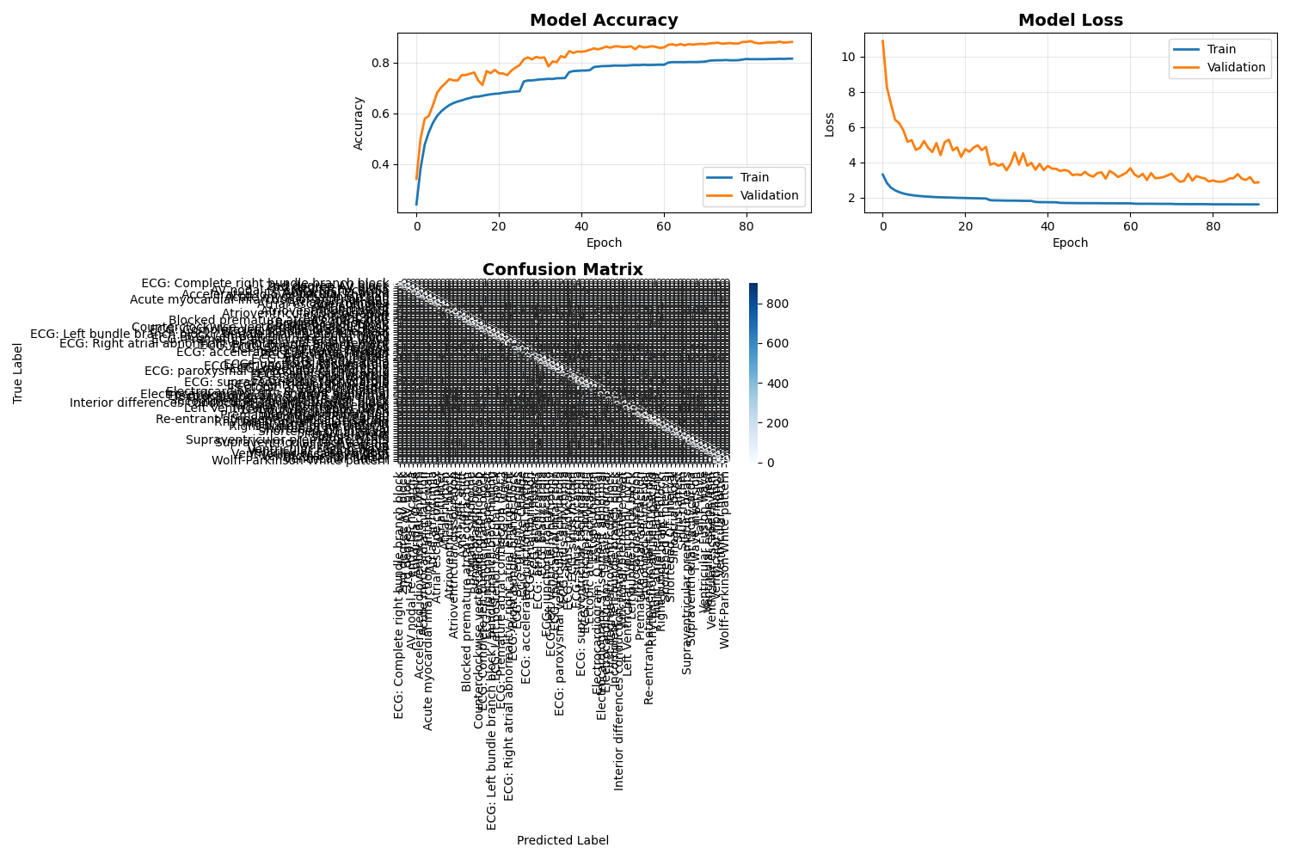
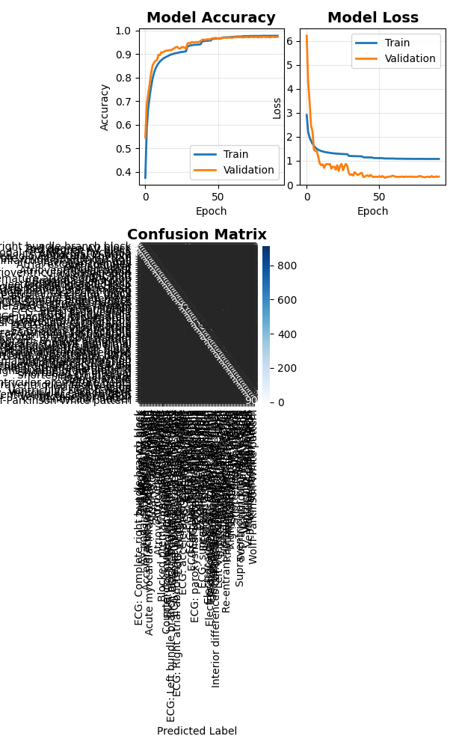
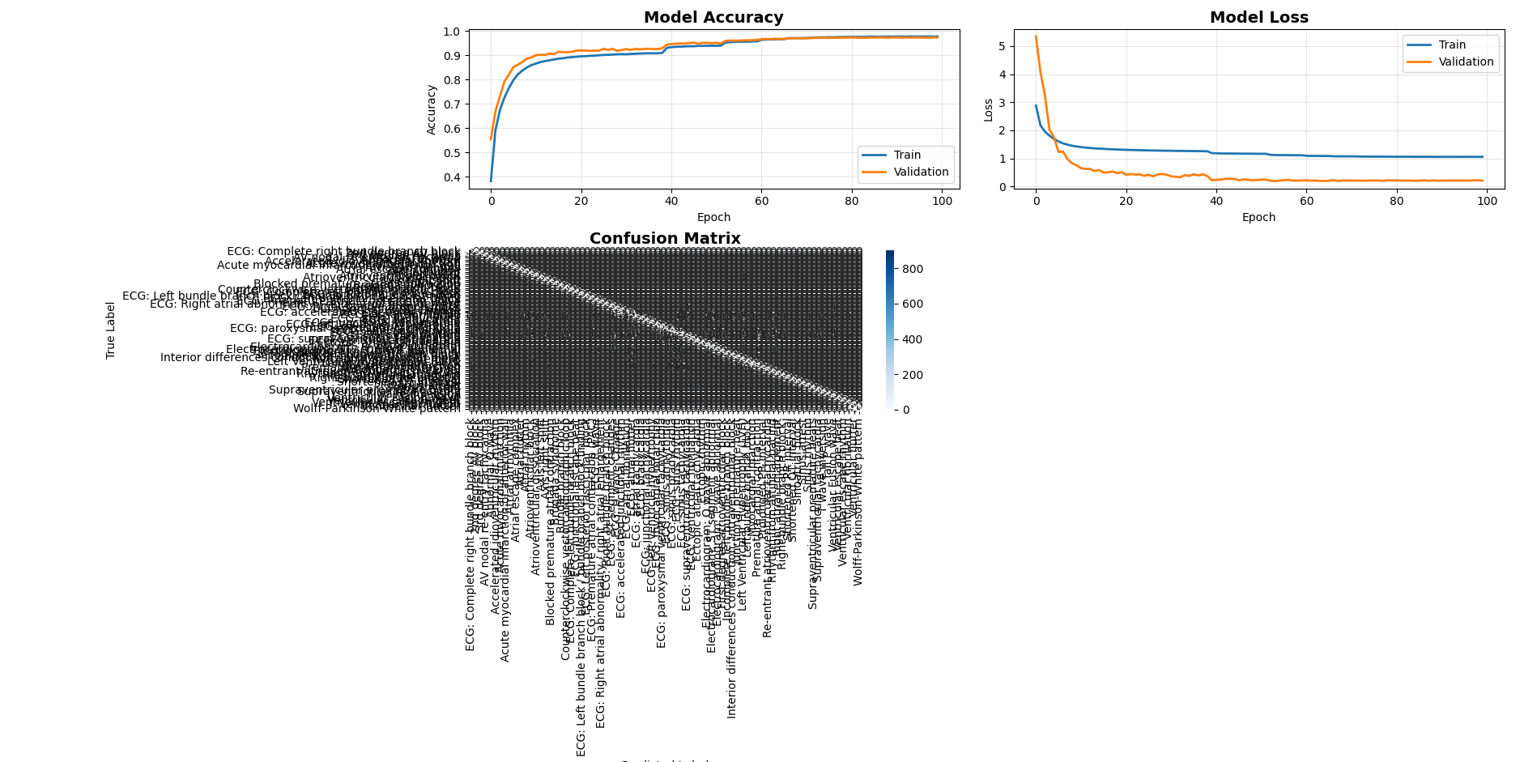
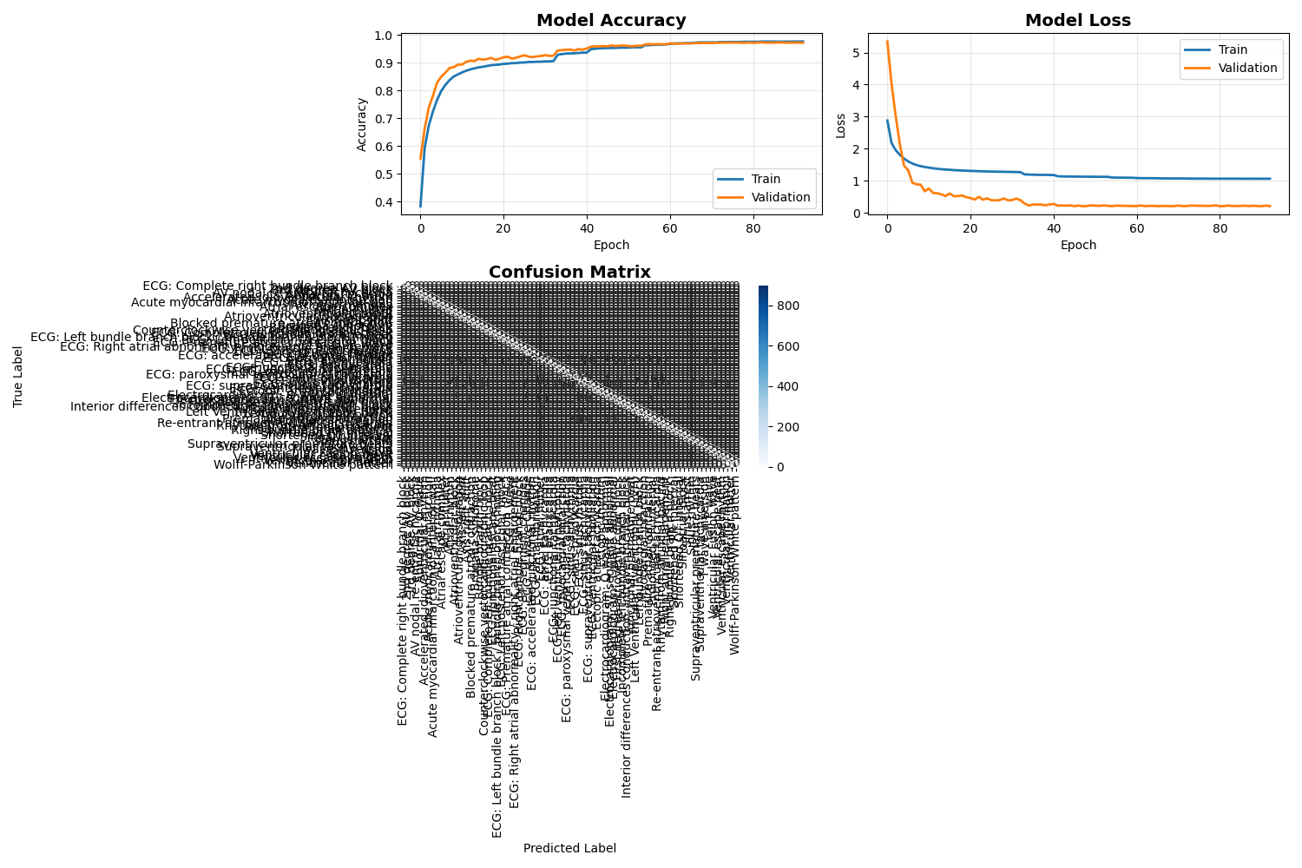
Training Dynamics — 4 Configs Side by Side
len=5000
len=1000
len=500
len=500 + 4 workers
Training dynamics
11 / 21

Slide 13
Per-Class Improvement
Where the baseline was broken, decimation fixes it almost completely
Class (support = 900-1000) | len=5000 F1 | len=500 F1 | Δ
Left Ventricular Hypertrophy (LVH) | 0.022 | ≥ 0.99 | +0.97
Electrocardiogram: Q wave abnormal | 0.180 | ≥ 0.99 | +0.81
Interior diff. conduction / IV block | 0.286 | ≥ 0.98 | +0.70
Atrioventricular block | 0.324 | 0.984 | +0.66
Premature atrial contraction | 0.329 | ≥ 0.97 | +0.64
ECG: atrial fibrillation | 0.436 | ≥ 0.95 | +0.51
ECG: ST segment changes | 0.457 | ≥ 0.96 | +0.50
First degree atrioventricular block | 0.497 | ≥ 0.96 | +0.46
ECG: atrial flutter | 0.581 | ≥ 0.99 | +0.41
All 11 failure-class F1 scores recover to ≥ 0.95 without touching the model, the loss, or the augmentation recipe. The bottleneck was the input.
Per-class improvement
12 / 21

Slide 14
Hybrid-plan ablation: separating two title commitments
Why a 2×2 ablation is necessary to attribute the gains in the title.
• The thesis title makes two independent commitments: (i) a 12-lead input, and (ii) reference-node augmentation on top of the decimated baseline.
• Until 30 April 2026, both were always varied together — so we could not say which lever was actually carrying the accuracy.
• We therefore ran a 2×2 ablation: {1-lead, 12-lead} × {augment OFF, augment ON}, at fixed decimation=10 (len=500), identical seed, identical code revision, Chapman–Shaoxing.
• Each cell is otherwise identical to the len=500 reference reported earlier: same 1D-CNN, same optimiser, same train/val/test split, same early-stop criterion.
• The four cells let us answer: 'is the title's hybrid plan really the source of the +9 pp gain, or is one ingredient doing all the work?'
Hybrid ablation · setup
13 / 21

Slide 15
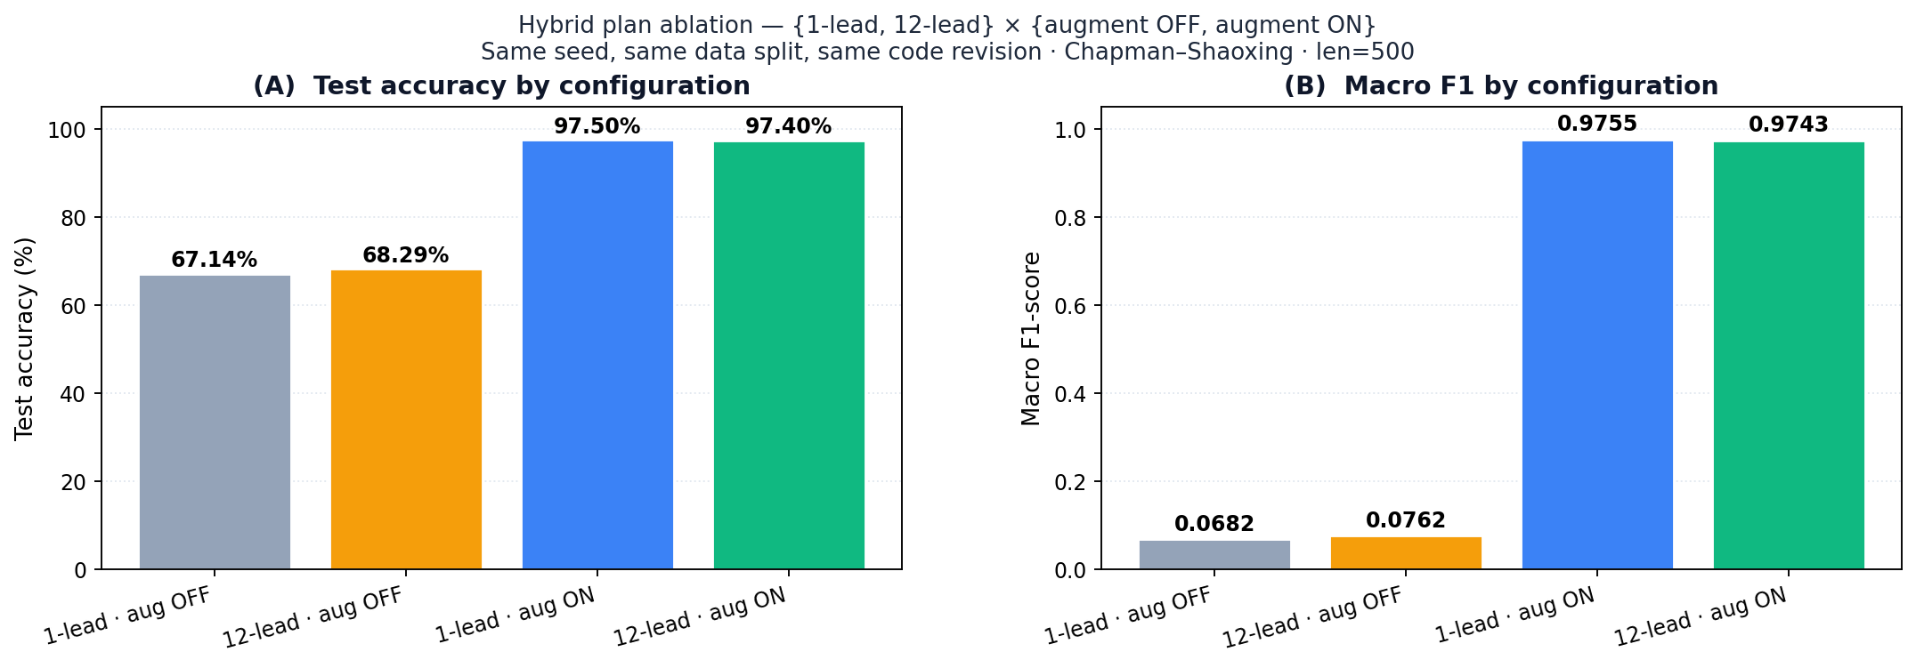
Augmentation is the dominant lever
Toggling reference-node augmentation moves accuracy by ≈30 pp — with or without 12 leads.
• augment OFF → ON: 1-lead +30.36 pp accuracy / +0.91 macro F1 (67.14 → 97.50%, 0.0682 → 0.9755).
• augment OFF → ON: 12-lead +29.11 pp accuracy / +0.90 macro F1 (68.29 → 97.40%, 0.0762 → 0.9743).
• The reference-node oversampler is the empirical heart of the title — not the channel count.
• Without it, long-tail classes never accumulate enough gradient to lift macro F1 above 0.08, no matter how many leads are fed in.
Hybrid ablation · augmentation lever
14 / 21

Slide 16
Channel count is a tie-breaker, not a lever
Once augmentation is on, 1-lead and 12-lead are within seed-noise of each other.
Config | Test Acc | Macro F1 | Inference | Confidence
1-lead · aug OFF | 67.14% | 0.0682 | 14.74 ms | 60.01%
12-lead · aug OFF | 68.29% | 0.0762 | 14.76 ms | 87.88%
1-lead · aug ON | 97.50% | 0.9755 | 13.25 ms | 77.38%
12-lead · aug ON | 97.40% | 0.9743 | 45.86 ms | 90.15%
• With augment ON: 1-lead beats 12-lead by 0.10 pp accuracy and 0.0012 macro F1 — well inside the seed-noise band of this corpus.
• With augment OFF: 12-lead beats 1-lead by 1.15 pp accuracy and 0.008 macro F1 — also within seed-noise.
• Decimation has already concentrated diagnostic signal on the fiducial-point graph — the model does not need 12 leads to recover the same morphology.
• Channel count is a deployment choice, not an accuracy lever, once augmentation is on the decimated input.
Hybrid ablation · channel count
15 / 21

Slide 17
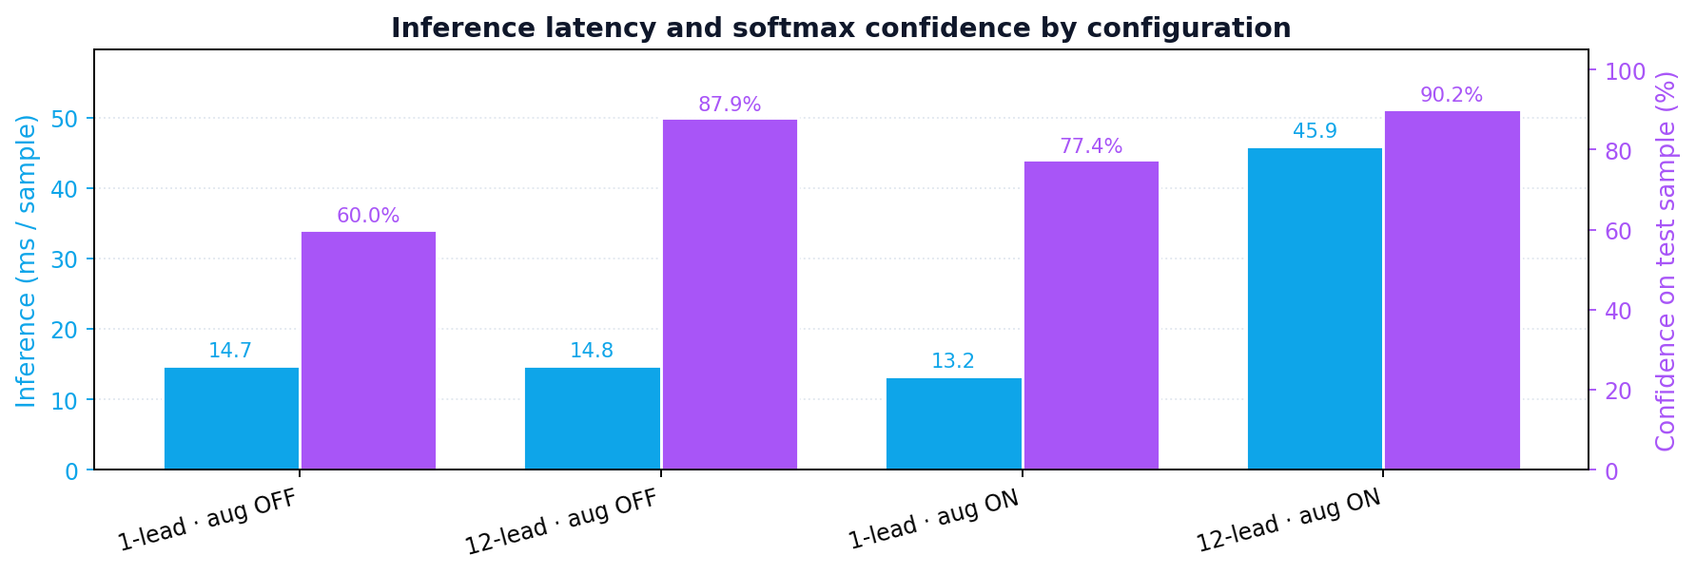
Deployment implication: edge vs hospital
Same accuracy, different operating-point: speed vs confidence.
• 1-lead is 3.5× faster than 12-lead on single-sample CPU inference (13.25 ms vs 45.86 ms).
• 12-lead softmax confidence on a held-out sample is higher than 1-lead (90.15% vs 77.38%) — more headroom for confidence-thresholded reads.
• Edge / wearable deployment → 1-lead: faster, same accuracy, lower hardware and bandwidth budget.
• Hospital workflow with per-decision confidence reporting → 12-lead: accuracy is identical but the calibration margin is larger.
• The title's '12-lead' commitment is therefore best read as the hospital-grade operating point of a single classifier family.
Hybrid ablation · deployment
16 / 21

Slide 18
Speed: Training and Inference
Side effect of shorter input: experiments become interactive
Epoch time (Chapman-Shaoxing, RTX 5090, AMP):
len=5000 ≈ 195 s / epoch
len=1000 ≈ 32 s / epoch (6.1× faster)
len=500 ≈ 30 s / epoch (6.5× faster)
len=500 + 4 wrk ≈ 20 s / epoch (9.8× faster)
Inference (single 12-lead sample):
len=5000: 89.88 ms
len=500: 27.20 ms (3.3× faster)
• Hyper-parameter tuning becomes an interactive loop (≈ 10 min runs).
• DataLoader workers=4 uncovers an I/O bottleneck we did not know we had — another +33 % epoch speedup, no model change.
• Inference well under the 1-second clinical budget, on CPU-class margins.
• Model file unchanged in size and parameter count; CPU / edge deployment also gets the ≈3× inference speedup for free.
Speed
17 / 21

Slide 19
Why Does This Work?
• Receptive field. Our 1D-CNN's last layer sees ≈ 2048 input samples at len=5000 — most of a 10 s window. QRS features fit comfortably in ≈ 200 ms (100 samples at 500 Hz). Shorter input concentrates gradient signal on physiologically-relevant patterns.
• Parameter economy. Same 3.72 M parameters now model 10× fewer timesteps. Capacity is spent on class distinctions, not on redundant temporal padding.
• Label duplicates partly absorbed. 'ECG: atrial flutter' and 'Atrial flutter' both reach ≥ 0.95 F1 at len=500 — apparently the model can afford to memorise both when it is not also memorising long irrelevant stretches.
• Anti-aliasing matters. A naïve strided pooling by 10 produces folded spectra; the Chebyshev LP is the difference between '+10 pp F1' and 'worse than baseline'.
• Does NOT work because of augmentation, attention, or loss engineering — all held constant. The win is purely in the input representation.
Discussion
18 / 21

Slide 20
Limitations
• Single-dataset experiment (Chapman-Shaoxing). PTB-XL cross-dataset validation is the next-month priority.
• Sweet-spot for decimation factor is not characterised below 500 samples (50 Hz).
• High-frequency information (late-potential notching, micro-alternans) is removed by design — any downstream task relying on them would need to be re-evaluated.
• Baseline 1D-CNN is fixed; the interaction between input length and a deeper CNN, or CNN + attention, is not yet measured.
• Clinical confidence score (single-sample softmax) rose from 12.9% to 76.2%, but still needs per-class calibration for deployment.
Limitations
19 / 21

Slide 21
Future Work
• 1. Cross-dataset validation on PTB-XL (100 Hz native) with and without decimation.
• 2. Label-taxonomy clean-up: merge the ≈ 23 'ECG: X' / 'X' duplicates (→ ~55 classes), then rerun len=500 baseline.
• 3. Attention-CNN-LSTM full model on decimate-500 input. Prediction: headroom remains mostly in borderline ST-segment / atrial-tachycardia confusions.
• 4. Focal loss γ ∈ {1,2,3} grid search and adaptive per-class thresholding; expected extra +1–2 pp macro F1.
• 5. GradCAM + SHAP on decimate-500: do the attention peaks still land on P/QRS/T when the input is already temporally compressed?
• 6. Edge deployment: INT8 quantisation + anti-aliased decimation should fit on a Raspberry Pi 4 at < 100 ms/sample with < 1 pp accuracy loss.
• 7. Report decimation as a design variable, not a hyper-parameter, in future EKG benchmarks.
Future work
20 / 21

Slide 22
Conclusion
On 12-lead ECG multi-label classification, replacing the default 500 Hz × 10 s input with a 50 Hz × 10 s anti-aliased signal lifts a plain 1D-CNN from 88.43% to 97.34% test accuracy, at 3.3× lower inference cost, with no change to the model.
• The biggest single lever in the baseline was the input representation.
• After decimation, the bigger lever for the title's hybrid plan is reference-node augmentation, not channel count.
• Aspirational numbers in the literature may hide a length-optimisation artefact more than a modelling one.
• All planned hybrid-model / loss-engineering improvements remain on the roadmap — now starting from a much stronger reference point.
Conclusion
21 / 21

Slide 23
Thank you.
Questions welcome.
Elaman Nazarkulov · elaman.job@gmail.com · KTMÜ

