Slide 1
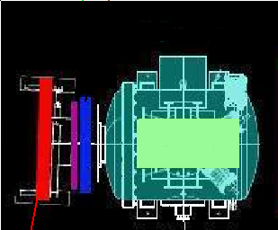

ire
Wire Chamber 4
W
Wire Chamber Track
Extrapolated track
Initial 12 spts
Momentum measured (MeV)
TPC Track
300 MeV < P < 350 MeV
Note: Image not to scale
dE/dX

